Slide 1
Q2-Extract the genes that overlap with a specified list of genomic regions. The list of regions can be specified in BED format
Ho Ping Chong
155057016

Slide 2
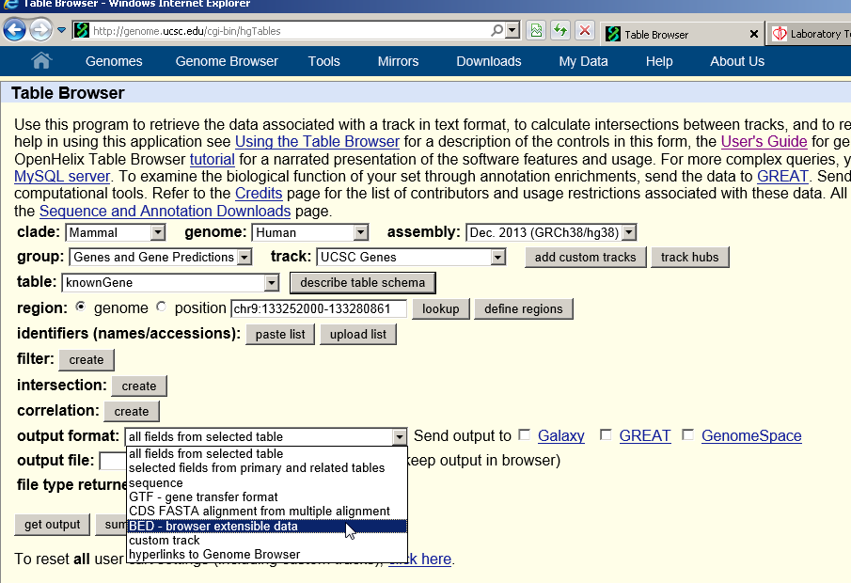
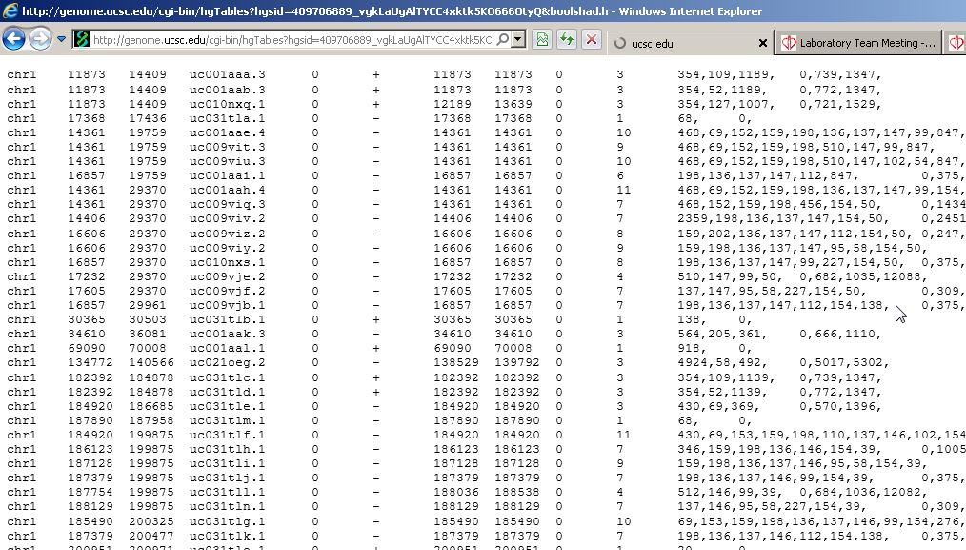
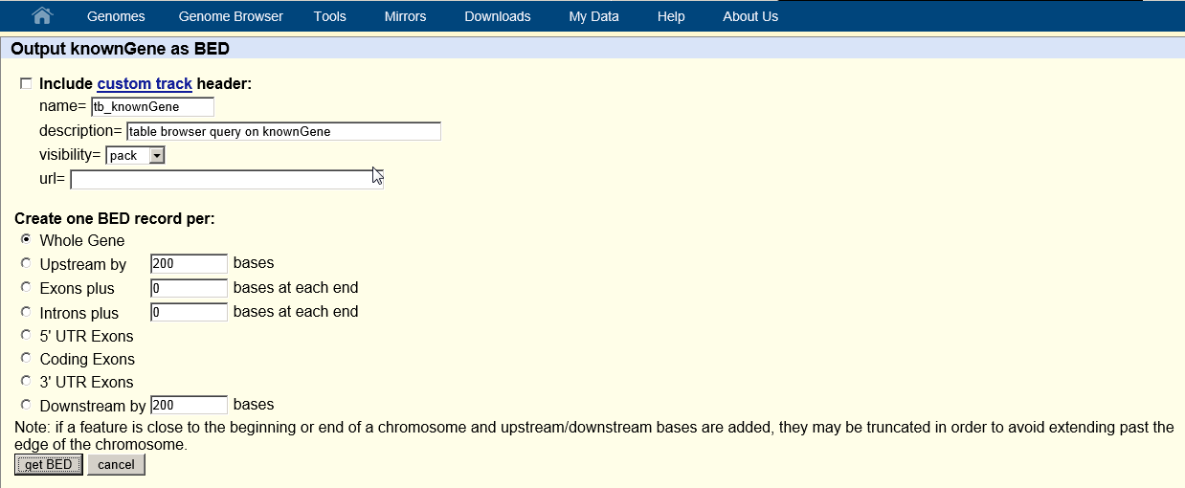

Slide 3
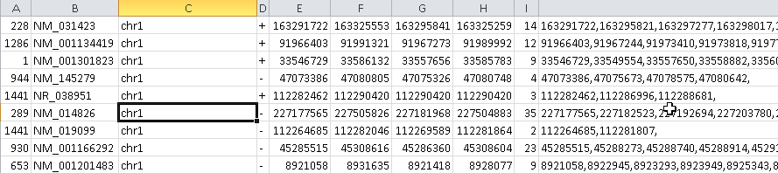

Refgene.txt
Pos.bed

Slide 4
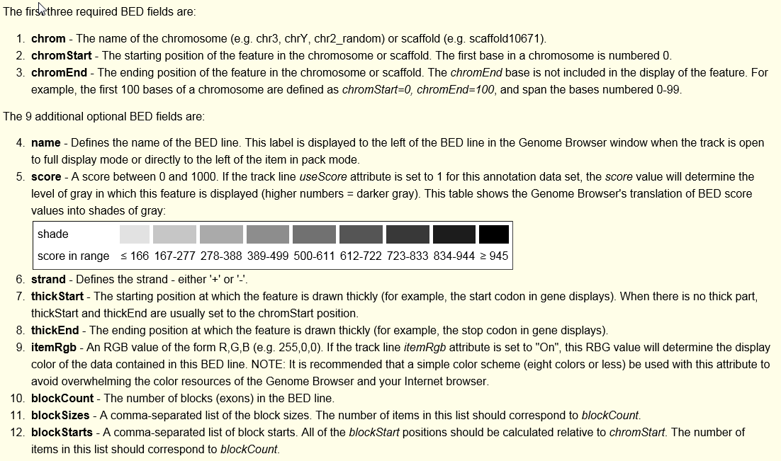

Slide 5
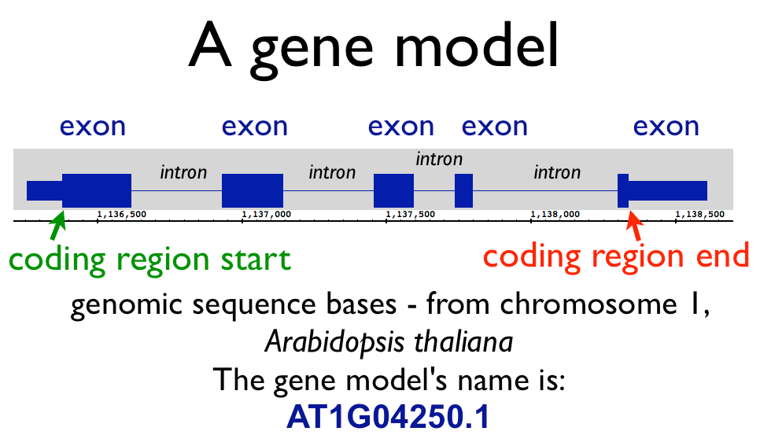
Exon block size
Exon block start relate to chrom start

Slide 6
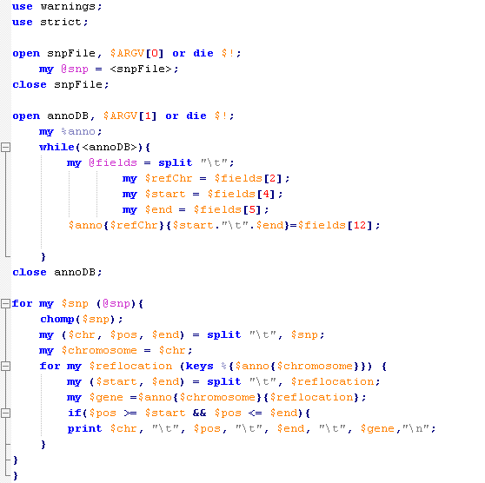

Slide 7
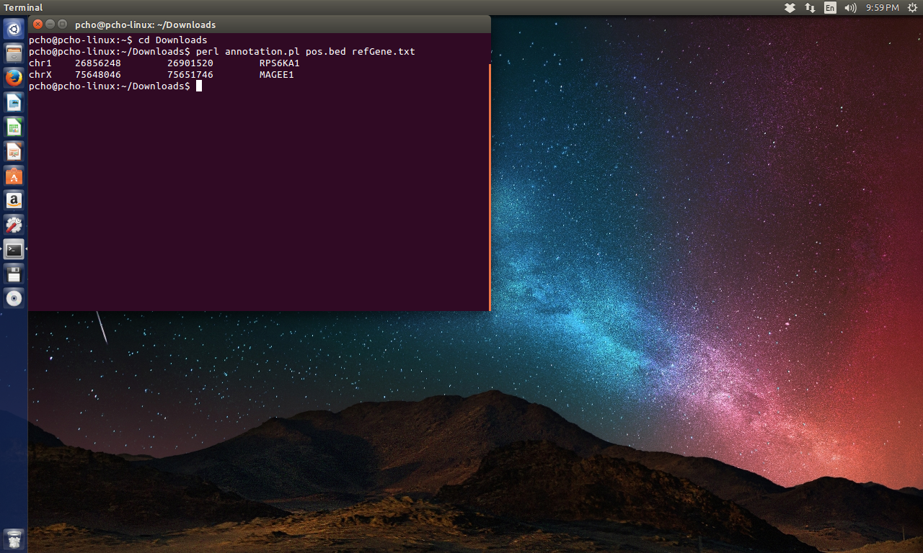

Slide 8
-END-

