Slide 1
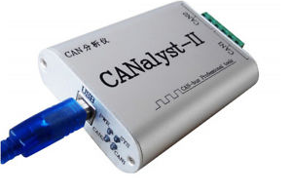
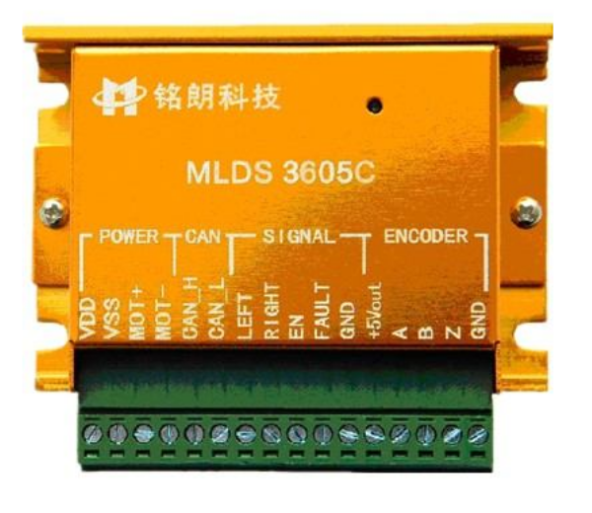
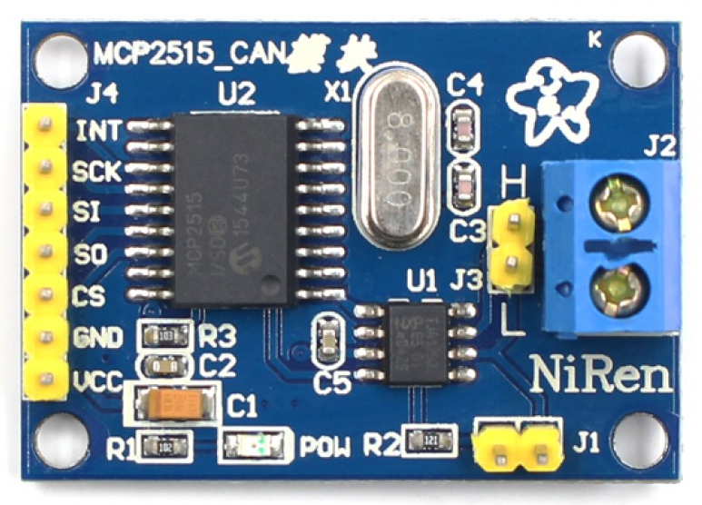
AGV Controller

Slide 2
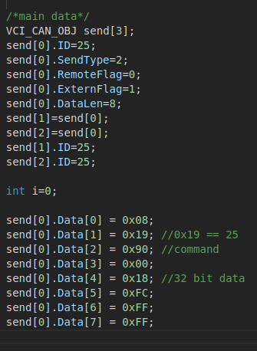
AGV Controller
Pre-set frame
Data

Slide 3
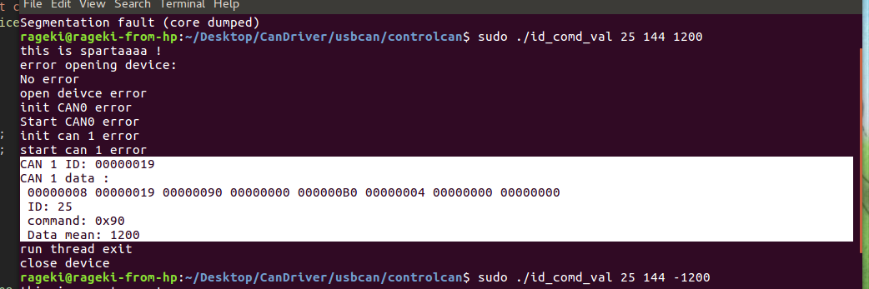
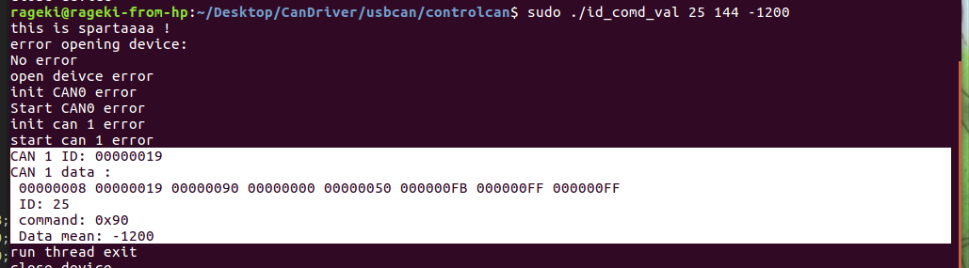
AGV Controller

Slide 4
AGV Controller
Future work:
+ Get familiar with MCP2515’s Python program to control motor
+ Convert some function to Py
+ Connect laptop and Raspberry via wifi
+ Using ros to control AGV (by laptop and raspberry)

Slide 5
AGV software
Using USB-CAN on PC:
Function.h
get_data
dec_to_hex
_init_
send_message
receive_func
reset_position
set_speed
set_abs_position
changed_mode
(Position/Speed)
read_speed
set_rel_position
speed_motion
read_position
break_motor

Slide 6
AGV software
Using MCP-25515 on Raspberry:
Function.py
mcp2515_reset
mcp2515_writeReg
mcp2515_init
mcp2515_readReg
get_data
mcp2515_write
mcp2515_read
dec_to_hex
set_zero_abs
angle_turn
set_speed
motor_position
set_abs_position
set_mode
(Position/Speed)
read_speed
poin_following
set_rel_position
speed_motion
read_position
break_motor

Slide 7
speed_motion
Start
lin(mm/s)
phi (rad/s)
r_v = (2*lin - phi*wheels_distance)/(2.0)
l_v = (2*lin + phi*wheels_distance)/(2.0)
l_v_rotate = int(l_v*(wheels_encoder/(pi*wheels_diameter)))
r_v_rotate = int(r_v*(wheels_encoder/(pi*wheels_diameter)))
Set “l_v_rotate” as speed of left motor,
“r_v_rotate” as speed of right motor
End

