Slide 1
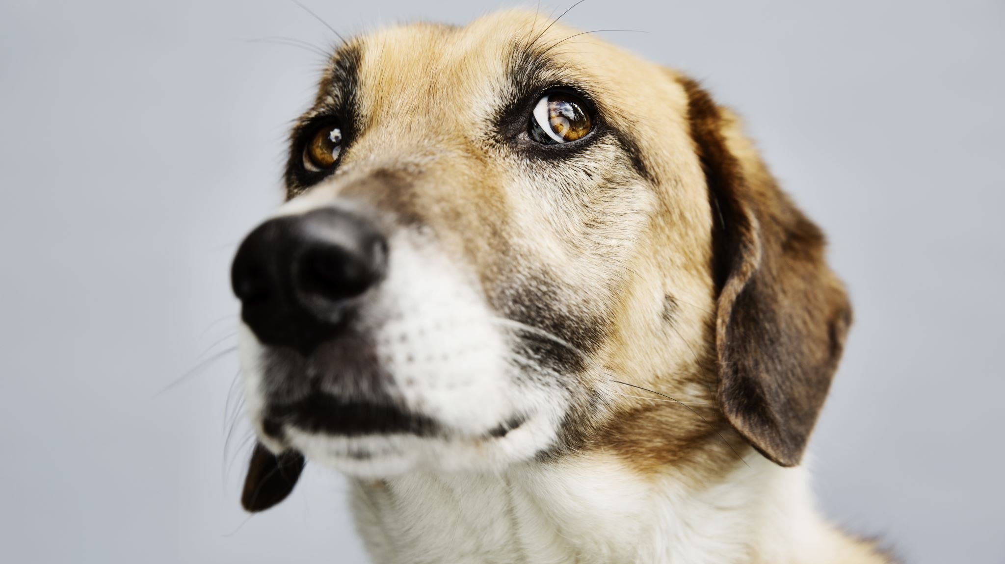
Dog Breed Classification
Com 307
Younghoon Choi

Slide 2
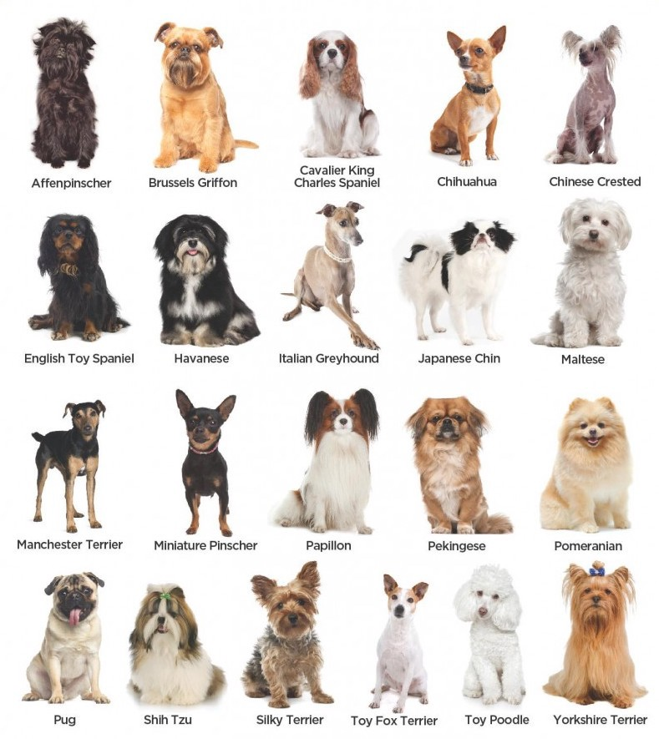
Why dog breed classification?
Dogs are awesome!
Something I struggle with personally
I wanted to implement machine learning into computer vision

Slide 3
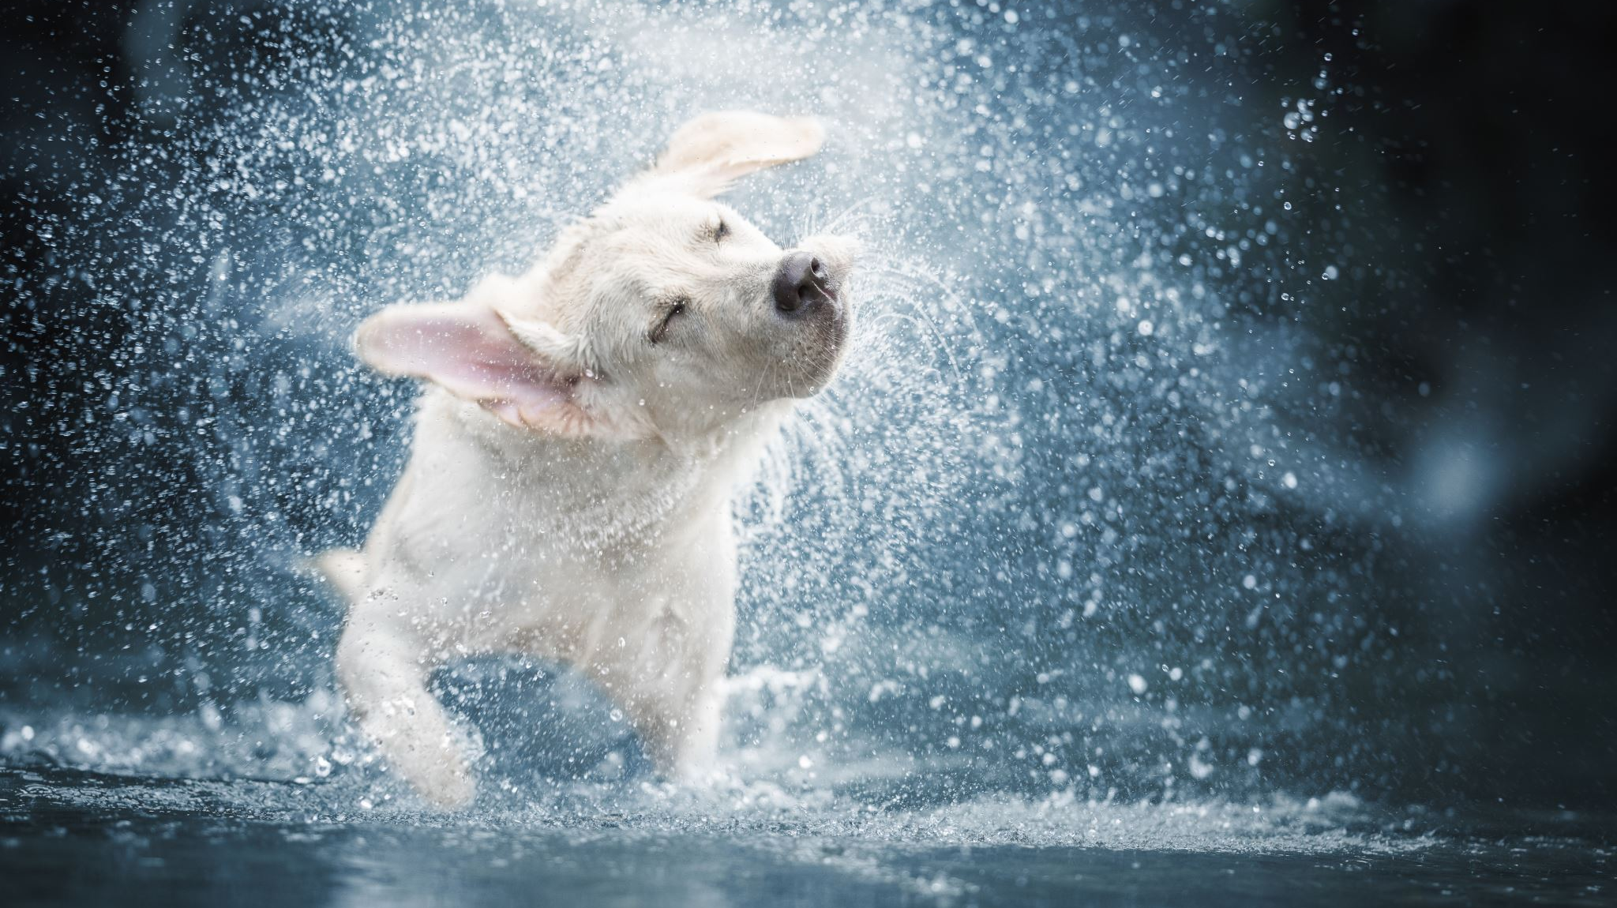
Data
Training Data(275 images of 5 breed)
59 Beagles, 53 Bulldogs, 63 Golden Retriever, 56 Greyhound, 44 Pomeranian
Test Data(50 images)
10 images of each breed

Slide 4
Models Tested
K-Nearest Neighbours
75% accuracy
Had a hard time with multiclass

Slide 5
Pre-Processing
Process the images from the folder
01
Process the images from the folder
02
2. Resize the image, 150 by 150.
03
3. Flattened image to an array
04
Goes into Training Mode
05

Slide 6
Training
SVM
Support Vector Machine
Grid Search
- Technique for finding the optimal parameter values from a given set of parameters in a grid.
Model
- Create a model that will be used for predictions
- Cross-validation technique.
- Learning methods used for classification and regression.
- Effective in high dimensional spaces.
- After extracting the best parameter values, predictions are made.

Slide 7
Testing
Go through all the images in the testing folder or image file
01
1. Resize the testing image to match testing, 150 by 150.
02
2. Flatten the images
03
3. Predict each image to the model
04

Slide 8
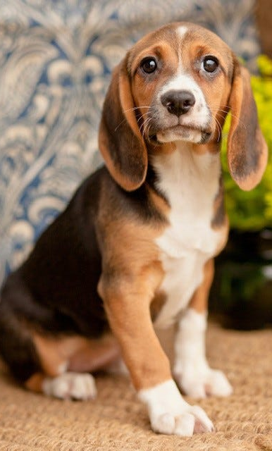
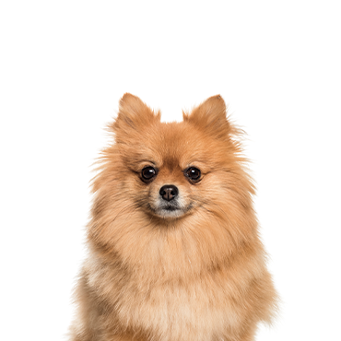
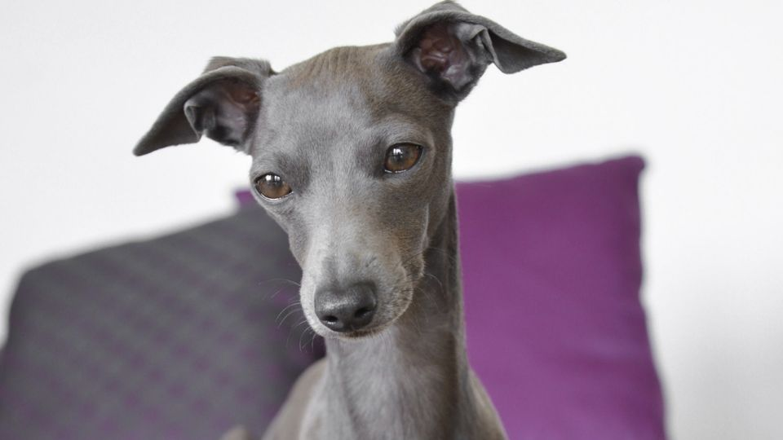
Accuracy Result
Pomeranian = 100%
- Fluffy hair
Beagle = 90%
- Spots
Greyhound = 90%
- Lengthy mouth

Slide 9
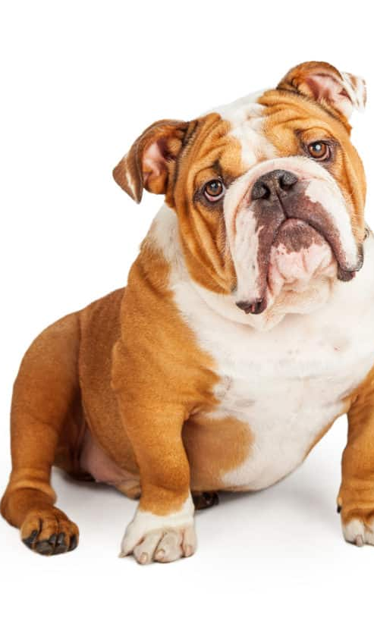
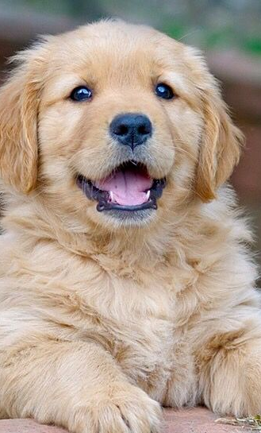
Accuracy result 2
Bulldogs = 80%
- Certain bulldogs spot
Golden Retriever = 80%
- Fluffy hair of baby gold retriever

Slide 10
Analysis
The total percentage came to 88% which I was happy with
Would like to work with a bigger dataset both for training and testing
More breeds and images for each of them
This would help with issues I was having explained in the previous slide
Match the size of the image

Slide 11

Sources
https://www.kaggle.com/datasets/amandam1/120-dog-breeds-breed-classification
http://scipy-lectures.org/packages/scikit-image/
https://scikit-learn.org/stable/modules/svm.html
https://scikit-learn.org/stable/modules/generated/sklearn.model_selection.GridSearchCV.html

Slide 12

Demo Time

