Slide 1
Holiday Package Prediction
Recommendations to marketing team to target customers with new travel package
Team 5:
Aditya Mathur, Palash Choudhary, Remi Levinson, Tianshun Zhang, Yura Joun
Notes:
Yura

Slide 2

Project Overview
Trips & Travel
.com
Basic
Standard
Deluxe
Super Deluxe
King
5
Packages
+
Wellness Tourism Package
Identify which set of customers to target for their new package offering
Data Source:
www.kaggle.com/datasets/susant4learning/holiday-package-purchase-prediction?resource=download
Notes:
Yura
High level topic/context/data source
"Trips & Travel. Com" company wants to enable and establish a viable business model to expand the customer base. One of the ways to expand the customer base is to introduce a new offering of packages. Currently, there are 5 types of packages the company is offering - Basic, Standard, Deluxe, Super Deluxe, King. Looking at the data of the last year, we observed that 18% of the customers purchased the packages. However, the marketing cost was quite high because customers were contacted at random without looking at the available information. The company is now planning to launch a new product i.e. Wellness Tourism Package. Wellness Tourism is defined as Travel that allows the traveler to maintain, enhance or kick-start a healthy lifestyle, and support or increase one's sense of well-being. However, this time company wants to harness the available data of existing and potential customers to make the marketing expenditure more efficient.
The company wants to use the demographic and interaction features to identify which set of customers to target for their new package offering.

Slide 3
Variables Description
Variable | Description | Data
CustomerID | Unique customer ID | 200k-205k
ProdTaken | Whether the customer take the product or not | 0: No, 1: Yes
Age | Age of customer | 18-61
TypeofContact | How customer was contacted (Company invited or Self Inquiry) | 70% Self Enquiry, 29% Company Invited, 1% Other
CityTier | City tier depends on the development of a city, population, facilities, and living standards, | 1, 2, 3
DurationOfPitch | Duration of the pitch by a salesperson to the customer | 5-127
Occupation | Occupation of customer | Salaried, Small Business, Large Business, Free Lancer
Gender | Gender of customer | Male or Female
NumberOfPersonVisiting | Total number of persons planning to take the trip with the customer | 1-5
NumberOfFollowups | Total number of follow ups has been done by the salesperson after the sales pitch | 1-6
Notes:
Yura

Slide 4
Variables Description (Cont.)
Variable | Description | Data
ProductPitched | Product pitched by the salesperson | Basic, Deluxe, Standard, Super Deluxe, King
PreferredPropertyStar | Preferred hotel property rating by customer | 3,4,5
MaritalStatus | Marital status of customer | Married, Divorced, Single, Unmaried
NumberOfTrips | Average number of trips in a year by customer | 1-22
Passport | The customer has a passport or not | 0: No, 1: Yes
PitchSatisfactionScore | Sales pitch satisfaction score | 1-5
OwnCar | Whether the customers own a car or not | 0: No, 1: Yes
NumberOfChildrenVisiting | Total number of children with age less than 5 planning to take the trip with the customer | 0-3
Designation | Designation of the customer in the current organization | Executive, Manager, Senior Manager, AVP, VP
MonthlyIncome | Gross monthly income of the customer | 1000-98.7k
Notes:
Yura

Slide 5
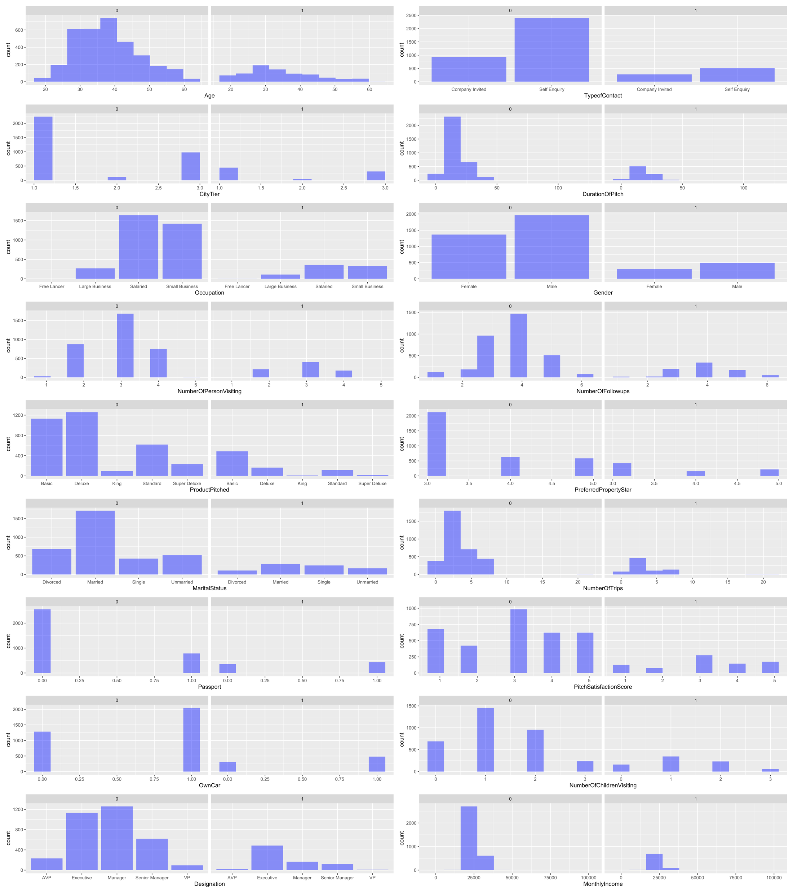
Visualization
Distribution Plots Across Relevant Factors
Affecting Product Purchase (0 = No, 1 = Yes)
Most Interesting Patterns
Age
Type of Contract
Occupation
Gender
Marital Status
Designation
Monthly Income
Notes:
Remi
Construct 2-4 PLOTS/VISUALIZATIONS that you think show the most interesting patterns of variation in these data. Briefly describe why you found the plots interesting. Do they help you form any hypotheses that you feel are worth investigating further?

Slide 6
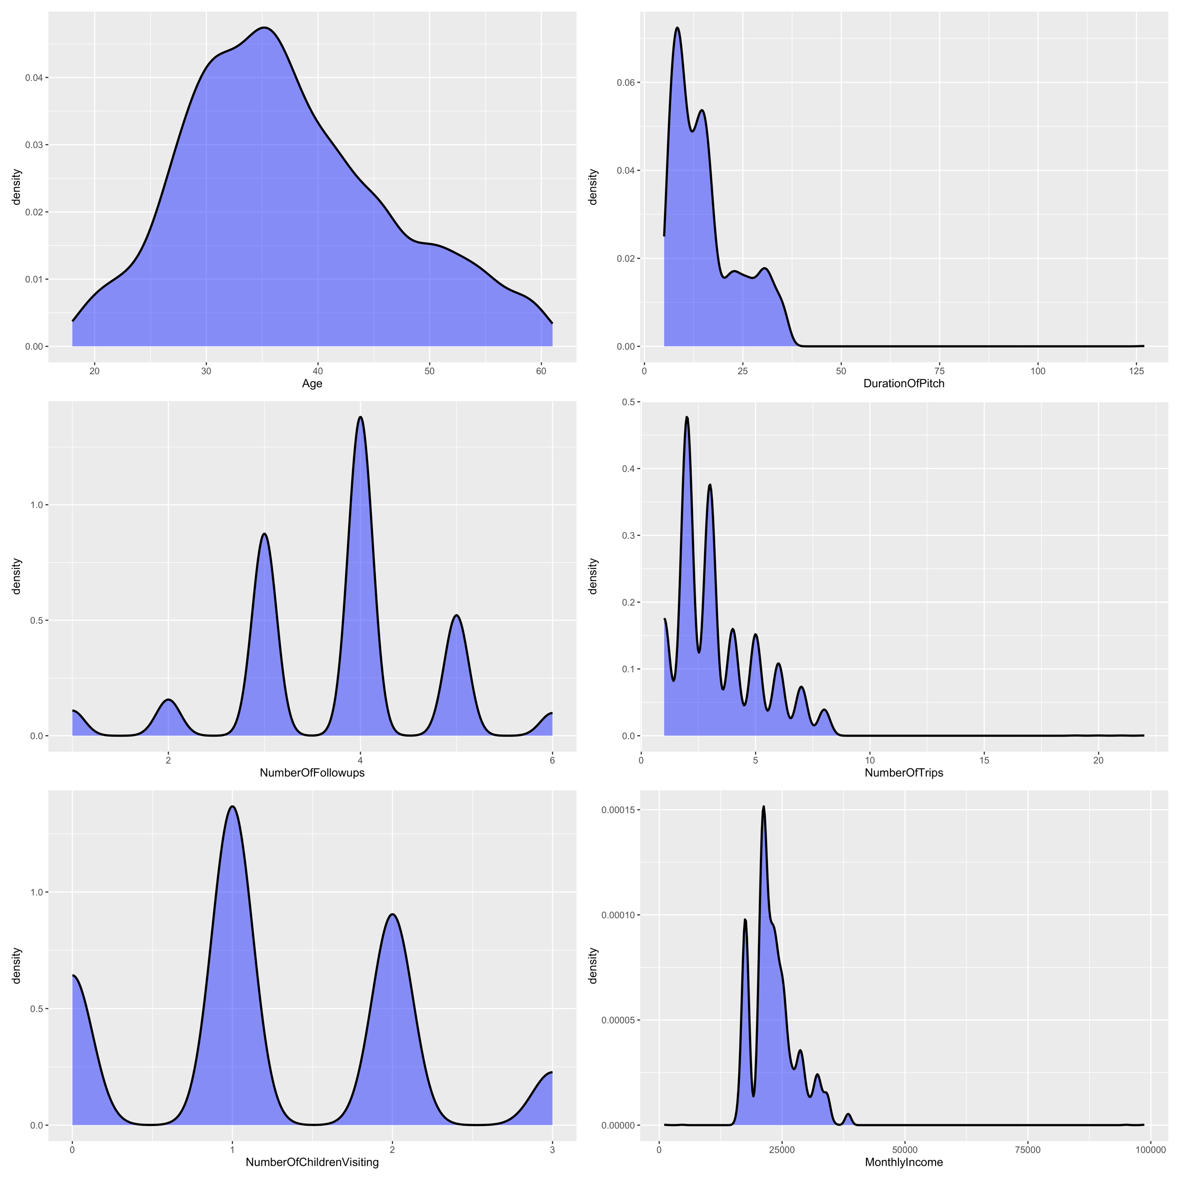
Visualization
Density Maps of Relevant
Continuous Features
Notes:
Remi

Slide 7
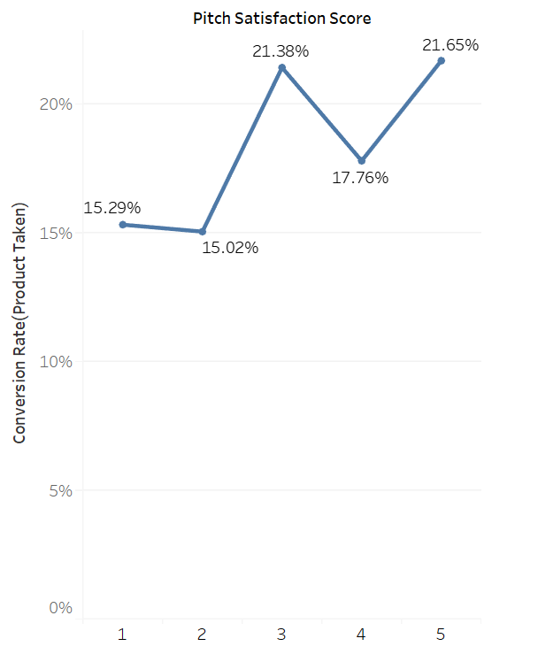
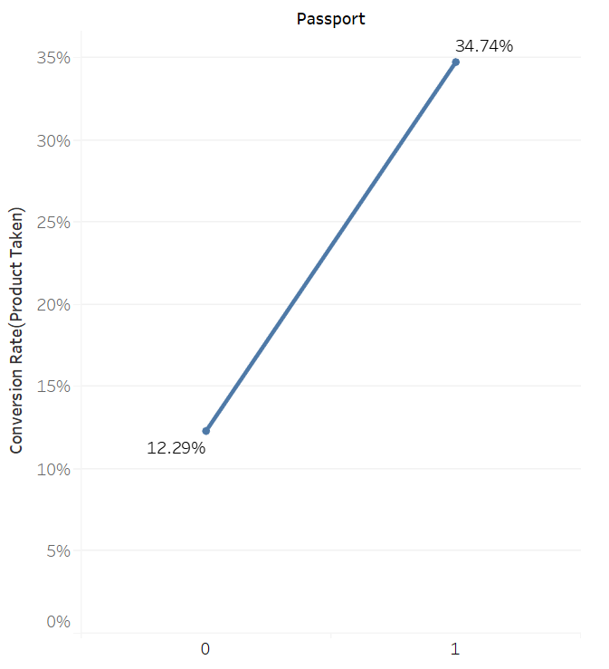
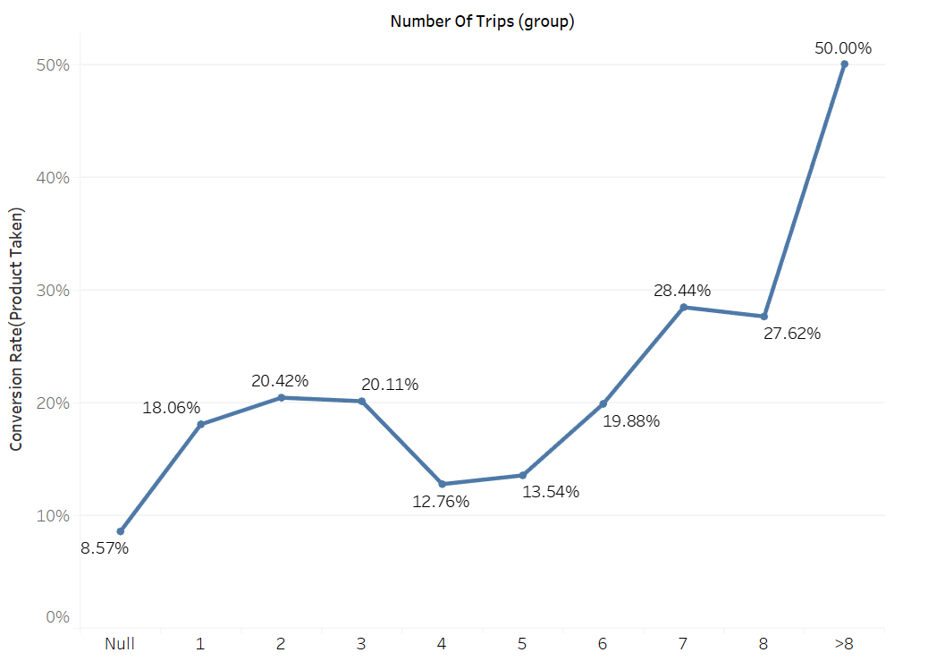
Visualizations and Insights
Purchase conversion rate appears to vary with all three – Pitch Satisfaction Score, Passport and Number of Trips per year- although no linear relationship can be immediately be seen
Notes:
Remi

Slide 8
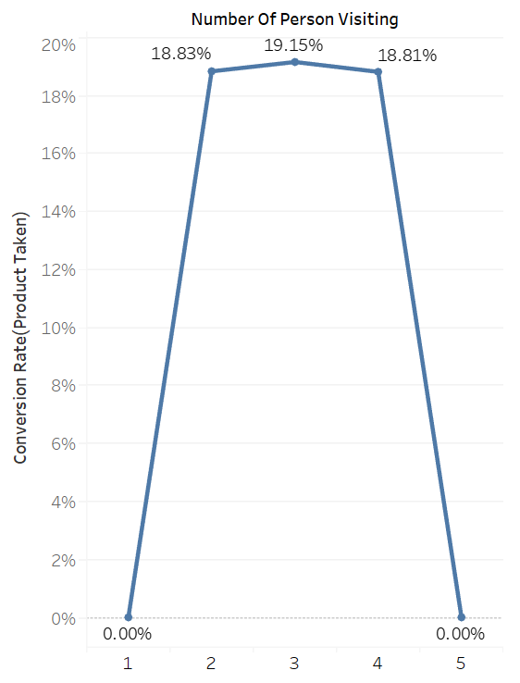
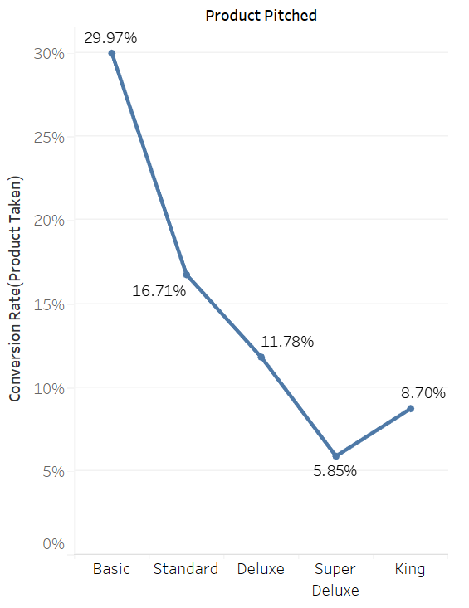
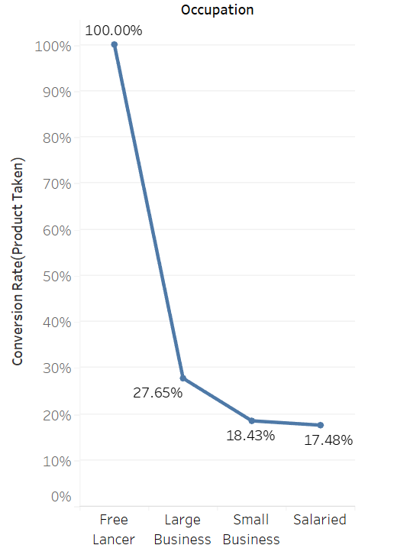
Visualizations and Insights
All purchases made for 2-4 people trip groups (none for single or 5 member groups)
Conversion rate decreases sharply for more expensive packages
Conversion rates for customers with large business > with small business > salaried
Notes:
Remi

Slide 9
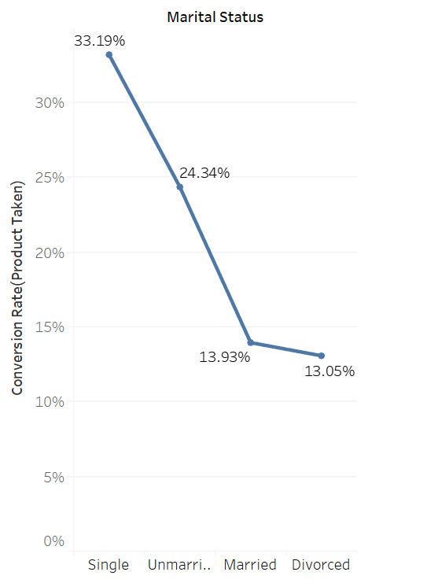
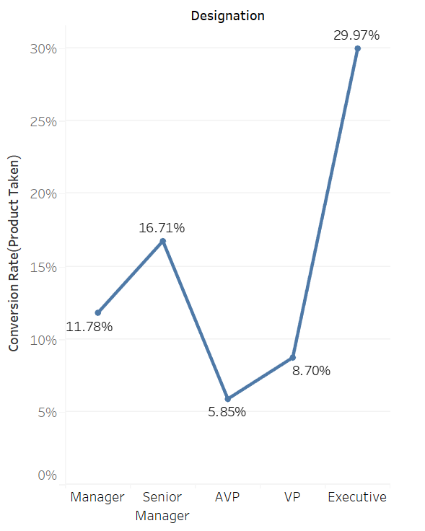
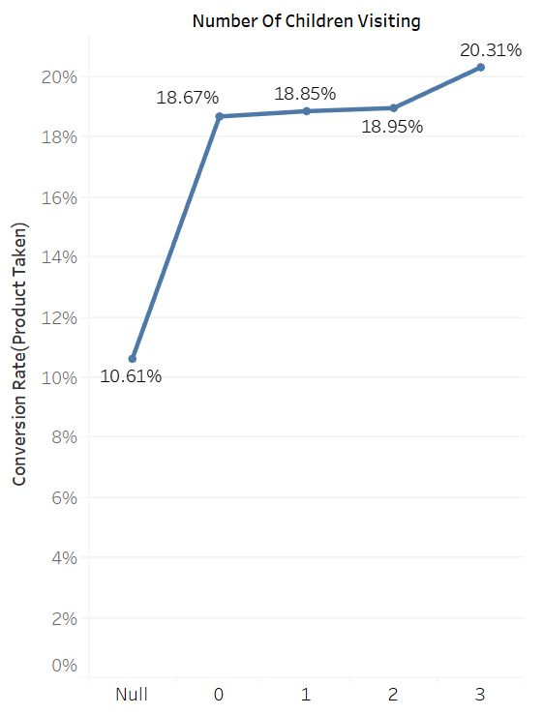
Visualizations and Insights
Single customers likelier to convert than those with partners (unmarried/married) and divorced
Customers with "Executive" designation are most likely to make a purchase
Notes:
Remi

Slide 10
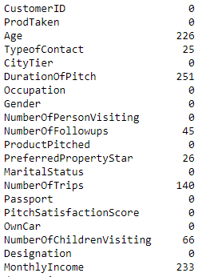
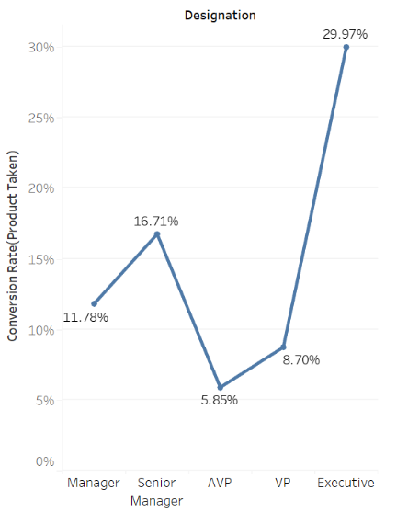
Exploratory Data Analysis
Interesting Insights
Missing data across multiple features
Initial Data Size: 4888 rows, 20 feats
Final Data Size: 4128 rows, 20 feats
Package Offered has 1-on-1 mapping with Designation
Good Marketing Strategy?
Designation | Package Offered
 | Basic | Standard | Deluxe | Super Deluxe | King
Executive | 1615
Senior Manager |  | 737
Manager |  |  | 1422
AVP |  |  |  | 250
VP |  |  |  |  | 104
Notes:
Aditya

Slide 11
Hypotheses
Given the insights above, we propose two hypotheses to test-
Hypothesis 1: Whether a purchase is made or not is correlated to the following parameters (in order of impact)- product pitched, passport present or not, pitch satisfaction score, occupation, number of yearly trips, marital status, age, type of contact, duration of pitch, gender, number of persons visiting, number of follow-ups, preferred property star, designation, monthly income and number of children visiting.
Hypothesis 2: Pitch satisfaction score has a positive correlation with duration of the pitch.
Reason for choosing this hypothesis: Our intuition is that pitch satisfaction score has a major impact on purchase probability. We want to test if factors such as duration of the pitch affect pitch satisfaction. Also, customer outreach efforts make up a large portion of the costs for running promotional campaigns)- this test will validate if our costs are justified.
Notes:
hypotheses and to whom they are valuable
Everyone
Write down any 2 HYPOTHESES from the above list you considered most promising/interesting. Please remember to pay special attention to your key stakeholders andthe practical/business value of these hypotheses (who stands to benefit the most from a better understanding of the hypotheses you proposed?).
Descriptive:
Which customers are likely to purchase the new package
Significant factors driving purchase decisions
Identifying segment of customers that should be targeted
Causal:
Comparing different package offering
Impact of certain marketing campaign on customer satisfaction and purchase

Slide 12
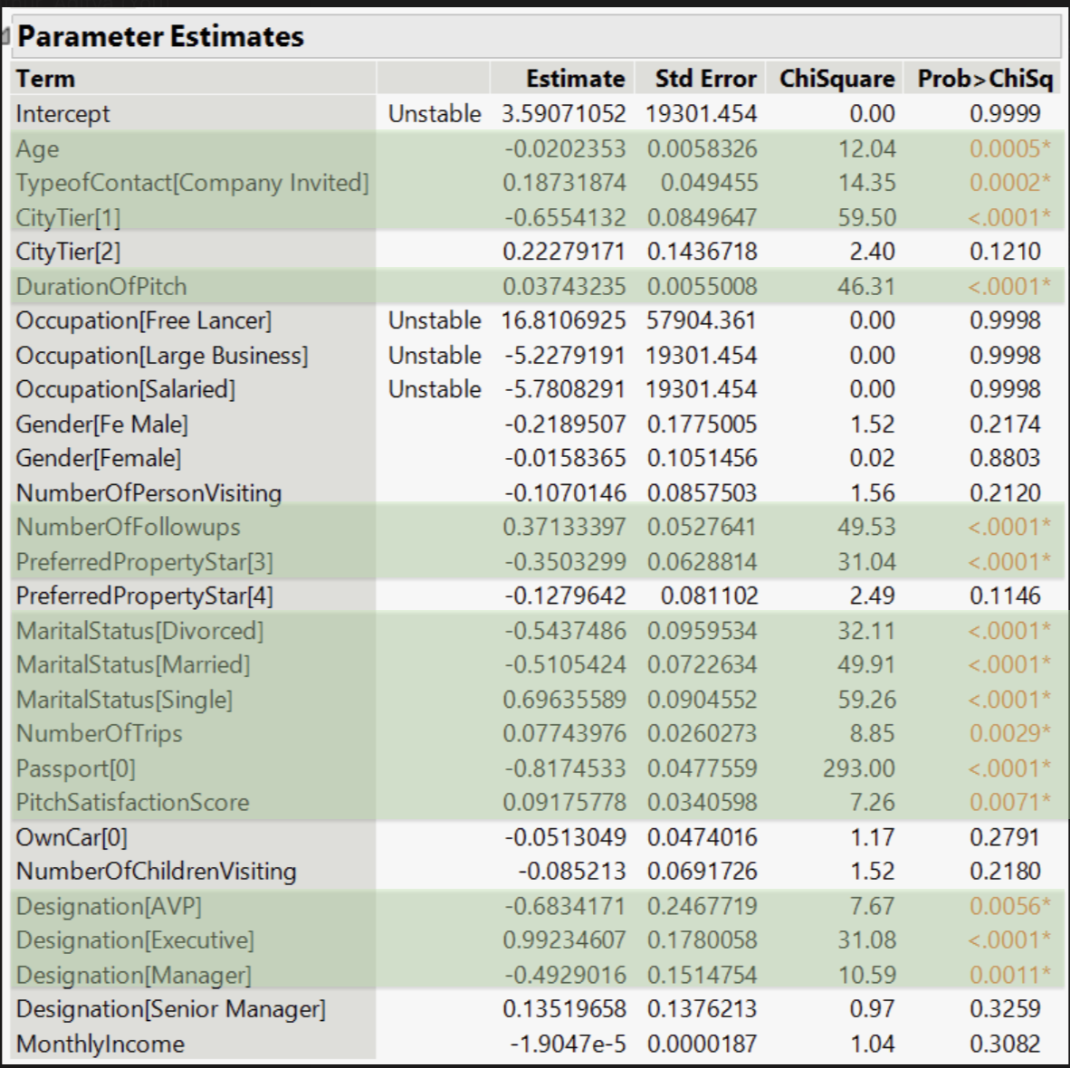
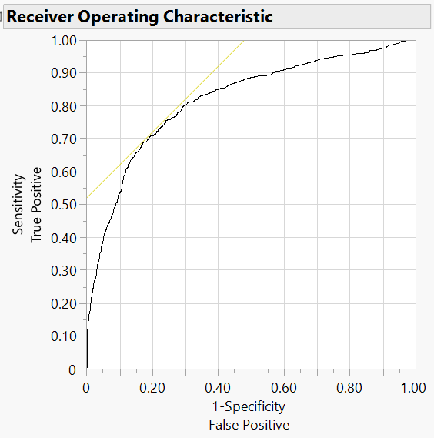
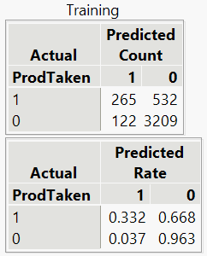
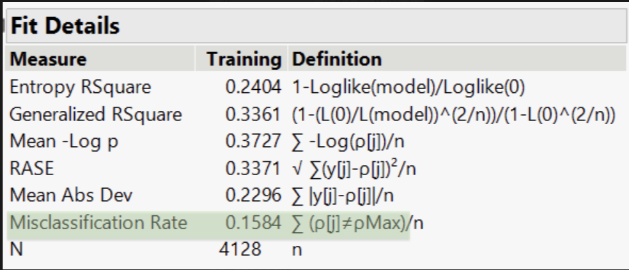
Analysis- Hypothesis 1
Logistic regression to find correlation between purchase conversion and independent variables

Slide 13
Hypothesis 1- Analysis Results
We observe the following on doing this analysis-
15 coefficients of following independent variables are significant and 13 are not significant. These are listed below in order of impact-
Positively Correlated (coefficient) | Negatively Correlated (coefficient)
Designation [Executive] (0.9923) | Passport [0] (-0.8174)
Marital Status [Single] (0.696) | Designation [AVP] (-0.6834)
Number of follow ups (0.3713) | City Tier [1] (-0.655)
Type of Contact [Company Invited] (0.187) | Marital Status [Divorced] -(0.5437)
Pitch Satisfaction Score (0.091) | Marital Status [Married] (-0.5105)
Number of Trips (0.077) | Designation [Manager] (-0.4929)
Duration of Pitch (0.0374) | Preferred property star [3] (-0.350)
 | Age (–0.020)
Notes:
hypotheses and to whom they are valuable
Everyone
Write down any 2 HYPOTHESES from the above list you considered most promising/interesting. Please remember to pay special attention to your key stakeholders andthe practical/business value of these hypotheses (who stands to benefit the most from a better understanding of the hypotheses you proposed?).
Descriptive:
Which customers are likely to purchase the new package
Significant factors driving purchase decisions
Identifying segment of customers that should be targeted
Causal:
Comparing different package offering
Impact of certain marketing campaign on customer satisfaction and purchase

Slide 14
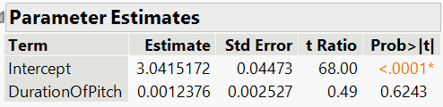
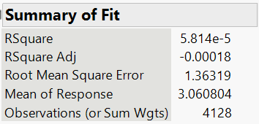
Analysis- Hypothesis 2
Linear regression to find correlation between pitch satisfaction and duration of pitch

Slide 15
Hypotheses 2- Analysis Results
We observe the following on doing this analysis-
Given that this test was not statistically significant, we cannot infer any relationship between duration of pitch (time spent on call with customer) and pitch satisfaction.
We are not storing enough datapoints to identify driving factors of sales pitch satisfaction score.
Text analysis of sales pitch can be conducted to identify customer’s sentiment. Further, evaluation of sales pitch should be conducted to ensure key information about the package are provided along with addressing major concerns of customers.
Notes:
hypotheses and to whom they are valuable
Everyone
Write down any 2 HYPOTHESES from the above list you considered most promising/interesting. Please remember to pay special attention to your key stakeholders andthe practical/business value of these hypotheses (who stands to benefit the most from a better understanding of the hypotheses you proposed?).
Descriptive:
Which customers are likely to purchase the new package
Significant factors driving purchase decisions
Identifying segment of customers that should be targeted
Causal:
Comparing different package offering
Impact of certain marketing campaign on customer satisfaction and purchase

Slide 16
Who to Target for New Package?
Cluster Analysis
Age
Pitch Satisfaction Score
Monthly Income
Number of Follow-ups
Number of Children Visiting
Duration of Pitch
Number of Trips
Number of Person Visiting
Cluster | Customer Count | Age | Duration Of Pitch | Number Of Person Visiting | Number Of Follow-ups | Number Of Trips | Pitch Satisfaction Score | Number Of Children Visiting | Monthly Income
1 | 472 | 49.00 | 14.01 | 2.45 | 3.39 | 3.05 | 3.48 | 0.78 | 30029.50
2 | 550 | 41.65 | 12.69 | 3.38 | 4.22 | 6.17 | 3.05 | 1.71 | 24123.93
3 | 4 | 35.00 | 13.00 | 3.00 | 3.50 | 20.50 | 3.00 | 1.00 | 21372.50
4 | 909 | 33.45 | 11.95 | 3.48 | 4.41 | 2.73 | 3.40 | 1.81 | 23425.80
5 | 1 | 53.00 | 127.00 | 3.00 | 4.00 | 4.00 | 1.00 | 2.00 | 22160.00
6 | 581 | 35.87 | 13.70 | 2.57 | 3.74 | 2.71 | 1.30 | 0.80 | 21258.26
7 | 332 | 35.74 | 14.90 | 3.00 | 1.86 | 2.97 | 2.77 | 1.34 | 21488.46
8 | 516 | 37.49 | 29.87 | 3.38 | 4.20 | 3.46 | 3.07 | 1.63 | 23971.66
9 | 1 | 37.00 | 12.00 | 3.00 | 5.00 | 2.00 | 2.00 | 1.00 | 98678.00
10 | 762 | 32.77 | 14.91 | 2.30 | 3.33 | 2.43 | 3.86 | 0.45 | 19532.33
Cluster | 1 | 2 | 3 | 4 | 5 | 6 | 7 | 8 | 9 | 10 | Overall
Purchase Rate | 12.3% | 18.9% | 50.0% | 20.7% | 0.0% | 17.2% | 13.9% | 24.4% | 0.0% | 22.7% | 19.3%

Slide 17
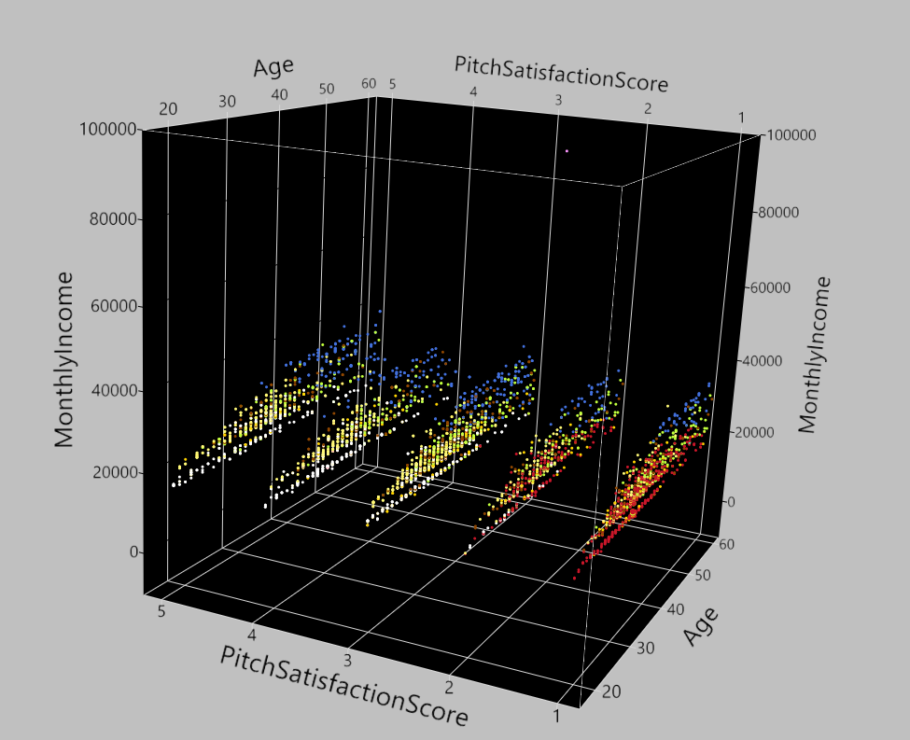
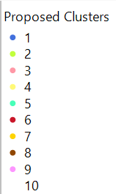
Cluster Visualization
3D Scatter Plot using following features:
Age
Pitch Satisfaction Score
Monthly Income
We can visually identify a few clusters even though we are representing 8-D data in 3-D

Slide 18
Who does our clusters represent?
We fit logistic model to each cluster to find its properties.
A cluster can be described as a combination of clustering features and descriptive features
Cluster | Purchase Rate | Count | Age | Duration Of Pitch | Number Of Person Visiting | Number Of Follow-ups | Number Of Trips | Pitch Satisfaction Score | Number Of Children Visiting | Monthly Income
1 | 12.3% | 472 | 49.0 | 14.01 | 2.45 | 3.39 | 3.05 | 3.48 | 0.78 | 30029.50
2 | 18.9% | 550 | 41.7 | 12.69 | 3.38 | 4.22 | 6.17 | 3.05 | 1.71 | 24123.93
3 | 50.0% | 4 | 35.0 | 13.00 | 3.00 | 3.50 | 20.50 | 3.00 | 1.00 | 21372.50
4 | 20.7% | 909 | 33.4 | 11.95 | 3.48 | 4.41 | 2.73 | 3.40 | 1.81 | 23425.80
5 | 0.0% | 1 | 53.0 | 127.00 | 3.00 | 4.00 | 4.00 | 1.00 | 2.00 | 22160.00
6 | 17.2% | 581 | 35.9 | 13.70 | 2.57 | 3.74 | 2.71 | 1.30 | 0.80 | 21258.26
7 | 13.9% | 332 | 35.7 | 14.90 | 3.00 | 1.86 | 2.97 | 2.77 | 1.34 | 21488.46
8 | 24.4% | 516 | 37.5 | 29.87 | 3.38 | 4.20 | 3.46 | 3.07 | 1.63 | 23971.66
9 | 0.0% | 1 | 37.0 | 12.00 | 3.00 | 5.00 | 2.00 | 2.00 | 1.00 | 98678.00
10 | 22.7% | 762 | 32.8 | 14.91 | 2.30 | 3.33 | 2.43 | 3.86 | 0.45 | 19532.33
Cluster | Gender | Marital Status | Designation | Occupation | City Tier | Preferred Property star | Own Car
1 | - | Single | AVP; VP | - | Tier 2 | 5 | -
2 | Male | Married | Manager; Senior Manager | Small Business | - | - | -
3 | Merge With closest cluster
4 | Male | Unmarried | Executive, Manager, VP | - | - | 5 | 1
5 | Merge With closest cluster
6 | - | Unmarried | All except AVP | - | - | 3 | -
7 | - | Married | Executive; Manager | - | - | 5 | -
8 | - | Unmarried | Manager;Senior Manager | - | - | - | -
9 | Merge With closest cluster
10 | - | Single | All except AVP | - | - | 4 | -
Each cluster is represented by customers from different designation (Better marketing strategy?)

Slide 19


Who do we target?
Target Group -1
Avg Age>49
Avg Income >30K
Single
Tier 2 City
5 Star Preferred
Pitch Satisfaction Score >3.5
Target Group -2
Avg Age<32
Avg Income <20K
Single
4 Star Preferred
Pitch Satisfaction Score >3.8
Target Group -3
Avg Age~33
Avg Income~23.5K
Traveling with >=2 Children
5 Star Preferred
Male
Target Group -4
Avg Age~42
Avg Income>24K
Traveling with >=2 Children
Small Business Owner
Married Male
Target Groups should show tendency to purchase Wellness tourism packages

Slide 20
Causal Question
Question: Assuming that number of trips are positively correlated with purchase probability. We want to test if the discounts to trips causes the purchase probability to increase.
Design:
In order to expand the customer base, we want to test a loyalty program that will offer discounts to trips to a randomized population.
Control group for our experiment is the population without offering discounts. Experiment group is those who get the discounts.
Tracking and Recording their purchases and number of trips and other variables over time.
Path:
Notes:
Palash, Aditya, Tian
Identify one CAUSAL question that you feel is the most promising, given your dataset. Sketch out your analysis approach (e.g., discuss an appropriate research design and/or a mathematical model) for answering that causal question. Discuss any threats that may interfere with your ability to draw reliable causal conclusions from your data/model. Summarize one solution for overcoming each threat that you identified. [Note: Step 4 is focused on thoughtful research design/description & argumentation, and not so much on actual implementation/model estimation.]

Slide 21
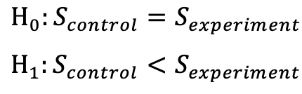
Causal Question
Method: We use sample average and sample variance of the purchase probability (using ProdTaken) of experiment group and control group to test whether the expectation between two groups are the same.
Notes:
Palash, Aditya, Tian
Identify one CAUSAL question that you feel is the most promising, given your dataset. Sketch out your analysis approach (e.g., discuss an appropriate research design and/or a mathematical model) for answering that causal question. Discuss any threats that may interfere with your ability to draw reliable causal conclusions from your data/model. Summarize one solution for overcoming each threat that you identified. [Note: Step 4 is focused on thoughtful research design/description & argumentation, and not so much on actual implementation/model estimation.]

Slide 22
Causal Question
Threat to causality:
Randomization validity (the control group and the experiment group may not have all controlled variables the same in a specific significant level)
Incentives method validity (discounts to trip may affect both numbers of trips and purchase probability)
Notes:
Palash, Aditya, Tian
Identify one CAUSAL question that you feel is the most promising, given your dataset. Sketch out your analysis approach (e.g., discuss an appropriate research design and/or a mathematical model) for answering that causal question. Discuss any threats that may interfere with your ability to draw reliable causal conclusions from your data/model. Summarize one solution for overcoming each threat that you identified. [Note: Step 4 is focused on thoughtful research design/description & argumentation, and not so much on actual implementation/model estimation.]

Slide 23
Next Steps
The client should narrow down its messaging for the wellness package to the clusters identified through this analysis
To find ways of improving pitch satisfaction, we would need to capture additional customer-service quality data, which will allow us to focus on the right areas.
We would need to capture data on additional dimensions related to customers' travel preferences (not just demographics and past purchase data) to better predict their future behavior.
With respect to taking the existing packages to market, the client should double down on customers with attributes positively correlated to purchase probability- such as executive designation, single marital status while avoiding negatively correlated ones such as non-passport holders, AVP designation etc.
Notes:
Palash, Aditya, Tian
(threats with inferring causality+ your proposed solutions

Slide 24
Thank You!

Slide 25
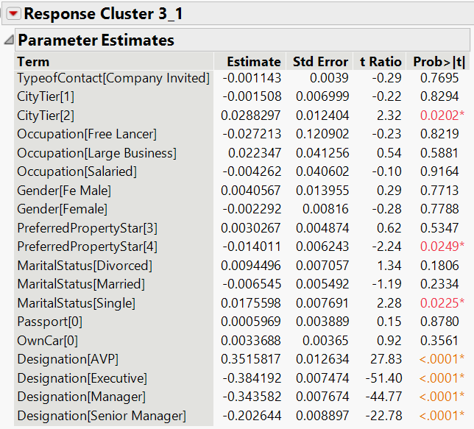
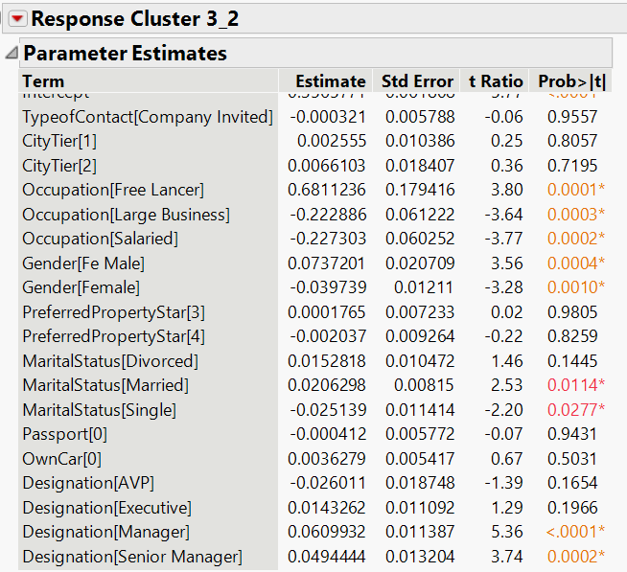
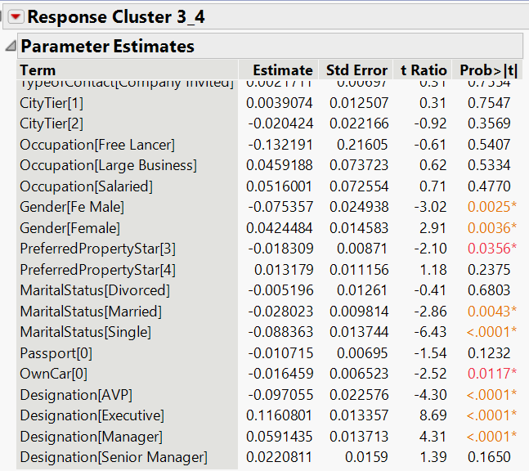
Appendix

Slide 26
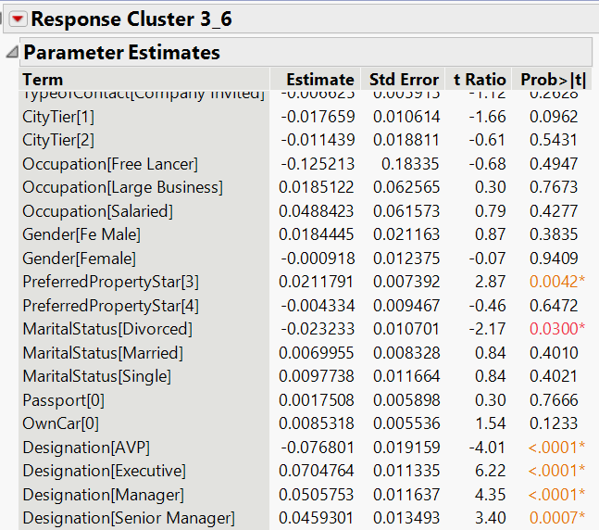
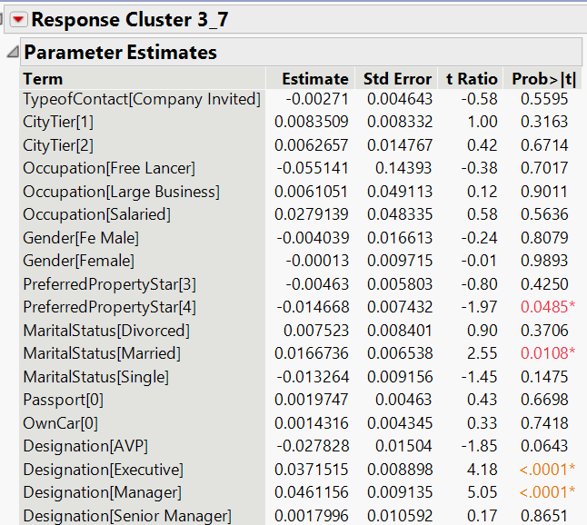
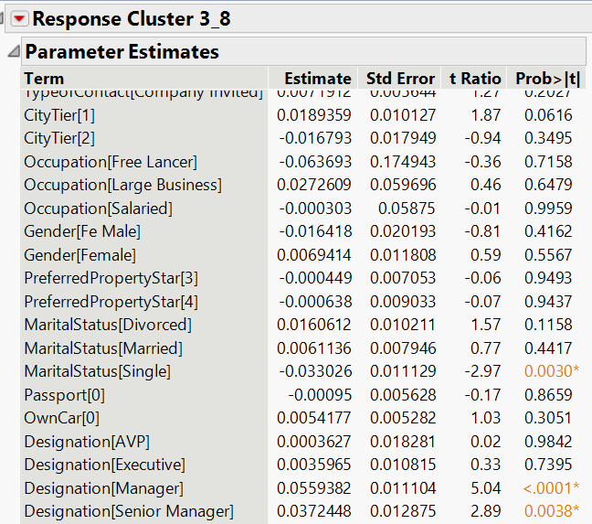
Appendix

Slide 27
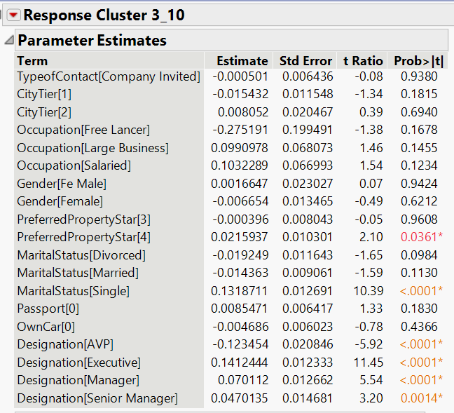
Appendix

Slide 28
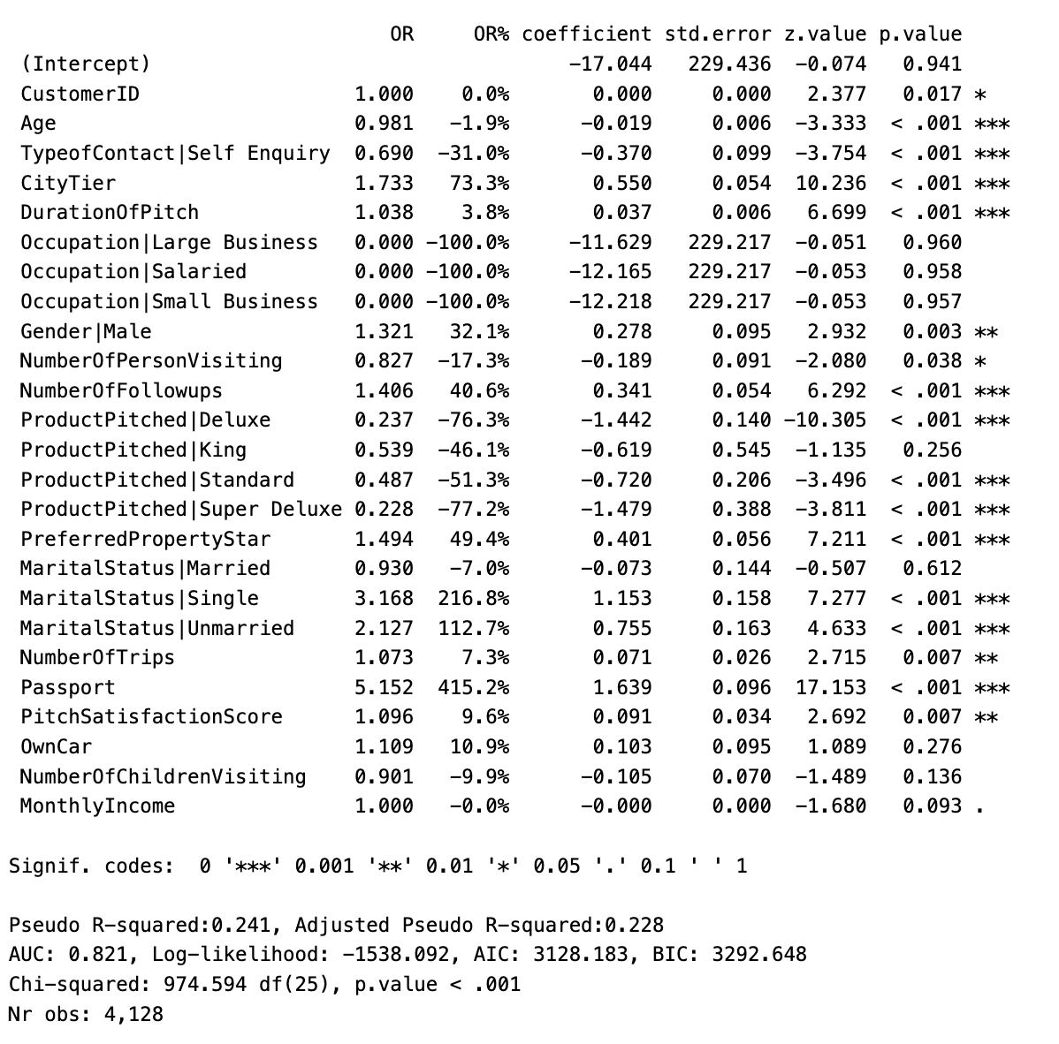
Preliminary Analysis
Important Factors:
Age
Type of Contact
City Tier
Duration of Pitch
Gender
No. of People Visiting
No. of Follow Ups
Product Pitched
Preferred Property Star
Marital Status
No. of Trips
Passport
Pitch Satisfaction Score
Insignificant Factors:
Occupation
Car Ownership
No. of Children Visiting
Monthly Income

