Slide 1
RSNA-MICCAI Brain Tumor Radio genomic MGMT Classification (Methylguanine Methyltransferase)
Presented By:
Prakash Chourasia
Department of Computer Science,
Georgia State University
The Radiological Society of North America (RSNA) along with the Medical Image Computing and Computer Assisted Intervention Society (the MICCAI Society)
Notes:
Methylguanine Methyltransferase

Slide 2
cONTENT
Summary
Introduction
About Cancer and Gene
Problem Statement
Dataset
Deep Learning and its role – Models
Results
Conclusion

Slide 3
Problem Statement
Aim to study the Brain Tumor MRI images and classify for MGMT promoter methylation status
MRI scan images are quite different from our traditional RGB images
First preprocess the images data, then fit it to several baseline models to investigate the utility of AI

Slide 4
Introduction
The brain is the most complex part of the human body.
Brain tumor is an uncontrolled development of brain cells in brain cancer
Brain Tumors can be malignant or benign.
Benign Tumor | Malignant Tumor
Slow rate of growth | Rapid rate of growth
Non invasive (Capsule covered) | Invasive (No capsule) Highly spreadable
Metastasis – Absent | Metastasis – Present (Spread in organs)
Hemorrhage and Necrosis – Absent | Hemorrhage and Necrosis - Present

Slide 5
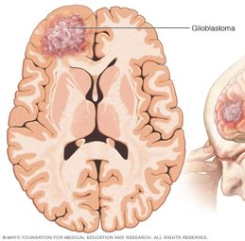
What Is Glioblastoma?
Glioblastoma is an aggressive type of cancer that can occur in the brain. (Grade IV tumor GBM)
Frontal Lobe is most common but can occur Brainstem, Cerebellum
Treatments:
Surgery
Radiation
Chemotherapy
*Image Source - https://www.mayoclinic.org/diseases-conditions/glioblastoma/cdc-20350148

Slide 6
MGMT promoter methylation?
MGMT - Methylguanine Methyltransferase it is an enzyme which removes the molecule to synthesize chemo drug, helps in DNA repair for cancer cell
Methylated MGMT associated with improved outcome in glioblastoma
It is a favorable prognostic factor and a strong predictor of responsiveness to chemotherapy.
Help in therapy decision making

Slide 7
Motivation
Currently, genetic analysis of cancer requires surgery to extract a tissue sample.
Then it takes several weeks to determine the genetic characteristics of the tumor.
An automatic model to detect the presence of MGMT promoter methylation might help faster treatment and avoid surgery for test

Slide 8


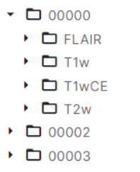
Dataset
Images are in DICOM format.
Three cohorts of multi-parametric MRI (mpMRI) scans:
1. Training Data
2. Validation Data
3. Test Data
Four subfolders within cohorts:
1. Fluid Attenuated Inversion Recovery (FLAIR)
2. T1-weighted pre-contrast (T1w)
3. T1-weighted post-contrast (T1WCE)
4. T2-weighted (T2)
Notes:
The Radiological Society of North America (RSNA) along with the Medical Image Computing and Computer Assisted Intervention Society (the MICCAI Society)

Slide 9
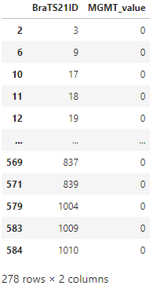
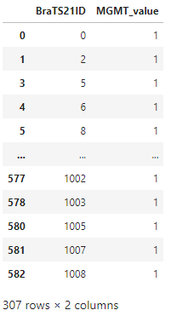
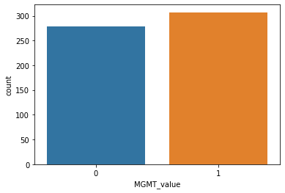
Prediction of Genetic characteristic of Glioblastoma
The MGMT promoter methylation status data is defined as a binary label (0: unmethylated, 1: methylated)
307 Positive Cases (Methylated)
278 Negative Cases (Unmethylated)
585 Total Patients

Slide 10
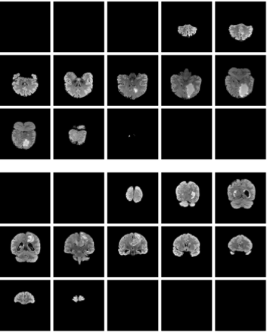
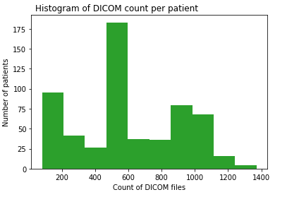
Each patient has several scans for each MRI Type (4 types).

Slide 11
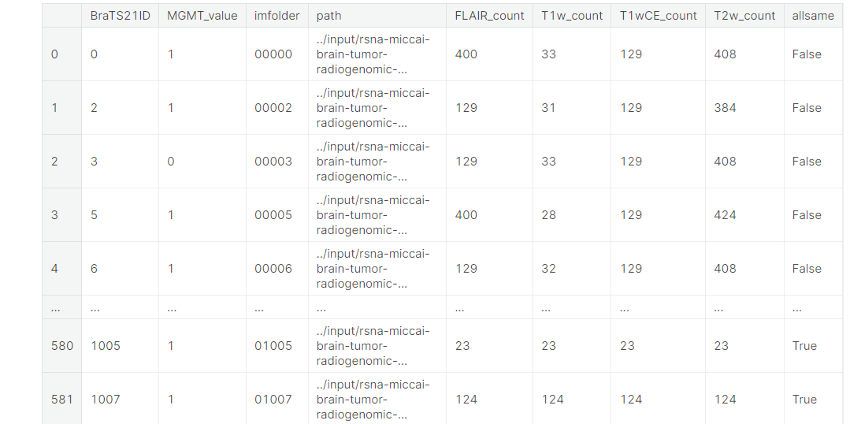
Exploratory Data Analysis
87 Patients have Similar count of images in subfolder
Total number of patients: 585
Total file count: 348641

Slide 12
BaseLine Model
A simple solution
For each patient, we consider 4 sequences (FLAIR, T1w, T1Gd, T2), and for each of those sequences take a slice randomly.
Use CNN to perform Classification
Convolutional Neural Network
ResNet50 [4]
EfficientNet [5]

Slide 13
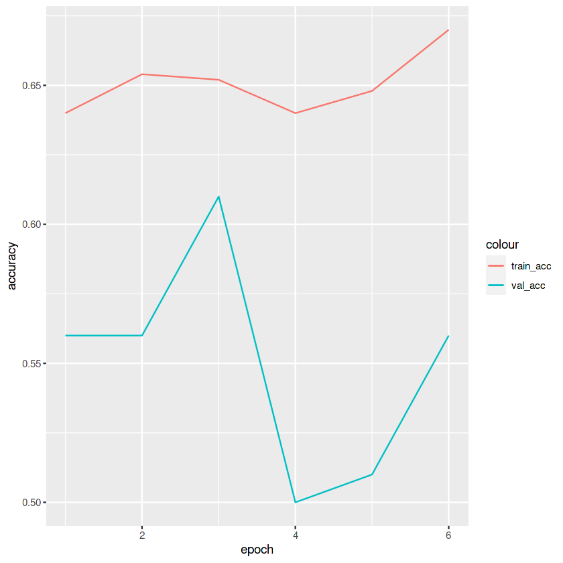
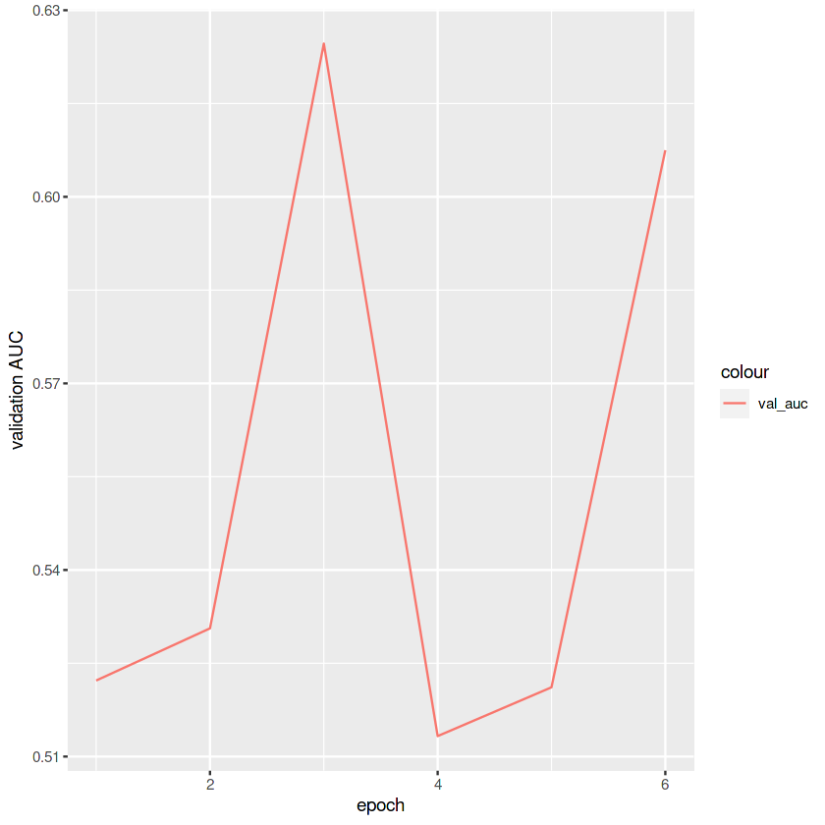
Results with CNN – With More Images
Very poor results with random selection of images
Lets consider more images
Still poor results
Validation Accuracy ~55%
Training Accuracy ~ 65%
Validation AUC ~ 0.55

Slide 14
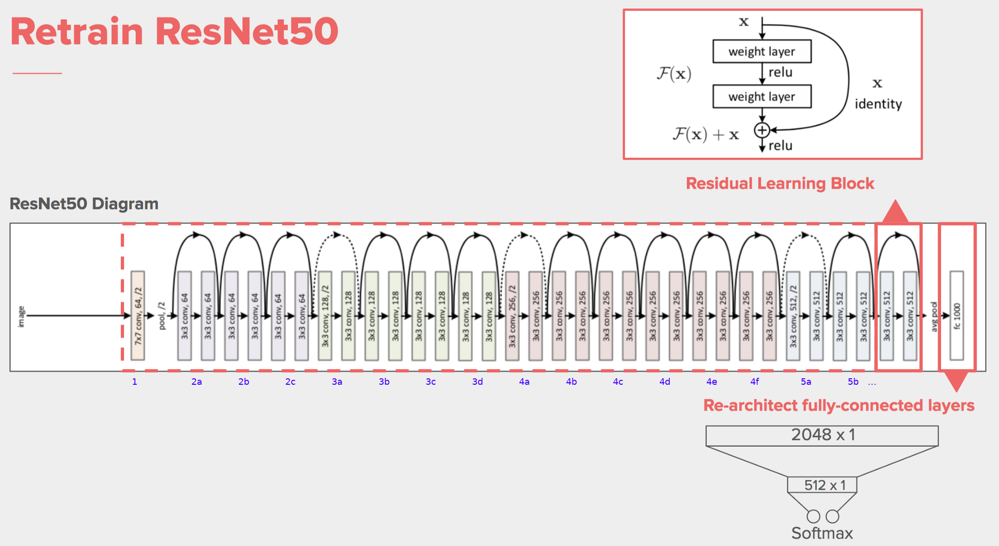
ResNet50
Deep Learning model for image classification of the Convolutional Neural Network.
50 layers deep
Deep neural networks are susceptible to vanishing gradients
Resnet used skip connection to propagate information over layers
*Image Source - [5] He, Kaiming, et al. "Deep residual learning for image recognition."

Slide 15
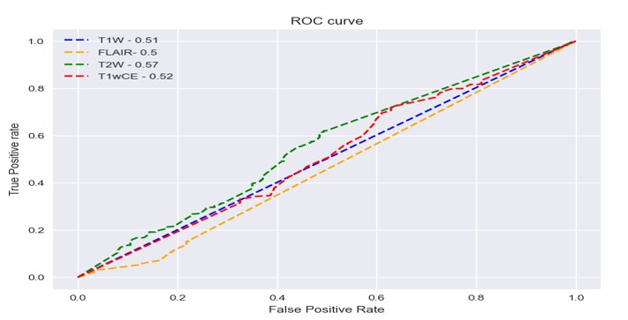
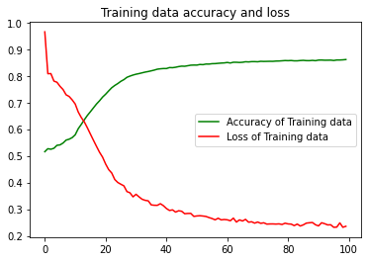
Experimental Analysis [ResNet50]

Slide 16
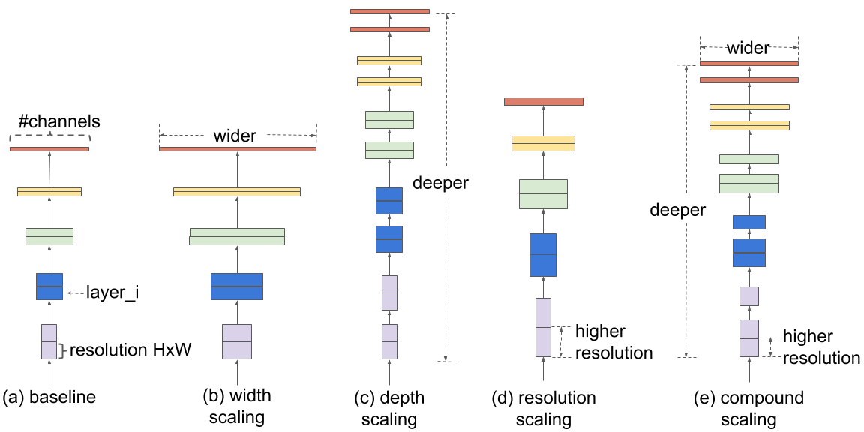
EfficientNet
EfficientNet, as the name suggests are very efficient computationally.
Achieved state of art result on ImageNet dataset which is 84.4% top-1 accuracy.
Model scaling is about scaling the network depth (more layers), width (more channels per layer), resolution (input image)
*Image Source - https://ai.googleblog.com/2019/05/efficientnet-improving-accuracy-and.html#:~:text=EfficientNet%20Performance&text=Compared%20with%20the%20widely%20used,Accuracy%20Comparison

Slide 17
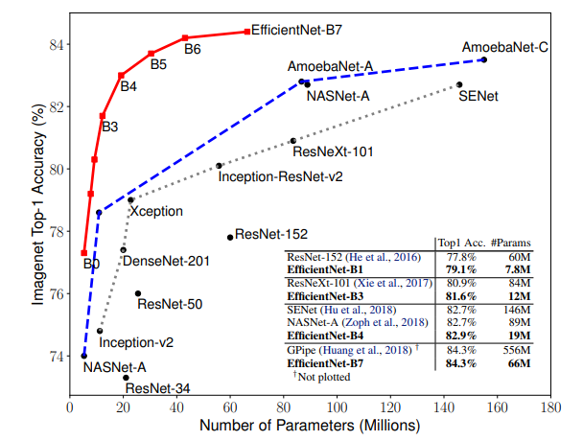
Why EfficientNet ?
EfficientNets has large activations which cause a larger memory footprint because
Use similar FLOPs as ResNet to give better Accuracy
FLOPs, simply means the total number of floating point operations required for a single forward pass. The higher the FLOPs, the slower the model and hence low throughput.
*Image Source - https://ai.googleblog.com/2019/05/efficientnet-improving-accuracy-and.html#:~:text=EfficientNet%20Performance&text=Compared%20with%20the%20widely%20used,Accuracy%20Comparison

Slide 18
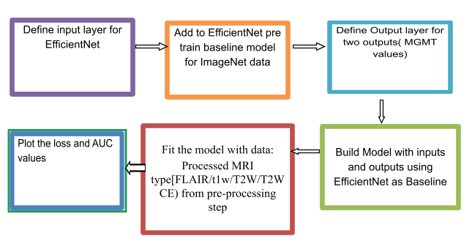
Workflow of Deep Learning Model Architecture

Slide 19
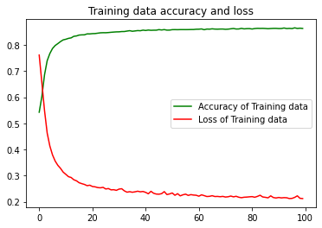
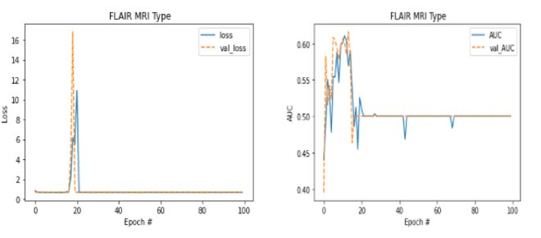
Experimental Analysis [EfficientNet]

Slide 20
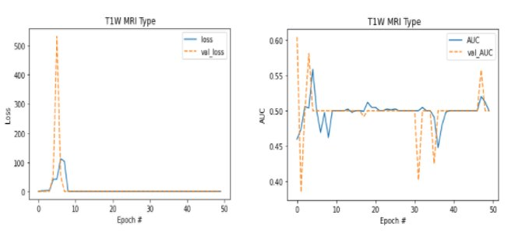
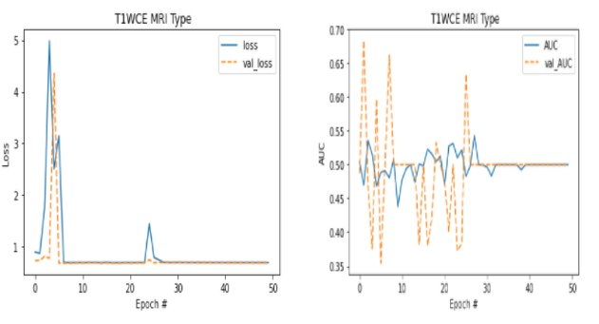
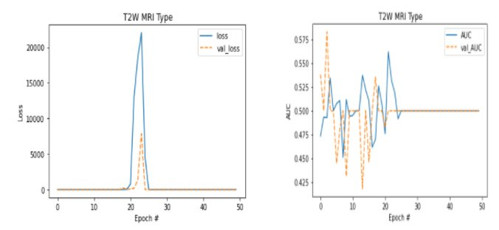
Experimental Analysis [EfficientNet]

Slide 21
Test Results
MRI Type | Test Accuracy | Test AUC
FLAIR | 0.7551 | 0.458
T1w | 0.822 | 0.29
T1Gd | 0.59 | 0.91
T2W | 0.9125 | 0.7842

Slide 22

Conclusion And Future Work
Conclusion
MRI images are very different from non-medical images
Pre-trained models for ImageNet may not be as good as baseline
Unique pre processing may require
Future Work
Additional, higher quality pre-processed data
Apply sequence model like LSTM along with CNN
Use VGG 16 /19 DenseNet or other Pretrained Models
*Image Source - https://memegenerator.net/instance/72296984/waiting-skeleton-near-computer-still-waiting-for-my-neural-network-to-train

Slide 23
References
[1] A Deep Convolutional Neural Network for Annotation of Magnetic Resonance Imaging Sequence Type Sara Ranjbar, Kyle W. Singleton, Pamela R. Jackson, Cassandra R. Rickertsen, Scott A. Whitmire, Kamala R. Clark-Swanson, J. Ross Mitchell, Kristin R. Swanson & Leland S. Hu
[2] Ker J, Singh SP, Bai Y, Rao J, Lim T, Wang L (2019) Image thresholding improves 3-dimensional convolutional neural net- work diagnosis of different acute brain hemorrhages on computed tomography scans. Sensors 19(9):2167
[3] Robben D, Boers AMM, Marquering HA, Langezaal LLCM, Roos YBWEM, van Oostenbrugge RJ, van Zwam WH, Dippel DWJ, Majoie CBLM, van der Lugt A et al (2020) Prediction of final infarct volume from native CT perfusion and treatment parameters using deep learning. Med Image 59:101589
[4] He, Kaiming, et al. "Deep residual learning for image recognition." Proceedings of the IEEE conference on computer vision and pattern recognition. 2016.
[5] Tan, Mingxing, and Quoc Le. "Efficientnet: Rethinking model scaling for convolutional neural networks." International conference on machine learning. PMLR, 2019.

Slide 24
THANK YOU

