Slide 1
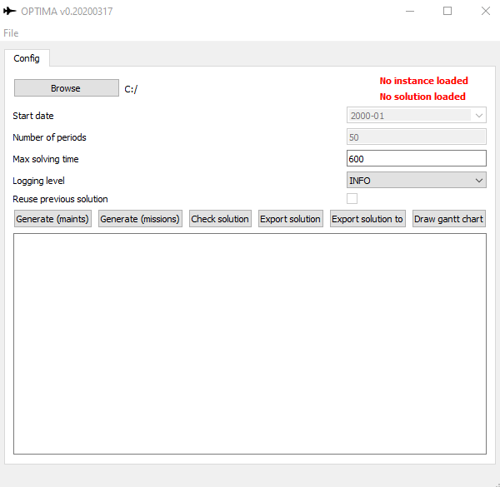
Reading a template
Status label
Configuration
Action buttons
Log screen

