Slide 1
Intelligent tutoring systems
A Better Approach

Slide 2
ABOUT US
We are the members of group 6.
- Piyush Chanduka - Govind Tuli - Vatsal Agarwal

Slide 3
Paper review
The paper we inferred is “A Web-Based Intelligent Tutoring System for Computer Programming”.
It uses a model called BITS (Bayesian Intelligent Tutoring System). It is a web-based intelligent tutoring system for computer programming that utilizes Bayesian networks for uncertainty management.
A user learns a topic with minimum amount of knowledge he needs to know. BITS obtains evidence for updating the Bayesian network through two methods: (a) direct feedback from the student if they know a particular concept or not, and (b) sample quiz results to determine if a student has understood a particular concept.
BITS has been implemented for use in the initial computer programming course at the University of Regina and demonstrates the practical usefulness of Bayesian networks for web intelligence in tutoring systems.

Slide 4
Our changes
Chatgpt
Infusion of ChatGPT saves time and improve error detection ability. It takes both correct as well as erroneous code to specify the errors user made.
domain knowledge integration
We have assigned relative weights to each node to mark their importance. This helps to create a tree which will lead to shorter path.
optimization of probability propagation
This makes our model a unique one as it ensures a slight change in the parent node whenever child node’s probability updates.
Problem solving
We have introduced problem solving coding quizzes after each lesson. This would make the whole difference as it would increase the thinking ability of the user and practice for use in future.

Slide 5
Concepts we used
Bayesian Networks
Graph-based Results
model that visually represents the joint probability distribution of a set of random variables using a directed acyclic tree and conditional probability distributions for each node in the tree.
Generating graphs three dimensional to provide better insights for a change in child node
Accuracy Calculation
Weights and Optimization
Categorized ChatGPT’s response into 4 types – TP, TN, FP, FN. This helps to calculate the accuracy of the response of ChatGPT
Assigned weights to each node to mark its importance. And optimizing the change in each child node’s probability with parent node.

Slide 6
Code OVERVIEW
Bayesian Network Implementation
--
Weights Assignment and Updating
--
Results and Probabilities
--
Graph Generation
--

Slide 7
Chatgpt overview
Easy
Medium
hard
It works excellently well.
--
--

Slide 8
COMPANY OVERVIEW

Slide 9
BUSINESS MODEL
ABSTRACT
We based our research on market trends and social media
DESIGN
We believe people need more products specifically dedicated to this niche market
RESEARCH
Minimalist and easy to use

Slide 10
Market comparison
$3B
$2B
$1B
Opportunity to build
Freedom to invent
Few competitors
Addressable market
Serviceable market
Obtainable market

Slide 11
OUR COMPETITION
CONTOSO
COMPETITORS
Our product is priced below that of other companies on the market
Design is simple and easy to use, compared to the complex designs of the competitors
Affordability is the main draw for our consumers to our product
Company A Product is more expensive
Companies B & C Product is expensive and inconvenient to use
Companies D & E Product is affordable, but inconvenient to use

Slide 12
Our competition
Convenient
Contoso
Competitor A
Affordable
Expensive
Competitor D
Competitor C
Competitor B
Competitor E
Inconvenient

Slide 13
Growth strategy
Feb 20XX
Roll out product to high profile or top-level participants to help establish the product
Mar 20XX
Release the product to the general public and monitor press release and social media accounts
Oct 20XX
Gather feedback and adjust product design as necessary

Slide 14
TRACTION
Forecasting for success
Key Metrics
 | Clients | Orders | Gross revenue | Net revenue
20XX | 10 | 1100 | $10,000 | $7,000
20XX | 20 | 200 | $20,000 | $16,000
20XX | 30 | 300 | $30,000 | $25,000
20XX | 40 | 400 | $40,000 | $30,000
REVENUE BY YEAR

Slide 15
TWO-YEAR ACTION PLAN
DRAFT BLUEPRINTS
GATHER FEEDBACK
DELIVER TO CLIENT
20XX
JAN
FEB
MAR
APR
MAY
JUN
JUL
AUG
SEP
OCT
NOV
DEC
20XX
JAN
FEB
MAR
APR
MAY
JUN
JUL
AUG
SEP
OCT
NOV
DEC
RUN FOCUS GROUPS
TEST DESIGN
LAUNCH DESIGN

Slide 16
FINANCIALS
 | Year 1 | Year 2 | Year 3
INCOME
Users | 50,000 | 400,000 | 1,600,000
Sales | 500,000 | 4,000,000 | 16,000,000
Average price per sale | 75 | 80 | 90
Revenue @ 15% | 5,625,000 | 48,000,000 | 216,000,000
GROSS PROFIT | 5,625,000 | 48,000,000 | 216,000,000
Expenses
Sales & marketing | 5,062,500 | 38,400,000 | 151,200,000 | 70%
Customer service | 1,687,500 | 9,600,000 | 21,600,000 | 10%
Product development | 562,500 | 2,400,000 | 10,800,000 | 5%
Research | 281,250 | 2,400,000 | 4,320,000 | 2%
TOTAL EXPENSES | 7,593,750 | 52,800,000 | 187,920,000

Slide 17
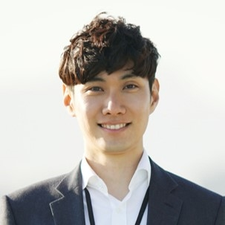
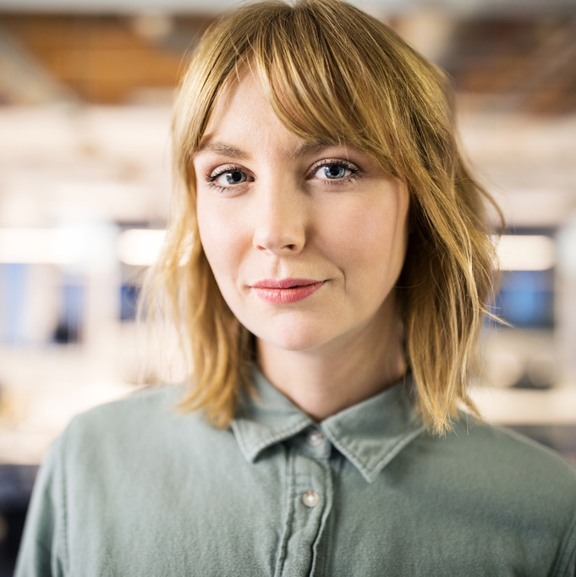


MEET THE TEAM
TAKUMA HAYASHI​
MIRJAM NILSSON​
FLORA BERGGREN​
RAJESH SANTOSHI​
President
Chief Executive Officer
Chief Operations Officer
VP Marketing

Slide 18
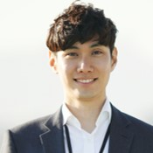







MEET THE TEAM
TAKUMA HAYASHI
MIRJAM NILSSON​
FLORA BERGGREN​
RAJESH SANTOSHI
President
Chief Executive Officer
Chief Operations Officer
VP Marketing
GRAHAM BARNES
ROWAN MURPHY
ELIZABETH MOORE
ROBIN KLINE
VP Product
SEO Strategist
Product Designer
Content Developer

Slide 19
FUNDING
$14,000
$12,000
$82,000
$32,000
ANGEL INVESTMENTS
PROPERTY
SHARES
CASH
Amount obtained through other investors
Revenue obtained from property rentals
Number of shares converted into USD
Liquid cash we have on hand

Slide 20
SUMMARY
At Contoso, we believe in giving 110%. By using our next-generation data architecture, we help organizations virtually manage agile workflows. We thrive because of our market knowledge and great team behind our product. As our CEO says, "Efficiencies will come from proactively transforming how we do business.”

Slide 21
THANK YOU
Mirjam Nilsson​
206-555-0146
mirjam@contoso.com
www.contoso.com

