Slide 1
Smart Contract Auto Auction
Presented by:
Andreas Christodoulou, Preston Claypoole, Michael Dukes, Ghazi Muhammad, and Dean Maruna

Slide 2
Project Goal
Create a Smart Contract on the Blockchain that executes the following functions:
-Create Auction
-Register Assets / Register Auctioneers
-Add Bidders
-Transact Highest Bid
-Execution via Python or Wallet Extension (MetaMask).

Slide 3
Problem Solved
Allow users to buy or sell vehicles (non-fungible assets) on a decentralized network and transact through SmartContracts avoiding traditional methods of payment (i.e. using Crypto).

Slide 4
Necessary Equipment
Solidity / Python languages
OpenZepplin ERC721- Solidity
Web3 - Python
Ganache Install
Remix IDE Install
MetaMask Install Extension (Crypto Wallet)

Slide 5
Install Instructions
Install Instruction for MetaMask and Ganache can be found at these links: https://github.com/mdukes10/Decentralized-Smart-Auto-Auction/blob/main/Supplemental/install-guide.md
Remix IDE: https://remix.ethereum.org/#optimize=false&runs=200&evmVersion=null
Useful Languages Used:
Python & Solidity

Slide 6

Car Auction Contract
Car auction contract is the interface that allows users to place bids and, after the auction is complete, withdraw their funds.

Slide 7
Bidder Contract
The bidder contract uses a struct to register bidder wallet addresses for any given auction.

Slide 8
Car Contract
This function allows you to enter the: the Vin, the year, Make, Model, Miles, accidents, Etc.

Slide 9
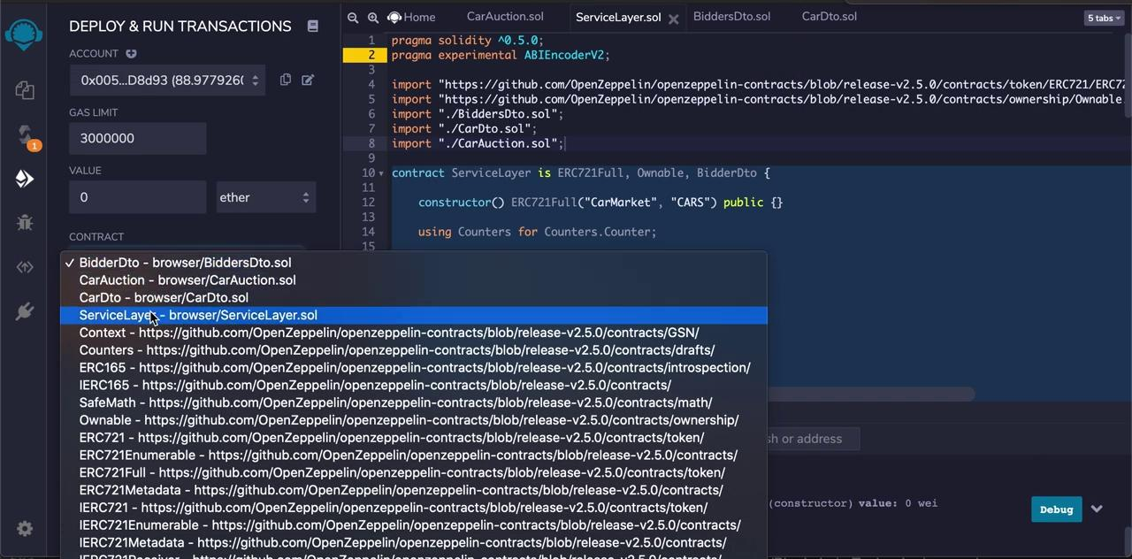
Smart Contract Compiler
Uses OpenZepplin contracts to import ERC721 standard ,which tokenizes non-fungible assets into unique tokens to create secure transactions.
Uses mapping and events
Uses functions like createAuction, registerCar, addBidders, viewCars, endAuction, highestBid, highestBidder, bid
**SEE CODE (ServiceLayer.sol)**

Slide 10
Python - Smart Contract
Imports
Connect to web3
Read in ABI file from Smart Contract
Plug in smart contract address
Establish functions and parse in information (i.e. bidder address, vehicle info., bid amount, etc.)
Watch transaction in Ganache

Slide 11
Run Python Code
Run Python code using
web3.middleware
Register Car & Create Auction
Add Bidder
Place Bid
End Auction
We will use the address ending
in ...57F6 to transact a bid with the
Smart Contract
Notice how account ending
…57F6 balance dropped to 93.93ETH

Slide 12
More Time/Additional Features
Chatbot with ability to ask users for necessary info for Smart Contract inputs usings AWS and Lambdas.
AWS does not have Web3 library for Lambdas. Work-around would be API feature.

Slide 13
Q&A

