Slide 1

About
Contact
Sign in
Observational Astronomy United
~~~~~~~~~~~~~~~~~~~~~~~~~~~~~~~~~~~~~~~~~~~~~~~~~~~~~~~~~~~~~~~~~~~~~~~~~~~
Sign up

Slide 2
Sign Up
Create an Account
Username
Name
Email
Password
Title
Country
Already have an account? Log in!
Sign Up

Slide 3
Login
Welcome Back!
Username
Password
Create an account?
Login

Slide 4

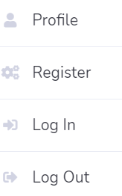
Home Page
Hi, Douglas McGee
Recommend Project
Home
Title Project_type
Description
Project
Observe Supernova 1 | transient
Observe GRB 1 | regular
Observe Exoplanets 1 | regular
Observe Exoplanets 2 | transient
Observe Supernova 2 | regular
Observe Exoplanets 3 | regular
Observe Exoplanets 4 | transient
Observe GRB 2 | regular
Observe Supernova 1 76 times
Observe GRB 1 45 times
Observe Exoplanets 1 65 times
Observe Exoplanets 2 45 times
Observe Supernova 2 90 times
Observe Exoplanets 3 81 times
Observe Exoplanets 4 50 times
Observe GRB 2 1 times
Schedule
Equipment
Relation

Slide 5


Profile
Hi, Douglas McGee
Home
Project
Username
Douglas McGee
Schedule
Equipment
Name
Mveabjz
Relation
Email
Mveabjz@Observatory0.com
Title
Amature
Country
Taiwan

Slide 6
Add Recommend project

Slide 7
Hi, Douglas McGee
Recommend Project
Home
欄位只顯示這三列
Title Project_type
Description
Project
Observe Supernova 1 | transient
Observe GRB 1 | regular
Observe Exoplanets 1 | regular
Observe Exoplanets 2 | transient
Observe Supernova 2 | regular
Observe Exoplanets 3 | regular
Observe Exoplanets 4 | transient
Observe GRB 2 | regular
Observe Supernova 1 76 times
Observe GRB 1 45 times
Observe Exoplanets 1 65 times
Observe Exoplanets 2 45 times
Observe Supernova 2 90 times
Observe Exoplanets 3 81 times
Observe Exoplanets 4 50 times
Observe GRB 2 1 times
Schedule
Equipment
Relation

Slide 8
Hi, Douglas McGee
Project : Observe Supernova 1
Home
Project
Info Target
Schedule
Project Type
PI
aperture_upper_limit
aperture_lower_limit
FoV_upper_limit
需顯示所有欄位
Equipment
Relation
………
Back
Join

Slide 9
Hi, Douglas McGee
Project : Observe Supernova 1
Home
Project
Info Target
欄位只顯示這三列
Schedule
 | Target Name | RA (longitude) | Dec (latitude)
1
2
3
Equipment
Relation
… … … ….
Back
Join

Slide 10
Manage my project (Project Manager)

Slide 11
Hi, Douglas McGee
Recommend Project
Home
Title Project_type
Description
Project
Observe Supernova 1 | transient
Observe GRB 1 | regular
Observe Exoplanets 1 | regular
Observe Exoplanets 2 | transient
Observe Supernova 2 | regular
Observe Exoplanets 3 | regular
Observe Exoplanets 4 | transient
Observe GRB 2 | regular
Observe Supernova 1 76 times
Observe GRB 1 45 times
Observe Exoplanets 1 65 times
Observe Exoplanets 2 45 times
Observe Supernova 2 90 times
Observe Exoplanets 3 81 times
Observe Exoplanets 4 50 times
Observe GRB 2 1 times
Schedule
Equipment
Relation

Slide 12
Hi, Douglas McGee
Recommend Project
Home
Title Project_type
Description
Project
Observe Supernova 1 | transient
Observe GRB 1 | regular
Observe Exoplanets 1 | regular
Observe Exoplanets 2 | transient
Observe Supernova 2 | regular
Observe Exoplanets 3 | regular
Observe Exoplanets 4 | transient
Observe GRB 2 | regular
Observe Supernova 1 76 times
Observe GRB 1 45 times
Observe Exoplanets 1 65 times
Observe Exoplanets 2 45 times
Observe Supernova 2 90 times
Observe Exoplanets 3 81 times
Observe Exoplanets 4 50 times
Observe GRB 2 1 times
Participate
Project Manager
Create Project
Schedule
Equipment
Relation

Slide 13
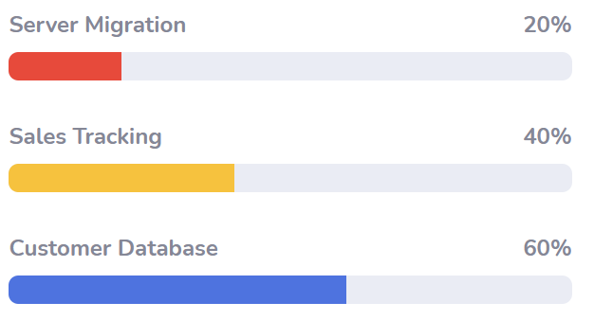
Hi, Douglas McGee
Project management
*同個顏色即可
Home
Observe Supernova 1
150 people
Project
Observe GRB 1
300 people
Participate
Project Manager
Observe Exoplanets 1
450 people
Create Project
Schedule
欄位只顯示這三列
Project Title Project Type
Description
Observe Supernova 1 | transient
Observe GRB 1 | regular
Observe Exoplanets 1 | regular
Observe Supernova 1 76 times
Observe GRB 1 45 times
Observe Exoplanets 1 65 times
Equipment
Relation

Slide 14
Hi, Douglas McGee
Project : Observe Supernova 1
Home
Project
Info Target Participant& Equipment ID + Site
Participate
Project Manager
Project Type
PI
aperture_upper_limit
aperture_lower_limit
FoV_upper_limit
需顯示所有欄位
Create Project
Schedule
Equipment
Relation
Back

Slide 15
Hi, Douglas McGee
Project : Observe Supernova 1
Home
Project
Info Target Participant& Equipment ID + Site
Participate
欄位只顯示這三列
Project Manager
 | Target Name | RA (longitude) | Dec (latitude)
1
2
3
Create Project
Schedule
Equipment
Relation
Back

Slide 16
Hi, Douglas McGee
Project : Observe Supernova 1
Home
Info Target Participant& Equipment ID + Site
Project
Participate
Username | Equipment ID + Site
Project Manager
Create Project
Schedule
Equipment
Relation
Back

Slide 17
Manage my project (Participated project)

Slide 18
Hi, Douglas McGee
Recommend Project
Home
Title Project_type
Description
Project
Observe Supernova 1 | transient
Observe GRB 1 | regular
Observe Exoplanets 1 | regular
Observe Exoplanets 2 | transient
Observe Supernova 2 | regular
Observe Exoplanets 3 | regular
Observe Exoplanets 4 | transient
Observe GRB 2 | regular
Observe Supernova 1 76 times
Observe GRB 1 45 times
Observe Exoplanets 1 65 times
Observe Exoplanets 2 45 times
Observe Supernova 2 90 times
Observe Exoplanets 3 81 times
Observe Exoplanets 4 50 times
Observe GRB 2 1 times
Project Manager
Participate
Create Project
Schedule
Equipment
Relation

Slide 19
Hi, Douglas McGee
Participated Project
Home
Project Title Project_type
欄位只顯示這三列
Description
Project
Observe Supernova 1 | transient
Observe GRB 1 | regular
Observe Exoplanets 1 | regular
Observe Supernova 1 76 times
Observe GRB 1 45 times
Observe Exoplanets 1 65 times
Project Manager
Participate
Create Project
Schedule
Equipment
Relation

Slide 20
Hi, Douglas McGee
Project : Observe Supernova 1
Home
Project
Info Target
Project Manager
Project Type
PI
aperture_upper_limit
aperture_lower_limit
FoV_upper_limit
Participate
需顯示所有欄位
Create Project
Schedule
Equipment
………
Relation
Back
Join

Slide 21
Hi, Douglas McGee
Project : Observe Supernova 1
Home
Project
Info Target
欄位只顯示這三列
Project Manager
 | Target Name | RA (longitude) | Dec (latitude)
1
2
3
Participate
Create Project
Schedule
Equipment
… … … ….
Relation
Back
Join

Slide 22
Create a new project

Slide 23
Hi, Douglas McGee
Recommend Project
Home
Title Project_type
Description
Project
Observe Supernova 1 | transient
Observe GRB 1 | regular
Observe Exoplanets 1 | regular
Observe Exoplanets 2 | transient
Observe Supernova 2 | regular
Observe Exoplanets 3 | regular
Observe Exoplanets 4 | transient
Observe GRB 2 | regular
Observe Supernova 1 76 times
Observe GRB 1 45 times
Observe Exoplanets 1 65 times
Observe Exoplanets 2 45 times
Observe Supernova 2 90 times
Observe Exoplanets 3 81 times
Observe Exoplanets 4 50 times
Observe GRB 2 1 times
Project Manager
Participate
1.
Create Project
Schedule
Equipment
Relation

Slide 24
Hi, Douglas McGee
Create Project
Home
Project
2. For user to input
需輸入所有欄位
Project Title
Observe Exoplanets 11
Project
Project Manager
Project Type
Participate
Description
Create Project
Schedule
Target
Equipment
Target | RA (Longitude) | Dec (Latitude)
Relation
Add Target
Create Project

Slide 25
Hi, Douglas McGee
Create Project
Home
Project
Project Title
Observe Exoplanets 11
Project
Project Type
Regular
3.
Project Manager
Target of opportunity
Participate
Description
Transient
Create Project
Schedule
Target
Equipment
Target | RA (Longitude) | Dec (Latitude)
Relation
Add Target
Create Project

Slide 26
Hi, Douglas McGee
Create Project
Home
Project
Project Title
Observe Exoplanets 1
Project
Project Manager
Project Type
Regular
Participate
4.
Description
Observe Supernova 1 76 times
Create Project
Schedule
Target
Equipment
Target | RA (Longitude) | Dec (Latitude)
Relation
Add Target
Create Project

Slide 27
Hi, Douglas McGee
Create Project
Home
Project
Project Title
Observe Exoplanets 1
Project
Project Manager
Project Type
Regular
Participate
Description
Observe Supernova 1 76 times
Create Project
Schedule
Target
只需輸入3個欄位
Equipment
Target | RA (Longitude) | Dec (Latitude)
V* V1886 Cyg | 314.0565 | 36.36454
5.
Relation
Add Target
6.
Create Project

Slide 28
Hi, Douglas McGee
Create Project
Home
Project
Project Title
Observe Exoplanets 1
Project
Project Manager
Project Type
Regular
Participate
Description
Observe Supernova 1 76 times
Create Project
Schedule
Target
Equipment
Target | RA (Longitude) | Dec (Latitude)
V* V1886 Cyg | 314.0565 | 36.36454
RAFGL 2679 | 314.2226 | 37.4196
Relation
7.
Add Target
8.
Create Project

Slide 29
Schedule

Slide 30
Hi, Douglas McGee
Recommend Project
Home
Title Project_type
Description
My Project
Observe Supernova 1 | transient
Observe GRB 1 | regular
Observe Exoplanets 1 | regular
Observe Exoplanets 2 | transient
Observe Supernova 2 | regular
Observe Exoplanets 3 | regular
Observe Exoplanets 4 | transient
Observe GRB 2 | regular
Observe Supernova 1 76 times
Observe GRB 1 45 times
Observe Exoplanets 1 65 times
Observe Exoplanets 2 45 times
Observe Supernova 2 90 times
Observe Exoplanets 3 81 times
Observe Exoplanets 4 50 times
Observe GRB 2 1 times
Schedule
Equipment
Relation

Slide 31
Hi, Douglas McGee
Home
Select Equipment
My Project
Project Title
根據User 參與的project列出表單
Schedule
Equipment ID + Site
Equipment ID + Site
根據User 擁有的equipment列出表單
Equipment
Relation
Next

Slide 32
Hi, Douglas McGee
Project Title:
Equipment ID + Site:
Home
只顯示3個欄位
My Project
Target Name Start Observation Time
End Observation Time
NSV 25525
V* V1800 Cyg
[D75] 123
Schedule
Equipment
Relation
程式計算

Slide 33
Equipment

Slide 34
Hi, Douglas McGee
Recommend Project
Home
Title Project_type
Description
My Project
Observe Supernova 1 | transient
Observe GRB 1 | regular
Observe Exoplanets 1 | regular
Observe Exoplanets 2 | transient
Observe Supernova 2 | regular
Observe Exoplanets 3 | regular
Observe Exoplanets 4 | transient
Observe GRB 2 | regular
Observe Supernova 1 76 times
Observe GRB 1 45 times
Observe Exoplanets 1 65 times
Observe Exoplanets 2 45 times
Observe Supernova 2 90 times
Observe Exoplanets 3 81 times
Observe Exoplanets 4 50 times
Observe GRB 2 1 times
Schedule
Equipment
Relation

Slide 35
Hi, Douglas McGee
Equipment
Home
顯示所有欄位
My Project
Equipment ID
Site
Time zone
Camera Type
Schedule
290 Mauna Kea Observatory UTC-9 mono, cooled
……..
Equipment
520 Large Millimeter Telescope UTC+0 colored, cooled
Relation
… … … … …. .
Add Equipment

Slide 36
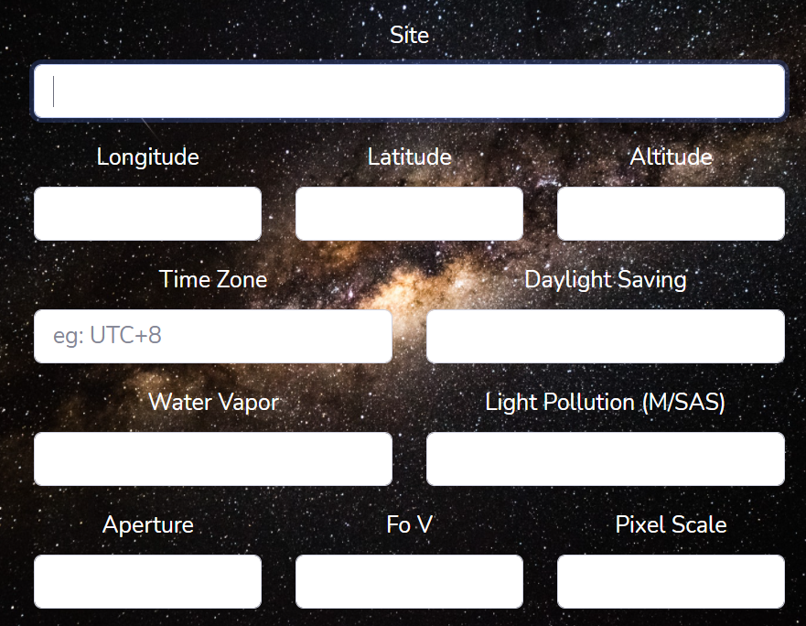
Add Equipment
Hi, Douglas McGee
Home
需顯示所有欄位
My Project
Schedule
Equipment
Relation
……..
Add

