Slide 1
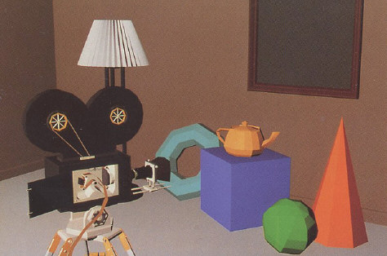
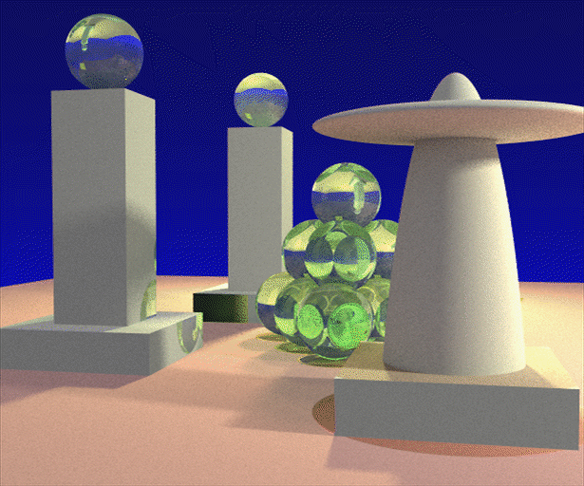
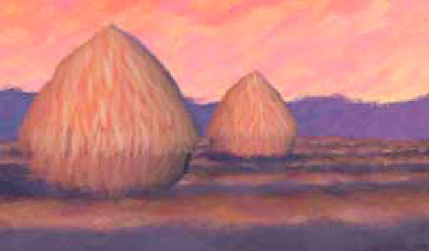
Advanced Computer Graphics (Fall 2009)
CS 294-13, Rendering Lecture 1: Introduction and Basic Ray Tracing
Ravi Ramamoorthi
http://inst.eecs.berkeley.edu/~cs294-13/fa09
Some slides courtesy Thomas Funkhouser and Pat Hanrahan

Slide 2
To Do
Start working on raytracer assignment (if necessary)
Start thinking about path tracer, final project

Slide 3
First Assignment
In groups of two (find partners)
Monte Carlo Path Tracer
If no previous ray tracing experience, ray tracer first.
See how far you go. Many extra credit items possible, fast multi-dim. rendering, imp. sampling…
This lecture focuses on basic ray tracing
Likely to be a review for most of you, go over fast

Slide 4
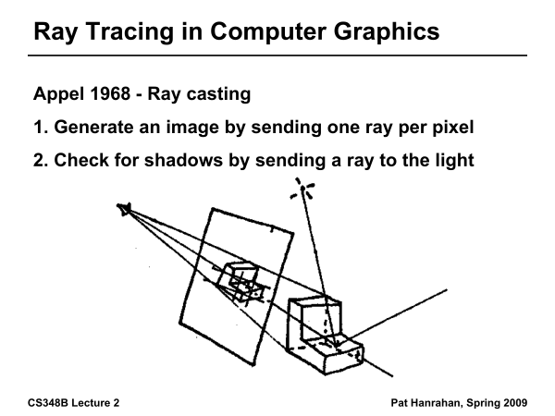
Ray Tracing History

Slide 5
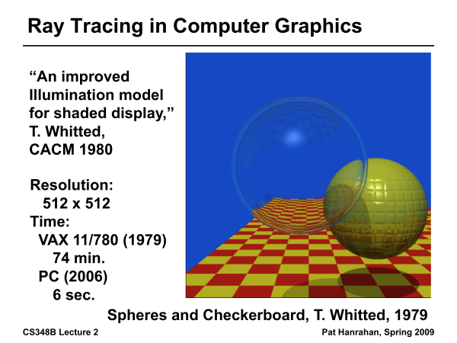
Ray Tracing History

Slide 6
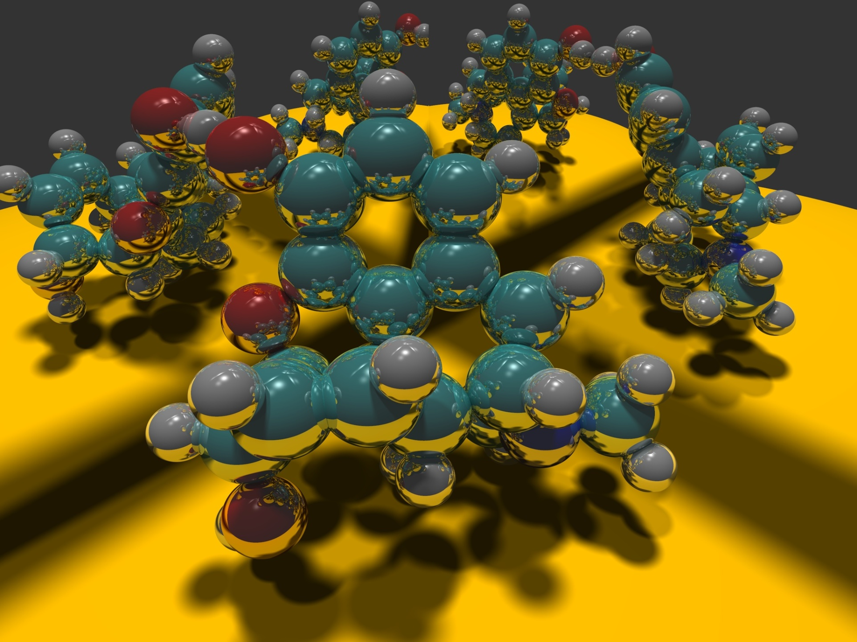
Image courtesy Paul Heckbert 1983

Slide 7
Outline
Camera Ray Casting (choosing ray directions)
Ray-object intersections
Ray-tracing transformed objects
Lighting calculations
Recursive ray tracing

Slide 8
Outline in Code
Image Raytrace (Camera cam, Scene scene, int width, int height)
{
Image image = new Image (width, height) ;
for (int i = 0 ; i < height ; i++)
for (int j = 0 ; j < width ; j++) {
Ray ray = RayThruPixel (cam, i, j) ;
Intersection hit = Intersect (ray, scene) ;
image[i][j] = FindColor (hit) ;
}
return image ;
}

Slide 9
Ray Casting
Virtual Viewpoint
Virtual Screen
Objects
Ray intersects object: shade using color, lights, materials
Ray misses all objects: Pixel colored black
Multiple intersections: Use closest one (as does OpenGL)

Slide 10
Finding Ray Direction
Goal is to find ray direction for given pixel i and j
Many ways to approach problem
  Objects in world coord, find dirn of each ray (we do this)
  Camera in canonical frame, transform objects (OpenGL)
Basic idea
  Ray has origin (camera center) and direction
  Find direction given camera params and i and j
Camera params as in gluLookAt
  Lookfrom[3], LookAt[3], up[3], fov

Slide 11
Similar to gluLookAt derivation
gluLookAt(eyex, eyey, eyez, centerx, centery, centerz, upx, upy, upz)
Camera at eye, looking at center, with up direction being up
Up vector
Eye
Center

Slide 12
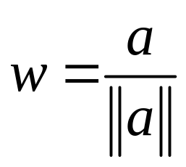
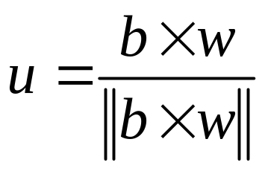

Constructing a coordinate frame?
We want to associate w with a, and v with b
  But a and b are neither orthogonal nor unit norm
  And we also need to find u

Slide 13
Camera coordinate frame
We want to position camera at origin, looking down –Z dirn
Hence, vector a is given by eye – center
The vector b is simply the up vector
Up vector
Eye
Center

Slide 14
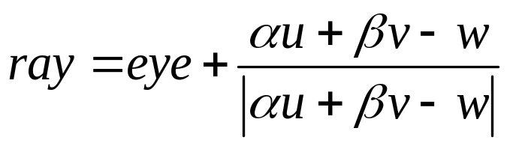
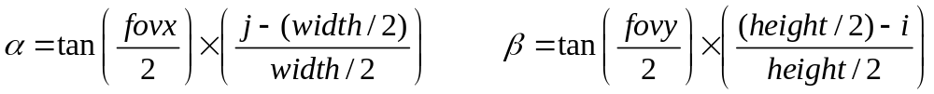
Canonical viewing geometry
βv
-w
αu

Slide 15
Outline
Camera Ray Casting (choosing ray directions)
Ray-object intersections
Ray-tracing transformed objects
Lighting calculations
Recursive ray tracing

Slide 16
Outline in Code
Image Raytrace (Camera cam, Scene scene, int width, int height)
{
Image image = new Image (width, height) ;
for (int i = 0 ; i < height ; i++)
for (int j = 0 ; j < width ; j++) {
Ray ray = RayThruPixel (cam, i, j) ;
Intersection hit = Intersect (ray, scene) ;
image[i][j] = FindColor (hit) ;
}
return image ;
}

Slide 17
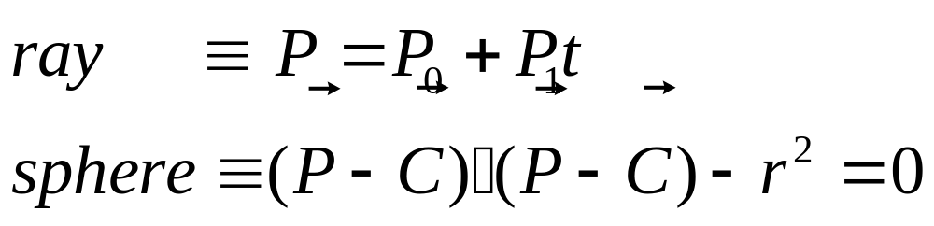
Ray-Sphere Intersection
C
P₀

Slide 18
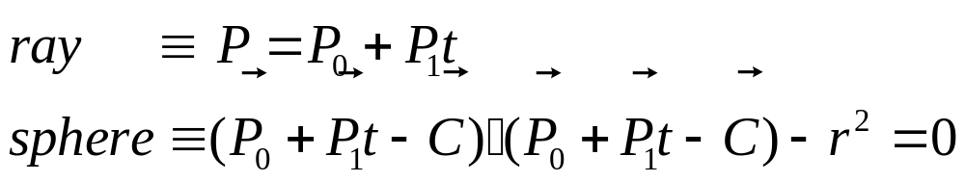
Ray-Sphere Intersection
Substitute
Simplify

Slide 19
Ray-Sphere Intersection
2 real positive roots: pick smaller root
Both roots same: tangent to sphere
One positive, one negative root: ray origin inside sphere (pick + root)
Complex roots: no intersection (check discriminant of equation first)
Solve quadratic equations for t

Slide 20
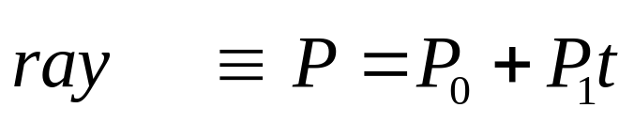
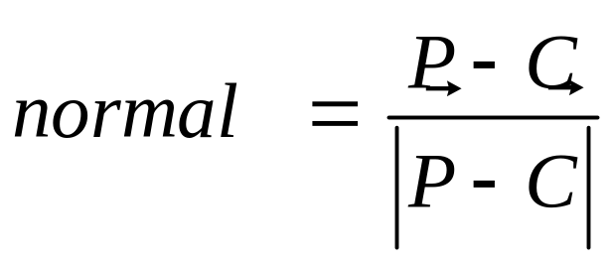
Ray-Sphere Intersection
Intersection point:
Normal (for sphere, this is same as coordinates in sphere frame of reference, useful other tasks)

Slide 21
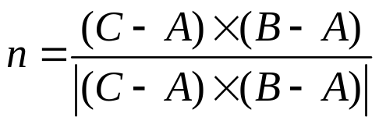
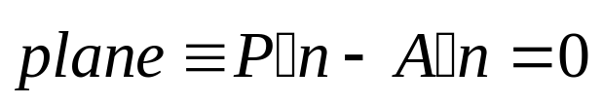
Ray-Triangle Intersection
One approach: Ray-Plane intersection, then check if inside triangle
Plane equation:
B
A
C

Slide 22
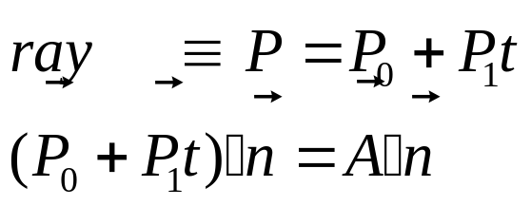
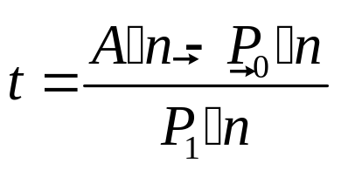
Ray-Triangle Intersection
One approach: Ray-Plane intersection, then check if inside triangle
Plane equation:
Combine with ray equation:
B
A
C

Slide 23
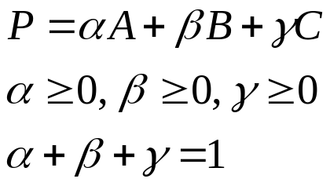
Ray inside Triangle
Once intersect with plane, still need to find if in triangle
Many possibilities for triangles, general polygons (point in polygon tests)
We find parametrically [barycentric coordinates]. Also useful for other applications (texture mapping)
B
A
α
β
P
γ
C

Slide 24

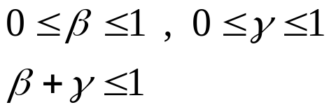
Ray inside Triangle
B
A
α
β
P
γ
C

Slide 25
Other primitives
Much early work in ray tracing focused on ray-primitive intersection tests
Cones, cylinders, ellipsoides
Boxes (especially useful for bounding boxes)
General planar polygons
Many more
Many references. For example, chapter in Glassner introduction to ray tracing (see me if interested)

Slide 26
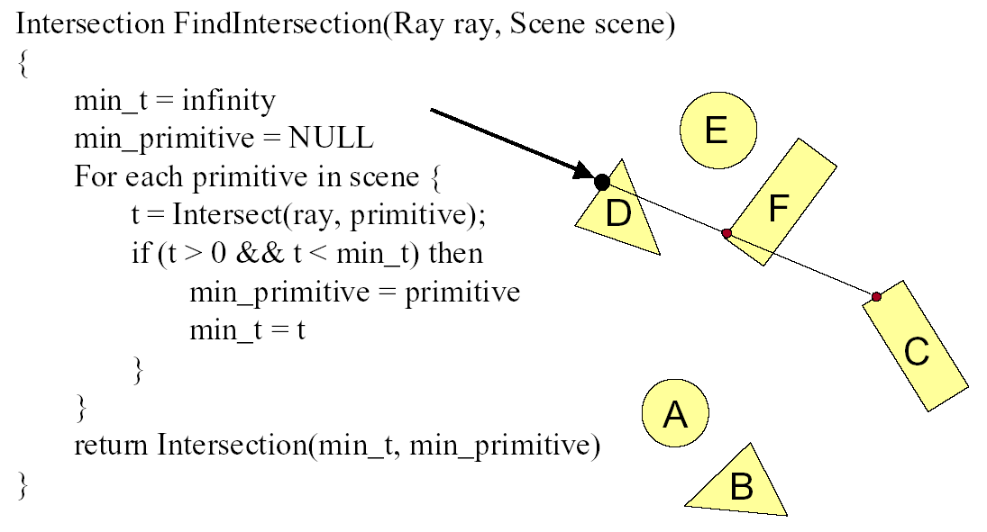
Ray Scene Intersection

Slide 27
Outline
Camera Ray Casting (choosing ray directions)
Ray-object intersections
Ray-tracing transformed objects
Lighting calculations
Recursive ray tracing

Slide 28
Transformed Objects
E.g. transform sphere into ellipsoid
Could develop routine to trace ellipsoid (compute parameters after transformation)
May be useful for triangles, since triangle after transformation is still a triangle in any case
But can also use original optimized routines

Slide 29
Transformed Objects
Consider a general 4x4 transform M
  Will need to implement matrix stacks like in OpenGL
Apply inverse transform M⁻¹ to ray
  Locations stored and transform in homogeneous coordinates
  Vectors (ray directions) have homogeneous coordinate set to 0 [so there is no action because of translations]
Do standard ray-surface intersection as modified
Transform intersection back to actual coordinates
  Intersection point p transforms as Mp
  Distance to intersection if used may need recalculation
  Normals n transform as M^{-t}n. Do all this before lighting

Slide 30
Outline
Camera Ray Casting (choosing ray directions)
Ray-object intersections
Ray-tracing transformed objects
Lighting calculations
Recursive ray tracing

Slide 31
Outline in Code
Image Raytrace (Camera cam, Scene scene, int width, int height)
{
Image image = new Image (width, height) ;
for (int i = 0 ; i < height ; i++)
for (int j = 0 ; j < width ; j++) {
Ray ray = RayThruPixel (cam, i, j) ;
Intersection hit = Intersect (ray, scene) ;
image[i][j] = FindColor (hit) ;
}
return image ;
}

Slide 32
Shadows
Light Source
Virtual Viewpoint
Virtual Screen
Objects
Shadow ray to light is unblocked: object visible
Shadow ray to light is blocked: object in shadow

Slide 33
Shadows: Numerical Issues
Numerical inaccuracy may cause intersection to be
below surface (effect exaggerated in figure)
Causing surface to incorrectly shadow itself
Move a little towards light before shooting shadow ray

Slide 34
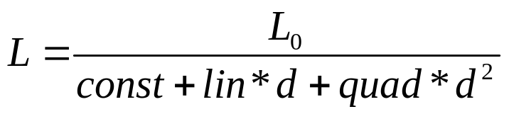
Lighting Model
Similar to OpenGL
Lighting model parameters (global)
  Ambient r g b (no per-light ambient as in OpenGL)
  Attenuation const linear quadratic (like in OpenGL)
Per light model parameters
  Directional light (direction, RGB parameters)
  Point light (location, RGB parameters)

Slide 35
Material Model
Diffuse reflectance (r g b)
Specular reflectance (r g b)
Shininess s
Emission (r g b)
All as in OpenGL

Slide 36
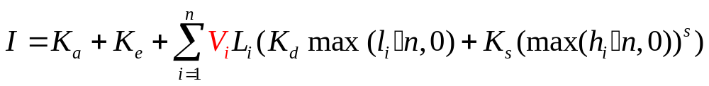
Shading Model
Global ambient term, emission from material
For each light, diffuse specular terms
Note visibility/shadowing for each light (not in OpenGL)
Evaluated per pixel per light (not per vertex)

Slide 37
Outline
Camera Ray Casting (choosing ray directions)
Ray-object intersections
Ray-tracing transformed objects
Lighting calculations
Recursive ray tracing

Slide 38
Mirror Reflections/Refractions
Virtual Viewpoint
Virtual Screen
Objects
Generate reflected ray in mirror direction,
Get reflections and refractions of objects

Slide 39
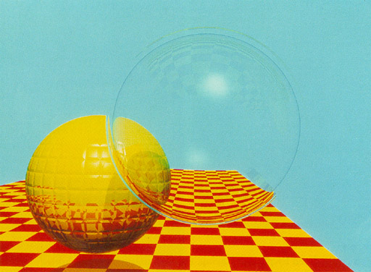
Turner Whitted 1980

Slide 40
Basic idea
For each pixel
  Trace Primary Eye Ray, find intersection
  Trace Secondary Shadow Ray(s) to all light(s)
    Color = Visible ? Illumination Model : 0 ;
  Trace Reflected Ray
    Color += reflectivity * Color of reflected ray

Slide 41
Recursive Shading Model
Highlighted terms are recursive specularities [mirror reflections] and transmission
Trace secondary rays for mirror reflections and refractions, include contribution in lighting model
GetColor calls RayTrace recursively (the I values in equation above of secondary rays are obtained by recursive calls)

Slide 42
Problems with Recursion
Reflection rays may be traced forever
Generally, set maximum recursion depth
Same for transmitted rays (take refraction into account)

Slide 43
Effects needed for Realism
(Soft) Shadows
Reflections (Mirrors and Glossy)
Transparency (Water, Glass)
Interreflections (Color Bleeding)
Complex Illumination (Natural, Area Light)
Realistic Materials (Velvet, Paints, Glass)
Discussed in this lecture so far
Not discussed but possible with distribution ray tracing
Hard (but not impossible) with ray tracing; radiosity methods

Slide 44
Some basic add ons
Area light sources and soft shadows: break into grid of n x n point lights
  Use jittering: Randomize direction of shadow ray within small box for given light source direction
  Jittering also useful for antialiasing shadows when shooting primary rays
More complex reflectance models
  Simply update shading model
  But at present, we can handle only mirror global illumination calculations

Slide 45
Acceleration
Testing each object for each ray is slow
  Fewer Rays
    Adaptive sampling, depth control
  Generalized Rays
    Beam tracing, cone tracing, pencil tracing etc.
  Faster Intersections
    Optimized Ray-Object Intersections
    Fewer Intersections

Slide 46
Acceleration Structures
Bounding boxes (possibly hierarchical)
  If no intersection bounding box, needn’t check objects
Bounding Box
Ray
Spatial Hierarchies (Oct-trees, kd trees, BSP trees)

Slide 47
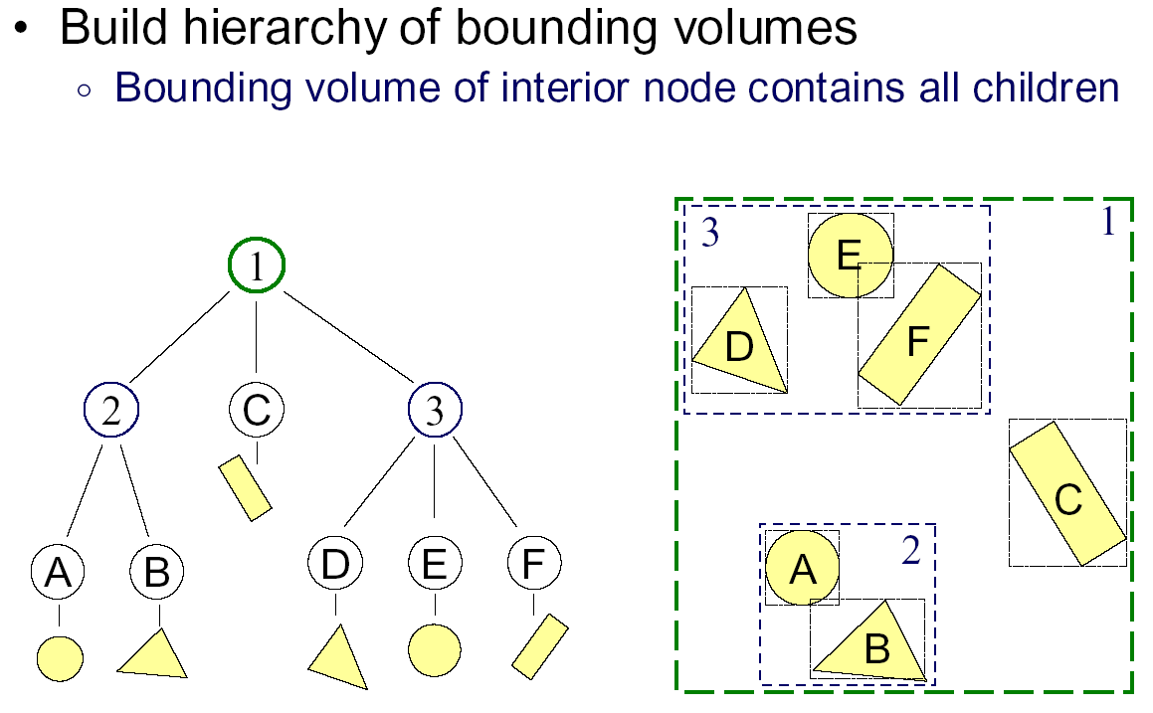
Bounding Volume Hierarchies 1

Slide 48
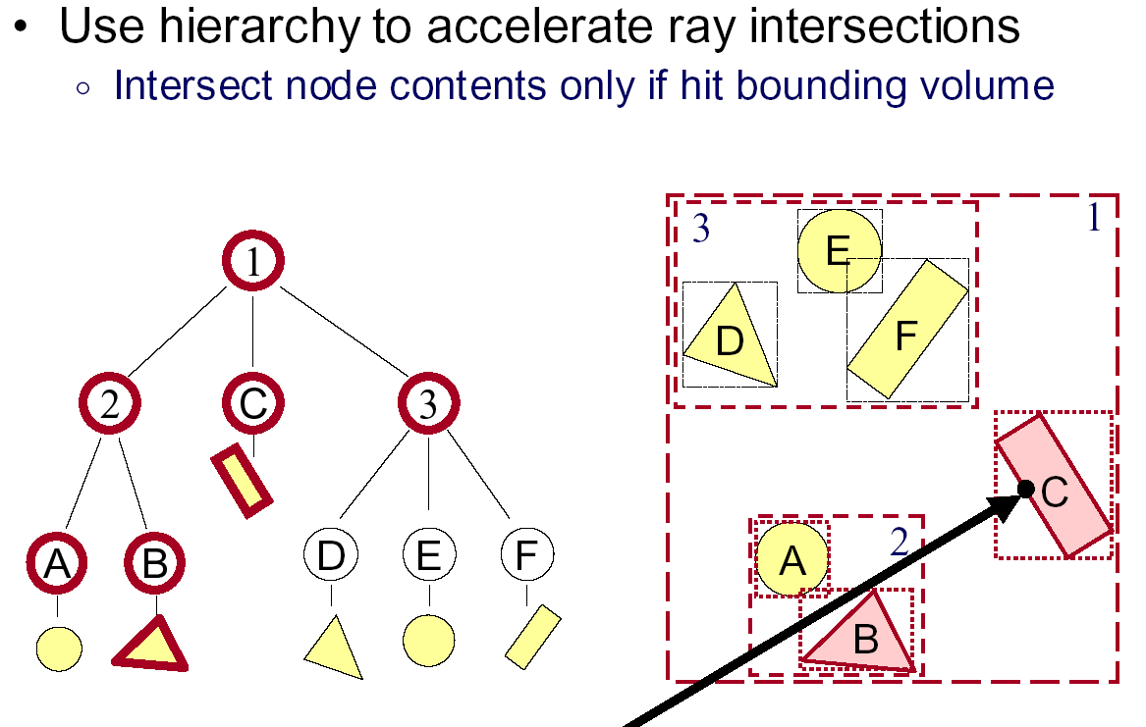
Bounding Volume Hierarchies 2

Slide 49
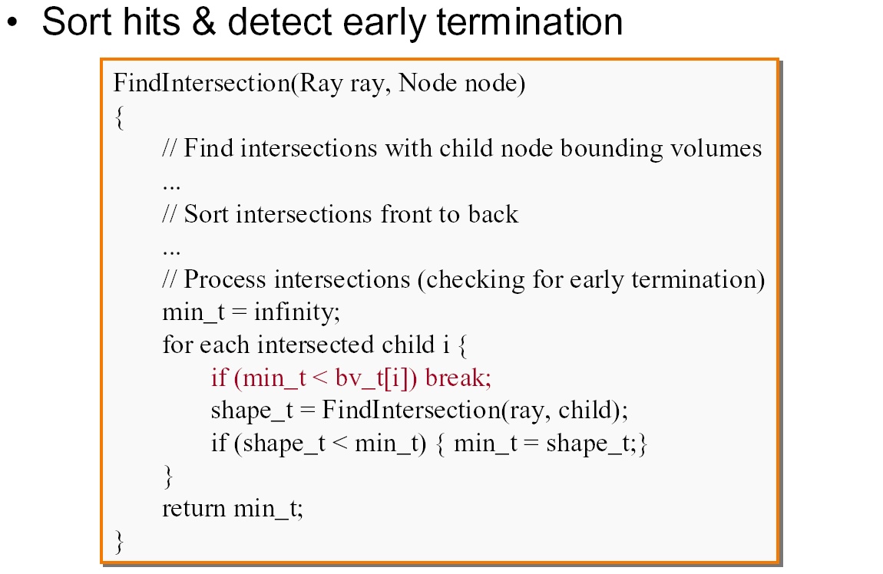
Bounding Volume Hierarchies 3

Slide 50
Acceleration Structures: Grids

Slide 51
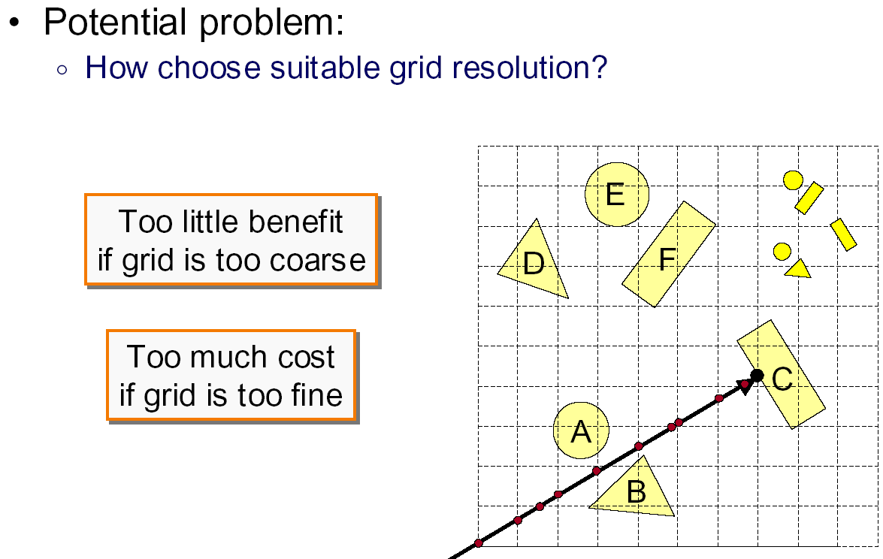
Uniform Grid: Problems

Slide 52
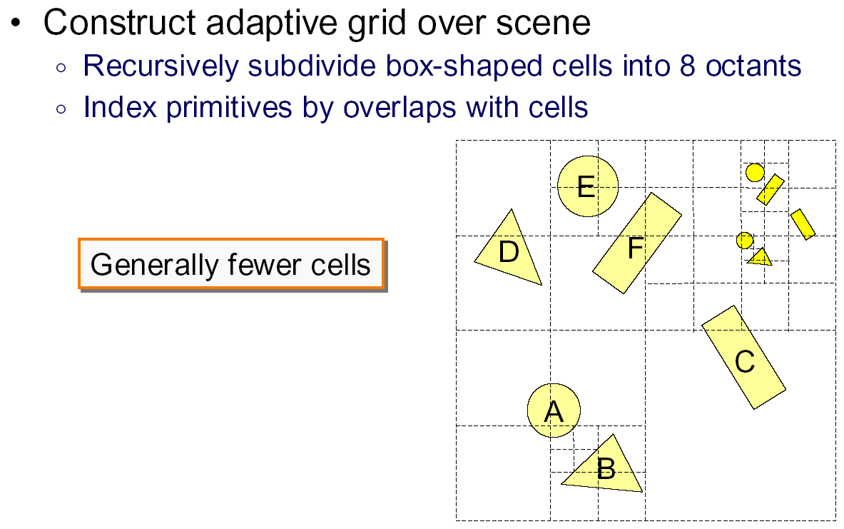
Octree

Slide 53
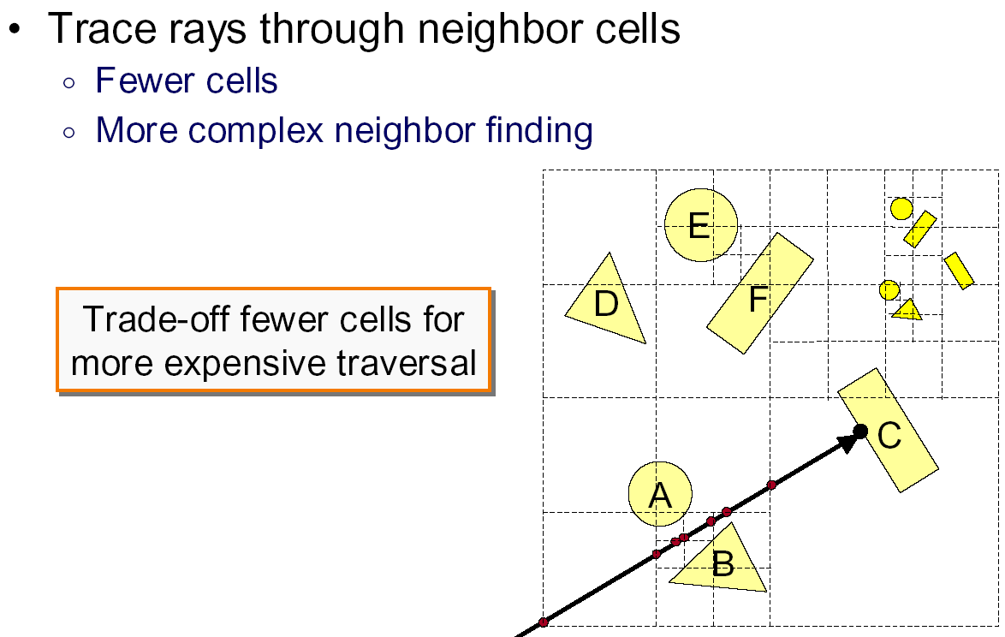
Octree traversal

Slide 54
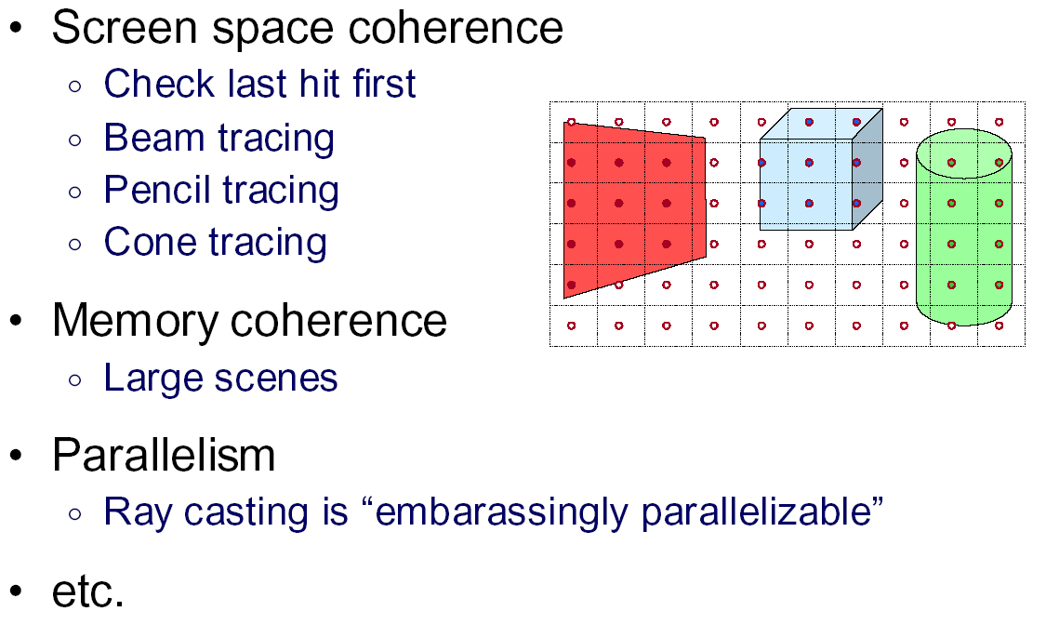
Other Accelerations

Slide 55
Interactive Raytracing
Ray tracing historically slow
Now viable alternative for complex scenes
  Key is sublinear complexity with acceleration; need not process all triangles in scene
Allows many effects hard in hardware
OpenRT project real-time ray tracing (http://www.openrt.de)

Slide 56
Raytracing on Graphics Hardware
Modern Programmable Hardware general streaming architecture
Can map various elements of ray tracing
Kernels like eye rays, intersect etc.
In vertex or fragment programs
Convergence between hardware, ray tracing
  NVIDIA now has CUDA-based raytracing API !
[Purcell et al. 2002, 2003]
http://graphics.stanford.edu/papers/photongfx

Slide 57
