Slide 1
Intro to Ray Tracing

Slide 2
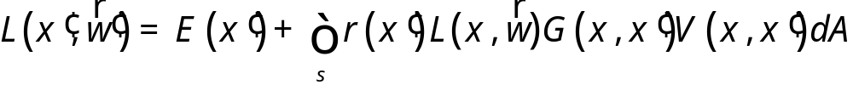
Rendering Equation
L is the radiance from a point on a surface in a given direction ω
E is the emitted radiance from a point: E is non-zero only if x’ is emissive
V is the visibility term: 1 when the surfaces are unobstructed along the direction ω, 0 otherwise
G is the geometry term, which depends on the geometric relationship between the two surfaces x and x’
It includes contributions from light bounded many times off surfaces

Slide 3
Classifying Rendering Algorithms
One way to classify rendering algorithms is according to the type of light interactions they capture
For example: The OpenGL lighting model captures:
  Direct light to surface to eye light transport
  Diffuse and rough specular surface reflectance
  It actually doesn’t do light to surface transport correctly, because it doesn’t do shadows
We would like a way of classifying interactions: light paths

Slide 4
Classifying Light Paths
Classify light paths according to where they come from, where they go to, and what they do along the way
Assume only two types of surface interactions:
  Pure diffuse, D
  Pure specular, S
Assume all paths of interest:
  Start at a light source, L
  End at the eye, E
Use regular expressions on the letters D, S, L and E to describe light paths
  Valid paths are L(D|S)*E

Slide 5
Simple Light Path Examples
LE
  The light goes straight from the source to the viewer
LDE
  The light goes from the light to a diffuse surface that the viewer can see
LSE
  The light is reflected off a mirror into the viewer’s eyes
L(S|D)E
  The light is reflected off either a diffuse surface or a specular surface toward the viewer
Which do OpenGL (approximately) support?

Slide 6
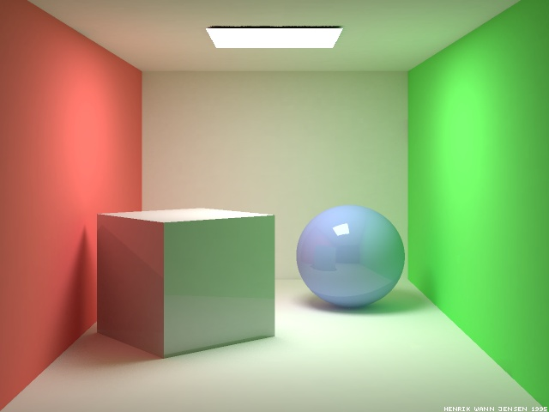
More Complex Light Paths
Find the following:
  LE
  LDE
  LSE
  LDDE
  LDSE
  LSDE
Radiosity Cornell box, due to Henrik wann Jensen,
http://www.gk.dtu.dk/~hwj, rendered with ray tracer

Slide 7
More Complex Light Paths
LE
LDDE
LSDE
LSE
LDSE
LDE

Slide 8
The OpenGL Model
The “standard” graphics lighting model captures only L(D|S)E
It is missing:
  Light taking more than one diffuse bounce: LD*E
    Should produce an effect called color bleeding, among other things
    Approximated, grossly, by ambient light
  Light refracted through curved glass
    Consider the refraction as a “mirror” bounce: LDSE
  Light bouncing off a mirror to illuminate a diffuse surface: LS+D+E
  Many others
  Not sufficient for photo-realistic rendering

Slide 9

Raytraced Images
PCKTWTCH by Kevin Odhner, POV-Ray

Slide 10
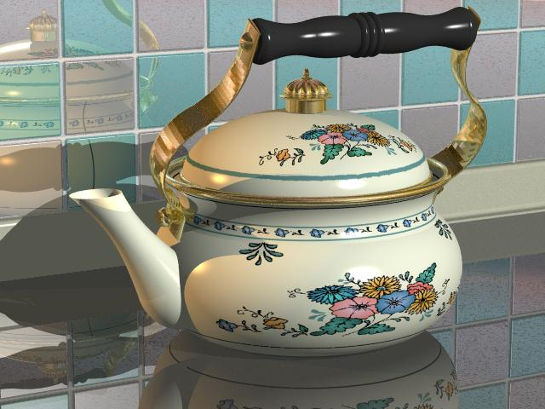
Kettle, Mike Miller, POV-Ray

Slide 11
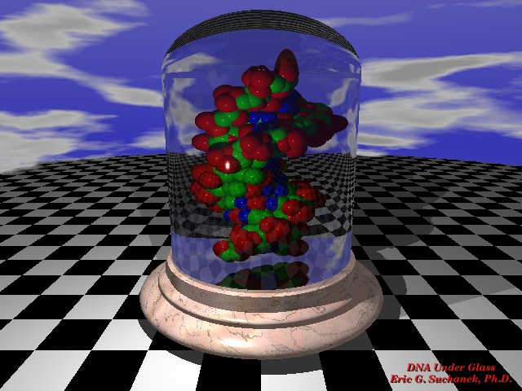

Slide 12
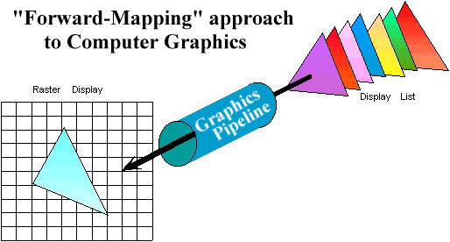
Graphics Pipeline Review
Properties of the Graphics Pipeline
  Primitives are transformed and projected (not depending on display resolution)
  Primitives are processed one at a time
  Forward-mapping from geometrical space to image space

Slide 13
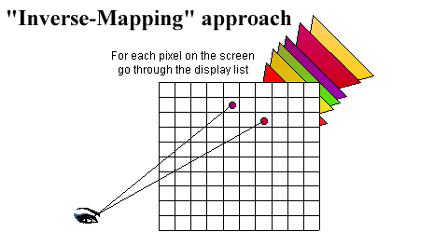
Alternative Approaches: Ray Casting
Ray-casting searches along lines of sight, or rays, to determine the primitive that is visible along it.
Properties of ray-casting:
Go through all primitives at each pixel
Image space sample first
Analytic processing afterwards

Slide 14

Ray Casting Outline
For every pixel shoot a ray from the eye through the pixel.
For every object in the scene
  Find the point of intersection with the ray closest to (and in front of) the eye
  Compute normal at point of intersection
Compute color for pixel based on point and normal at intersection closest to the eye (e.g. by Phong illumination model).
t₀

Slide 15
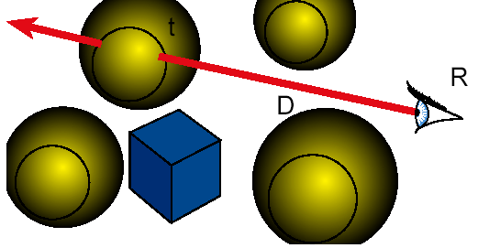
Ray Casting
Object Cast ( Point R, Ray D ) {
  find minimum t>0 such that R + t D hits object
  if ( object hit )
  return object
  else return background object
}

Slide 16
Raytracing
Cast rays from the eye point the same way as ray casting
  Builds the image pixel by pixel, one at a time
Cast additional rays from the hit point to determine the pixel color
  Shoot rays toward each light. If they hit something, then the object is shadowed from that light, otherwise use “standard” model for the light
  Reflection rays for mirror surfaces, to see what should be reflected in the mirror
  Refraction rays to see what can be seen through transparent objects
  Sum all the contributions to get the pixel color

Slide 17
Raytracing
Shadow rays
Reflection ray
refracted ray

Slide 18
Recursive Ray Tracing
When a reflected or refracted ray hits a surface, repeat the whole process from that point
  Send out more shadow rays
  Send out new reflected ray (if required)
  Send out a new refracted ray (if required)
  Generally, reduce the weight of each additional ray when computing the contributions to surface color
  Stop when the contribution from a ray is too small to notice or maximum recursion level has been reached

Slide 19
Raytracing Implementation
Raytracing breaks down into two tasks:
  Constructing the rays to cast
  Intersecting rays with geometry
The former problem is simple vector arithmetic
Intersection is essentially root finding (as we will see)
  Any root finding technique can be applied
Intersection calculation can be done in world coordinates or model coordinates

Slide 20
Constructing Rays
Define rays by an initial point and a direction: x(t)=x₀+td
Eye rays: Rays from the eye through a pixel
  Construct using the eye location and the pixel’s location on the image plane. X₀ = eye
Shadow rays: Rays from a point on a surface to the light.
  X₀ = point on surface
Reflection rays: Rays from a point on a surface in the reflection direction
  Construct using laws of reflection. X₀ = surface point
Transmitted rays: Rays from a point on a transparent surface through the surface
  Construct using laws of refraction. X₀ = surface point

Slide 21
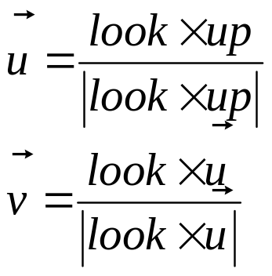
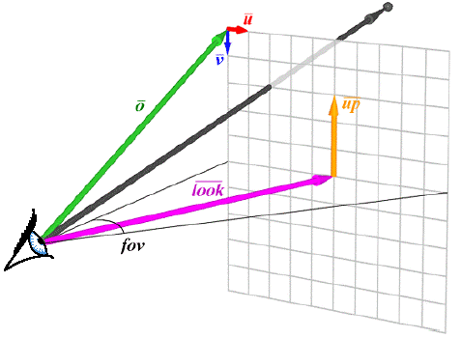
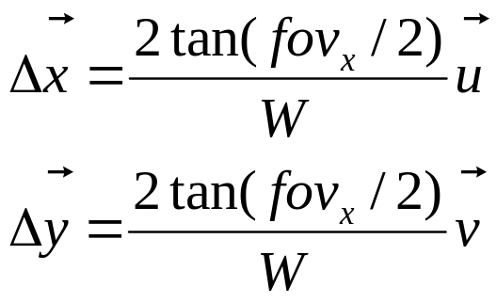
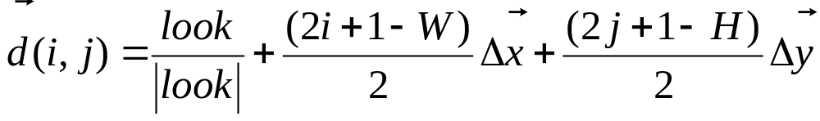
From Pixels to Rays

Slide 22
Ray-Object Intersections
Aim: Find the parameter value, t_{i}, at which the ray first meets object i
Write the surface of the object implicitly: f(x)=0
  Unit sphere at the origin is x•x-1=0
  Plane with normal n passing through origin is: n•x=0
Put the ray equation in for x
  Result is an equation of the form f(t)=0 where we want t
  Now it’s just root finding

Slide 23
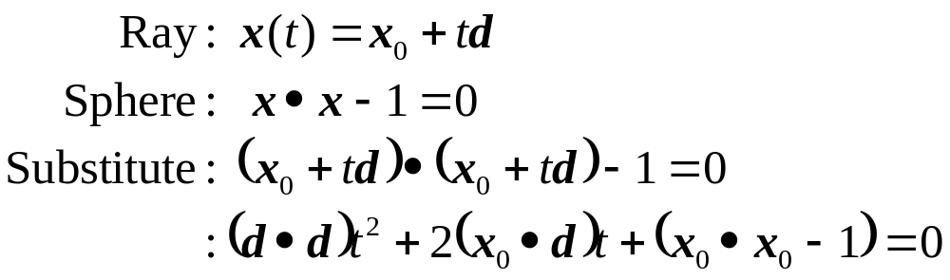
Ray-Sphere Intersection
Quadratic in t
  2 solutions: Ray passes through sphere - take minimum value that is > 0
  1 solution: Ray is tangent - use it if >0
  0 solutions: Ray does not hit sphere

Slide 24
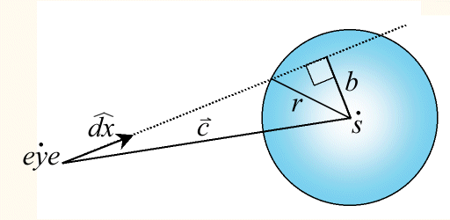
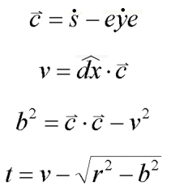
Sphere Intersection
A sphere is defined by its center, s, and its radius r. The intersection of a ray with a sphere can be computed as follows:

Slide 25
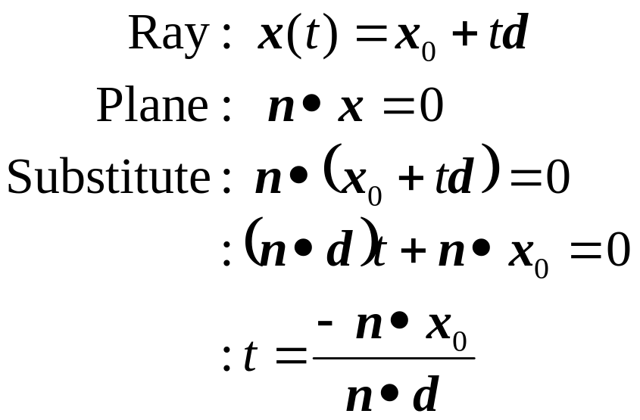
Ray-Plane Intersections
To do polygons, intersect with plane then do point-in-polygon test…

Slide 26
Point-in-Polygon Testing
Project point and polygon onto a 2D plane
  Find biggest component of normal vector, and just use other two coordinates
  For example, if n=(0.2, 0.4, 0.9), just use x,y coordinates, which is like projecting down onto the x-y plane
Use the clipping algorithms to determine if the point in the polygon
  Cast a ray from the point to infinity and count the number of edges it crosses
    Odd number means point is inside
  Evaluate against each polygon edge

Slide 27
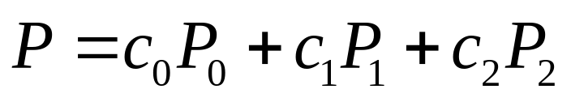
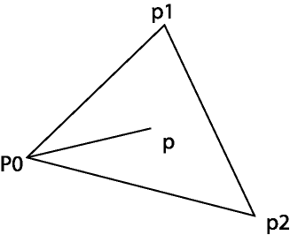
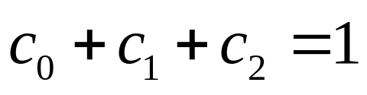
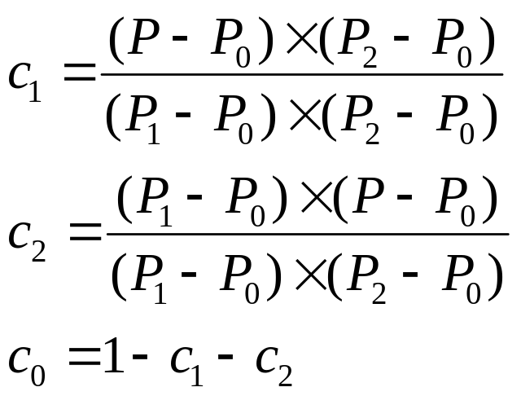
Barycentric Coordinates
This can be used for checking if P is
In the triangle. It is also useful when
Computing the texture coordinates and
Other linear interpolations (normal).
P is in the triangle if c₁ > 0, c₂ >0, and
c₁+c₂ < 1

Slide 28
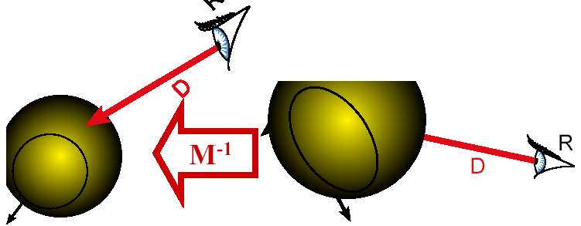
Intersection in Model Coordinates
Transform ray into object space!
  – Intersections straightforward, even trivial there
  How do we transform the ray's origin and direction?

Slide 29
Intersection in Model Coordinates
Transform ray origin into object space
  R’ = M⁻¹R
How do we transform the ray's direction?
  Same M⁻¹ as in homogenous coordinates
How do we transform normal back to world space?
  Cannot use M
  Use (M^{T})⁻¹

Slide 30
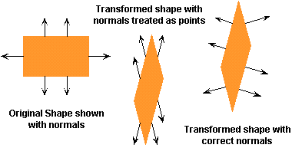
Transforming Surface Normals
Surface normals are the most important geometric surface characteristic used in computing illumination models. They are used in computing both the diffuse and specular components of reflection.
However, the vertices of a model do not transform in the same way that surface normals do. A naive implementer might consider transforming normals by treating them as points offset a unit length from the surface. But even this approach will not work. Consider the following two dimensional example.

Slide 31
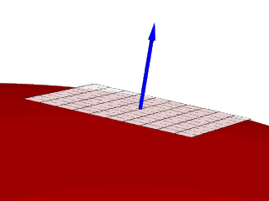
Normals Represent Tangent paces
The fundamental problem with transforming normals is largely a product of our mental model of what a normal really is.
A normal is not a geometric property relating to points of of the surface. Instead normals represent geometric properties on the surface. They are an implicit representation of the tangent space of the surface at a point.
In three dimensions the tangent space at a point is a plane. A plane can be represented by either two basis vectors, but such a representation is not unique. The set of vectors orthogonal to such a plane is, however unique and this vector is what we use to represent the tangent space, and we call it a normal.

Slide 32
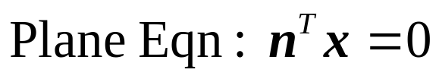
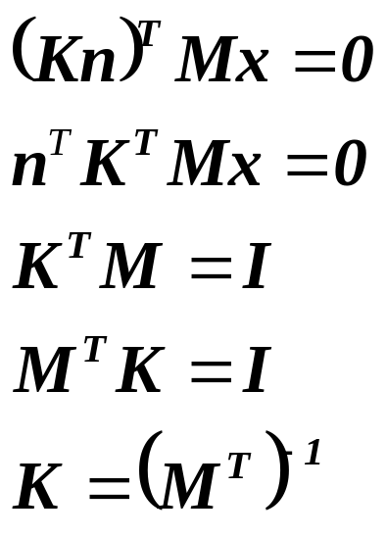
Transforming Normal Vectors
Normal vectors are not transformed the same way points are
  Ray directions behave like normal vectors
Plane equation should still be true with transformed points!
Transform normal vectors with the inverse transpose of the transformation matrix
  For rotations, matrix is its own inverse transpose

Slide 33






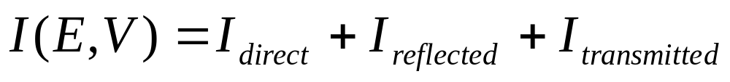
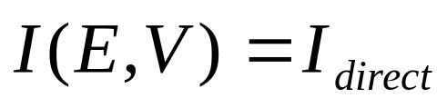
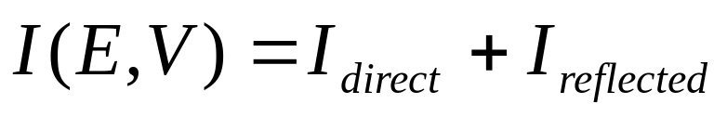



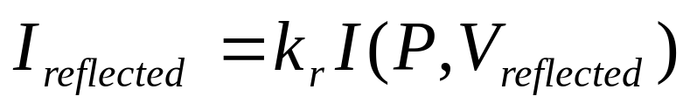


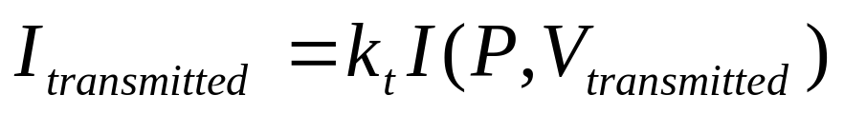
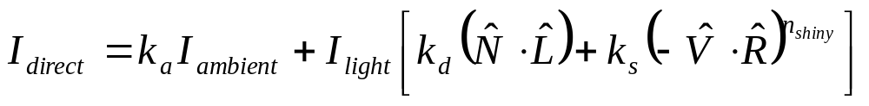
Ray Tracing Illumination
Recursive
Check for shadowing (intersection with object along ray (P,L))

Slide 34
The Ray Tree
N₃
T₃
R₂
Viewpoint
N₂
T₁
R₃
R₁
L₁
L₂
N₁
L₃
L₁
R₁
T₁
L₂
L₃
Eye
N_{i} surface normal
R_{i} reflected ray
L_{i} shadow ray
T_{i} transmitted (refracted) ray
Psuedo-code
R₂
R₃
T₃

Slide 35
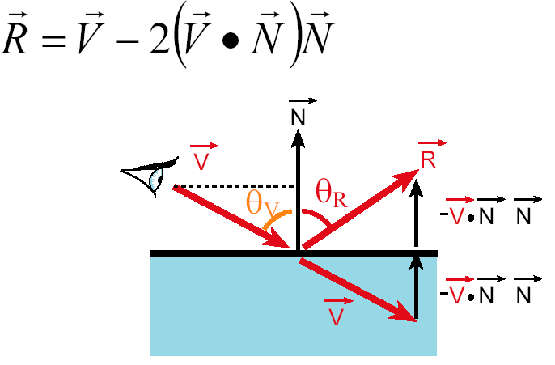
Reflection
Reflection angle = view angle

Slide 36
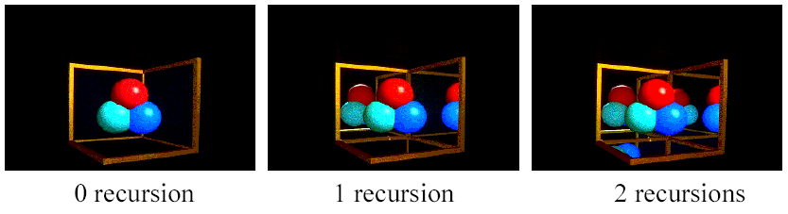
Reflection
The maximum depth of the tree affects the handling of refraction
If we send another reflected ray from here, when do we stop? 2 solutions (complementary)
  Answer 1: Stop at a fixed depth.
  Answer 2: Accumulate product of reflection coefficients and stop when this product is too small.

Slide 37
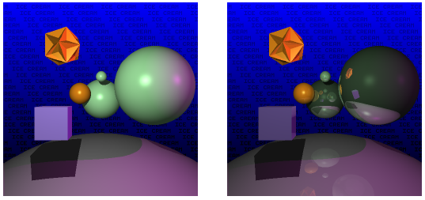
Reflection

Slide 38

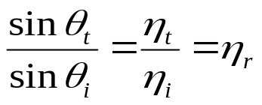





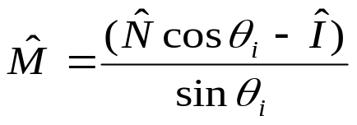



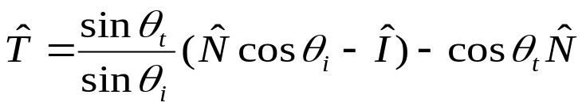

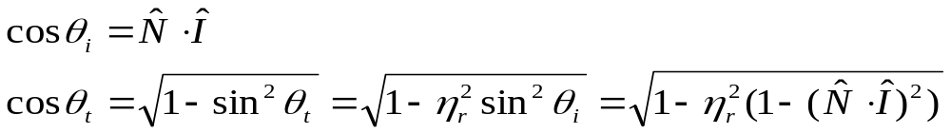
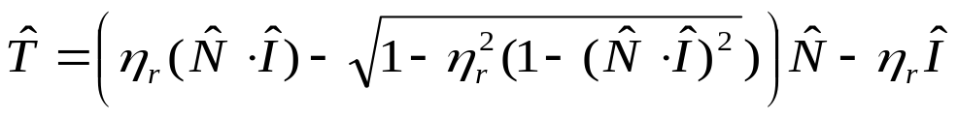
Refraction
Snell’s Law
Note that I is the negative of the incoming ray
Total internal reflection when the square root is imaginary

Slide 39
Pseudo Code for Ray Tracing
rgb lsou; // intensity of light source
rgb back; // background intensity
rgb ambi; // ambient light intensity
Int depth; // depth of ray tree consisting of multiple paths
Vector L // vector pointing to light source
Vector N // surface normal
Object objects [n] //list of n objects in scene
float Ks [n] // specular reflectivity factor for each object
float Kr [n] // refractivity index for each object
float Kd [n] // diffuse reflectivity factor for each object
Ray r;
void raytrace() {
for (each pixel P of projection viewport in raster order) {
r = ray emanating from viewer through P
the frame buffer pixel at P = intensity(r)
}
}

Slide 40
rgb intensity (Ray r) {
Ray flec, frac;
rgb spec, refr, dull, intensity;
depth = depth +1
if (depth >= 5) intensity = back;
else {
check ray r for intersection with all objects in scene
if (no intersection) {
if (r parallel to L) intensity =lsou;
else intensity =back;
} else { Take closest intersection which is object[j]
compute normal N at the intersection point
if (Ks[j] >0) { // non-zero specular reflectivity
compute reflection ray flec;
spec = Ks[j]*intensity(flec);
} else spec =0;
if (Kr[j]>0) { // non-zero refractivity
compute refraction ray frac;
refr = Kr[j]*intensity(frac);
} else refr =0;
check for shadow;
if (shadow) dull= Kd[j]*ambi
else dull= Phong illumination computation;
intensity =spec +refr +dull;
} }
depth = depth -1
return intensity; }

Slide 41
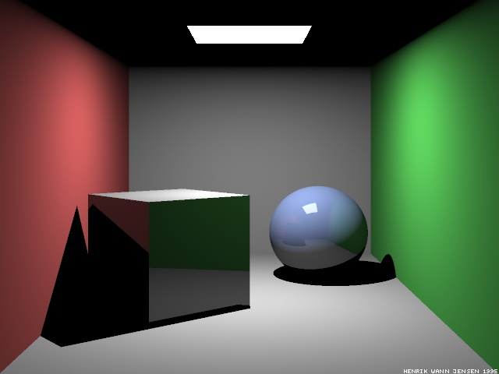
Raytraced Cornell Box
Which paths are missing?
Ray-traced Cornell box, due to Henrik Jensen,
http://www.gk.dtu.dk/~hwj

Slide 42
A Better Rendered Cornell Box

Slide 43
Paths in RayTracing
Ray Tracing
  Captures LDS*E paths: Start at the eye, any number of specular bounces before ending at a diffuse surface and going to the light
Raytracing cannot do:
  LS*D⁺E: Light bouncing off a shiny surface like a mirror and illuminating a diffuse surface
  LD⁺E: Light bouncing off one diffuse surface to illuminate others
Basic problem: The raytracer doesn’t know where to send rays out of the diffuse surface to capture the incoming light
Also a problem for rough specular reflection
  Fuzzy reflections in rough shiny objects
Need other rendering algorithms that get more paths

