Slide 1
Ray Tracing: Soft Shadows
Soon Tee Teoh
CS 116B

Slide 2
Point Light Sources
A “point” light source is usually not truly a point light source. Considering a light source as a point is just a convenient model.
Consider a light bulb, for example. It is not an infinitesimally small point. It has volume.
Implication: Real light sources produce soft shadows.

Slide 3
Soft Shadows
Shadows are not uniformly dark.
The shadow is divided into two parts: the umbra and penumbra.
No light at all from the light source reaches the umbra. It is completely dark.
Some light from the light source reaches the penumbra. It is partially dark.
If we model the light source as a point light source, there will be no penumbra (soft shadow).
penumbra
umbra
penumbra
Point Light source
Finite Light source

Slide 4

Soft Shadows in Ray Tracing
For more realistic shadows, model light sources as volumes rather than points.
Use a sphere to model a light source, rather than a point.
This is often quite realistic because many light sources in real life are spherical, e.g. light bulbs and lanterns.
When calculating lighting, shoot several rays to the light source, instead of just one ray.
Calculate lighting for each ray, and take the average.
Surface
Surface
Point light source: The surface is completely lighted by the light source.
Finite light source: 3/5 of the rays reach the light source. The surface is partially lighted.

Slide 5
Need to find Random Positions
To calculate lighting by a spherical light source on a surface point, shoot several (say 20) rays to the light source.
For each ray, we need to pick a random point on the sphere.

Slide 6
Point on a Sphere
A point on a sphere can be described by its spherical coordinates: q and f.
A point on the sphere in spherical coordinates p(q,f) can be converted to Cartesian coordinates p(x,y,z) with:
    x = r cos q sin f
    y = r sin q sin f
    z = r cos f
z
f
y
q
x

Slide 7
Random Point on a Sphere
If you just pick a random q and random f, you will not get an even distribution of points. You’ll get more points closer to the center.
Instead, pick two random variables u and v in the range 0.0 to 1.0.
Then, generate q and f this way:
    q = 2 p u
    f = cos⁻¹ (2v – 1)

Slide 8
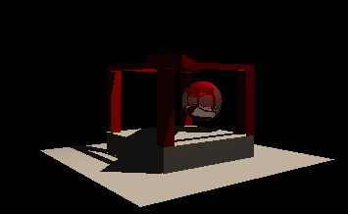
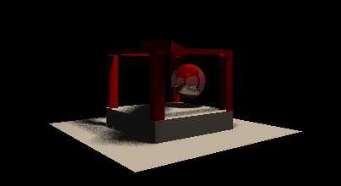
Soft Shadow Example
Point Light Source:
Hard Shadow
Finite Light Source:
Soft Shadow
(generated with 20 random samples per pixel)

Slide 9
Anti-Aliasing
Subdivide each pixel into sub-pixels.
Shoot one ray for each pixel.
Take the average color of all the rays.
Camera
Pixel
Camera
Pixel
No anti-aliasing
With anti-aliasing
Divide pixel into 4x4 sub-pixels

Slide 10
Anti-Aliasing
Splitting a pixel into a regular sub-pixel grid may still have aliasing if the underlying pattern matches the sub-pixel division.
Alternative: We can randomly sample from the pixel
  Problem: Randomly picked positions may be very uneven
Alternative: Pick from random positions within regular sub-pixel grid
c

Slide 11
Speeding Up Ray-Tracing
Now, we need to test each object in the scene for intersection with each ray.
This is too time-consuming.
Let’s try to keep the objects in some data structure so that we can quickly determine if a set of objects will definitely not intersect a ray.

Slide 12
Octree
Represent the 3D volume with a cube.
Subdivide cube by half in each direction: We get 8 sub-cubes.
Repeatedly subdivide each sub-cube the same way.

Slide 13
Octree Construction Example
Scene Octree
1. Put a bounding cube around all objects.
This is the root of the octree.
2. Subdivide each node into 8 equal cubes. These will be the children of the node. Put each object in the respective node.
*The nodes A, B, C and D are shown.
A B
D
C
ABCD
3. For each node, subdivide again recursively, until MAX_LEVEL has been reached or there is no object left in the node.
*The node B is shown.
A B
D
C

Slide 14
Octree Traversal Example
Suppose now, we have a ray, and we want to know which objects it intersects.
We don’t have to test all the objects in the scene.
We only need to test the objects in the nodes intersected by the ray.
Example:
1. Test intersection of ray with root node.
2. Intersect root, therefore check all children of root node.
3. Find that ray only intersects node X. Therefore, only traverse the octree down node X.
4. Find that ray only intersects node X0, X1 and X3, so traverse only those nodes.
5. Nodes X0, X1 and X3 are leaf nodes, so now just test ray-object intersections for all objects contained in these leaf nodes.
x
X0 X1
X3

Slide 15
Octree to speed up Ray-Tracing
A
B
A B C D
C
D
This example shows a quad-tree, a 2D version of an octree, for simplicity.
The camera and ray are shown.
Only the red nodes need to be tested for intersections.
All the objects in the marked leaf nodes need to be tested for intersections.

Slide 16
Octree Implementation
class Octree {
Octree children[8];
// dimensions of this octree (need for testing intersection)
float center[3];
float length;
// the graphical objects in node (usually just for leaf node or
// maybe also to keep objects that cross the boundaries of this
// node’s children)
Geometry **objects;
int nobjects;
bool isLeaf();
bool intersectsRay(float P, float D);
bool insideFrustum( … );
};

