Slide 1
DevOps

Slide 2
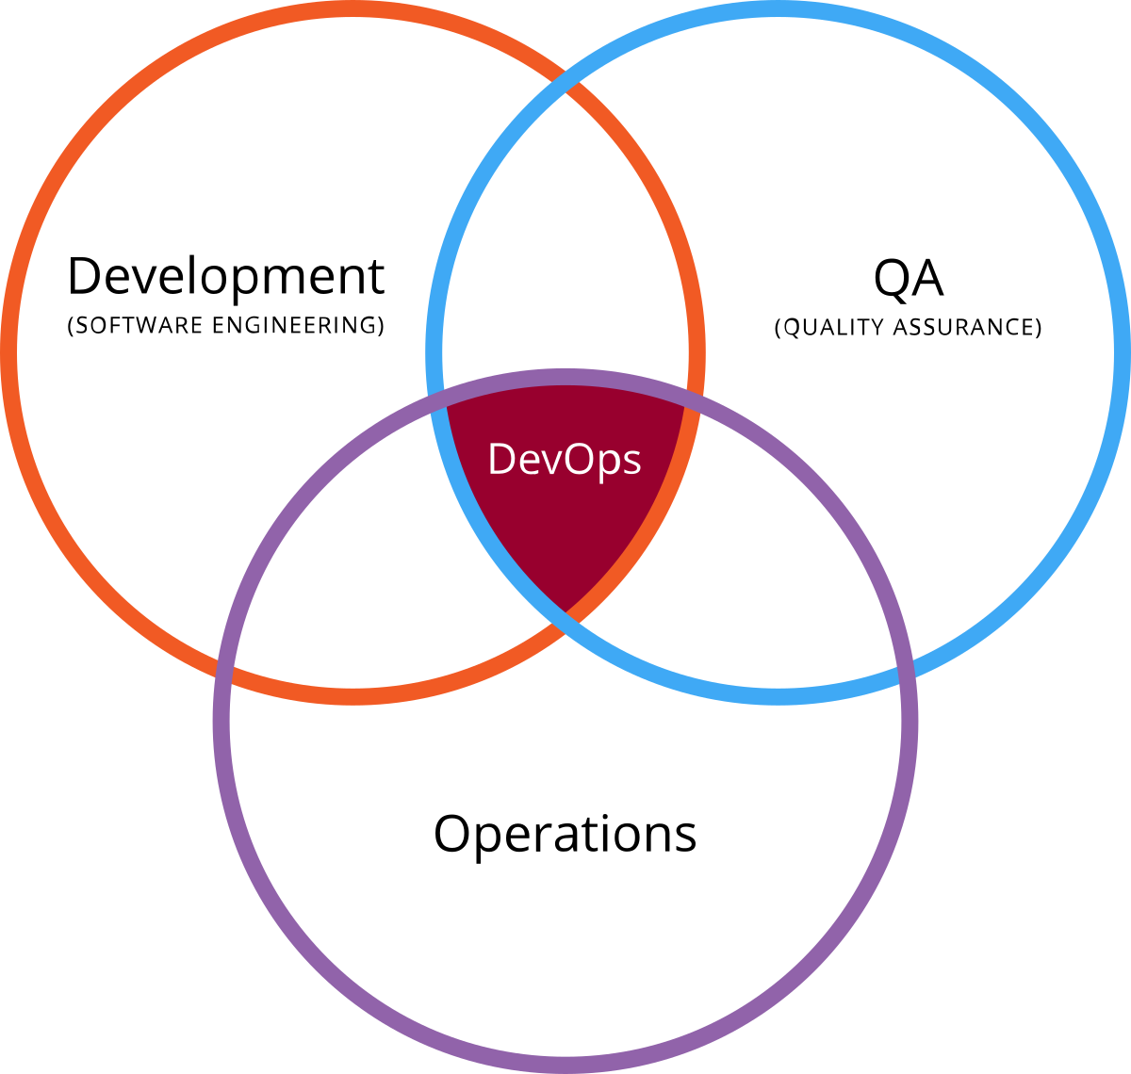
Can you explain your understanding of DevOps and how it differs from traditional software development methodologies?
DevOps
Agile
Microservices
CI/CD
Traditional
Waterfall
Monolithic
Notes:
DevOps is a software development method that emphasizes collaboration and communication between development and operations teams. It aims to bring these two teams together to enable faster and more reliable delivery of software. DevOps also includes practices such as continuous integration and delivery, automation of processes, and monitoring of applications in production.
DevOps differs from traditional software development methodologies in several ways. Firstly, traditional methodologies often have a separation of responsibilities between development and operations teams, with limited collaboration between the two. DevOps, on the other hand, emphasizes collaboration and integration between teams. Secondly, traditional methodologies often have a slower release cycle, with more manual processes, whereas DevOps aims for a continuous delivery model with automated processes. Finally, traditional methodologies often have a siloed approach to testing and deployment, whereas DevOps seeks to integrate these processes into the overall development process, improving speed and reliability.

Slide 3
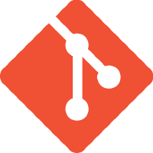


How do you use tools such as Git, Jenkins, and Ansible to automate the software development and deployment process?
Git
Version Control
Jenkins
Automate builds
Ansible
Automate deployment and infrastructure
Notes:
Git is a version control system that allows developers to manage and track changes to their code. It can be used to automate the software development process by allowing developers to easily manage code changes and collaborate with others.
Jenkins is an open-source automation server that can be used to automate various stages of the software development process, including building, testing, and deploying code. It integrates with tools such as Git to automate the process of pulling code changes, building the application, and deploying it to different environments.
Ansible is an automation tool that can be used to manage and automate various infrastructure and application deployment tasks. For example, it can be used to automate the provisioning of infrastructure resources, such as servers, databases, and network configurations. It can also be used to automate the deployment of applications, including updating configuration files and starting and stopping services.
By using these tools together, organizations can automate much of the software development and deployment process, including building and testing code, provisioning infrastructure, and deploying applications. This can help to increase speed and reliability, reduce errors, and free up time for development teams to focus on more strategic tasks.

Slide 4
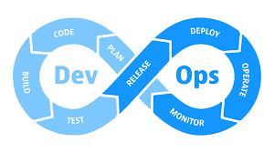
Can you walk me through a recent project you managed using DevOps practices and the challenges you faced?
Notes:
Imagine a project to develop a new web application for a company. The development team was using a DevOps approach, with a focus on collaboration and automation. The project involved the following steps:
Code development: The developers used Git for version control and collaborated on the code through pull requests.
Continuous integration: Jenkins was used to automate the process of building and testing the code after each change was pushed to the Git repository.
Infrastructure provisioning: Ansible was used to automate the provisioning of the necessary infrastructure resources, such as servers, databases, and network configurations.
Deployment: The application was deployed to a test environment for further testing and then to a production environment. Jenkins was used to automate the deployment process, including updating configuration files and starting and stopping services.
One of the main challenges faced during the project was ensuring that the infrastructure was properly configured and secure. This required close collaboration between the development and operations teams, as well as careful testing and validation of the infrastructure before deployment.
Another challenge was ensuring that the continuous integration and deployment processes were reliable and efficient. This involved continuous monitoring and optimization of the Jenkins pipeline, as well as regular testing and validation of the deployment process.

Slide 5
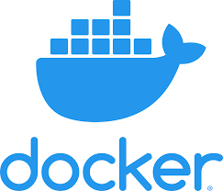

How do you use containerization and orchestration technologies, such as Docker and Kubernetes, to improve scalability and reliability?
Docker
Containerization Technology
Kubernetes
Orchestration Technology
Notes:
Containerization and orchestration technologies, such as Docker and Kubernetes, are used to improve scalability and reliability in software development and deployment.
Docker is a containerization technology that allows applications to be packaged and run as containers, isolated from the underlying host system. This makes it easier to deploy and run applications consistently across different environments. Containers also allow applications to be easily scaled, as multiple instances of a container can be run on different hosts.
Kubernetes is an orchestration technology that can be used to manage and automate the deployment, scaling, and management of containers. With Kubernetes, developers can define the desired state of their application and its dependencies, and Kubernetes will automatically manage the containers to meet this desired state. This can include automatically scaling the number of containers to meet demand, rolling out updates, and rescheduling containers in the event of failures.
By using containerization and orchestration technologies, organizations can improve scalability and reliability by making it easier to deploy and run applications consistently across different environments. This can help to reduce downtime, improve the speed and efficiency of deployments, and make it easier to manage and scale applications.

Slide 6
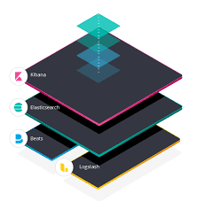
Can you explain how you use monitoring and logging tools, such as Prometheus and ELK, to improve visibility and troubleshoot issues in a production environment?
Prometheus
Monitoring Tool
Alerting toolkit
The ELK stack
Elasticsearch
Logstash
Kibana
Notes:
Monitoring and logging tools, such as Prometheus and the Elasticsearch-Logstash-Kibana (ELK) stack, are used to improve visibility and troubleshoot issues in a production environment.
Prometheus is a that can be used to gather metrics and perform automated alerts and notifications. It allows administrators to monitor various aspects of a production environment, such as resource usage, application performance, and system health. Prometheus can be integrated with Kubernetes and other systems to provide a comprehensive view of the production environment.
The ELK stack, which consists of Elasticsearch, Logstash, and Kibana, is a logging solution that can be used to centralize, store, and analyze logs from multiple sources. Logstash is used to collect and process logs, and Elasticsearch is used to store and index the logs. Kibana is used to visualize and analyze the logs, allowing administrators to quickly search and identify trends and issues.
By using these tools, organizations can improve visibility and troubleshoot issues in a production environment by having a centralized view of metrics and logs. This can help to reduce downtime and improve the speed and efficiency of issue resolution. For example, if an issue is detected, administrators can quickly search and analyze the logs to identify the root cause, rather than having to manually search through logs on multiple servers.

Slide 7

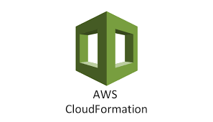
How do you handle and manage infrastructure as code using tools such as Terraform or CloudFormation?
Terraform
Enforce Policy as code
Manage Kubernetes
Infrastructure as code
CloudFormation
Aws
Manage infrastructure with DevOps
Scale Production Stacks
Share Best Practices
Notes:
Handling and managing infrastructure as code using tools such as Terraform or CloudFormation involves using code and scripts to manage the infrastructure resources of an application.
Terraform is an infrastructure as code tool that allows administrators to define, configure, and manage infrastructure resources as code. It supports a wide range of cloud providers and can be used to manage resources such as virtual machines, databases, and network configurations. Terraform can be used to automate the provisioning of infrastructure, as well as to manage and update the infrastructure over time.
CloudFormation is a similar tool that is specifically designed for Amazon Web Services (AWS). Like Terraform, CloudFormation allows administrators to define, configure, and manage infrastructure resources as code. It can be used to automate the creation and management of AWS resources, such as virtual machines, databases, and network configurations.
By using tools such as Terraform or CloudFormation, organizations can handle and manage infrastructure as code by defining and automating the management of their infrastructure resources. This can help to improve the speed and efficiency of infrastructure provisioning, as well as to ensure that the infrastructure is consistent and repeatable across different environments. Additionally, by using code to manage infrastructure, organizations can take advantage of version control and collaboration tools, such as Git, to manage changes to the infrastructure over time.

Slide 8
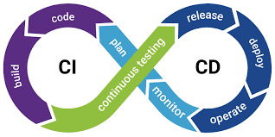
Can you discuss your experience with continuous integration and delivery (CI/CD) pipelines?
Continuous Integration
Continuous Delivery
Notes:
CI/CD pipelines are an important aspect of DevOps and are used to automate the software development and deployment process. A CI/CD pipeline typically consists of a series of stages, such as build, test, and deploy, that are automated and executed in a defined order.
In a CI/CD pipeline, code changes are automatically built, tested, and deployed to production. This helps to ensure that only high-quality, tested code is deployed to production, reducing the risk of production issues. Additionally, by automating the deployment process, CI/CD pipelines can improve the speed and efficiency of deployments, making it easier to deploy code changes and new features.
Some common tools used to implement CI/CD pipelines include Git, Jenkins, TravisCI, and CircleCI. These tools can be used to automate the various stages of the pipeline, such as building and testing code changes, and to manage the deployment of code to production.
In summary, CI/CD pipelines are an important aspect of DevOps that are used to automate the software development and deployment process, improving the speed and efficiency of deployments and reducing the risk of production issues.

Slide 9


How do you use tools such as JIRA or Trello to manage and track work in a DevOps environment?
JIRA
Project & Issue Tracking
Automate your work at scale
Trello
Workflows for any project, big or small
Integrations
Butler Automation
Notes:
JIRA and Trello are tools that are commonly used to manage and track work in a DevOps environment. These tools are known as project management tools and provide a centralized platform for teams to manage their work.
JIRA is a popular tool that is specifically designed for software development teams. It allows teams to track and manage the progress of software development projects, including the planning, development, testing, and deployment of new features. JIRA provides a range of features, including issue tracking, project management, and reporting, which can be used to manage and track work in a DevOps environment.
Trello is a more general project management tool that provides a simple and flexible platform for teams to manage their work. Trello allows teams to create boards to represent their projects, and cards to represent individual tasks. Teams can use Trello to track the progress of their work and to manage the dependencies between tasks.
By using tools such as JIRA or Trello, DevOps teams can have a centralized platform for managing and tracking their work, improving collaboration and communication between team members. These tools can be used to track the progress of software development projects, manage issues and bugs, and monitor the status of deployments to production. Additionally, by using project management tools, DevOps teams can gain a better understanding of their work and can make informed decisions about how to prioritize and manage their work.

Slide 10
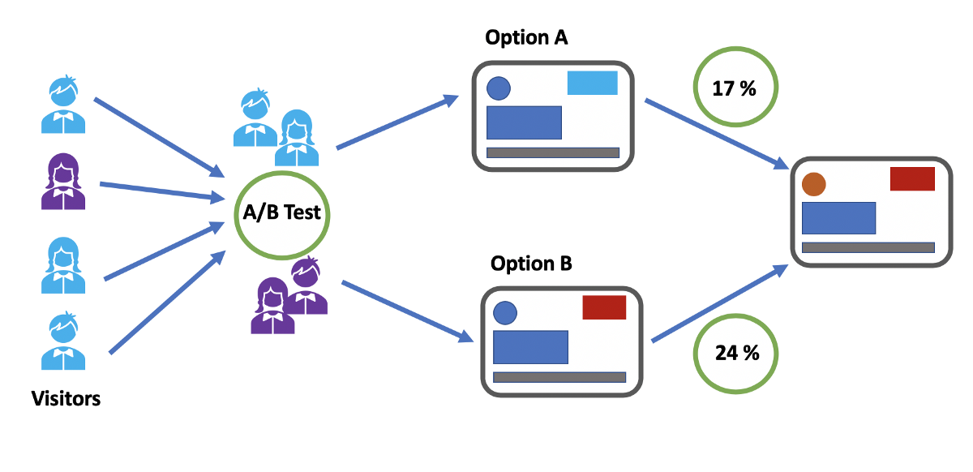
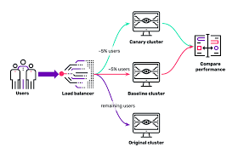
Can you explain how you use A/B testing and canary releases to minimize risk and improve the release process?
Notes:
A/B testing and canary releases are two techniques used to minimize risk and improve the release process in software development.
A/B testing involves releasing a new version of a software application to a small percentage of users, while the majority of users continue to use the previous version. The performance of the new version is then compared to the previous version, and if the new version performs better, it is gradually rolled out to the rest of the user base. This allows organizations to minimize the risk of introducing new features, as they can be tested on a small scale before being rolled out to the entire user base.
Canary releases are a type of A/B testing in which a new version of a software application is released to a small, select group of users before it is released to the rest of the user base. This allows organizations to test the new version in a production environment, and to identify and resolve any issues before the new version is rolled out to the rest of the user base. Canary releases are often used in combination with other testing and deployment techniques, such as blue-green deployments and feature toggles, to minimize the risk of introducing new features and to improve the release process.
In summary, A/B testing and canary releases are techniques used to minimize the risk of introducing new features and to improve the release process. These techniques allow organizations to test new versions of their software applications on a small scale before they are rolled out to the entire user base, improving the reliability and stability of the software and reducing the risk of production issues.

Slide 11
How do you foster a culture of collaboration, automation, and continuous improvement within a DevOps team?
Encourage collaboration
Emphasize automation
Embrace continuous improvement
Foster a culture of experimentation
Provide training and support
Lead by example
Notes:
Fostering a culture of collaboration, automation, and continuous improvement within a DevOps team requires several key steps:
Encourage collaboration: DevOps teams should be cross-functional, with members from different departments such as development, operations, and quality assurance working together to achieve common goals. Encouraging collaboration between team members can improve communication and lead to a more efficient and effective workflow.
Emphasize automation: Automating repetitive tasks and processes can improve efficiency, reduce errors, and speed up the delivery of new features. Teams should be encouraged to use automation tools, such as scripts and deployment pipelines, to streamline their workflows and minimize manual effort.
Embrace continuous improvement: Teams should continuously evaluate their processes and seek ways to improve. This can involve regularly reviewing metrics, such as deployment frequency and lead time, and making changes to processes and tools to optimize performance.
Foster a culture of experimentation: Teams should be encouraged to experiment with new tools, technologies, and processes, and to share their findings with the rest of the team. This can lead to the adoption of best practices, and the continuous improvement of the team's workflow.
Provide training and support: Teams should be provided with training and support to ensure they are equipped to adopt new tools and technologies. This can include training on new tools, access to online resources, and regular knowledge-sharing sessions within the team.
Lead by example: Team leaders should lead by example, demonstrating the values and behaviors that are expected of team members. This can include demonstrating a commitment to collaboration, automation, and continuous improvement, and encouraging team members to adopt these practices in their day-to-day work.
In summary, fostering a culture of collaboration, automation, and continuous improvement within a DevOps team requires encouraging collaboration, emphasizing automation, embracing continuous improvement, fostering a culture of experimentation, providing training and support, and leading by example. By adopting these practices, teams can improve their workflow, increase efficiency, and deliver new features faster and more reliably.

