Slide 1
Data Literacy Foundations
DS 100 — Module 1

Slide 2
Disclosure of Relevant Financial Relationships
The faculty, committee members, and staff who are in position to control the content of this activity are required to disclose to MSACL and to learners any financial relationships that have occurred within the last 24 months with ineligible companies whose primary business is producing, marketing, selling, re-selling, or distributing healthcare products used by or on patients. MSACL has reviewed the disclosures and mitigated all relevant financial relationships.
You can view the financial disclosures of any Steering / Scientific Committee Member or Podium Presenters (except for Industry Workshops, which do not qualify for CME credit) on the MSACL website directly underneath the person’s name. Click “Review Relevant Financial Disclosures”.
MSACL staff associated with the development of content for this activity report no relevant financial relationships.
Notes:
This slide must be included in your deck WITHOUT MODIFICATION. You will declare your Relevant Financial Relationships on the following slide.

Slide 3
Relevant Financial Relationships
Company | Relationship | Ended?
None

Slide 4
Getting STarted
Open the course website:
https://github.com/pcmathias/MSACL-data-literacy/

Slide 5
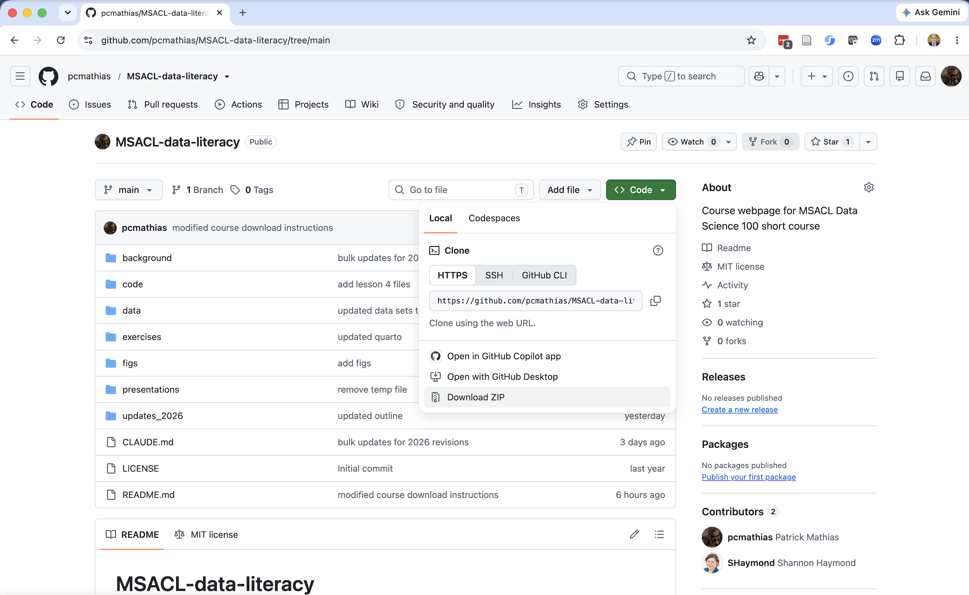
1. Click green “Code” button
2. Click “Download ZIP”
3. Save file to visible place (e.g. a Projects folder)
4. Unzip

Slide 6
Module 1 Learning Objectives
By the end of this module, you will be able to:
Distinguish common data types and explain why type matters for downstream analysis
Identify whether a dataset follows tidy data principles — and articulate the tradeoffs
Recognize common data quality issues and their downstream consequences

Slide 7
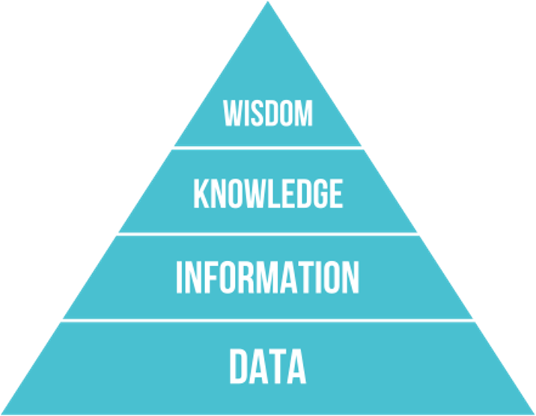
The DIKW Pyramid
Data to be synthesized into knowledge
Knowledge, in turn, can drive decision making

Slide 8
What is data science?
Interdisciplinary field that uses computational methods, statistics, and broad analysis techniques (including visualization) to extract knowledge from data
Draws on a variety of academic disciplines, including mathematics, statistics, computer science, and information science/informatics
Critical to integrate domain knowledge: laboratory medicine

Slide 9
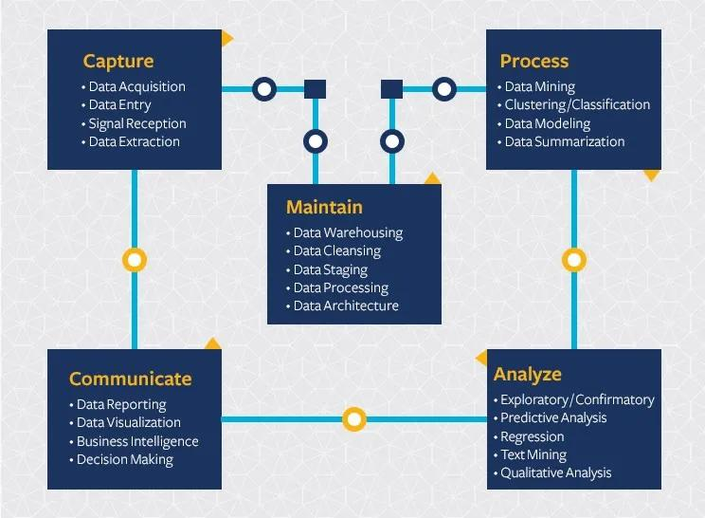
Computational tools support a broad lifecycle to manage a broad range of data
Data science extends beyond analysis of data and includes considerations for capturing and maintaining data
https://ischoolonline.berkeley.edu/data-science/what-is-data-science/

Slide 10
Statistics helps us interpret data based on expectations
Many categories of numeric lab data can be described by known distributions, e.g. normal distribution
Statistical methods allow us to evaluate hypotheses about the data
  Does the data fit a normal distribution? If not, why not?
  Are the differences between these sets of observations significant?
Notes:
Statistics can also be applied to non-numeric data
E.g. analysis of how words are used in clinical notes and deriving methods to extract useful info

Slide 11
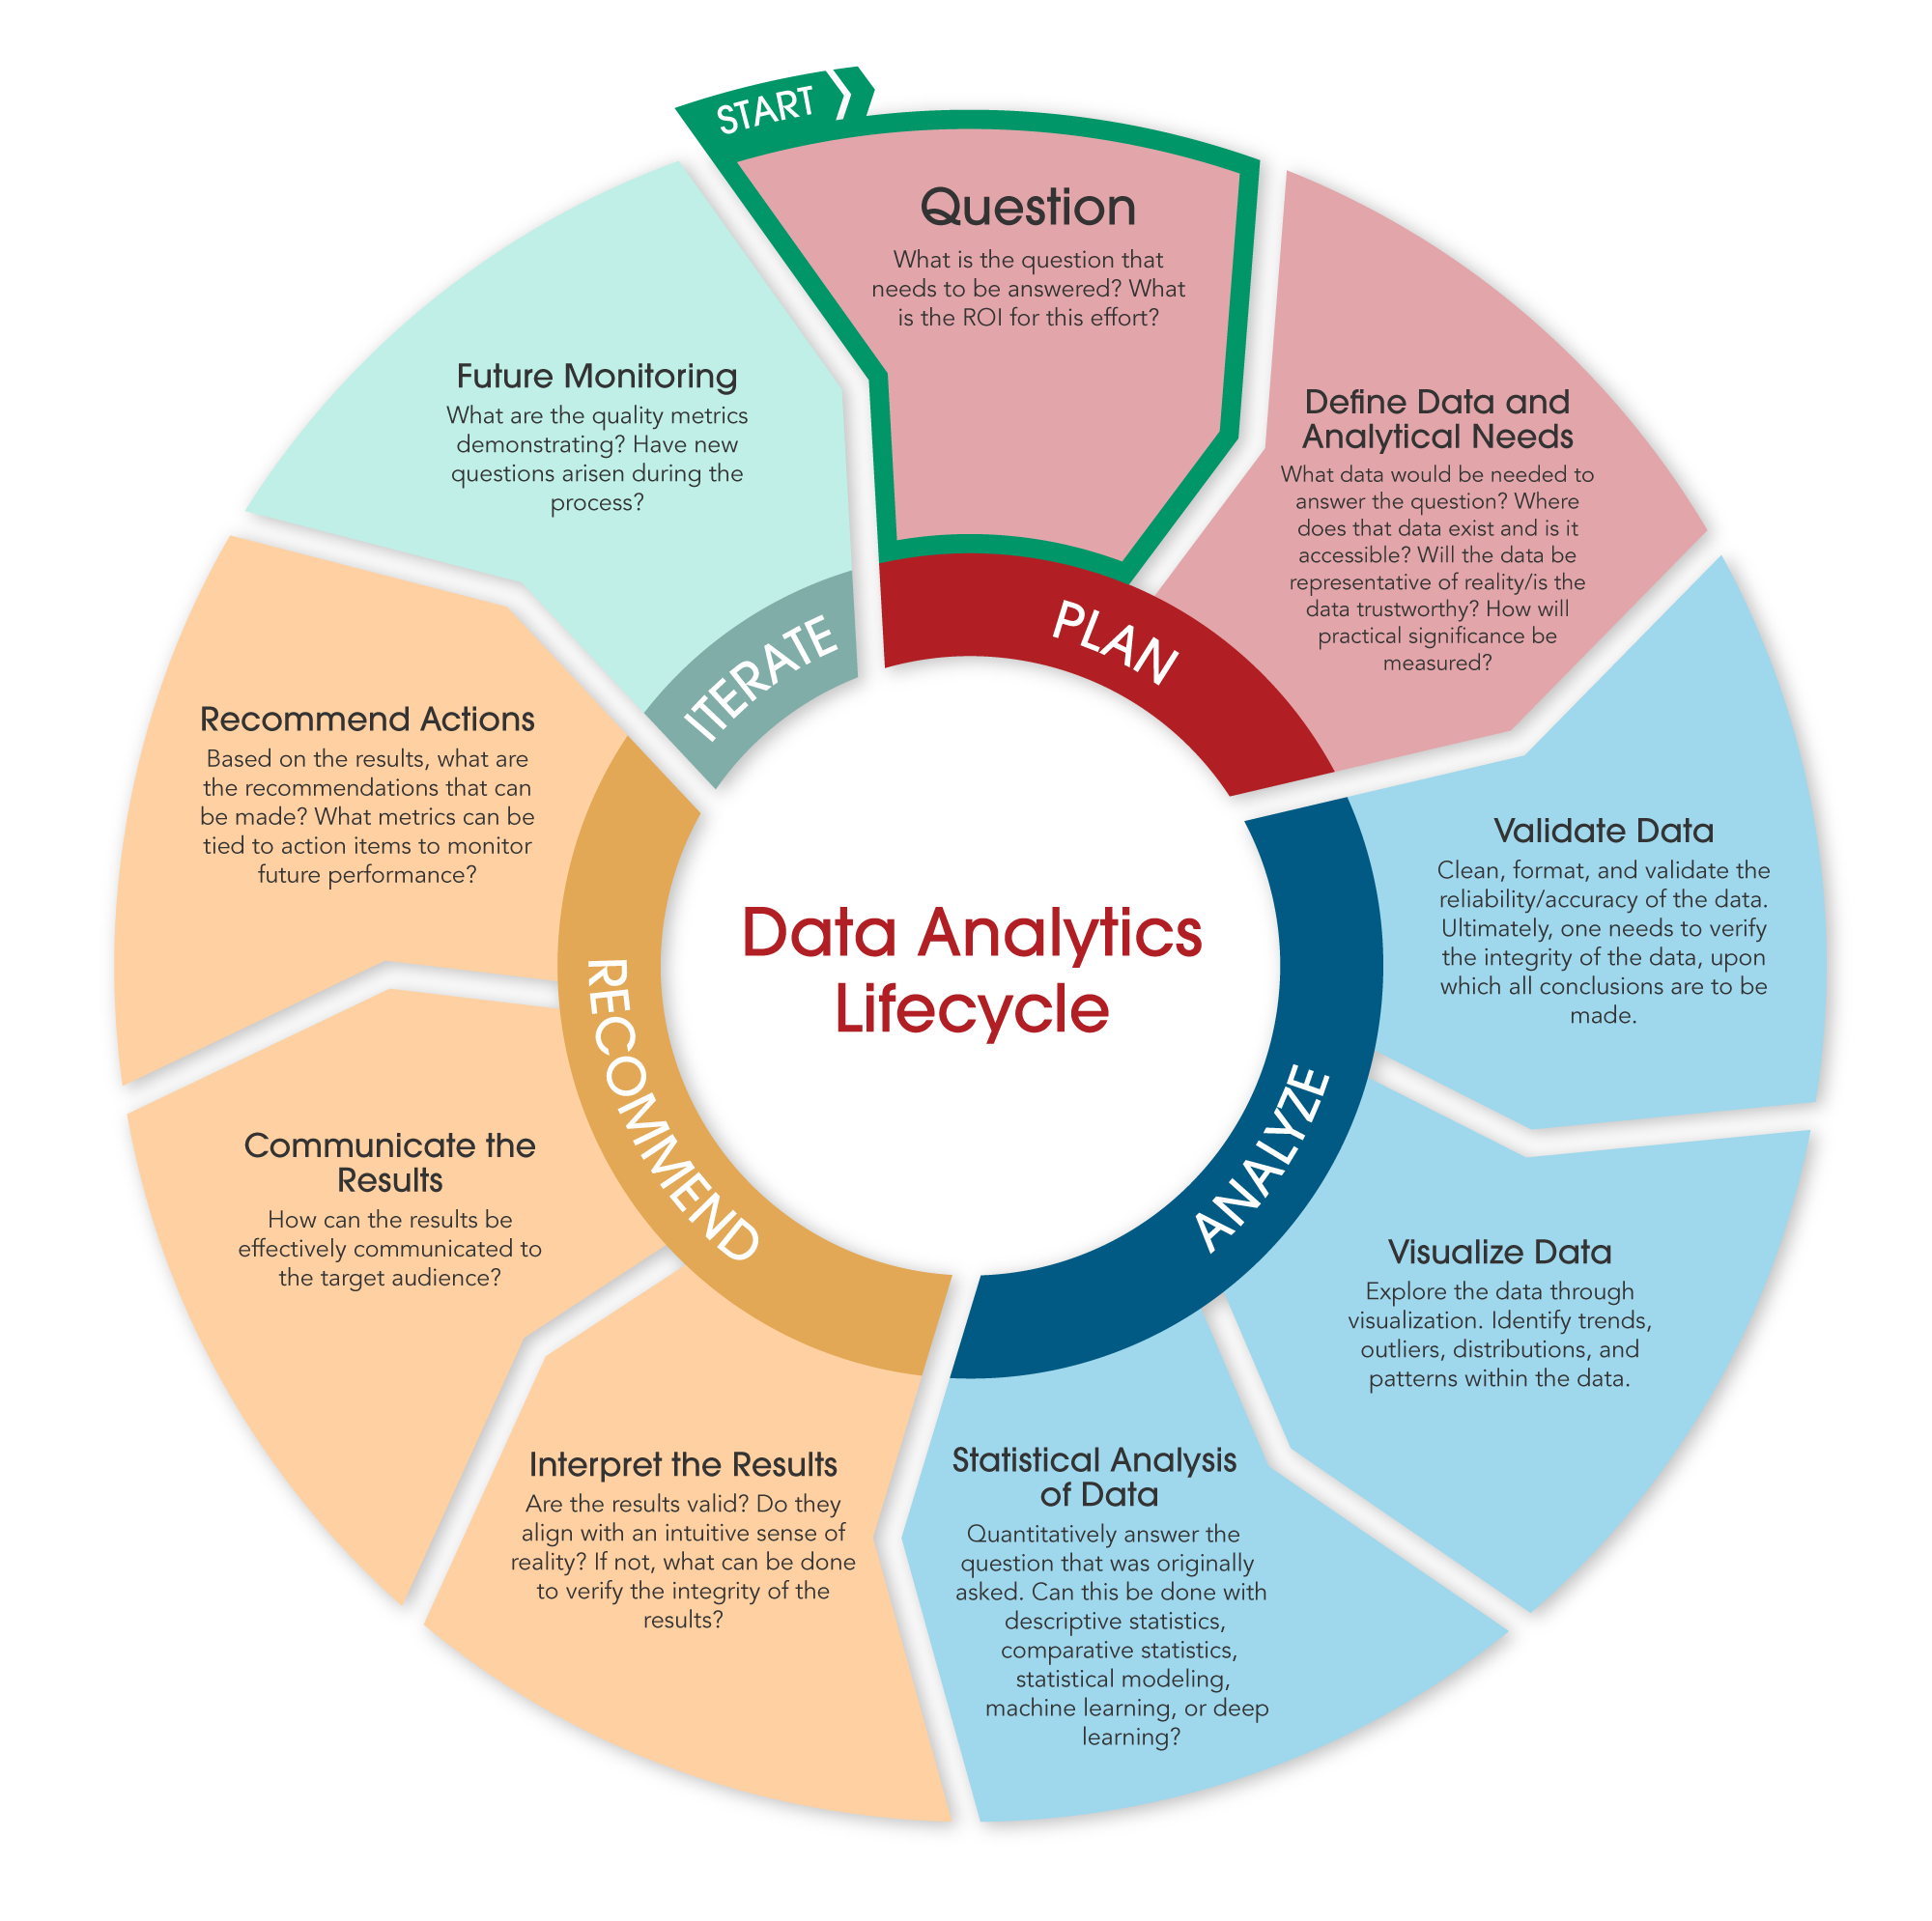
Data Analytics IS a SUBSET of Data Science
Data analytics includes discovering useful information and conclusions to support decision making from data
Using real-world data
Visualization
Statistical and exploratory analysis
Machine learning
Communicating results

Slide 12
Data Science Can be Categorized By How the Data is Applied
Descriptive
Diagnostic
Predictive
Prescriptive
What is happening?
Right now
Recent past
Why is it happening?
What are the root causes?
What will happen?
When might it happen?
What should we do?
Integrate what we think will happen with what has happened

Slide 13
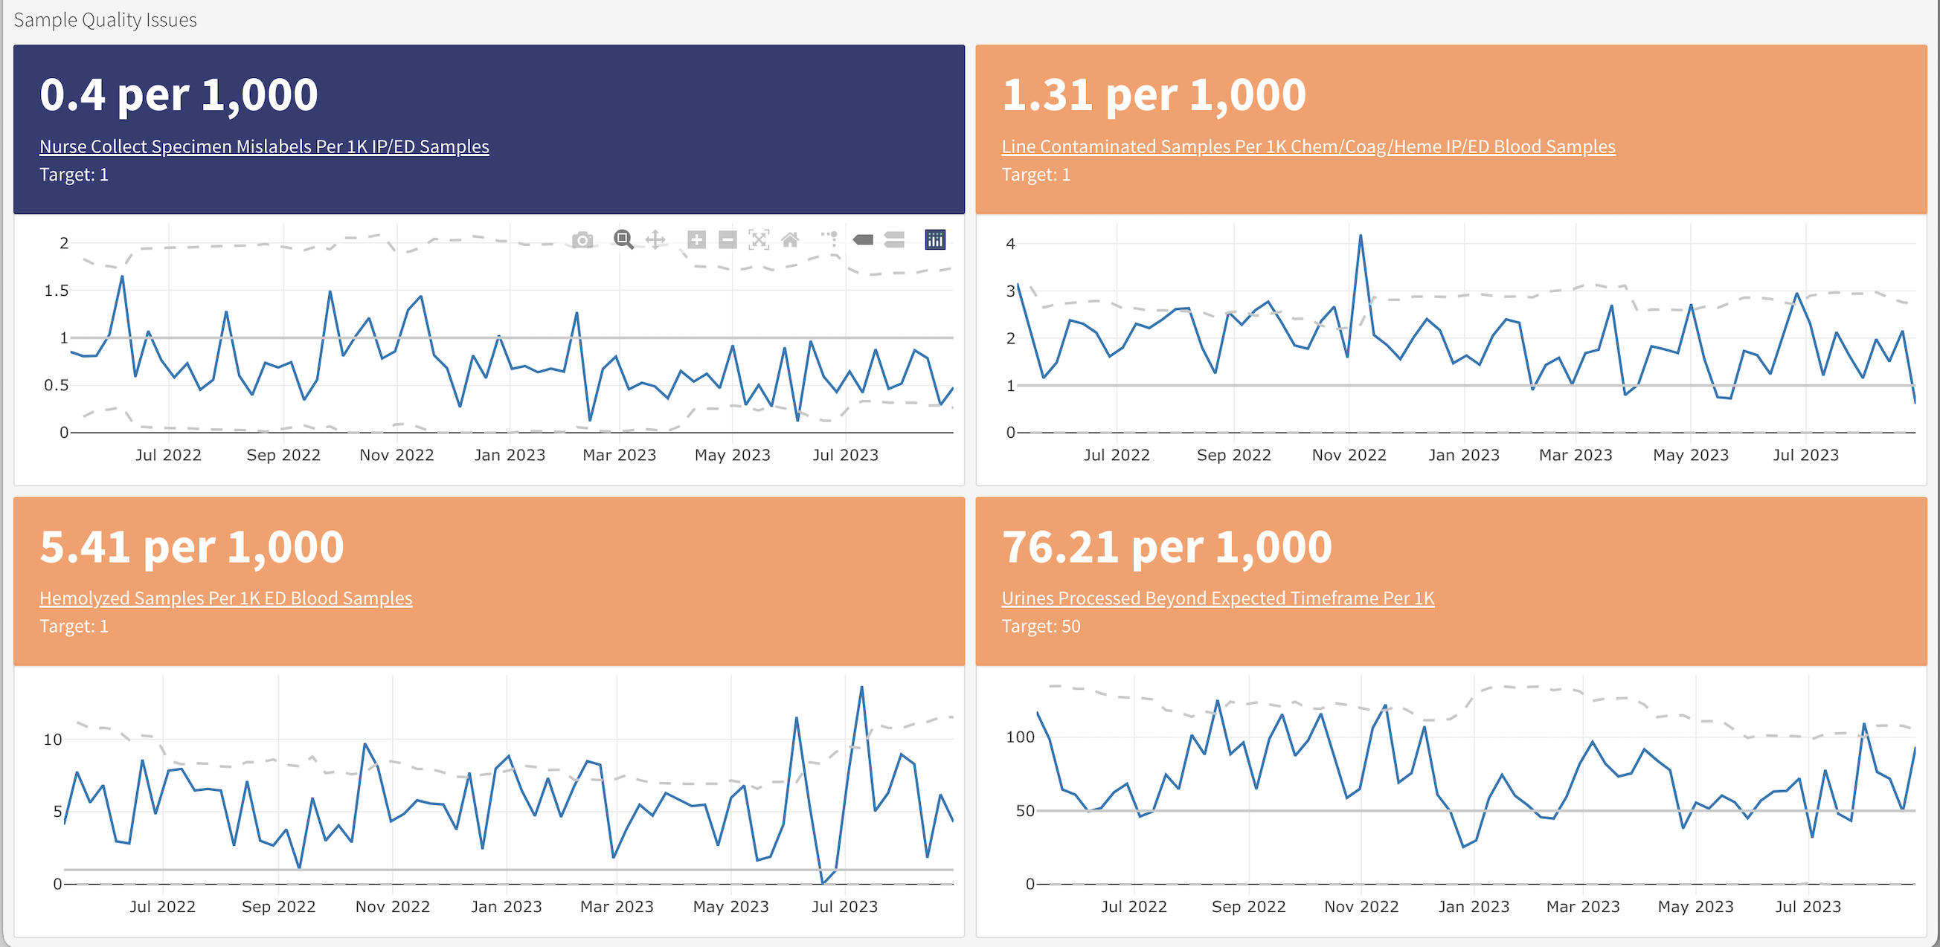
Descriptive Analytics Are Becoming More Common Across Healthcare Settings
DLMP Quality Assurance Dashboard

Slide 14
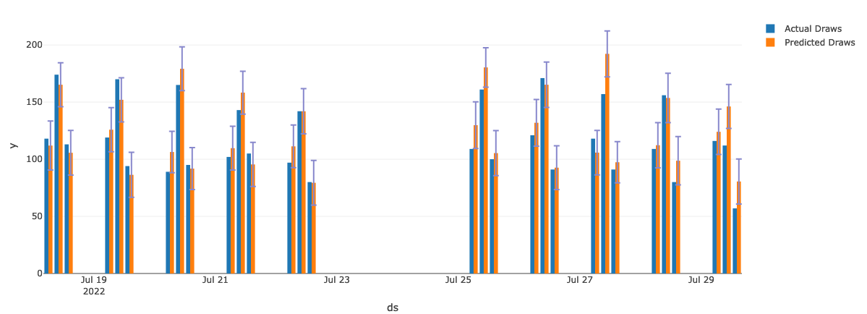
Predictive Analytics Are Emerging In Multiple Domains
UWMC Phlebotomy Prediction

Slide 15
What is the Role of the Laboratorian?
Define the important problems to solve and/or questions to answer
Subject matter expert: those generating the data best understand the data
Perform and interpret routine analyses (e.g. quality control)
Support the validation of analyses done by others
Develop and/or perform new analyses for quality improvement

Slide 16
Data & Data Types

Slide 17
What Is Data?
Data = observations recorded systematically
Every value in a dataset represents something measured, reported, or logged in the real world
Two categories worth separating:
  Raw data — recorded as originally captured (an instrument reading, a timestamp)
  Derived data — calculated or transformed from raw values (a turnaround time, a mean)
If you can't say what real-world event a value represents, you don't yet understand your data.

Slide 18
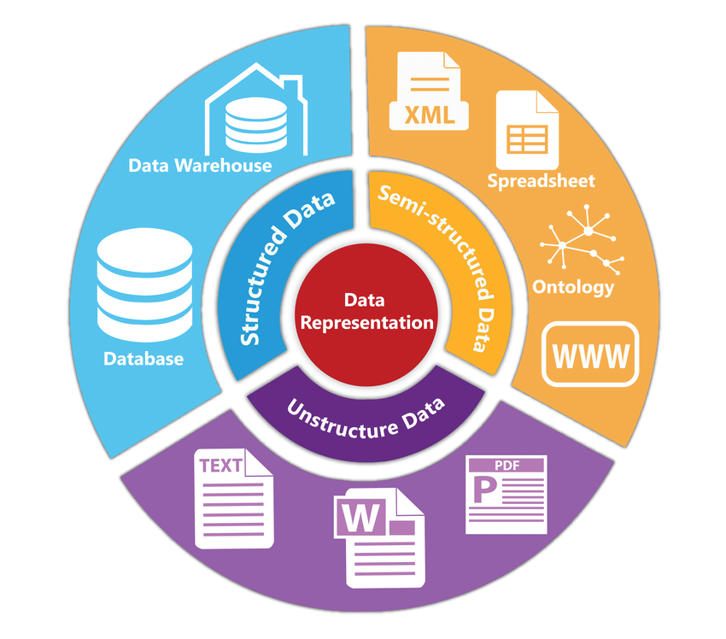
Data representation
Assignment of meaning to physical artifacts
  Characters, numbers, words, phrases
  Electronic states of computer memory
Human language: Unstructured data
  Extremely flexible
  Form and usage varies with location and time
  Context-dependent
Structured data
  Constrained language
  Well-defined syntax and semantics
Data standard: Formal agreement on data representation
Siriyasatien et al. IEEE Access 2018.
doi:10.1109/ACCESS.2018.2871241
© 2023 James H. Harrison, Jr.
Notes:
Pre-computer we usually meant visual artifacts
Data standards allow data sharing and interoperability

Slide 19
Why Data Types Matter
A data type isn't just a technical label — it determines:
  What operations are valid (can you average it? sort it? subtract it?)
  How software will interpret ambiguous values
  Whether a value like NA means missing or is an abbreviation for sodium
Misidentifying a type is one of the most common — and most silent — sources of analysis errors.
A wrong data type doesn't crash your code. It just quietly gives you the wrong answer.

Slide 20
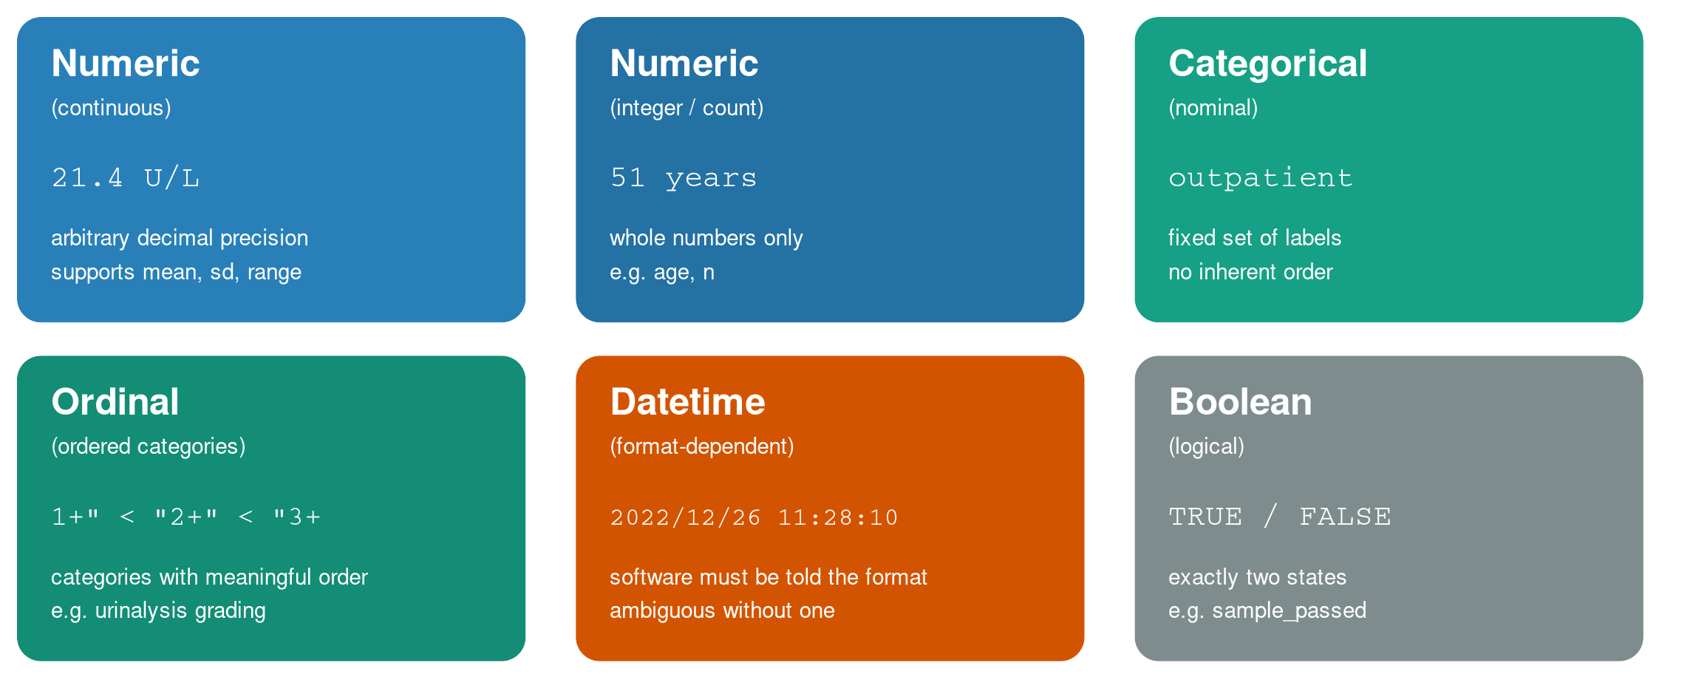
Common Data Types

Slide 21
How many ways can “100” be represented in a computer?
Poll

Slide 22
Representation has functional implications
How many ways can “100” be represented in a computer?
  All representations are binary
  Integer (can’t divide with decimal result or include in text)
  Floating point (inexact, can’t include in text)
  Character string (can’t do math without conversion)
Medical systems often represent numbers as text.
  Space saving with usual sized numbers (less space to store a few chars)
  Display as characters is often primary purpose
    Math not often needed and can convert when necessary
© 2023 James H. Harrison, Jr.

Slide 23
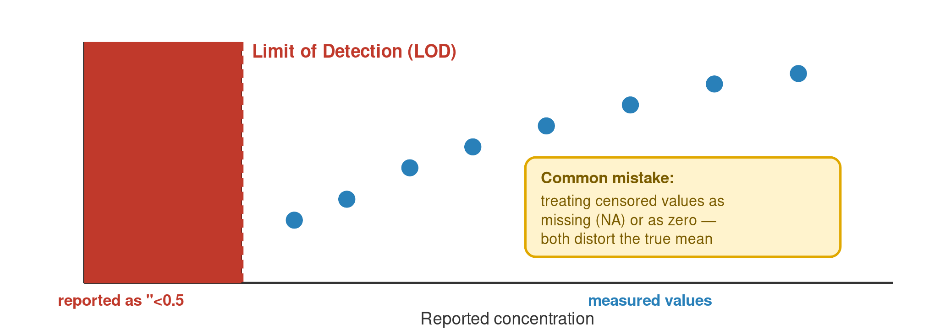
A Special Case: Censored / Below-LOD Values
Clinical and MS data often contain values reported as “<0.5” or “undetectable”
These are not missing — they are a special type: censored data
The true value is known to be somewhere below a threshold, not unknown entirely
Treating a censored value as missing (or worse, as zero) can distort every downstream summary statistic

Slide 24
Types in the Wild: A Raw CSV Row
No column tells you the type — you have to infer it from the value and context
NA appears twice, but for two different reasons
The datetime has no explicit format label — R will have to be told how to read it
Every column in this row is a small decision you'll have to make deliberately.

Slide 25
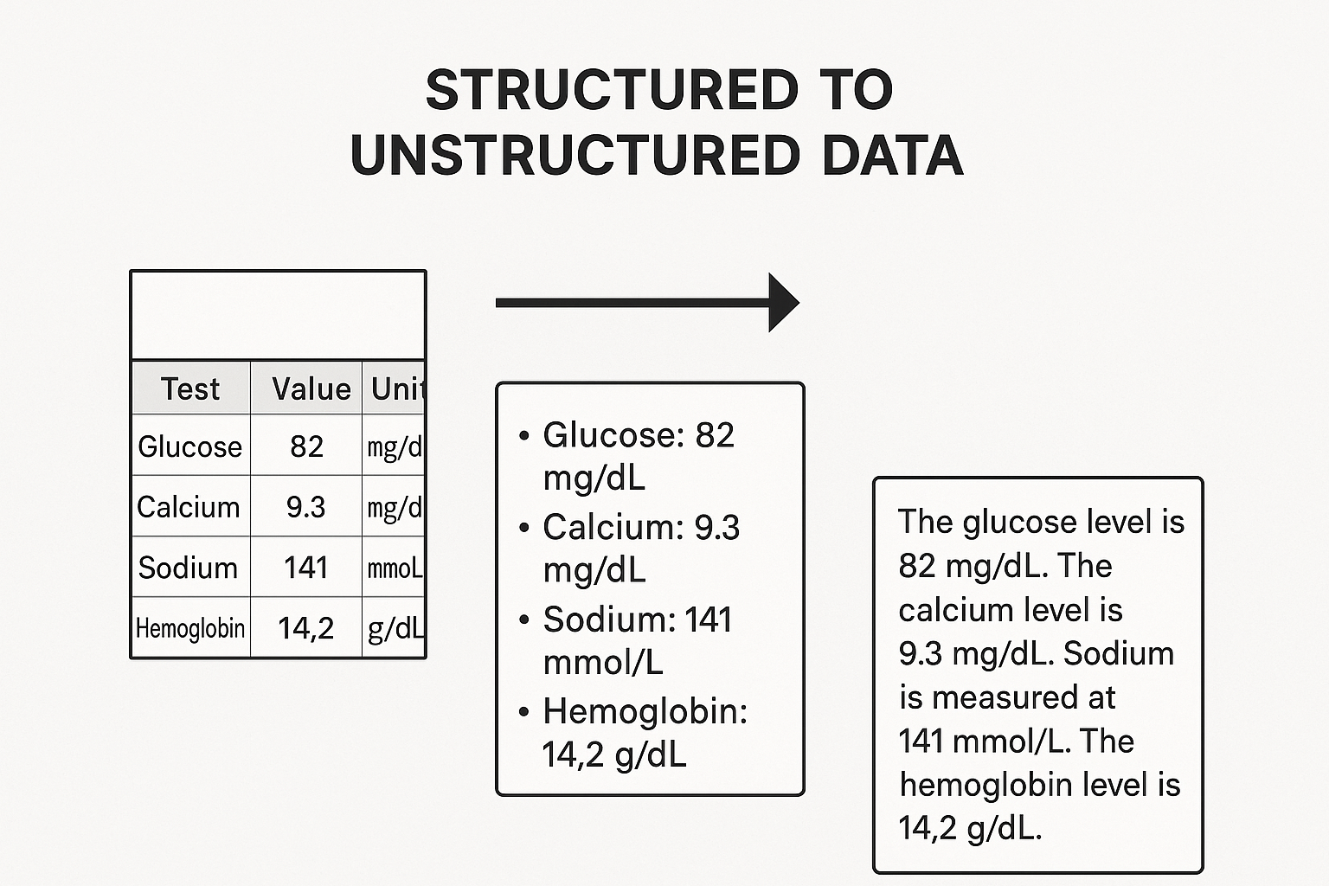
Data limitations: structured vs. unstructured data
“Structuredness” of data refers to degree of data organization in consistent, predefined format
Laboratory data ranges from highly structured to unstructured
Notes:
Tidy data is covered in module 3 so can add here or not- PCM referenced a visual in presentation. Might be helpful
image generated with chat gpt- can refine this visual and label if needed

Slide 26
Why Structure Matters — Before Any Analysis
The same facts can be organized many different ways
Structure determines:
  What questions are easy to answer
  What questions are possible to answer at all
  How easily errors are introduced or hidden
Structure is a decision you make — not a fact about the data itself.

Slide 27
Data Frames
Data frame = two-dimensional collection of heterogeneous data
  Spreadsheet-like data – typically organized in columns with a fixed data type
  Columns (or variables) often explicitly named
Identifier | Location | Test | Value
F123456 | Inpatient | Sodium | 140
W987654 | Outpatient | Potassium | 4.8
X234537 | ED | AST | 70

Slide 28
Before We Start: Orienting in RStudio
This module has no R code — but we'll still work inside RStudio.
Start with RStudio as simply a text editor: a place to open files, read them carefully, and record your answers.
In the Files pane, open exercises/module_1_exercises.qmd
This file opens in the Source pane — you'll type your answers directly into it
Save often (Cmd/Ctrl+S) — nothing here runs or executes

Slide 29
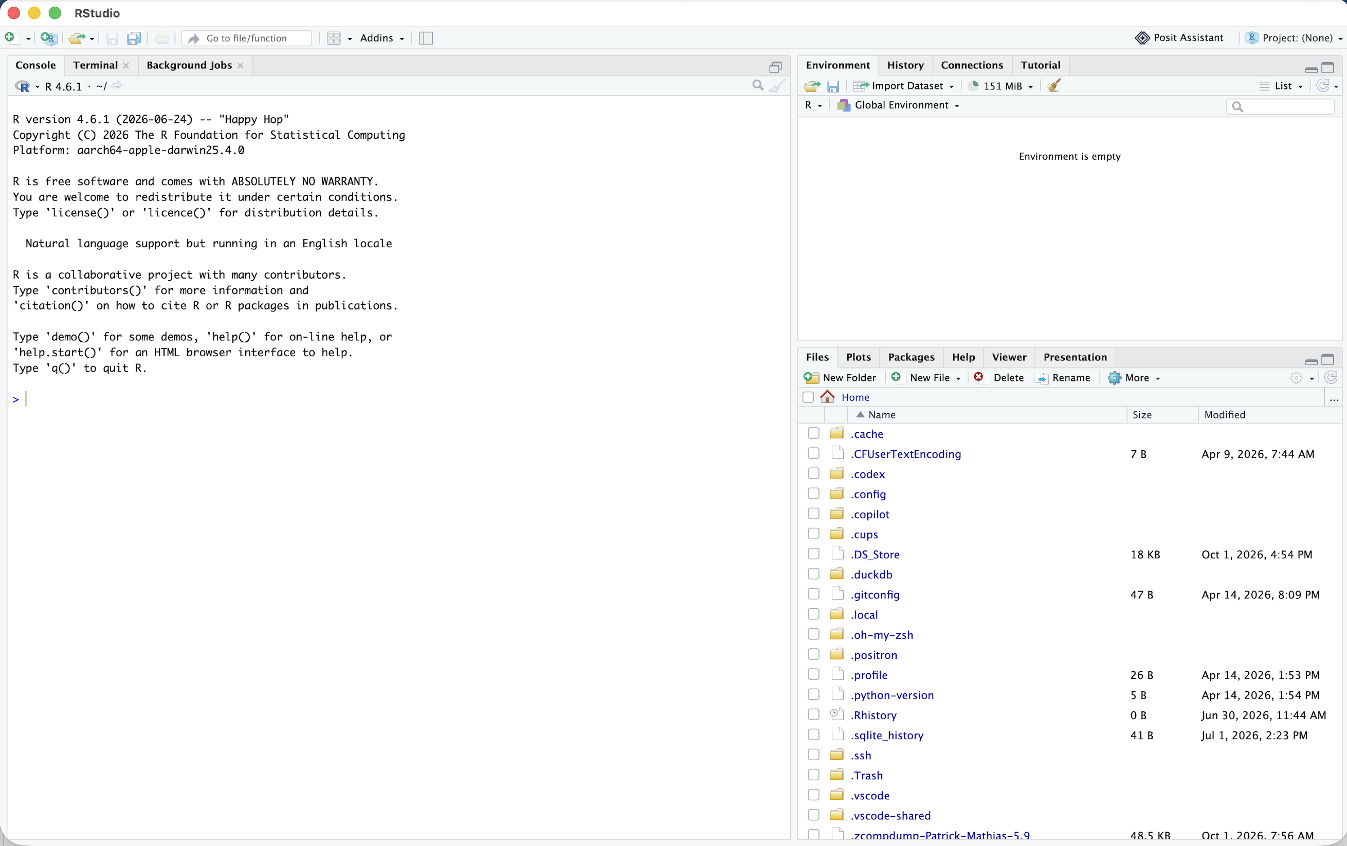
ENVIRONMENT
CONSOLE
FILES

Slide 30
1. Find unzipped course folder
2. Navigate to “exercises” folder
3. Click on “module_1_exercises.qmd” to open

Slide 31
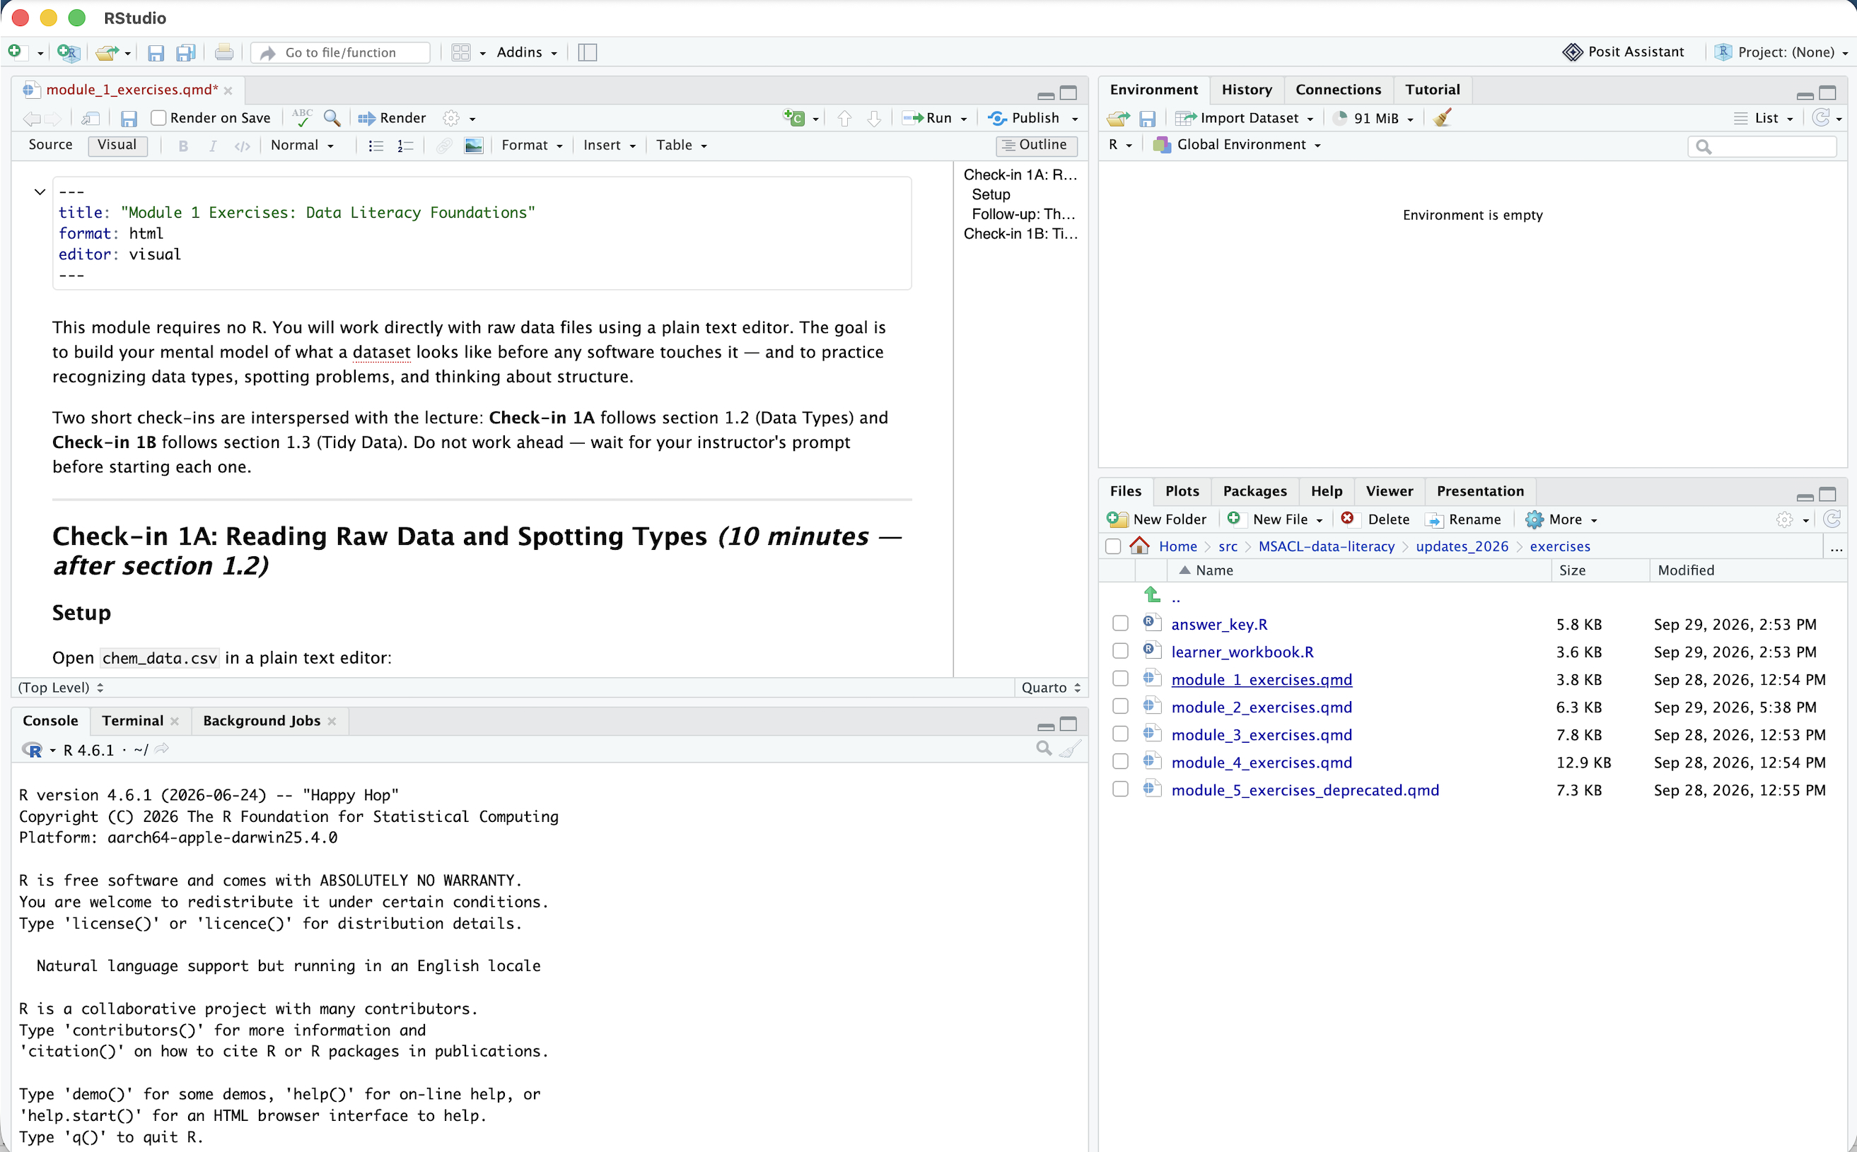
The source pane functions as file editor
ENVIRONMENT
SOURCE
CONSOLE
FILES

Slide 32
Check-in: Spot the Types
Open chem_data.csv in a plain text editor (not RStudio — a real text editor).
For each of the 13 columns, predict the data type and flag any concerns.
Which columns look numeric vs. categorical? Where might censored or missing values be hiding? Which column will need an explicit datetime format?
Return to module_1_exercises.qmd in RStudio to record your answers.

Slide 33
1.3 Tidy Data Principles

Slide 34
Three Principles of Tidy Data
A dataset is tidy when:
  Every variable has its own column
  Every observation has its own row
  Every value has its own cell
Not a matter of taste — a precise, checkable definition
Most tidyverse tools assume tidy input
Tidy data isn't prettier data. It's data shaped for the tools you're about to use.

Slide 35
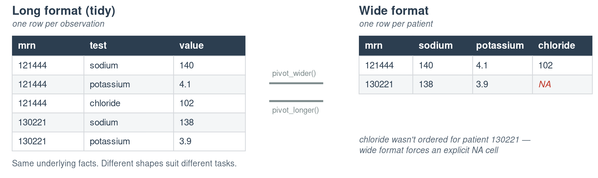
The Same Facts, Two Structures
Same information — very different shapes. Notice the explicit NA that appears only once the data is widened.

Slide 36
Tradeoffs: Long vs. Wide
 | Long (tidy) | Wide
Add a new analyte | Add rows | Add a column, restructure
Filter by analyte | Easy (filter()) | Awkward
Human-readable summary table | Harder to scan | Easy to scan
Feed into ggplot2 | Usually required | Usually needs reshaping first
Neither format is “wrong” — but one is almost always easier for a given task
The tidyverse gives you tools (pivot_longer(), pivot_wider()) to convert between them — we'll see these in Module 4

Slide 37
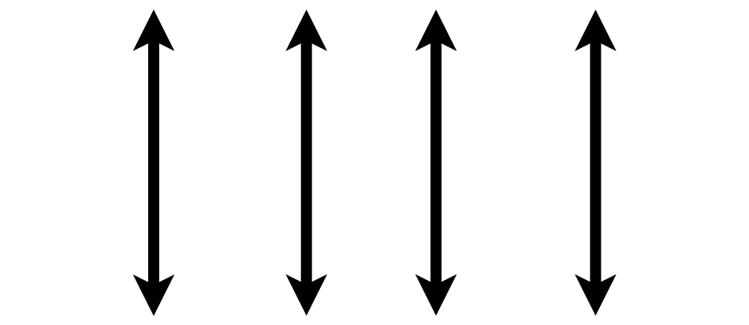

Tidy Data Summarized
A data set is tidy if:
Each variable is in its own column
Each observation is in its own row
Each value is in its own cell
MRN
Wickham, H. . (2014). Tidy Data. Journal of Statistical Software, 59(10), 1–23.

Slide 38
Check-in: Tidy or Not Tidy?
Compare chem_data.csv (long) and chem_data_wide.csv (wide).
Answer three written questions in module_1_exercises.qmd:
Which tidy principle does the wide format bend?
When is each format easier to use?
What would you need to do to a wide file before analyzing it in R?

Slide 39
1.4 Data Quality and Common Pitfalls

Slide 40
Data quality
Completeness | Is data present and available?
Correctness | Is data true?
Concordance | Is there agreement and consistency between data elements?
Plausibility | Does data make sense in the clinical context?
Currency | Is data a relevant representation at a defined point in time?
Weiskopf NG, Weng C. Methods and dimensions of electronic health record data quality assessment: enabling reuse for clinical research. J Am Med Inform Assoc. 2013;20(1):144-151. doi:10.1136/amiajnl-2011-000681
© 2023 James H. Harrison, Jr.
Notes:
Why is data quality important for computers? Humans become conservative when data is uncertain and the stakes are high computers don’t unless programmed in, handling uncertainty, incorporating low quality into result (result quality may reflect lowest quality data), garbage in & garbage out

Slide 41
Common Data Quality Issues
Missing values — and knowing why they're missing (not tested vs. not applicable vs. lost)
Duplicate rows — same observation recorded more than once
Out-of-range values — a pH of 45, an age of 200
Encoding inconsistencies — "Male" vs. "M" vs. "male" treated as three different categories
Timestamp errors — a verify time earlier than the collect time
Each of these can silently corrupt a downstream summary — often without any error message.

Slide 42
Why “Silent” Errors Are the Dangerous Ones
Software rarely stops and warns you when data is plausible but wrong
A mis-encoded category doesn't crash your analysis — it just quietly gets excluded, or double-counted
This is exactly why Module 2 introduces a validation checklist as a required first step, every time you import data
The most dangerous bugs are the ones that produce an answer — just the wrong one.

Slide 43
Bringing It Together
Data types — determine what's even possible to compute
Tidy structure — determines what's easy to compute
Data quality — determines whether your answer is trustworthy
Three habits. Zero lines of R code. All essential before you ever open a script.

Slide 44
Coming Up: Module 2
RStudio as a computational tool, not just a text editor
How to set up a project so your code runs the same way on any machine
Importing chem_data.csv with the tidyverse
Correcting the types you predicted today
A hands-on data validation checklist
Bring your laptop, charged, with R and RStudio installed.

Slide 45
References & Acknowledgements
James Harrison, Introduction to Pathology Informatics, Session 8: Cybersecurity, API Distribution 1.0, 2023. Available at: https://www.pathologyinformatics.org/teaching-slide-sets
Robert Benirschke, Michelle Stoffel, & Chris McCudden for slides adapted from ADLM Data Science Certificate materials

