Slide 1
Introduction to R and RStudio
DS 100 — Module 2

Slide 2
Welcome Back
Module 1 gave you the vocabulary: types, structure, quality, organization
Today, those ideas become operational — RStudio moves from a text editor to a computational tool
We'll import real data, inspect it, and validate it before drawing a single conclusion
Today's question: can we trust this dataset enough to build on it?

Slide 3
Module 2 Learning Objectives
By the end of this module, you will be able to:
  Navigate the RStudio interface and explain the purpose of each pane
  Import and inspect a dataset using the tidyverse
  Recognize and correct common data type misassignments
  Apply a systematic data validation checklist after importing data
Interface: Where do things happen, and why does it matter?
Import: Getting data in — correctly, not just successfully
Types: Catching R's wrong guesses before they cost you
Validation: Proving the data is what you think it is

Slide 4
2.1 Why Use a Programmatic Tool?

Slide 5
From Cells to Operations
A spreadsheet asks: what value goes in this cell?
A script asks: what operation transforms this whole dataset?
That shift — from individual cells to systematic operations — is the mental model this entire course is built on
You are no longer editing values. You are describing a process.

Slide 6
Why It Matters: Reproducibility, Auditability, Scale
A spreadsheet remembers your last click. A script remembers your entire reasoning.

Slide 7
What This Looks Like in Practice
 | Spreadsheet | Script
Repeat an analysis next month | Redo every click | Re-run the file
Explain what you did | Try to recall | Read the code
Catch a mistake | Hope someone notices | Re-run and compare
Hand off to a colleague | Walk them through it live | Send the file
None of this requires you to be a "programmer" — it requires you to write down what you did.

Slide 8
Check-in 2A: RStudio Orientation (8 minutes)
Open the course .Rproj file from your file system
In the Console, type 1 + 1 and press Enter — confirm you see [1] 2
Return to module_2_exercises.qmd, run the setup chunk
Fill in the RStudio Panes table and answer three written questions in the exercise file.

Slide 9
2.2 R Basics: Objects, Functions, and Packages

Slide 10
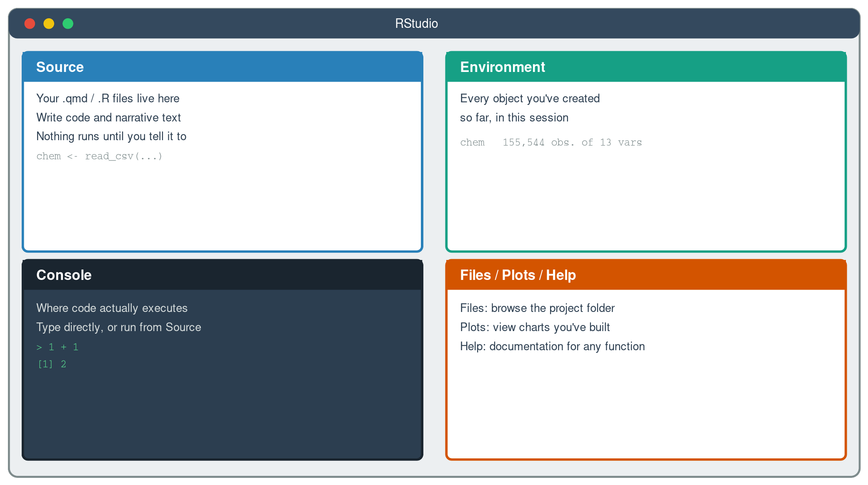
The RStudio Interface, at a Glance
Source writes, Console runs, Environment remembers, Files/Plots/Help supports.

Slide 11
Objects: Naming a Result So You Can Reuse It
<- assigns a value to a name — chem <- read_csv(...) means "call this result chem"
Once assigned, an object shows up in the Environment pane and can be reused in any later chunk
Assignment is how a script remembers — a spreadsheet has no equivalent concept
chem <- read_csv("data/chem_data.csv")
Every object is a named, reusable answer to a question you already asked.

Slide 12
Functions: Verbs That Act on Objects
If you can name what you want to happen to your data, there is very likely already a function for it.

Slide 13
Packages: Bundled, Reusable Tools
A package is a collection of functions written and shared by someone else, so you don't reinvent them
library(tidyverse) loads the one package family this entire course relies on
Packages must be installed once, but loaded (via library()) every new session
Almost every function you'll type this week comes from a package someone already built and tested.

Slide 14
2.3 Importing Data with Explicit Column Types

Slide 15
read_csv() and the Type-Guessing Problem
read_csv() reads the first ~1,000 rows and guesses each column's type from what it sees
That guess is often reasonable — and sometimes exactly wrong, especially for dates and categories
A column of "2022/12/26 00:24:02" values has no built-in marker that says "I am a datetime"
A wrong guess doesn't throw an error. It just quietly limits what you can do next.

Slide 16
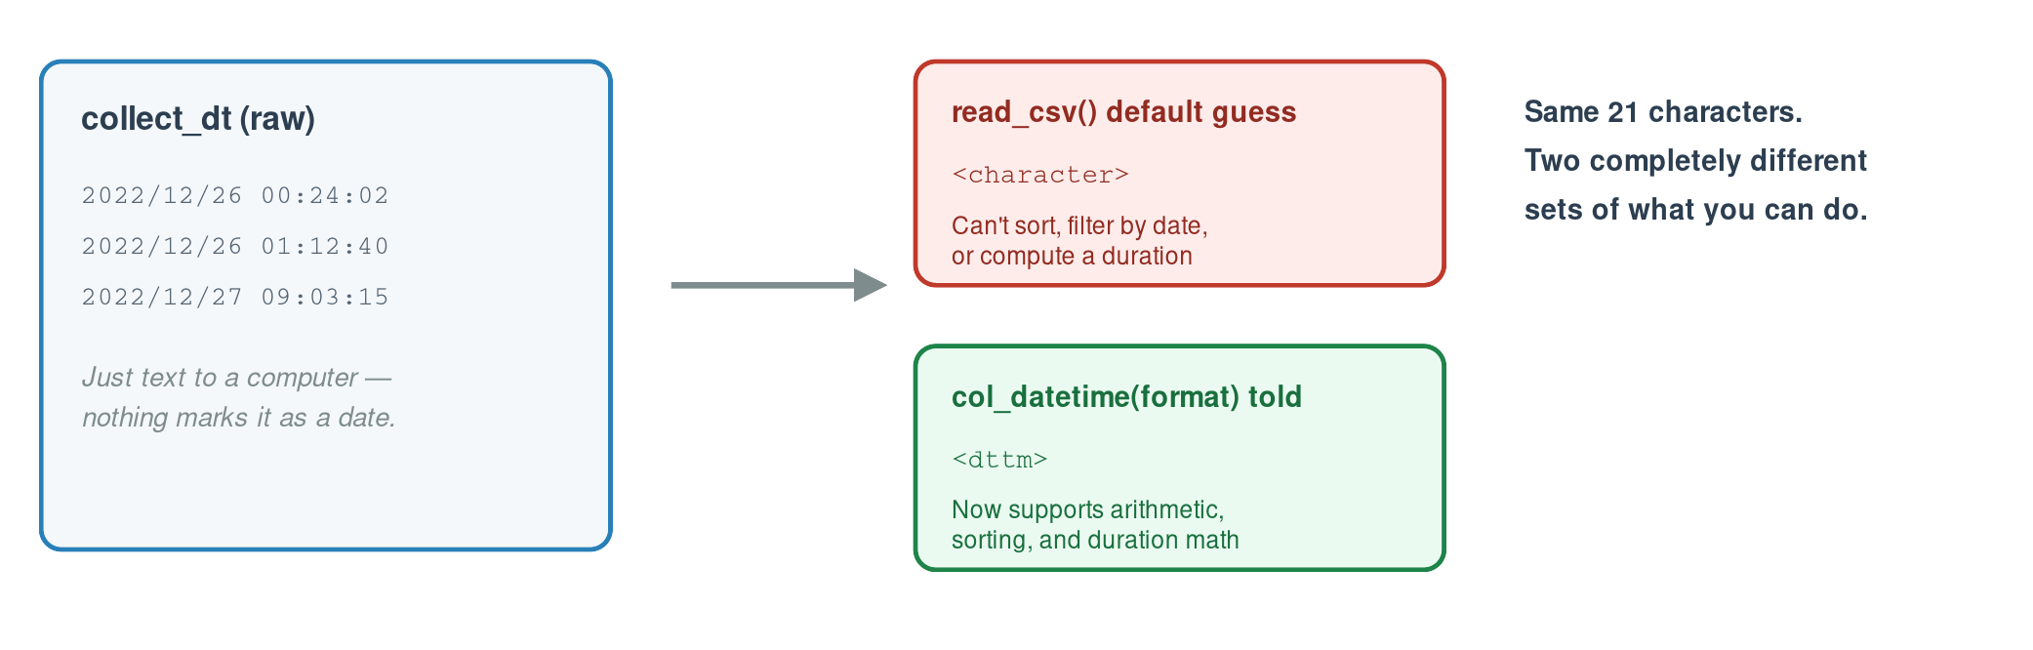
Same Text, Two Very Different Outcomes
Same 21 characters. Two completely different sets of what you can do.

Slide 17
Telling R What You Already Know
col_types = cols(...) lets you specify the type for every column explicitly, rather than trusting the guess
col_datetime("%Y/%m/%d %H:%M:%S") — you supply the exact format the raw text is in
col_factor() — for a column with a fixed, known set of category labels (like pat_type or gender)
collect_dt = col_datetime("%Y/%m/%d %H:%M:%S")
pat_type = col_factor()
You are not fighting R's guess — you're replacing a guess with a fact you already know.

Slide 18
Check-in 2B: Import and Inspect chem_data (20 minutes)
Part 1: Import with default types. Run glimpse() and summary() — identify which columns look wrong.
Part 2: Re-import with explicit col_types. Fill in two blanks: the datetime format string, and the col_ function for pat_type. Confirm the corrections.

Slide 19
2.4 Data Validation Checklist

Slide 20
Why Validation Comes First — Every Time
An import that runs without an error message has told you nothing about whether the data is right.

Slide 21
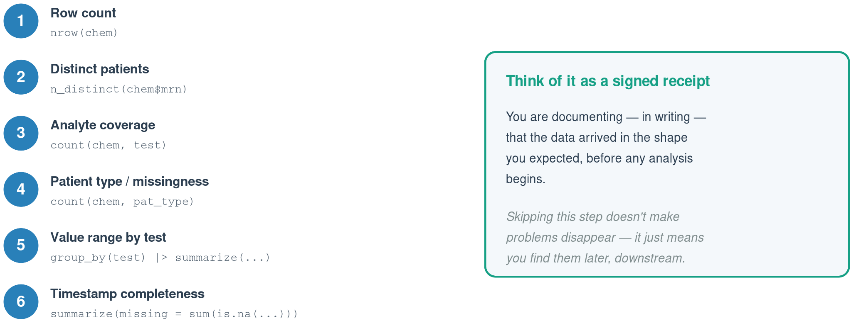
The Six-Step Checklist

Slide 22
What a Failed Check Actually Tells You
Row count off? You may have imported a stale file, or a filter ran earlier than intended
Analyte counts uneven? Some analytes may only be ordered for certain patient types — is that expected?
Missing timestamps? Is that a data entry gap, or a real workflow state (e.g., not yet verified)?
Every checklist item ends in the same question: is this what I expected, and if not, why not?

Slide 23
Check-in 2C: Run the Checklist (15 minutes)
Step through all six validation checks on the correctly imported chem_data. Record your interpretation of each result — not just the number, but what it means.
Closing question: identify one data quality issue you'd want to investigate further before presenting results to a lab director.

Slide 24
Bringing It Together
Interface — Source writes, Console runs, Environment remembers
Import — Tell R the types — don't trust the guess
Validation — A receipt that the data is what you expect
Mindset — Reproducible, auditable, and built to scale
You now have a validated, correctly typed dataset. Module 3 puts it on screen.

Slide 25
Coming Up: Module 3
Visualization principles and best practices
Choosing the right chart for the question you're asking
Building and refining plots with ggplot2
A first look at code you won't fully understand yet — and that's intentional
Bring the validated chem_data import from today — Module 3 builds directly on it.

