Slide 1
Computational Thinking
Shannon Haymond

Slide 2
Lesson Goals
Develop computational thinking skills to more effectively utilize emerging digital technologies
Lesson Objectives
Identify the key components of a complex problem and break it down into smaller, more manageable parts.
Use patterns to predict future outcomes or generalize solutions.
Create simplified models to represent complex systems.
Design step-by-step instructions or algorithms to solve a problem.
Describe basic coding concepts to better apply computational solutions.
Notes:
.

Slide 3
What is computational thinking?
Formulating things with enough clarity, and in a systematic enough way, that one can tell a computer how to do them
- Stephen Wolfram
We tell computers how via language
  coding in programming language
  using data scientist interpreter
  low code/no code interface
Notes:
In the latter two you don’t need to know how to code, you need to understand computational thinking so you are more effective at delivering your message or ideas to those who will translate it to a programming language and determine how to get it done. Understanding computational thinking will likely also improve your attempts to learn a programming language.

Slide 4
computational thinking skills
Decomposition
Abstraction
Algorithm design
Pattern recognition
Evaluation & debugging
Notes:
In addition to these skills must have right attitude and behaviors
Attitudes
Confident: believing in one's own ability to solve problems
Communicative: willing and able to communicate effectively with others.
Flexible: able to deal with change and open-ended problems
Approaches
Tinkering: experimenting and playing
Creating: designing and making
Debugging: finding and fixing errors
Persevering: keeping going
Collaborating: working together.

Slide 5
Today's lab case
ICU clinicians say their chemistry results come back slower than results for other units.
The lab director asks:
Q1. Does turnaround time (TAT) differ by patient type?
Q2. Are we meeting a 3-hour collect-to-verify goal?
chem_data.csv
Synthetic chemistry results
6,481 patients
24 tests per patient
Tools today:
R & Rstudio
Claude (free account)

Slide 6
Warm-up: build your subset
Exercise
Coding concepts (Objective 5): objects, vectors, functions, the pipe
Open learner_workbook.R in RStudio.
Session > Set Working Directory > To Source File Location
In Part 0, fill in the two blanks: "potassium" and "creatinine".
Run Part 0 one section at a time (Ctrl/Cmd + Enter).
Check: you should have 19,443 rows (6,481 patients x 3 tests).
tests_keep <- c("glucose",
___, ___)
read_csv("chem_data.csv") |>
filter(test %in% tests_keep) |>
write_csv("chem_subset.csv")

Slide 7
Cold prompt
Exercise
Why computational thinking matters
ICU clinicians say their chemistry results come back slower than results for other units.
The lab director asks:
Q1. Does turnaround time (TAT) differ by patient type?
Q2. Are we meeting a 3-hour collect-to-verify goal?
Open claude.ai and start a new chat.
Type a prompt to generate R code to help you answer the lab director’s questions. Do not upload data.
Paste Claude's code under COLD PROMPT in your workbook. Run it.
What happened? Did Claude know your column names? Your data? Your question? Does the code work? Is it what you intended?
Save your prompt and Claude's full reply. Rate your confidence that the answer is right, from 1 to 5.
Notes:
Write R code to answer these two questions. Do it correctly and double-check your work. Q1. Does turnaround time differ by patient type? Q2. Are we meeting a 3-hour collect-to-verify goal? My data is in a file called chem_subset.csv. The columns are: mrn, gender, age, pregnancy_status_at_exam, collect_dt, receive_dt, verify_dt, pat_type, payor_groups, last_name, col_rec_tat, rec_ver_tat, test, value.
Facilitator: do not fix anything. Prompts with no column names usually get code built on invented column names and a made-up dataset. Watch for learners who run that code and take its output as the answer.
Prompts that include the column names usually get long working code and a list of assumptions. Ask learners to keep that list. It is used in the algorithm exercise and the debrief.
In test runs (free Claude, October 2026) Claude asked no questions unless told to ask first.

Slide 8
computational thinking skills
Decomposition
Abstraction
Algorithm design
Pattern recognition
Evaluation & debugging
Notes:
In addition to these skills must have right attitude and behaviors
Attitudes
Confident: believing in one's own ability to solve problems
Communicative: willing and able to communicate effectively with others.
Flexible: able to deal with change and open-ended problems
Approaches
Tinkering: experimenting and playing
Creating: designing and making
Debugging: finding and fixing errors
Persevering: keeping going
Collaborating: working together.

Slide 9
decomposition
Decomposition
Break down a large, complex problem into smaller, more manageable parts to make it easier to understand and solve
Identify the main (large, complex) problem
Break it down into smaller tasks
Solve each sub-task
Combine solutions to solve main problem
Notes:
This is the process of breaking down a large, complex problem into smaller, more manageable parts. It is important because it makes the problem less overwhelming and easier to understand. Each smaller problem can be addressed individually, which is much more feasible than trying to solve the complex whole all at once.

Slide 10
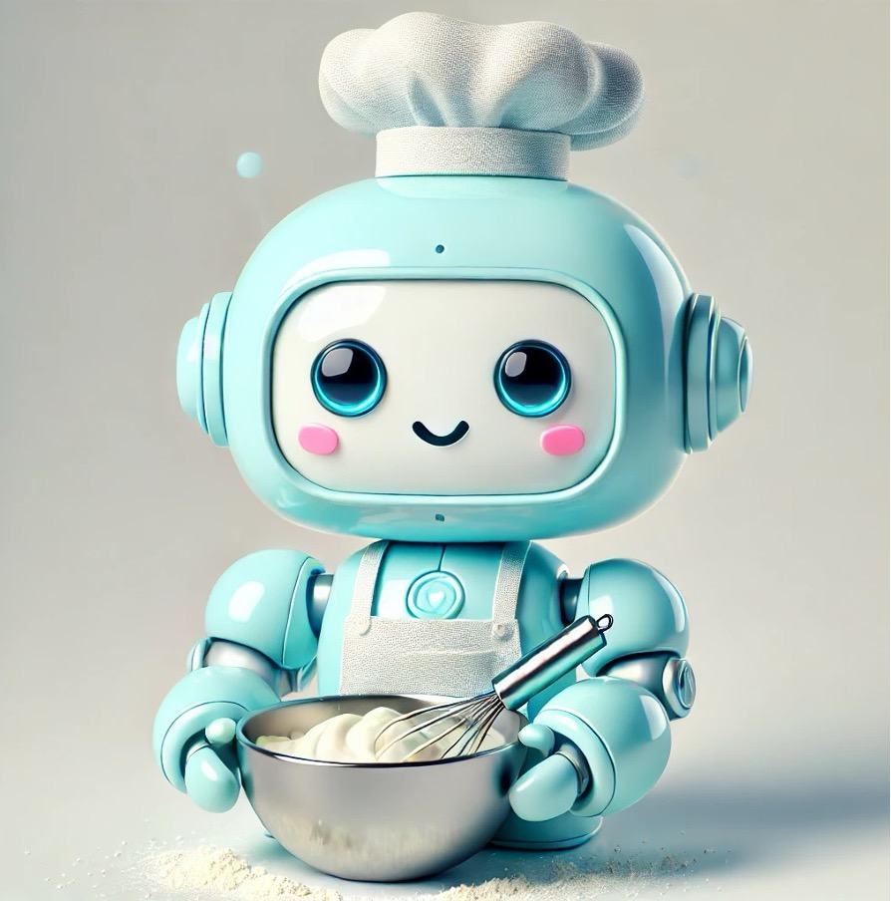
Decomposing the act of Baking cupcakes
Planning & Preparation
01
Mixing
02
Baking
03
Finishing
04

Slide 11
Cupcakes: planning & preparation
Select the recipe and flavor
Gather ingredients
Collect kitchen supplies, tools, and equipment
Preheat the oven to required temp

Slide 12
Cupcakes: Mixing
Prepare dry ingredients
Prepare wet ingredients
Combine wet and dry ingredients
Notes:
Prepare dry ingredients: Measure and combine the flour, sugar, baking powder, and salt in one bowl.
Prepare wet ingredients: In another bowl, mix the eggs, milk, and oil.
Combine wet and dry: Gradually mix the wet ingredients into the dry ingredients, following the recipe's instructions for order and speed to prevent overmixing.

Slide 13
Cupcakes: Baking
Prepare the pan
Pour the batter
Bake for required time
Check for doneness
When done remove pan from oven

Slide 14
Cupcakes: finishing
Remove cupcakes from pan
Cool the cupcakes
Decorate cupcakes

Slide 15
Let’s try it

Slide 16
Decomposition
Exercise
Objective 1: Break a complex problem into smaller, manageable parts
On your own first (5 min): list the sub-tasks needed to answer Q1 and Q2.
For each sub-task, note its input and its output.
Then ask Claude (prompt at right).
Compare the lists. What did Claude miss? What did you miss?
Share one difference with the group.
I work in a clinical lab.
I need to find out whether
turnaround time differs by
patient type, and whether we
meet a 3-hour collect-to-verify
goal. Break this problem into
smaller sub-tasks. List the
input and output of each.
Do not write code.

Slide 17
Model sub-tasks
Define question and metrics: what is TAT, goal, inclusion/exclusion
Identify and obtain data
Assess data structure and quality: missing, absurd, duplicate, quirks, overall
Clean and prepare the data: new fields, standardized, transformed
Analyze data: stat summaries, stat differ tests, comparisons, plots
  TAT: overall and by group and tests
  3-h goal compliance
Check that the results make sense
Notes:
Compare with learners' lists and Claude's list. Look for where lab knowledge adds something Claude's generic list misses: how TAT is defined, what counts as one patient, what to do with missing patient type.
This exercise is also the first step of the step-by-step recipe on the next slides: asking for a plan before any work.

Slide 18
How does this help us?
Anticipate necessary components, required expertise, data access, tools
Start to define user requirement and identify constraints and potential blockers
Helps clarify the job and makes it more manageable
Computational examples: writing code in chunks and splitting by task (reading data, graphing), distributed work of virtual machines, bioinformatic pipelines, prompt chaining

Slide 19
All at once vs step by step
All at once
One prompt, one answer
Good for: small, familiar tasks
Risk: Claude fills every gap with its own assumptions
Step by step
Plan first, then one step at a time
Good for: several steps, or data the AI has not seen
Cost: more messages
Go step by step to verify the approach and catch wrong assumptions.
This is decomposition applied to prompting. It is also called prompt chaining.
Notes:
The purpose of going step by step is to verify the approach and to identify errors in assumptions. It is not to watch the model think or to follow every line of code.
A single large prompt can work. Its weakness is that a polished final answer can hide where an error entered.
Optional spoken example: 20 incident reports and a request for recommendations. One prompt extracts, analyzes and writes in one pass. If the summary is wrong, you cannot tell whether extraction, interpretation or writing failed.

Slide 20
Better prompting: plan first, then step by step
Provide the prompt. Ask for the plan and the assumptions before it answers.
Check the output. Is the approach right? Is anything assumed that isn't true?
Correct what's wrong.
Proceed with the next step, one at a time. Check each result against what you know before proceeeding.
One sentence starts the process:
If anything essential is missing, ask me before answering.
You did step 1 in the decomposition exercise. You will use the whole process in the algorithm exercise.
Notes:
You are the check. The learner's lab knowledge is what verifies the plan and the assumptions. No one needs to read R to do this.
Example from our test runs: the same question was sent twice. Without the last sentence, Claude invented column names and a dataset and wrote code at once. With it, Claude asked about the data structure, the patient type values, the scope, what meeting the goal means, and data quality rules. Then it showed a plan and waited.
The sentence is the 'Ask first' line in the prompting framework shown later.

Slide 21
computational thinking skills
Decomposition
Abstraction
Algorithm design
Pattern recognition
Evaluation & debugging
Notes:
In addition to these skills must have right attitude and behaviors
Attitudes
Confident: believing in one's own ability to solve problems
Communicative: willing and able to communicate effectively with others.
Flexible: able to deal with change and open-ended problems
Approaches
Tinkering: experimenting and playing
Creating: designing and making
Debugging: finding and fixing errors
Persevering: keeping going
Collaborating: working together.

Slide 22
Pattern recognition
Pattern recognition
Identify recurring patterns or trends within a problem to help formulate solutions
Look for common characteristics, motifs, and trends
Use pattern to identify solution
Generalize solution across pattern in sub-tasks but also in other problems
Notes:
After decomposing problems, the problem solver will look for patterns among the parts. Recognizing patterns helps in identifying similarities or trends that can inform the solution. This is important because it can lead to solutions that solve not just one specific instance of a problem, but a whole class of problems.
Look for motifs: weekday/weekend shifts, staffing transitions, maintenance windows. Feature ideas: rolling median, IQR, 95th percentile, slope, run length. Generalize by parameterizing thresholds—e.g., different SLAs for STAT vs routine. Beware Simpson’s paradox—always stratify.

Slide 23
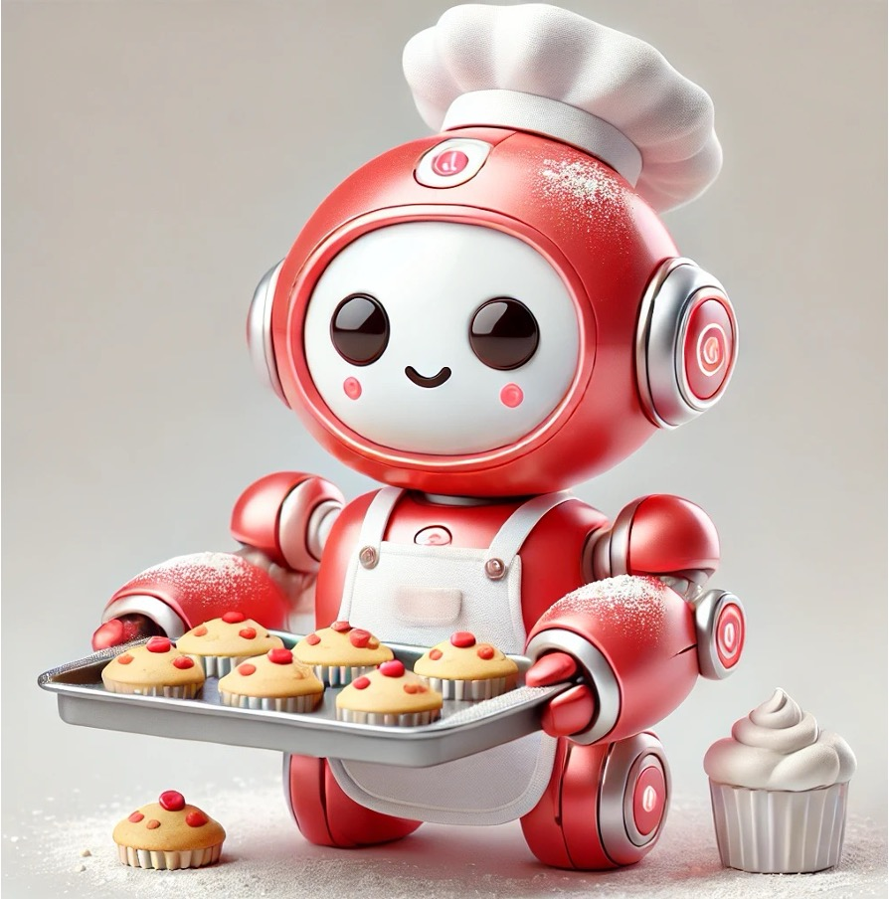
Recognizing patterns in sub-tasks
We’ll need to gather ingredients, for each ingredient this involves:
    Identifying (naming) the ingredient
    Specifying the amount needed
    Measuring the amount needed
We can then apply this method to each ingredient

Slide 24
Recognizing patterns across problems
Baking a cake vs cupcakes vs muffins
Select the recipe and flavor |  | Select and prepare the pan
Gather ingredients |  | Pour the batter
Collect kitchen supplies, tools, and equipment |  | Bake for required time
Preheat the oven to required temp |  | Check for doneness
Prepare dry ingredients |  | When done remove pan from oven
Prepare wet ingredients |  | Remove items from pan
Combine wet and dry ingredients |  | Cool items
 |  | Decorate items

Slide 25
What is a loop?
Coding process that executes a specific instruction (block of code) repeatedly until a condition is met
Common conditions describe the type of loop:
    For loop: repeat a specified number of times
    For each loop: Iterate over specified items without knowing index
    While loop: continue if a condition is true

Slide 26
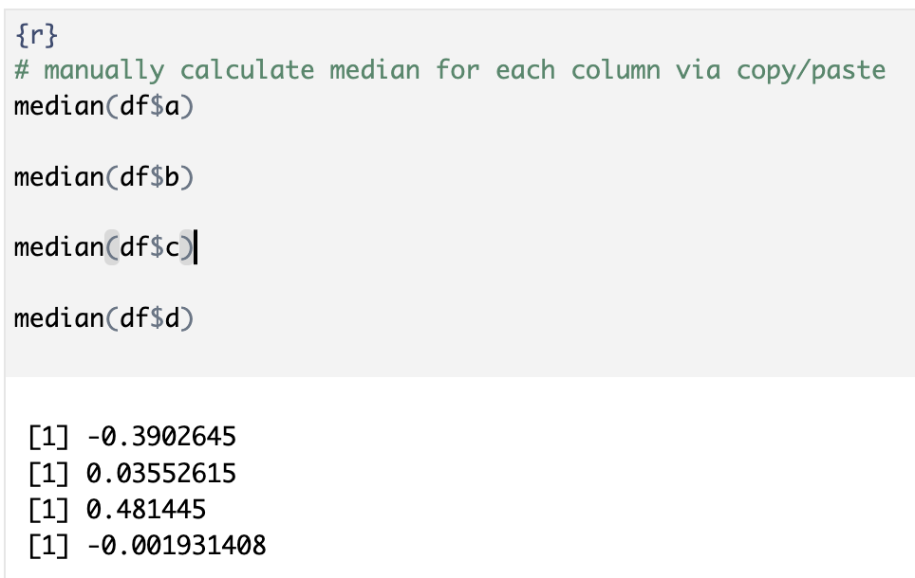
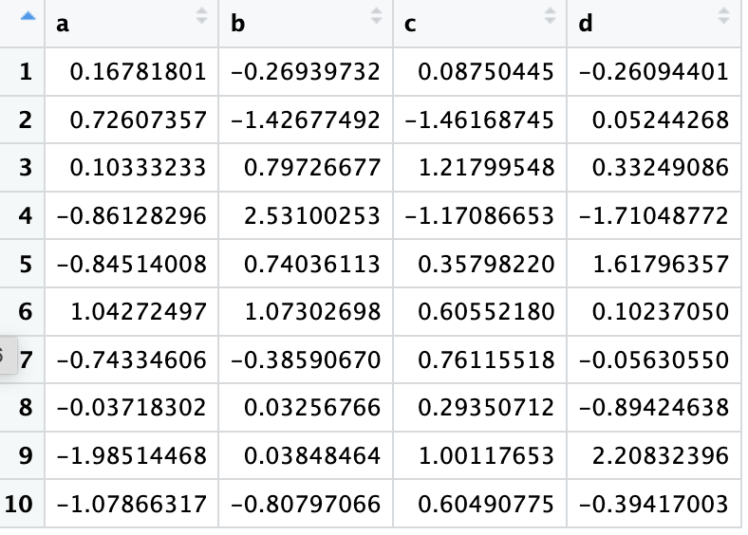
Calculate the median for each column:
Copy and paste method
Notes:
How would you do this in Excel – copy and paste formula

Slide 27
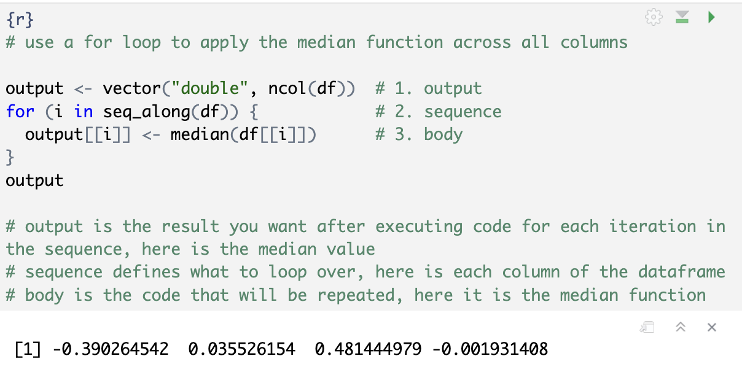
Calculate the median for each column: for loop method

Slide 28
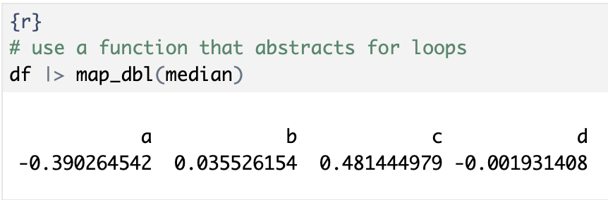
Calculate the median for each column: for loop method
Do you see this in your Claude code output?
Where would it apply in our TAT example?
Notes:
Look back at your Claude output from the first exercise in this session – do you see any ‘for loops’ or the map function being used? In our TAT example, we want to do this type of repetitive calculation but over groups vs columns of data – so by test or by patient type.

Slide 29
From loops to group_by()
Coding concepts (Objective 5): loops, grouping, summarizing
Cupcakes: sort the cupcakes onto trays by flavor. Then count and taste each tray.
R: group_by() sorts rows onto trays. summarize() does the math once per tray.
You write the step once. R repeats it for every group. No loop to write.
This is well-recognized pattern so developers coded it to be a widely used tool.
chem |>
group_by(pat_type) |>
summarize(
median_value = median(value)
)
This approach is very powerful for generating numeric summaries for subgroups
Notes:
In our TAT example, we want to do this type of repetitive calculation but over groups vs columns of data – so by test or by patient type.
For simple summaries, summarize is faster. dplyr has optimized paths for common functions like mean and sum, while map calls your R function once per element.
Map also works on things that are not data frames, such as a vector of file paths you want to read in.
If you find yourself writing a long custom function inside summarize, that is usually the signal to switch to nest and map.
Use group_by and summarize when each group reduces to a few numbers. Medians, counts, and percentiles per group fit this. The code reads as a sentence, and the output is a tidy table with one row per group.
Use map when the work per group is more than a summary number. Map applies a function to each element of a list or vector and returns whatever the function returns. That matters when the result is a model, a plot, a data frame, or a file read. Summarize expects a single value per group, so it fights you on these. The usual pattern is nest, then map inside mutate

Slide 30
Let’s try it

Slide 31
Pattern recognition
Exercise
Objective 2: Use patterns to generalize a solution
Run the starter code in Exercise 2. It works for glucose in ICU patients only. But you want this for all patient types and selected tests.
Paste the starter code into Claude. Ask it to generalize:
    A) every patient type, glucose only
    B) every test you kept, every patient type
Run each version. How many rows? Compare the medians.
Which words in the code did the generalizing?
# starter code is the pattern
chem |>
filter(test == "glucose",
pat_type == "icu") |>
summarize(
n_results = n(),
median_value = median(value))
Apply this pattern to generate the same summary for every test kept and all patient types

Slide 32
Applying a pattern to generalize
Use two filter() conditions to select single test and single patient type.
One filter() condition became one group_by(). Generalizes to every pat_type for glucose.
Drop both filter() conditions and group_by()both columns to analyze all test and pat_type combos.
chem |>
filter(test == "glucose",
pat_type == "icu") |>
summarize(
n_results = n(),
median_value =
median(value))
chem |>
filter(test == "glucose") |>
group_by(pat_type) |>
summarize(n_results = n(),
median_value =
median(value))
chem |>
group_by(test, pat_type) |>
summarize(n_results = n(),
median_value =
median(value))
n_results median_value
1 1103 92
pat_type n_results median_value
1 cancer center 1059 92
2 client 1092 92
3 icu 1103 92
4 inpatient 1067 92
5 outpatient 1072 92
6 NA 1088 92
test pat_type n_results median_value
1 creatinine cancer center 1059 0.82
2 creatinine client 1092 0.82
3 creatinine icu 1103 0.81
4 creatinine inpatient 1067 0.81
5 creatinine outpatient 1072 0.83
6 creatinine NA 1088 0.81
7 glucose cancer center 1059 92
8 glucose client 1092 92
9 glucose icu 1103 92
10 glucose inpatient 1067 92
11 glucose outpatient 1072 92
12 glucose NA 1088 92
13 potassium cancer center 1059 4.1
14 potassium client 1092 4.1
15 potassium icu 1103 4.1
16 potassium inpatient 1067 4.1
17 potassium outpatient 1072 4.1
18 potassium NA 1088 4.1

Slide 33
How does this help us?
Identifying similarities or trends can inform solution that may be generalized to solve classes of problems vs single
Addressing patterns with a shared solution ensures consistency and scalability
Improve persistence and efficiency when faced with solving new problems
Computational examples: applying loops to iterate over items, structuring prompts
Notes:
Once you design a script or dashboard element that calculates duration between two timestamps, you can apply it across all time-based KPIs.

Slide 34
computational thinking skills
Decomposition
Abstraction
Algorithm design
Pattern recognition
Evaluation & debugging

Slide 35
abstraction
Abstraction
Focus on the essential details and ignore the irrelevant information to create a generalized understanding of the problem and solution. Utilizes recognized patterns.
Identify essential information needed to solve the problem
Filter unnecessary details
Form a model that will be used to solve problem
Notes:
This involves filtering out the unnecessary details and focusing on what’s important. Abstraction is important to the computational thinking process because it allows problem solvers to disregard the irrelevant and complex details that can clutter the thought process, thus simplifying the problem-solving steps. It helps define the problem without getting sidetracked by details that do not affect the outcome.
Keep the dataset minimal but sufficient. Define entities (specimen, order, instrument-day), keys (specimen_id, instrument_id, location, day), and policies (units, time zones, missingness, handling canceled orders). Add fields only if they change decisions.
This schema is enough to compute TAT, stratify by context, and trend: specimen_id, order/collect/receive/result_time, assay_code, instrument_id, priority, patient_location, and derived tat_minutes. Extend later with batch_id or maintenance flags as needed.

Slide 36
Abstracting the science of baking
Instead of thinking about the details of the chemistry of cooking or the physics and mechanics of the oven’s operations, we follow the steps of a recipe and operate the oven’s controls

Slide 37
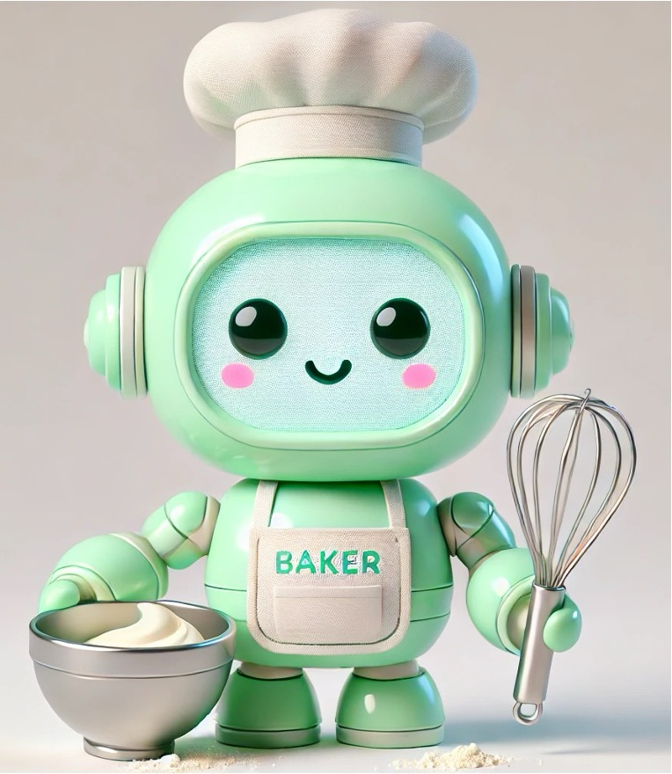
Basic recipe: a model for baking
During pattern recognition we observed what was the same vs different.
Now we’ll design a model based on those observations.
Keep fixed: the model
Gather ingredients*
Select the pan*
Set the oven temperature*
Prepare and combine
Bake for required time*
Check for doneness
Prepare for serving*
Pull out: what the user chooses
Type of baked good:
  cake, cupcake, muffin, …
Flavor
Frosting or decoration
* Worked out from the user's choices. The user doesn't decide these directly.

Slide 38

Baking as a computational model
task
inputs – chosen by user
bake <- function(item, flavor, frosted) {
ingredients <- gather_ingredients(item, flavor) # *
pan <- select_pan(item) # *
oven <- set_temp_time(item) # *
decorate <- decorate(frosted) # *
# prepare and combine
# bake
# check for doneness
# finish and serve
}
bake("cupcake", "chocolate", TRUE)
bake("cupcake", "vanilla", FALSE) # same item, different choices
bake("muffin", "blueberry", FALSE)
the steps

Slide 39
What is a function?
Computational method for performing a specified task you will use repeatedly
Takes inputs (arguments) and generates outputs
May be custom or pre-built within a tool
Ensures consistency and efficiency
Packaged into packages (R) or libraries (python) in coding languages
Excel formulas: manually enter or use existing (e.g., AVERAGE() )
R functions: create your own or use from packages (e.g., group_by() and summarize(), ggplot())

Slide 40
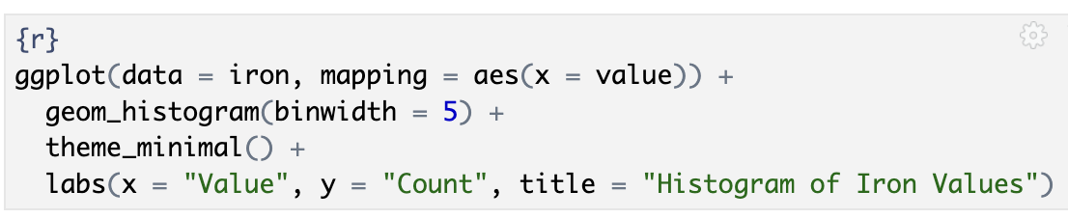
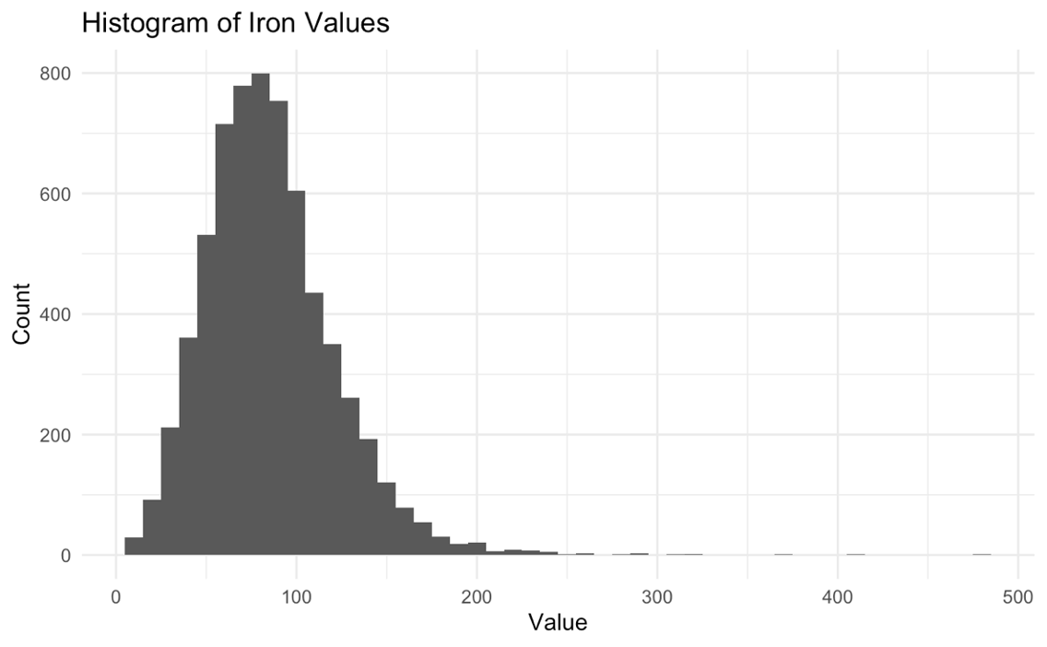
Ggplot R function creates a new graph object
function inputs (aka arguments) – chosen by user
function name
the steps or components
Plot style
Theme or axes formats
function output

Slide 41
Let’s try it

Slide 42
Abstraction
Exercise
Objective 3: Create a simplified model
Claude prompt template:
Think. Run the two code blocks in Exercise 3. Find the two things that differ in the code blocks. Those are what the user chooses.
Prompt. Fill in the two blanks in the template at right: creatinine (the test) and 1.2 (the cutoff). Send it to Claude in a new chat.
Check. Run Claude's code. For ICU patients, the percent of creatinine results above 1.2 should be 7.4%. Then fill in the template for glucose above 125, send it in the same chat, and run that code. ICU should be 9.1%, the same as the glucose block in your workbook.
Write R code that reports the
percent of ______ results
above ______, by patient type.
My data frame is called chem.
Columns: test (text),
value (number), pat_type (text).
Use dplyr.
Notes:
The two differences are the test name and the cutoff. Circling them is pattern recognition. Deciding they are what the user chooses, and turning them into blanks, is abstraction.
The template is a model of the request: fixed text plus two blanks. The last lines are a three-column description of the data. Learners describe the data. They do not upload it.
Cutoffs are for illustration. They are not clinical decision limits.

Slide 43
Abstraction: what you should see
# creatinine above 1.2
pat_type n_results pct_above
1 cancer center 1059 8.2
2 client 1092 6.8
3 icu 1103 7.4
4 inpatient 1067 9.1
5 outpatient 1072 7.6
6 NA 1088 9.4
Your template has fixed text and two blanks. It is a function written in English.
The blanks are the arguments: test and cutoff.
A new question costs two words, not a new prompt.
Previously we recognized a pattern and used an existing function, now we’ve identified the model and used a pattern to write our own function.
# Demo: the same template as an R function
pct_above("creatinine", 1.2)

Slide 44
How does this help us?
Simplifies the situation to help focus on most important aspects, highlights similarities, and makes actions efficient and easier to perform
Already seen examples of how this can make decision making easier in data visualization context and generating simple statistical summaries of large data sets
Computational examples: APIs, programming functions, LLM prompting, business intelligence tools

Slide 45
LLM prompting framework
Component | What the user supplies | Plain version
Task | The job, in one sentence | Review this proposal from four perspectives: lab director, bench technologist, finance, and clinician [specify].
Context | The decision, deadline, key facts, and audience. Specifying role may be useful. | We are deciding whether to bring [test] in-house by [date]. Current send-out volume is [N] per year at $[X]. The audience is the department leadership team.
Material | The documents or data to work from | Here is the proposal: [paste proposal]
Constraints | Limits, allowed sources, and what to flag | Use only the proposal above. Mark any point based on your own assumptions. Capital budget is capped at $[Y].
Output | Format, length, and what a good answer contains | For each perspective, give the top concern in 2 sentences and one question they would ask. Then list where the perspectives conflict and what data would resolve each conflict.
Ask first | Nothing; it is a fixed line | If anything essential is missing, ask me before answering.

Slide 46
Templates, projects and saved instructions
 | Written once | Supplied each time
Our prompt template | The wording and the data description | The test and the cutoff
The prompting framework | Six components: Task, Context, Material, Constraints, Output, Ask first | What goes under each
Projects and saved instructions | What rarely changes: often Context, Constraints, Output and Ask first | Today's Task and Material
Same move each time: decide what stays fixed and what changes.

Slide 47
computational thinking skills
Decomposition
Abstraction
Algorithm design
Pattern recognition
Evaluation & debugging

Slide 48
Algorithm Design
Algorithm design
Develop clear, step-by-step instructions or plans for how to solve a problem, which can then be executed by a human or computer.
Define starting point (input) and ending point (output) with sequential steps in between
Represent with words/pseudocode/code or flow diagram
Notes:
The final component of computational thinking is about creating a clear, ordered series of instructions to solve a problem. This is important because having a well-defined set of steps ensures that the problem can be solved systematically and that the solution is repeatable. It also allows for the solution to be communicated to others easily—or even be automated.

Slide 49
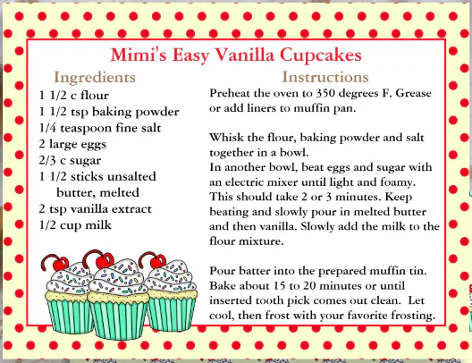
Detailed recipe: algorithm for baking
The model says what goes in. The algorithm says what happens, in what order.
Abstraction provided a basic model
bake <- function(item, flavor, frosted) {
ingredients <- gather_ingredients(item, flavor)
pan <- select_pan(item)
oven <- set_temp_time(item)
decorate <- decorate(frosted)
# prepare and combine
# bake
# check for doneness
# finish and serve
}
Notes:
"Abstraction gave us the model: what the user chooses and what stays fixed. But remember what we saw inside bake(). The steps were just a list of comments. Nothing says exactly what to do, in what order, or what to do when something varies. That's algorithm design: turning the model into instructions precise enough for someone else, or something else, to carry out."

Slide 50
What is a condition?
Algorithms frequently include decision points with different actions taken based on decision result
Use conditionals to apply functions appropriately given situation, whether statements are true or false
If, else if, and else are very commonly used examples
When selecting a pan:
If baking cupcakes, use cupcake tin
    If not cupcakes, but is (else if) a cake, use round cake pan,
        Otherwise (else), use square pan

Slide 51
Combining functions with conditionals
Functions can provide different outputs based on inputs and conditions
Write the function to reflect the conditions
Use the function: provide input and get output
input
{r}
select_pan <- function(item) {
if(item == "cupcake" | item == "muffin"){
pan <- "cupcake tin"
} else if (item == "cake") {
pan <- "round cake pan"
} else {
pan <- "square cake pan"
}
return(pan)
}
{r}
select_pan(item = "cake")
[1] "round cake pan"
{r}
select_pan(item = "brownie")
[1] "square cake pan"
output
conditions

Slide 52
Let’s try it

Slide 53
Algorithm design Part 1
Exercise
Objective 4: Design step-by-step instructions
Think. Put your Exercise 1 sub-tasks in order as numbered steps.
Prompt. In a new chat, send your cold prompt again with one line added (at right).
Answer Claude's questions. Use your own work and the facts page on the handout.
Check the plan against your steps. Correct it or approve it. Then ask for the code.
Run the code. Check: the table totals 6,481 patients, and patients with no patient type are still there.
Add this line to your cold prompt:
If anything essential is missing, ask me before answering.
No cold prompt worth reusing? A standard one is on the handout.

Slide 54
Algorithm design part 2
Compare the output if you create a prompt that follows the provided framework:
Task: Write R code to answer two questions. Q1. Does turnaround time differ by patient type? Q2. Are we meeting a 3-hour collect-to-verify goal?
Context: I am a core lab director answering a concern from an ICU physician, who says ICU chemistry results come back slower than results for other units. Our target is ____% of patients within 3 hours. I am new to R.
Material: My data is in a file called chem_subset.csv. I can't upload it. The columns are: [paste the column names]. One row is ___. Each patient has ____ rows. The columns col_rec_tat and rec_ver_tat are turnaround times in ___.
Constraints: Use dplyr. Count patients, not rows. For patients with no patient type, ___. Tell me anything you assume.
Output: First give me your plan as numbered steps. Do not write code until I approve the plan. Then give me one table by patient type with the number of patients, the median total turnaround time and the percent within 3 hours, plus one sentence answering each question. Keep the code short, with a comment on each step.
If anything essential is missing, ask me before answering.

Slide 55
Algorithm: what you should see
pat_type n_patients median_total_hrs p90_total_hrs pct_within_3h
1 inpatient 1067 2.55 3.39 73.4
2 missing 1088 2.55 3.38 73.1
3 outpatient 1072 2.55 3.36 75.2
4 client 1092 2.53 3.37 74.5
5 icu 1103 2.53 3.38 74.1
6 cancer center 1059 2.51 3.37 73.9
Q1: Turnaround time does not differ by patient type. The ICU is not slower.
Q2: 74% of patients are within 3 hours. Our target is 90%, so we are not meeting the goal.
Claude may report minutes: 2.53 hours is 152 minutes. Judge the code by its output.
Now you have an algorithm or code base to perform the same analysis tomorrow or for a different patient area if needed. It is transparent and reproducible. All decisions were built into the code.
Notes:
These numbers do not depend on which tests are in the subset.
Check the total first. 6,481 is right. 5,393 means patients with no patient type were dropped. An ICU count of 3,309 means rows were counted as patients.
The director's question never said what share of results must meet the 3-hour goal. Our lab's target is 90%. Learners supply it when Claude asks what meeting the goal means.
Claude's code will differ between learners. Judge it by its output.

Slide 56
How does this help us?
Designing an algorithm helps understand the problem and often means the solution is generalizable
Strengthens critical thinking and problem-solving skills
Process and decisions become transparent
Makes output predictable and reliable
Computational examples: computer code, machine learning, autoverification rules

Slide 57
computational thinking skills
Decomposition
Abstraction
Algorithm design
Pattern recognition
Evaluation & debugging

Slide 58
Evaluation & debugging
Assess whether solution does the job it has been designed to do, fix errors, and consider improvements
Evaluate the solution, check correctness + usefulness
Debug it, find and fix errors with test cases
Expect iteration to refine correctness and efficiency
Notes:
is easily understood – is it fully decomposed?
is complete – does it solve every aspect of the problem?
is efficient – does it solve the problem, making best use of the available resources (eg as quickly as possible/using least space)?
meets any design criteria we have been given

Slide 59
Does this make sense?
Exercise
Objective 5: Apply coding concepts to check a solution
Add up the patient counts in your table. Do they total 6,481?
Do the results support the ICU complaint? If not, what would you check next?
Compare your cold prompt with your final one. What did Claude fill in the first time that you supplied the second time?
Look at your confidence rating from the cold prompt. Was it justified?

Slide 60
Whatever you leave out, Claude fills in
What we gave Claude | What Claude may have filled in itself (various tests)
The question only | Column names and a made-up dataset
The question and the column names | A 90% target, which patients to drop, what counts as one specimen
The question and "ask me first" | Nothing. It asked five questions and showed a plan
Without that line, Claude asked no questions in our tests. It assumed, said so, and kept going.
One default dropped every patient with no patient type: 1,088 people, 17% of the data.
Claude can list the decisions. Making them is your job.

Slide 61
How does this help us?
Builds confidence in results
Ensures solution is useful and will be effective
Develops problem-solving skills through systematic analysis
Increases adaptability as more comfortable experimenting, testing, and iterating
Doing it along the way prevents rework or failed output

Slide 62
Building a foundation for ds101
The computational thinking skills we’ve learned so far relate directly to basic programming concepts
Computational thinking skill | Programming concept
Abstraction steps identify essential elements that are re-used | Function
Abstraction and algorithm design identify rules or decisions that guide actions | Conditional
Pattern recognition and algorithm design identify repeated steps | Loop

Slide 63
GenAI habits to keep
Think first. Write your own answer before you ask.
Tell it to ask first. "If anything essential is missing, ask me before answering."
Describe your data. Say what one row is and key structures. Don't upload patient data.
Read the assumptions before the code. Decide each one yourself.
Check the result against what you know.
Save prompts that work as templates with blanks or within customization features.

Slide 64
Lesson Goals
Develop computational thinking skills to more effectively utilize emerging digital technologies
Lesson Objectives
Identify the key components of a complex problem and break it down into smaller, more manageable parts.
Use patterns to predict future outcomes or generalize solutions.
Create simplified models to represent complex systems.
Design step-by-step instructions or algorithms to solve a problem.
Describe basic coding concepts to better apply computational solutions.
Notes:
.

