Slide 1
A. Discounted total costs
B. Reliability
C. Investment costs
D. Discounted damages
Sensitivities
First-Order
Total-Order
Second-Order
1%
99%
5%
37%
2%
24%

Slide 2
A. Discounted total costs
B. Flood probability
C. Investment costs
D. Discounted damages
Sensitivities
First-Order
Total-Order
Second-Order
1%
99%
29%
95%
2%
24%

Slide 3
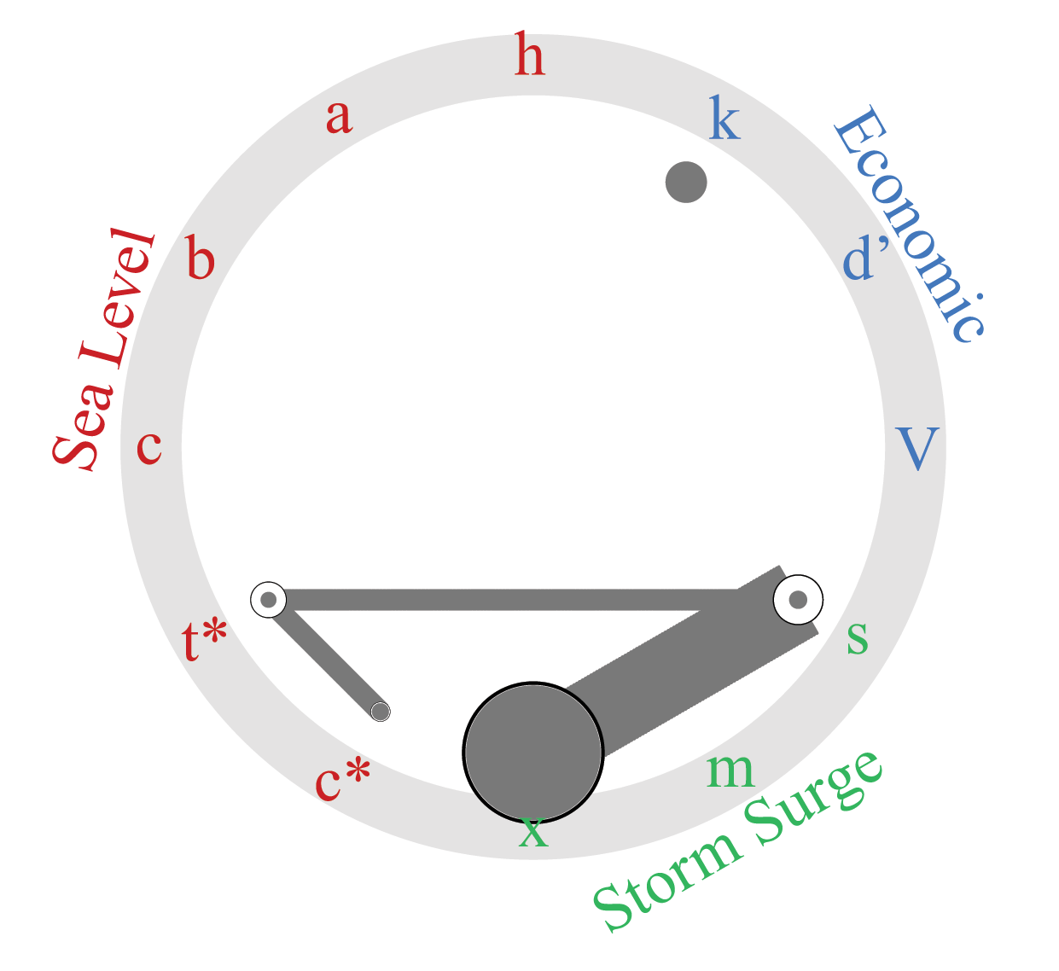
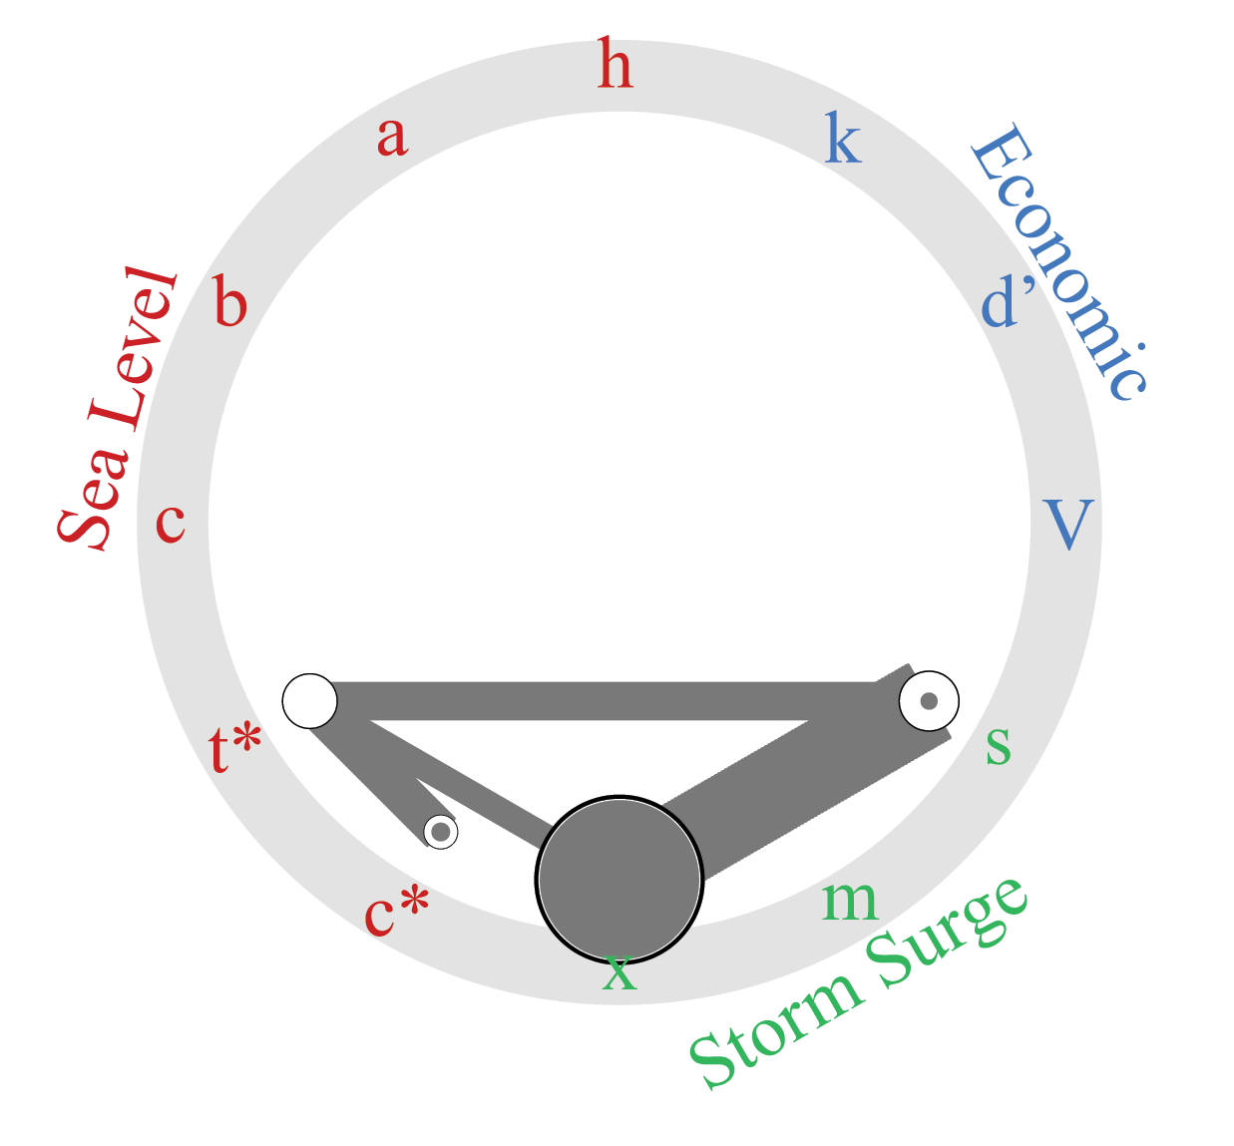
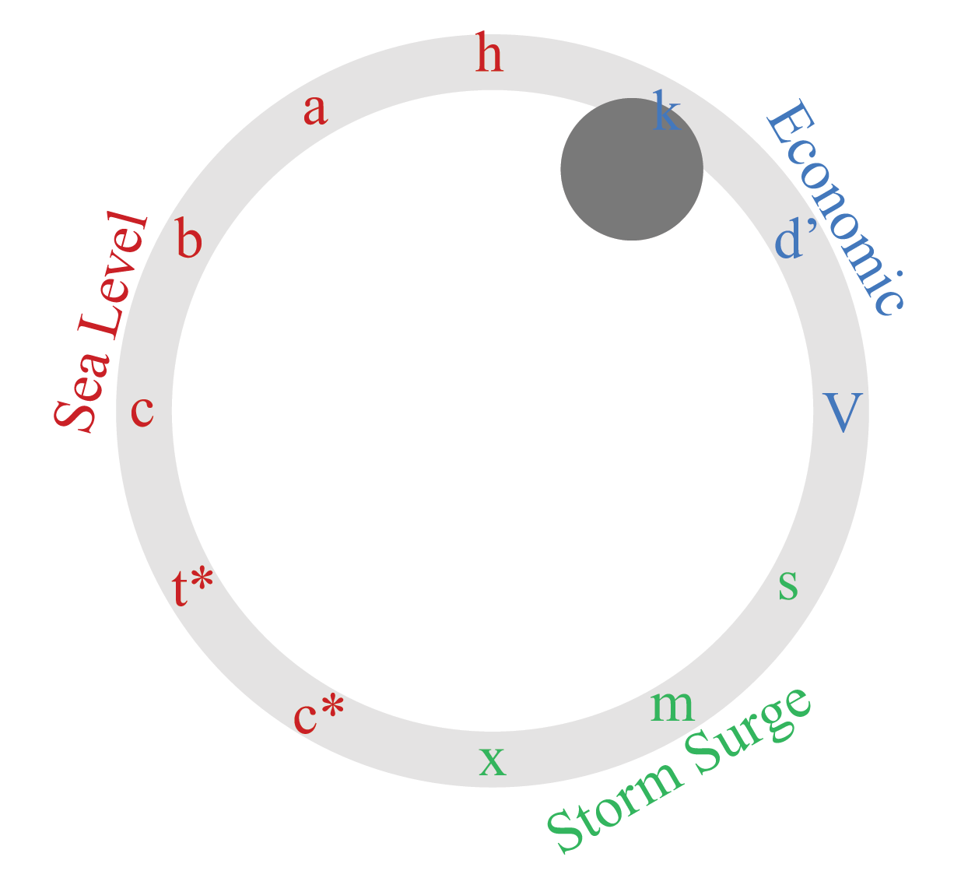

A. Discounted total costs
B. Flood probability
C. Investment costs
D. Discounted damages
Sensitivities
First-Order
Total-Order
Second-Order
1%
99%
29%
95%
2%
24%

