Slide 1
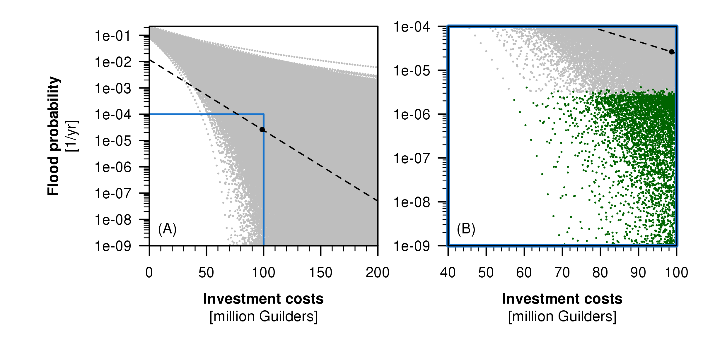
Succeeds
Fails

