Slide 1

Chapter4 Logs not just for camp fires
By: Brett Hoff

Slide 2
Overview
Chapter 4 of 8
chapter 1 Firewalls introduction.
chapter 2 Effective Network Security
chapter 3 Wireless how safe it is NOT!
chapter 4 Logs not just for camp fires
chapter 5 Tracing down your problem
chapter 6 Tracing down your problem II
chapter 7 How/who/when/why
chapter 8 Overview

Slide 3
My Disclaimer
  Some of the things discussed in this Presentation fall out of the normal methods. These ideas presented herein are set as a guide and by no means the end all of security....
  The suggestions in this presentation will not keep you 100% safe secure! The old saying is
  Locks are to keep honest people honest.

Slide 4
Overview!
We are going to talk a little tonight about the Log files. Talking about what kind of data can be gleaned from them. And also how to make them more secure.

Slide 5
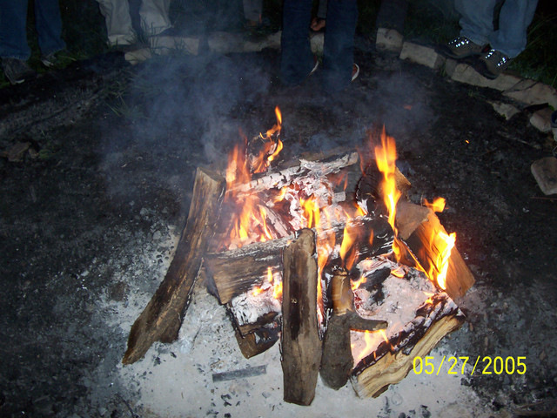
What they are not for!

Slide 6
Where are they hiding?
On most standard install the log files can be found at /var/log/

Slide 7
Log files
The log files we are going to go over tonight are.
debug, dmesg, messages, lastlog, faillog, secure, syslog.

Slide 8
lastlog
lastlog -u user name
lastlog -tn where n is days
This log will tell you the exact last time a user or service logged in and what port they logged in from.

Slide 9
lastlog example
# lastlog
bin **Never logged in**
daemon **Never logged in**
adm **Never logged in**
lp **Never logged in**

Slide 10
debug
The debug log file is used for debugging.
If you take a look at this you can see your general debug messages. It can also give you debugging info like which irq is assigned to what and what drivers your hardware is using.

Slide 11
debug example
# head /var/log/debug
Feb 5 18:28:59 laptop kernel: PCI: setting IRQ 10 as level-triggered
Feb 5 18:28:59 laptop kernel: PCI: setting IRQ 5 as level-triggered
Feb 5 18:28:59 laptop kernel: Probing IDE interface ide0...
Feb 5 18:28:59 laptop kernel: Probing IDE interface ide1...

Slide 12
dmesg
dmesg is used to examine or control the kernel ring buffer. The program helps users to print out their bootup messages. Instead of copying the messages by hand, the user need only:
#dmesg > boot.messages
and mail the boot.messages file to whoever can debug their problem

Slide 13
dmesg example
# dmesg | head
arting at 40000000 (gap: 30000000:cec10000)
Built 1 zonelists
Kernel command line: auto BOOT_IMAGE=Linux-2.6.16.17 ro root=304
Found and enabled local APIC!
mapped APIC to ffffd000 (fee00000)
Enabling fast FPU save and restore... done.
Enabling unmasked SIMD FPU exception support... done.
Initializing CPU#0
PID hash table entries: 4096 (order: 12, 65536 bytes)
Detected 1499.340 MHz processor.

Slide 14
messages
Messages contains a lot of information from various different parts to see exactly what is sent to /var/log/messages simply
# vi /etc/syslog.conf

Slide 15
/etc/syslog.conf
authpriv.none;cron.none;mail.none;news.none -/var/log/messages

Slide 16
Messages example
# head messages.1
Feb 3 04:40:02 laptop syslogd 1.4.1: restart.
Feb 3 04:50:44 laptop -- MARK --
Feb 3 05:10:44 laptop -- MARK --
Feb 3 05:30:44 laptop -- MARK --
Feb 3 05:50:44 laptop -- MARK --

Slide 17
faillog
formats the contents of the failure log from /var/log/faillog database. It also can be used for maintains failure counters and limits. Run faillog without arguments display only list of user faillog records who have ever had a login failure.

Slide 18
faillog options
-a
-h
-l Lock account to SEC seconds after failed login.
-m Set maximum number of login failures after the account is disabled to MAX.
-r Reset the counters of login failures
-t Display faillog records more recent than DAYS.
-u LOGIN

Slide 19
faillog example
# faillog
Username Failures Maximum Latest
root 0 0 Fri Mar 16 12:10:42 -0600 2007 on tty1
gdm 1 0 Fri Mar 16 12:10:35 -0600 2007 on tty1

Slide 20
secure
This log shows all secure logins for your system from users and services.

Slide 21
secure example
# head secure
Feb 10 10:48:33 laptop login[4760]: ROOT LOGIN on `tty1'
Feb 17 17:13:06 laptop login[4749]: ROOT LOGIN on `tty1'
Feb 21 16:47:02 laptop login[4749]: ROOT LOGIN on `tty1'
Feb 28 18:36:11 laptop login[4781]: ROOT LOGIN on `tty1'

Slide 22
syslog
This file is used for all mission sensitive logs and also the number one place for you to configure logs to be sent to.
Taking one look at /etc/syslog.conf can show you exactly what is being sent here.

Slide 23
syslog example
# grep 18:28:59 syslog | grep hd
Feb 5 18:28:59 laptop kernel: hda: TOSHIBA MK6025GAS, ATA DISK drive
Feb 5 18:28:59 laptop kernel: hdc: TOSHIBA DVD-ROM SD-R2512, ATAPI CD/DVD-ROM drive

Slide 24
pf.log
pf.log's are the logs created when using BSD packet filtering known as PF. It creates a binary file that makes no sense with a text editor.
So your choices are to use Tcpdump or Wireshark. There is third party tools that I use
like pf2x found at
http://craz1.homelinux.com/

Slide 25
Using logs
Logs are a very useful thing they can be of immense help in troubleshooting a bad component or letting you know when you are coming upon a problem. For security they can tell you the persons that have accessed your machine and when, Also what services have started up maybe without your knowledge.

Slide 26
Be careful!
Due to the nature of logs and the information they provide once your machine is compromised these are the first things the bad guys go for.
You have a couple options
1. remove your logs from your key machine to a more secure environment
2. make you log files append only.

Slide 27
Append only
To set the append only flag under Linux
#chattr +a filename
Under BSD you use.
#chflags sappnd filename
Now you have to remove the ability to undo your handiwork. Download and install this app.
http://packetstormsecurity.org/linux/admin/lcap-0.0.3.tar.bz2
#./llllpcap CAP_LINUX_IMMUTABLE
#./lpcap CAP_SYS_RAWIO

Slide 28
Useful commands
You will notice several times I used these commands to pull information out of my log files vs. using a editor like vi.
Learn these basic commands they are a wonderful time saver!
head
tail
grep
pipe command |

Slide 29
Files of interest
Some files we have used in here.
/var/log/
/etc/syslog.conf

