Slide 1
Webpack
Module Bundler

Slide 2
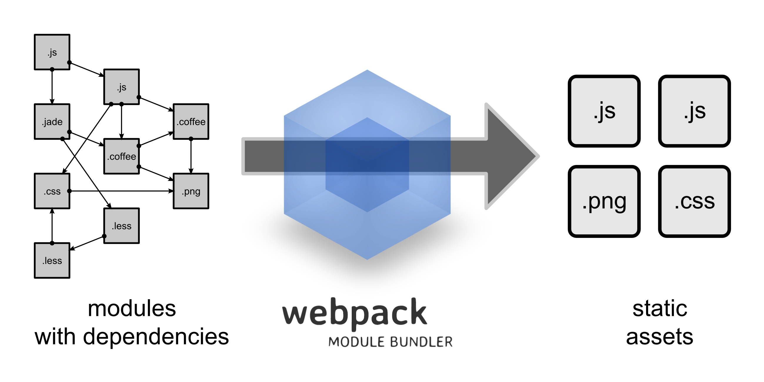
What is Webpack?

Slide 3
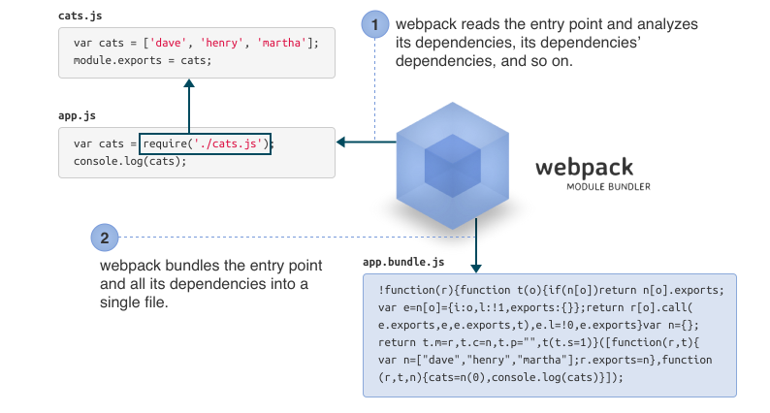
What is Webpack? Cont’d.

Slide 4
How is Webpack Different
Loaders
Clever parsing
Plugin System
Code splitting (http://webpack.github.io/docs/code-splitting.html)

Slide 5
Loaders
Loaders allow you to preprocess files as you require() or “load” them. Loaders are kind of like “tasks” are in other build tools, and provide a powerful way to handle frontend build steps. Loaders can transform files from a different language like, CoffeeScript to JavaScript, JSX to javascript, or inline images as data URLs. Loaders even allow you to do things like require() css/less/sass files right in your JavaScript.

Slide 6
Plugin System
Webpack features a rich plugin system. Most internal features are based on this plugin system. This allows you to customize webpack for your needs and distribute common plugins.
Plugins can be used inject custom build steps:

Slide 7
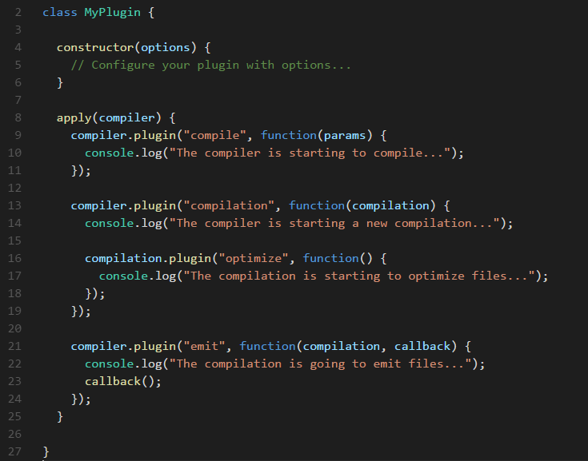
Plugin System Cont’d.
Example:

Slide 8
Clever Parsing
Webpack has a clever parser that can process nearly every 3rd party library. It even allows expressions in dependencies like so `require("./templates/" + name + ".jade")`.
It handles the most common module styles: CommonJs and AMD.
ES6 Modules (import/export) are not yet supported out of box but can be used with the babel loader (which you probably were going to use anyways). This works because babel loader will transpile ES6 modules to CommonJS.

Slide 9
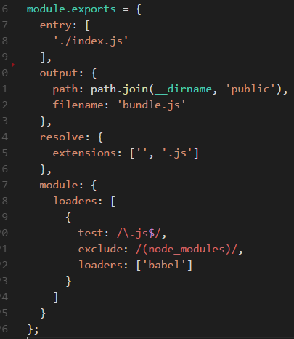
Basic Build Configuration
Simple config with babel loader:

Slide 10
Development vs Production
Configure webpack-dev-server for development
Separate configuration files for production and development

Slide 11
Loaders
Less Loader
JSON Loader
ESLint Loader
File Loader
URL Loader

Slide 12
Directory Structure
Configure file and url loaders
Relative paths for less/css resources
Clean up source and output directory structures

Slide 13
Plugins
Configure Uglify JS plugin for production builds
Define Plugin
Provide Plugin

Slide 14
Caching
To effectively cache your files, they should have a hash or version in their URL.
Webpack provides an easy way to do this with hashes.
We will configure our production builds to add a computed hash to the output file names.
I.e. `bundle.js` will become `bundle.<computed_hash>.js`
We will use the HtmlWebpackPlugin to automatically generate an index.html page that points to the built files. This way we do not need to update the name each time the hash changes.

Slide 15
Reference List
http://webpack.github.io/docs/what-is-webpack.html
http://webpack.github.io/docs/plugins.html
http://webpack.github.io/docs/loaders.html
http://webpack.github.io/docs/

