Slide 1
CIS 276: Introduction to Enterprise Web Development
ex1: tennis folder

Slide 2
Learning Outcomes
This presentation will . . .
Describe the evolution of style sheets from print media to the Web
List advantages of using Cascading Style Sheets
Discuss color codes and coding systems
Create embedded and external style sheets
Introduce linked CSS file
Use CSS to configure common color and text properties

Slide 3
Cascading Style Sheets (CSS)
Embedded Styles (NOT the best option!)
head section
HTML style element
apply to the entire web page document
<style> …. </style>
External Styles
Separate text file with .css file extension
Associate with a HTML link element in the head section of a web page

Slide 4
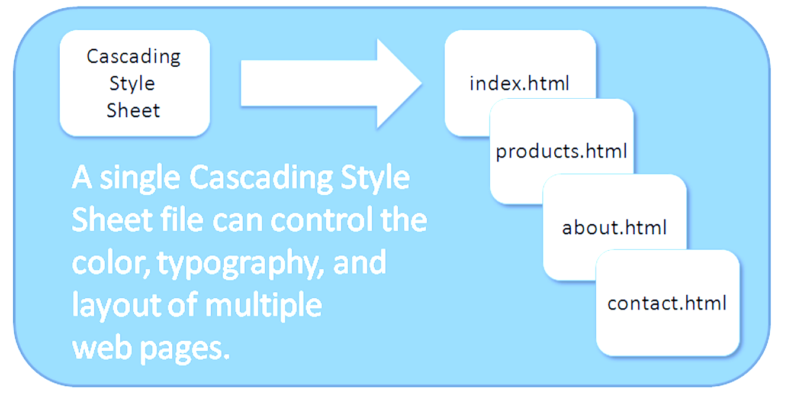
CSS Advantages
Greater typography and page layout control
Style is separate from structure
Styles can be stored in a separate document and associated with the web page
Potentially smaller documents/projects
Easier site maintenance

Slide 5

CSS Syntax
Style sheets are composed of "Rules" that describe the styling to be applied.
Each Rule contains a Selector and a Declaration

Slide 6

CSS Syntax Sample
Configure the body of site web pages to display blue text and yellow background:
body { color: blue;
background-color: yellow; }
This could also be written using hexadecimal color values (preferable):
body { color: #0000ff;
background-color: #ffff00; }
Notes:
W3Schools color picker is a good way to find hex color codes.

Slide 7
Sample Formatting: CSS Properties
background-color
border
color
border-bottom-color
cursor
font-family
font-kerning
font-size
font-style
font-weight
letter-spacing
line-height
margin
tab-size
text-align
text-decoration
white-space
word-spacing
word-wrap
width

Slide 8
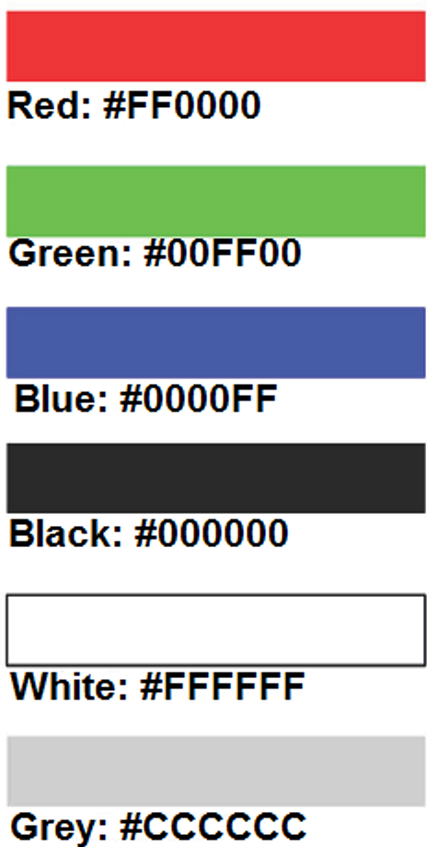
Using Color on Web Pages
Computer monitors display color as intensities of red, green, and blue light
RGB Color
The values of red, green, and blue vary from 0 to 255.
Hexadecimal numbers (base 16) represent these color values.

Slide 9
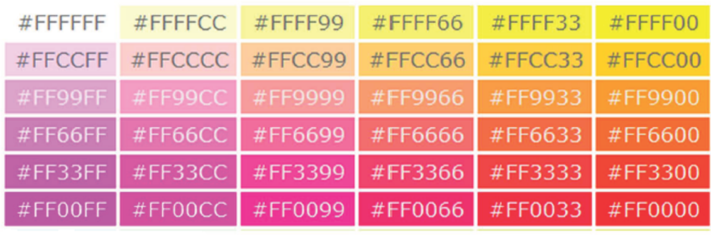
Hexadecimal Color Values
# indicates a hexadecimal value
Hex value pairs range from 00 to ff
Three hex value pairs describe an RGB color
#000000 black #ffffff white
#ff0000 red #00ff00 green
#0000ff blue #cccccc grey

Slide 10
Hexadecimal Color Values
Shortcut: When all three are doubles, only 1 entry for each is required
Hex Digits
Red
Green
Blue
0
..
..
9
a
b
c
d
e
f
0 0
.. .. .. ..
9 9
aa
bb
cc
dd
ee
ff
0 0
.. .. .. ..
9 9
aa
bb
cc
dd
ee
ff
0 0
.. .. .. ..
9 9
aa
bb
cc
dd
ee
ff
#000
#af0
#fff
#ccc
#333

Slide 11
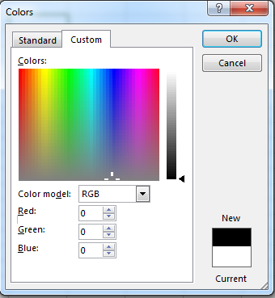
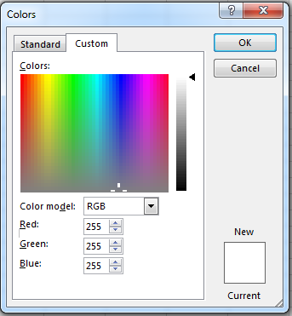
Hex Color Values
So how do the hex color values equate to the 0-255 RGB display in most color-pickers?
99
9* 1= 9
9 *10= 90
+
99
Let's use the ff value of one of the RGB's.
ff has the same position values in hex as 99 does in a base 10 system.
ff
f* 1= 15
f *16= 240
+
255

Slide 12
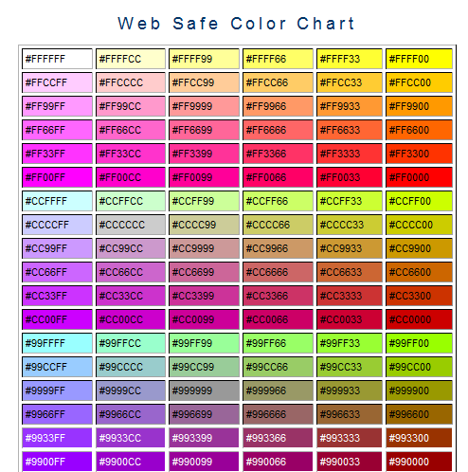
Web Safe Color Palette
A collection of 216 colors
Display the most similar on the Mac and PCplatforms
Hex values: 00, 33, 66, 99, cc, ff
Color Chart http://webdevfoundations.net/color
http://www.w3schools.com/colors/colors_picker.asp

Slide 13
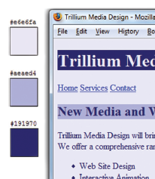
Making Color Choices
How to choose a color scheme
Monochromatic (having one color; of, relating to, or having tones of one color in addition to the ground hue)
http://meyerweb.com/eric/tools/color-blend
Choose from a photograph or other image
http://www.colr.org
Begin with a favorite color
Use one of the sites below to choose other colors
http://colorsontheweb.com/colorwizard.asp
https://color.adobe.com/create/color-wheel
http://paletton.com

Slide 14
Support Web Accessibility Verify Sufficient Contrast
When you choose colors for text and background, sufficient contrast is needed so that the text is easy to read.
Use one of the following online tools to verify contrast:
http://webaim.org/resources/contrastchecker
http://snook.ca/technical/colour_contrast/colour.html
http://juicystudio.com/services/luminositycontrastratio.php

Slide 15
CSS Styles
After this slide deck, you will use external .css files to apply styles. However, for sake of simplicity, without having to flip back and forth between files, I will sometimes use embedded styles in illustrations. The code from the embedded style can be cut/pasted into an external file.

Slide 16
CSS Embedded (Internal) Styles
Configured in the head section of a web page. (Not Recommended)
Uses the HTML <style> element
Prior to HTML5, a type attribute was also required:
<style type="text/css">
Applies to the web page (one page) document
Style declarations are contained between the opening and closing <style> tags
<head>
<style>
body { background-color: #000000;
color: #ffffff;
}
</style>
</head>
Example: Configure a web page with white text on a black background

Slide 17
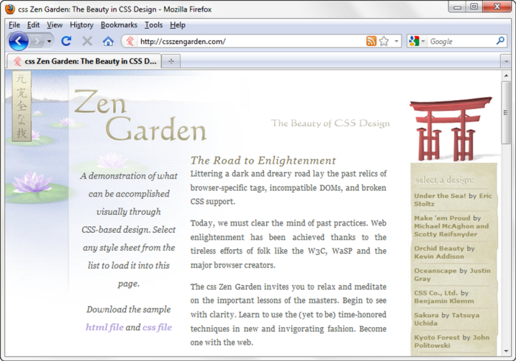
Overview of Cascading Style Sheets (CSS)
See what is possible with CSS:
Visit http://www.csszengarden.com
Style Sheets
used for years in Desktop Publishing
apply typographical styles and spacing to printed media
CSS
provides the functionality of style sheets (and much more) for web developers
a flexible, cross-platform, standards-based language developed by the W3C.

Slide 18
External Style Sheets
CSS style rules are contained in a text file separate from the HTML documents.
The External Style Sheet text file …
extension is ".css"
contains only style rules
does not contain any HTML tags

Slide 19
External Style Sheets
Multiple web pages can associate with the same external style sheet file.
project.css
index.html
body {background-color:#e6e6fa;
color:#000000;
font-family: Arial, sans-serif;
font-size:90%; }
h2 { color: #003366; }
nav { font-size: 16px;
font-weight: bold; }
clients.html
about.html
Etc…

Slide 20
link Element
*A self-contained tag
*Placed in the head section of HTML file
*Purpose: associates the external style sheet
file with the web page. (Each page must
contain a link element with appropriate path
and file name.)
*Example:
Some browsers also require type="text/css"
<link rel="stylesheet" href="styles/project.css">

Slide 21
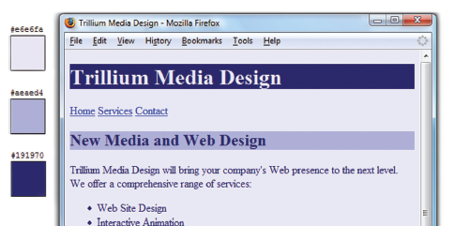
CSS Styles -- Color Coordination
Can you convert the body background color to RGB?
The body selector sets the global style rules for the entire page.
The global rules are overridden for <h1> and <h2> elements
body { background-color: #e6e6fa;
color: #191970;}
h1 { background-color: #191970;
color: #e6e6fa;}
h2 { background-color: #aeaed4;
color: #191970;}

Slide 22
CSS Styles, cont.
When the same style is to be applied to multiple tags, the tags can be combined:
body { background-color: #e6e6fa; color: #191970;}
h1 { background-color: #191970; color: # e6e6fa;}
h2 { background-color: #aeaed4; color: #191970;}
h1, h2 { font-style: italic; font-family: arial; color: #000000;}
p, blockquote {color: #ffffff; background-color: #ffcc00;}
Recall that if a legacy in-line style attribute has been used in one of these HTML elements, it will override this global style.

Slide 23
Comments in CSS
If you wish to include a comment in your CSS code, incase the comment between /* */ marks:
/* Your comments here */
The browser will ignore everything between those characters.

Slide 24
Configuring Text with CSS
CSS properties for configuring text:
font-weight
Configures the boldness of text
font-style
Configures text to an italic style
font-size
Configures the size of the text
font-family
Configures the font typeface of the text

Slide 25
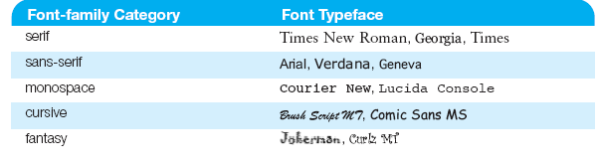
The font-family Property
CSS uses a set of five predefined names as generic font families since not every computer has the same fonts installed
Configure a list of fonts and include a generic family name
p { font-family: Arial, Verdana, sans-serif; }
Notes:
serif has ornamentation at the ends of most sides of a letter.

Slide 26
Your turn! (external CSS file)
View the tennis project in a browser. You will edit the HTML and add CSS to the project:
Create a CSS styles file and add a <link> element to the header of the index page. (see slide 20)
Make all <h1> text black (use hex value).
Make all <h3> text navy (find a hex code in a color picker or chart)
Give all pages a background color of dark green (perhaps dark sea green).
Apply white to the text within the body area
Use the Kartika typeface in the body of the document and include a san-serif option if Kartika isn't found.
Save and view in Chrome, FireFox, and Internet Explorer
Why is the scores page different? Fix the problem.
At this point, the formatting is applied only to the index page. Add link elements throughout the remaining pages.

Slide 27
Your turn, cont.! (external CSS file)
Comment the previous rules and try the following instead.
Use Courier, plus another of your choice, with a monospace option for the body text.
Make the <h1> text color goldenrod (#daa520).
Make the <h1> and <h3> tags use the Baskerville or Lucida Bright or something in an appropriate font family typeface.
Format all paragraphs in italic, a font size of 150%, and a background color of some shade of lilac.
Make all of the anchor elements orange.
Save and view in Chrome, FireFox, and Internet Explorer

