Slide 1
Learning Outcomes
Use additional font and text properties
Create element, class, and id selectors
Configure descendant element selectors
Use span element
kitchenBegin.html
carrotcover.gif
CSS Exercise 2.docx
tennis_revisited project folder

Slide 2
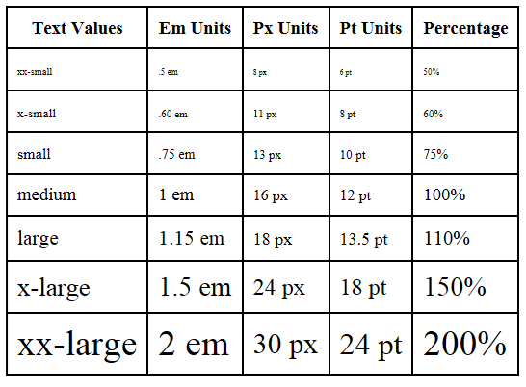
The font-size Property
absolute
Font size can be
relative to the
- monitor
- browser
- parent's
font-size
property
absolute

Slide 3
The font-size Property, cont.
Accessibility Recommendation: Use em or percentage font sizes – easily resized in all browsers by users. Also, think mobile.
absolute
Pt and Px are not scalable.
One Pt =1/72 of an inch
Px is defined as 0.75pt, but display can vary with screen resolution.
--Text values: sized relative to the browser font size
--em refers to the height of the metal body on which the font was cast, or the point size of the font
--Percentage represents text size in proportion to
the size of the parent element
Notes:
https://www.w3.org/Style/Examples/007/units.en.html (good explanation of when to use em, px, pt (esp since px depends on monitor resolution)
Pixels are fixed-size units that are used in screen media (i.e. to be read on the computer screen). Pixel stands for "picture element" and as you know, one pixel is one little "square" on your screen.
Points are traditionally used in print media (anything that is to be printed on paper, etc.). One point is equal to 1/72 of an inch. Points are much like pixels, in that they are fixed-size units and cannot scale in size.
One em was traditionally defined as the width of the capital "M" in the current typeface and point size, as the "M" was commonly cast the full-width of the square "blocks", or "em-quads" (also "mutton-quads"), which are used in printing presses. However, in modern typefaces, the character M is usually somewhat less than one em wide. Moreover, as the term has expanded to include a wider variety of languages and character sets, its meaning has evolved; this has allowed it to include those fonts, typefaces, and character sets which do not include a capital "M", such as Chinese and the Arabic alphabet. Thus, em generally means the point size of the font in question, which is the same as the height of the metal body a font was cast on.
A common unit of measurement in typography. Em is traditionally defined as the width of the uppercase M in the current face and point size. It is more properly defined as simply the current point size. For example, in 12-point type, em is a distance of 12 points.
There is another reason to avoid absolute units for other uses than print: You look at different screens from different distances. 1cm on a desktop screen looks small. But the same on a mobile phone directly in front of your eyes looks big. It's better to use relative units, such as em or %, instead.

Slide 4

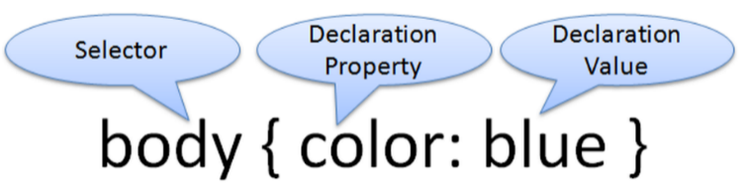
Styles Example
body { background-color: #e6e6fa;
color: #191970;
font-family: Arial, Verdana, sans-serif; }
h1 { background-color: #191970;
color: #E6E6FA;
line-height: 200%;
font-family: Georgia, "Times New Roman", serif; }
h2 { background-color: #aeaed4;
color: #191970; text-align: center;
font-family: Georgia, "Times New Roman", serif; }
p {font-size: .90em; text-indent: 3em; }
ul {font-weight: bold; }
Notes:
font-weight can be normat, bold, bolder, lighter, a number (100, 200, 300, … 900), initial (default) or inherit (same as parent element)

Slide 5
More CSS TEXT Properties (need values)
line-height
Configures the height of the line of text (use the value 200% to appear double-height; double-spaced)
text-align
Configures alignment of text within a block display element http://www.w3schools.com/css/css_display_visibility.asp
text-indent
Configures the indentation of the first line of text
text-decoration
Modifies the appearance of text with an underline, overline, or line-through
Notes:
http://www.w3schools.com/css/css_display_visibility.asp
A block-level element always starts on a new line and takes up the full width available (stretches out to the left and right as far as it can).
The <div> element is a block-level element.
Examples of block-level elements:
<div>
<h1> - <h6>
<p>
<form>
<header>
<footer>
<section>
Inline Elements
An inline element does not start on a new line and only takes up as much width as necessary.
This is an inline <span> element inside a paragraph.
Examples of inline elements:
<span>
<a>
<img>

Slide 6
More CSS TEXT Properties, cont.
text-transform (check w3schools; CSS text for values)
Configures the capitalization of text
letter-spacing
Configures space between text characters
word-spacing
Configures space between words
text-shadow
Configures a drop shadow on text h-shadow v-shadow blur-radius color
(h and v required)
These are declaration properties.
How will you find declaration values?

Slide 7
Your turn!
First open index.html in the kitchen project in a browser to see that there is no style.
Create a css file in Notepad++; save it in the styles folder; and in the HTML file, add a link element to the CSS file.
Your last exercise (end of PowerPoint 1) demonstrated text color, background color, and font families. Now let's experiment with more of the declaration properties and values introduced so far. We will work together on this one.

Slide 8
CSS Selectors
CSS style rules can be configured for an:
HTML element selector
class selector
id selector
descendant selector

Slide 9
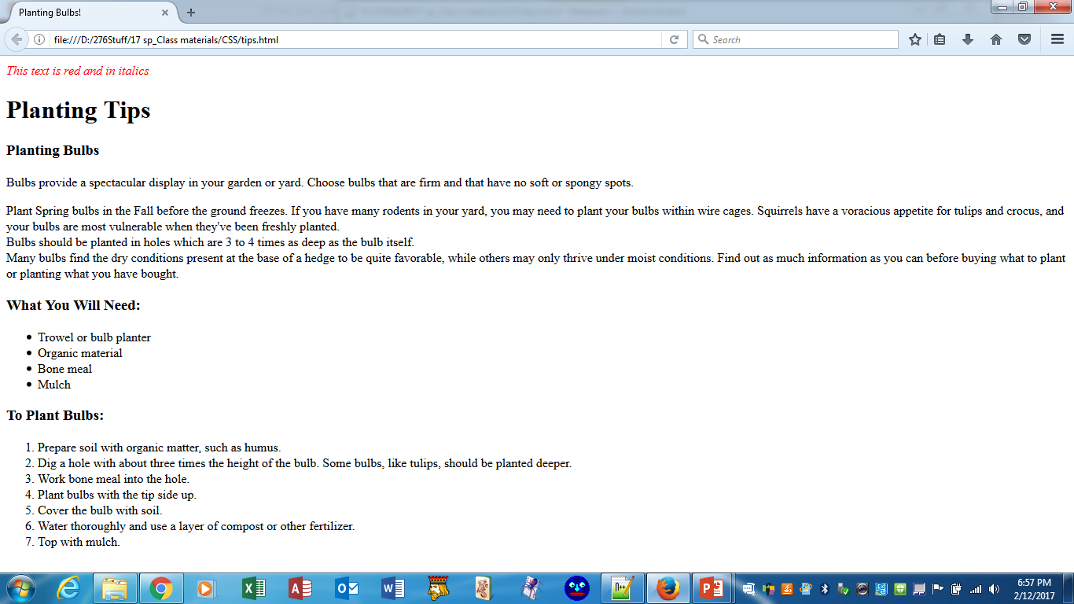
Using CSS with “class”
class Selector
Apply a CSS rule to a certain "class" of elements on a web page
Does not associate the style to a specific HTML element
Configure with: .classname
code CSS to create a class called “new” with red italic text.
Apply with: class="classname"
<p class=“new”>This text is red and in italics</p>
.new { color: #ff0000;
font-style: italic;
}

Slide 10
Using CSS with “id”
id Selector
Used to identify a unique object; therefore, use only once on a web page.
Configure with: #idname
Code CSS to create an id called “new” with red, large, italic text.
#new { color: #ff0000;
font-size:2em;
font-style: italic;
}
Apply with: id="idname"
<p id=“new”>This text is red, large, and in italics</p>
This text is red, large, and in italics

Slide 11
CSS Descendant Selector
Specify an element within the context of its container (parent) element.
AKA contextual selector
The first example configures italicized text only for list item tags located within unordered lists;
the last configures green text to p tags subordinate to the HTML element assigned the id named idea
Advantage of contextual selectors: Reduces the number of classes and ids you need to apply in the HTML
ul li {font-style: italic;}
div p {text-align: center;}
#idea p { color: #00ff00; }

Slide 12
span element
Purpose:
configure a specially formatted area displayed in-line with other elements, such as within a paragraph.
Perhaps I want just a few words within a paragraph to be underlined, and I have a class for underlining. Span will allow me to apply the class to just the desired text within the paragraph.

Slide 13
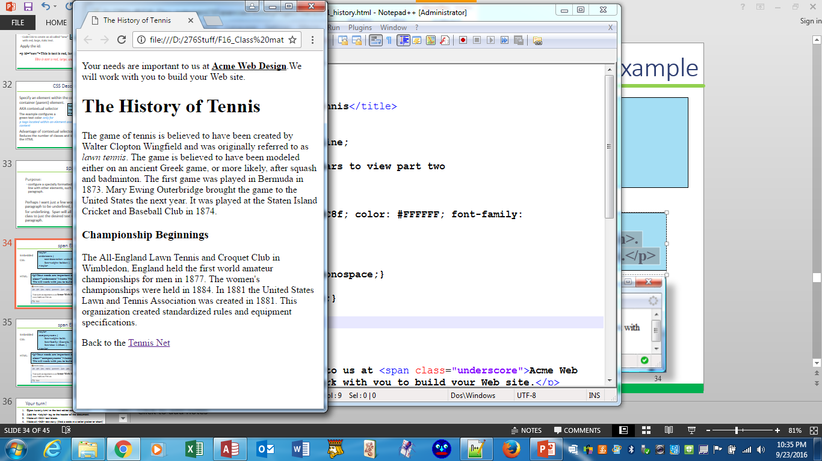
span Element Example 1
.underscore {
text-decoration: underline;
font-weight: bolder; }
CSS:
HTML:
<p>Your needs are important to us at <span class="underscore">Acme Web Design</span>. We will work with you to build your Web site.</p>
In Google Chrome:

Slide 14
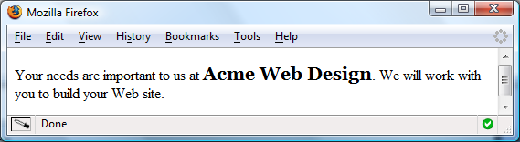
span Element Example 2
.companyname {
font-weight: bold;
font-family: Georgia, "Times New Roman", serif;
font-size: 1.25em; }
CSS:
<p>Your needs are important to us at <span class=“companyname">Acme Web Design</span>. We will work with you to build your Web site.</p>
HTML:

Slide 15
Your turn!
Open CSS Exercise 2-tennis_revisited.docx and follow the instructions.

