Slide 1
Learning Outcomes
This presentation will….
Expand knowledge of selectors
Introduce pseudo classes
Introduce the Box Model
Present padding, border, and margin properties
Show how to validate CSS
color_descendant_child.html
KitchenProject_wChild_wClass
box.html
css_exercise3.docx

Slide 2

Centering Page Content with CSS
or, margin:auto;
#wrapper { margin-left: auto;
margin-right: auto;
width:80%; }
h1 { background-color: #0000ff;
color: #ffffff;}
80% of its parent element
Where would the id be placed in the HTML to produce illustration?

Slide 3
Descendant Selectors
What do the following mean?
main p {font-size: .75em;}
nav a {text-decoration: none;}
div ul ol li {color:#ff0000;}
All of the above target "descendant" relationships.
But there is not necessarily a "parent / child" relationship.

Slide 4
Descendant, Parent, and Child
What are descendant, parent, and child relationships?
An element is a child if it is a descendant and it is nested directly in that element.
Element B is nested directly in element A if there are no opening tags without corresponding closing tags between the opening tag of A and that of B.
If B is the child of A, we call A the parent of B.

Slide 5
Descendant, Parent, and Child
Child selectors can be used to target specific elements
Select li elements only when they are children of ol:
ol > li {property: value}
Select img elements only when they are children of h2 elements that are children of p elements:
p > h2 > img {property: value}
Examples:
color_descendant_child.html file
fruits_descendant_child project
overview of various selectors:
http://www.w3schools.com/cssref/css_selectors.asp

Slide 6
Descendant Classes
--an element-specific class as opposed to the independent classes
we have been using.
li.silly{font-family: "Wingdings 2", fantasy;}
li.serious{font-family:Arial, "Times New Roman", san-serif;}
h3.green{color:#00ff00;}
h3.blue{color:#0000ff;}
…
<li class="silly">What is Wingdings 2, you ask?</li>
…
Just a note… not all browsers will support "Wingdings" so if you try this one specifically, it may have mixed results!
Notes:
Firefox does not support "Wingdings". IE & Chrome do.

Slide 7
Duplication of Class Names
An independent class can have the same class name as a dependent class:
.copy{font-size: 1.5em;}
h3.copy{color:#ff0000;}
<p class="copy">This is a paragraph with content.</p>
<h3 class="copy">Illustrative Text Here!</h3>
<div class="copy"> ….Lots of stuff!... </div>
All elements assigned the copy class will have a 1.5em font size. All <h3> elements assigned the copy class will be 1.5em and red.

Slide 8
id Selectors
id selectors can also be associated with a specific element; however, the name can still be used only once on a page
#abc{color:pink;}
li#abc{border-style:solid;border-color:#ff0000;}
<p id="abc">This is a paragraph with content.</p>
<li id="abc">Illustrative Text Here!</li>
If the id is assigned to the p element, it will have pink text.
If the id is assigned to the li element, it will have pink text with a solid, red border.
The usefulness of this arrangement is the ability to assign the id on different pages… i.e., to a paragraph on one page and a li on another.

Slide 9
Homework!
Open (in Notepad++) the index file in kitchen-wChild_wClass project and follow the instructions.
Complete the exercise before our next class, and we will review the "solutions" together.

Slide 10
Pseudo-Class Styles
Pseudo-class styles are applied when something happens, rather than because the target element simply exists
--Names begin with colons
--Especially useful for changing appearance of links (see notes)
/* unvisited link */ a:link {color:#f00;} /* visited link */ a:visited {color: #abc;} /* mouse over link */ a:hover {color: rgb(250,0,255);} /* selected link */ a:active {background-color:#000000;}
:link
:visited
:hover
:active
https://www.w3schools.com/css/css_pseudo_classes.asp
Notes:
Note: a:hover MUST come after a:link and a:visited in the CSS definition in order to be effective! a:active MUST come after a:hover in the CSS definition in order to be effective! Pseudo-class names are not case-sensitive.

Slide 11
The Box Model
HTML elements are contained inside imaginary rectangular "boxes" that have margins, borders, padding, and floating (wrapping) properties.
Margin
Border
Padding
Content

Slide 12
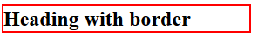
CSS border Property
Configures a border on the top, right, bottom, and left sides of an element
"border" is shorthand for setting…
border-width
border-style
border-color
(in that order) in one declaration
h2 { border: 2px solid #ff0000 }

Slide 13
CSS border-width Property
p {border-width: thin medium thick 5em;}
top border is thin
right border is medium
bottom border is thick
left border is 5em
A shorthand version for setting border-width values.
Values must be in order.
Note that there is no punctuation between the values.

Slide 14
CSS border-style Property
p {border-style: dotted solid double dashed;}
top border is dotted
right border is solid
bottom border is double
left border is dashed
A shorthand version for setting border-style values.
Values must be in order.
Note that there is no punctuation between the values.
Click on the link below to see more.
http://www.w3schools.com/cssref/tryit.asp?filename=trycss_border-style

Slide 15
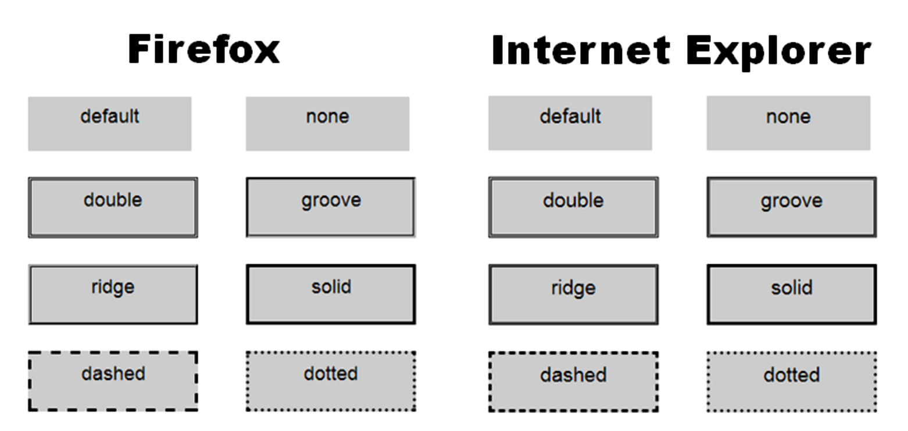
Browser Display Can Vary

Slide 16
CSS border-color Property
p {border-style: solid;
border-color: #ff0000 #00ff00 transparent
rgb(250,0,255);}
top border is solid red
right border is solid green
bottom border is transparent
left border is lilac
The "border-color" property does not work if it is used alone. Use the "border-style" property to set the borders first.
http://www.w3schools.com/cssref/tryit.asp?filename=trycss_border-color

Slide 17
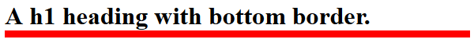
Configuring Specific Sides of a Border
Configure a line on one or more sides of an element
border-top
border-right
border-bottom
border-left
h2 { border-bottom: .3em solid #ff0000 }
Shorthand for
border-bottom-width
border-bottom-style
border-bottom-color
Must be listed in order.

Slide 18
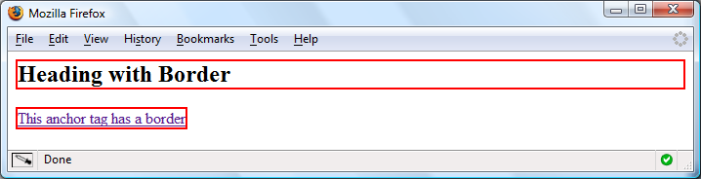
CSS Borders: Block & Inline Elements
Block display element
Default width of element content extends to parent margin (or specified width)
Inline display element
Border closely outlines the element content
h2 { border: 2px solid #ff0000; }
a { border: 2px solid #ff0000; }

Slide 19
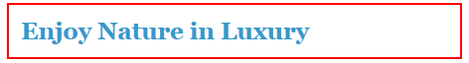
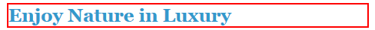
CSS padding Property
Configures empty space between the content of the HTML element and the border
Set to 0px by default
h2 { border: 2px solid #ff0000; padding: .5em; }
No padding property configured:

Slide 20
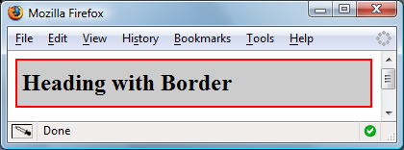
Configure Padding on Specific Sides of an Element
Use CSS to configure padding on one or more sides of an element
padding-top
padding-right
padding-bottom
padding-left
h2 { border: 2px solid #ff0000;
background-color: #cccccc;
padding-left: 5px;
padding-bottom: 10px;
padding-top: 10px; }

Slide 21
CSS margin Property
Configure the margin on one or more sides of an element
margin-top
margin-right
margin-bottom
margin-left
p {margin: 2cm 4cm 3cm cm;}
cm used only to illustrate a possible format. There are others, like em and px. Check w3schools for more.

Slide 22
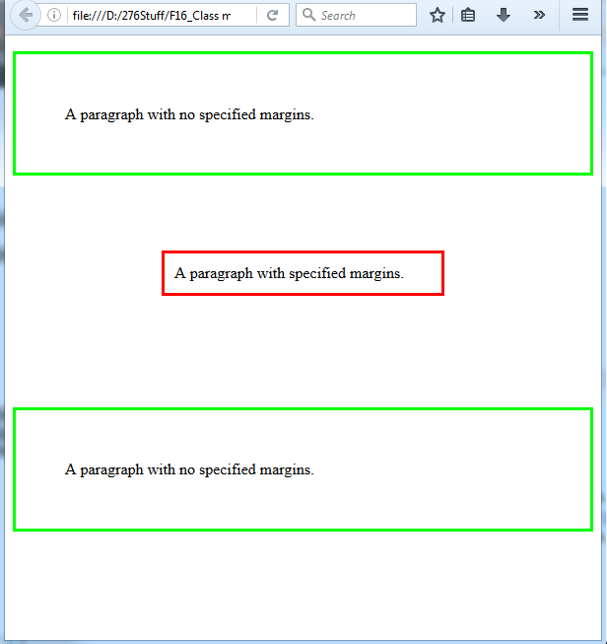
CSS margin Property
p.ex1 {margin:none; padding:50px;
border-style:solid; border-color:#00ff00;}
p.ex2 {margin: 2cm 4cm 3cm 4cm; padding:10px;
border-style:solid; border-color:#ff0000;}
<p class="ex1">A paragraph with no
specified margins.</p>
<p class="ex2">A paragraph with specified
margins.</p>
<p class="ex1">A paragraph with no
specified margins.</p>
Margin
Border
Padding
Content
open box.html

Slide 23
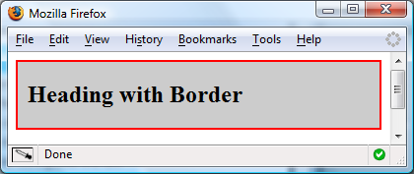
CSS Property Shorthand
border-style:dotted ridge dashed double
border-width:thin thick 20px
border-color:#ff0000 #00ff00
border-padding:20px
Top, Right, Bottom, Left
Top, Right & Left, bottom
Top & Bottom, Right & Left
Top & Right & Bottom & Left
h2 { border: 2px solid #ff0000;
background-color: #cccccc;
padding: 20px 10px;
}

Slide 24

CSS Property Shorthand
h2 { background-color:#aeaed4; color:#191970; font: bold 1.1em Georgia "Times New Roman" serif; text-align: center; border-bottom: 2px dashed #191970; }
font is:
weight, size, family
border-bottom is:
width, style, color

Slide 25
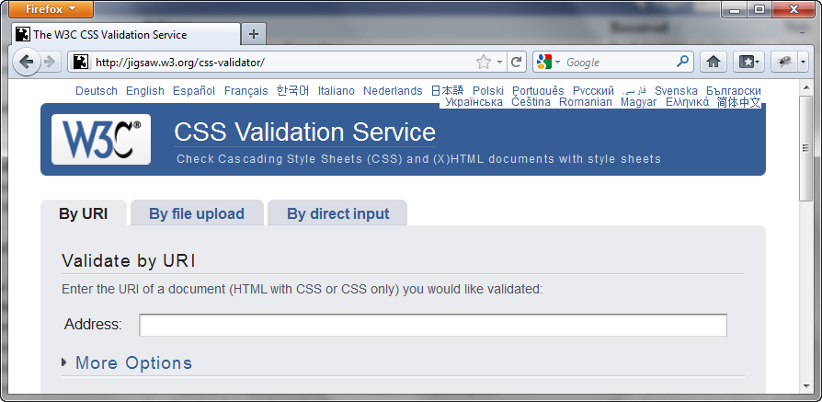
W3C CSS Validation
http://jigsaw.w3.org/css-validator/

Slide 26
Your Turn!
Open exercise 3 and follow the instructions.

