Slide 1
Learning Outcomes
Describe common uses of forms on web pages
Create forms on web pages using the form, input, textarea, and select elements
Associate form controls and groups using the label, fieldset, and legend elements
Create custom image buttons and use the button element
Use CSS to style a form
beginforms.html

Slide 2

Overview of Forms
Forms are used all over the Web to
Accept information
Provide interactivity
Types of forms:
Search form, Order form, Newsletter sign-up form, Survey form, Add to Cart form, sign-in form and so on…

Slide 3
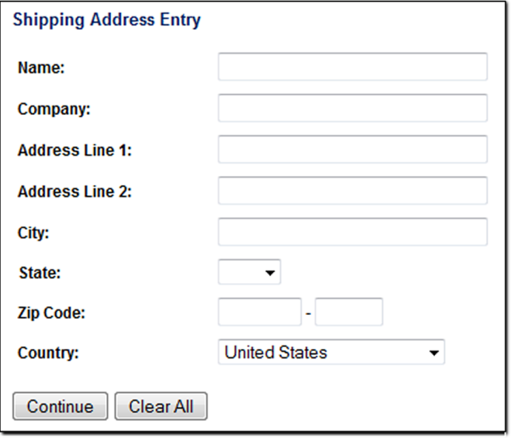
Overview of Forms, cont.
Form
An HTML element that contains and organizes
form controls such as text boxes check boxes buttons that can accept information
from website visitors.

Slide 4
Two Components of Using Forms
The HTML form (client-side)
the web page user interface
and
2. The server-side processing
Server-side processing works with the form data and sends e-mail, writes to a text file, updates a database, or performs some other type of processing on the server.

Slide 5
HTML Form Elements
<form> …. </form>
Contains the form elements on a web page
Container tag
<input … >
Configures a variety of form elements including text boxes, radio buttons, check boxes, buttons …
Empty tag
<textarea> …. </textarea>
Configures a scrolling text box
Container tag
<select> …. </select>
Configures a select box (drop down list or combo)
Container tag
<option> …. </option>
Configures an option in the select box
Container tag

Slide 6
HTML form element
The form element attributes:
id
Identifies the form… unique to the page
use with CSS and access by client-side scripting (JS)
name
Identifies the form… unique to the form
access for client-side scripting and server-side processing languages (php, java, python …)
type
action
Sends form data to a specified URL & file name on server-side that has script to process form data
method
get – default value, form data passed
to server in URL
post – more secure, form data passed
in HTTP Entity Body

Slide 7
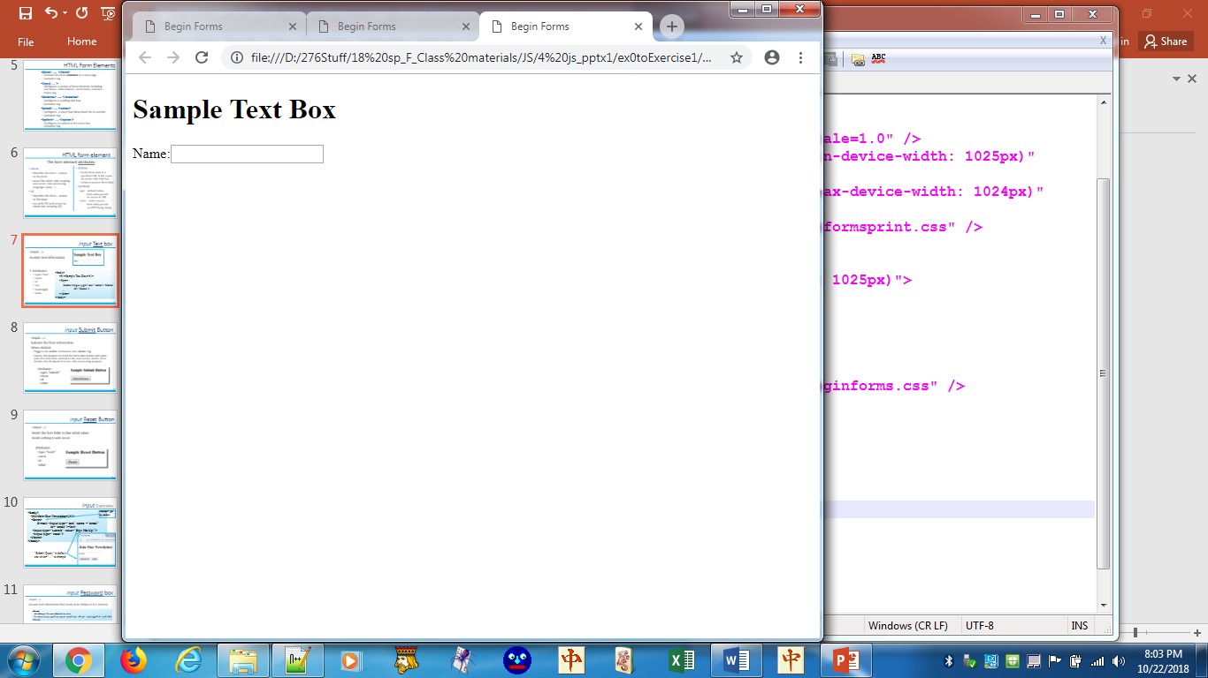
Input Text box
Empty tag
<input …>
Accepts text information
Attributes:
type="text“
name
id
size
maxlength
value
<body>
<h1>Sample Text Box</h1>
<form>
…
<label for="name">Name: </label> <input id="name" type="text"
name="cust_name">
…
</form>
</body>

Slide 8
Label element
<label> … </label>
Associates a text label with a form control
<label for="email">Email: </label> <input id= "email"> type="email" name="cust_email"
*for="…" and id="…" must be the same
*name="…" used by client-side scripting & server-side processing
*id="…" used by label element, anchor element, & CSS selectors
js_Exercise3

Slide 9
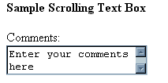
textarea Scrolling Text Box
<textarea> … </textarea>
Configures a scrolling text box
<form>
…..
<h2><label for="comments">Comments:</label></h2>
<textarea id="comments" name="comments" cols="40" rows="2" >
Enter your comments here
</textarea>
..…
</form>
Attributes:
name
id
cols
rows
maxlength
readonly
accesskey
tabindex
Notes:
The "Enter your comments here" statement acts like a <pre> element. Type the statement at the far left side of Notepad++ if no spaces are desired.
JS can be used to eliminate the text.

Slide 10

input Password box
<input …>
Accepts text information that needs to be hidden as it is entered
<form>
…..
<h1>Sample Password Box</h1> <br>
<label for=pw>Password:</label>
<input id="pw" type="password" name="pw" maxlength="9" size="12">
…..
</form>
Attributes:
type=“password”
name
id
size
maxlength
value
Notes:
Maxlength is the number of characters that can be entered; size is the width of the textbox

Slide 11
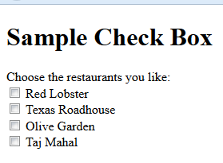
input Checkbox
<input …>
Allows the user to select one or more of a group
<form>
Choose the restaurants you like:
<input type="checkbox" name="rl" id="rl" value="yes"> Red Lobster<br />
…
<input type="checkbox" name="taj" id="taj" value="yes"> Taj Mahal<br />
</form>
"value" is not setting the initial value but rather the value IF the box is checked. It can be tested… If taj="yes"…
Attributes:
type="checkbox"
name
id
checked
value

Slide 12
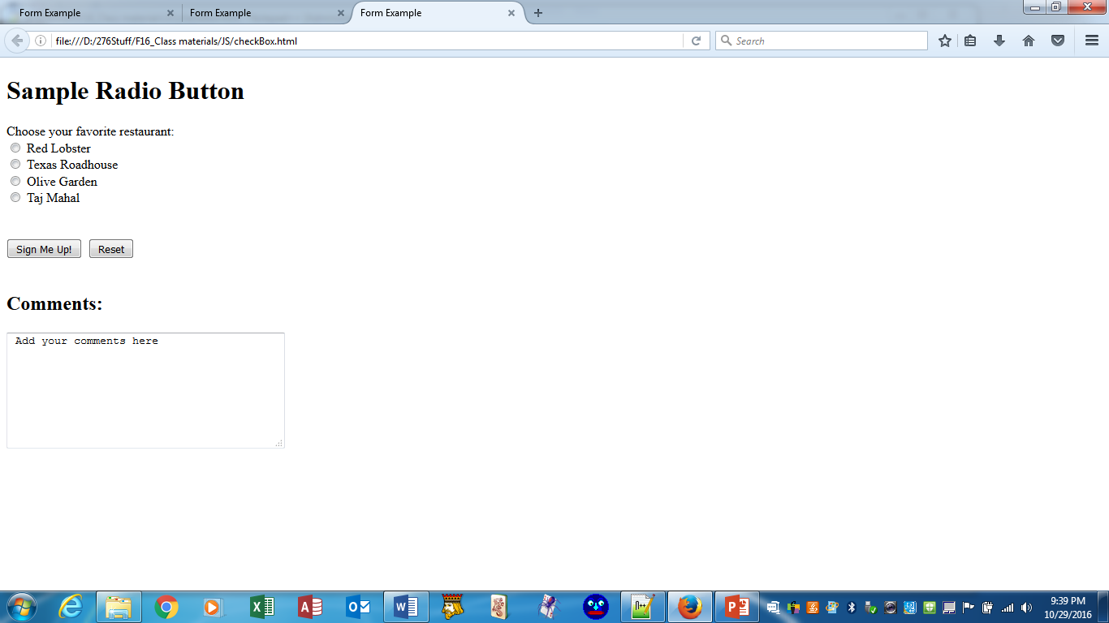
input Radio Button
<input …>
Allows the user to select exactly one from a group
Each radio button in a group is given the same name and a unique value
<form>
Choose your favorite restaurant :
<input type="radio" name="favrestaurant" id="rl" value="red"> Red Lobster<br />
….
<input type="radio" name="favrestaurant" id="taj" value="taj"> Taj Mahal<br />
</form>
Attributes:
type="radio"
name
id
checked
value

Slide 13
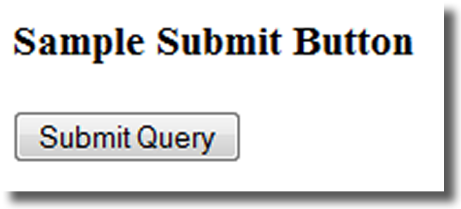
input Submit Button
<input …>
Submits the form information
When clicked:
Triggers the action method on the <form> tag
Causes the browser to send the form data (name and value pairs for each form control) to the web server, which then invokes the designated server-side processing program
Attributes:
type=“submit”
name
id
value

Slide 14
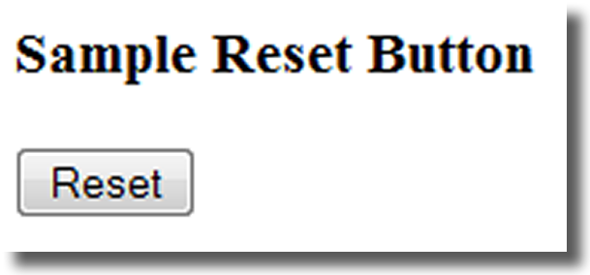
input Reset Button
<input …>
Resets the form fields to their initial values
Sends nothing to web server.
Attributes:
type=“reset”
name
id
value

Slide 15
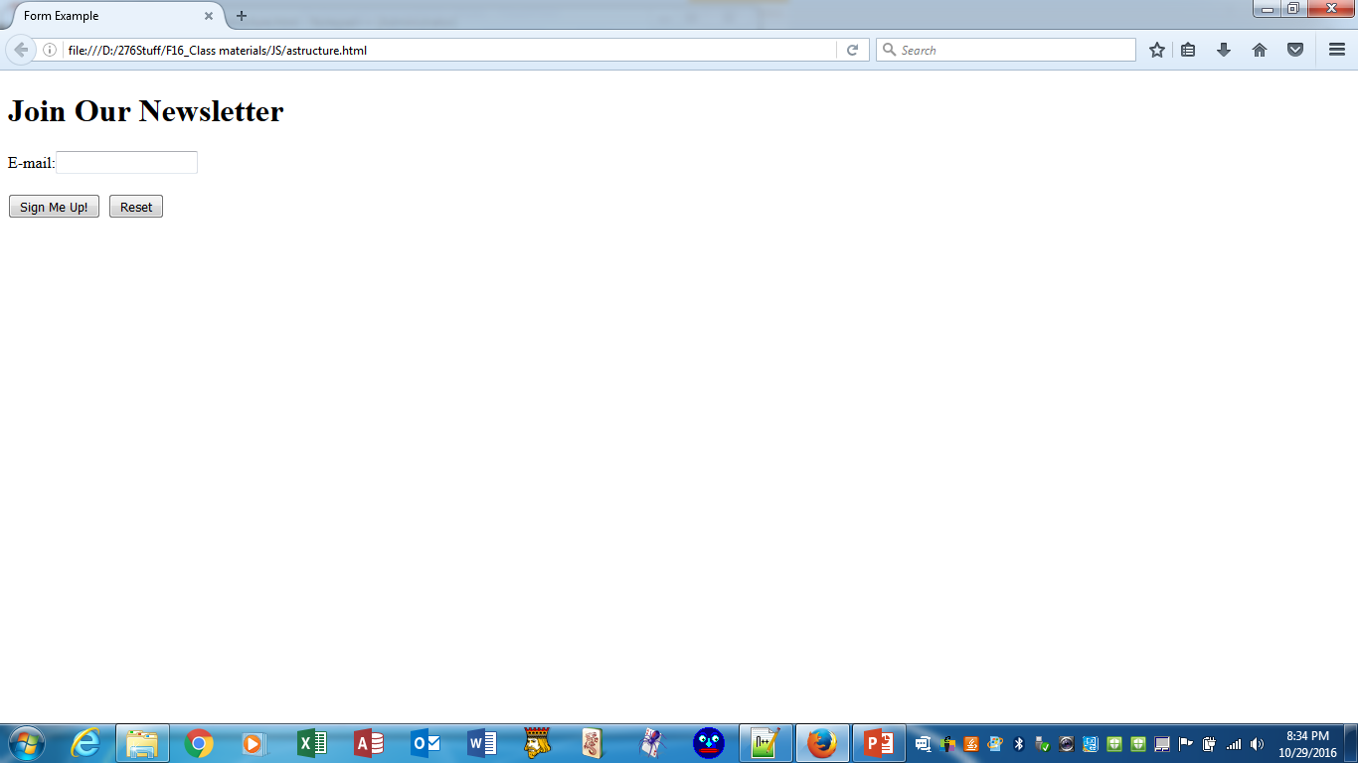
Input Examples
method="get" by default;
"post" more secure
<body>
<h1>Join Our Newsletter</h1>
<form>
<label for=email>E-mail: </label>
<input id="email" type="email" name ="email">
<br> <input type="submit" value="Sign Me Up!"> <input type="reset">
</form>
</body>
"Submit Query" is default; use value="…" to change.
Notes:
Browsers that don't support type "email" fall back to being a standard "text" input.

Slide 16
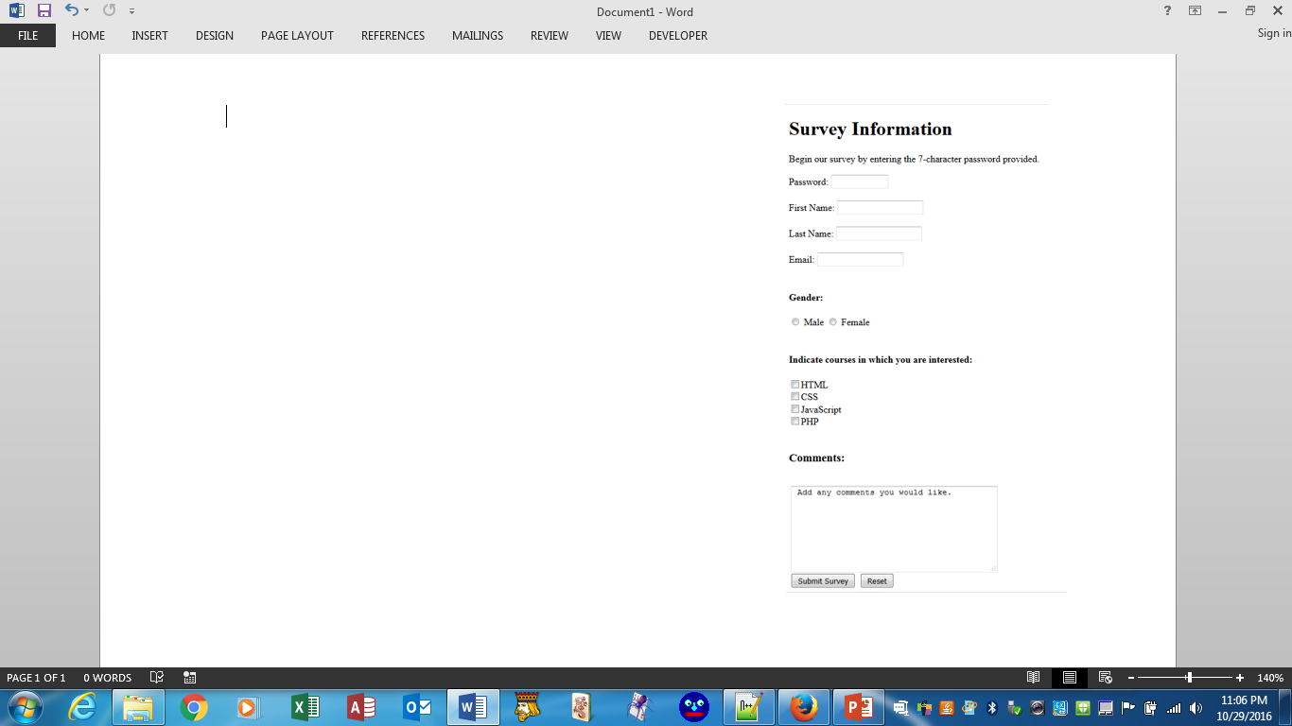
Your Turn!
Reproduce the form (one form; several elements) to the right:
js_Exercise1

Slide 17
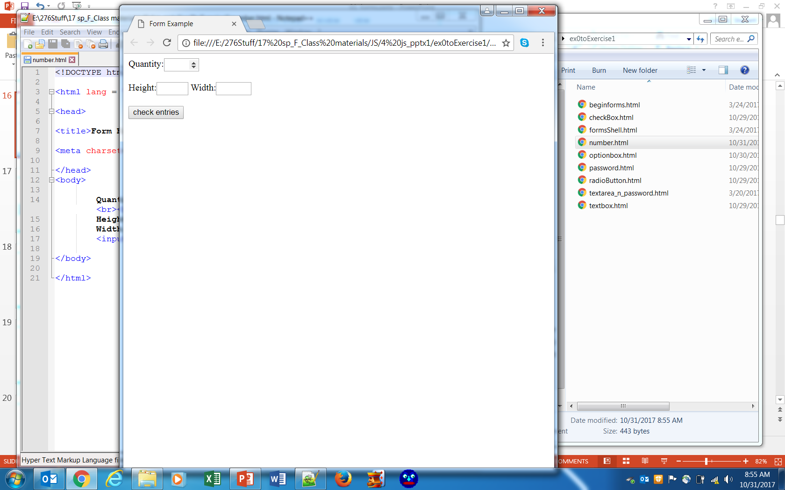
Input Number
Runs in Chrome and FireFox.
Not supported in IE9 & earlier
<input …>
Accepts numeric entries
Provides spinner
<form>
<label for="qty">Quantity:</label>
<input id="qty" type="number" name="qty" min="1" max="20"><br><br>
<label for="hgt">Height:</label>
<input id="hgt" type="number" name="hgt" min="3" max="9">
<label for=" wth">Width:</label>
<input id="wth" type="number" name="wth" min="5" max="15"><br><br>
<input type="submit" name="check" id="check" value="check entries">
</form>
Attributes:
type="number“
name
id
min
max
value
number.html

Slide 18
input Hidden form data
<input …>
This form control is not displayed on the web page.
Hidden form fields
Can be accessed by both client-side and server-side scripting
Sometimes used to contain information needed as the visitor moves from page to page.
<input type="hidden" name="invoice_num" id="invoice_num" value="12345">
<input type="hidden" name="customerid" value="c2415-345-8563">
<input type="hidden" name="language" value="English">
<input type="hidden" name="country" value="Norway">
Attributes:
Do not need a label when field is not visible.
name
type
id
value

Slide 19

Select List
<select> … </select>
Configures a select list (along with option elements)
Also known as: Select Box, Drop-Down List, Drop-Down Box, and Option Box.
Allows the user to select one or more items from a list
Attributes:
name
id
size (num visible options)
multiple (choices)

Slide 20
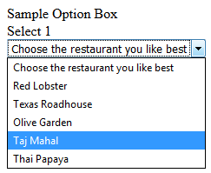
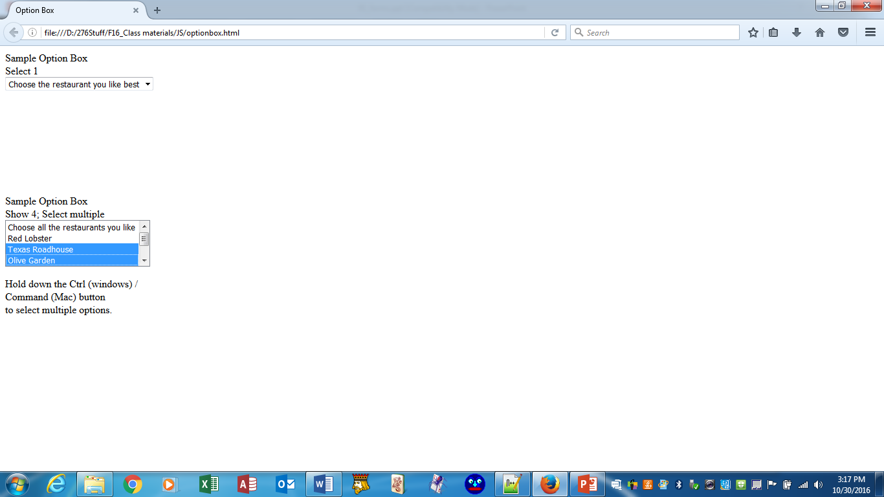
Options in a Select List
<option></option>
Configures the options in a Select List
<select multiple size="4" name="favrestaurant4" id="favrestaurant4">
<option> Choose all the restaurants you like</option>
<option value="rl"> Red Lobster</option>
…
<option value="tp"> Thai Papaya</option>
</select>
<select size="1"…
<select multiple size="4" …
Attributes:
value
selected

Slide 21
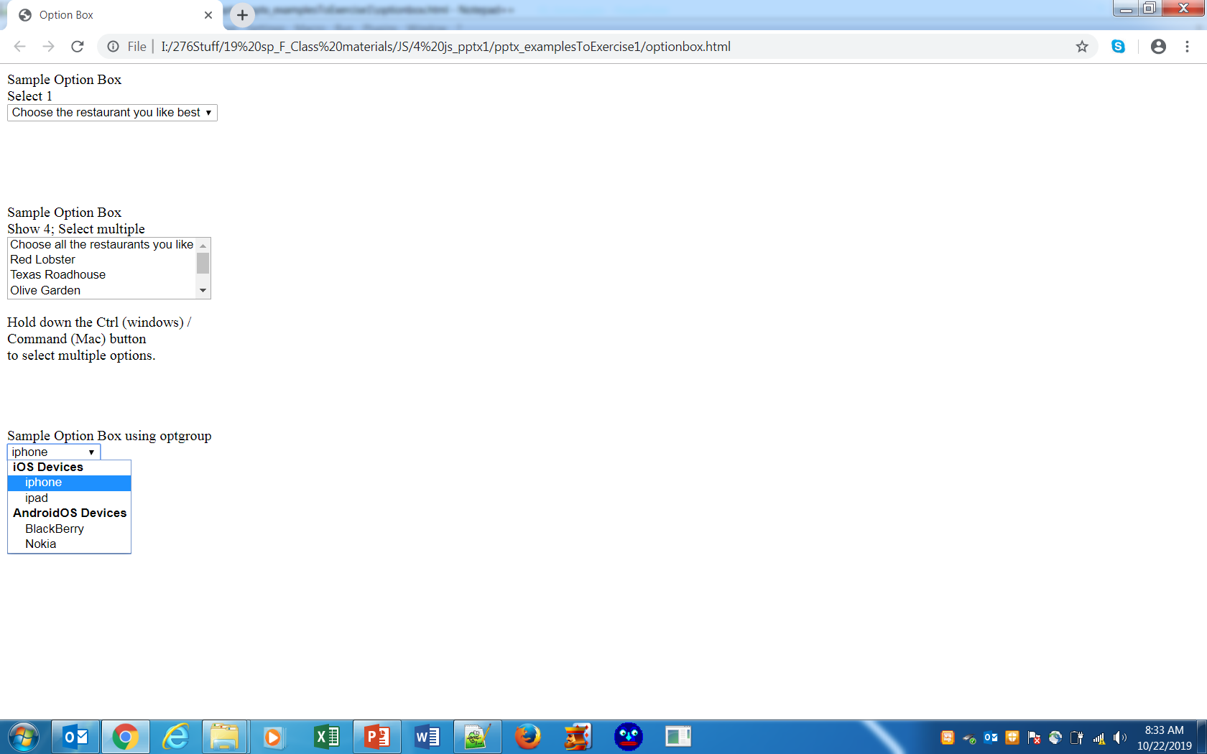
OptGroup Select List
<optgroup></optgroup>
Groups the options in a Select List
<select>
<optgroup label="iOS Devices">
<option value="iphone">iphone</option>
<option value="ipad">ipad</option>
</optgroup>
<optgroup label="AndroidOS Devices">
<option value="BlackBerry">BlackBerry</option>
<option value="Nokia">Nokia</option>
</optgroup>
</select>

Slide 22
…And your decision would be?
1. You are designing a web site for a client who sells items in a retail store.
They want to create a customer list for e-mail marketing purposes. Your client sells to consumers and needs a form that accepts their customer’s name and e-mail address.
Would you recommend using two input boxes (one for the name and one for the e-mail) or three input boxes (for the first name, last name, and email address)? Explain your answer.

Slide 23
…More Decisions
2. You are designing a survey form for a client. One of the questions has 10 possible responses. Only one response can be selected.
What type of form control would you use to configure this question on the web page?
3. True or False In a radio button group, the value attribute is used by the browser to process the radio buttons as a group.

Slide 24
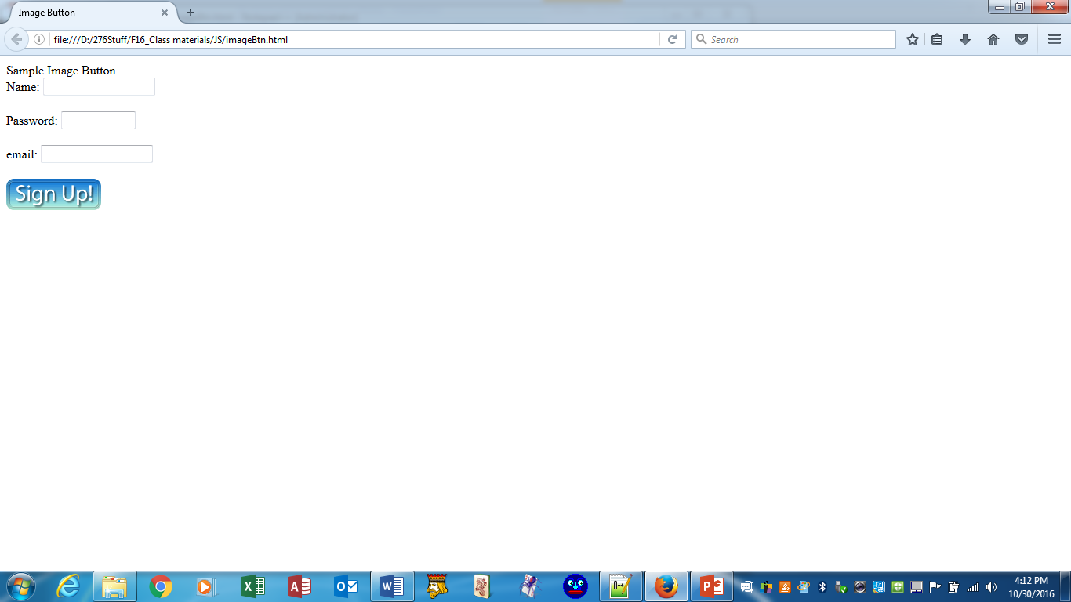
input Image Button
<input …>
Submits the form
When clicked:
Triggers the action attribute on the form tag
Sends the form data (the "name=value" pair for each form element)
to the web server.
action sends form data to a specified file on server-side
<input type="image" src="signup.gif" height="40px" width="121px"
alt="Signup Button">
Attributes:
type=“image”
name
id
src
Notes:
Recall that slide 15 introduced an input button. An input image button is much the same. It submits a form.
Find button graphics on line.

Slide 25
Input Types
button checkbox file hidden image
password radio reset submit text
color
date
datetime-local
email
month
number
range
search
tel
time
url
week
We have also previewed textarea and select that do not use input type=

Slide 26
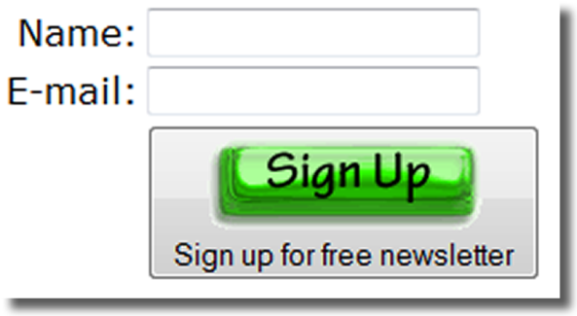
Button Element
<button></button>
A container tag
Can contain a combination of text, images, and media, unlike input type= button, that cannot
<button type="submit">
<img src="signup.gif" height="40px" width="121px" alt="Signup for
free newsletter">
<br/>Sign up for Free Newsletter
</button>
Attributes:
type="submit" type="reset" type="button"
name
id
alt
value
Notes:
For example, a button could be for "Next"

Slide 27
Compare Buttons
<input type="submit" value="Sign Me Up!"> <input type="reset">
Attributes:
type=“submit”
type="reset"
<input type="image" src="signup.gif" height="40px" width="121px"
alt="Signup Button">
Attributes:
type=“image”
<button type="submit">
<img src="signup.gif" height="40px" width="121px"
alt="Signup for free newsletter">
<br/>Sign up for Free Newsletter
</button>
Attributes:
type=“submit” type="reset" type="button"
Notes:
Note that <input… > triggers form submission (or reset);; whereas <button… > could be submit, reset, or just a button to be programmed to do something, like "continue" or "find" or "calculate" or ….

Slide 28
Accessibility & Forms
Label Element
Fieldset Element
Legend Element
Tabindex Attribute
Accesskey Attribute (shortcut key- -see link below)
https://www.w3schools.com/tags/att_global_accesskey.asp

Slide 29
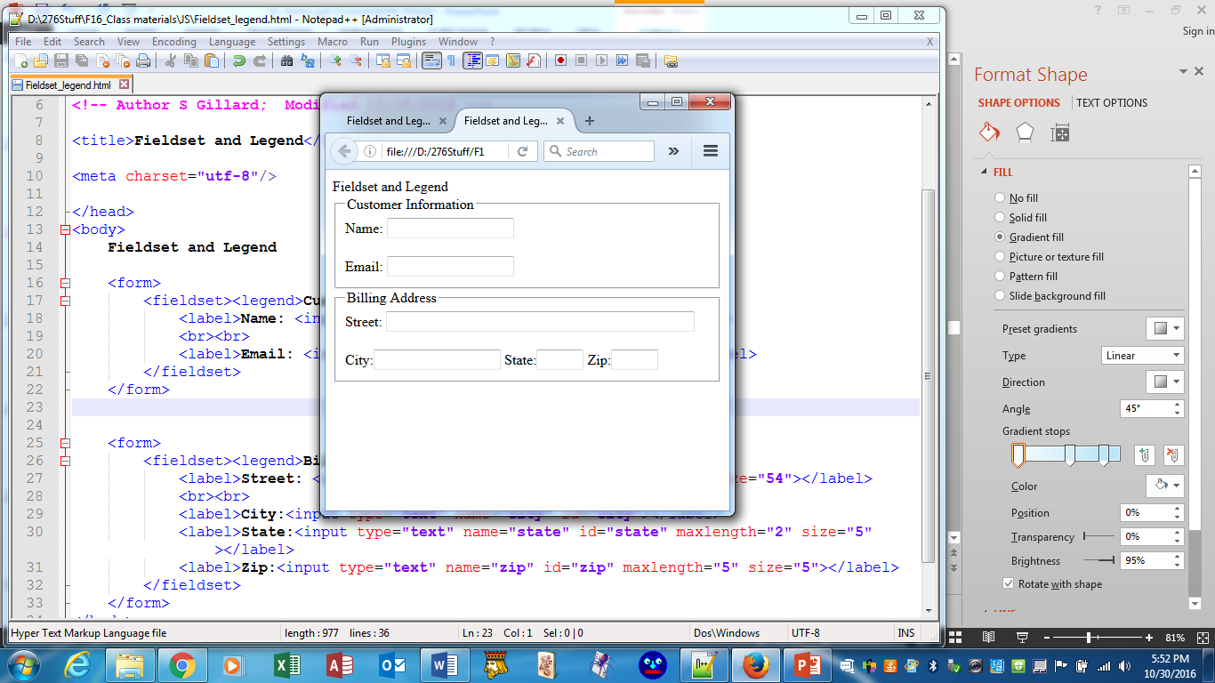
Fieldset and Legend Elements
The Fieldset Element
Container tag
Creates a visual group of form elements on a web page
The Legend Element
Container tag
Creates a text label within the fieldset
<fieldset><legend>Customer Information</legend>
<label for="name" >Name: </label> <input type="text" name="name" id="name“> <br><br>
<label for="email"> Email: </label> <input type="email" name="email" id="email">
</fieldset>

Slide 30
Fieldset and Legend Elements
<fieldset><legend>Billing Address</legend>
<label for ="street">Street: </label>
<input type="text" name="street" id="street" size="54">
<br><br>
<label for="city">City:</label>
<input type="text" name="city" id="city">
<label for ="state">State:</label>
<input type="text" name="state" id="state" maxlength="2" size="5">
<label for="zip">Zip:</label>
<input type="text" name="zip" id="zip" maxlength="5" size="5">
</fieldset>

Slide 31
Your Turn!
You created the form to the right in our previous exercise. Adjust the form as indicated in the next slide.
js_Exercise1

Slide 32
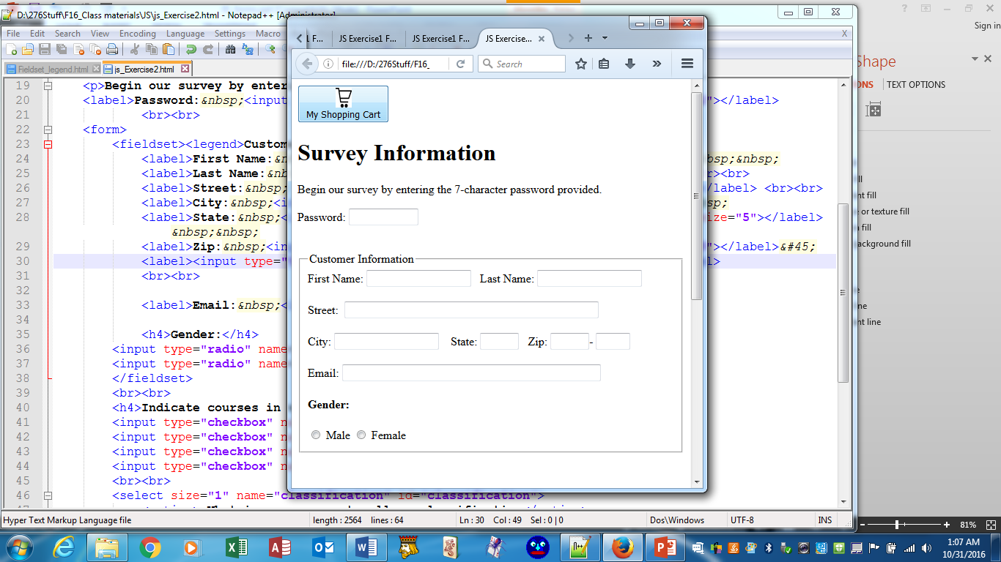
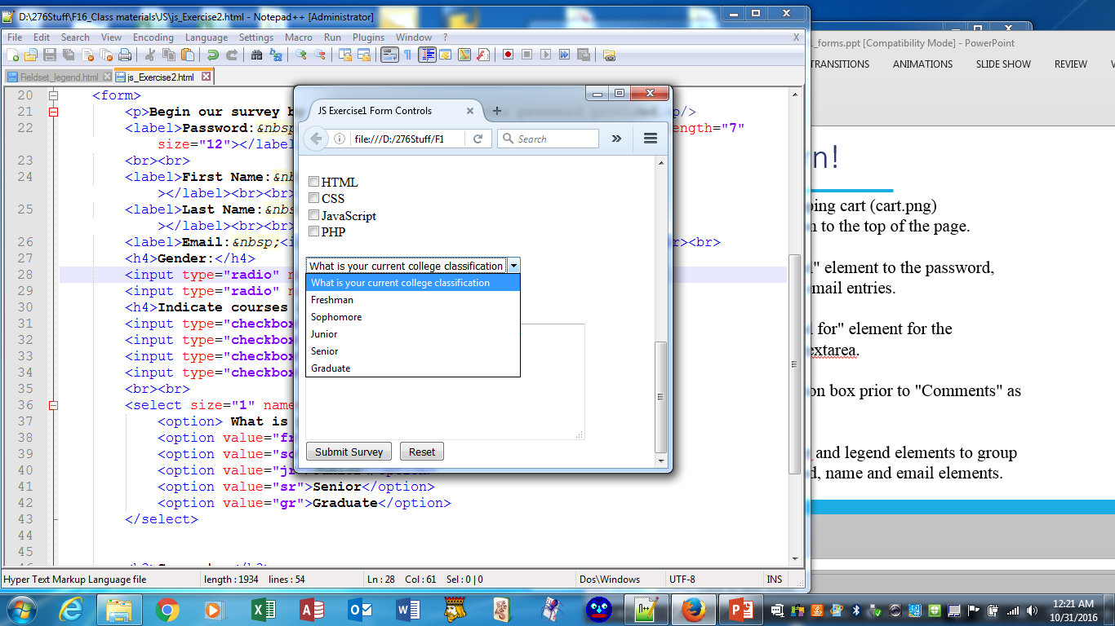
Your Turn!
Adjust your form as shown:
--add a shopping cart (cart.png)
image button
--adjust layout & add input boxes to
customer information (note size of
boxes and that zip is 5-4 layout).
--add fieldset and legend elements to
group customer information
--add an option box prior to "Comments" as
shown
--breaks, non-breaking spaces, & hyphens (remember character codes?) may be useful
js_Exercise2

Slide 33
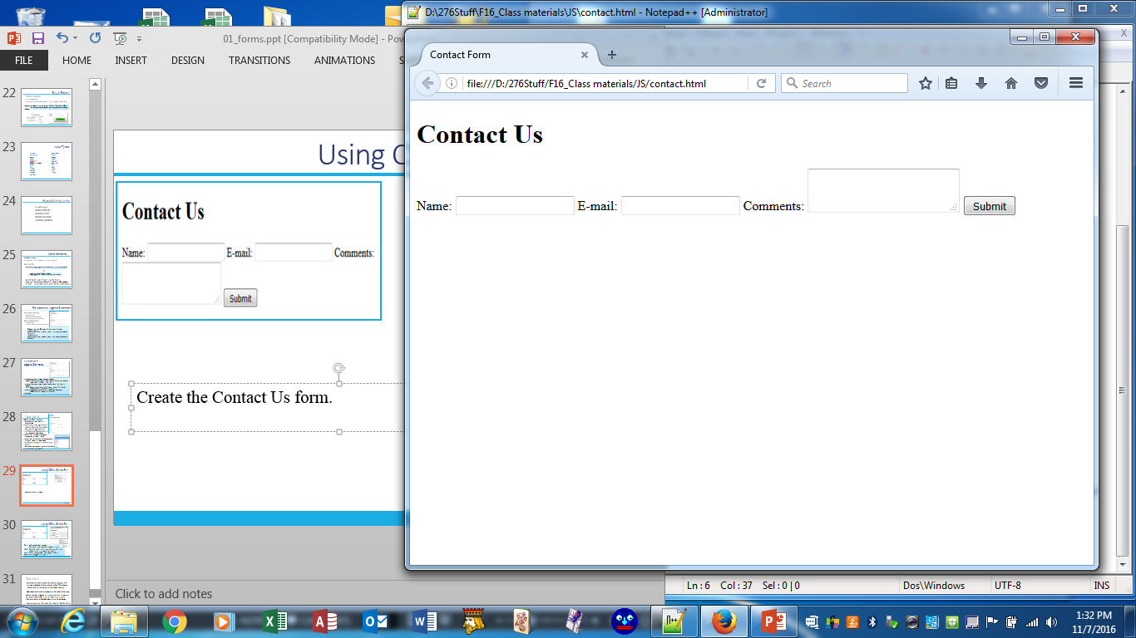
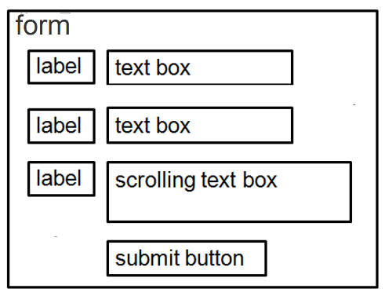
Using CSS to Style a Form
Create the "Contact Us" form.
Use CSS to style the form as indicated in the wireframe and include a background color for the form to set it apart from the remainder of the page.
Try to complete the task without looking at the next slide!
Contact

Slide 34
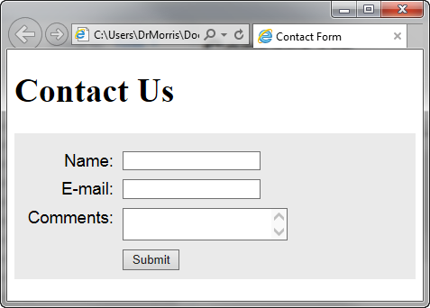
Using CSS to Style a Form
form { background-color: #eaeaea; font-family:Arial, sans-serif; padding:10px; }
label {clear:left; float:left; width:100px; text-align:right; padding-right:10px; margin-top:10px; }
input, textarea { margin-top:10px; display:block; }
#mySubmit { margin-left:110px; }

Slide 35
Using CSS to Style a Form
When the form "goes live", a method and action would be added:
<form method="post"
action="http://webaddressforprocessing/scripts/demo.php">
For now, use the method = "get" and check the title for data to be sent.
<form method="get" >

Slide 36
Your Turn!
Return to your survey form and add a bit of style using css. Use an external style sheet.
--place the shopping cart on the right-hand side of the page
--add a background color to the customer information content area
--so that you can distinguish the difference between label and text box, place dashed borders around the labels in the customer information section and dotted borders around the text boxes
--you may find it easier to style the boxes as block elements
--change at least three of the labels from "label" to "label for" format
--you decide on at least two additional styles to apply
js_Exercise3

Slide 37
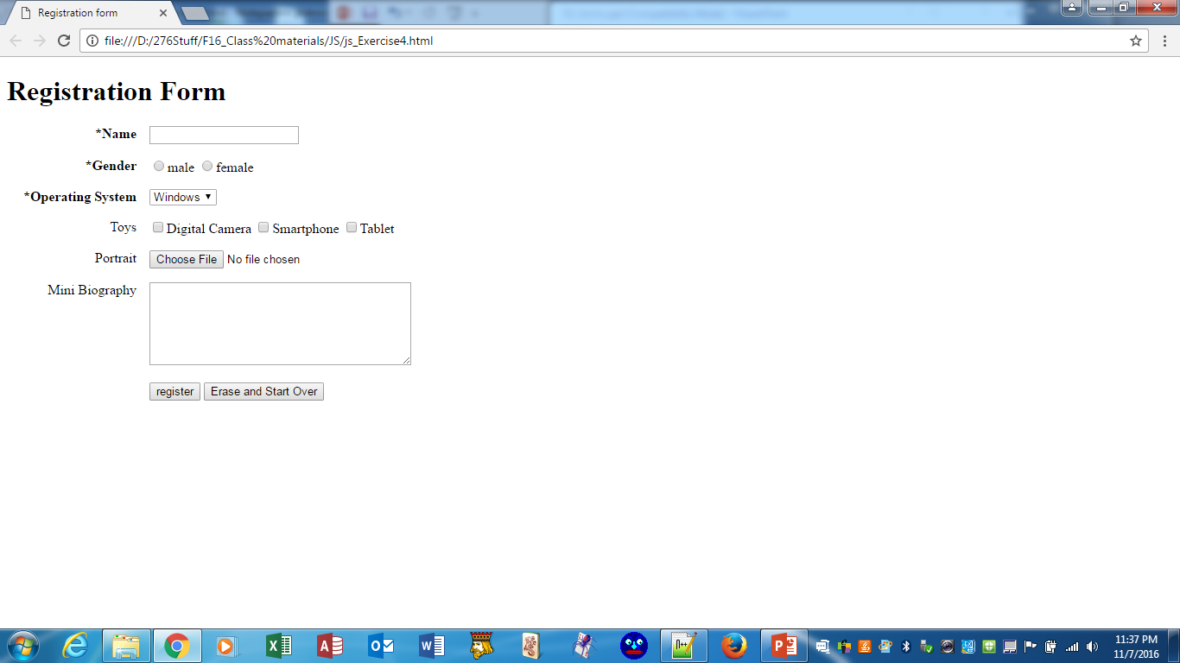
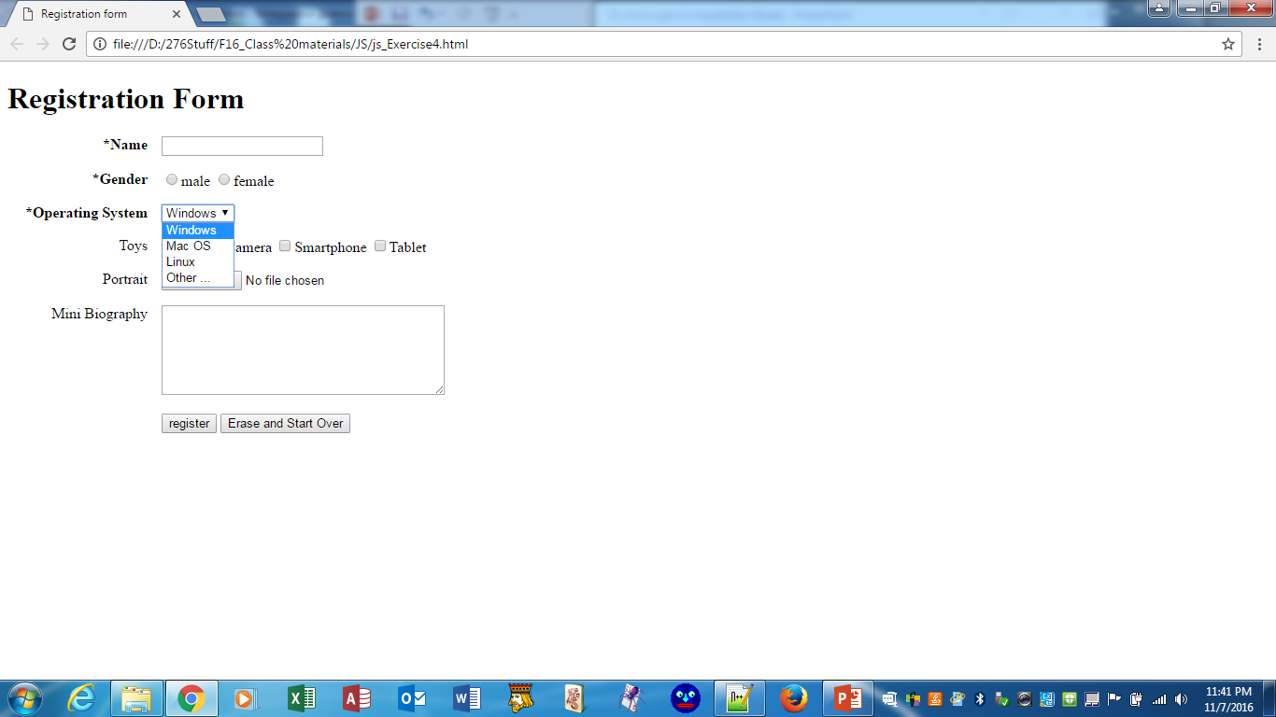
Still Your Turn!
Create the form.
Style it with css.
Use a character code for the *
js_Exercise4

Slide 38
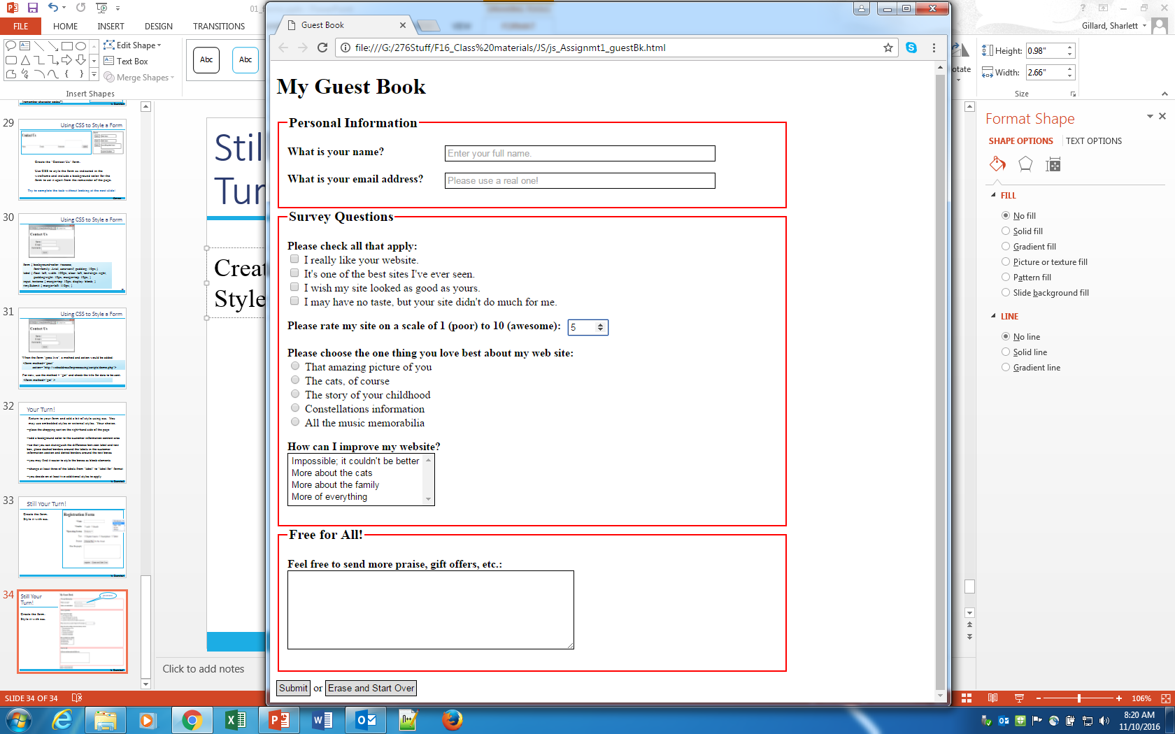
Still Your Turn!
Attribute of the text box:
Placeholder="…."
Forms Exercise
Create the form to the right.
--Find (and use) appropriate graphics for the two buttons instead of the text.
--Add a red * to the name and email address to indicate required fields.
--The form should be just a bit wider than the widest object.
--The textarea should have at least one additional option (your choice) beyond the four being displayed.
Style your form with css.
js_Assignmt1_guestBk

Slide 39
<head>https://www.w3schools.com/css/css_rwd_viewport.asp
<meta charset="utf-8" />
<!-- meta is often used to provide info for search engines using name and content attributes-->
<meta name = "Title" content = "Don Quixote" />
<meta name = "Author" content = "Miguel Cervantes" />
<meta name ="keywords" content = "novel, Spanish literature, groundbreaking work" />
<meta name="viewport" content="width=device-width, initial-scale=1.0" />
<link rel="stylesheet" type="text/css" media="only screen and (min-device-width: 1025px)"
href="mls.css" />
<link rel="stylesheet" type="text/css" media="only screen and (max-device-width: 1024px)"
href="mlsmob.min.css" />
<link rel="stylesheet" type="text/css" media="print" href="mlsprint.css" />
<!--[if lt IE 10]>
<link rel="stylesheet" type="text/css" media="screen" href="mls.css" />
<![endif]-->
<link rel="shortcut icon" href="favicon.ico" />
<title>Murfreesboro Literary Society</title>
<script src="scripts/mls.js"></script>
</head>
Viewport example: https://www.w3schools.com/css/css_rwd_viewport.asp
Notes:
Responsive Web design is the approach that suggests that design and development should respond to the user’s behavior and environment based on screen size, platform and orientation. The practice consists of a mix of flexible grids and layouts, images and an intelligent use of CSS media queries. As the user switches from their laptop to iPad, the website should automatically switch to accommodate for resolution, image size and scripting abilities. In other words, the website should have the technology to automatically respond to the user’s preferences. This would eliminate the need for a different design and development phase for each new gadget on the market.
See: https://www.w3schools.com/css/css_rwd_intro.asp

