Slide 1
Goals
Describe common uses of JavaScript in web pages
Illustrate Object, Property, Method and dot construct
Create simple scripts using the script element
Determine placement of scripts and page rendering
Use getElementById, innerHTML, prompt, alert, variables, addition
hello_comments
ById_innerHTML
variables
js_Exercise5_task5

Slide 2
Server-Side Scripting Technologies
ColdFusion http://www.adobe.com/products/coldfusion
PHP http://www.php.net
Ruby on Rails http://www.rubyonrails.org
Microsoft’s .NET Framework http://www.microsoft.com/net

Slide 3
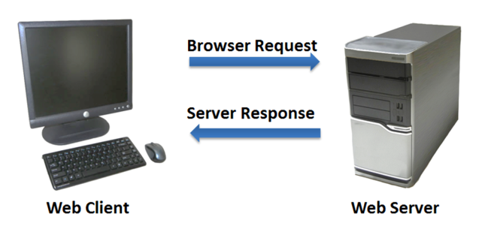
Common Uses of Server-Side Scripting
Search a database
Place an order at an online store
Send a web page address to a friend
Subscribe to a newsletter

Slide 4
Common Uses of JavaScript
Client Side
Display a message box
Edit and validate form information
Select list navigation (drop-down & side-bar)
Create a new window with a specified size and screen position
Display status messages
Display current date
Calculations

Slide 5
Is JavaScript the same as Java?
JavaScript
Java
Object-based scripting language
Not compiled; its scripts are interpreted (read line-by-line) by a browser
Works with the objects associated with a Web page document
window, document, forms, images, hyperlinks, etc.
Client-side processing
Programming language that competes with C, C++ and other languages, for developing complex applications.
Compiled (for syntax errors) and Interpreted (converted to virtual machine code)
Read by any platform using a Java interpreter.
Notes:
Basically, compiled code can be executed directly by the computer's CPU. That is, the executable code is specified in the CPU's "native" language (assembly language). The code of interpreted languages however must be translated at run-time from any format to CPU machine instructions.

Slide 6
Object
JavaScript is called an object-oriented language because it works with HTML objects. So what is an object?
An object is a thing or entity
Browser window
Submit button
Web page document
HTML form element

Slide 7
Property
A property is a characteristic or attribute of an object, for example…
The background color of a web page document document.bgcolor (object.property)
The date the web page file was last modified document.lastmodified (object.property)
The src file of an image object
image1.src (object.property)

Slide 8
Method
A method is an action (a verb), such as:
Writing text to a web page document
document.write() (object.method)
Submitting a form
form1.submit() (object.method)
Finding an element on an HTML page
document.getElementById() (object.method)

Slide 9
Dot Construct: Object.Property.Method
To put it another way…
Let's say you have a book. That's an object.
The book is a paperback. That's a description of the object…
A property.
You read the book. That's an action to take with the object…
A method.
JavaScript, like many languages, uses a "dot" construct to separate
JavaScript: book.paperback.read( );

Slide 10
Coding JavaScript
In an external file with a .js extension
Embedded in the HTML page <head> element
In the <body> element as part of an event attached to an HTML element
Unlike CSS, where the external file replaced the use of HTML embedded and/or inline tags, it is common for JS to be used in all three locations depending on the need.

Slide 11
Additional JavaScript Coding Requirements
In a file with a .js extension:
add a link statement in the HTML <head> element:
<script type="text/javascript" src="path/file.js"></script>
Embedded in the HTML page <head> element:
code between <script> </script> tags
<script>
….
</script>
in the <body> element as part of an event:
code between <script> </script> tags
<h1>Is it summer yet?!</h1>
<script>
document.write("<p>Today's date is: " + Date()+"</p>");
</script>
<h2>Sorry, No; it isn't summer yet!</h2>

Slide 12
Coding JavaScript, cont.
Loaded as a separate file (preferable) makes js code available to the entire site.
Embedded in the HTML page <head> element makes js code available to the entire page.
When imbedded in the HTML, the placement of js code depends on when it is needed:
--Recall that code in an HTML page is rendered
sequentially. So any js at the top of the <body> element
is rendered before any subsequent HTML code.
--Embedded near the bottom of the <body> allows HTML
elements that will be referenced by the js, to be rendered before
the js.

Slide 13
Getting Started
Open hello_comments
Note that the script is in the <head> element.
1) Render the page and check the sequence presented.
2) Move the script into the <p>. Render and check sequence again.
3) Add the following code before document.write …
window.alert("Welcome to my web page!");
4) Move the line of code after document.write and check sequence in Chrome and Firefox
5) Copy/paste the following code after window.alert….
Object .method
Object .property
document.bgColor="#ffff00";
document.write("<p>This document was last modified on:</p>");
document.write(document.lastModified);
document.write("<p>Today's date is: " + Date()+"</p>");
Case and punctuation are critical. Try it with a lower-case c for Color.
hello_comments

Slide 14
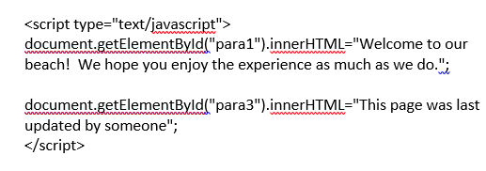
getElementById and innerHTML
document.write property adds content to a page. You can also replace content.
Open ById_innerHTML
Add the following in the <body>, after the HTML.
ById_innerHTML

Slide 15
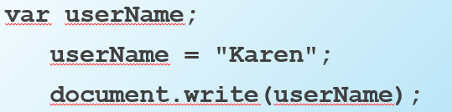
Variable 1
A variable is a placeholder for information.
The variable is stored in the computer’s random access memory (RAM).
Open variables.html
Add the above, within a script, to the file.
variables

Slide 16
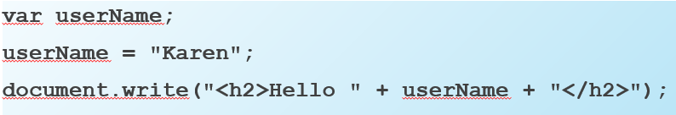
Variable 2
A variation of the previous illustration includes an HTML h2 element and the + to concatenate. Note:
1) <h2>Hello is in "", indicating string data type
2) username has no "" marks, indicating a value
3) there is a space after Hello for sentence structure
Add the document.write… statement to your variables file, just below the previous code.
variables, cont.

Slide 17
Prompt
prompt() method
Displays a message and accepts a value from the user
var myname = prompt("What is your name?");
document.write(myname);
The value typed by the user is stored in the variable myName and then written to the document.
Add the myname… code to your variables file, just below the previous code.

Slide 18
SO FAR….
object.property.method
document.bgColor
document.write(…)
alert
prompt
concatenation: +
text "…"
Function i.e., Date()
getElementById, innerHTML
Declare a variable: var variablename;
Use a variable: varname or method(varname)

Slide 19
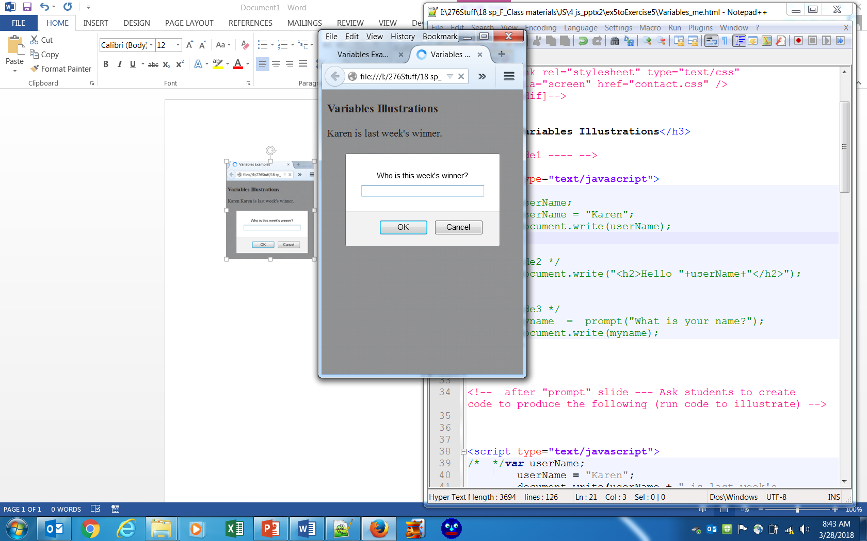
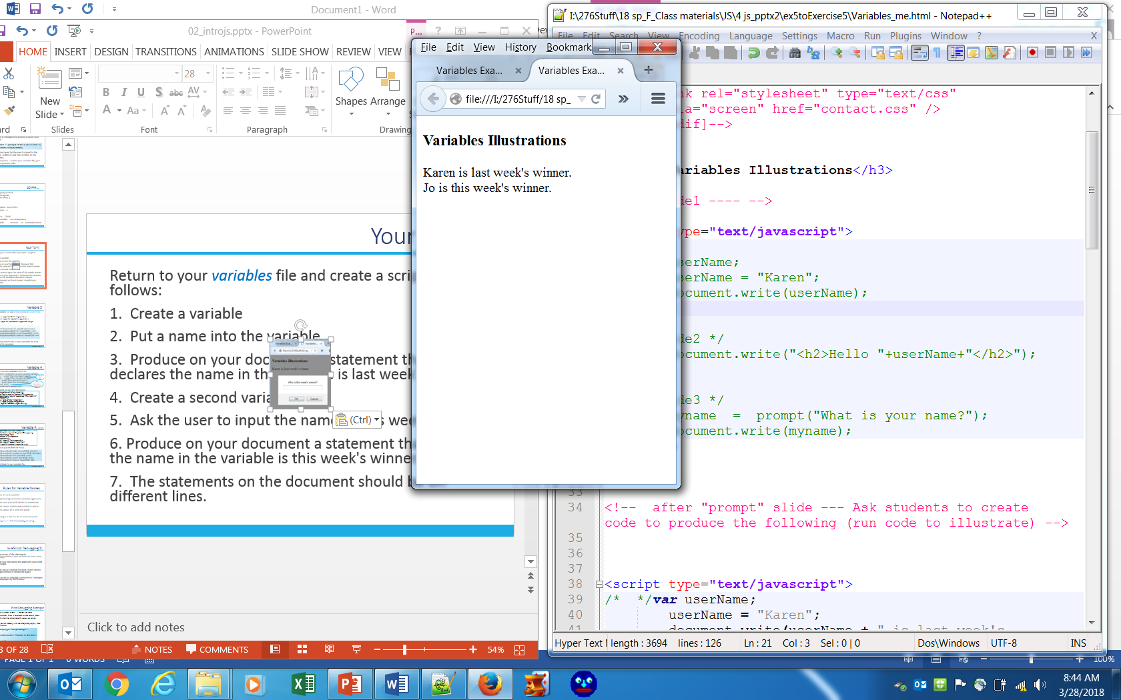
Your Turn!
Return to your variables file and create a script as follows:
1. Create a variable
2. Put a name into the variable
3. Produce on your document a statement that declares the name in the variable is last week's winner.
4. Create a second variable
5. Ask the user to input the name of this week's winner.
6. Produce on your document a statement that declares the name in the variable is this week's winner.
7. The statements on the document should be on different lines.
Illustrations are in Firefox and may render differently in Chrome.

Slide 20
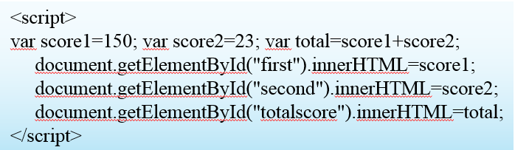
Variable 3
Now combine var and getElementById( ).innerHTML
<p>Score 1: <span id="first"></span><br />
Score 2: <span id="second"></span><br />
Total: <span id="totalscore"></span><br /></p>
Add the above script to your variables file after the HTML provided.
variables, cont.

Slide 21
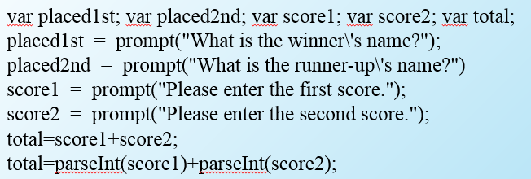
Variable 4
Script block to be placed before the HTML
Note the \ before the '
This concatenates; must convert to integer to add
HTML code block for our next illustration
<p>Congratulations to all of our winners!</p>
<p>In First Place is: <span id="firstplace">TBA</span></p>
<p>In Second Place is: <span id="secondplace">TBA</span></p>
<h2>Expressions</h2>
<p>Score 1: <span id="first"></span><br />
Score 2: <span id="second"></span><br />
Total: <span id="totalscore"></span><br /></p>
variables, cont.

Slide 22
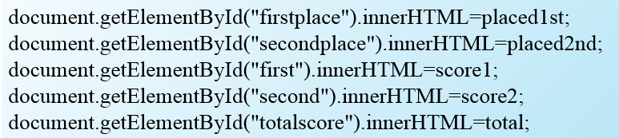
Variable 4, cont.
<p>Congratulations to all of our winners!</p>
<p>In First Place is: <span id="firstplace">TBA</span></p>
<p>In Second Place is: <span id="secondplace">TBA</span></p>
<h2>Expressions</h2>
<p>Score 1: <span id="first"></span><br />
Score 2: <span id="second"></span><br />
Total: <span id="totalscore"></span><br /></p>
Script block to be placed after the HTML
Add both script blocks to your variables file.
variables, cont.

Slide 23
Rules for Variable Names
*names are case-sensitive
*programming convention excludes upper-case
*names must start with a letter or underscore
*names cannot contain punctuation or spaces
*names cannot be js reserved words
Following is a link to a list of reserved words:
http://www.w3schools.com/js/js_reserved.asp

Slide 24
JavaScript Debugging(1)
Check the syntax of the statements
Pay very close attention to upper and lower case letters, spaces, and quotations
Verify that you have saved the page with your most recent changes
Verify that you are testing the most recent version of the page (refresh or reload the page)
If you get an error message, use the error messages that are displayed by the browser

Slide 25
First Debugging Example
Add the window.alert(…) below to your variables file. Run it to observe the result; then misspell alert to intentionally cause an error.
When you run the script with the misspelled property, there will be no alert.
<script type="text/javascript">
window.aalert("Welcome to Our Site");
</script>
variables, cont.
Notes:
<script type="text/javascript">
<!- -
window.aalert("Welcome to Our Site");
// - ->
</script>
Note the <!-- and // > tags used for legacy browsers and instances where JavaScript is disabled.

Slide 26
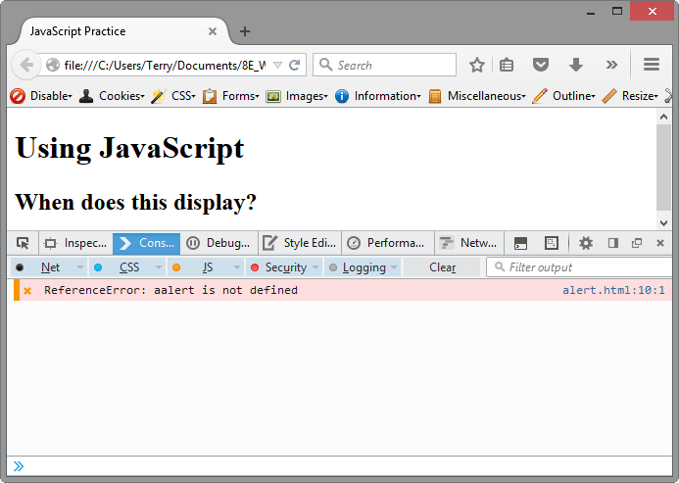
JavaScript Debugging(2)
Using the Firefox browser:
Select the top right menu icon (“Hamburger” icon)
Select Developer > Web Console (Ctrl-Shift-K)
The Web Console will indicate an issue and the line number
This may not be exactly where
the problem is
Sometimes the error is one or two lines above the indicated line number.
Ctrl-Shift-K without going through the hamburger will also work.

Slide 27
Your Turn!
Use a single web page for tasks 1-4. Label each task, and where feasible, leave space between each (blank lines).
Task 1: Prompt the user for the name of a song and print the song name in the document.
Task 2: Prompt the user for a name and age, and write a message using the name and age. Use the prompt() method and variables. End the sentence with a period.
Task 3: Create an alert message that welcomes the user to the web page. Use a script block in the head section.
js_Exercise5

Slide 28
Still Your Turn!
Task 4: The goal is to allow the user to specify a background color that is then applied to the document background and a text color that is applied to all document text.
Use prompts and variables.
Colors could be red, blue, green, orange, or whatever the user decides (do not ask for hex).
Use the bgColor and the fgColor properties to apply the choices.
js_Exercise5

Slide 29
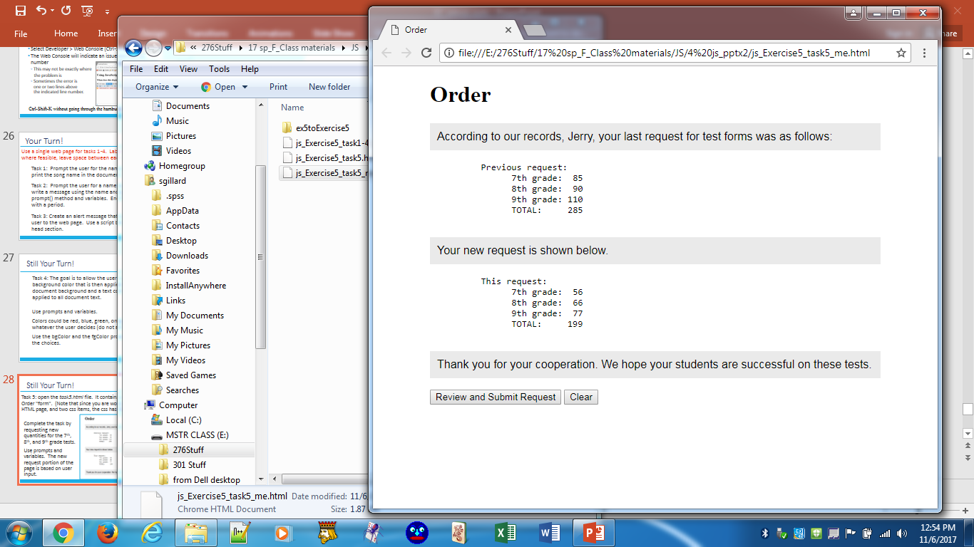
Still Your Turn!
Task 5: open the task5.html file. It contains a rudimentary Order "form" already styled with CSS.
Complete the task by requesting new quantities for the 7th, 8th, and 9th grade tests.
The new data is from that user input.
Use prompts and variables.
js_Exercise5 task5

