Slide 1
Goals
Create and use functions
From HTML, Call scripts in JS file
car rental seque and functions1 folder
task1 car rental & task2 4variables folder
porsche.html
display_vs_visibility folder
cars_mouseover.html
Faq – student.html

Slide 2
Function
A function is a block of one or more JavaScript statements, with a specific purpose, that can be run when needed.
function function_name() {
... JavaScript statements …
}
syntax:
function showalert() {
alert("Please click OK to continue.");
}
Define in js:
Call from html or js:
showalert();

Slide 3
Function Illustration
xyz.js file….
function usrname() {
var user;
user = prompt("Please enter your name");
alert("Thank you," + user);
}
xyz.html file….
<body>
<h1>Using JavaScript</h1>
<input type="button" value="Click to enter your name" onClick="usrname();">
</body>
Open functions1.html
functions1_students

Slide 4
Segue into Functions
Open car_rental_pptx4_functions_segue.html
Car Rental Revisited
Consider how cluttered our HTML will become if we continue to add scripts and events. It is time to separate the JavaScript.
Recall:
--rates are $75.30/day & $6.79/hour late
--text boxes are used to obtain days and hours
--a button with an onClick event triggers calculation and display
--2 decimals specified for $ amounts
Changes
--create a new file in Notepad++ and save it as car_rental.js
--in the head area of the HTML, add a link to the js file
--move all of the onClick= actions into the js file
--add function rental ( ) above the statements and { } around them
--in HTML after onClick= add "rental()" and be sure the /> closes input

Slide 5
Your Turn!
Task 1
Open task1_car_rental_pptx4_student.html
Improve the Car Rental program by tweaking it to pass the days_out and hrs_over as arguments of the js function. Also, code variables in the js function for the two rates ($75.30/day and $6.79/hour). Calculate Total Cost using variables.
Task 2
Open task2_4variables_student.html
This is from the functions file we have been using. Tweak the last illustration to pass four variables: the price of a packet of corn and peas and the qty being ordered. Calculate Total Cost using variables.

Slide 6
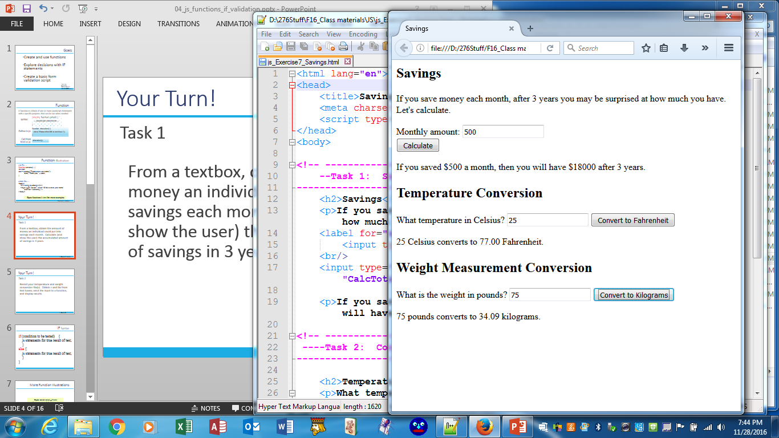
Your Turn!
Task 3
Code the HTML and js. From a textbox, obtain the amount of money an individual could put into savings each month. Calculate (and show the user) the accumulated amount of savings in 3 years. Include a call to a js function.
js_Exercise7_savings

Slide 7
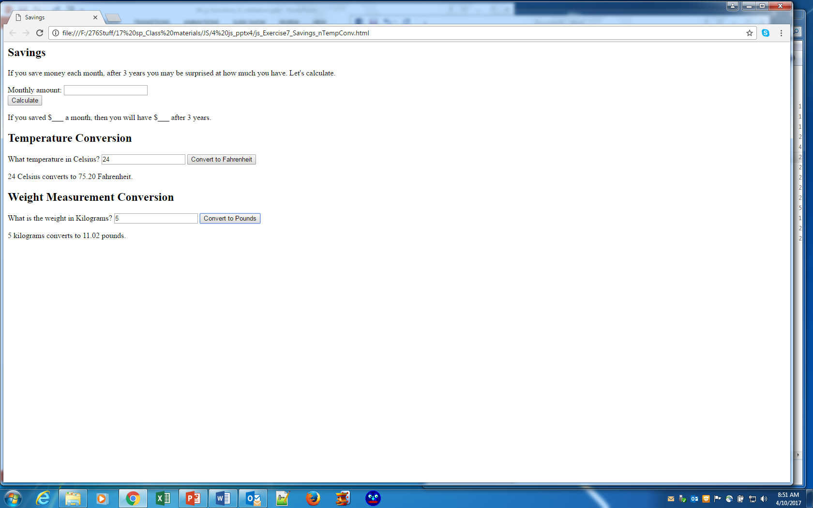
Your Turn!
Task 4
Revisit your temperature and weight conversion file(s). Obtain c and kgs from text boxes; send the input to a function, and display results.
js_Exercise7_savings

Slide 8
Hide/Show: Display vs Visibility
Open display_visibility.html
display_visibility.js
Display:"none" removes the element and collapses the space
Visibility:"hidden" retains the space but hides the element
<script>
function removeElement() {
document.getElementById("cardisplay").style.display = "none";
}
function changeVisibility() {
document.getElementById("carvisibility").style.visibility = "hidden";
}
function resetElement() {
document.getElementById("cardisplay").style.display = "block";
document.getElementById("carvisibility").style.visibility = "visible";
}
</script>

Slide 9
Function to Hide/Show
Open porsche.html
Code a link to a js file
Create and save the js file
We will do these steps together:
--In the HTML file, add an onLoad event in the body element to call the function, hidecar
--Look at the 2 ids in the HTML. What are they for?
--Now code 2 functions: one to hide and one to show the car.

Slide 10
Your Turn!
Open cars_mouseover.html
Code a link to a js file
Create and save the js file
--In the HTML file, add an onLoad event in the body element to call a function(s) to hide all detail text
--add onMouseover in <img> element tags to show details
--add onClick to <span> elements to allow a way to hide detail text (words: "hide detail" not a button)
--add ids in appropriate <td> elements to show/hide <td>
--Code js functions to hide and to show detail text for each car

Slide 11
Your Turn!
Open faq - student.html
Code a link to a js file
Create and save the js file
In the HTML file, add
--onLoad event in the body element
--onClick events in all <h2> elements
--2 ids in each <p> element
In the js file, code 5 functions

