Slide 1
students need
conditional2_if.html
conditional2_if.js
js_Exercise 9_tshirts_students.html
conditional3_radio_chkbox.html
conditional3_radio_chkbox.js
myCart.html
validation folder
conditional_if.html
conditional_if.js
conditional1_if.html
conditional1_if.js
case_illustrated.html
case_illustrated.js
js_Exercise8_softball_students.html

Slide 2
Goals
Explore IF statements
Examine Case structure
Check elements for
equality less than greater than
existence length range
string numeric
Create a basic form validation script for
Text boxes
Check boxes
Radio buttons

Slide 3
IF Syntax
if (condition to be tested) {
js statements for true result of test;
}
else {
js statements for false result of test;
}
else is not required; when omitted, nothing happens if condition is false

Slide 4
IF Illustrations
conditional_if.html
/* -- 1st if statement; result: "true" --*/
if ((20/2)==10){
document.write("true" + "<br>");
}
else{
document.write("false" + "<br>");
}
/* -- 2nd if statement; result: "false" --*/
if ((20/2)!=10){
document.write("true" + "<br>");
}
else{
document.write("false" + "<br>");
}
/* -- 3rd if statement; result: "true" --*/
if ((20/3)!=10) {….}
/* -- 4th if statement; result: "true" --*/
if ((20/2)>=10) {….}
/* -- 5^{h} if statement; result: "false" --*/
var value1="Jennifer"; var value2="jennifer";
if (value1==value2){
document.write("true" + "<br>");
}
else{
document.write("false" + "<br>");
}
conditional_if.html

Slide 5
Use caution when the js is "document.write" instead of .innerHTML="…" If other text is already on the document screen, the document.write may replace everything else.
HTML:
<input type="button" value="Try"
<span onClick="tryme();">calc</span>
JS:
function tryme(){
var score1=100; var score2=50; var tot;
tot=parseInt(score1)+parseInt(score2);
document.write(tot);
}

Slide 6
Function with IF
xyz.html file….
<body>
<h1>Using JavaScript</h1>
<input type="button" value="Click to enter quantity" onclick="prompt_quantity();">
</body>
xyz.js file….
function prompt_quantity() {
var quantity= prompt("Please enter a quantity greater than 0");
if (parseInt(quantity) <= 0) {
alert("Quantity is not greater than 0.");
}
else {
alert("Thank you for entering a quantity greater than 0.");
}
}

Slide 7
More Function Illustrations
Previous slide and additional illustrations are in
conditional1_if.html
conditional1_if.js
Please open those files.
Note the use of or, blank, null, not equal; switch case introduced
(st == "IN" || st=="in")
(parseInt(userage)=="" || userage == null)
(parseInt(useranswer) != 4)
conditional1_if.html & conditional1_if_students.js
Notes:
1.A NULL value represents the absence of a value in a field
2.An empty value is a "field-formatted" value with no significant data in it.
3.NULL isn't allocated any memory; however, Empty IS allocated to a memory location, although the value stored in the memory is "".
4.Null has no bounds, it can be used for string, integer, date, etc. fields. Empty string is just regarding a string.

Slide 8
SWITCH CASE ILLUSTRATED
function chk_color(mycolor)
{
switch (true)
{
case (mycolor=="blue"):
document.bgColor = "#00f";
break;
case (mycolor=="green"):
document.bgColor = "#0f0";
break;
case (mycolor=="red"):
document.bgColor = "#f00";
break;
case (mycolor=="orange"):
document.bgColor = "#f60";
break;
default:
document.bgColor = "#000";
}
}
Open case_illustrated.html

Slide 9
Your Turn!
Open js_Exercise8_softball_students.html
to begin and for additional instructions.
Determine the winner of a "tiny tots" softball competition. There are only 2 innings. Record the number of runs for each team in input text boxes and then use a button to call a function that calculates the score at any time during the game.
Display the score for each team for each inning; the total score for each team; and the name of the winning team (names are Purple and Yellow).
js_Exercise8_softball

Slide 10
More Function Illustrations
Please open
conditional2_if.html
conditional2_if.js
Note the use of length and onchange; case revisited
(usernum.length == 7)
onchange="pageColor(pagecolor.value)"
conditional2_if.html

Slide 11
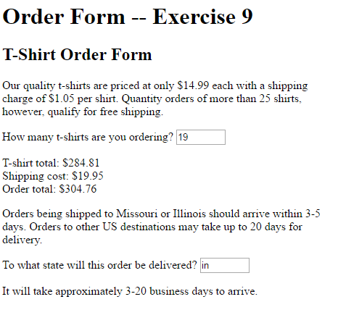
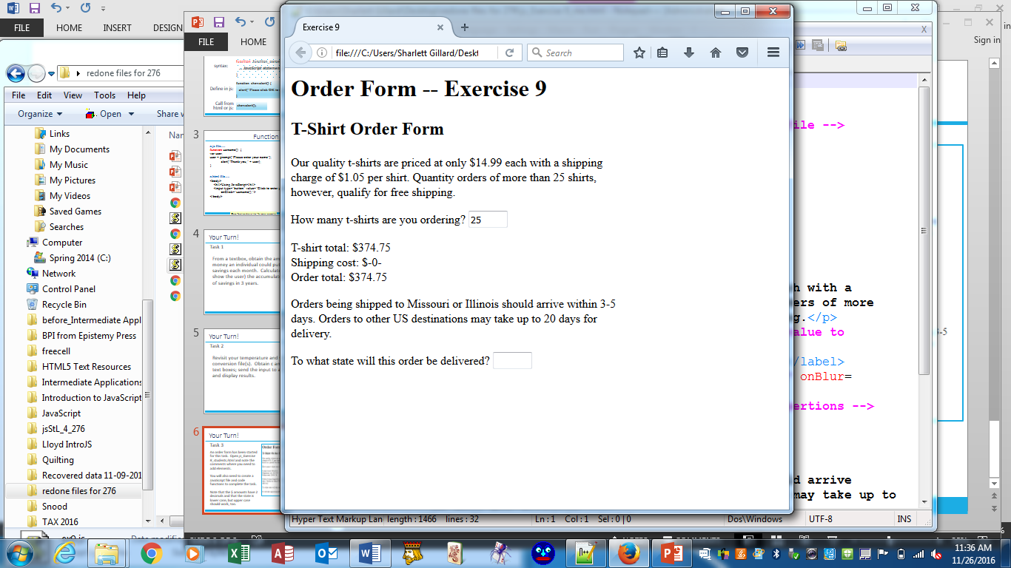
Your Turn!
Open js_Exercise9_tshirts_students.html
to begin and for additional instructions.
An order form has been started for this task. Note the comments where you need to add elements.
You will also need to create a JavaScript file and code functions to complete the task.
Note that the $ amounts have 2 decimals and that the state is lower case; but upper case should work, too (consider using .toUpperCase)
js_Exercise9_tshirts

Slide 12
More Function Illustrations
Please open
conditional3_radio_chkbox.html
conditional3_radio_chkbox.js
Note the use of case, if, "priming" variables, assembling a list or message
var note="";
var chcheese="false";
note+=showcheese;
conditional3_radio_chkbox

Slide 13
Your Turn!
Open myCart_students.html
to begin and for additional instructions.
From the checkboxes provided, create a shopping cart that displays when a button is pressed.
Another button should clear the cart.
js_Exercise8_softball

Slide 14
Form Validation
It is common to use JavaScript to validate form information before submitting it to the web server.
Is the name entered?
Is the e-mail address of correct format?
Is the phone number in the correct format?
The primary addition to our previous exercises is accessing form elements and returning a value (true/false) to the HTML.
Please open
form_validation_example1.html
form_validation_example1.js
form_validation_example2.html
form_validation_example2.js
form_validation

Slide 15
Your Turn!
Open validateforms folder
to begin and for additional instructions.
The html file contains multiple forms. The first collects basic data (name, address, etc.). The next
A style sheet has already been created, but there is no link from html.
A js sheet has been created, but not coded nor linked from html.
Link everything together and then code as necessary to validate input on the forms.
vaiidate

Slide 16
That brings us to the end of our semester materials. Any remaining time may be used to complete your final project.
I have enjoyed our time together. I hope you have learned much.
Best of luck in all of your finals!

