Slide 1
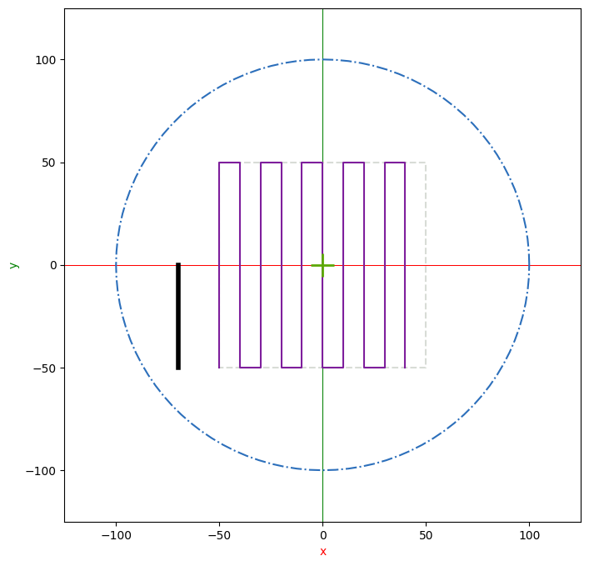

Slide 2
y width
1
2
3
4
5
6
7
8
pitch

