Slide 1
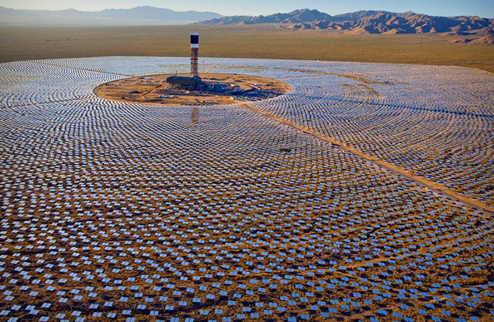

Module 4 Part 1 Electricity
Dr. Paul H. Comitz
pcomitz@live.com

Slide 2
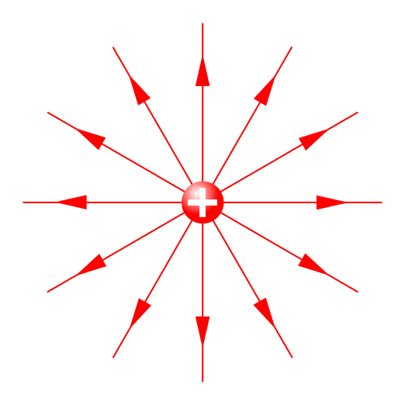
Agenda
Electric Charge
Coulombs Law
The Electric Field
Lab: Electricity
http://phet.colorado.edu/sims/charges-and-fields/charges-and-fields_en.html

Slide 3
Course Modules
# | Module | Weeks | Reading | Quiz
1 | Newton's laws | 1 | Ch 4,5 *
2 | Conservation of Energy and Momentum | 2,3 | Ch 6,7,8 | Quiz 1
3 | Thermodynamics | 4,5 | Ch 12,13,14
4 | Electromagnetism | 6,7 | Ch 17,18 | Quiz 2
5 | Waves, Sound, and Light | 8,9 | Ch 16, 20, 21 | Quiz 3
6 | Modern Physics | 10 | Ch 23 | Final Exam
* it is strongly recommended you read chapters 0 - 3

Slide 4
Module 4
Reading: Chapters 17,18
Chapter 17 – Basic Electricity
Chapter 18 = Magnetism
Exercise 4, due start of week 8 (4%)
Quiz 2 – next week in class
Discussion 2– due tonight (5%)
Labs
Gas Properties (3.75%)
Temperature and Heat (3.75%)

Slide 5
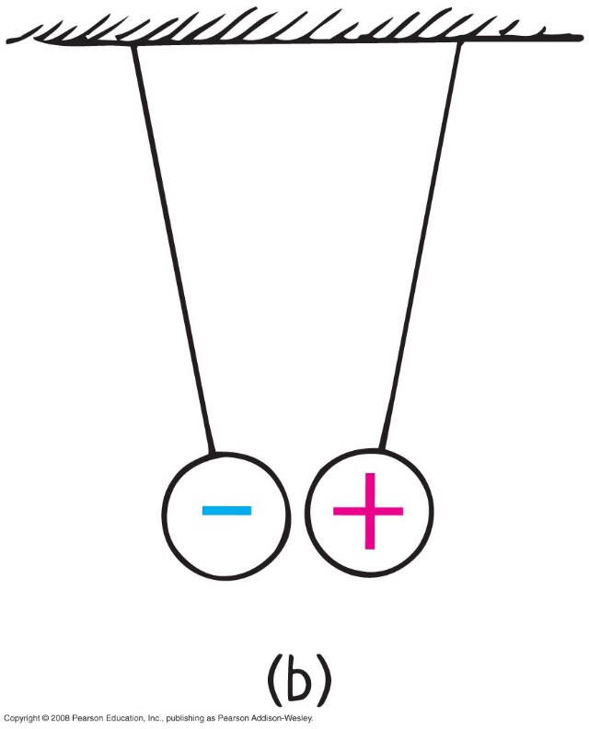
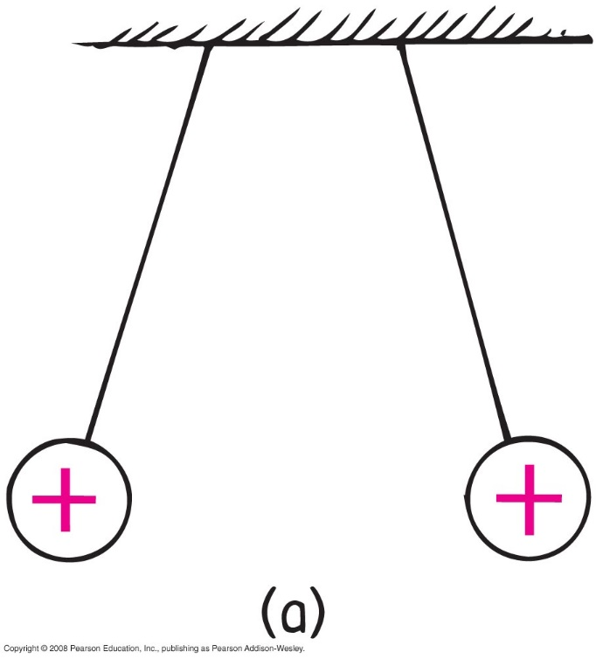
Electric Force and Charge
Central rule of electricity
opposite charges attract one another;
like charges repel

Slide 6
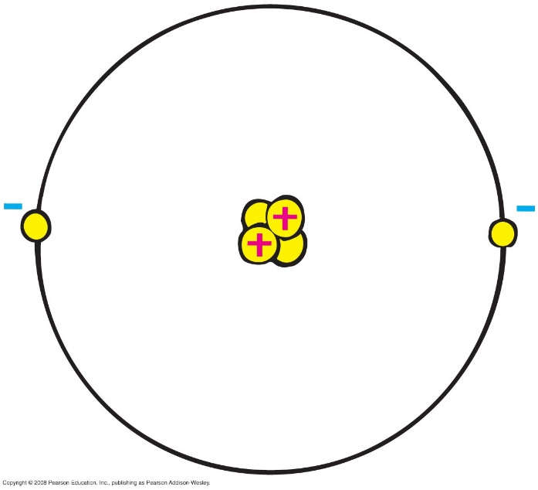
Electric Force and Charge
Protons
positive electric charges
repel positives, but attract negatives
Electrons
negative electric charges
repel negatives, but attract positives
Neutrons
neutral electric charge

Slide 7
Electric Force and Charge
Fundamental facts about atoms
1. Every atom is composed of a positively charged nucleus surrounded by negatively charged electrons.
2. Each of the electrons in any atom has the same quantity of negative charge and the same mass.

Slide 8
Electric Force and Charge
Fundamental facts about atoms (continued)
3. Protons and neutrons compose the nucleus. Protons are about 1800 times more massive than electrons, but each one carries an amount of positive charge equal to the negative charge of electrons. Neutrons have slightly more mass than protons and have no net charge.
4. Atoms usually have as many electrons as protons, so the atom has zero net charge.

Slide 9
Electric Force and Charge
Ion
positive ion—atom losing one or more electrons has positive net charge
negative ion—atom gaining one or more electrons has negative net charge

Slide 10
Electric Force and Charge
Electrons in an atom
Examples:
When rubbing a comb through your hair, electrons transfer from your hair to the comb. Your hair has a deficiency of electrons (positively charged).
When rubbing a glass rod with silk, electrons transfer from the rod onto the silk and the rod becomes positively charged.

Slide 11
When you brush your hair and scrape electrons from your hair, the charge of your hair is
Electric Force and Charge
CHECK YOUR NEIGHBOR
A. positive.
negative.
both A and B
neither A nor B
Notes:
A. positive.

Slide 12
When you brush your hair and scrape electrons from your hair, the charge of your hair is
Electric Force and Charge
CHECK YOUR ANSWER
A. positive.
negative.
both A and B
neither A nor B
Comment:
And if electrons were scraped off the brush onto your hair, your hair would have a negative charge.
Notes:
A. positive.

Slide 13

Electric Force and Charge
Conservation of Charge
In any charging process, no electrons are created or destroyed. Electrons are simply transferred from one material to another.

Slide 14
Coulomb’s Law
Coulomb’s law
relationship among electrical force, charge, and distance discovered by Charles Coulomb in the 18th century
states that for a pair of charged objects that are much smaller than the distance between them, the force between them varies directly, as the product of their charges, and inversely, as the square of the separation distance

Slide 15
Coulomb’s Law
Coulomb’s law (continued)
If the charges are alike in sign, the force is repelling; if the charges are not alike, the force is attractive.
in equation form:
k = 9,000,000,000 Nm²/C²
unit of charge is coulomb, C
similar to Newton’s law of gravitation for masses
underlies the bonding forces between molecules

Slide 16
According to Coulomb’s law, a pair of particles that are placed twice as far apart will experience forces that are
Coulomb’s Law
CHECK YOUR NEIGHBOR
A. half as strong.
one-quarter as strong.
twice as strong.
four times as strong.
Notes:
B. one quarter as strong.

Slide 17
According to Coulomb’s law, a pair of particles that are placed twice as far apart will experience forces that are
Coulomb’s Law
CHECK YOUR ANSWER
A. half as strong.
one-quarter as strong.
twice as strong.
four times as strong.
Notes:
B. one quarter as strong.

Slide 18
Coulomb’s Law
Differences between gravitational and electrical forces
electrical forces may be either attractive or repulsive
gravitational forces are only attractive

Slide 19
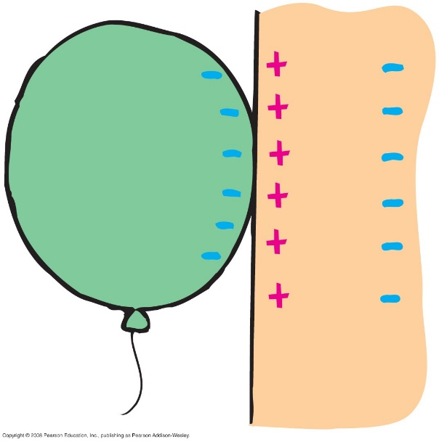
Coulomb’s Law
Charge polarization
Atom or molecule in which the charges are aligned with a slight excess of positive charge on one side and slight excess of negative charge on the other.
example: Rub an inflated balloon on
your hair and place the
balloon on the wall. The
balloon sticks to the wall
due to charge polarization in
the atoms or molecules of
the wall.

Slide 20
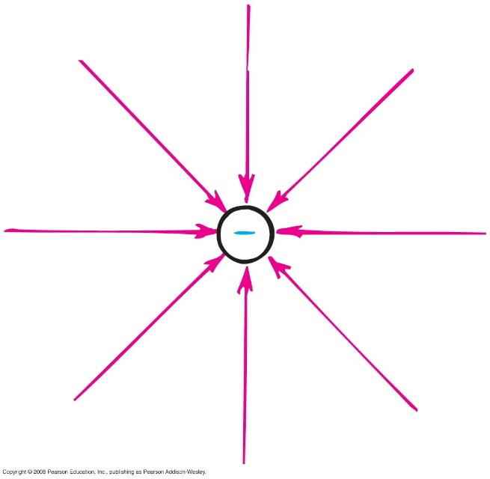
Electric Field
Electric field
space surrounding an electric charge (an energetic aura)
describes electric force
around a charged particle obeys inverse-square law
force per unit charge

Slide 21
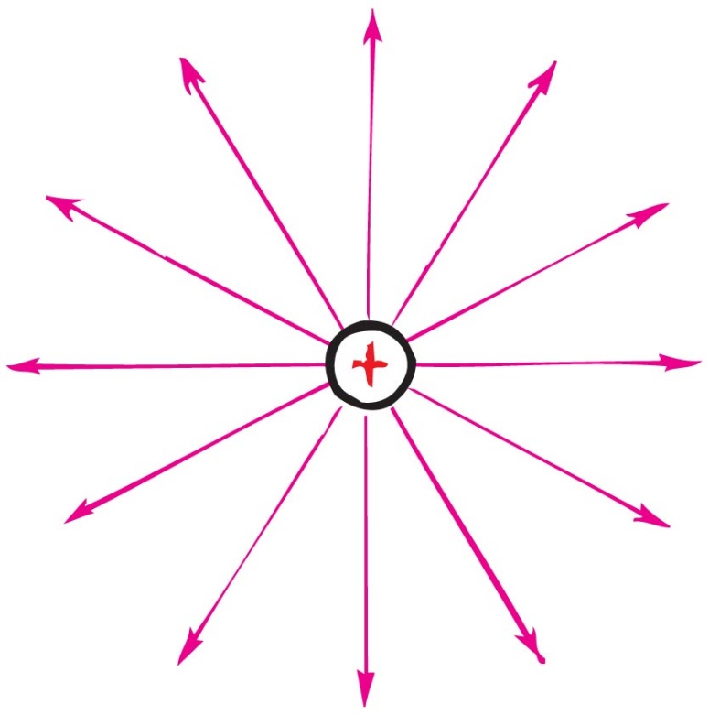
Electric Field
Electric field direction
same direction as the force on a positive charge
opposite direction to the force on an electron

