Slide 1
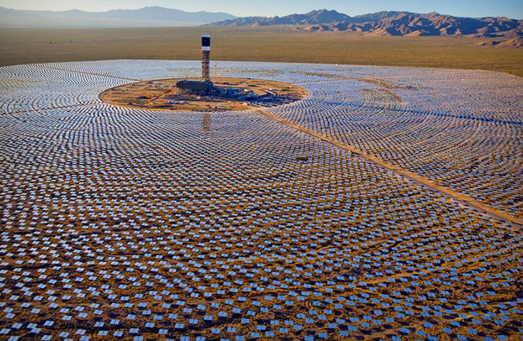

Module 4 Part 1 Electricity
Dr. Paul H. Comitz
pcomitz@live.com

Slide 2

Agenda
Electric Charge
Coulombs Law
The Electric Field
Ohm’s Law
Lab: Electricity
http://phet.colorado.edu/sims/charges-and-fields/charges-and-fields_en.html

Slide 3
Course Modules
# | Module | Weeks | Reading | Quiz
1 | Newton's laws | 1 | Ch 4,5 *
2 | Conservation of Energy and Momentum | 2,3 | Ch 6,7,8 | Quiz 1
3 | Thermodynamics | 4,5 | Ch 12,13,14
4 | Electromagnetism | 6,7 | Ch 17,18 | Quiz 2
5 | Waves, Sound, and Light | 8,9 | Ch 16, 20, 21 | Quiz 3
6 | Modern Physics | 10 | Ch 23 | Final Exam
* it is strongly recommended you read chapters 0 - 3

Slide 4
Module 4
Reading: Chapters 17,18
Chapter 17 – Basic Electricity
Chapter 18 = Magnetism
Exercise 4, due start of week 8 (4%)
Quiz 2 – next week in class
Labs
Electricity (3.75%)
Electromagnetic Lab (3.75%)

Slide 5
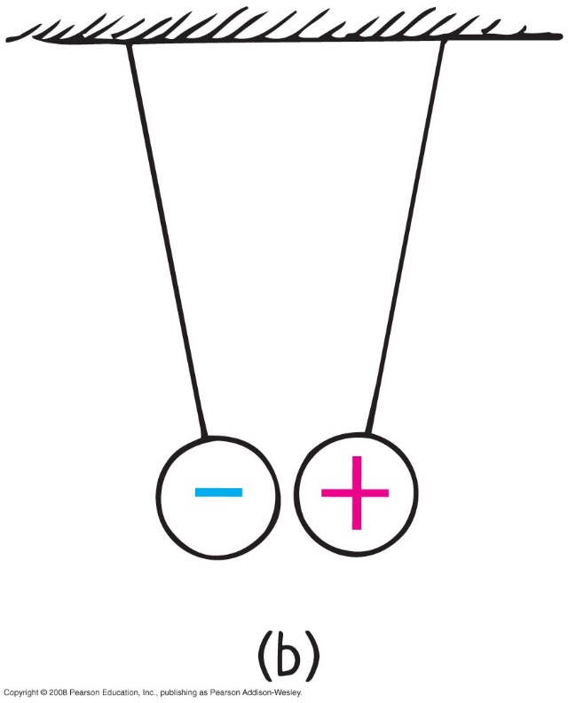
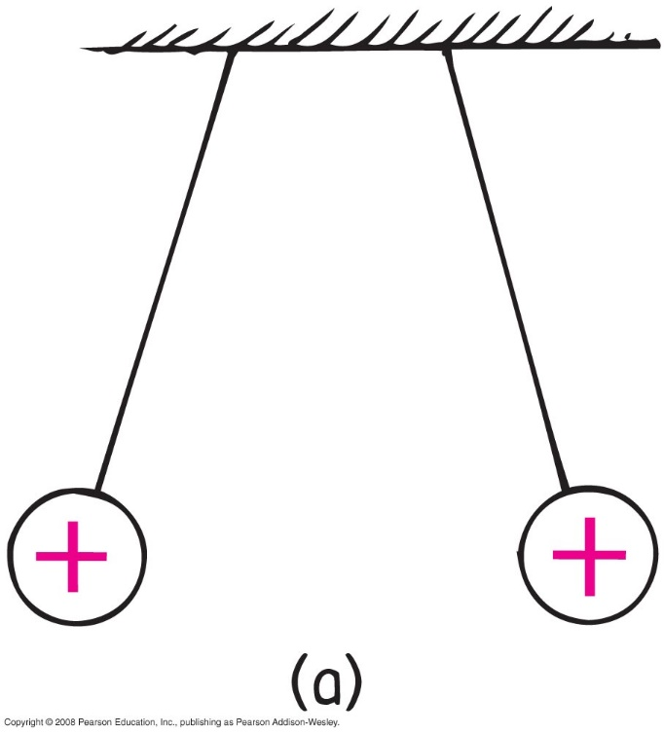
Electric Force and Charge
Central rule of electricity
opposite charges attract one another;
like charges repel

Slide 6
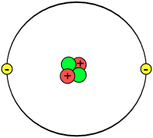
Electric Force and Charge
Protons
positive electric charges
repel positives, but attract negatives
Electrons
negative electric charges
repel negatives, but attract positives
Neutrons
neutral electric charge

Slide 7
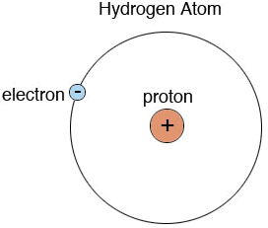
Electric Force and Charge
Fundamental facts about atoms
1. Every atom is composed of a positively charged nucleus surrounded by negatively charged electrons.
2. Each of the electrons in any atom normally has the same quantity of negative charge and the same mass.

Slide 8
Electric Force and Charge
Fundamental facts about atoms (continued)
3. Protons and neutrons compose the nucleus. Protons are about 1800 times more massive than electrons, but each one carries an amount of positive charge equal to the negative charge of electrons. Neutrons have slightly more mass than protons and have no net charge.
4. Atoms usually have as many electrons as protons, so the atom has zero net charge.

Slide 9

Electric Force and Charge
Ion
positive ion—atom losing one or more electrons has positive net charge
negative ion—atom gaining one or more electrons has negative net charge

Slide 10
Electric Force and Charge
Electrons in an atom
Examples:
When rubbing a comb through your hair, electrons transfer from your hair to the comb. Your hair has a deficiency of electrons (positively charged).
When rubbing a glass rod with silk, electrons transfer from the rod onto the silk and the rod becomes positively charged.

Slide 11
When you brush your hair and scrape electrons from your hair, the charge of your hair is
Electric Force and Charge
CHECK YOUR NEIGHBOR
A. positive.
negative.
both A and B
neither A nor B
Notes:
A. positive.

Slide 12
When you brush your hair and scrape electrons from your hair, the charge of your hair is
Electric Force and Charge
CHECK YOUR ANSWER
A. positive.
negative.
both A and B
neither A nor B
Comment:
And if electrons were scraped off the brush onto your hair, your hair would have a negative charge.
Notes:
A. positive.

Slide 13

Electric Force and Charge
Conservation of Charge
In any charging process, no electrons are created or destroyed. Electrons are simply transferred from one material to another.

Slide 14
Coulomb’s Law
Coulomb’s law
relationship among electrical force, charge, and distance discovered by Charles Coulomb in the 18th century
states that for a pair of charged objects the force between them varies directly, as the product of their charges, and inversely, as the square of the separation distance
electrical forces may be either attractive or repulsive

Slide 15
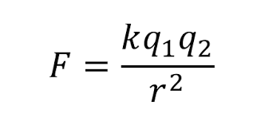
Coulomb’s Law
Coulomb’s law (continued)
If the charges are alike in sign, the force is repelling; if the charges are not alike, the force is attractive.
in equation form:
k = 9,000,000,000 Nm²/C²
unit of charge is coulomb, C

Slide 16
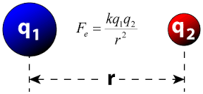
Coulomb’s Law

Slide 17
According to Coulomb’s law, a pair of particles that are placed twice as far apart will experience forces that are
Coulomb’s Law
CHECK YOUR NEIGHBOR
A. half as strong.
one-quarter as strong.
twice as strong.
four times as strong.
Notes:
B. one quarter as strong.

Slide 18
According to Coulomb’s law, a pair of particles that are placed twice as far apart will experience forces that are
Coulomb’s Law
CHECK YOUR ANSWER
A. half as strong.
one-quarter as strong.
twice as strong.
four times as strong.
Notes:
B. one quarter as strong.

Slide 19
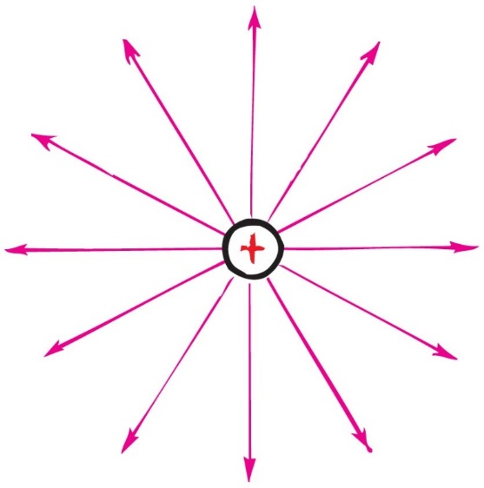
Electric Field
Electric field
Charge exhibits an electric field
space surrounding an electric charge (an energetic aura)
describes electric force
around a charged particle obeys inverse-square law
force per unit charge

Slide 20
Electric Potential
Electric potential difference
Energy possessed by a charged particle due to its location in an electric field.
Charge flows from higher potential to lower potential
A difference in potential between two points
charges in conductor flow from higher potential to lower potential
maintained for continuous flow by pumping device
A battery or generator can maintain a steady flow of charge

Slide 21
Electric Current
Rate of electric flow
measured in ampere (1 coulomb of charge per second)
charge flows through a circuit; voltage is established across a circuit
Relationship of current flow to material resistance and voltage (electrical potential)
OHMS LAW
V = IR

Slide 22
Ohm’s Law
Ohm’s law
relationship between voltage, current, and resistance
states that the current in a circuit varies in direct proportion to the potential difference, or voltage, and inversely with the resistance

Slide 23
Ohm’s Law
Ohm’s law (continued)
in equation form:
example:
for a constant resistance, current will be twice as much for twice the voltage
for twice the resistance and twice the voltage, current will be unchanged
Resistors
circuit elements that regulate current inside electrical devices

Slide 24
Electric Circuits
Circuits
connected in two common ways
series
forms a single pathway for electron flow between the terminals of the battery, generator, or wall outlet
parallel
forms branches, each of which is a separate path for the flow of electrons

