Slide 1

Conceptual Physics Fundamentals
Chapter 14:
PROPERTIES OF LIGHT

Slide 2
This lecture will help you understand:
Reflection
Refraction
Dispersion
Total Internal Reflection
Lenses
Polarization

Slide 3
Properties of Light
“I will love the light for it shows me the way. Yet I will endure the darkness for it shows me the stars.”
—Og Mandino

Slide 4
Reflection
Angle of incidence
  angle made by the incoming ray and the perpendicular
Angle of reflection
  angle made by the reflected ray and the perpendicular
Normal
  imaginary line perpendicular to the plane of the reflecting surface
  lies in the same plane as the incident and reflected rays

Slide 5
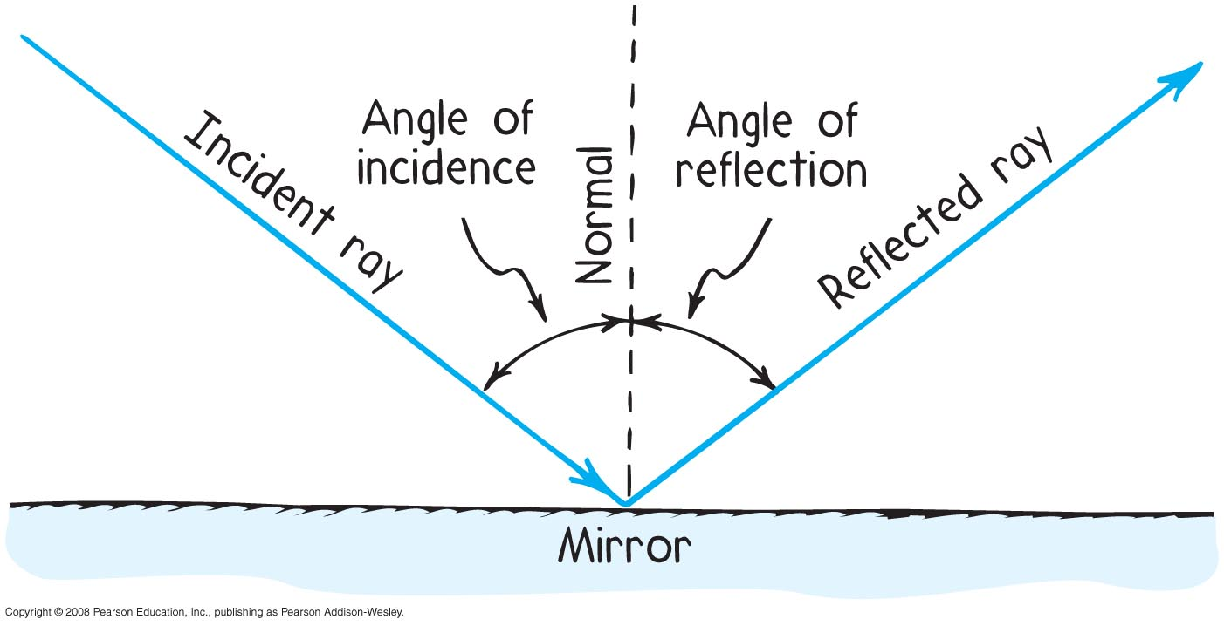
Reflection
Law of reflection
The angle of reflection equals the angle of incidence.

Slide 6
The law of reflection applies to
Reflection
CHECK YOUR NEIGHBOR
A. light.
sound.
both A and B
D. none of the above
Notes:
C. both of the above.

Slide 7
The law of reflection applies to
Reflection
CHECK YOUR ANSWER
A. light.
sound.
both A and B
none of the above
Notes:
C. both of the above.

Slide 8
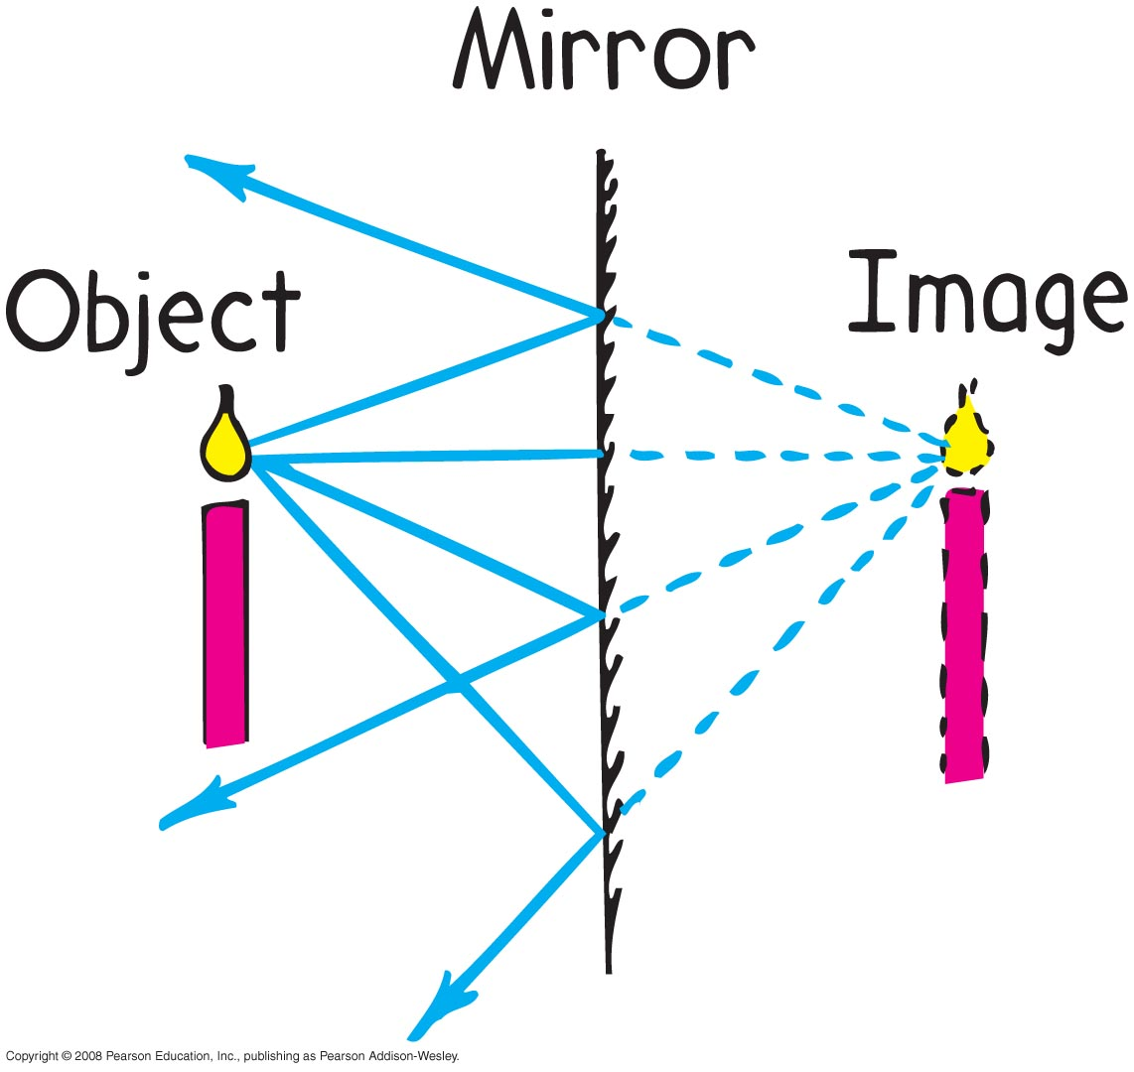
Reflection
Virtual image
is same size as object, formed behind a mirror, and located at the position where the extended reflected rays converge
as far behind the mirror as the object is in front of the mirror

Slide 9
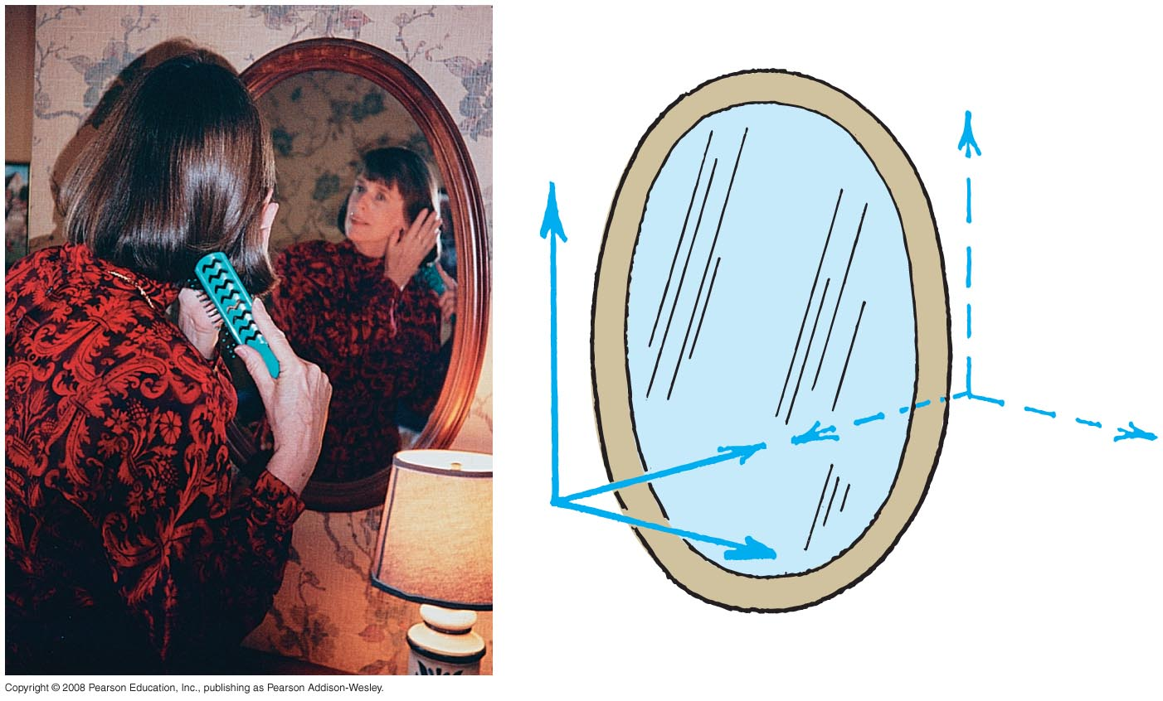
Reflection
Plane mirror
note, the only axis reversed in an image is the front-back axis

Slide 10
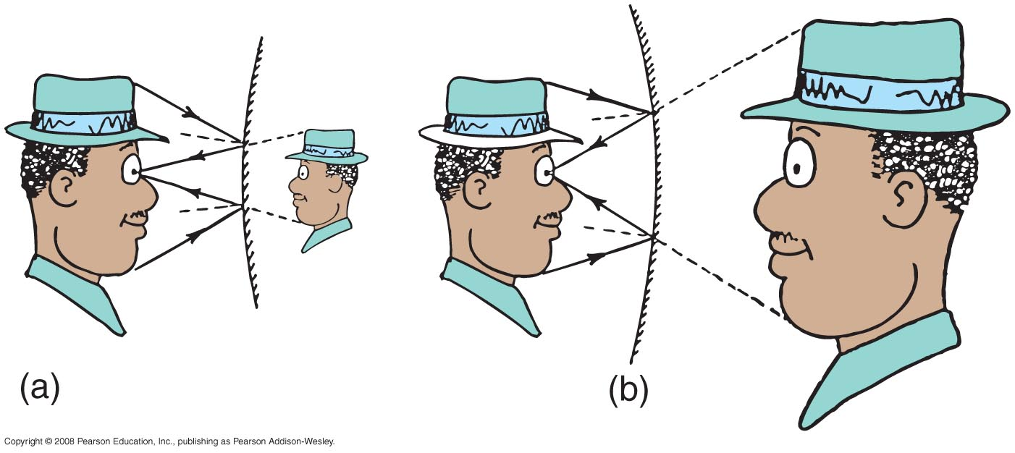
Reflection
Shape of mirror forms a different virtual image
  convex mirror (that curves outward): virtual image is smaller and closer to the mirror than the object
  concave mirror (that curves inward): virtual image is larger and farther away than the object

Slide 11
Light reflecting from a smooth surface undergoes a change in
Reflection
CHECK YOUR NEIGHBOR
A. frequency.
speed.
wavelength.
none of the above
Notes:
D. none of these.

Slide 12
Light reflecting from a smooth surface undergoes a change in
Reflection
CHECK YOUR ANSWER
A. frequency.
speed.
wavelength.
none of the above
Notes:
D. none of these.

Slide 13
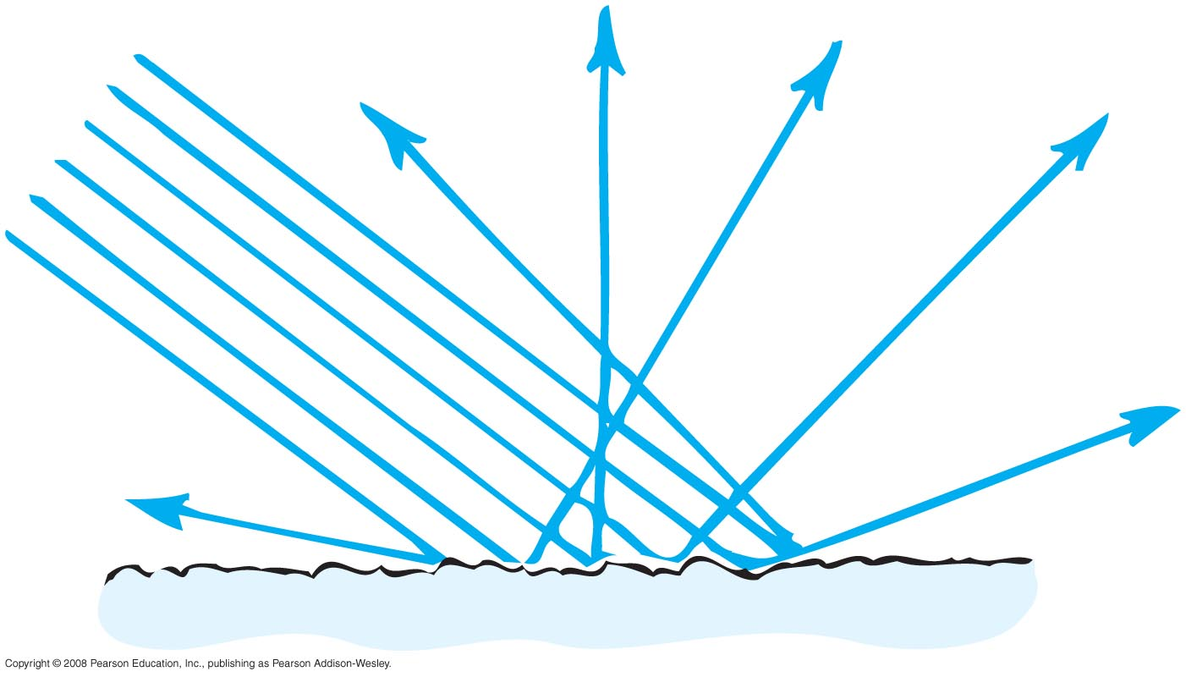
Reflection
Diffuse reflection
when light strikes a rough or irregular surface and reflects in many directions
an undesirable circumstance is the ghost image that occurs on a TV set when TV signals bounce off buildings and other obstructions

Slide 14
Reflection
Different road surfaces determine amount of diffuse reflection
  Rough road surface—because of diffuse reflection, see road ahead of car at night
  Wet road surface is smooth—because of less diffuse, reflection, difficult to see

Slide 15
Diffuse reflection occurs when the sizes of surface irregularities are
Reflection
CHECK YOUR NEIGHBOR
A. small compared with the wavelength of reflected radiation.
large compared with the wavelength of reflected radiation.
both A and B
none of the above
Notes:
B. large compared with the wavelength of reflected radiation.

Slide 16
Diffuse reflection occurs when the sizes of surface irregularities are
Reflection
CHECK YOUR ANSWER
A. small compared with the wavelength of reflected radiation.
large compared with the wavelength of reflected radiation.
both A and B
none of the above
Explanation:
Diffuse reflection occurs for rougher surfaces.
Notes:
B. large compared with the wavelength of reflected radiation.

Slide 17
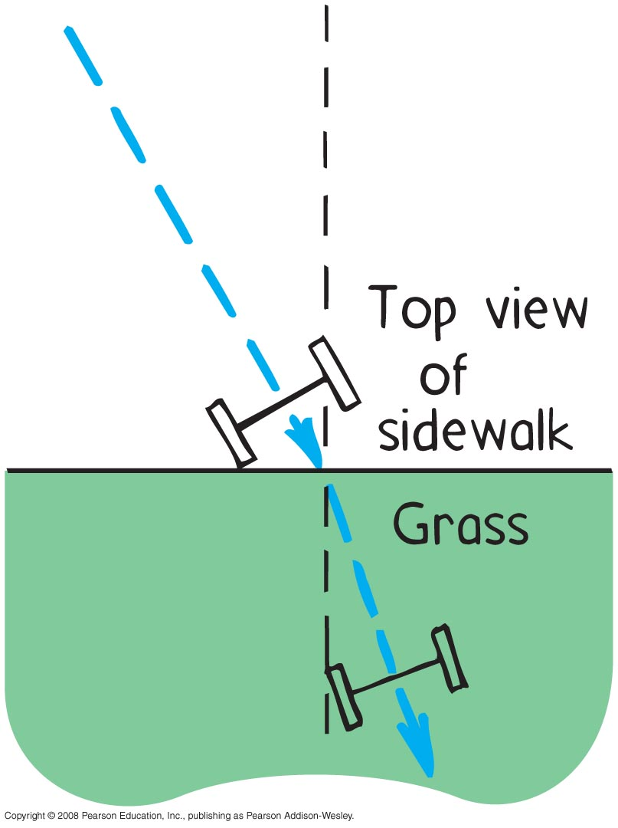
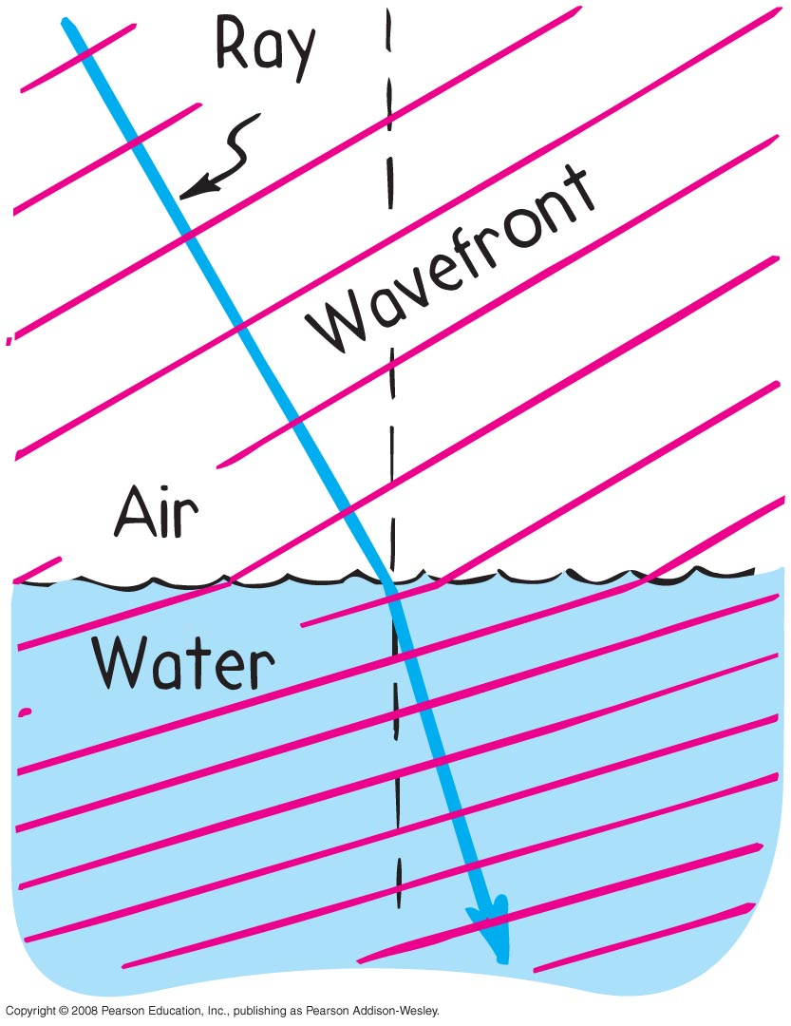
Refraction
Refraction
bending of light when it passes from one medium to another
caused by change in speed of light

Slide 18
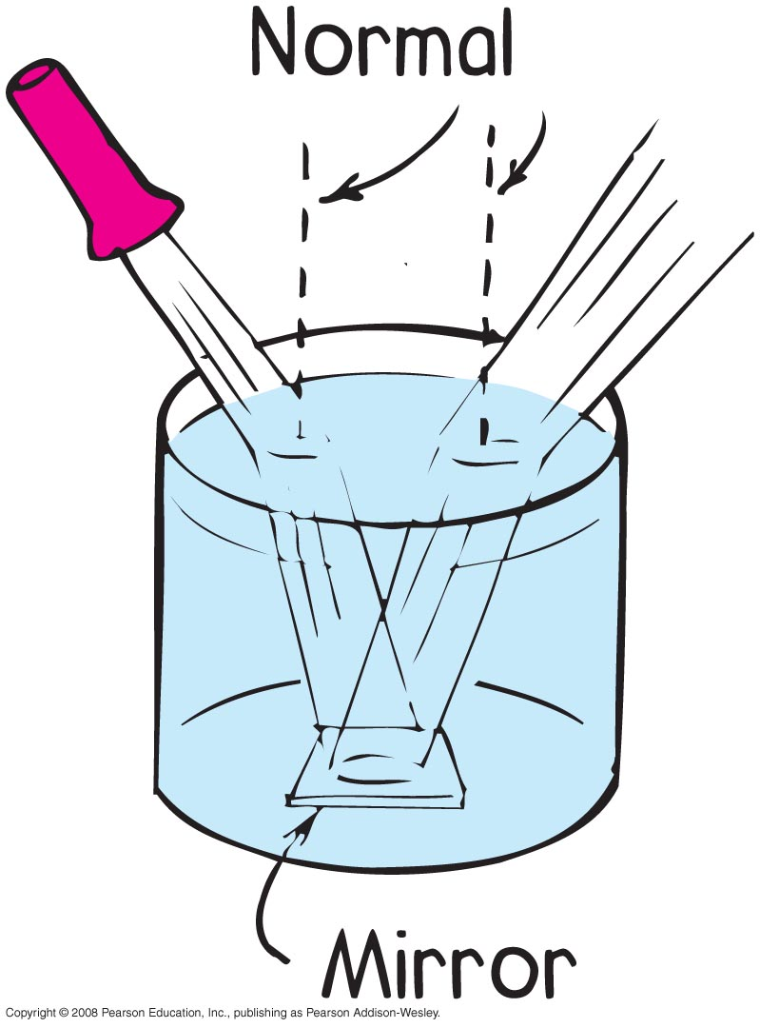
Refraction
Light rays pass from air into water and water into air
  pathways are reversible for both reflection and refraction

Slide 19
Refracted light that bends toward the normal is light that has
Refraction
CHECK YOUR NEIGHBOR
A. slowed down.
sped up.
nearly been absorbed.
diffracted.
Notes:
A. slowed down.

Slide 20
Refracted light that bends toward the normal is light that has
Refraction
CHECK YOUR ANSWER
A. slowed down.
sped up.
nearly been absorbed.
diffracted.
Notes:
A. slowed down.

Slide 21
Refracted light that bends away from the normal is light that has
Refraction
CHECK YOUR NEIGHBOR
A. slowed down.
sped up.
nearly been absorbed.
diffracted.
Notes:
B. speeded up.

Slide 22
Refracted light that bends away from the normal is light that has
Refraction
CHECK YOUR ANSWER
A. slowed down.
sped up.
nearly been absorbed.
diffracted.
Explanation:
This question is a consistency check with the question that asks about light bending toward the normal when slowing.
Notes:
B. speeded up.

Slide 23
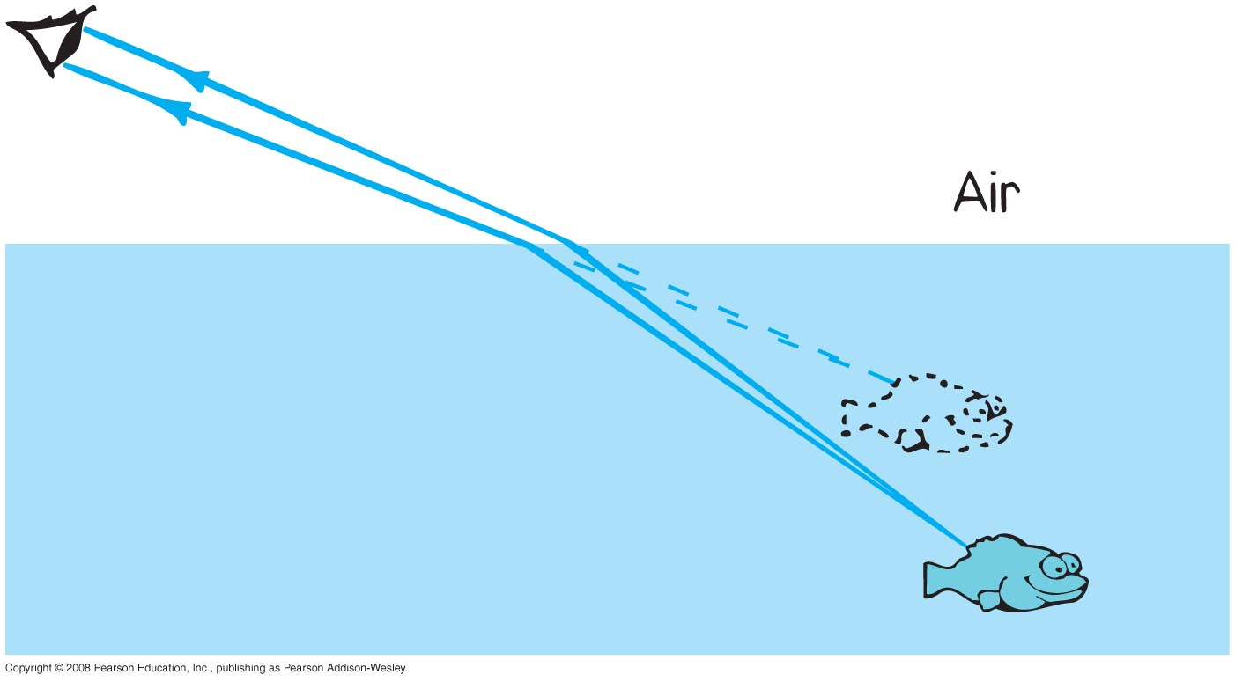
Refraction
Illusions caused by refraction
Objects submerged in water appear closer to the surface.

Slide 24
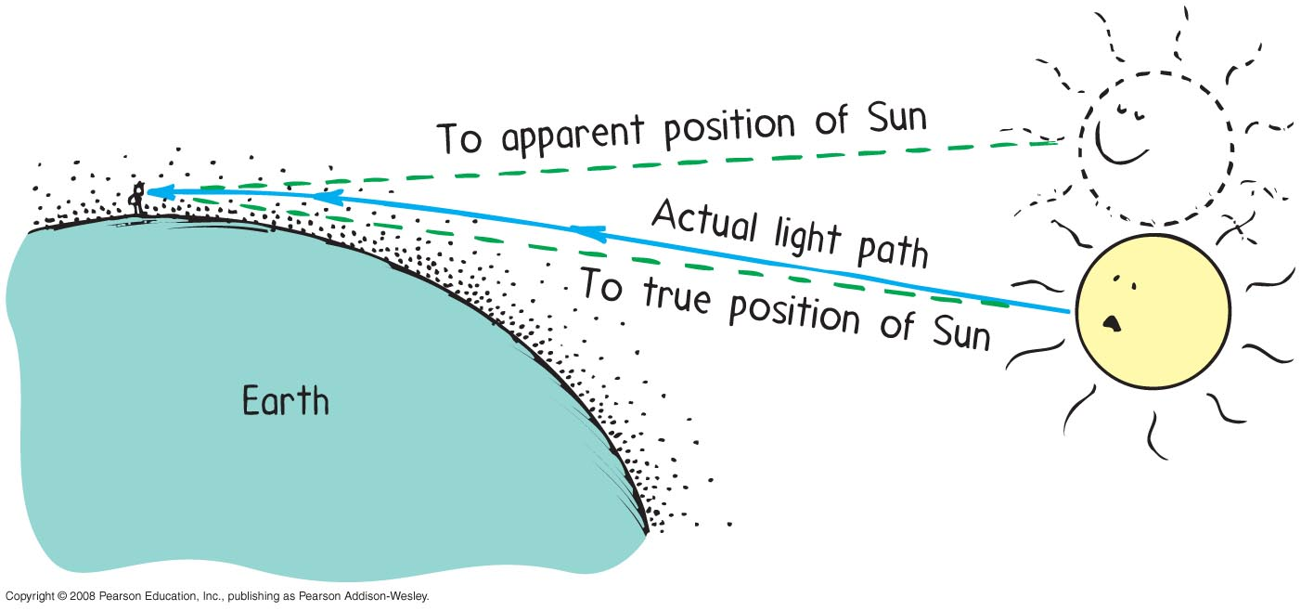
Refraction
Illusions caused by refraction (continued)
Objects such as the Sun seen through air are displaced because of atmospheric refraction.

Slide 25
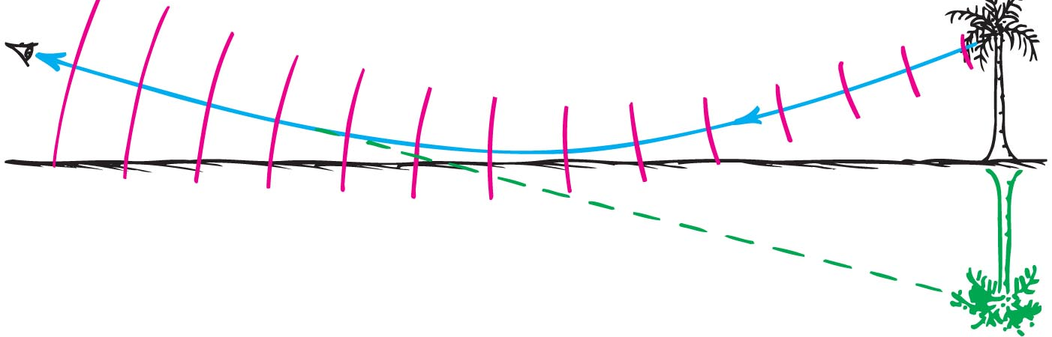
Refraction
Illusions caused by refraction (continued)
Atmospheric refraction is the cause of mirages.

Slide 26
When light travels from one medium to another and changes speed in doing so, we call the process
Refraction
CHECK YOUR NEIGHBOR
A. reflection.
interference.
dispersion.
refraction.
Notes:
D. refraction.

Slide 27
When light travels from one medium to another and changes speed in doing so, we call the process
Refraction
CHECK YOUR ANSWER
A. reflection.
interference.
dispersion.
refraction.
Notes:
D. refraction.

Slide 28
Refraction
Refractive index
Index of refraction, n, of a material
indicates how much the speed of light differs from its speed in a vacuum
indicates the extent of bending of rays
ratio of speed of light in a vacuum to the speed in a material

Slide 29
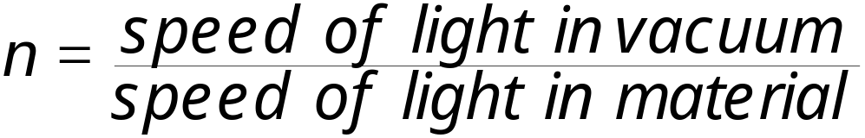
Refraction
Refractive index (continued)
in equation form:
medium with a high index means high bending effect and greatest slowing of light

Slide 30
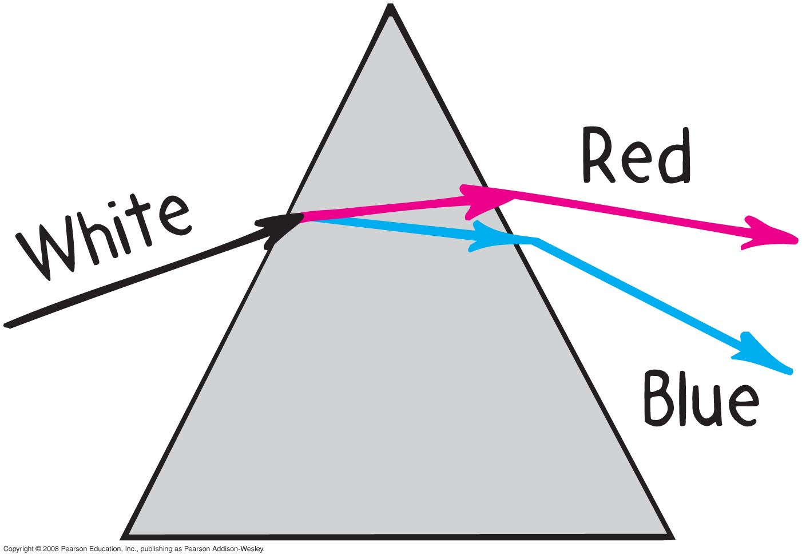
Dispersion
Dispersion
process of separation of light into colors arranged by frequency
Components of white light are dispersed in a prism (and in a diffraction grating)

Slide 31
When white light passes through a prism, green light is bent more than
Dispersion
CHECK YOUR NEIGHBOR
A. blue light.
violet light.
red light.
none of the above
Notes:
C. red light.

Slide 32
When white light passes through a prism, green light is bent more than
Dispersion
CHECK YOUR ANSWER
A. blue light.
violet light.
red light.
none of the above
Notes:
C. red light.

Slide 33
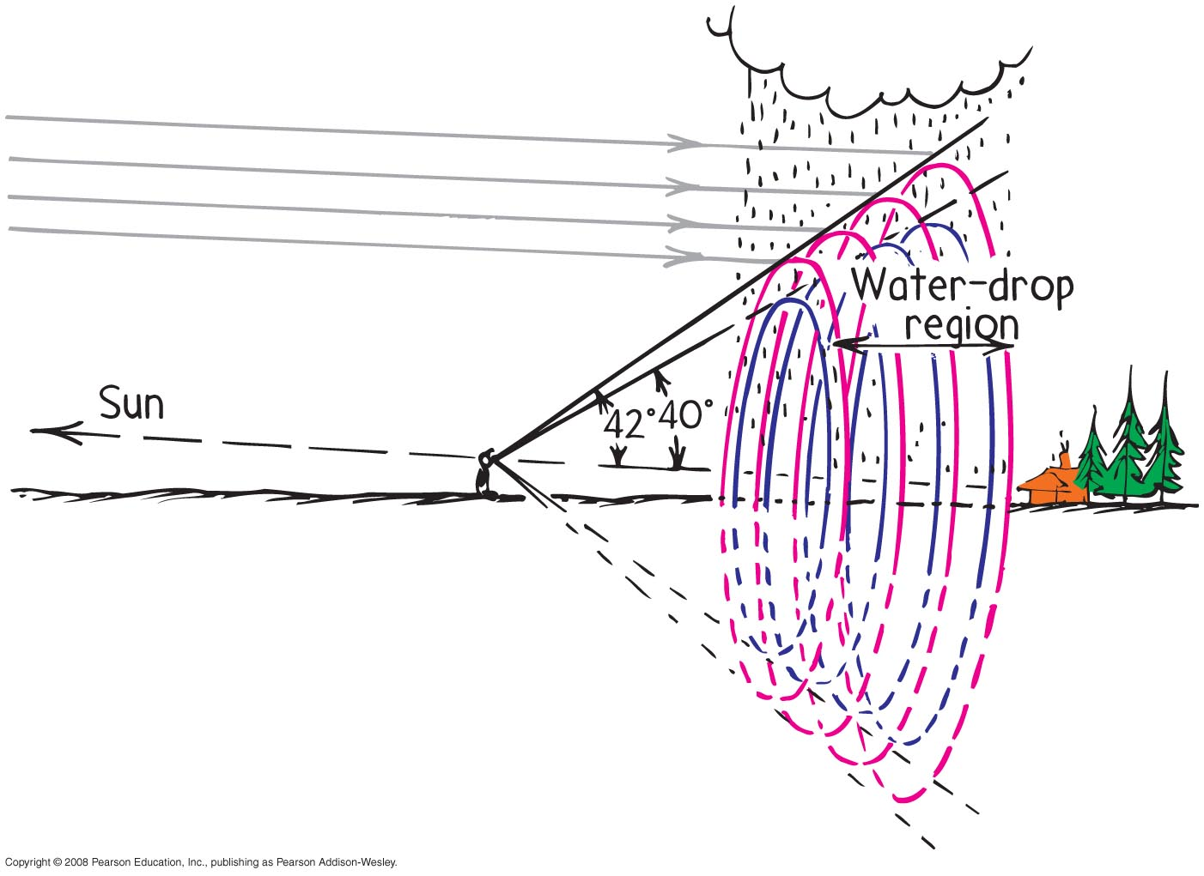
Dispersion
Rainbows
a colorful example of dispersion

Slide 34
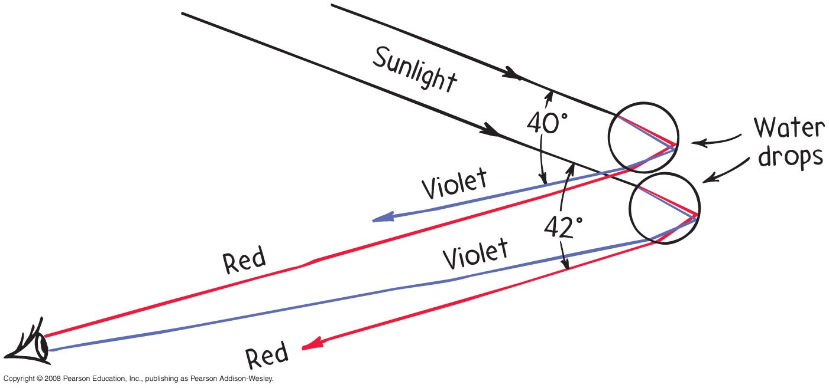
Dispersion
Rainbow detail

Slide 35
Dispersion
Rainbow facts
an observer is in a position to see only a single color from any one droplet of water.
your rainbow is slightly different from the rainbow seen by others
your rainbow moves with you
disk within the bow is brighter because of overlapping of multiple refractions (which don’t occur outside the disk)

Slide 36

Dispersion
Rainbow facts (continued)
secondary rainbow is fainter (due to two internal reflections and refracted light loss).
secondary bow is reversed in color (due to the extra internal reflection)

Slide 37
Compared with the primary rainbow, the secondary bow
Dispersion
CHECK YOUR NEIGHBOR
A. is dimmer.
has colors reversed.
is caused by two internal reflections.
all of the above
Notes:
D. all of these.

Slide 38
Compared with the primary rainbow, the secondary bow
Dispersion
CHECK YOUR ANSWER
A. is dimmer.
has colors reversed.
is caused by two internal reflections.
all of the above
Notes:
D. all of these.

Slide 39
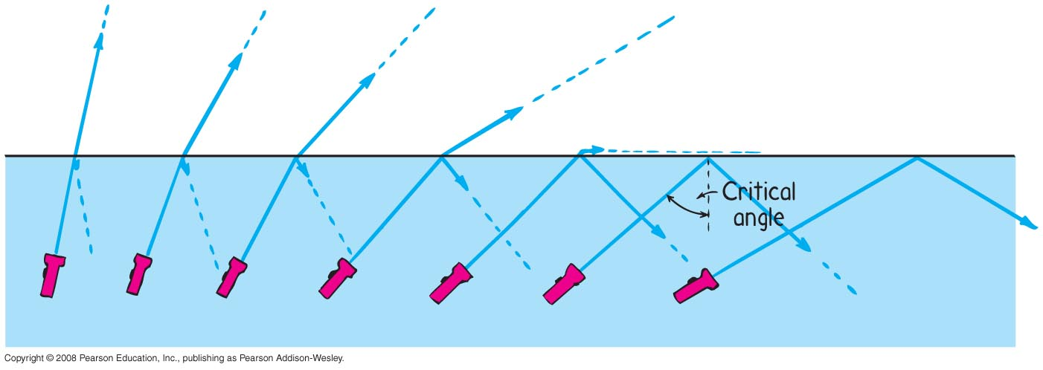
Total Internal Reflection
Total internal reflection
total reflection of light traveling within a medium that strikes the boundary of another medium at an angle at, or greater than, the critical angle

Slide 40
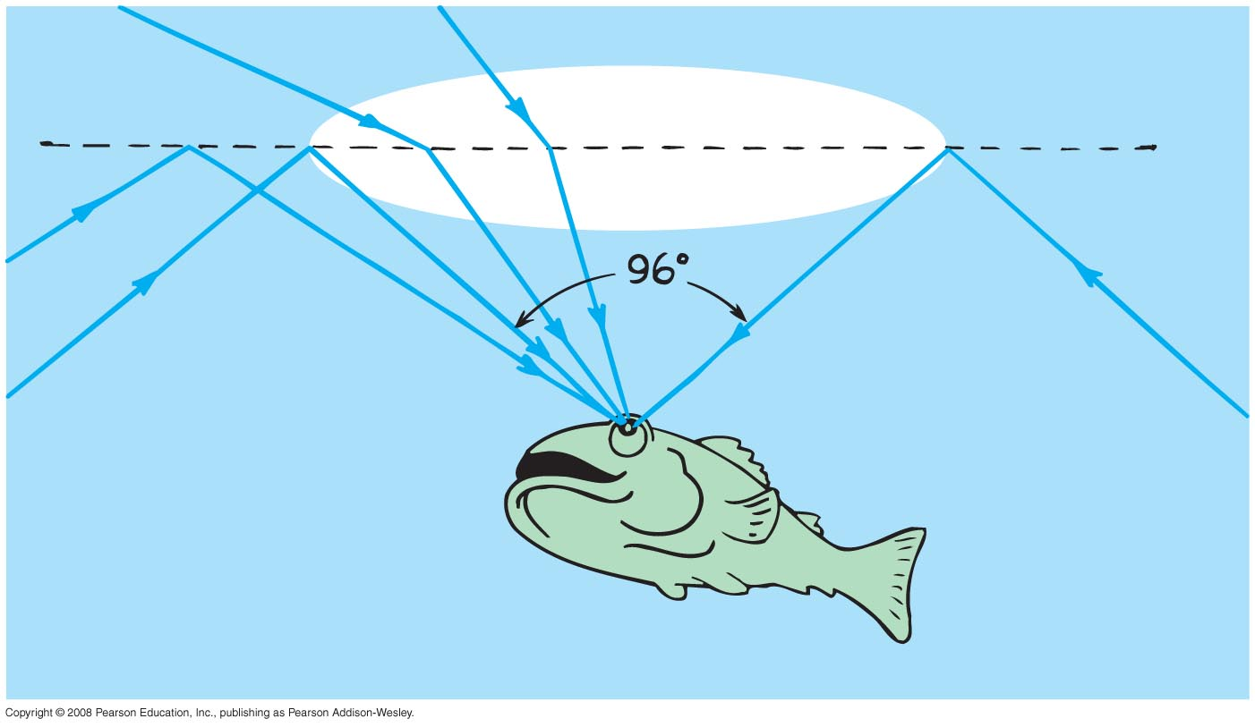
Total Internal Reflection
Critical angle
Minimum angle at which beam of light no longer emerges into the air above the surface. Varies for different materials.

Slide 41
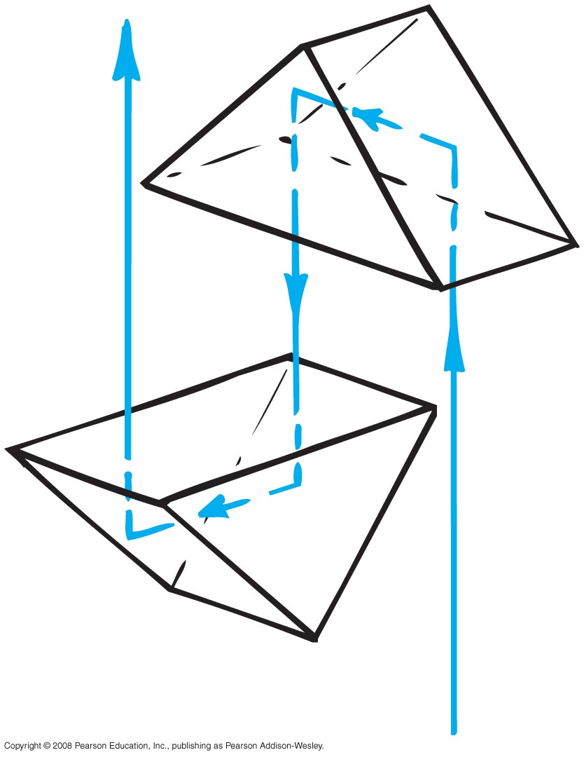
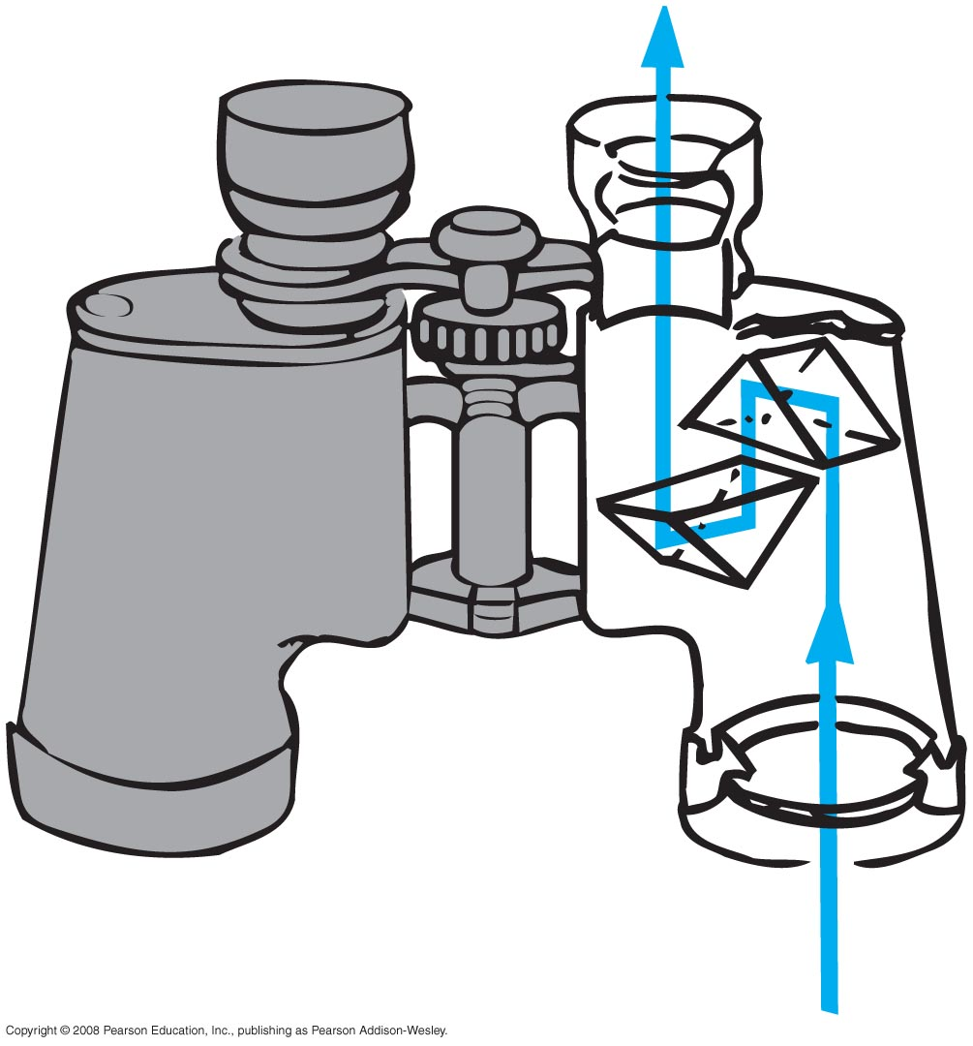
Total Internal Reflection
Advantages of glass prisms
internally reflect 100%, which is the principal reason for use in many optical instruments
lengthen the light path between lenses, thus eliminating the need for long barrels in binoculars
reflection by prisms reinverts the image in binoculars

Slide 42
Total Internal Reflection
Optical fibers or light pipes
thin flexible rods of special glass or transparent plastic
light from one end of the fiber is total internally reflected to the other end, resulting in nearly the same brightness of light

Slide 43
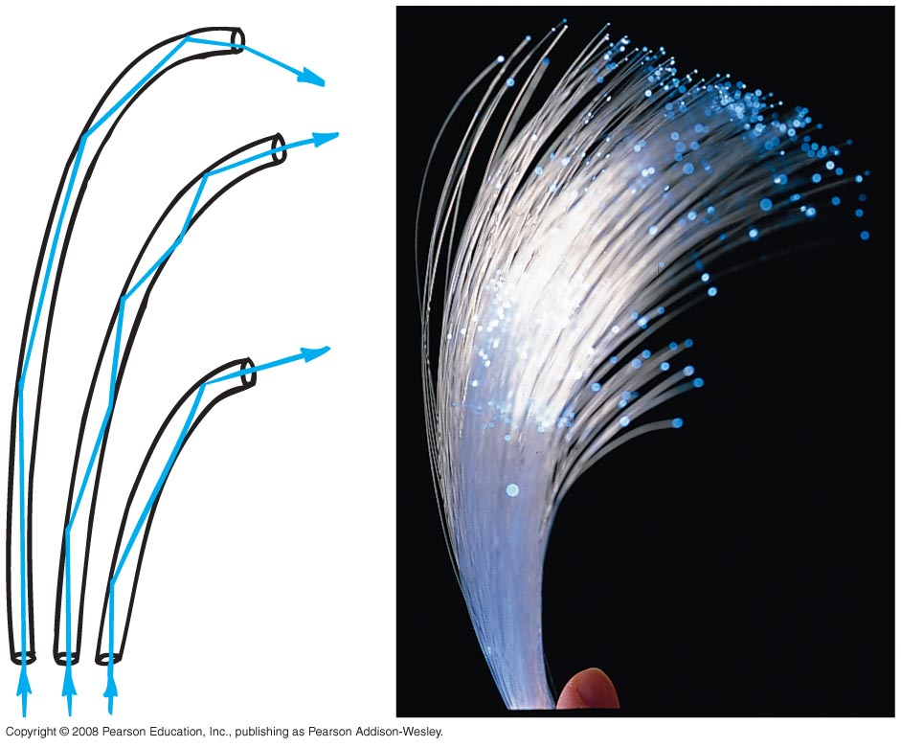
Total Internal Reflection
Optical fibers or light pipes (continued)
used in
  illuminating instrument displays
  concentrating light in dental procedures
  viewing of inaccessible regions of organs and other devices
  communications

Slide 44
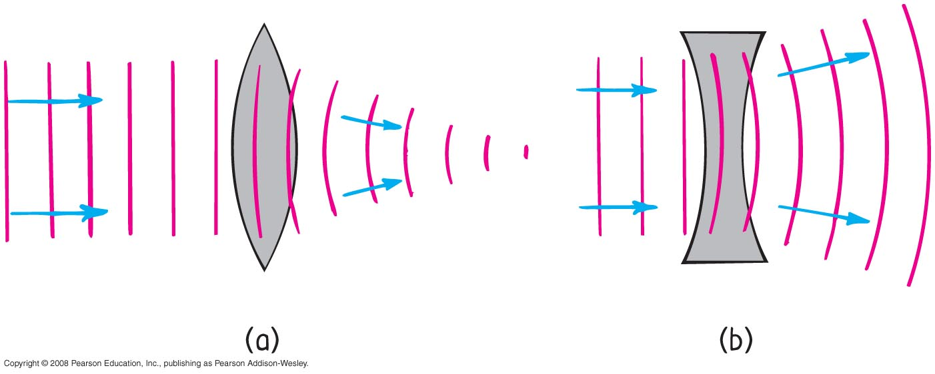
Lenses
Lenses
two common types
  converging (convex) lens
    thicker at the center than edges
    converges light
  diverging (concave) lens
    thinner at the center than edges
    diverges light

Slide 45
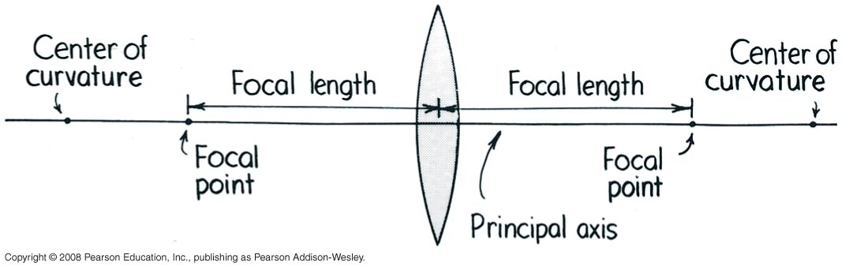
Lenses
Key features of lenses
principal axis
  line joining the centers of curvature of the two lens surfaces
focal point
  point at which all the light rays come together
focal length
  distance between the center of the lens and either focal point

Slide 46
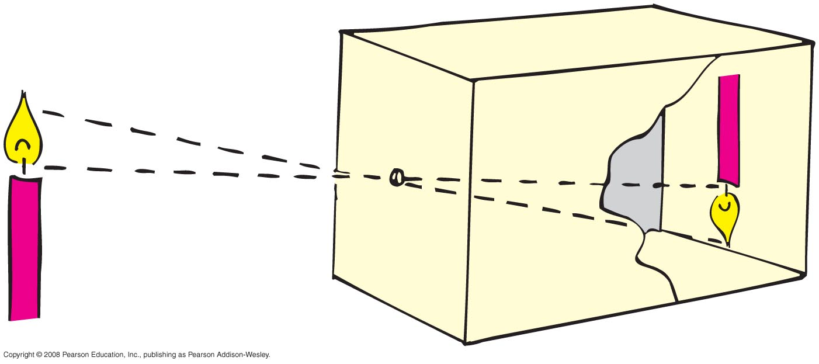
Lenses
Image formation is a consequence of light traveling in straight lines
The first camera—the pinhole camera— illustrates this fact.

Slide 47
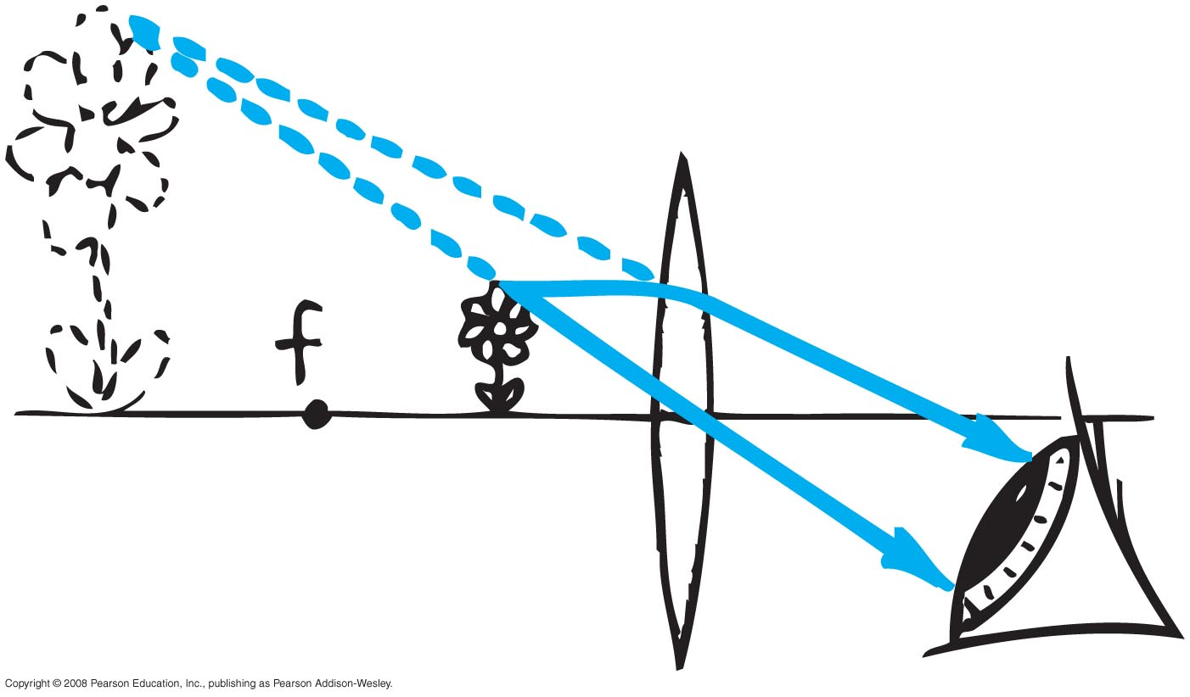
Lenses
A lens nicely bends the straight-line paths of light.

Slide 48
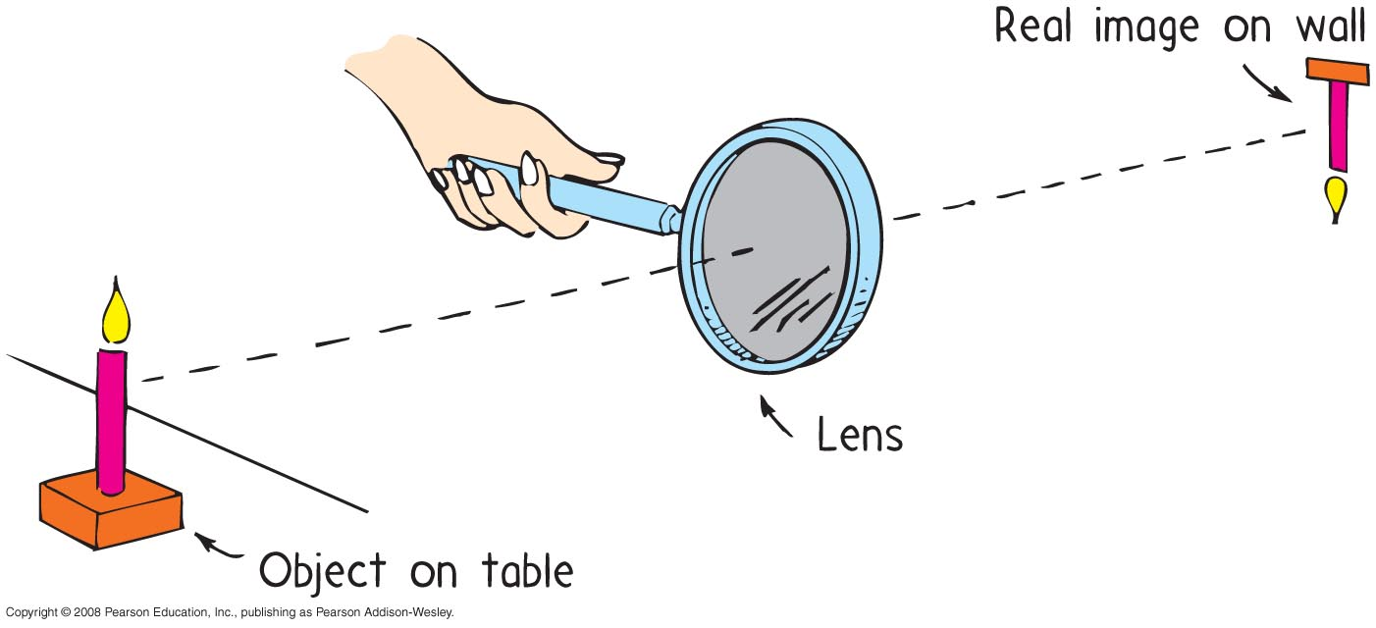
Lenses
A converging lens can project an image.

Slide 49
The action of lenses depends mainly on
Lenses
CHECK YOUR NEIGHBOR
A. reflection.
refraction.
both A and B
neither A nor B
Notes:
B. refraction.

Slide 50
The action of lenses depends mainly on
Lenses
CHECK YOUR ANSWER
A. reflection.
refraction.
both A and B
neither A nor B
Notes:
B. refraction.

Slide 51
Lenses
Lens Defects
Aberration
  distortion in an image
  types of aberrations
  spherical aberration
    result of light passing through the edges of a lens and focusing at a slightly different place from where light passing through the center of the lens focuses

Slide 52
Lenses
Aberration (continued)
  chromatic aberration
    result of various colors having different speeds and different refractions in the lens
  astigmatism
    front surface of the eyeball is unequally curved

Slide 53
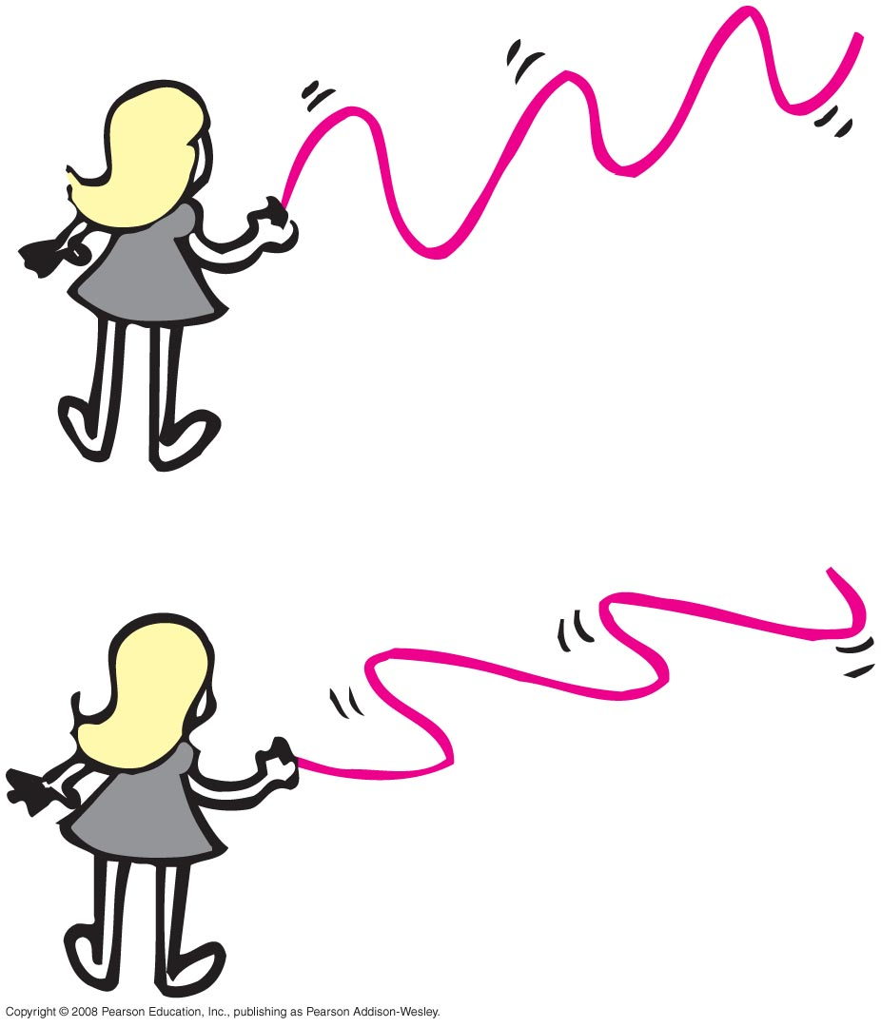
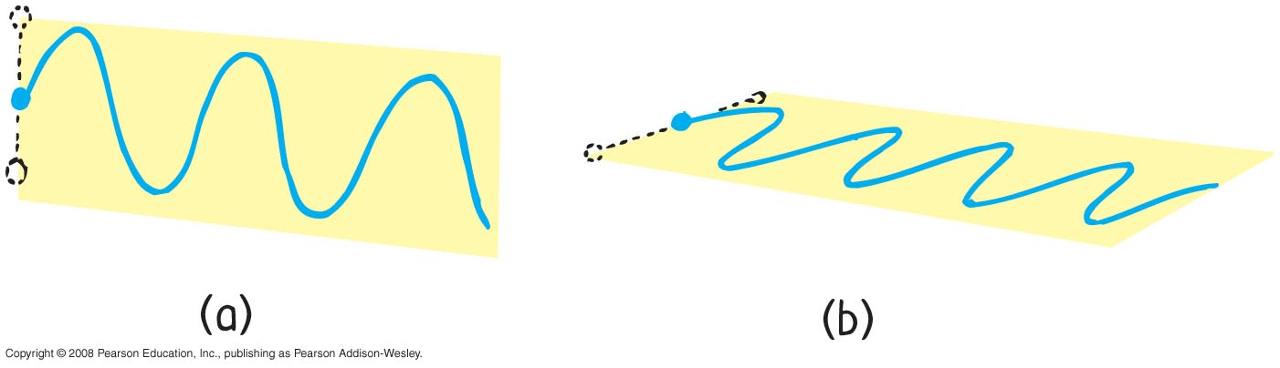
Polarization
Polarization
alignment of transverse electric vectors in electromagnetic radiation
property of transverse waves
Left: E & M wave is polarized Right: rope vibrations are polarized
In both cases, wave is in the same plane as the plane of vibration.

Slide 54
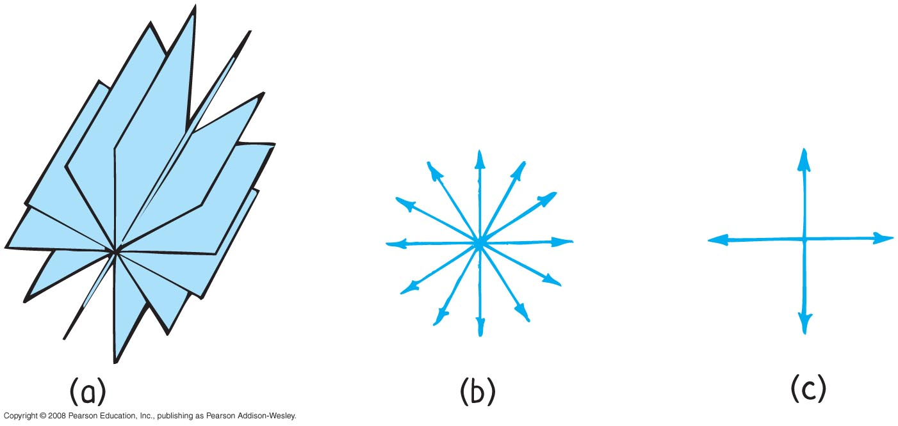
Polarization
Unpolarized light
vibrations producing light are in random directions
example: incandescent lamp, fluorescent lamp, candle flame

Slide 55
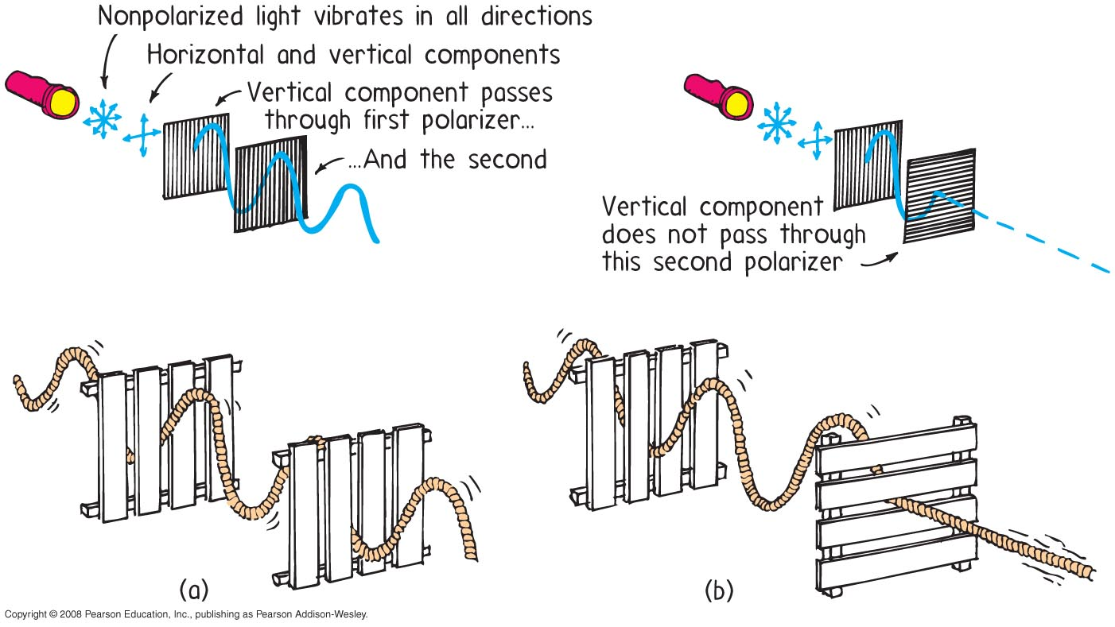
Polarization
Polarized light
Unpolarized light divided into two internal beams polarized at right angles to each other. One beam is absorbed while the other beam is transmitted.

Slide 56
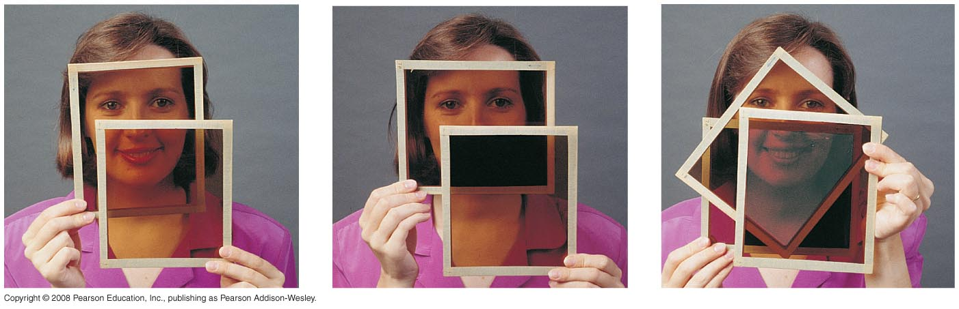
Polarization
Polarized light (continued)
Use your knowledge of vectors and vector components to explain how light that can’t pass through a pair of Polaroids at right angles to each other will pass light when a third Polaroid is sandwiched between them!

Slide 57
Polarization occurs for waves that are
Polarization
CHECK YOUR NEIGHBOR
A. translational.
longitudinal.
both A and B
neither A nor B
Notes:
A. translational.

Slide 58
Polarization occurs for waves that are
Polarization
CHECK YOUR ANSWER
A. translational.
longitudinal.
both A and B
neither A nor B
Notes:
A. translational.

