Slide 1
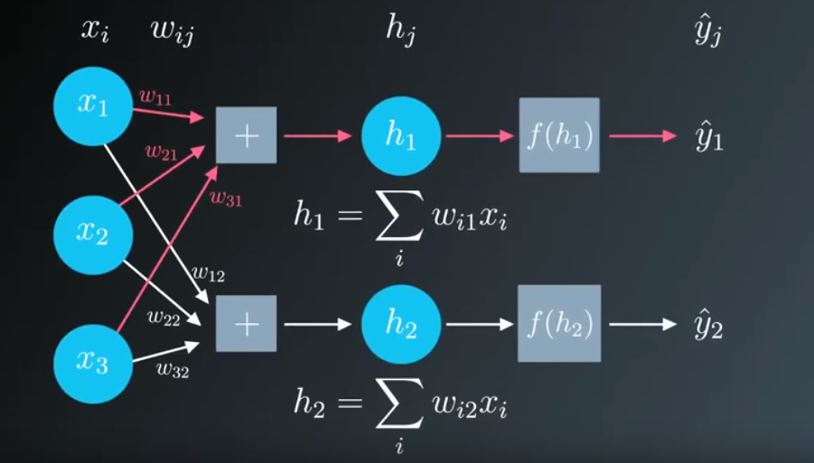
Intro to Neural Networks
Dr. Paul H. Comitz
pcomitz@live.com
This talk is loosely based on several lectures from the Udacity Self Driving Car program

Slide 2
Agenda
Machine Learning
Regression and Gradient Descent

Slide 3

So …what is machine learning?

Slide 4
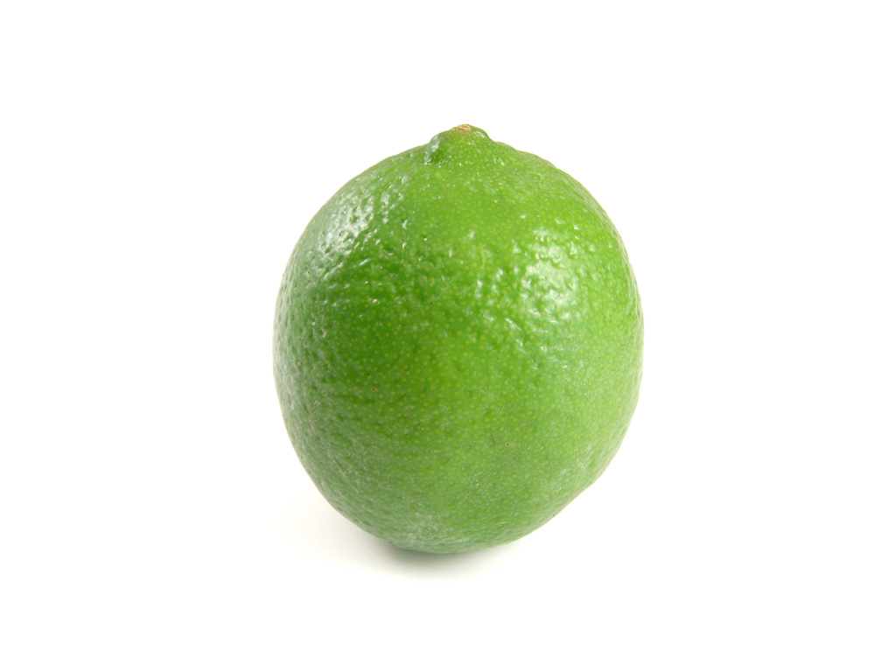

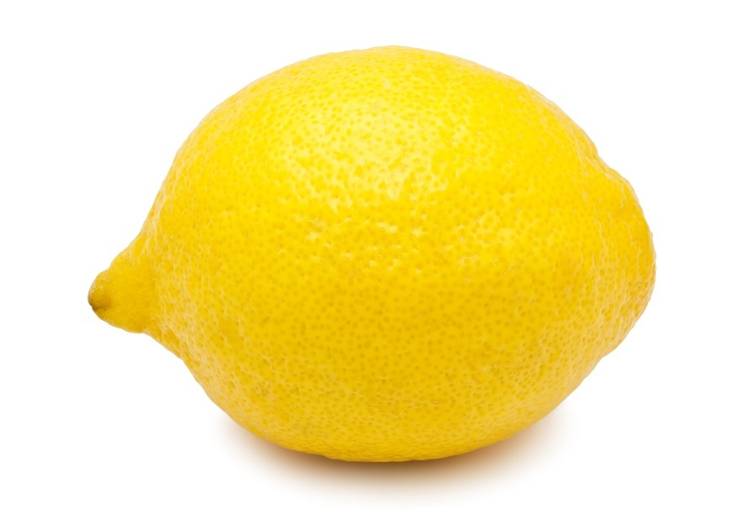
Write a program to identify
Easy right ?

Slide 5

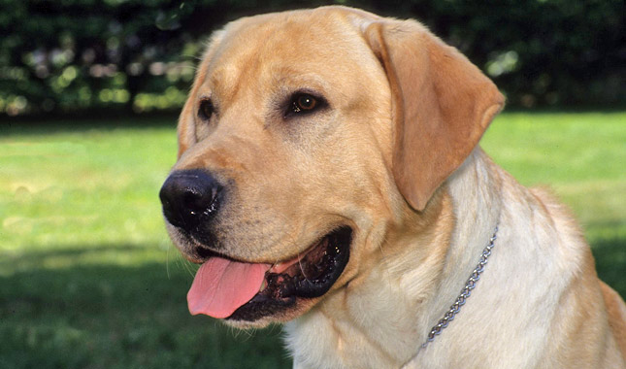
What if the objects are very different?

Slide 6
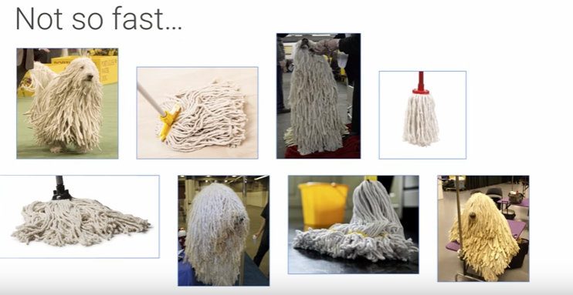
Can you pick ……
Google I/O 2017 Machine Learning APIs by Example
https://www.youtube.com/watch?v=ETeeSYMGZn0

Slide 7
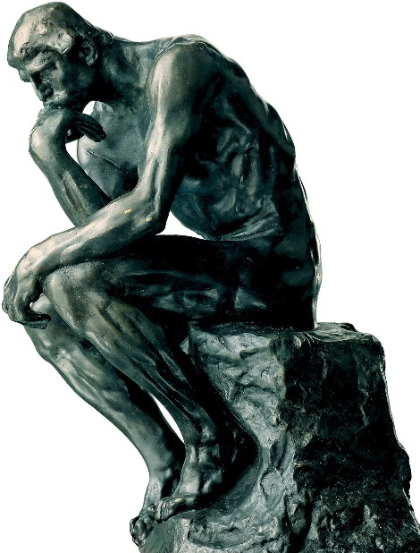
The Big Idea
Don’t want to write code that contains rules
Write code that will find the patterns
Write code that will learn from data
All kinds of data
Video, text, images

Slide 8
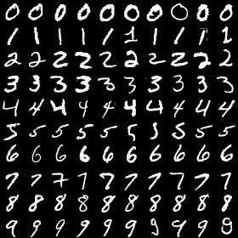
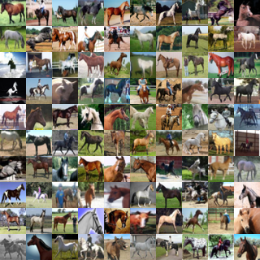
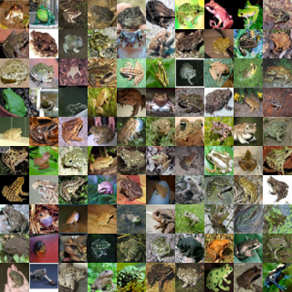
Machine Learning
Field of Artificial Intelligence
Computers learn environment from data rather that rules in computer programs
Supervised Learning
Train with known data
https://www2.warwick.ac.uk/fac/cross_fac/complexity/study/msc_and_phd/co902/

Slide 9
Block Diagram with Backpropagation

Slide 10
Learning from Data What is the best line that fits these points?
FIX THIS
Error = sum of individual errors

Slide 11
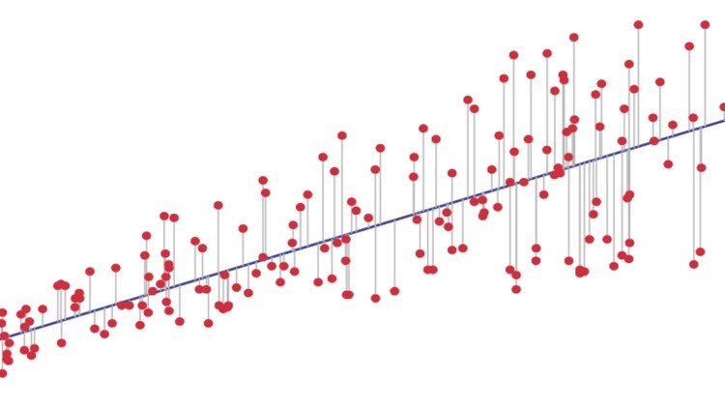


Linear Regression
Move the line in the direction of decreasing error until error is minimized
Square the error to avoid negative distances
Least squares
Use for continuous data

Slide 12
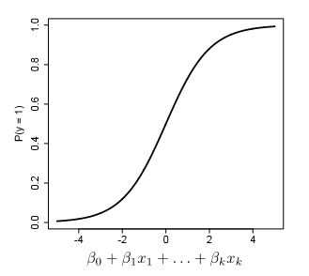

Logistic Regression
Linear regression provides a way to predict continuous data
Logistic regression provides a mechanism to classify data
Discrete or categorical data
Neural Network
Split into separate questions
Notes:
Assume logistic regression is something like:
P(y = 1) = 1/1+e**-(b0+b1x1+b2x2+...+bkxk)
the familiar sigmoid expression.
where the x's are features ,and the b's are the regression coefficients. The best
choice of coefficients has the smallest error.
For a neural network can we assume that the coefficients
are roughly analogous to the weights and the x are
the inputs? The structure of the neural network provides the
capability to separate a series of questions or conditions into
individual questions realized as individual artificial neurons.
For example suppose we are trying to predict health care quality as good
or poor. The features, the x's in the equation above are "number of
office visits" , and "number of medications prescribed". Could this
be modeled as a set of artificial neurons with weights w1, w2 which
roughly correspond to b1 and b2, with inputs x1 = "number of
office visits" and x2 = "number of medications prescribed", and y =
1 is good care and y = 0 is poor care.

Slide 13
Neural Networks

Slide 14
Perceptron

Slide 15
Backpropagation
Notes:
From Wikipedia https://en.wikipedia.org/wiki/Backpropagation
Backpropagation is a method to calculate the gradient of the loss function with respect to the weights in an artificial neural network. It is commonly used as a part of algorithms that optimize the performance of the network by adjusting the weights, for example in the gradient descent algorithm. It is also called backward propagation of errors.
The optimization algorithm repeats a two phase cycle, propagation and weight update. When an input vector is presented to the network, it is propagated forward through the network, layer by layer, until it reaches the output layer. The output of the network is then compared to the desired output, using a loss function, and an error value is calculated for each of the neurons in the output layer. The error values are then propagated backwards, starting from the output, until each neuron has an associated error value which roughly represents its contribution to the original output.
Backpropagation uses these error values to calculate the gradient of the loss function. In the second phase, this gradient is fed to the optimization method, which in turn uses it to update the weights, in an attempt to minimize the loss function.
The importance of this process is that, as the network is trained, the neurons in the intermediate layers organize themselves in such a way that the different neurons learn to recognize different characteristics of the total input space. After training, when an arbitrary input pattern is present which contains noise or is incomplete, neurons in the hidden layer of the network will respond with an active output if the new input contains a pattern that resembles a feature that the individual neurons have learned to recognize during their training.
Backpropagation requires a known, desired output for each input value in order to calculate the loss function gradient – it is therefore usually considered to be a supervised learning method; nonetheless, it is also used in some unsupervised networks such as autoencoders. It is a generalization of the delta rule to multi-layered feedforward networks, made possible by using the chain rule to iteratively compute gradients for each layer. Backpropagation requires that the activation function used by the artificial neurons (or "nodes") is differentiable.

Slide 16
TensorFlow
Open source machine learning framework
Released approx. 1 year ago
Current version is 1.2
APIs in Python, Java, C, Go
A software library for numerical computation using data flow graphs. Nodes in the graph represent mathematical operations, while the graph edges represent the multidimensional data arrays (tensors)
communicated between them.
https://www.tensorflow.org/

Slide 17
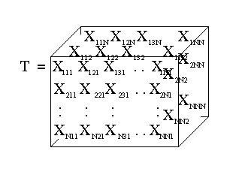
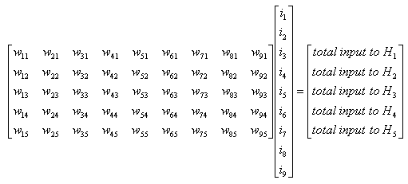
So …what’s a tensor? (https://www.tensorflow.org/get_started/get_started)
Central unit of data in TensorFlow
Multidimensional data array
Rank – number of dimensions
3 # a rank 0 tensor; this is a scalar with shape [] [1. ,2., 3.] # a rank 1 tensor; this is a vector with shape [3] [[1., 2., 3.], [4., 5., 6.]] # a rank 2 tensor; a matrix with shape [2, 3] [[[1., 2., 3.]], [[7., 8., 9.]]] # a rank 3 tensor with shape [2, 1, 3]

Slide 18
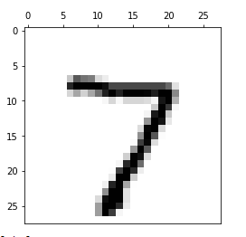
MNIST Database
Database of handwritten digits 0 - 9
Subset of larger data set available from National Institute of Standards and Technology
Training set : 55000 images
Test Set: 10000 images
Each image 28 x 28 = 784 pixels
Each pixels has a greyscale value of 0 - 255

Slide 19
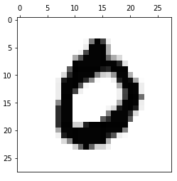
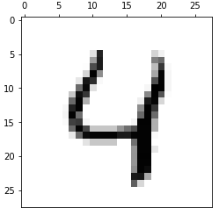
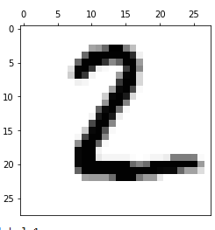
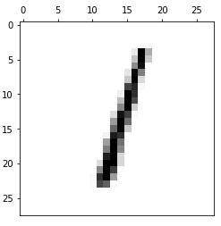
MNIST image data

Slide 20
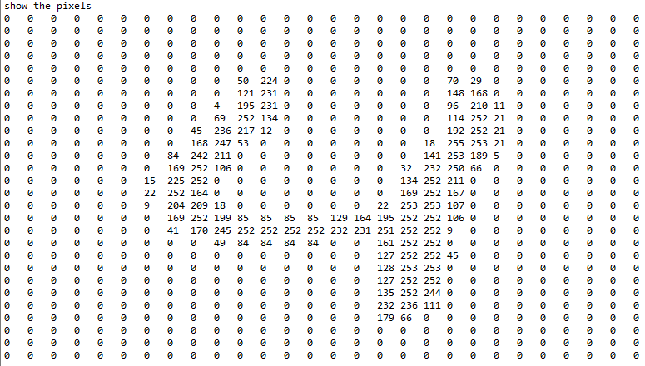
MNIST detail 784 features

Slide 21
Gradient Descent Detail
Gradient
Increase or decrease when moving from one point to another
Derivative applied to functions of more than variable
Image from Udacity Machine Learning Course https://www.udacity.com/

Slide 22
Gradient Descent Recipe
Compute network output
h = Σ (w_{i}x_{i})
y^ = f(h) # f is the activation function
Compute error
y – y^ # expected value – output
Compute error term
(y – y^)*f’(h) # f’ ii derivative of the activation function
Compute w_{i}
η*(y-y^)*x # η is the learning rate

Slide 23
Gradient Descent Recipe
Set the weight step to zero: Δw​i​​=0
For each record in the training data:
Make a forward pass through the network, calculating the output ​y​^​​=f(∑​i​​w​i​​x​i​​)
Calculate the error gradient in the output unit, δ=(y−​y​^​​)∗f​′​​(∑​i​​w​i​​x​i​​)
Update the weight step Δw​i​​=Δw​i​​+δx​i​​

Slide 24
Gradient Descent Recipe
Update the weights w​i​​=w​i​​+ηΔw​i​​/m where η is the learning rate and m is the number of records. Here we're averaging the weight steps to help reduce any large variations in the training data.
Repeat for e epochs.

Slide 25
Summary
Everything is made of waves; also particles !
Quantum physics is discrete
Quantum physics is probabilistic
Quantum physics is non-local
Quantum physic is very small
Quantum physics is not magic
Matter can exist in multiple states simultaneously!
Schrodinger's Cat
See this article for more information

Slide 26
Resources
Neural Networks and Deep Learning (by Michael Nielson)
Deep Learning Book (Ian Goodfellow and Yoshua Bengio and Aaron Courville)
TensorFlow Playground
Udacity Machine Learning Course (free)
Stanford CS231n CIFAR classifier in browser
Wikipedia Machine Learning Portal

Slide 27


