Slide 1
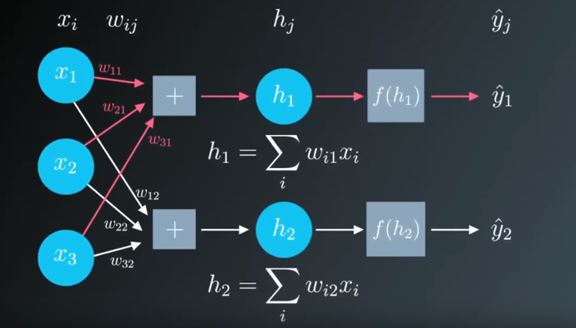
Intro to Neural Networks
Dr. Paul H. Comitz
pcomitz@live.com
This talk is loosely based on several lectures from the Udacity Self Driving Car program

Slide 2
Agenda
Machine Learning
Regression and Gradient Descent

Slide 3

So …what is machine learning?

Slide 4
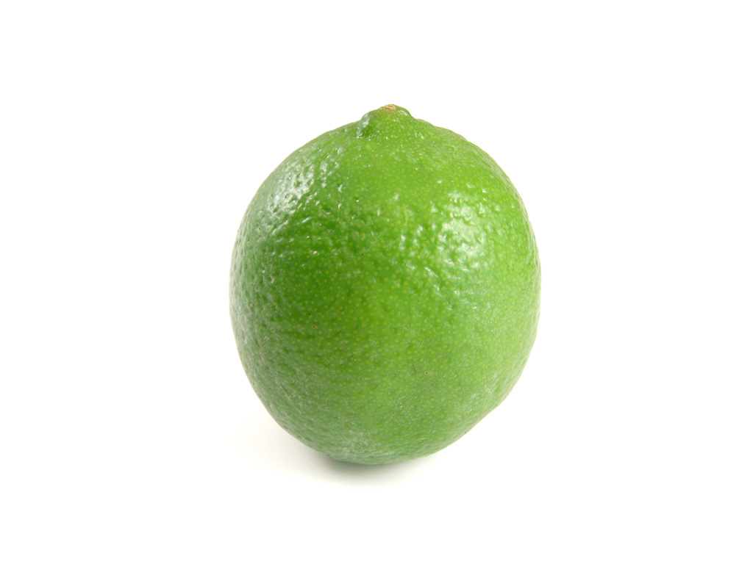

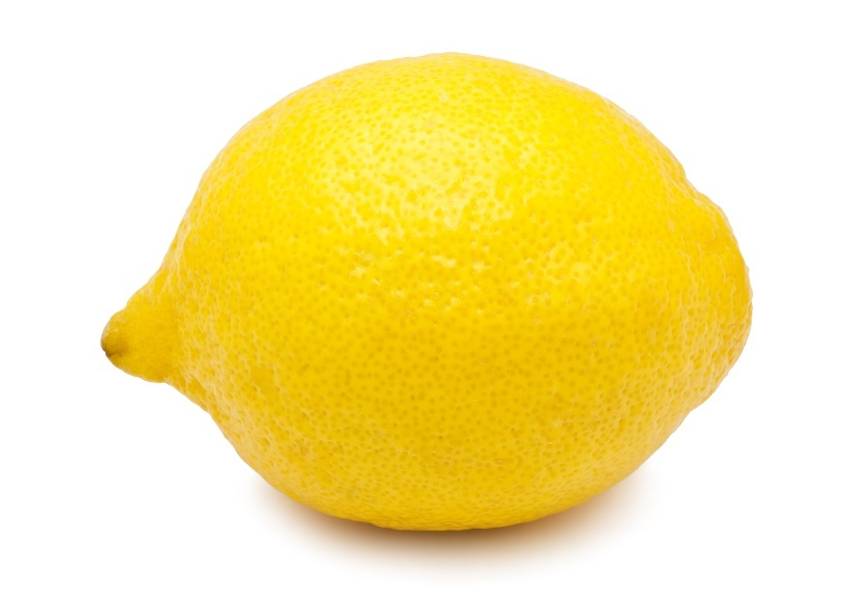
Write a program to identify
Easy right ?

Slide 5

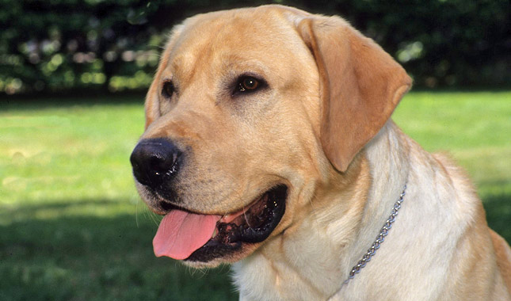
What if the objects are very different?

Slide 6
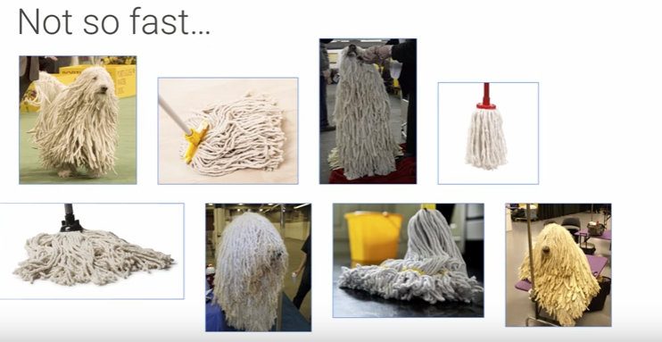
Can you pick ……
Google I/O 2017 Machine Learning APIs by Example
https://www.youtube.com/watch?v=ETeeSYMGZn0

Slide 7
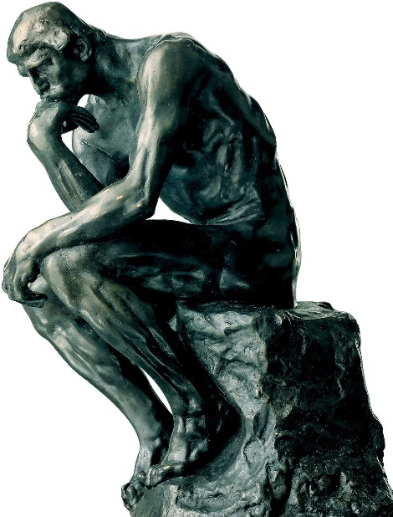
The Big Idea
Don’t want to write code that contains rules
Write code that will find the patterns
Write code that will learn from data
All kinds of data
Video, text, images

Slide 8
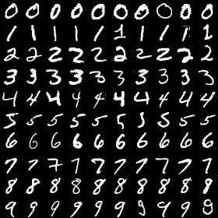
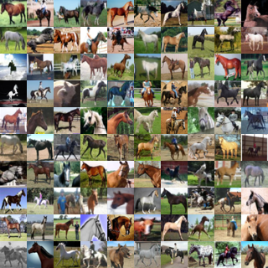
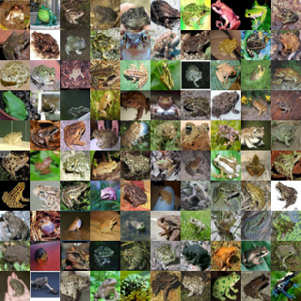
Machine Learning
Field of Artificial Intelligence
Computers learn environment from data rather that rules in computer programs
Supervised Learning
Train with known data
https://www2.warwick.ac.uk/fac/cross_fac/complexity/study/msc_and_phd/co902/

Slide 9
Block Diagram with Backpropagation

Slide 10
Learning from Data What is the best line that fits these points?
FIX THIS
Error = sum of individual errors

Slide 11
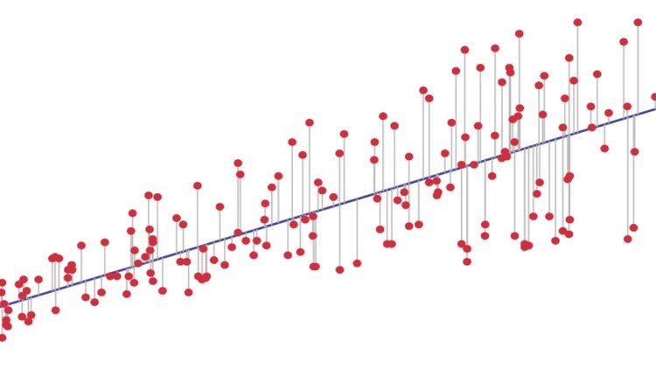


Linear Regression
Move the line in the direction of decreasing error until error is minimized
Square the error to avoid negative distances
Least squares
Use for continuous data

Slide 12
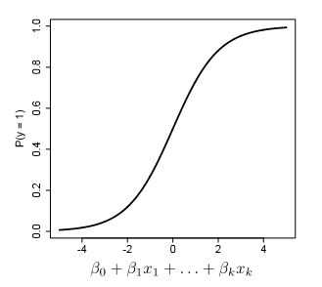

Logistic Regression
Linear regression provides a way to predict continuous data
Logistic regression provides a mechanism to classify data
Discrete or categorical data
Neural Network
Split into separate questions

Slide 13
Neural Networks

Slide 14
Perceptron

Slide 15
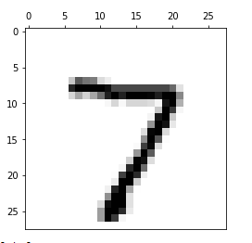
MNIST Database
Database of handwritten digits 0 - 9
Subset of larger data set available from National Institute of Standards and Technology
Training set : 55000 images
Test Set: 10000 images
Each image 28 x 28 = 784 pixels
Each pixels has a greyscale value of 0 - 255

Slide 16
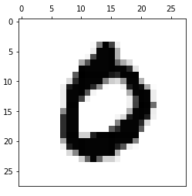
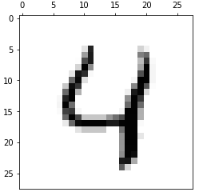
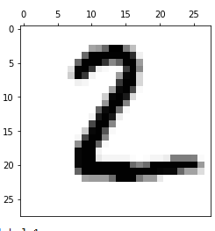
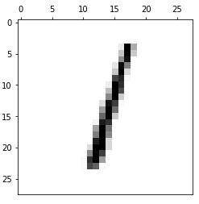
MNIST image data

Slide 17
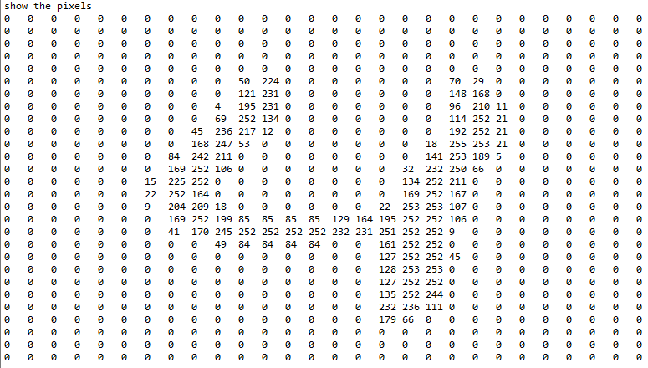
MNIST detail 784 features

Slide 18
Gradient Descent Detail
Gradient
Increase or decrease when moving from one point to another
Derivative applied to functions of more than variable
Image from Udacity Machine Learning Course https://www.udacity.com/

Slide 19
Gradient Descent Recipe
Compute network output
h = Σ (w_{i}x_{i})
y^ = f(h) # f is the activation function
Compute error
y – y^ # expected value – output
Compute error term
(y – y^)*f’(h) # f’ ii derivative of the activation function
Compute w_{i}
η*(y-y^)*x # η is the learning rate

Slide 20
Gradient Descent Recipe
Set the weight step to zero: Δw​i​​=0
For each record in the training data:
Make a forward pass through the network, calculating the output ​y​^​​=f(∑​i​​w​i​​x​i​​)
Calculate the error gradient in the output unit, δ=(y−​y​^​​)∗f​′​​(∑​i​​w​i​​x​i​​)
Update the weight step Δw​i​​=Δw​i​​+δx​i​​

Slide 21
Gradient Descent Recipe
Update the weights w​i​​=w​i​​+ηΔw​i​​/m where η is the learning rate and m is the number of records. Here we're averaging the weight steps to help reduce any large variations in the training data.
Repeat for e epochs.

Slide 22
Summary
Everything is made of waves; also particles !
Quantum physics is discrete
Quantum physics is probabilistic
Quantum physics is non-local
Quantum physic is very small
Quantum physics is not magic
Matter can exist in multiple states simultaneously!
Schrodinger's Cat
See this article for more information

Slide 23
Resources
Neural Networks and Deep Learning (by Michael Nielson)
Deep Learning Book (Ian Goodfellow and Yoshua Bengio and Aaron Courville)
TensorFlow Playground
Udacity Machine Learning Course (free)
Stanford CS231n CIFAR classifier in browser
Wikipedia Machine Learning Portal

Slide 24


