Slide 1
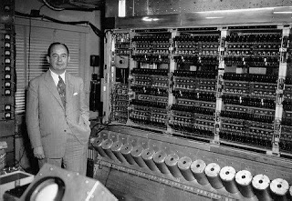
Machine Learning Introduction
Dr. Paul H. Comitz
pcomitz@live.com
Professor John Von Neumann and one of the first “Von Neumann” machines

Slide 2
Agenda
Machine Learning
Regression
Neural Networks
Gradient Descent
TensorFlow
Linear Regression
Simple NN
Classifier

Slide 3
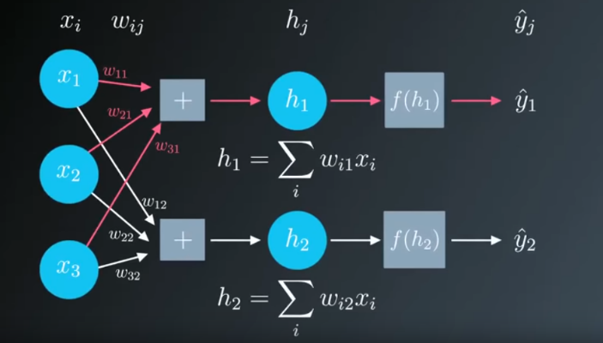
Objective
A short session introducing selected
Machine learning topics. No prior
knowledge is assumed.
Regression
Neural Networks
Classification
Slides, discussion, hands-on

Slide 4

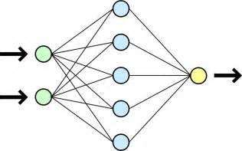
Context
Focus on Machine Learning
Regression, Neural Nets, Classifier
Use TensorFlow 1.2
Use Python 3.5 (other versions may work)
Use Anaconda on Windows 10 (other environments will work)
A little math and computer science experience will help
Not required
Beginner level – for this material
Approximately 2ish hours with short break

Slide 5

What is machine learning ?

Slide 6
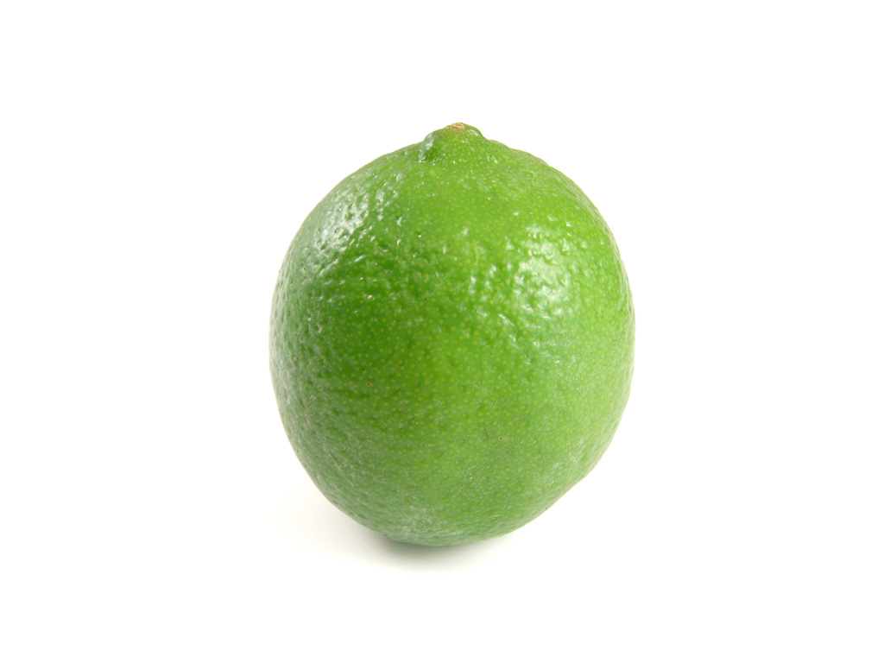

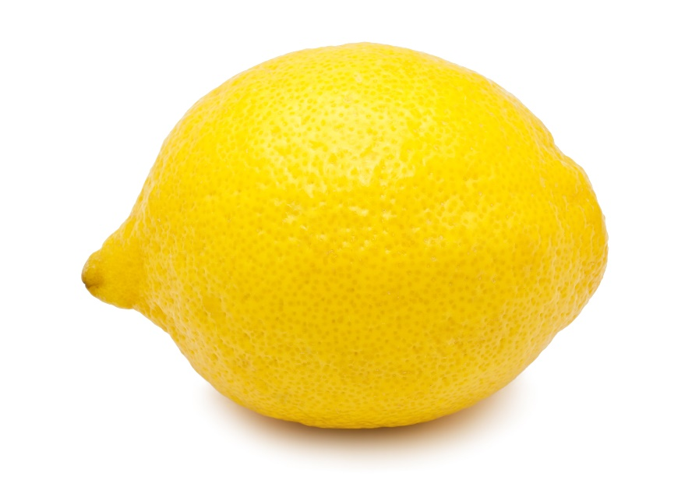
Write a program
Easy right ?

Slide 7

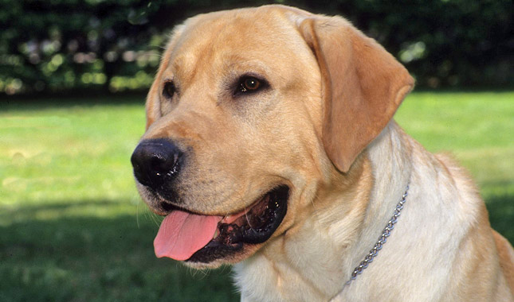
What if the objects are very different?

Slide 8
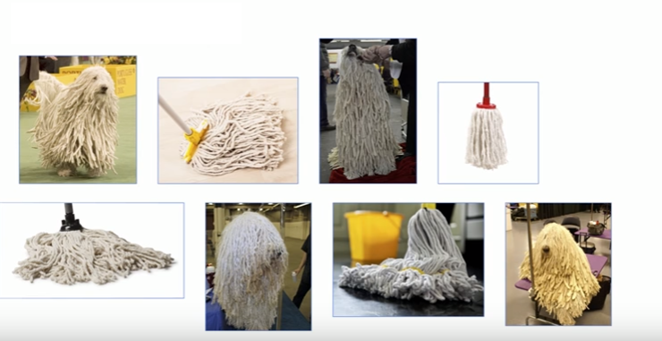
Not so fast ….
Google I/O 2017 Machine Learning APIs by Example
https://www.youtube.com/watch?v=ETeeSYMGZn0

Slide 9
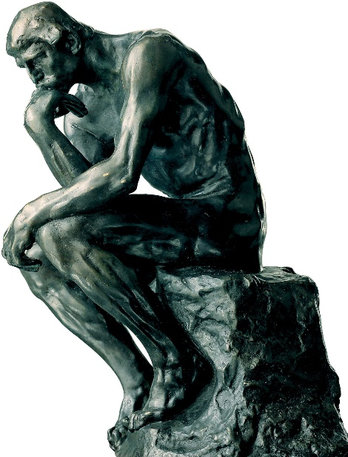
The Big Idea
Don’t want to write programs based on rules
Write code that will find the patterns
Write code that will learn from data
All kinds of data
Video, text, images
This is often referred to a machine learning

Slide 10
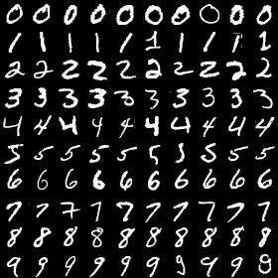
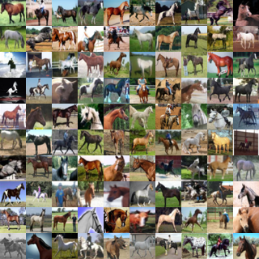
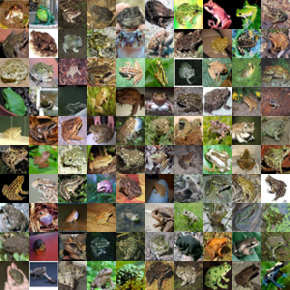
Machine Learning
Field of Artificial Intelligence
Computers learn environment from data rather that rules in computer programs
With Supervised Learning
Train with known data
Classifier in browser
http://cs231n.stanford.edu/

Slide 11
Learning from Data What is the best line that fits these points?
Error = sum of individual errors
Find the solution that fits the data

Slide 12
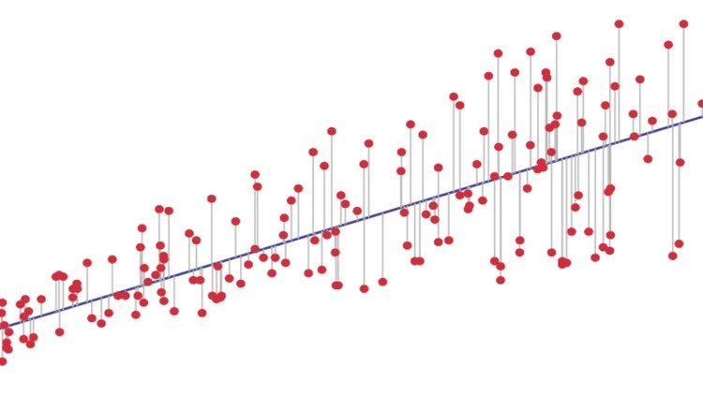


Linear Regression
Move the line in the direction of decreasing error until error is minimized
Square the error to avoid negative distances
Least squares
Use for continuous data
x^{i} = independent variable, ith observation
= regression coefficient
ε = error term
The best fit is the choice of coefficients that results in the smallest error

Slide 13
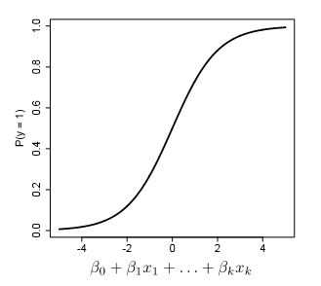

Logistic Regression
Linear regression provides a way to predict continuous data
Logistic regression provides a mechanism to classify data
Discrete or categorical data
The coefficient are selected to predict a probability for
a given class
P(digit = 1)
P(image is a bird)
P(patient is a smoker)

Slide 14
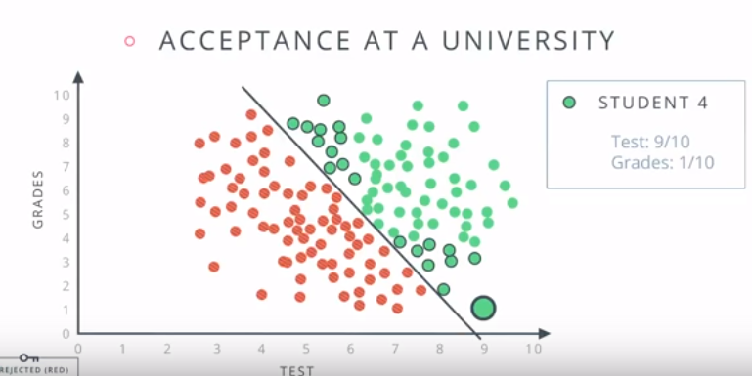
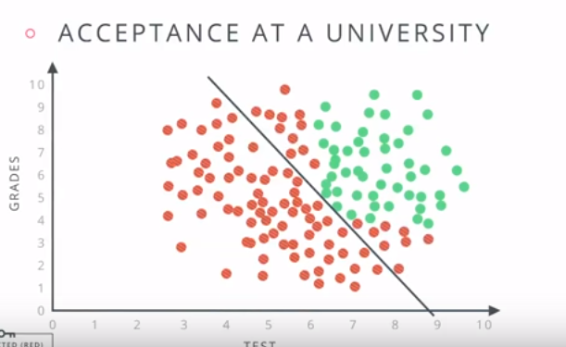
Neural Networks (1)
Green = accept students
Should student 4 be
accepted?
Perhaps there is a better
distribution
Is a single line sufficient?
Images from udacity.com

Slide 15
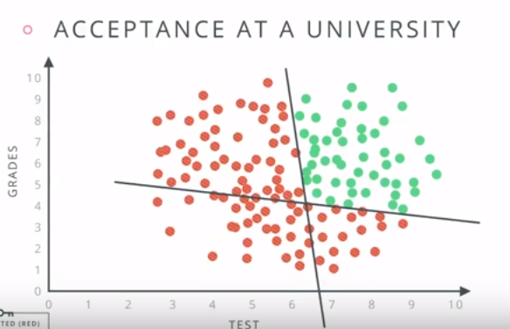
Neural Networks (2)
Use two lines
Find the two lines using
gradient descent
This is called a Neural Network
With a neural network we split the problem
into separate questions
Is the point of interest above the horizontal line?
Is the point of interest to the right of the vertical line?
Is the answer to both previous questions yes?
Images from udacity.com

Slide 16
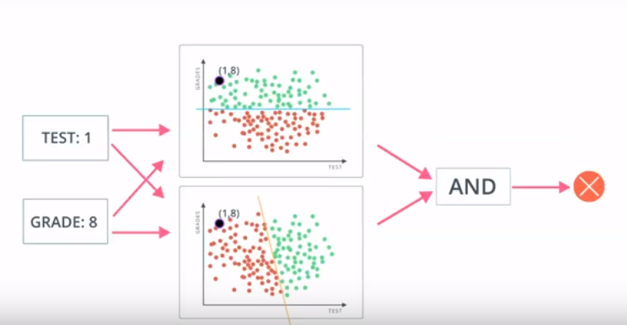
Neural Networks (3)

Slide 17
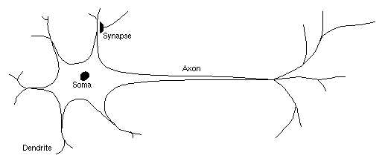
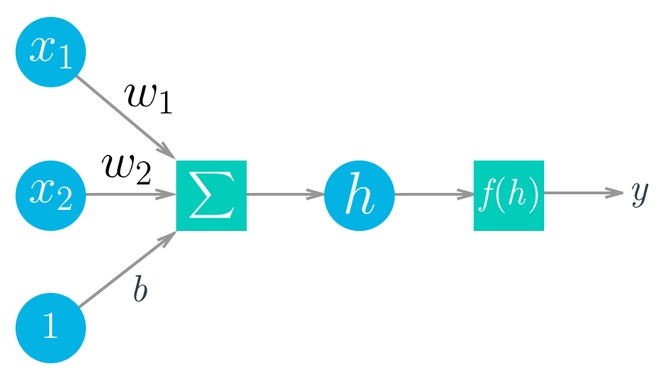
Artificial Neurons
Basic unit of a neural network
Loosely model after a biological neuron
Neurons can be combined to form complex networks
See https://sebastianraschka.com/faq/docs/logisticregr-neuralnet.html

Slide 18

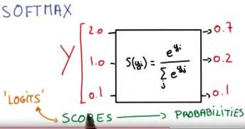
Weights and Activation
Linear combination of weights, inputs, and bias, denoted h, are passed to an activation function
The activation function can be any function
Common choices are:
sigmoid 1/(1+e​−^{x​​})
softmax – convert score to probabilities

Slide 19
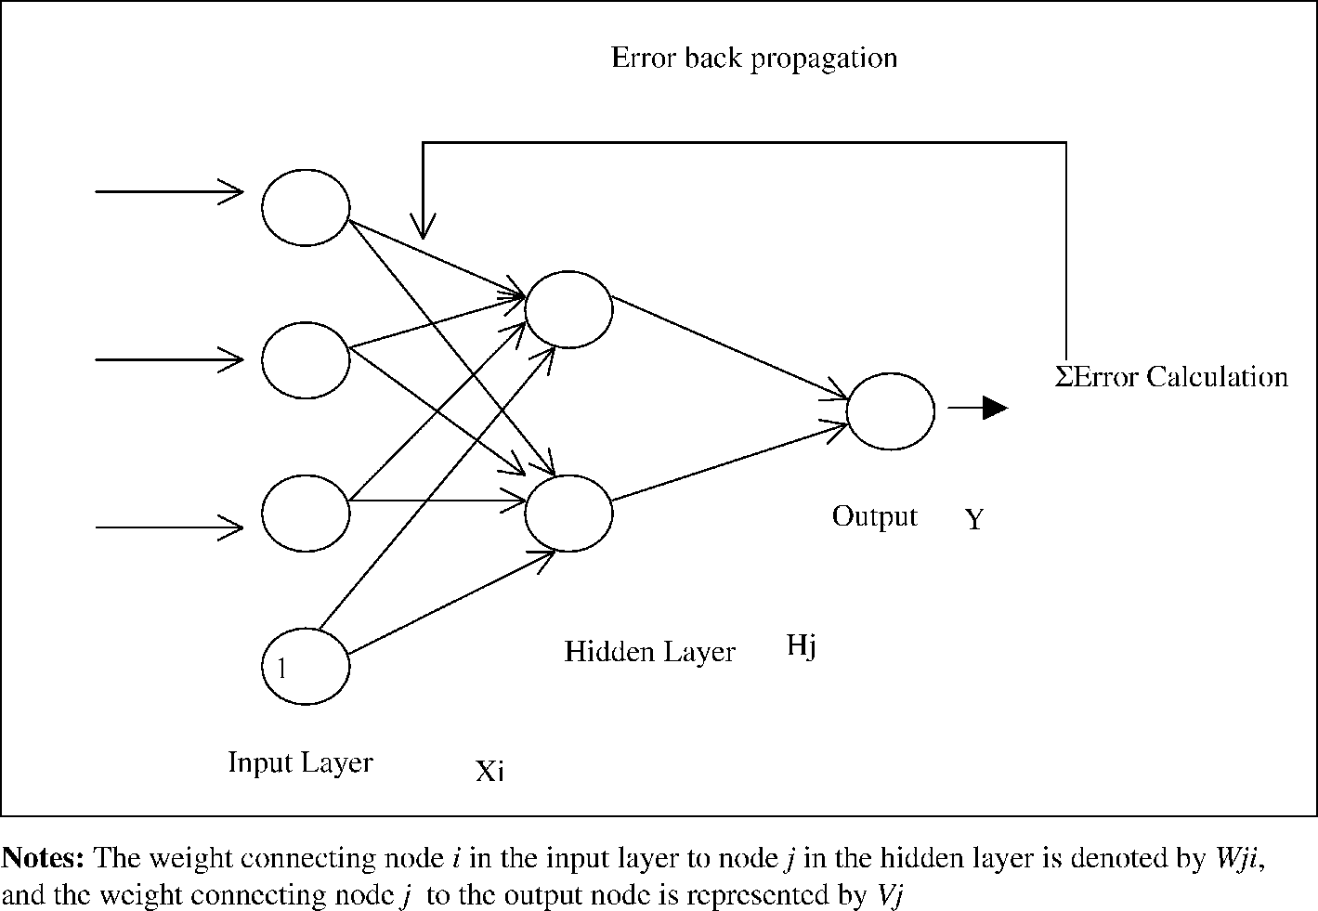
Gradient Descent
The weights in a neural network are trained using a known set of data usually referred to as the training set
Gradient Descent is used to minimize the error in a network
Backpropagation – the error is propagated back to adjust the weights
http://i.stack.imgur.com/pOR6t.png

Slide 20
Gradient Descent Recipe
Compute network output
h = Σ (w_{i}x_{i})
y^ = f(h) # f is the activation function
Compute error
y – y^ # expected value – output
Compute error term
(y – y^)*f’(h) # derivative activation function
Compute Δω_{i} (change in weights)
ω_{i =} η*(y-y^)*x # η is the learning rate

Slide 21
TensorFlow
Open source machine learning framework
Released approx. 1 year ago
Current version is 1.2
APIs in Python, Java, C, Go
A software library for numerical computation using data flow graphs. Nodes in the graph represent mathematical operations, while the graph edges represent the multidimensional data arrays (tensors)
communicated between them.
https://www.tensorflow.org/

Slide 22
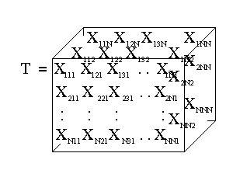
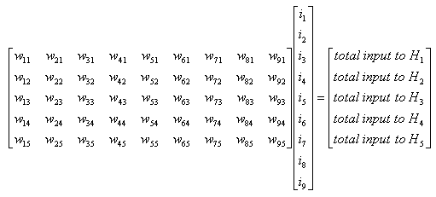
So …what’s a tensor? (https://www.tensorflow.org/get_started/get_started)
Central unit of data in TensorFlow
Multidimensional data array
Rank – number of dimensions
3 # a rank 0 tensor; this is a scalar with shape [] [1. ,2., 3.] # a rank 1 tensor; this is a vector with shape [3] [[1., 2., 3.], [4., 5., 6.]] # a rank 2 tensor; a matrix with shape [2, 3] [[[1., 2., 3.]], [[7., 8., 9.]]] # a rank 3 tensor with shape [2, 1, 3]

Slide 23

B R E A K

Slide 24
Getting Started with TensorFlow
Go to
https://github.com/pcomitz/reforge_ml
Open the interactive notebook
TensorFlowGetting Started.ipynb

Slide 25
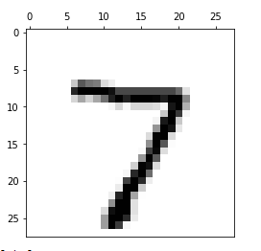
MNIST Classifier
MNIST is Database of handwritten digits 0 - 9
Subset of larger data set available from National Institute of Standards and Technology
Training set : 55000 images
Test Set: 10000 images
Each image 28 x 28 = 784 pixels
Each pixel has a greyscale value of 0 – 255

Slide 26
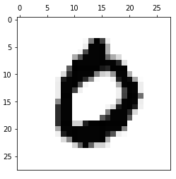
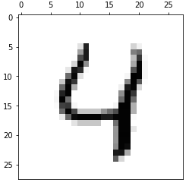
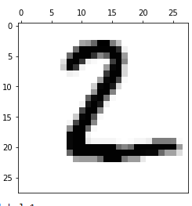
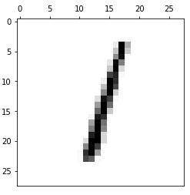
MNIST image data

Slide 27
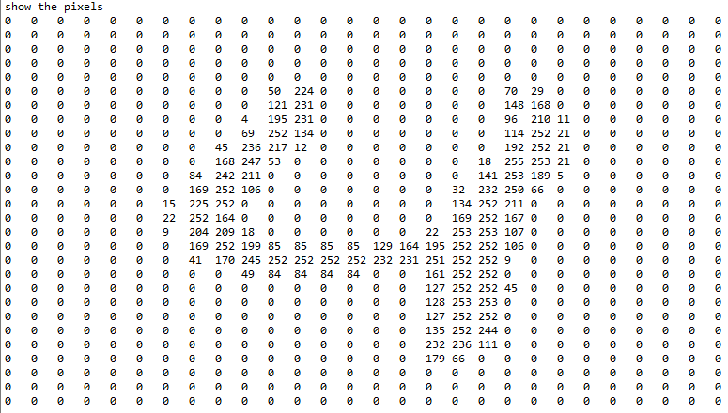
MNIST detail 784 features

Slide 28
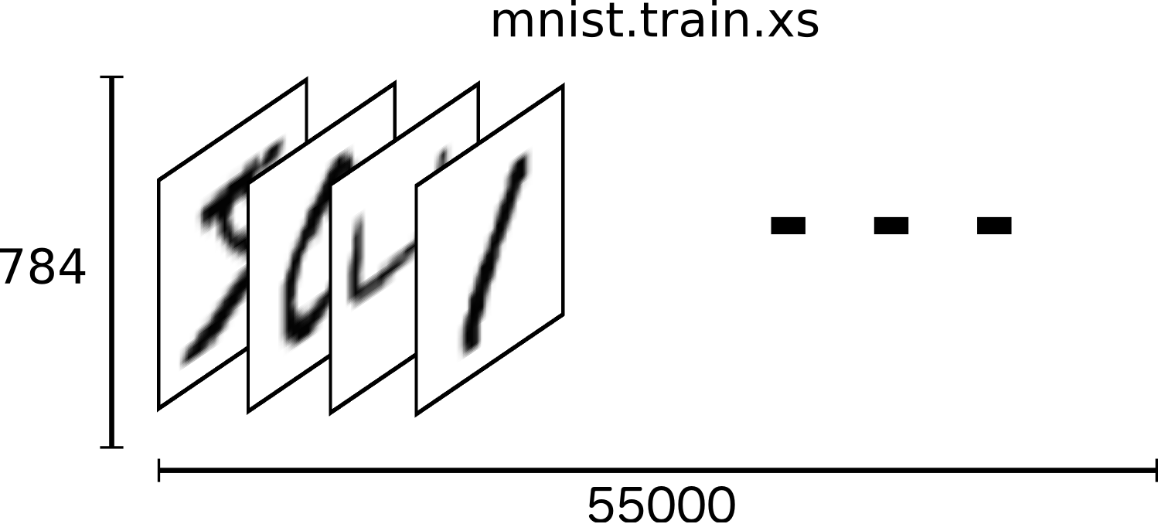
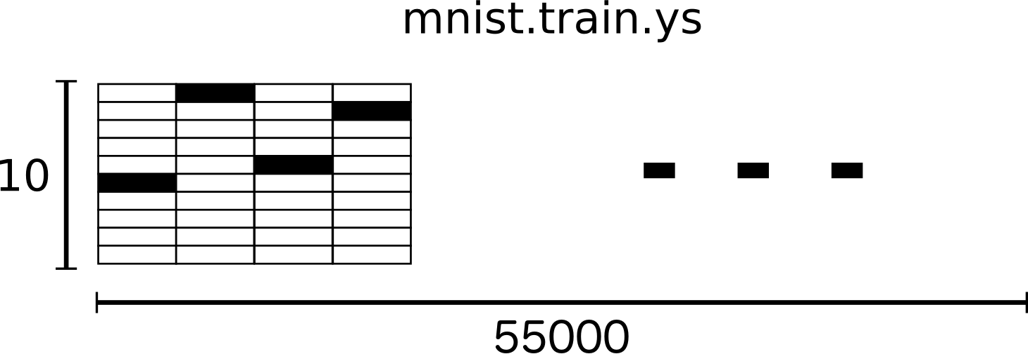
MNIST Classifier
Load the images
Training set
55000 inputs
784 features per input
28 x 28 pixels
10 labels
(0 1 2 3 4 5 6 7 8 9)
The classifier output is a label for each input

Slide 29
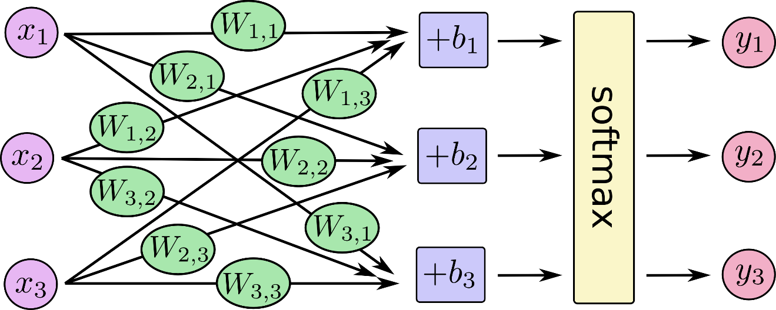
MNIST Classifier (2)
There is a weight for each input pixel – for each label or class.
784 input features * 10 classes = 7840 weights
10 bias values – one for each class
784 x’s
7840 w’s
10 b’s
10 y’s

Slide 30
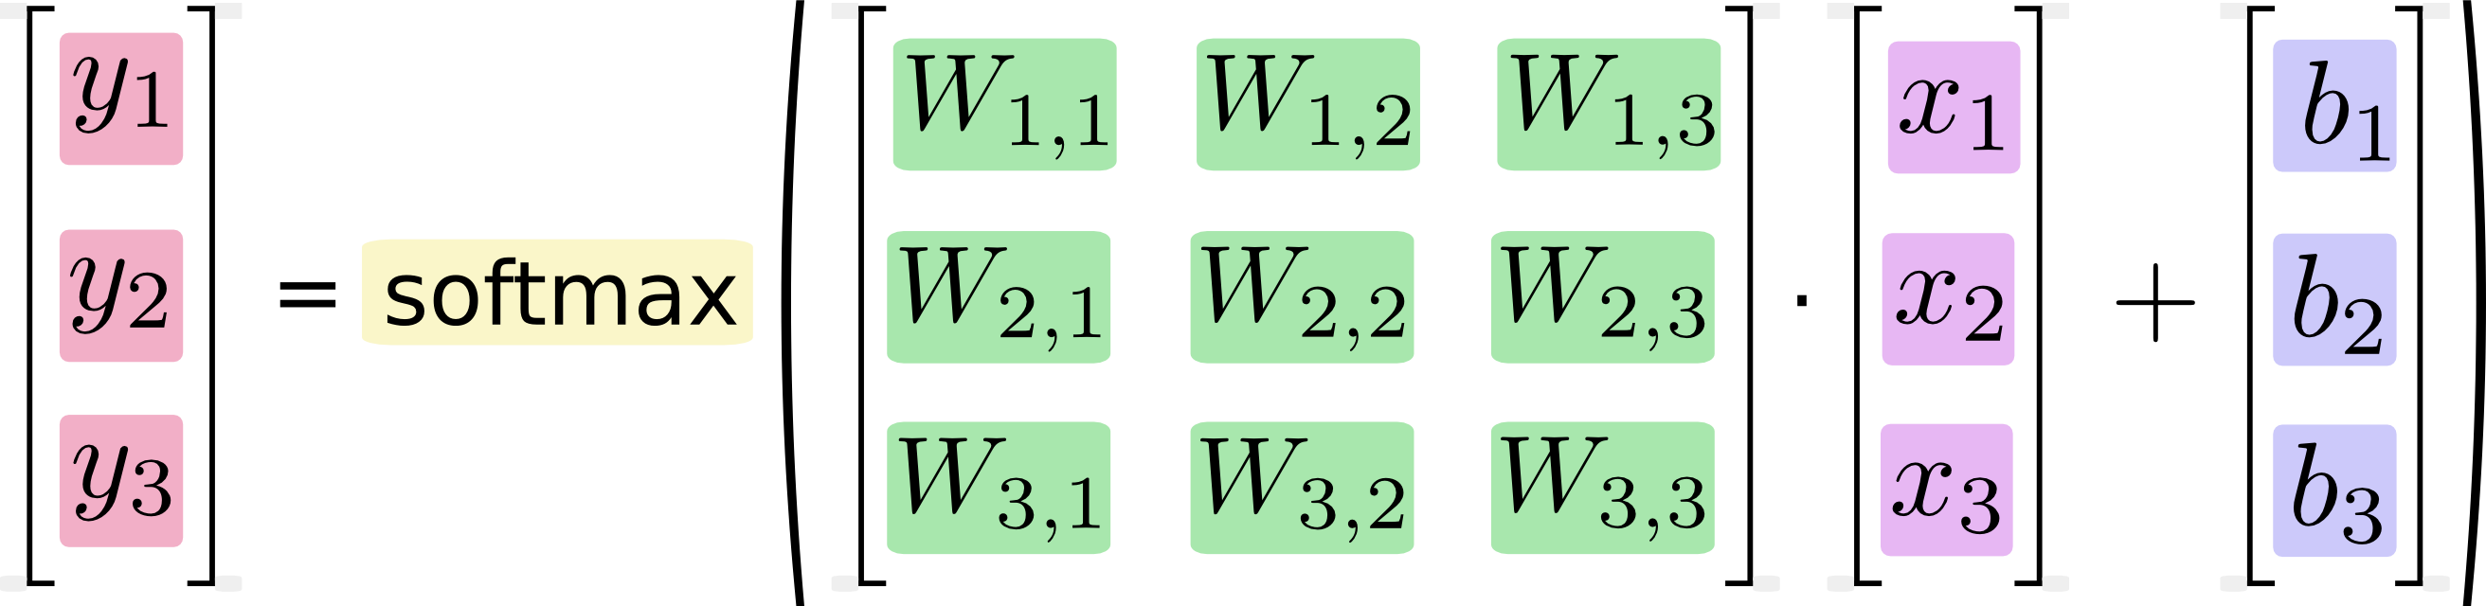
MNIST Classifier (3)
The model is:
y = tf.nn.softmax(tf.matmul(x,W)+b)
10 classes
784 rows, 10 columns
784 inputs
10 bias values

Slide 31
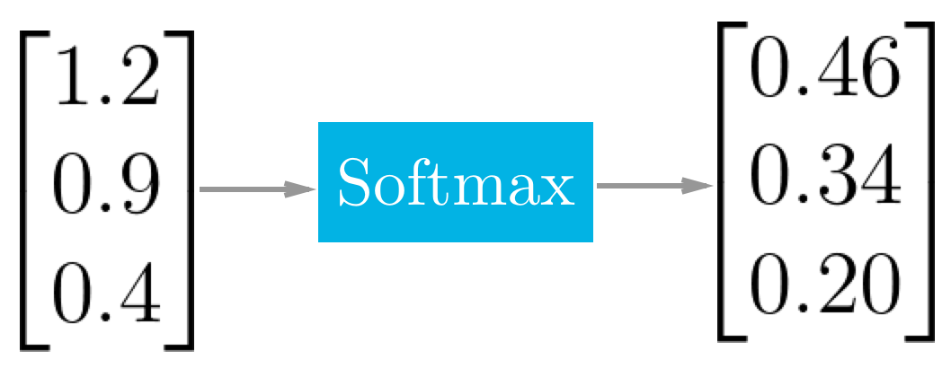

SoftMax in TensorFlow
SoftMax turns scores into a probability vector that sums to 1

Slide 32
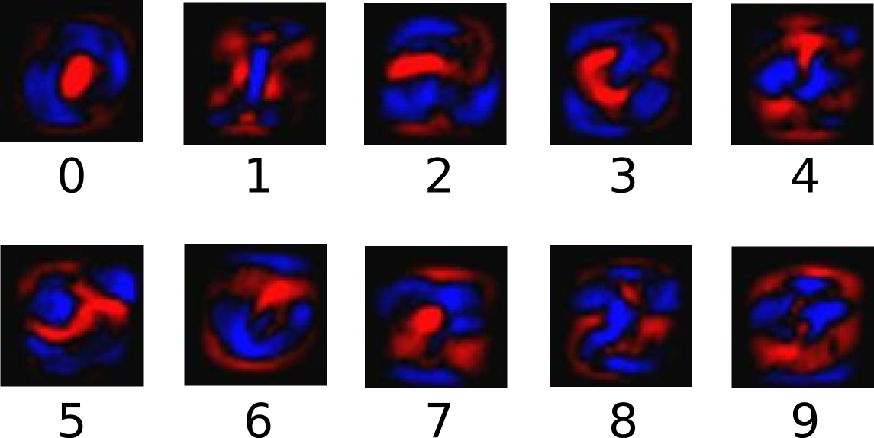
Training the Classifier
Use and stochastic gradient descent (sgd) and backpropagation to train the weights matrix

Slide 33
Classifier Notebook
On Github
https://github.com/pcomitz/reforge_ml/blob/master/MNIST_for_beginners.ipynb

Slide 34
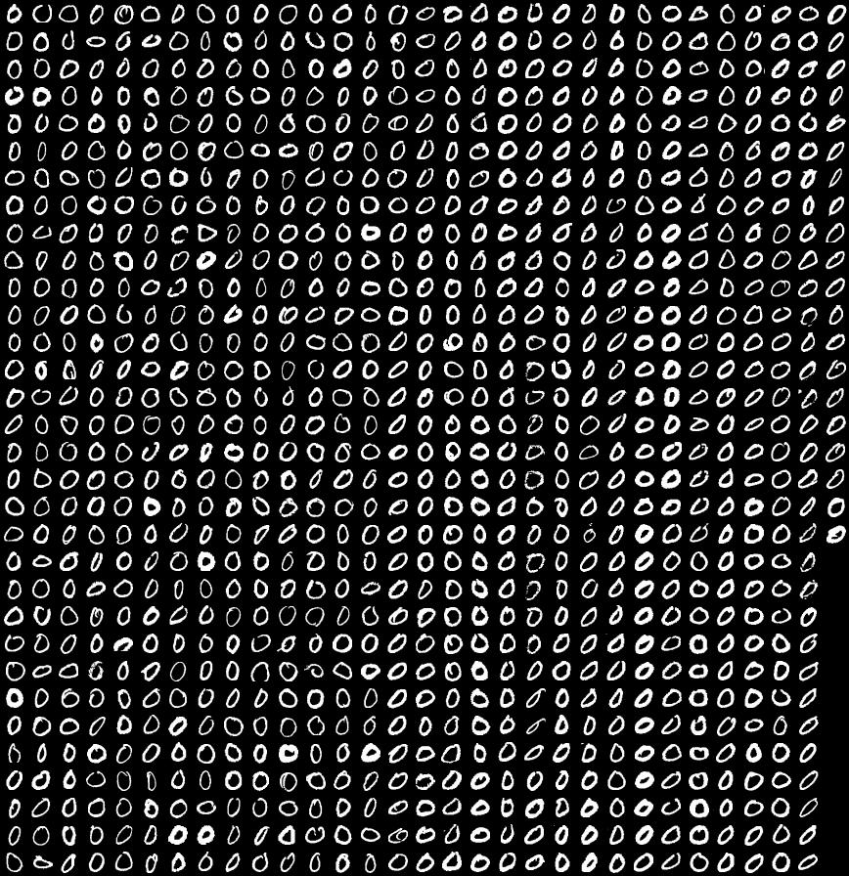
Summary
We have barely scratched the surface
Significant study required – but many excellent resources available
Machine learning is a paradigm shift in computer programming
Learn from data rather than encoded rules
Frameworks like TensorFlow are designed to run at scale
Thousands (millions) of complex inputs

Slide 35
Additional Resources
Neural Networks and Deep Learning (by Michael Nielson)
Deep Learning Book (Goodfellow, Bengio, Courville)
TensorFlow Playground
Udacity Machine Learning Course (free)
Stanford CS231n CIFAR classifier in browser
Wikipedia Machine Learning Portal
Artificial Intelligence: a Modern Approach
Free AI Course at edx
AI Courses at Coursera

Slide 36


