Slide 1
Analyzing Joseki in Go games
Peter Conerly 11-09-2010
Notes:
Give my name
Ask how many people have played Go
Of those people, how many have heard of Joseki?
Going spend the first half of my presentation talking about Go,
the second half about my analysis of games

Slide 2
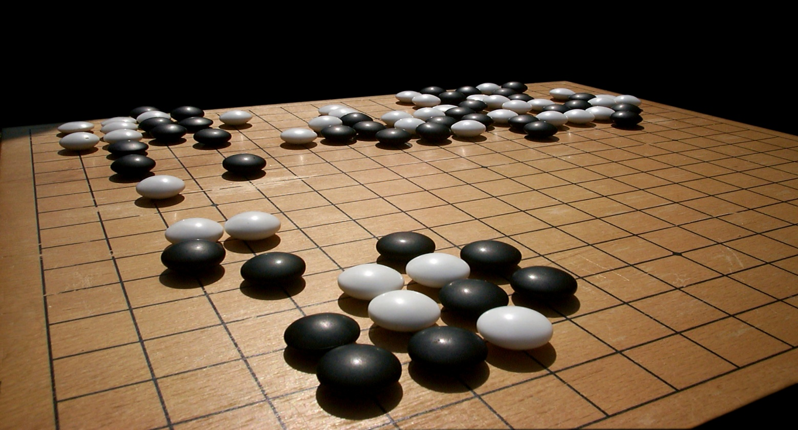
What is Go?
  "Igo" means surrounding boardgame
  The board is 19x19 and stones are played on the intersections, the game starts blank.
  The objective is to make more territory than your opponent.
  A player can capture an opponent by surrounding
  A few moments to learn, a lifetime to master. - Ancient Proverb

Slide 3
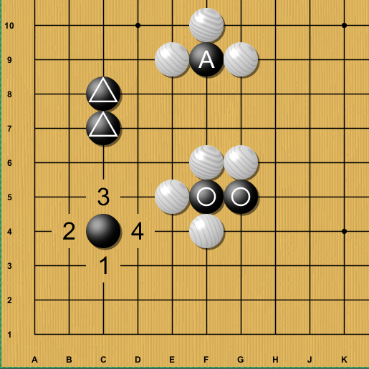
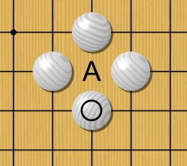
Capturing rules
  Liberties of single stone
  Liberties of triangle stones
  Liberties of A stone
  (Atari!)
  Liberties of circle stones?
Notes:
STAY AT THE HIGH LEVEL

Slide 4
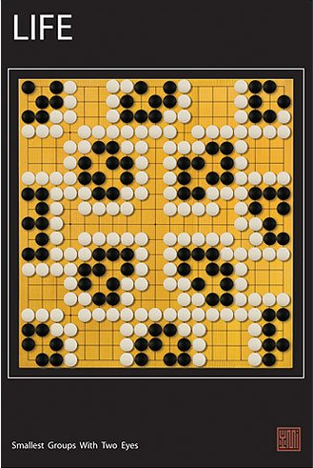
Two eyes!
Smallest groups with two eyes
NOT A REAL GAME

Slide 5
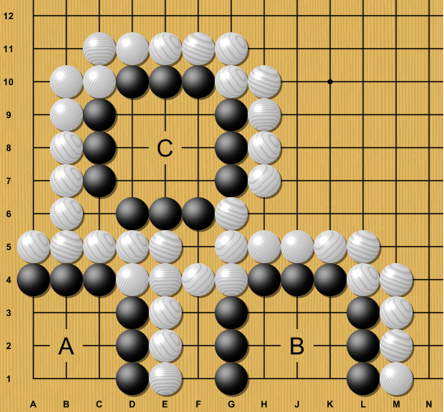
Getting Territory

Slide 6
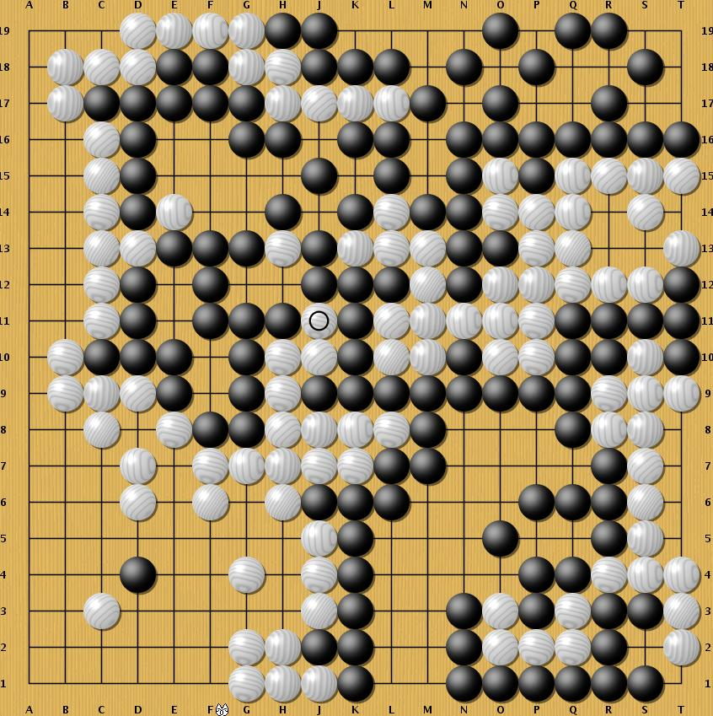
A completed game

Slide 7
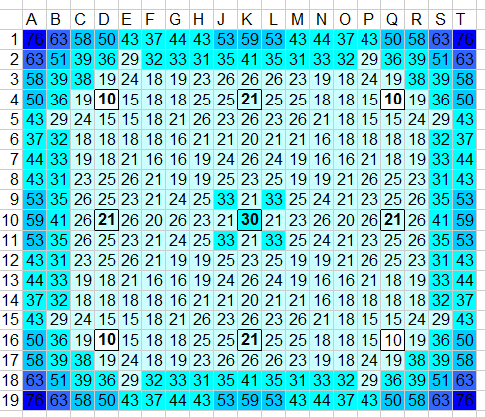
%
Territory heat map

Slide 8
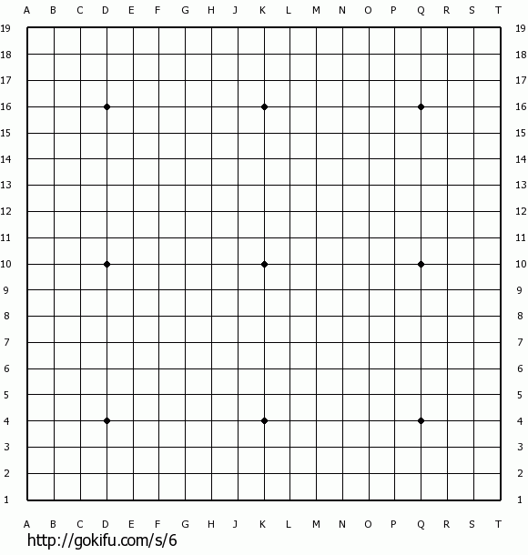
A game being played

Slide 9
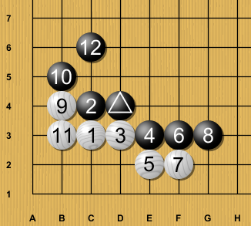
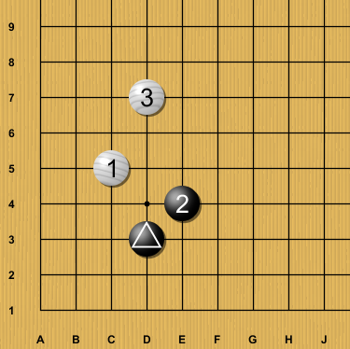
Josekis 'settled pattern'
  Basic Go dogma: You should first play in the corners.
  Over thousands of years the 'optimal' corner playing patterns have been created and refined. These are Joseki.
  An example of a couple Joseki:

Slide 10
Complexity of Go, a.k.a. "Why should a computer scientist care?"
  The number of possible games is greater than the number of atoms in the observable universe.
  Legal game positions: ~2.1 x 10^170
  Atoms in the observable universe: ~10^80
  There still hasn't been an AI written that can beat intermediate human players.
  There is a wealth of data about Go games on the internet!

Slide 11
I ask: How often are Josekis used?
To answer this question:
  Import Kogo's Joseki Dictionary
  Import 42,000+ professional games
  Compare!
  Expecting a number between 0 and 4. My guess was 2.

Slide 12
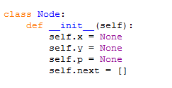
Kogo's Joseki Dictionary
  I made a tree node structure.
  Each node contains a move (x, y, player)
  Each node has a list of other moves it leads to in .next
  Used a recursive function to go through all the branches
  Run "print_tree()"

Slide 13
Importing the games
  Separate the moves by which quadrant they're played in.
  Normalize the coordinates so they are all in the same quadrant.
  Normalize the players so Black always goes first in each corner.
  Reflect the corner patterns over the y = 1x axis, since
  B(4,4) W(3,6) is equivalent to B(4,4) W(6,3)
  List format was:
  game_archive[game[corner[move] ] ]
  move = [x, y, player]

Slide 14
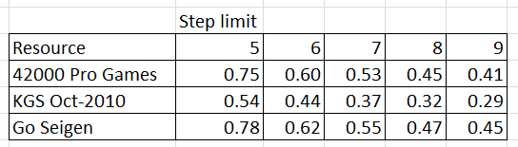
Results!

Slide 15
Questions?

