Slide 1
Designing a large scale aerial survey of polar bears and ice-associated seals in the Chukchi Sea
Paul B. Conn, E. E. Moreland, E. V. Regehr, E. L. Richmond, M. F. Cameron, and P. L. Boveng

Slide 2
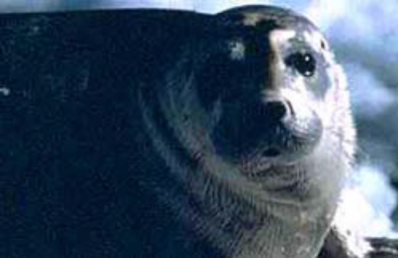
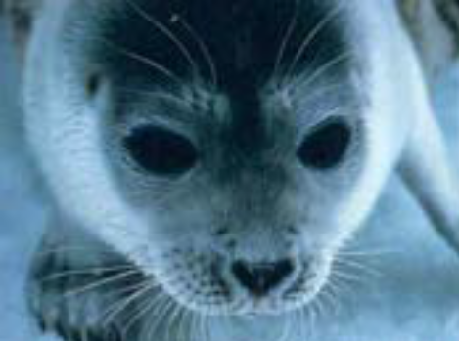
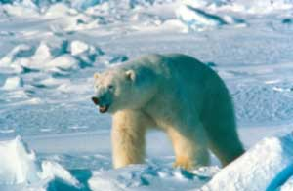
Rationale
Retreating summer sea ice and increasing human activity in Arctic marine environments have raised concerns about population trends of polar bears and ice-associated seals
Bearded seal Erignathus barbatus
Ringed seal
Phoca hispida
Polar bear
Ursus maritimus

Slide 3
Rationale
In coordination with Russian scientists, we conducted aerial, instrument-based surveys of these species in the Chukchi Sea in the spring of 2016
Before conducting surveys we performed simulation analyses to determine anticipated precision and examine the performance of alternative levels of effort and flight track allocation strategies
These are important analyses, because surveys are very expensive and we want to know whether they will generate reliable estimates of abundance

Slide 4
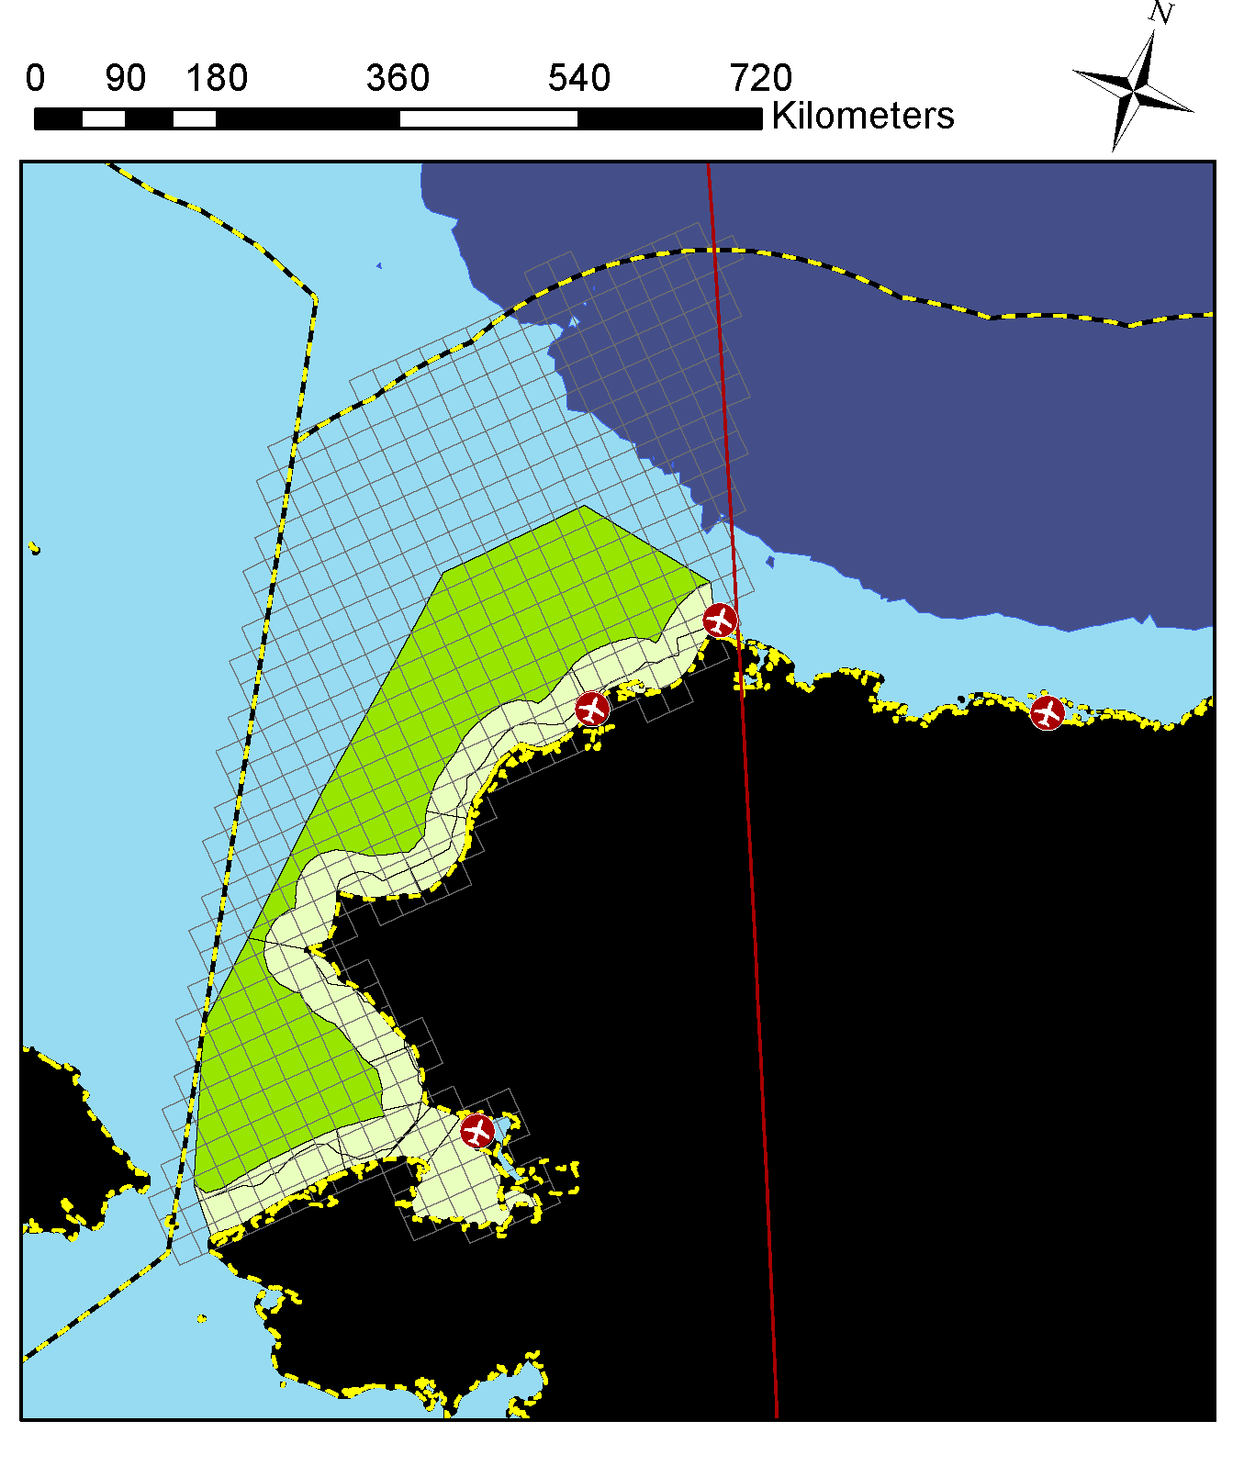
Study area
U.S. portion of Chukchi Sea
25km x 25km grid cells
Bounded to south by Bering Strait
Bounded to west and north by U.S. EEZ
Bounded to east by 156°

Slide 5
Simulation setup
1) Generate abundance
2) Simulate Surveys
3) Estimate abundance
4) Calculated bias and anticipated precision
iterate
Select survey design that maximizes cumulative precision

Slide 6
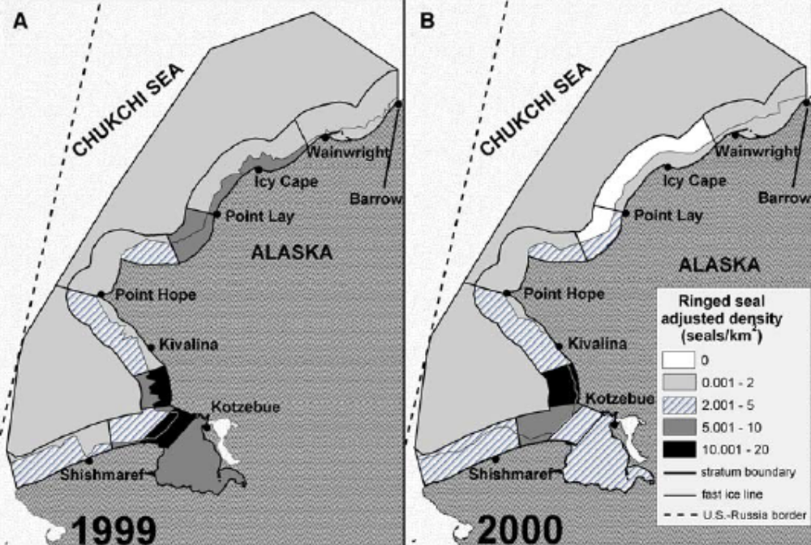
Simulating abundance
Base expected seal abundance on published density estimates (Bengtson et al. 2005)

Slide 7
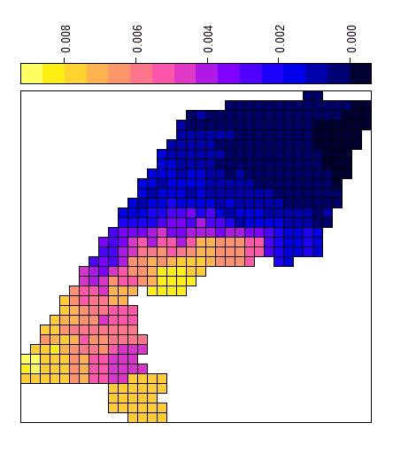
Simulating abundance
Base polar bear distribution on resource selection functions fitted to satellite records from neck-collared females

Slide 8
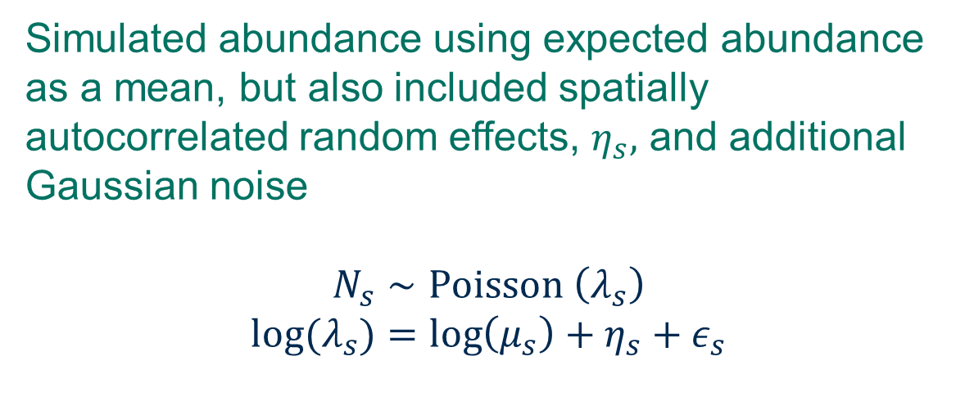
Simulating abundance
Expected polar bear abundance: 1,000
Expected ringed seal abundance: 434,000
Expected bearded seal abundance 19,300
Notes:
PB from IUCN Polar Bear Specialist Group, 2000 in Chukchi Sea

Slide 9
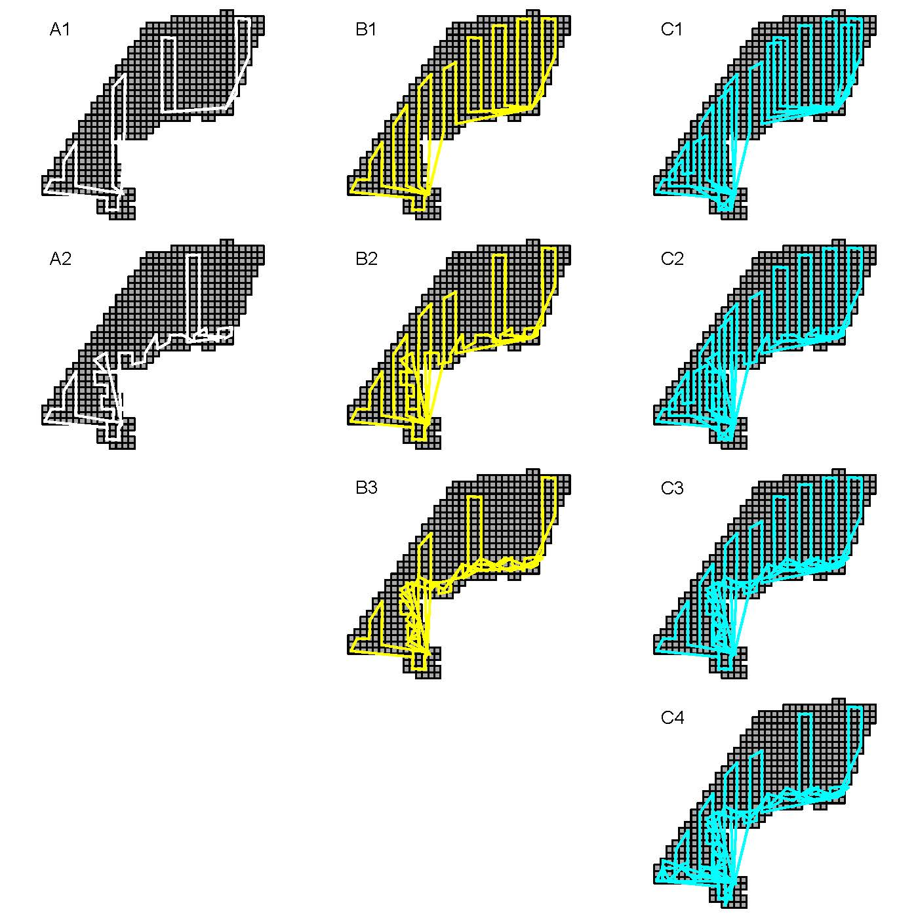
Simulating surveys

Slide 10
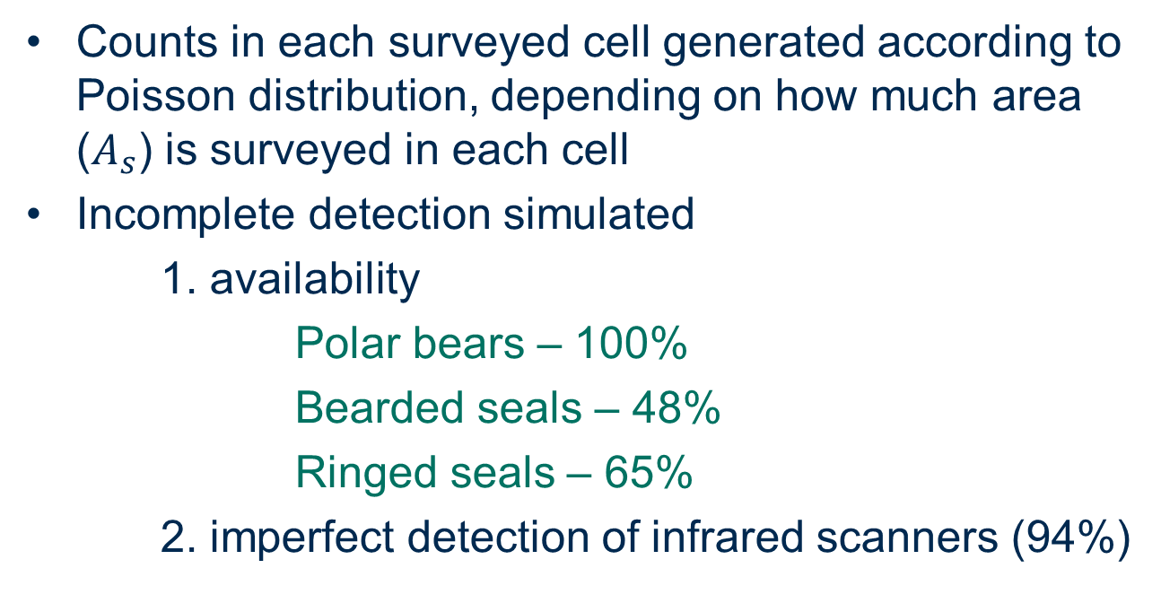
Simulating surveys

Slide 11
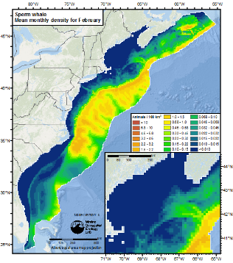
Estimating abundance
Refresher: Design- vs. model-based inference
A. Design-based
B. Model-based
Duke University (sperm whales)

Slide 12
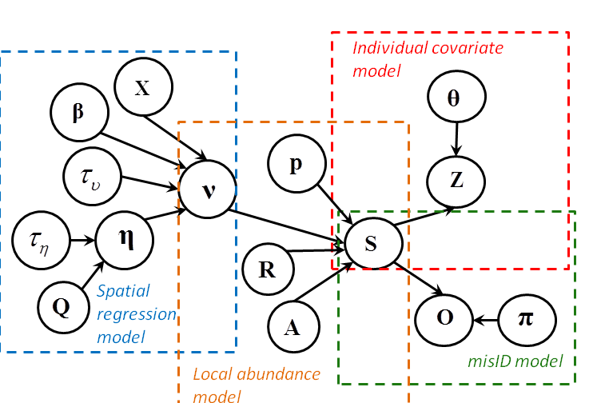
Estimating abundance
For each simulation, we estimated abundance of all 3 species with a hierarchical, Bayesian spatial regression model
Use covariate relationships to explain variation in counts and to predict abundance in unsampled locations (e.g., distance from land, northing, easting, strata, spatially autocorrelated random effects)
Conn et al. 2015, Methods in Ecology and Evolution

Slide 13
Estimating abundance
Fit multiple models with different levels of complexity to each dataset. 9 models for seals, 4 models for polar bears
We do not use the same variables to estimate abundance as we do to generate the data (that’s cheating!)
Importantly, model accounts for uncertainty in detection estimates
Conn et al. 2015, Methods in Ecology and Evolution

Slide 14
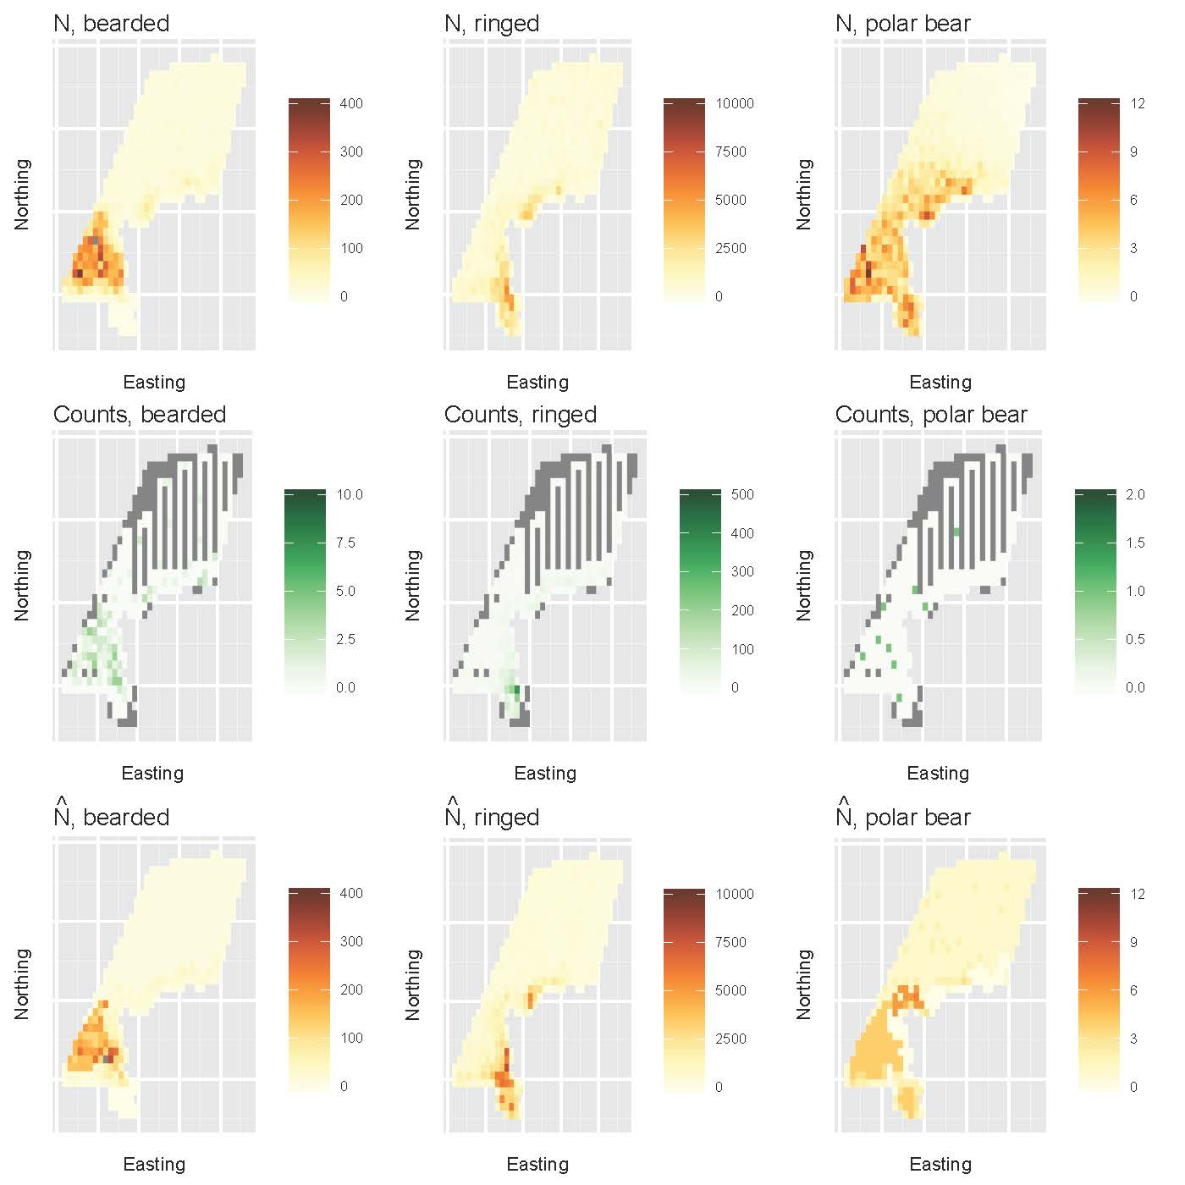
Example of one simulation
Repeat 100 times!

Slide 15
Simulation results: bias
Species | 4 flights (3920km) | 8 flights (7840km) | 12 flights (11760km)
Bearded seals | -8% to 54% | -7% to 8% | -9% to 7%
Ringed seals | -2% to 21% | -3% to 6% | -4% to 10%
Polar Bears | NA | -11% to 38% | -9% to 11%
Lower bias for flight designs with more even spatial coverage
Lower bias with more complicated estimation models

Slide 16
Simulation results: precision (CV)
Species | 4 flights (3920km) | 8 flights (7840km) | 12 flights (11760km)
Bearded seals | 0.19 – 0.39 | 0.15 – 0.18 | 0.13 – 0.15
Ringed seals | 0.10 – 0.14 | 0.09 – 0.11 | 0.09 – 0.10
Polar Bears | NA | 0.35 – 0.97 | 0.28 – 0.35
Could likely obtain sufficient precision for seals with 8 flights
12 or more flights would be better for polar bears, but still somewhat imprecise

Slide 17
Conclusions
This study provided confirmation that we could obtain good precision for ice-associated seals with 8 or more flights and a spatial regression estimation procedure
Increased number (12 or more) flights needed for polar bears
Integral to getting additional funding (e.g. U.S. Fish & Wildlife Service & WWF for Polar Bears)
More generally, this or a related analysis is an important step to conduct before implementing expensive population surveys

Slide 18
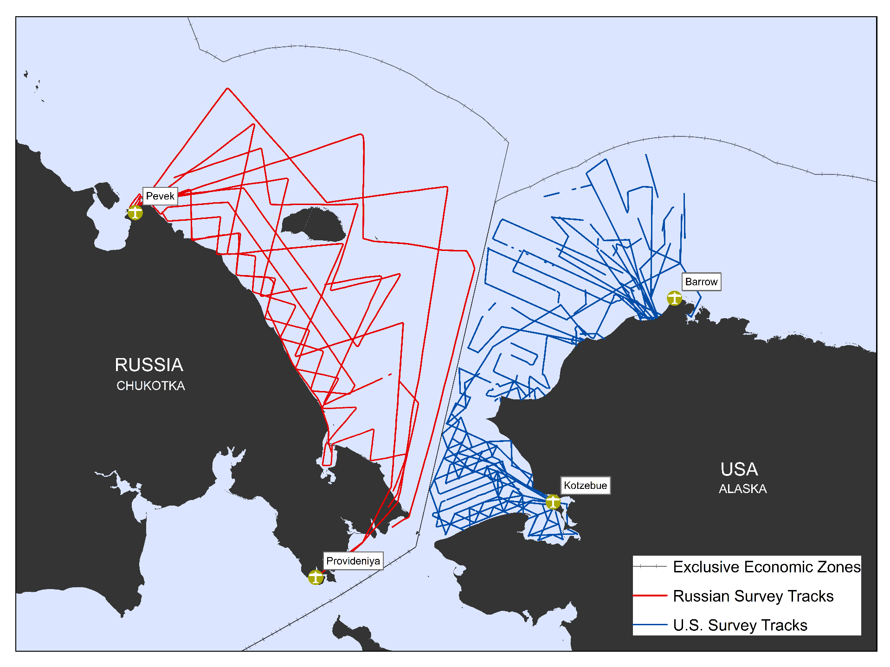






Chukchi and East Siberian Surveys (ChESS)
for Bearded Seals, Ringed Seals, and Polar Bears
April – May 2016
RUSSIAN SURVEY TRACKS:
on effort
U.S. SURVEY TRACKS:
on effort
U.S. Whaling Communities
Exclusive Economic Zone
Giprorybflot

Slide 19


Acknowledgments
Further information:
Conn, P. B., E.E. Moreland, E. Regehr, E.L. Richmond, M.F. Cameron, and P. L. Boveng. 2016. Using simulation to evaluate wildlife survey designs: polar bears and seals in the Chukchi Sea. Royal Society Open Science 3:150561.

