Slide 1
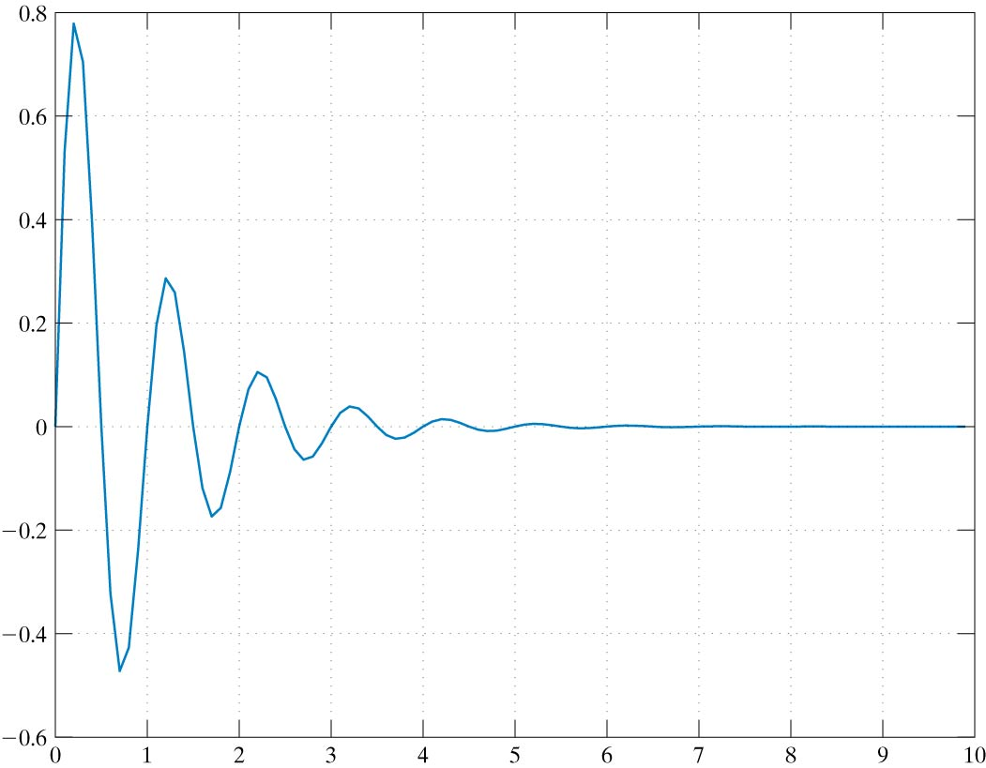
MATLAB Plot of a Damped Sine Function

Slide 2
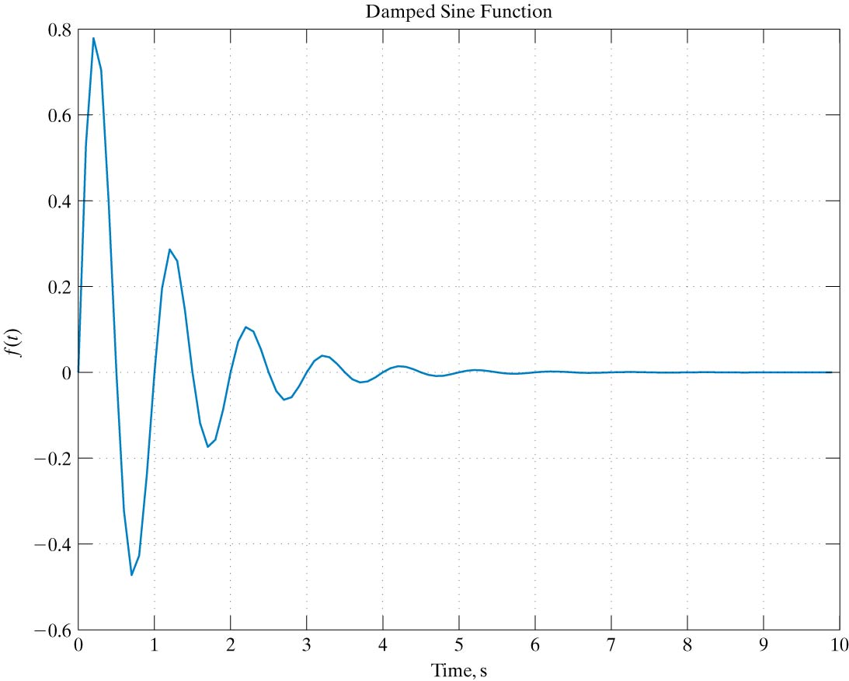
Enhanced MATLAB Plot of a Damped Sine Function

