Slide 1
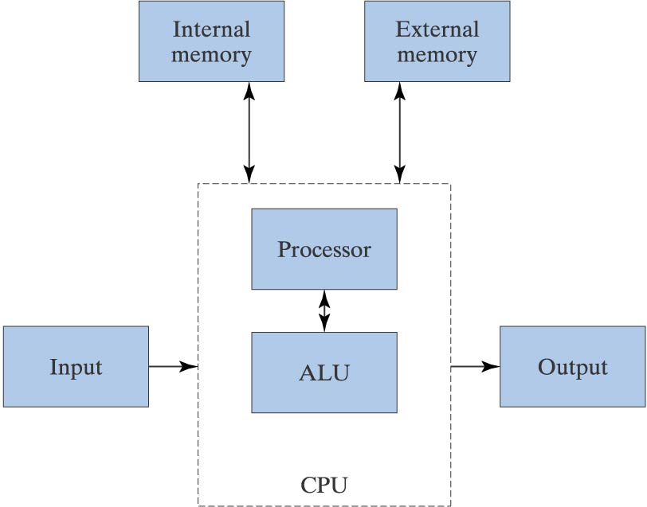
Internal Organization of a Computer

Slide 2
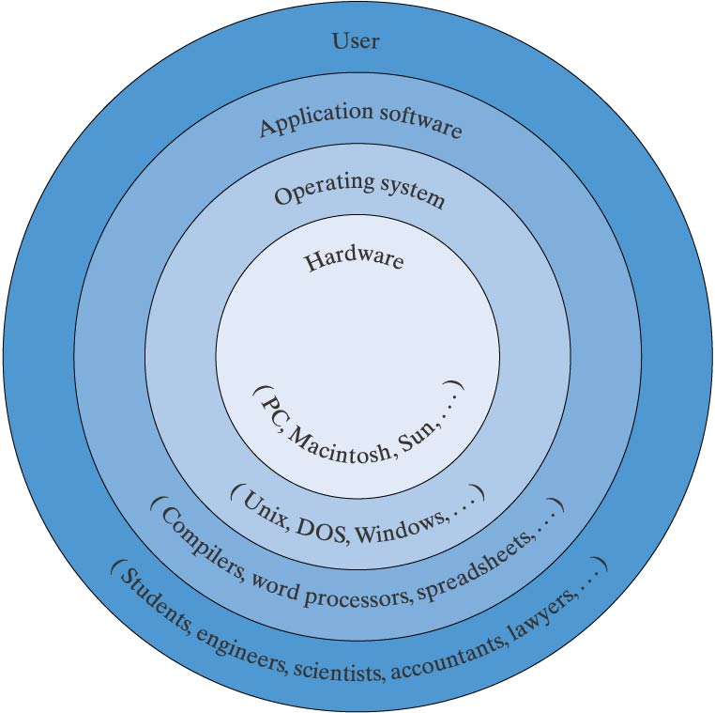
Software Interface to the Computer

Slide 3
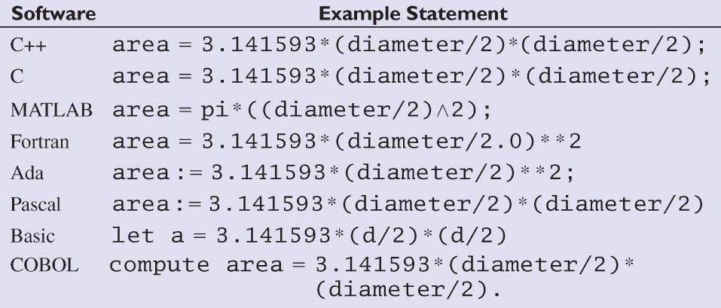
Comparison of
Software Statements

Slide 4
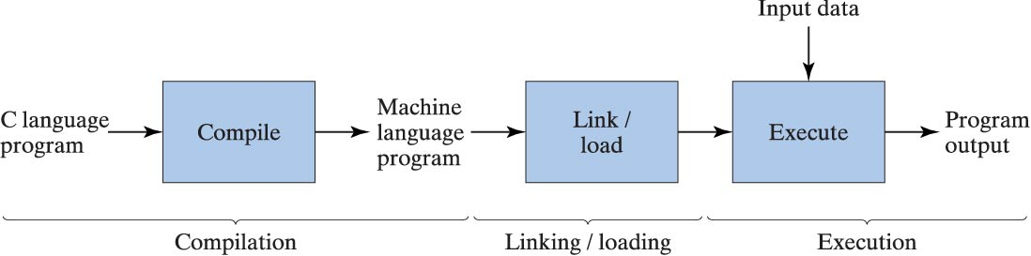
Program Compilation/Linking/Execution

Slide 5
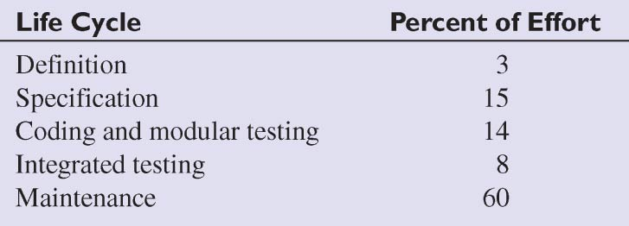
Software Life-Cycle Phases

Slide 6
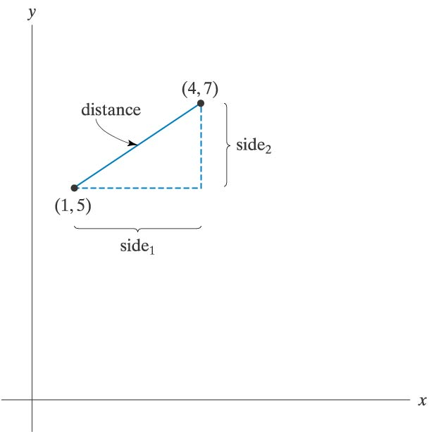
Straight-line Distance
Between Two Points

Slide 7
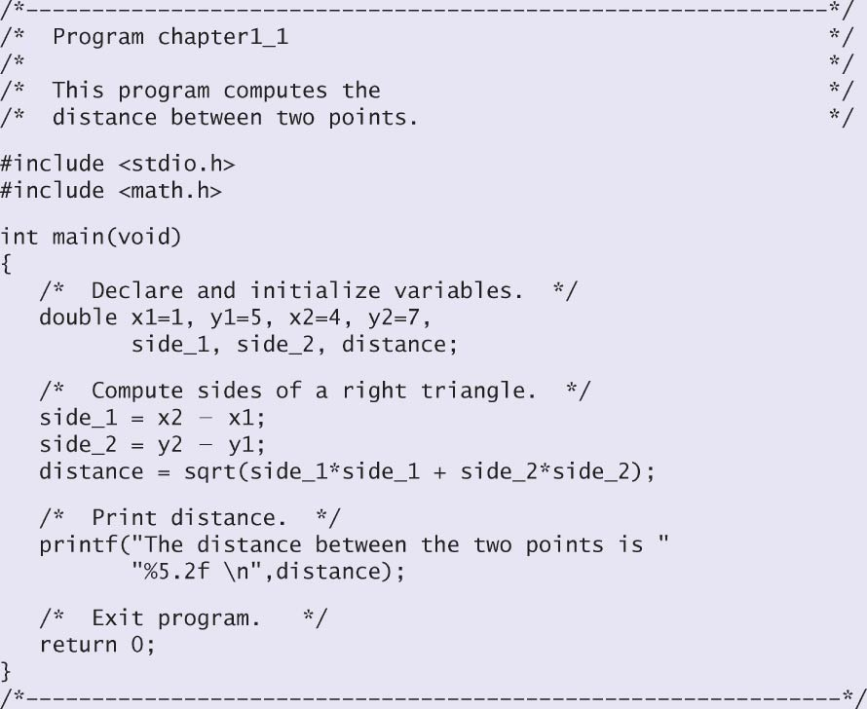
Program to Compute Distance Between Two Points

