Slide 1
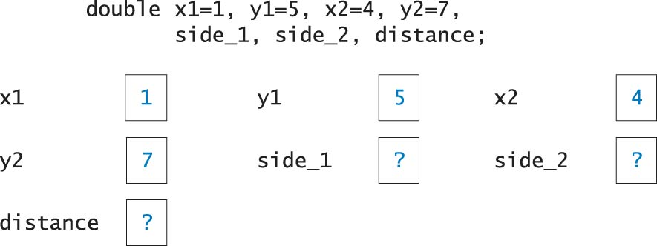
Constants and Variables

Slide 2
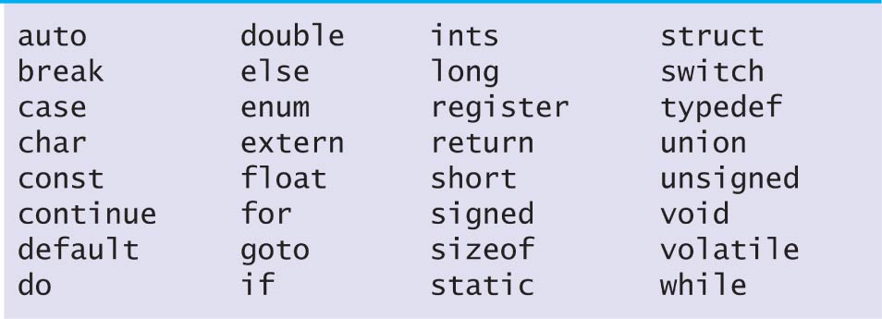
Keywords

Slide 3
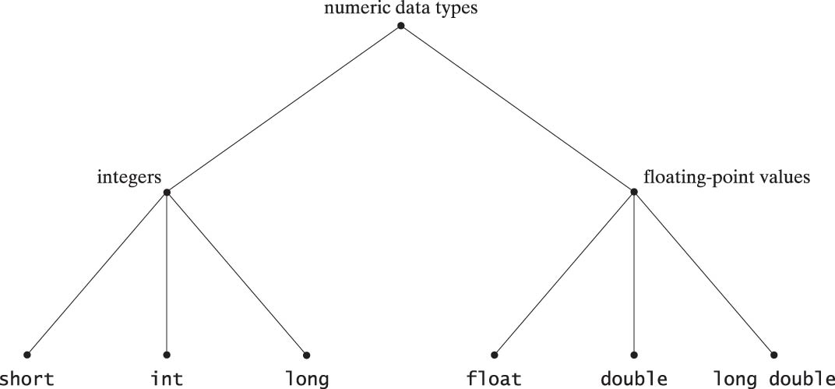
Numeric Data Types

Slide 4
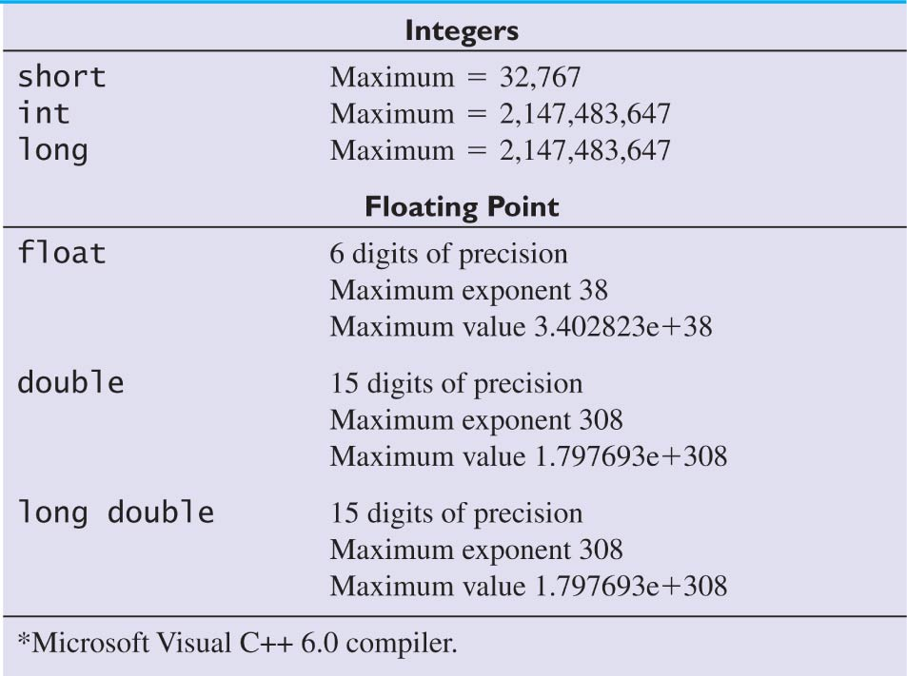
Example Data-Type Limits

Slide 5
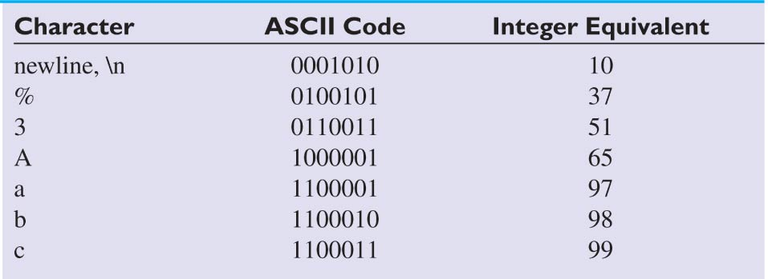
Examples of ASCII Codes

Slide 6
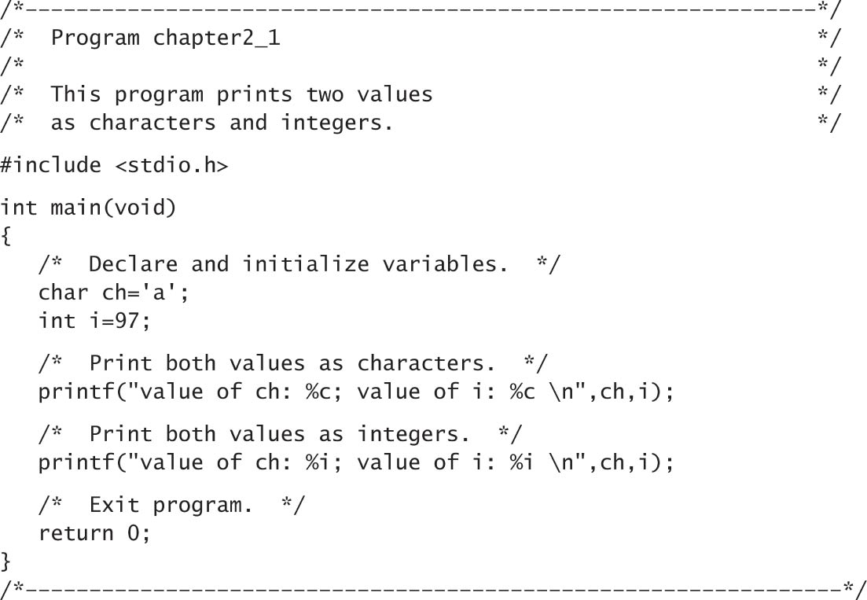
Program to Print Values as Characters and Integers

Slide 7
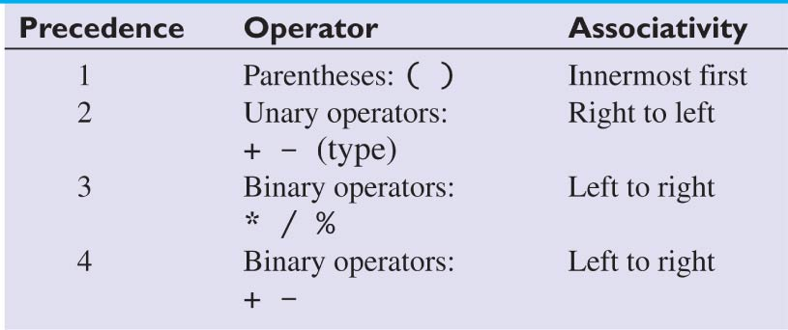
Precedence of
Arithmetic Operators

Slide 8
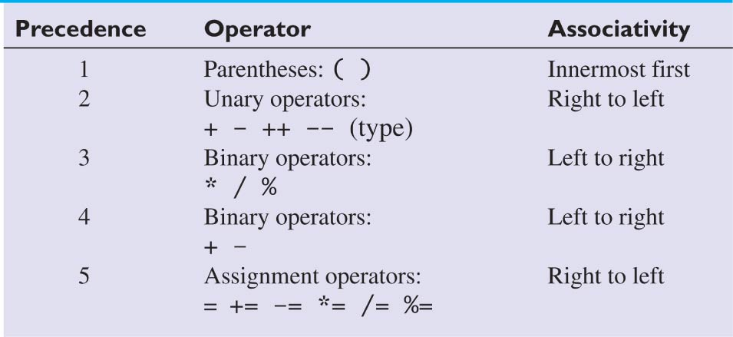
Precedence of Arithmetic and Assignment Operators

Slide 9
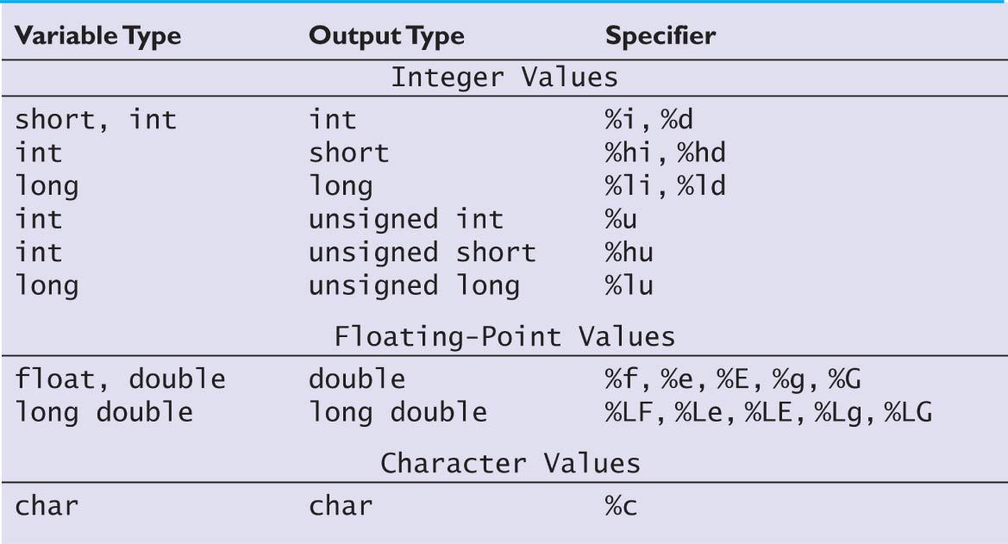
Conversion Specifiers for
Output Statements

Slide 10
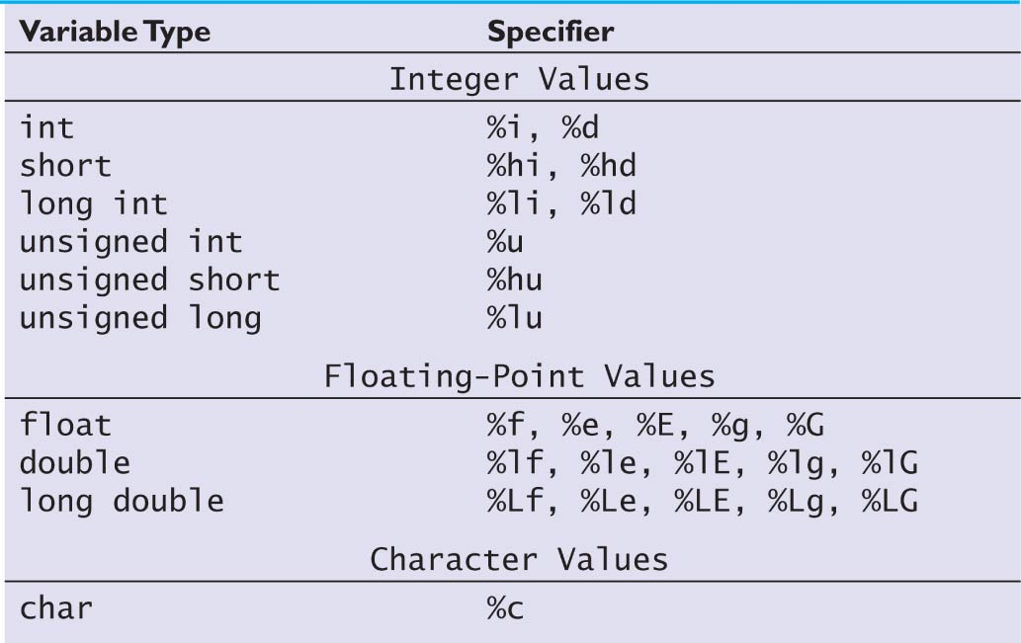
Conversion Specifiers for
Input Statements

Slide 11
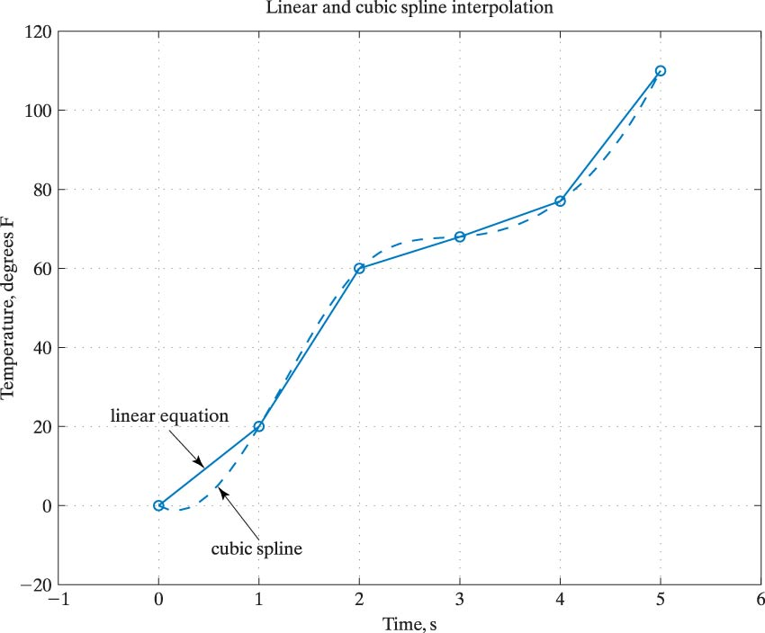
Linear and Cubic Spline Interpolation

Slide 12
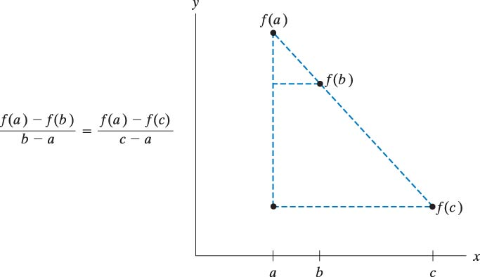
Similar Trianglees

Slide 13
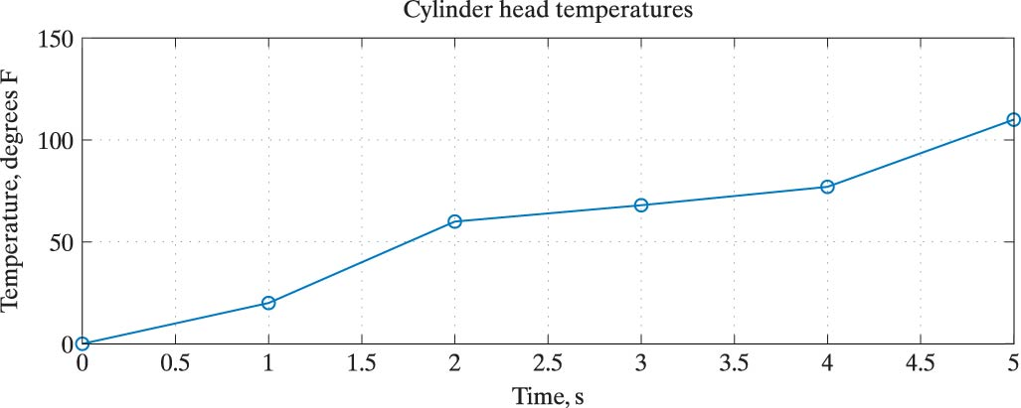
Cylinder Head Temperatures

Slide 14
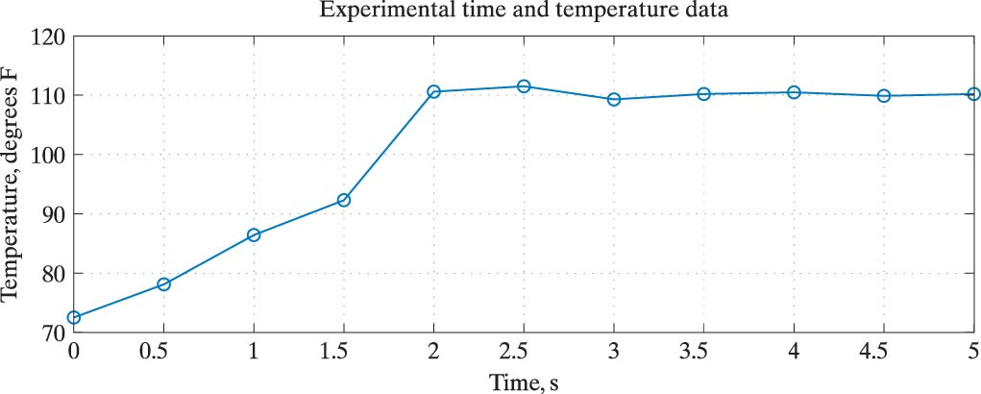
Experimental Time and Temperature Data

Slide 15
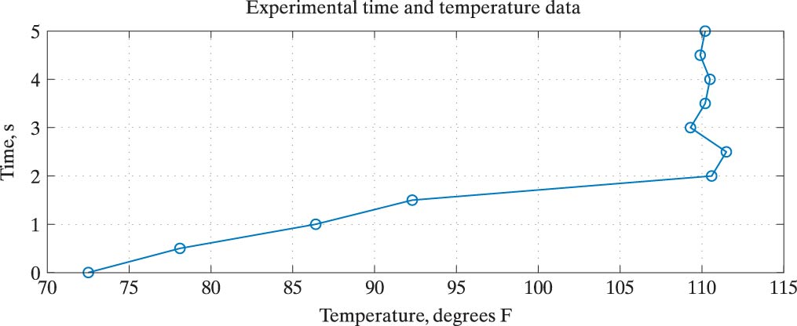
Experimental Time and Temperature Data

Slide 16
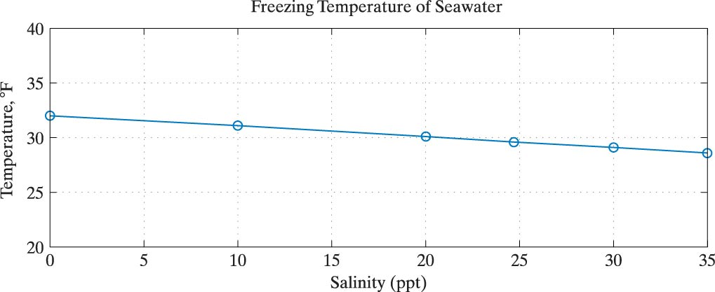
Freezing Temperature of Seawater

Slide 17
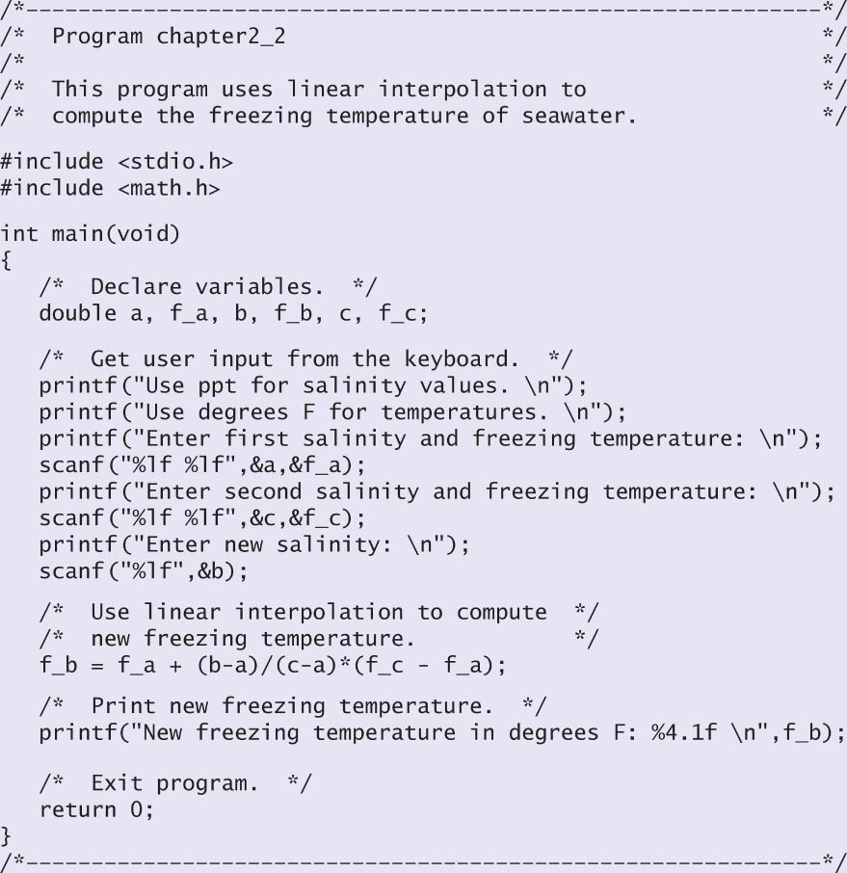
Program to Compute the Freezing Temperature of Seawater

Slide 18
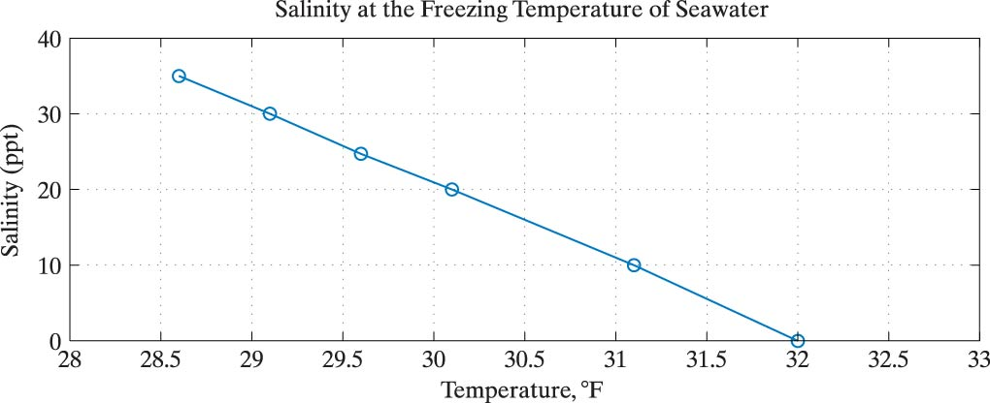
Salinity at the Freezing Temperature of Seawater

Slide 19
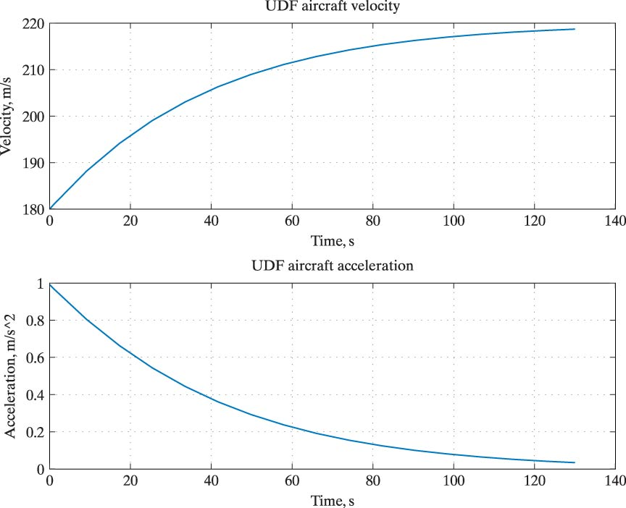
UDF Aircraft
Velocity and Acceleration

Slide 20
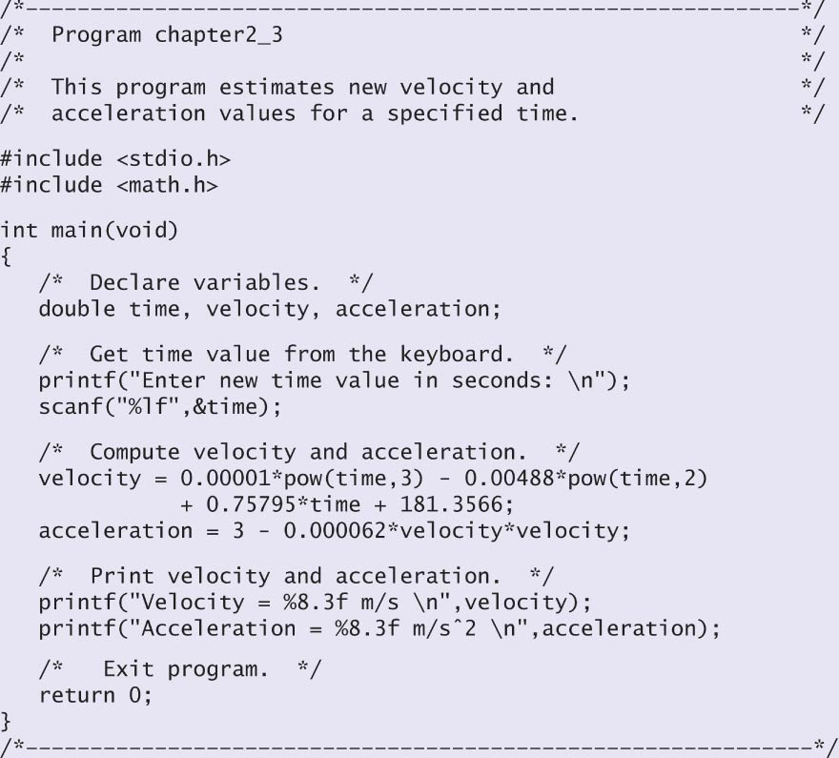
Program to Estimate Velocity and Acceleration Values

Slide 21
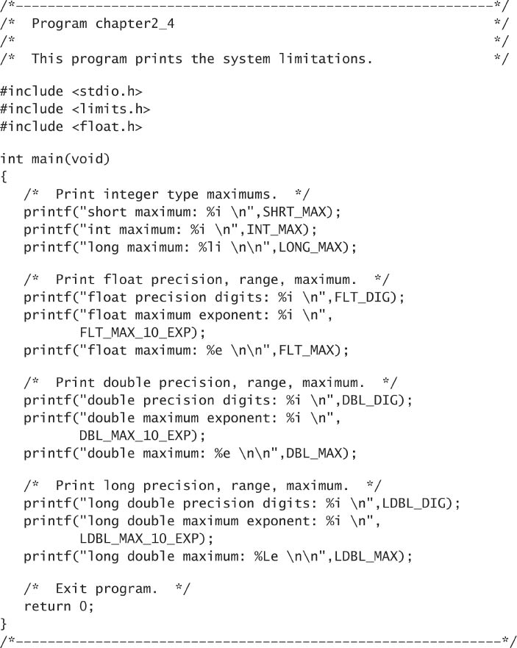
Program to Print
System Limitations

Slide 22
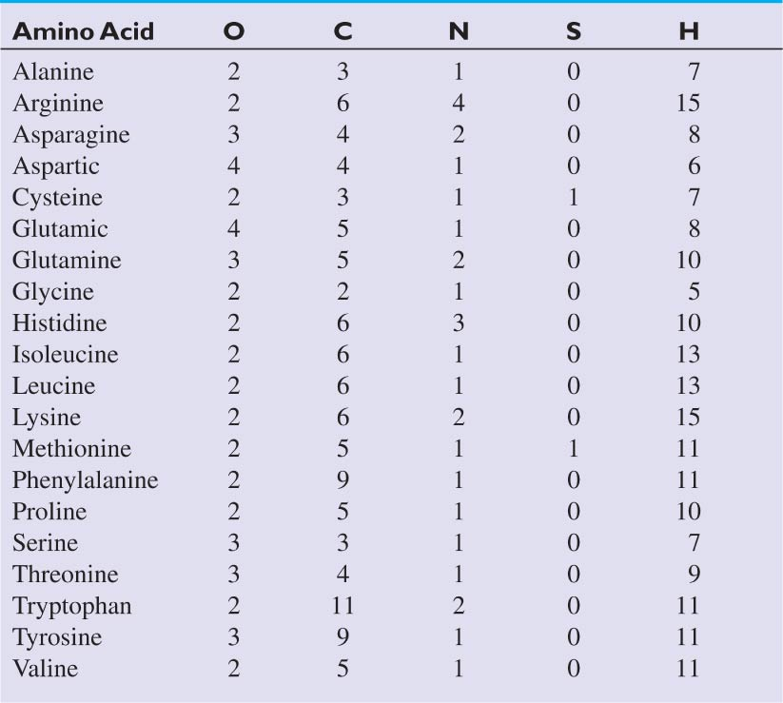
Amino Acid Molecules

Slide 23
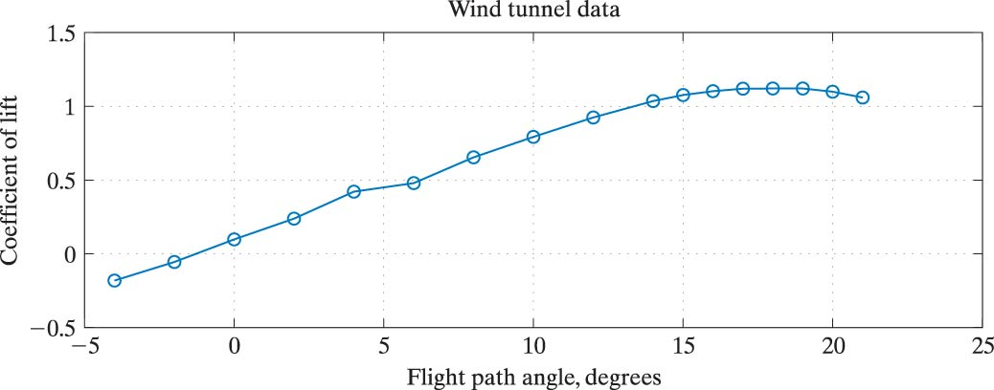
Wind Tunnel Data

