Slide 1
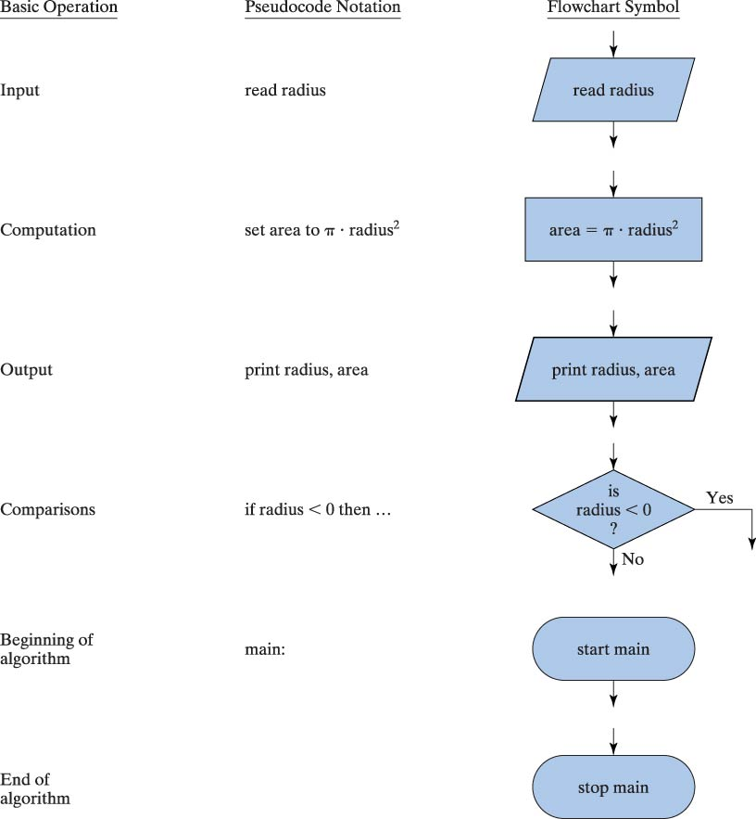
Pseudocode Notation and Flowchart Symbols

Slide 2
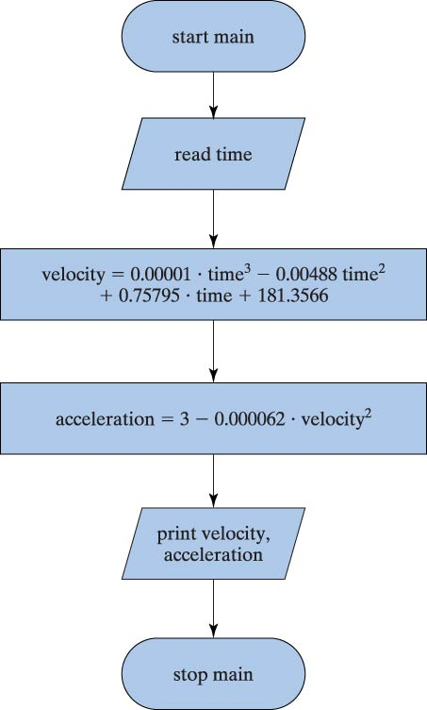
Flowchart for Unducted Fan Problem Solution

Slide 3
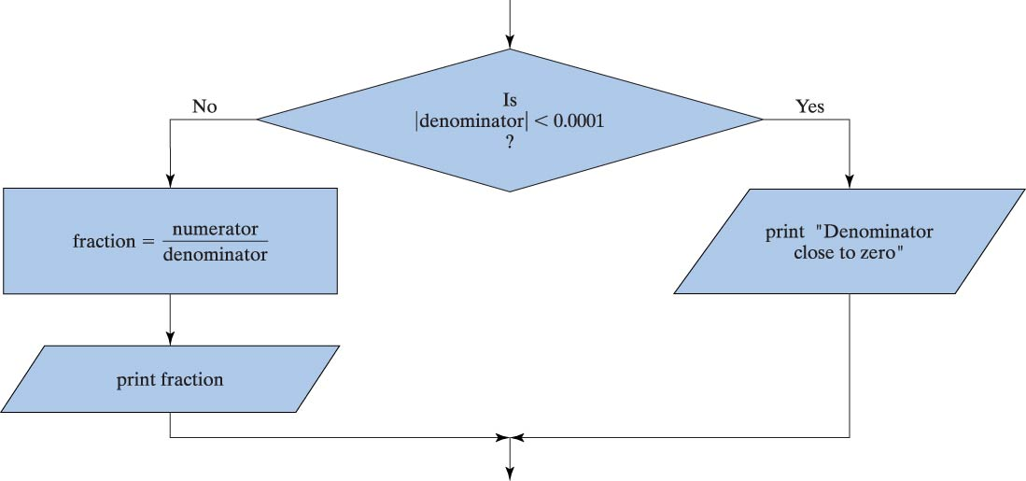
Flowchart for Selection Structure

Slide 4
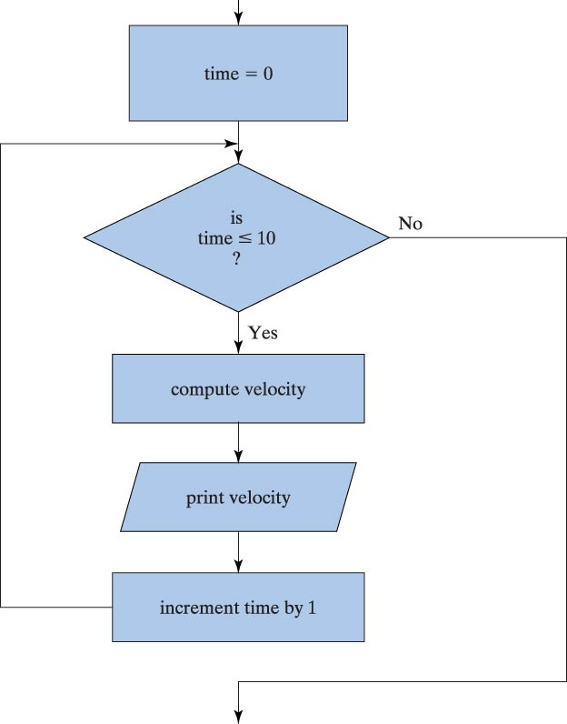
Flowchart for Repetition Structure

Slide 5
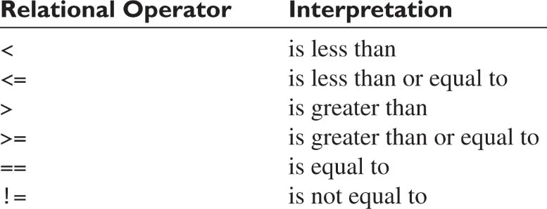
Relational Operators

Slide 6
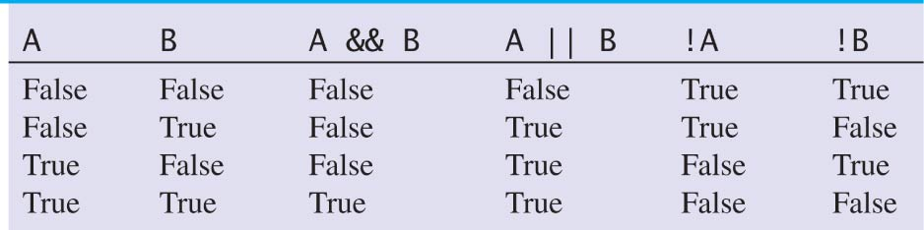
Logical Operators

Slide 7
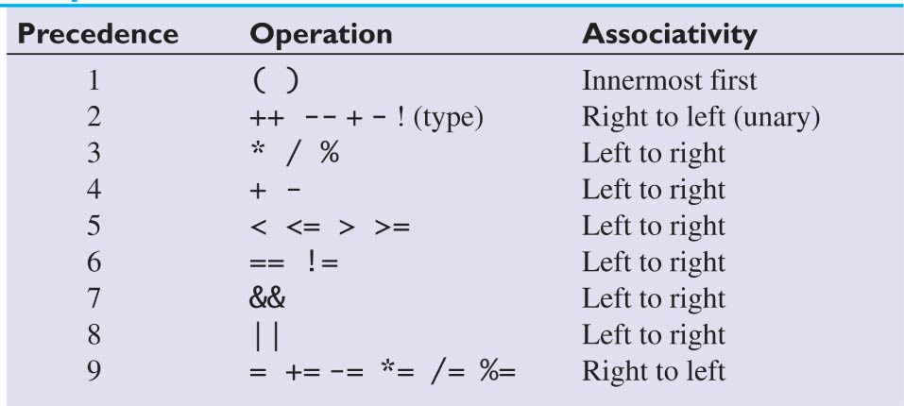
Precedence for Arithmetic, Relational, and Logical Operators

Slide 8
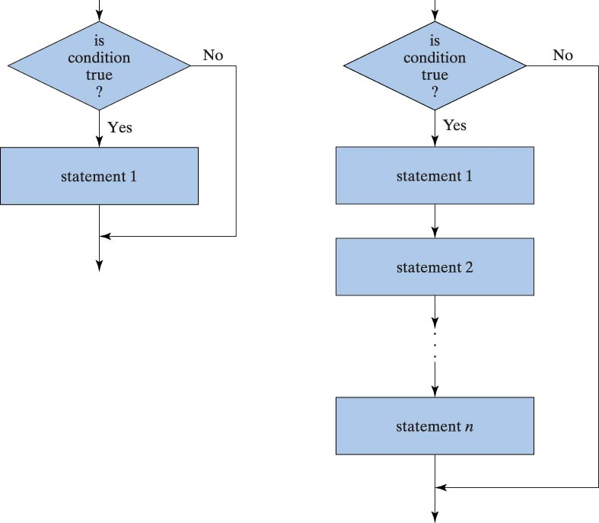
Flowcharts for
Selection Statements

Slide 9
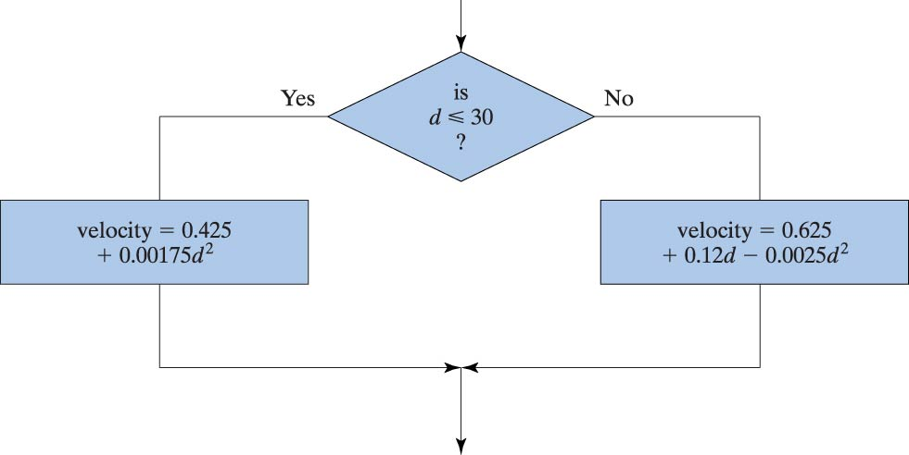
Flowchart for if/else Statement

Slide 10
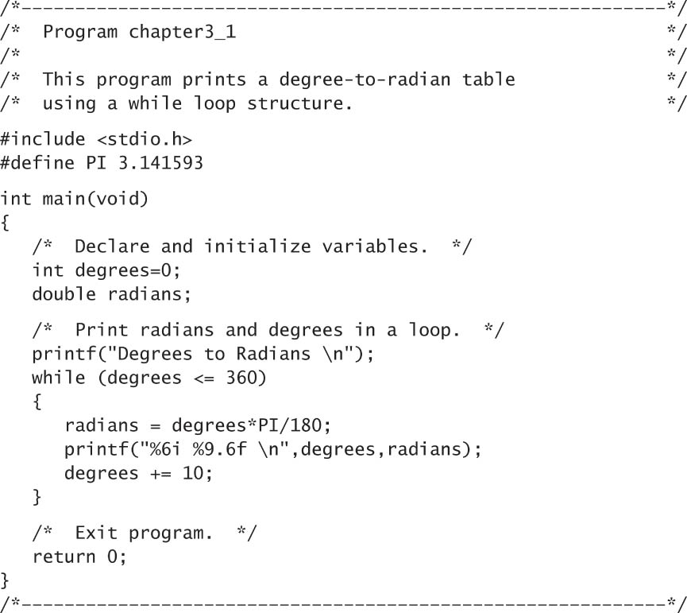
Program to Print a Table
Using a while Loop

Slide 11
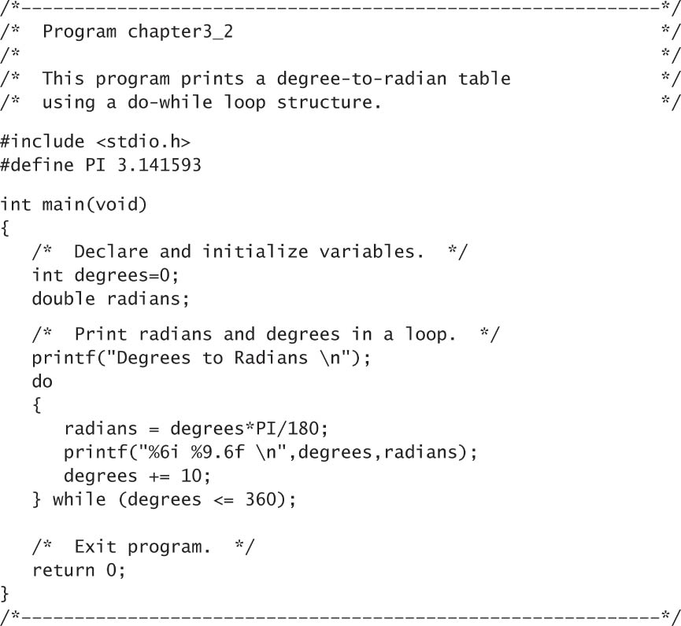
Program to Print a Table
Using a do-while Loop

Slide 12
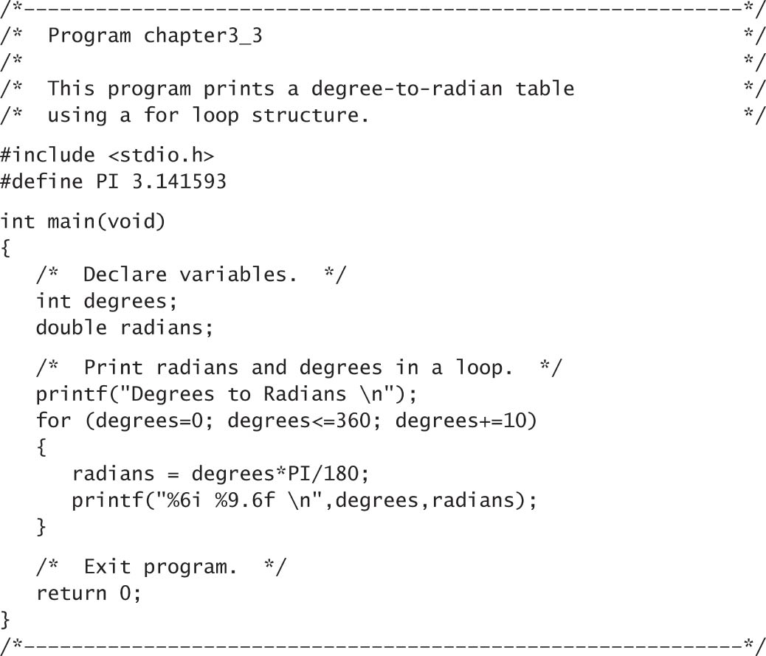
Program to Print a Table
Using a for Loop

Slide 13
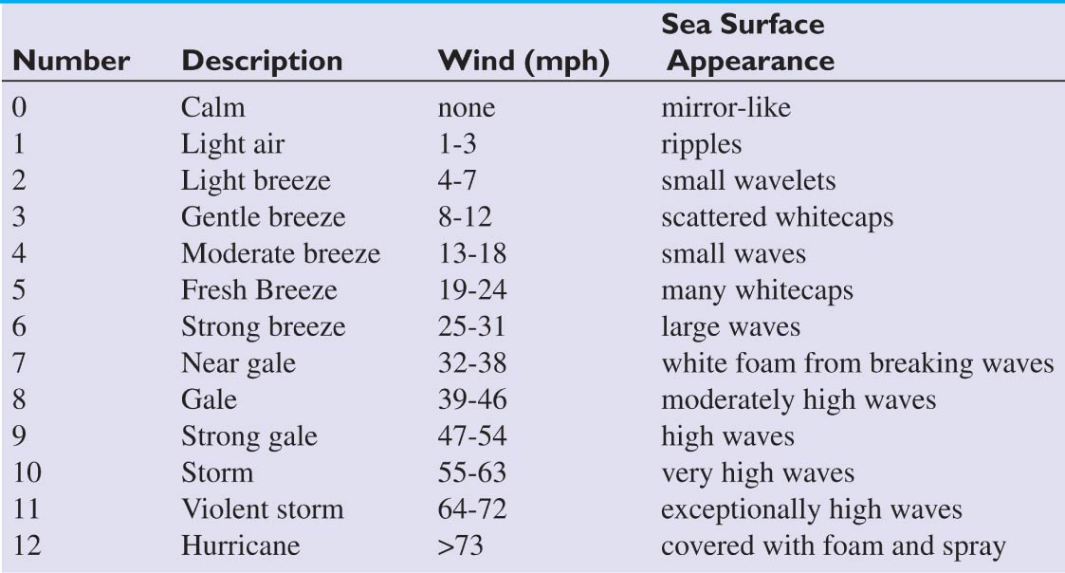
Sea State Number

Slide 14
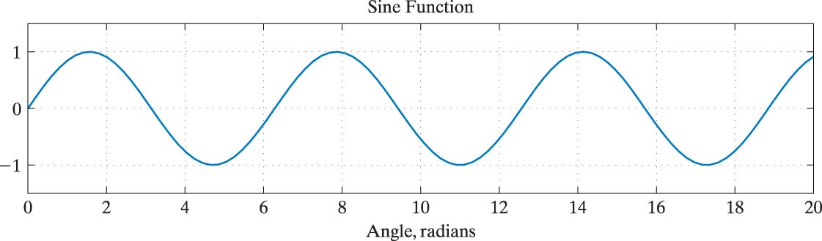
Plot of a Sine Function

Slide 15
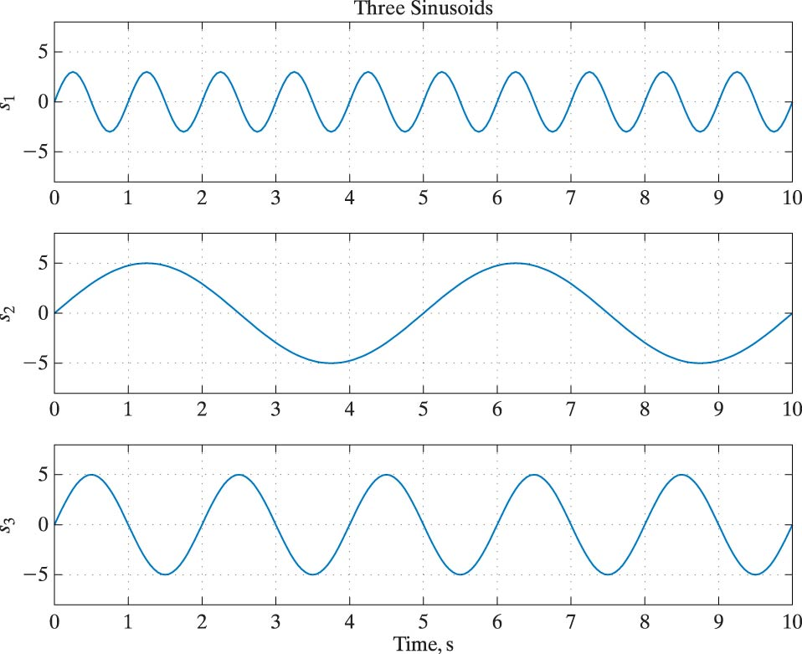
Plot of Three Sinusoids

Slide 16
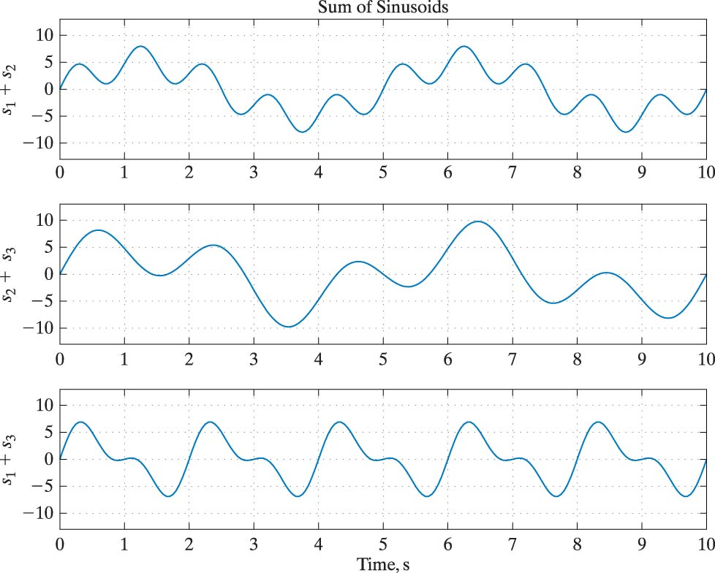
Plot of Sums of Pairs of Sinusoids

Slide 17
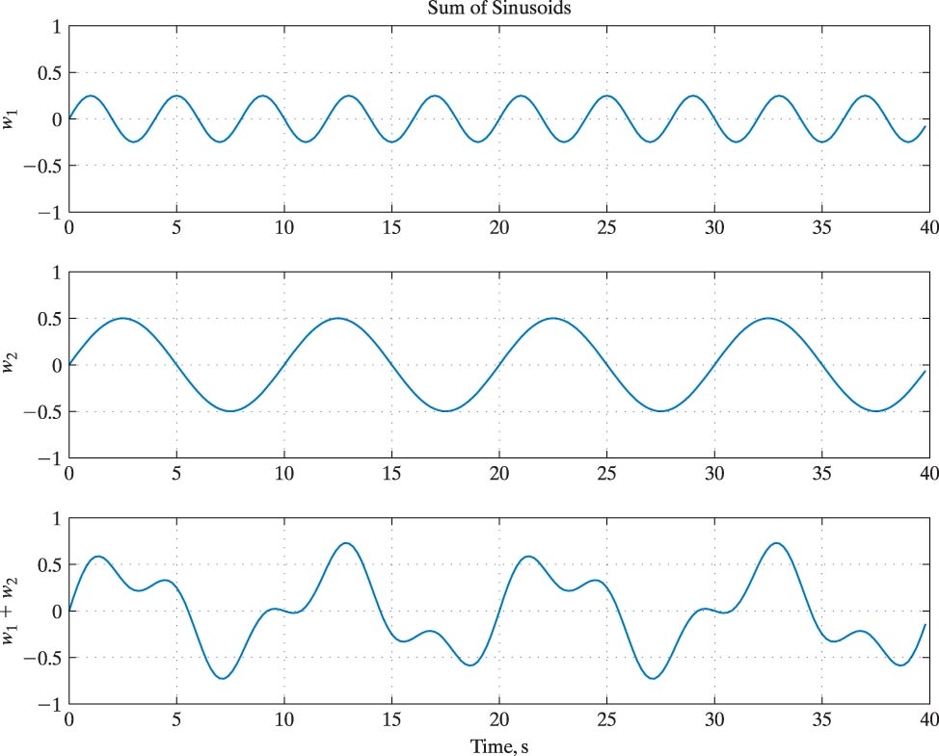
Plot of Combined Waves

Slide 18
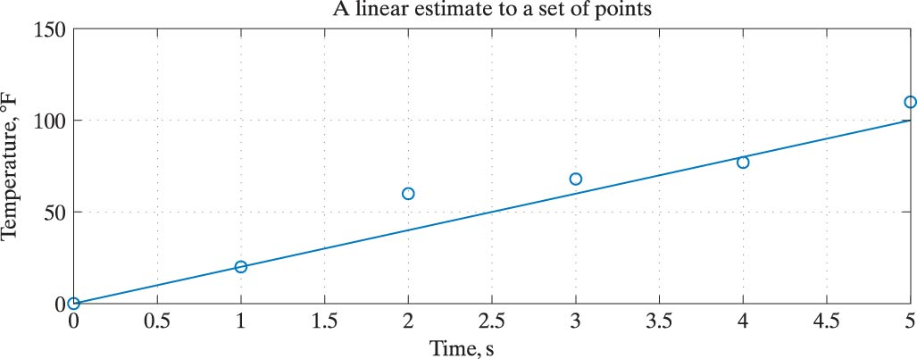
A Linear Estimate to
Model a Set of Points

Slide 19
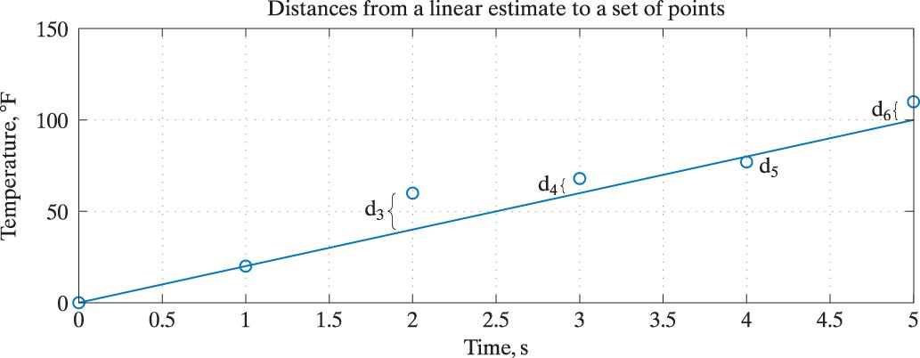
Distances Between Points and the Linear Estimate

Slide 20
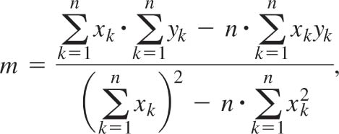
Equation for Least-Squares Slope

Slide 21
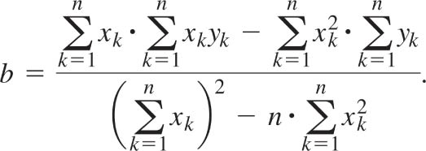
Equation for Least-Squares y-intercept

Slide 22
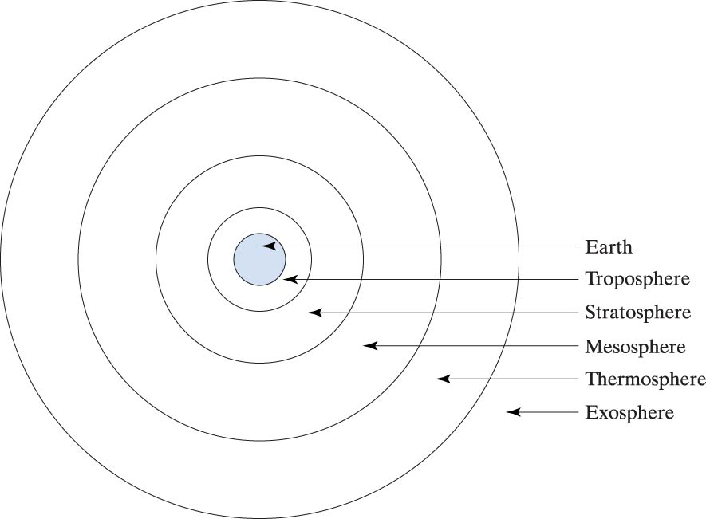
Atmospheric Layers
Around the Earth

Slide 23
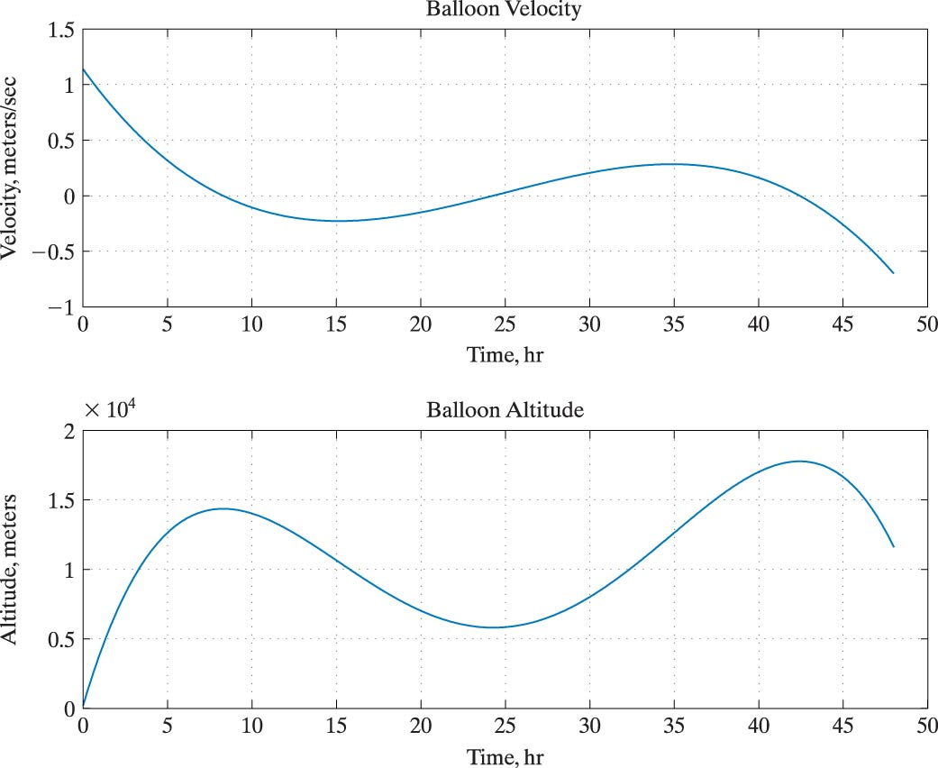
Velocity and Altitude Data for a Weather Balloon

