Slide 1
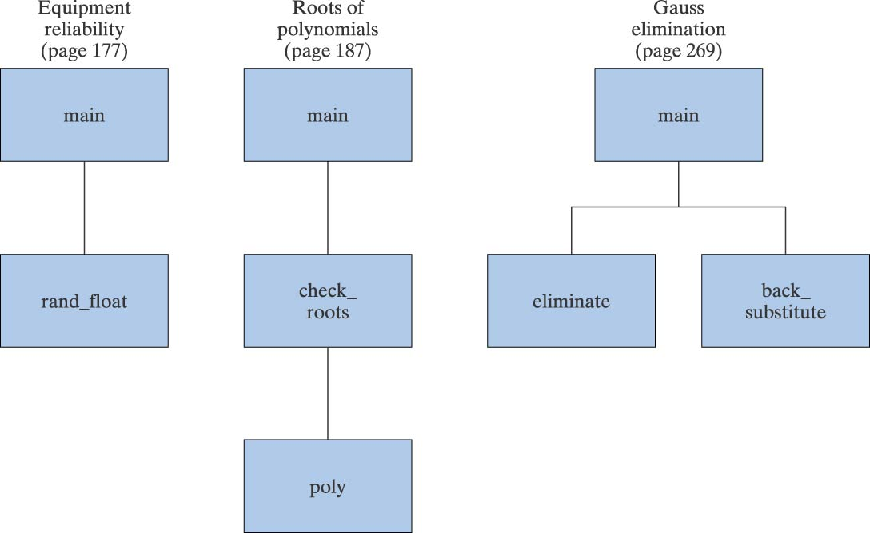
Examples of Structure Charts

Slide 2
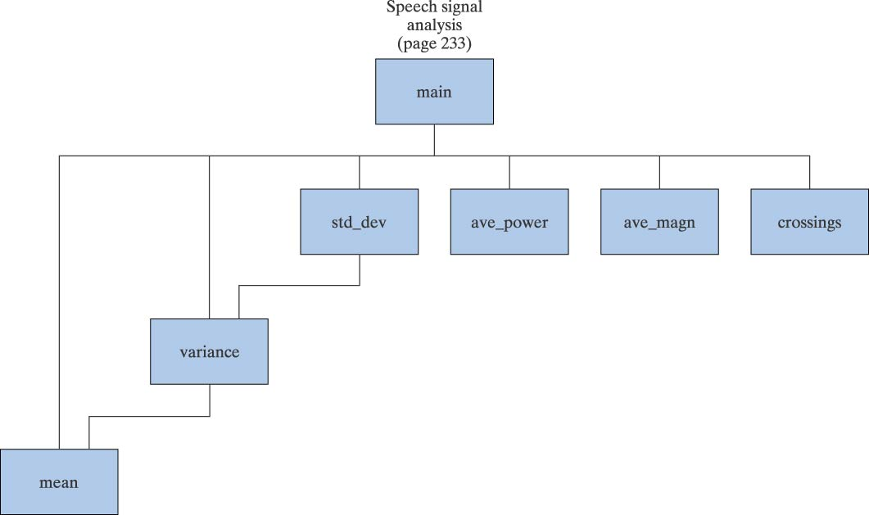
Example of Structure Chart

Slide 3
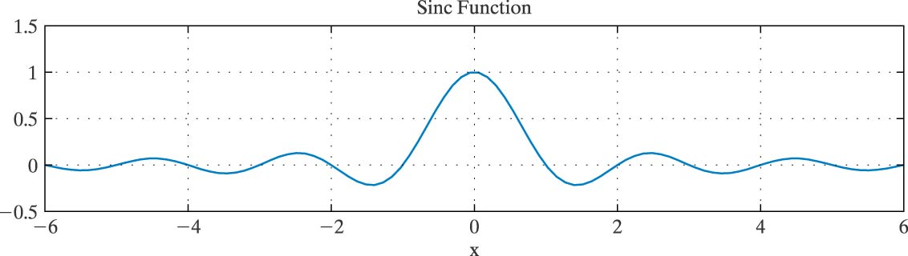
Sinc Function for [-6,6]

Slide 4
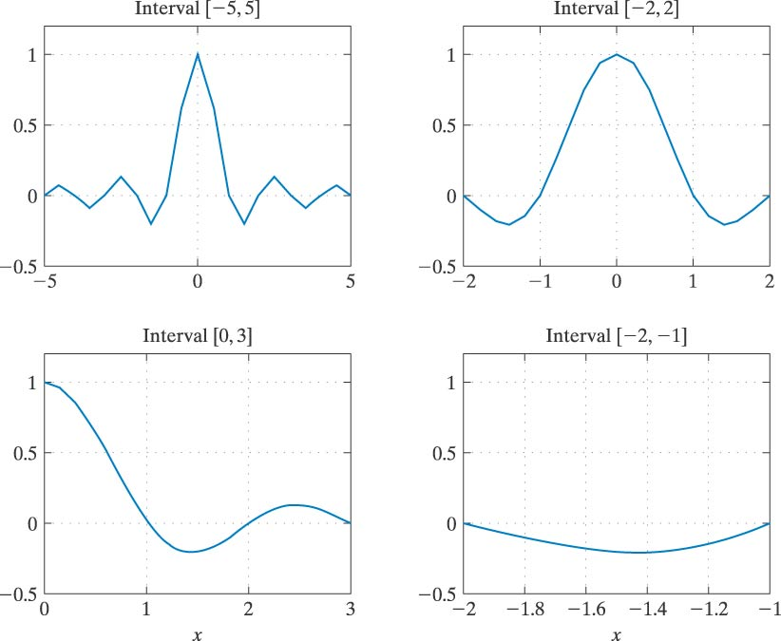
Sinc Function for Four Intervals

Slide 5
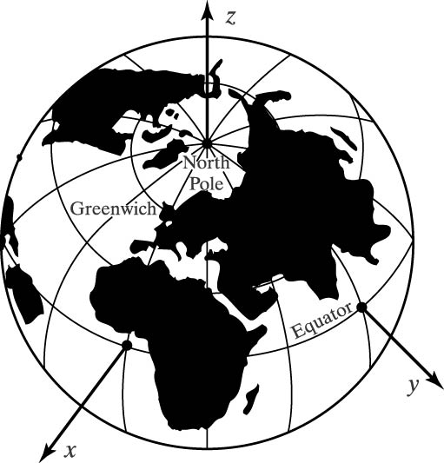
Rectangular Coordinate System for the Earth

Slide 6
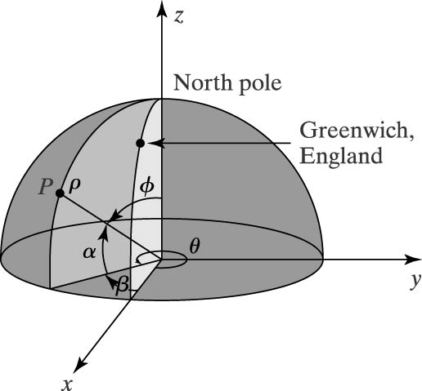
Spherical Coordinate System

Slide 7
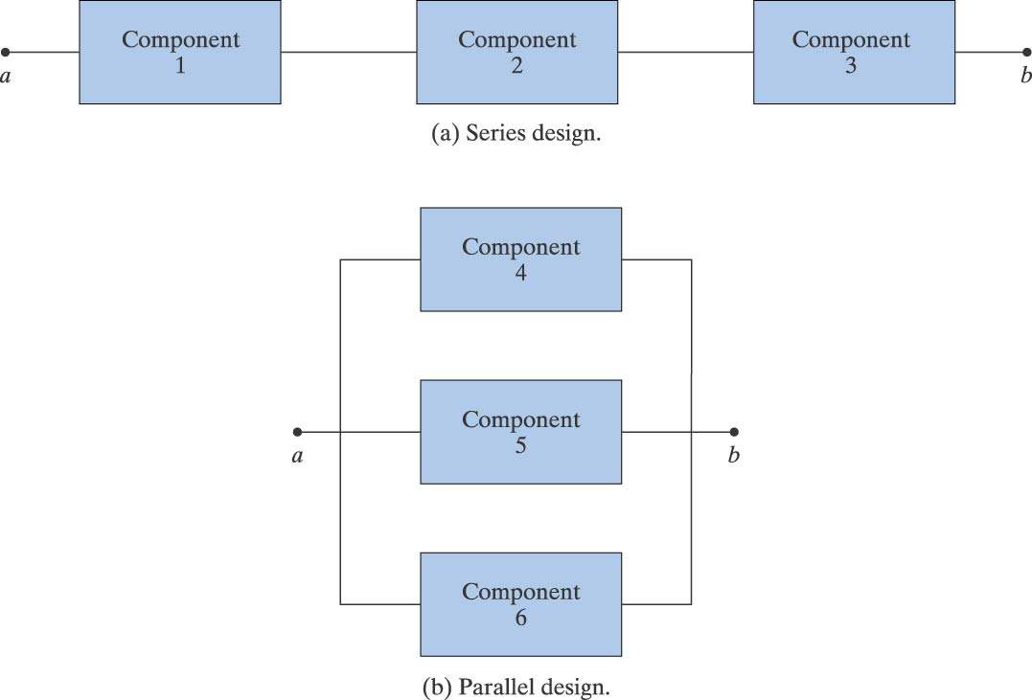
Series and Parallel Configurations

Slide 8
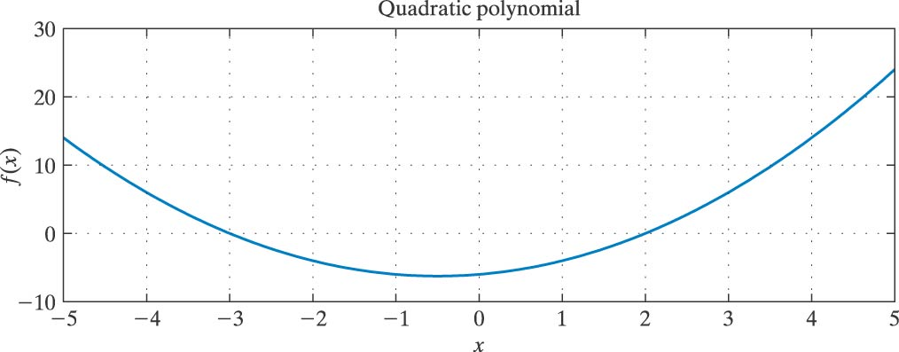
Polynomial with Two Real Roots

Slide 9
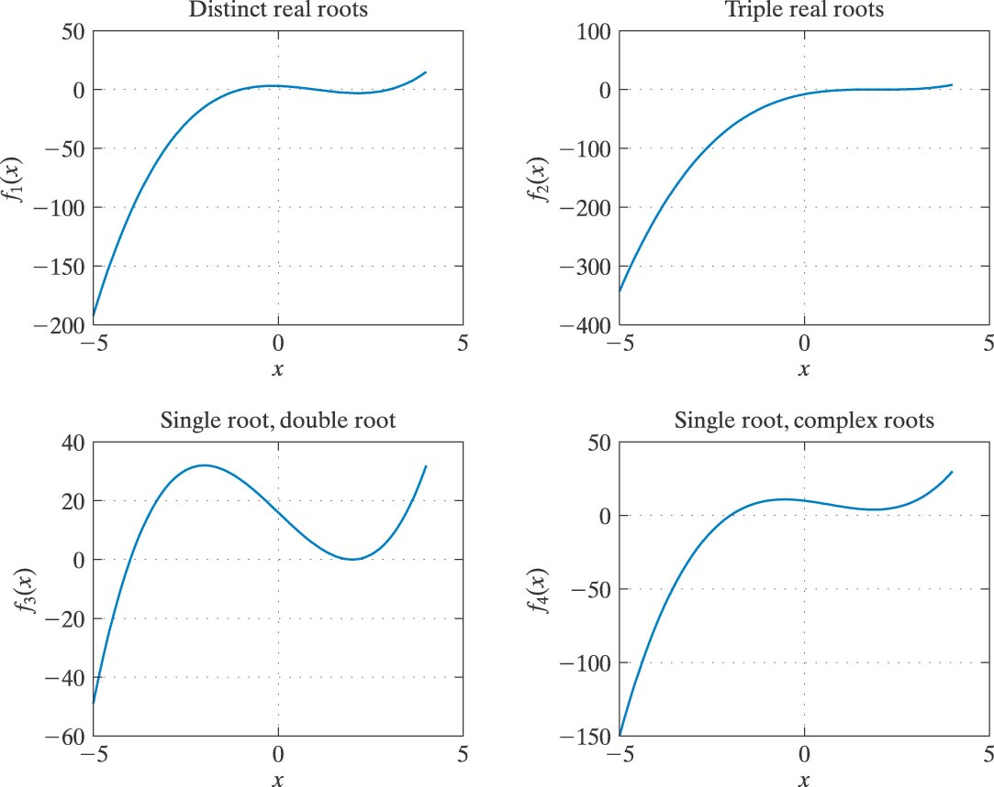
Cubic Polynomials

Slide 10
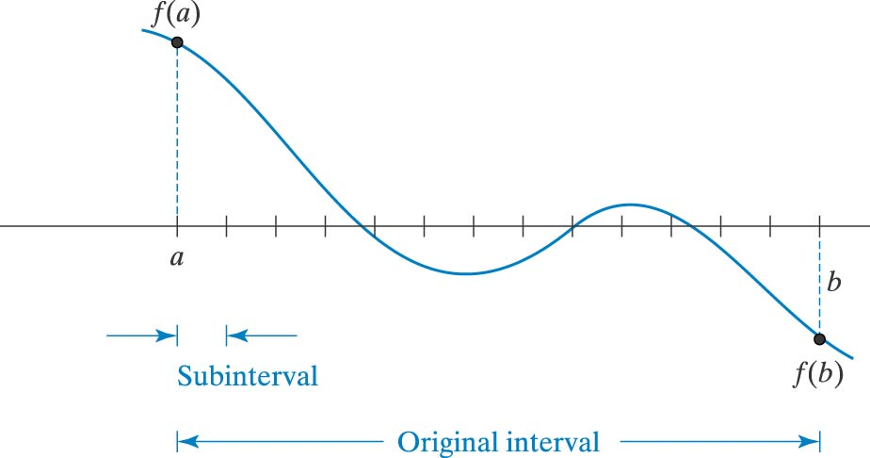
Incremental Search for Root

Slide 11
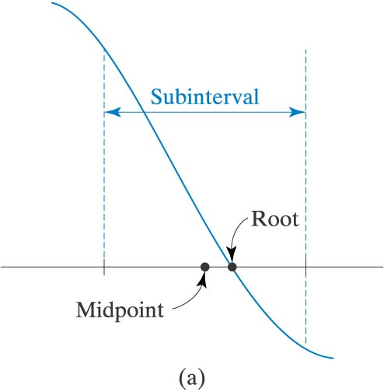
Subinterval Analysis

Slide 12
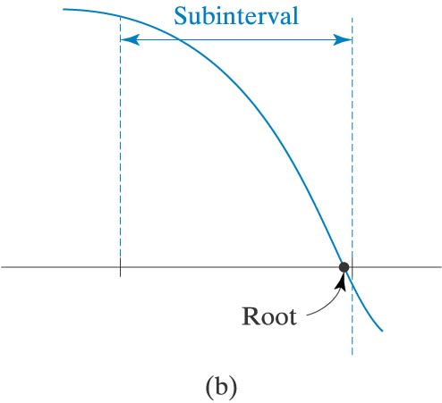
Subinterval Analysis

Slide 13
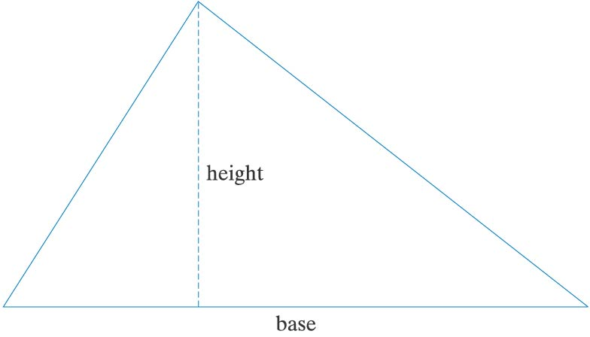
Parameters of a Triangle

Slide 14
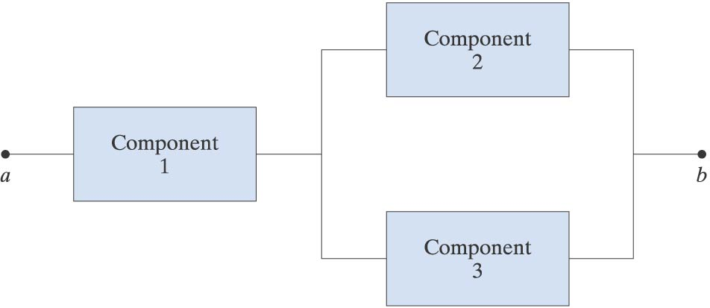
Configuration 1

Slide 15
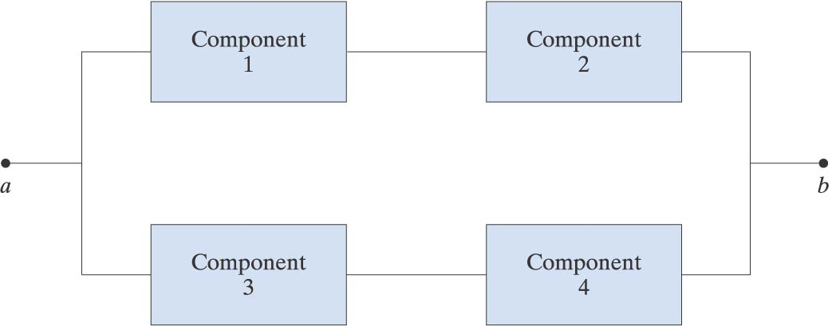
Configuration 2

Slide 16
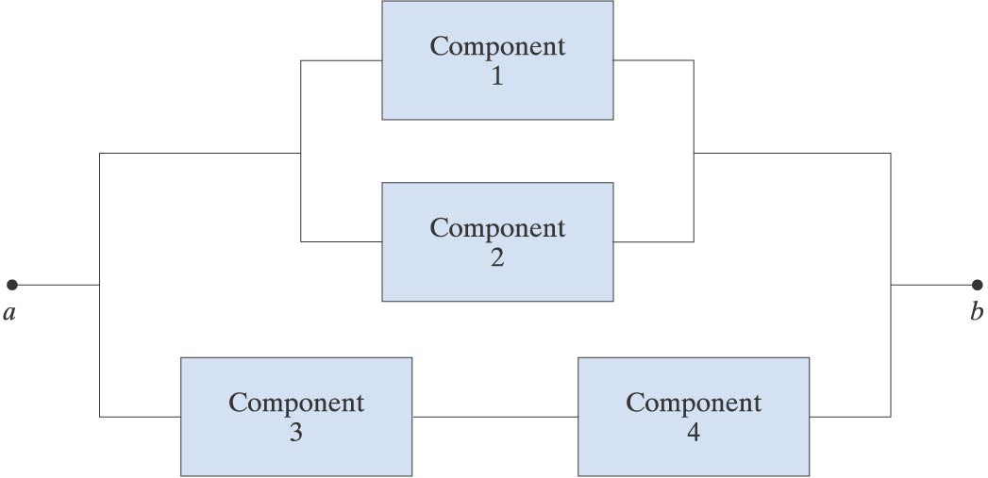
Configuration 3

Slide 17
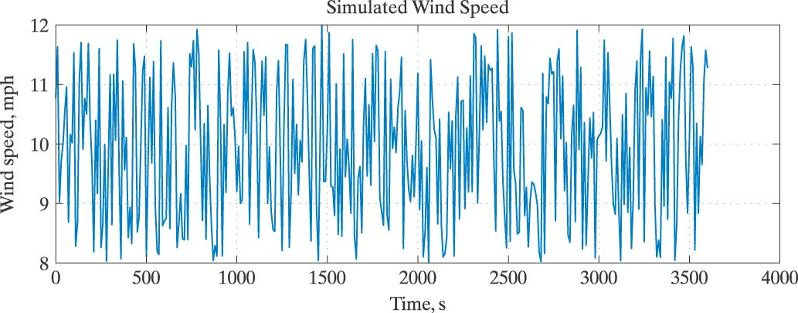
Simulated Wind Speed

Slide 18
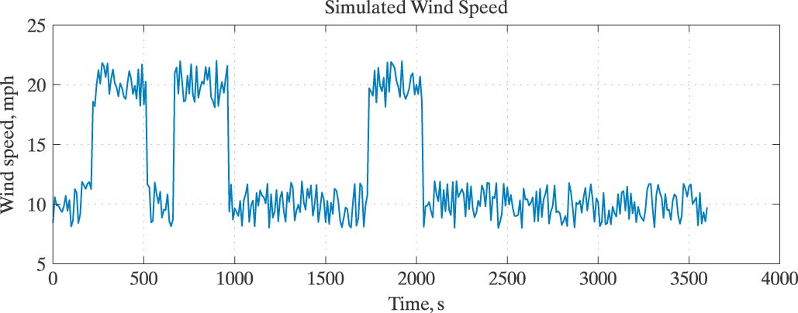
Simulated Wind Speeds with Three Storms

Slide 19
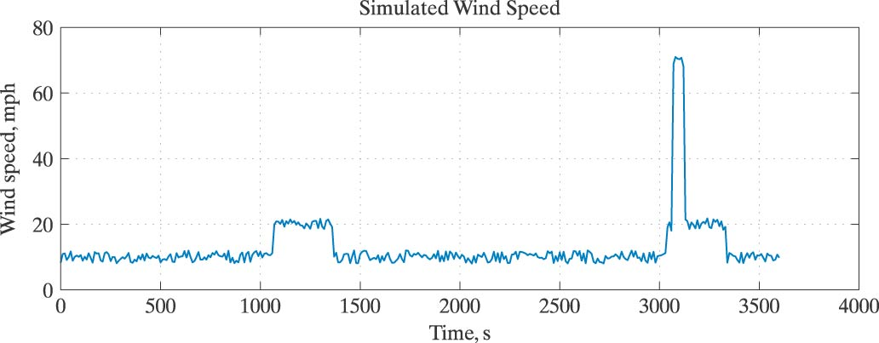
Simulated Wind Speeds with a Microburst

Slide 20
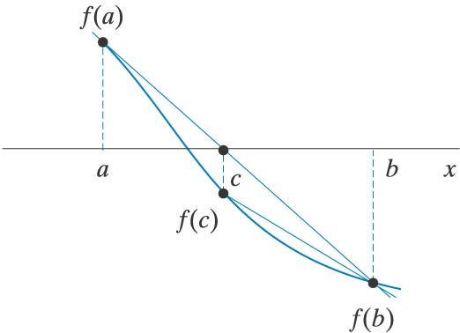
Straight Line Intersection in (a,b)

