Slide 1
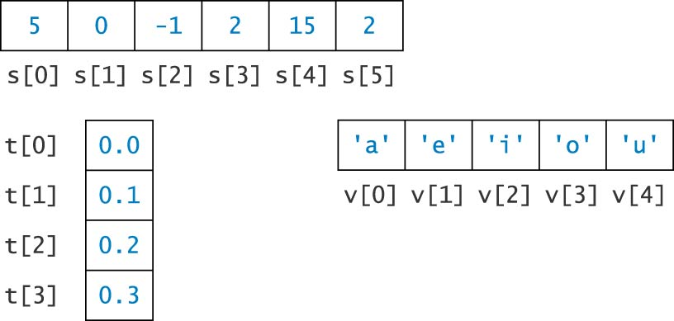
One-Dimensional Arrays

Slide 2
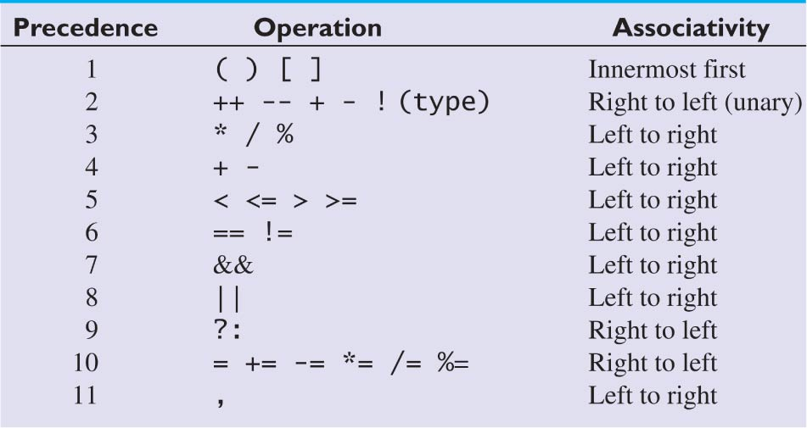
Operator Precedence

Slide 3
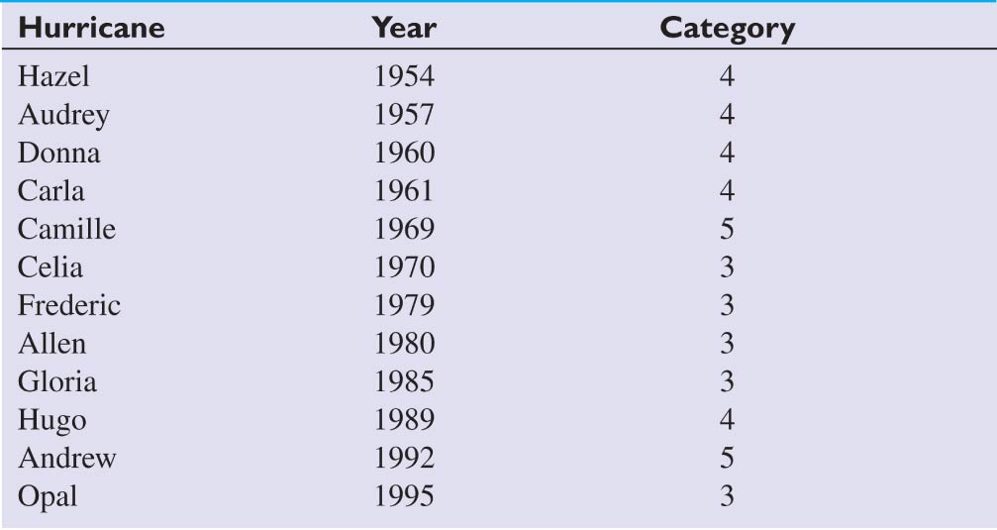
Strongest U.S. Hurricanes
During 1950-2002

Slide 4
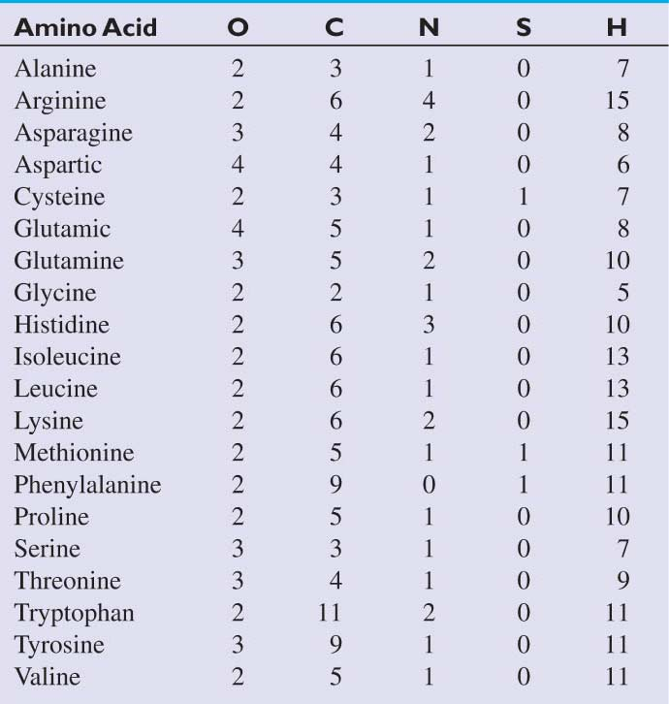
Amino Acid Molecules

Slide 5
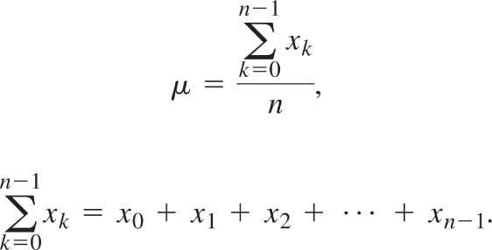
Equation for the Mean Value for a Set of Values

Slide 6
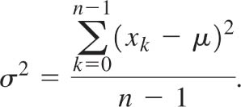
Equation for the Variance for a Set of Values

Slide 7

Equation for the Standard Deviation for a Set of Values

Slide 8
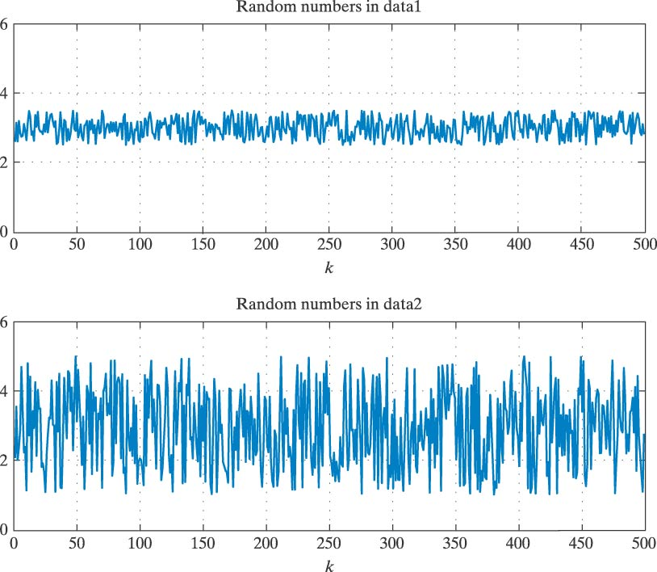
Examples of Random Sequences

Slide 9
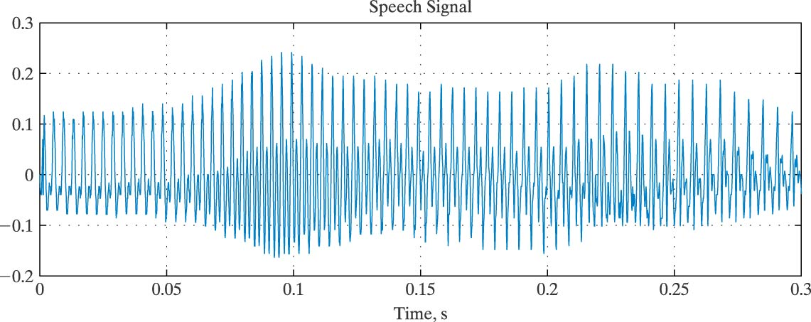
Utterance of the Word “zero”

Slide 10
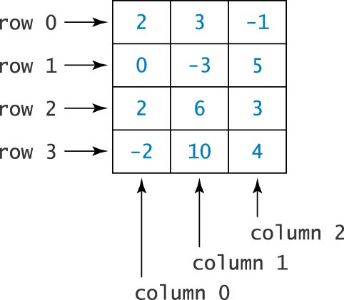
Example of a
Two-Dimensional Array

Slide 11
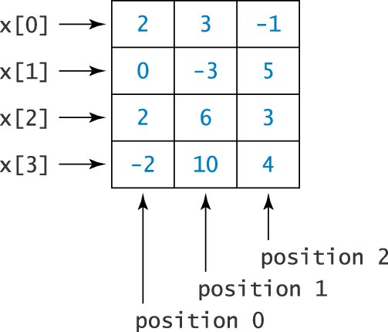
Example of a
Two-Dimensional Array

Slide 12
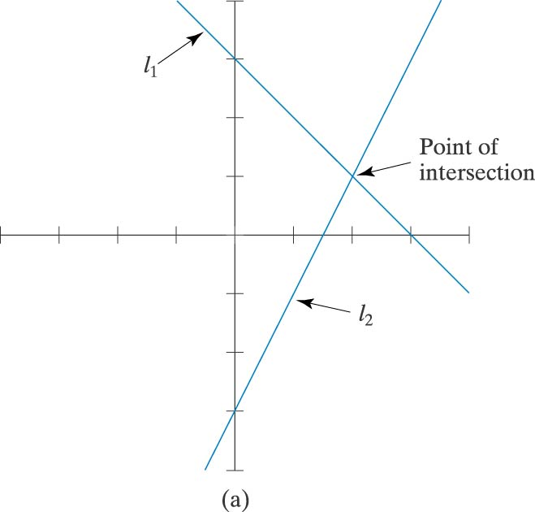
Intersecting Lines

Slide 13
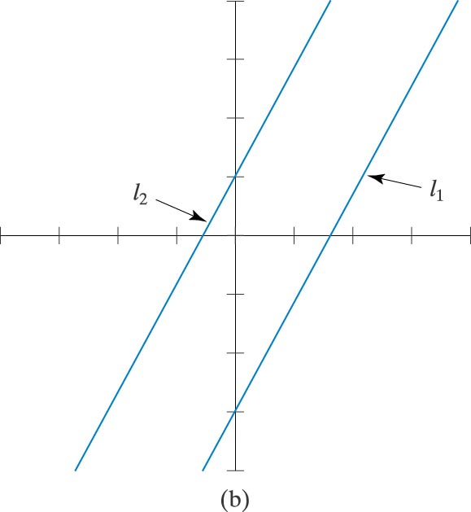
Parallel Lines

Slide 14
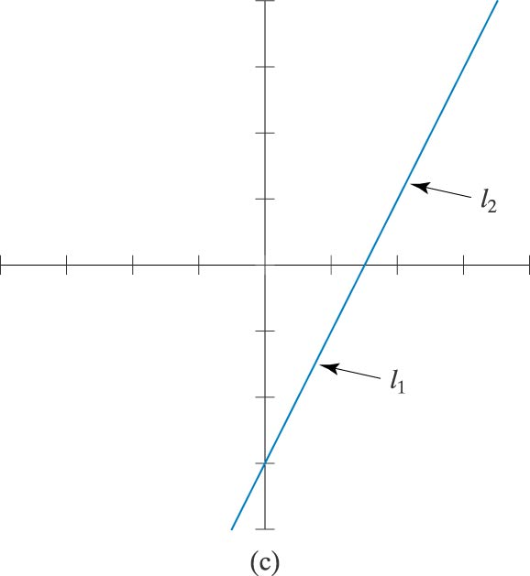
Same Line

Slide 15
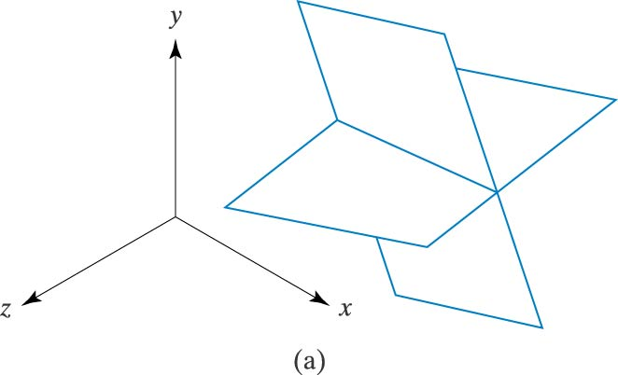
Intersecting Planes

Slide 16
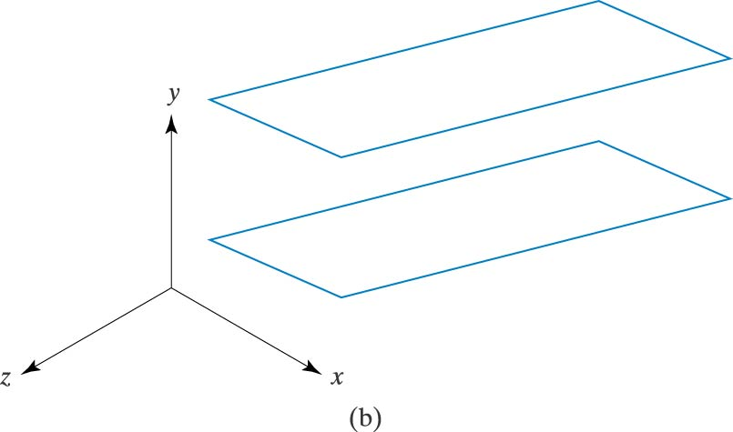
Parallel Planes

Slide 17
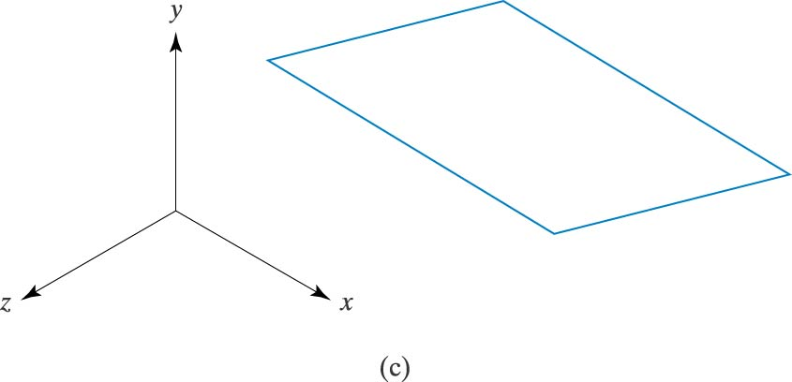
Same Plane

Slide 18
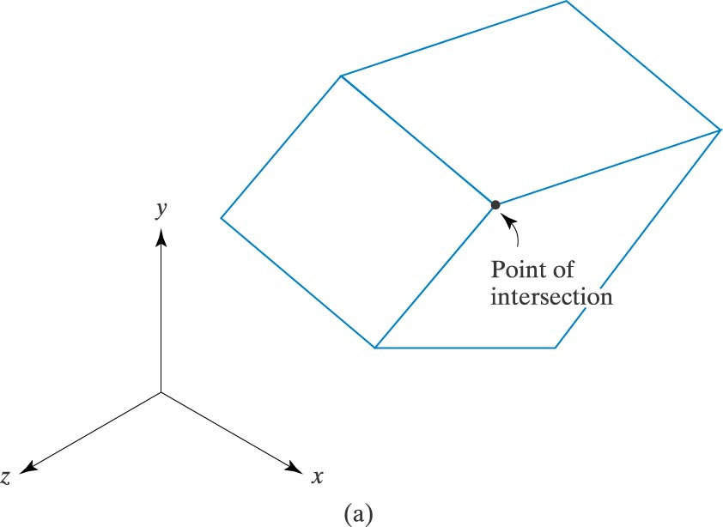
Three Planes Intersecting in a Point

Slide 19
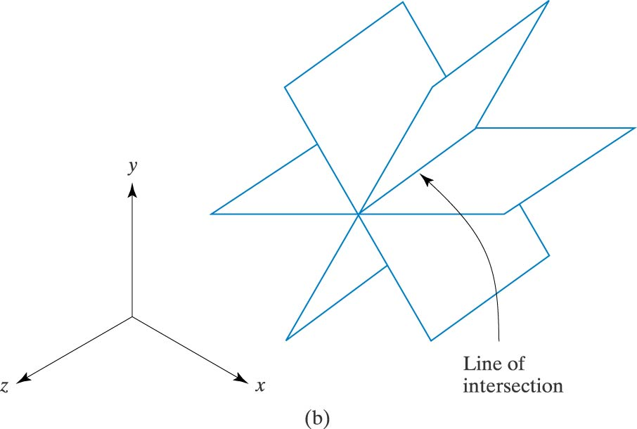
Three Planes Intersecting in a Line

Slide 20
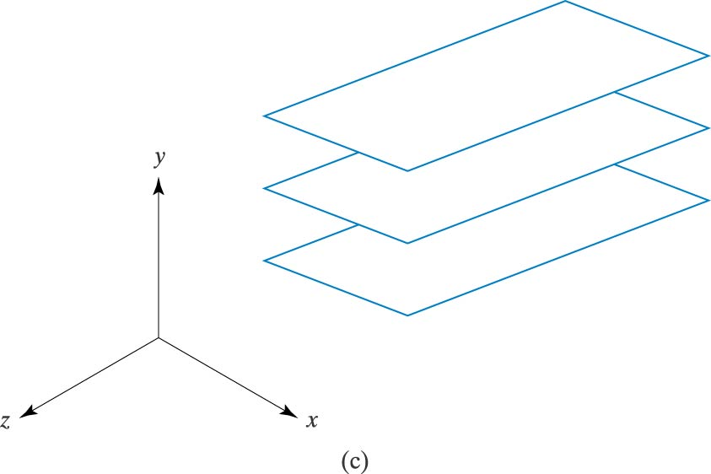
Three Parallel Planes

Slide 21
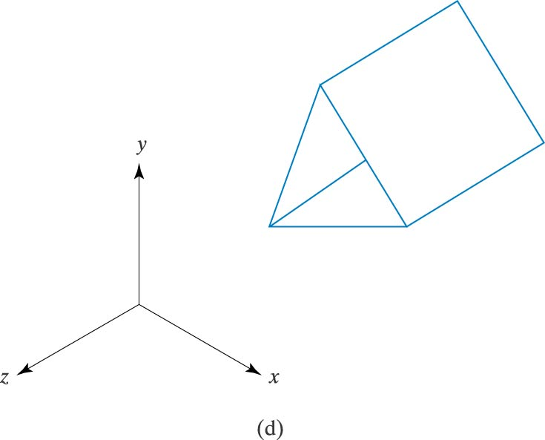
Three Planes with No Common Intersection Point

Slide 22
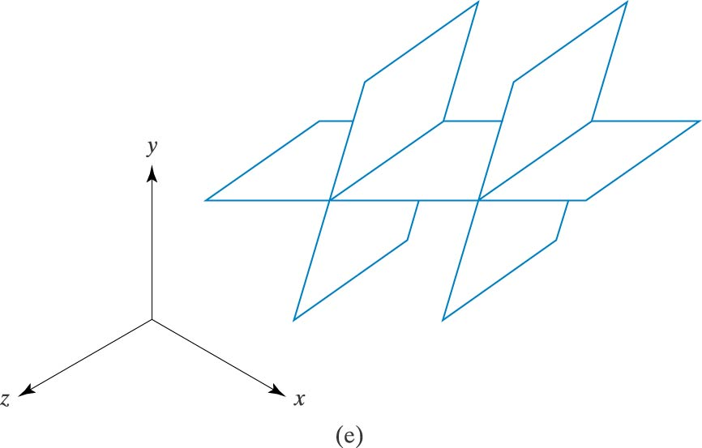
Three Planes with No Common Intersection Point

Slide 23
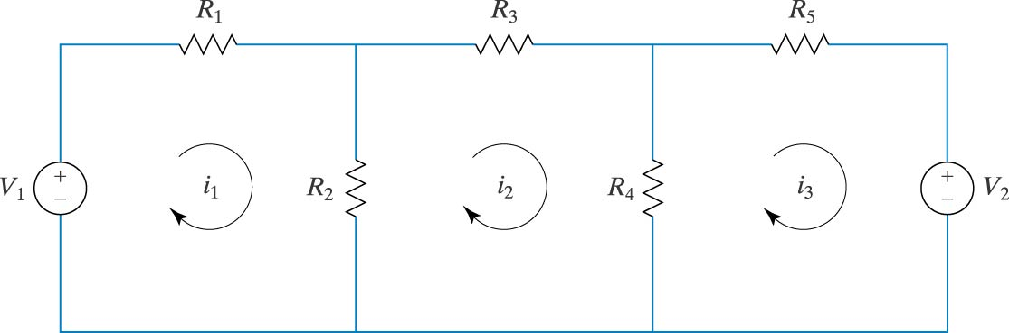
Circuit with Two Voltage Sources

Slide 24
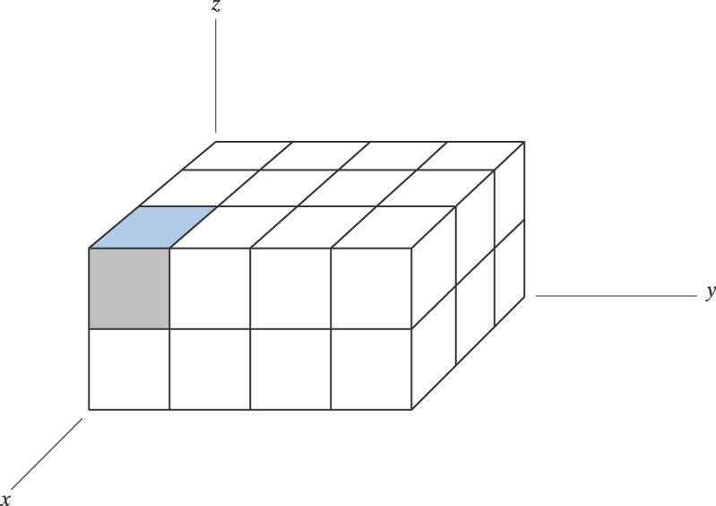
Three-Dimensional Array

Slide 25
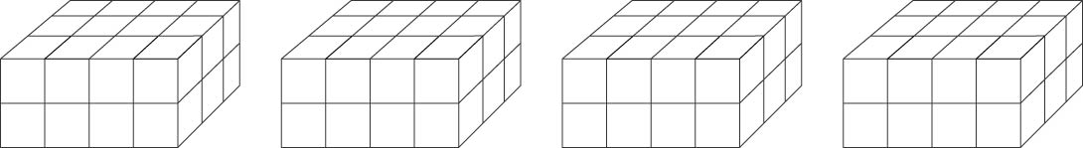
Concept for Visualizing a Four-Dimensional Arrays

Slide 26
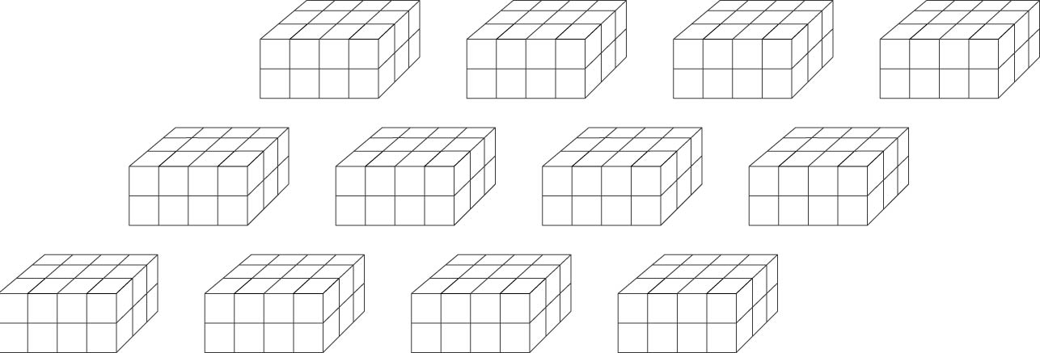
Concept for Visualizing a
Five-Dimensional Array

Slide 27
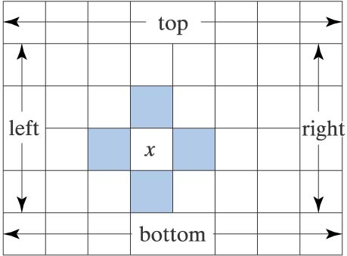
Temperature Grid in a Metal Plate

