Slide 1
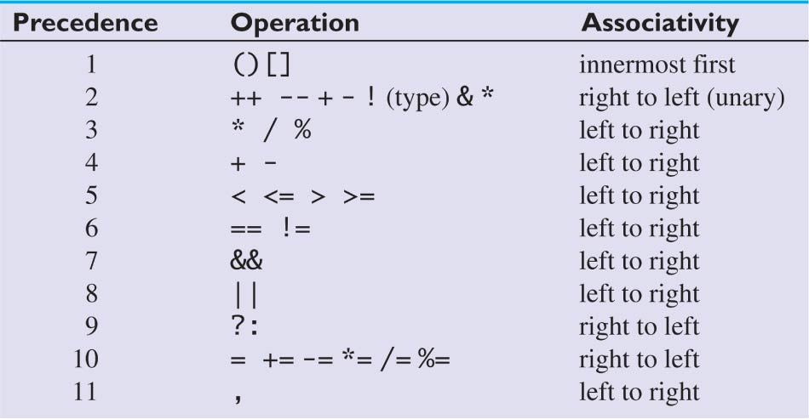
Operator Precedence

Slide 2
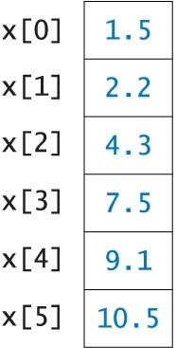
Memory Snapshot of
One-Dimensional Array

Slide 3
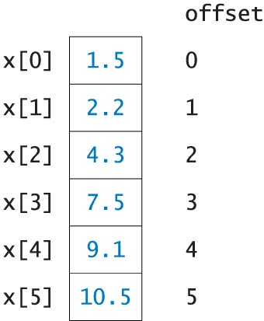
Memory Snapshot with
Array Offsets

