Slide 1
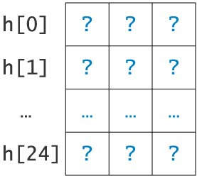
Array of Structures

Slide 2
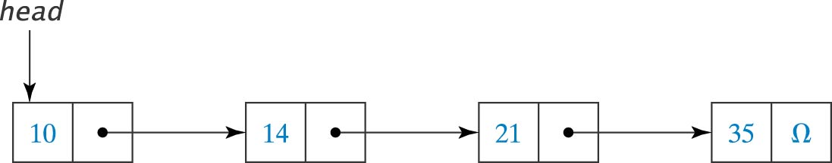
Linked List Example

Slide 3
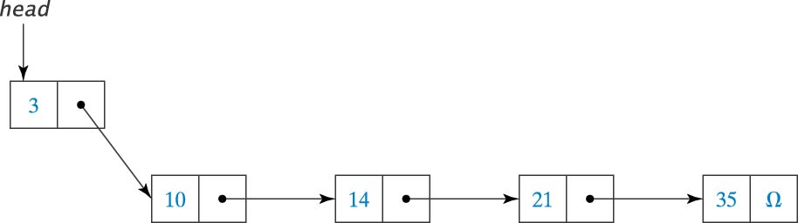
Insert Before the First Node
(updates the head pointer)

Slide 4
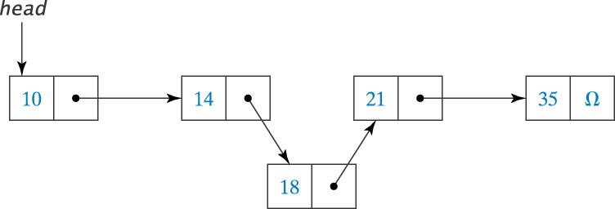
Insert Between Two Nodes

Slide 5
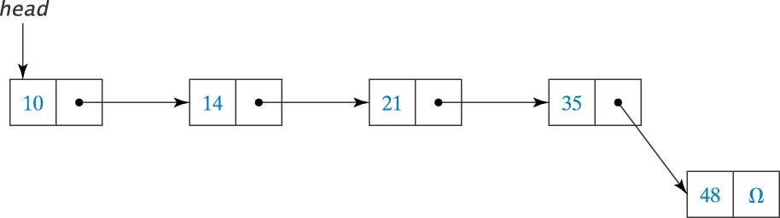
Insert After Last Node

Slide 6
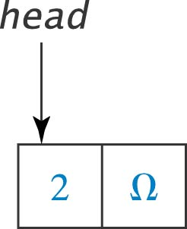
Insert in an Empty List
(updates the head pointer)

Slide 7
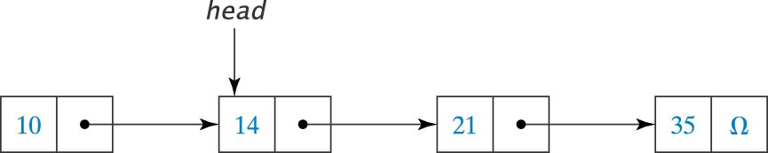
Delete the First Node
(updates the head pointer)

Slide 8
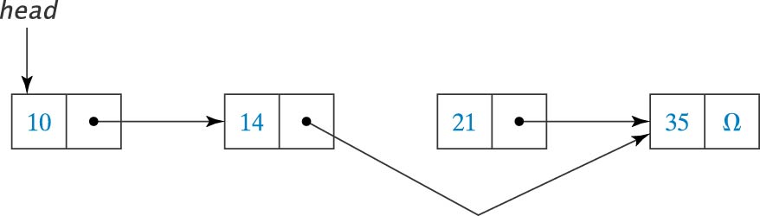
Delete a Node
Between Two Nodes

Slide 9
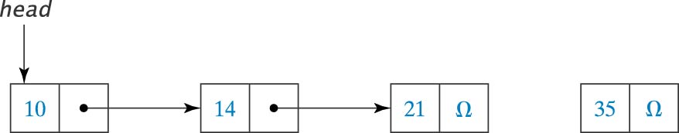
Delete the Last Node

Slide 10
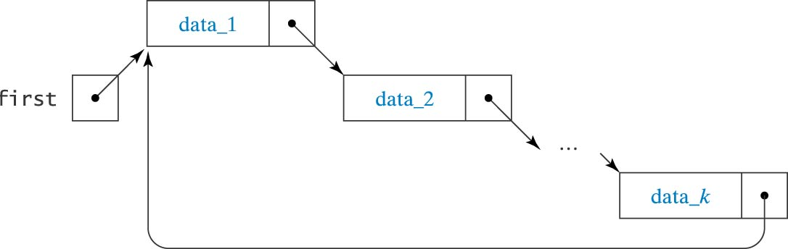
Circularly Linked List

Slide 11
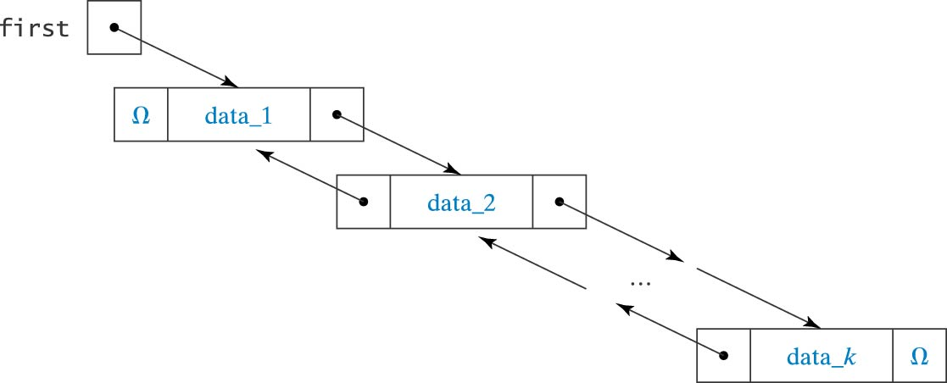
Doubly Linked List

Slide 12
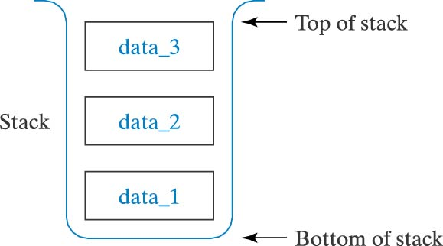
Stack Structure

Slide 13
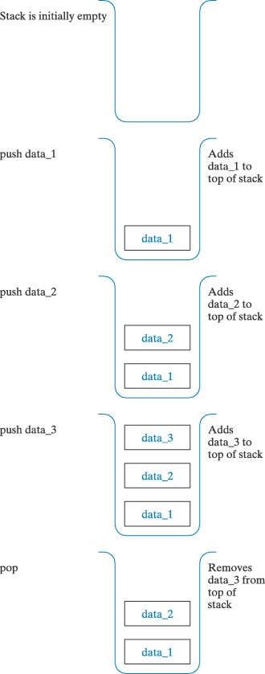
Push and Pop Operations

Slide 14
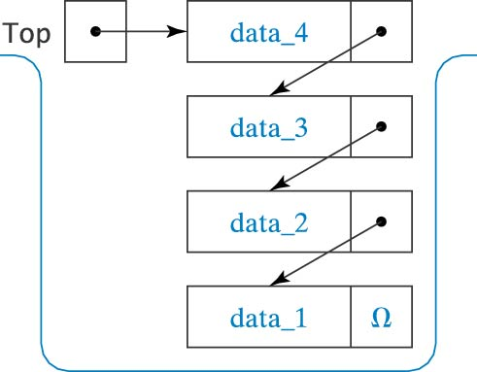
Implementation of a Stack
Using a Linked List

Slide 15
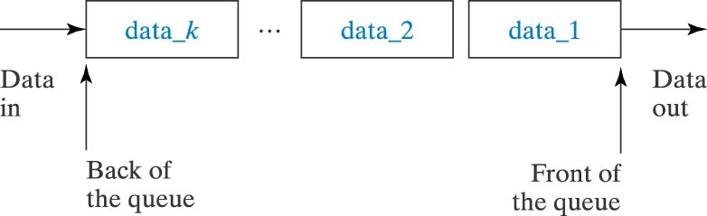
Queue Structure

Slide 16
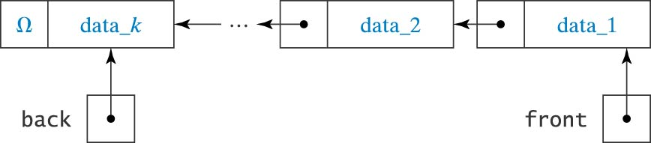
Implementation of a Queue
Using a Linked List

Slide 17
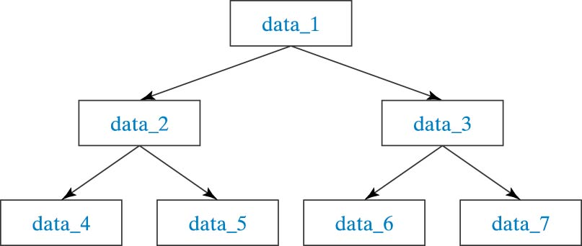
Tree Structure

Slide 18
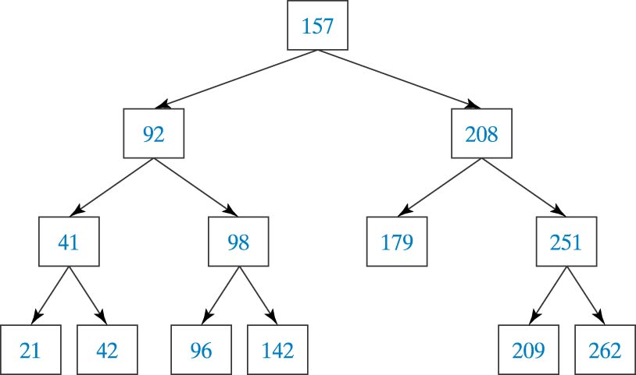
An Ordered List Stored in a Tree

Slide 19
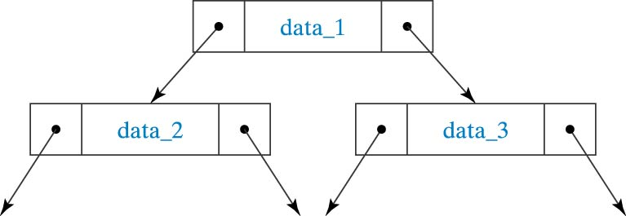
Implementation of a Tree
Using a Linked List

