Slide 1
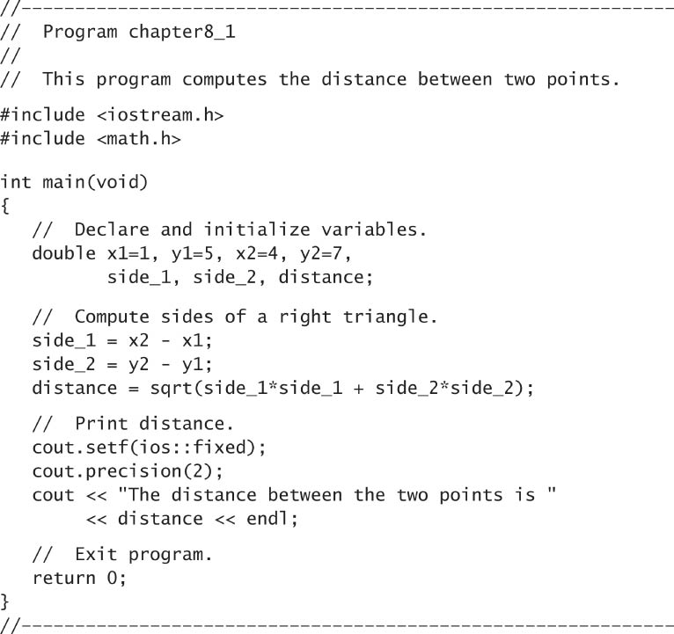
C++ Program to Compute the Distance Between Two Points

Slide 2
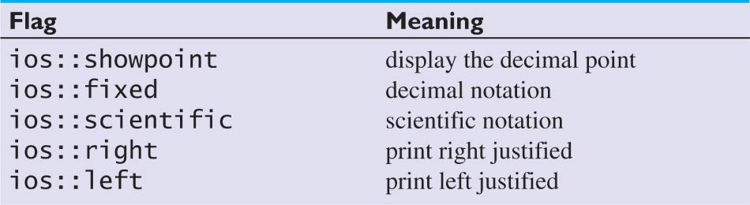
Common Format Flags

Slide 3
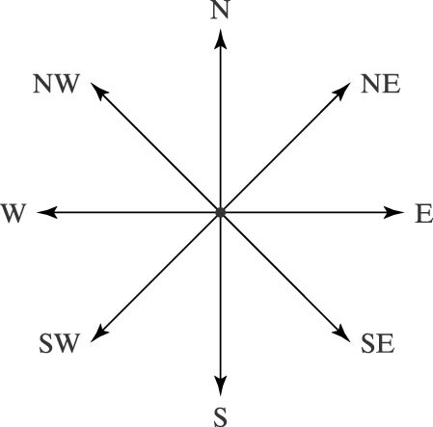
Compass Directions

Slide 4
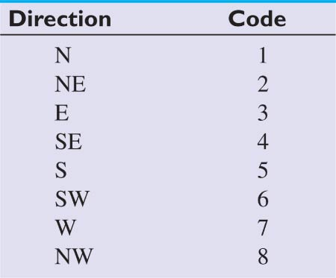
Wind Direction Codes

Slide 5
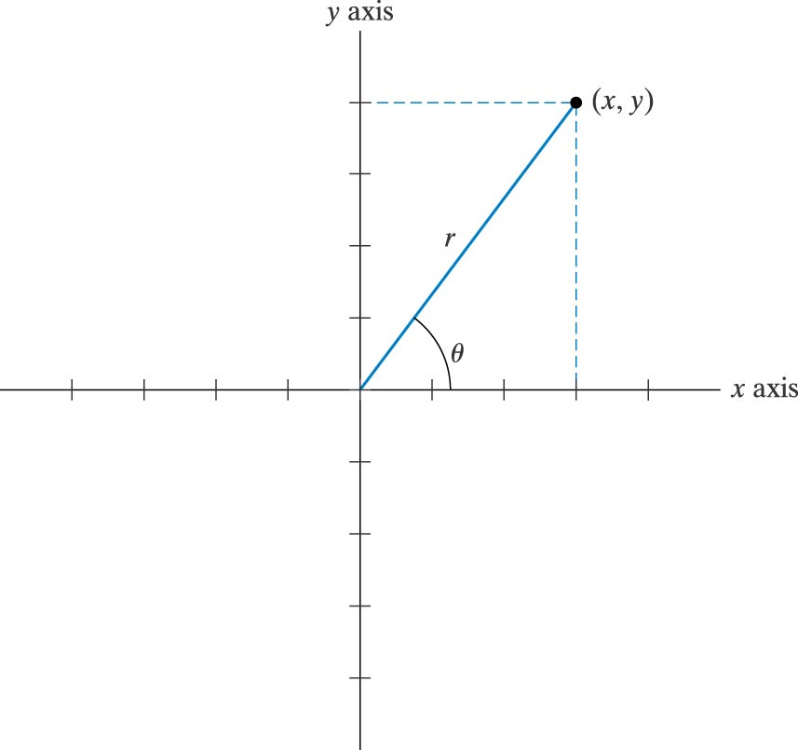
Rectangular Coordinates for a Data Point

Slide 6
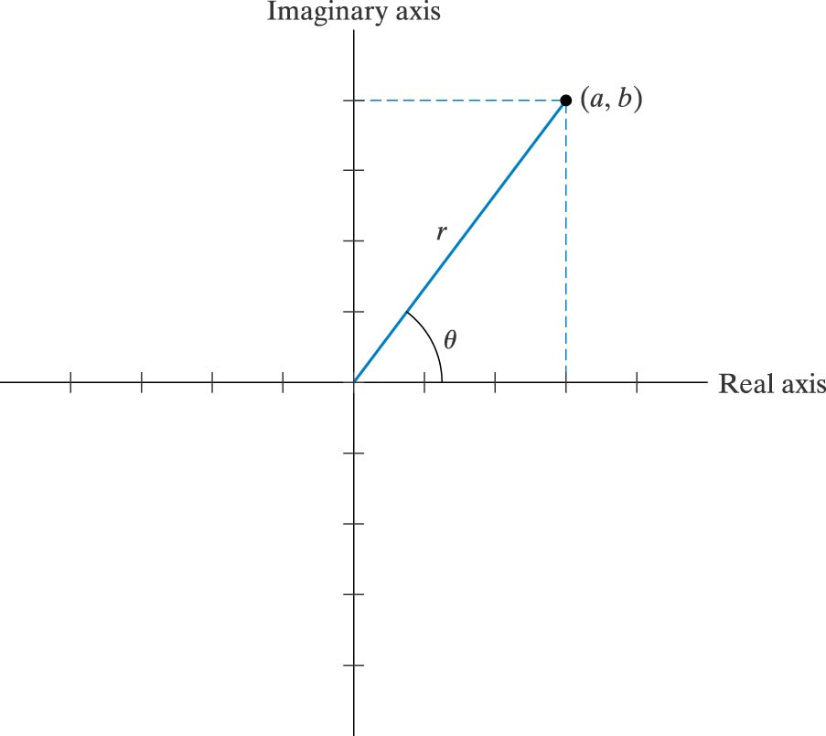
Graphical Representation for a Complex Number

Slide 7
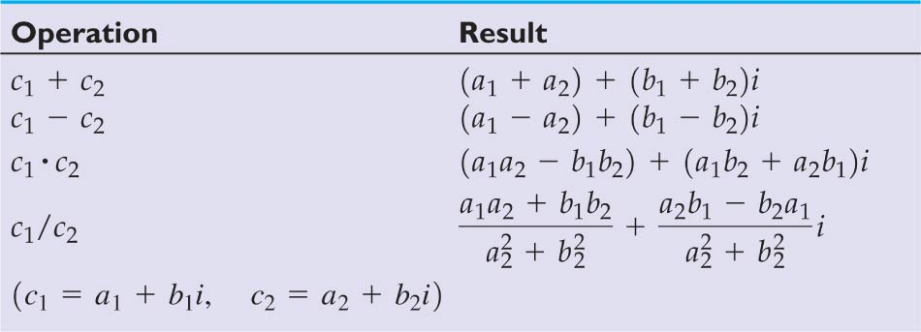
Arithmetic Operations with Complex Numbers

