Slide 1
Infusionsoft BSIMM Tracking Project
Matthew Abbruscato
Paul Conway
Calvin Crow
Greg Higgins
Tyler Matteson
Chia-Wei Wang

Slide 2
Project
Building Security In Maturity Model – BSIMM
“The BSIMM is a study of real-world software security initiatives organized so that you can determine where you stand with your software security initiative and how to evolve your efforts over time.” - www.bsimm.com
Infusionsoft would like us to build a system to help keep track of their security initiatives compared to the rest of the industry.

Slide 3
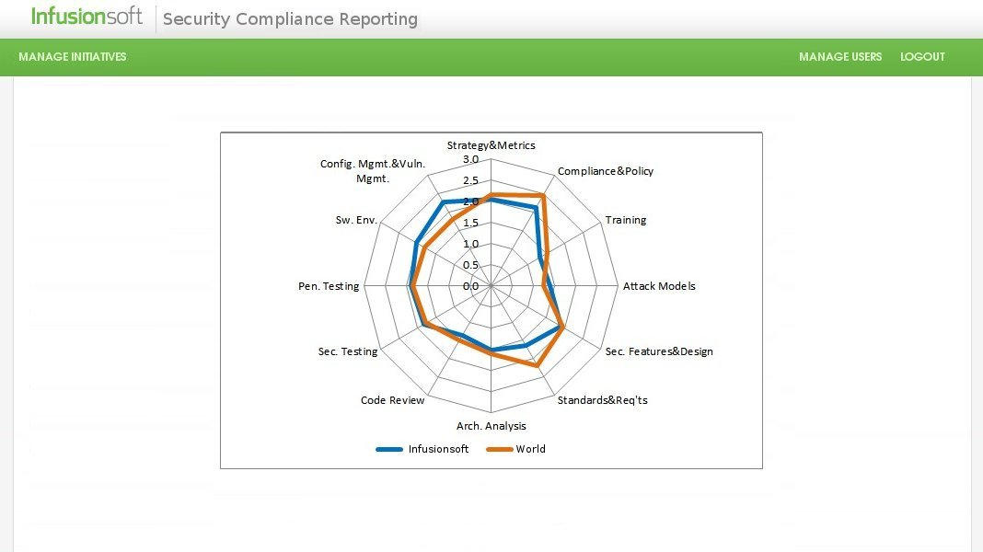
Project User Stories
As a Security Compliance Specialist I want to compare our security against the BSIMM so that we can track progress.

Slide 4
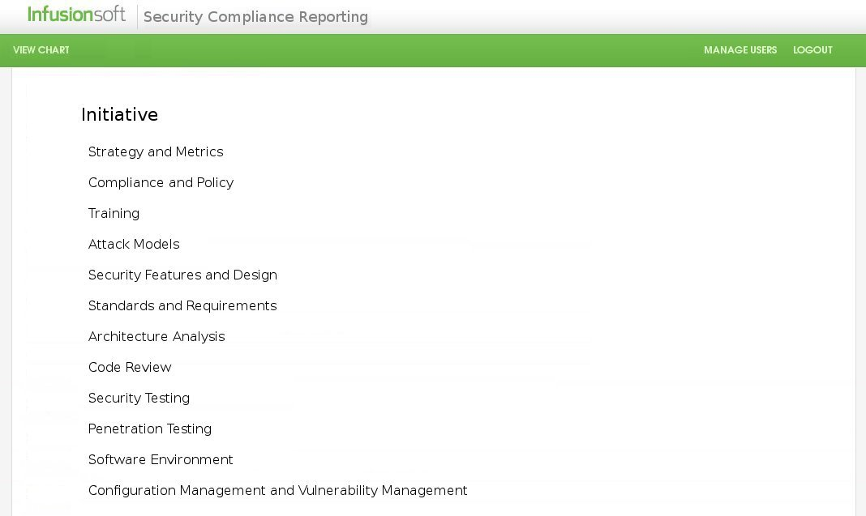
Project User Stories
As a system administrator, I want to have a list of BSIMM initiatives that I can manage for the organization.

Slide 5
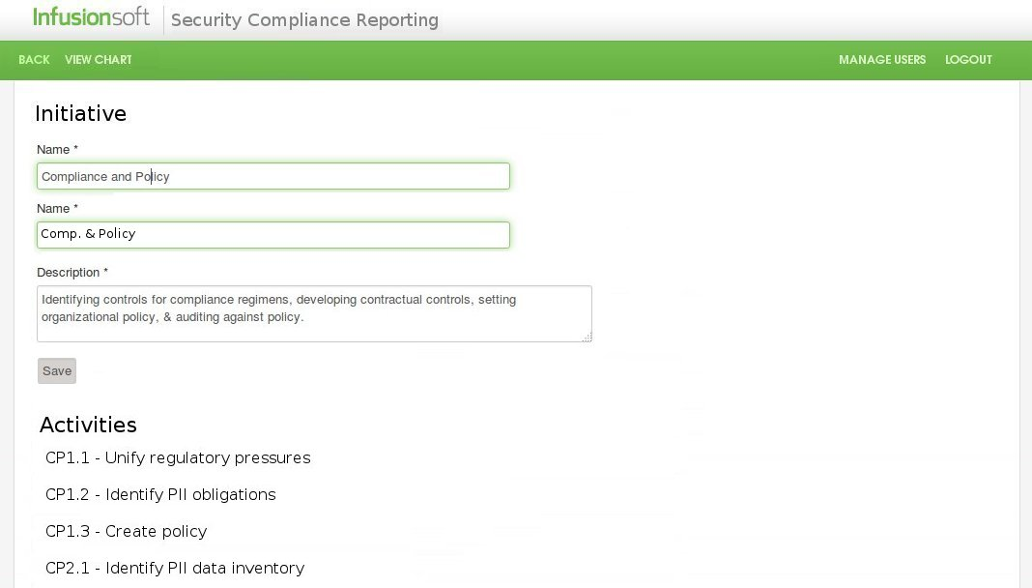
Project User Stories
As an administrator, I want to be able to adjust names and descriptions for each initiative while keeping the association with the BSIMM.

Slide 6
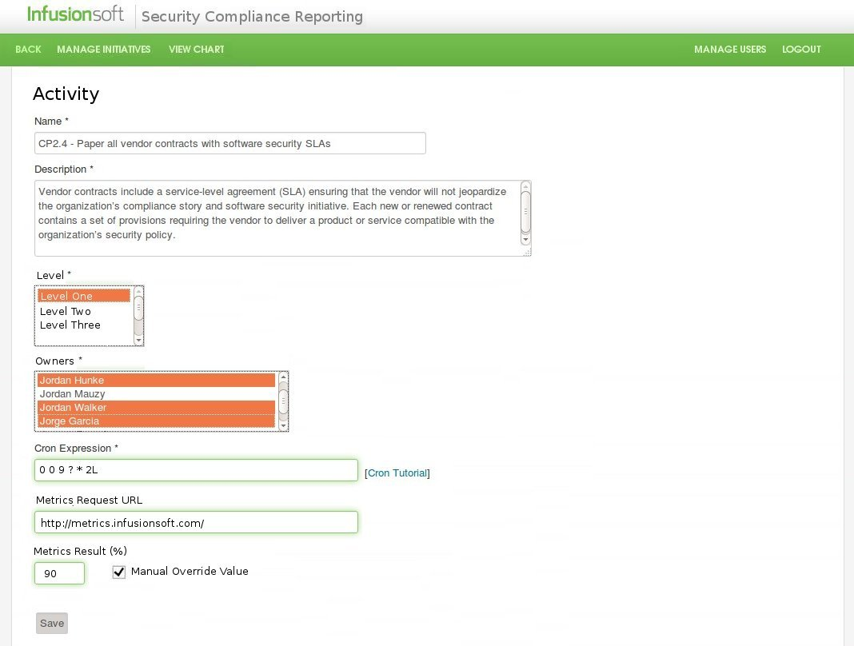
Project User Stories
As an administrator, I want to have access to a list of BSIMM activities per initiatives.

Slide 7
Questions?

