Slide 1


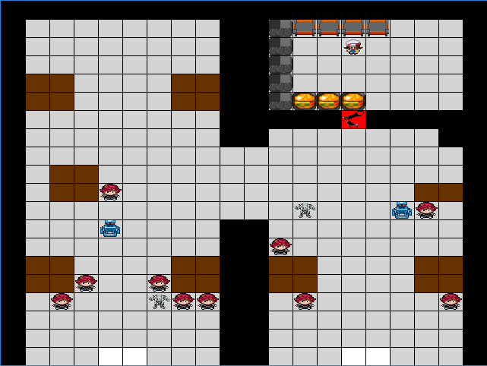
Robot Café
Human-Robot and Robot-Robot Interaction
Philip Cooksey & Ben Holden
Introduction
Customers
Robots
Robot Café is a restaurant where the food is cooked by humans and served by robots. We have multiple different types of robots all interacting between the customers and chefs i.e. the customers only ever see the robots.
Robot Waiter
Breadth-first search
Closest customer first (requested to serve)
Defaults back to birth place when nothing to do
Robot Server
Same I and III as Robot Waiter
FIFO customer service
If multiple orders then waits to get that much food maxing at 3 burgers.
Robot Arm
Grabs food from conveyor belt
Distributed path planning
Robot Hierarchy : Determines which robot has to move out of the way (lowest moves)
Servers (numerically ordered)
Waiters (numerically ordered)
In our world, customers appear at the door given a random chance every world step. They then randomly depth-first search for an open table. They request a burger after being asked a random number of times by the waiter. After receiving their burger from the robot server, they leave searching breadth-first search for a door.
Customer Arrives
Command Center chooses Robot Waiter
Waiter goes to customer and asks for order
Chef gets order and starts cooking food
Command Center chooses Robot Server for order
Robot Server receives food from robot arm
Robot Server delivers food
Customer leaves
Chef’s Kitchen
Café Flow
The Kitchen receives an order from the robot waiter and starts to cook the food if there is an open counter. The food takes 10 steps to make. The food goes on the conveyor belt to the robot arm. If after 15 steps of cooking and the conveyor belt is full the food is thrown away and cooked again.
Command Center
Experiment
Jobs split evenly between robots
Each new customer goes to the next robot and eventually cycles back to the first robot.
Jobs split by room location
We split the room vertically in half
One Waiter and Server per side
The back tables are not used as often due to random chance but still have an effect
Compare two management styles used by the Command Center and Free For All
1:20 chance for new customer every step
Two Robot Waiters and two Robot Servers
30,000 time steps for each experiment
Customer total time from arrival to departure recorded along with initial time showing up.
The results demonstrate that with the current world setup for the experiment that splitting the room was better for getting customers out faster.

