Slide 1

Small Area Estimation Area level models
Training prepared for the Equity Policy Lab (EPL)
November 2023
Paul Corral Rodas (pcorralrodas@worldbank.org)

Slide 2
Introduction
Household surveys are the main sources of indicators of living conditions, poverty, and social exclusion.
Provide detailed information on multiple indicators of well-being
Samples too small to be representative for small sub-national units.
Do not cover all areas
Population censuses
Provide 100% coverage, permitting assessment for small areas
Very limited information on poverty and social exclusion indicators
Combine survey and census data to exploit the strengths of each information source. Requires hands-on work with national statistical institutes, use official data sources (population censuses and household surveys) to estimate risk of poverty at lowest possible sub-national level.
Small Area Estimation is a branch of statistics focused on improving reliability of estimates and the associated measures of uncertainty for populations where samples cannot produce sufficiently reliable estimates. Poverty mapping relies on survey and census data from the same time frame.

Slide 3
FH overview
Fay-Herriot models are the traditional approach for cases where access to microdata is not possible or when the census and survey are not aligned
Fay Herriot models were introduced to estimate mean per capita income in small areas in the USA (Fay and Herriot 1979)
The method consists of modelling poverty rates (or other indicators) at the area level
The resulting estimate is a weighted average between the direct estimates (those derived directly from the survey) and the model-based estimates
The weight given to each estimate in a given area depends on the sample size for that area and the quality of the model
For areas not in the sample we rely solely on the model-based estimates
Because the model is only fit on sampled areas as opposed to households, the estimates obtained are often much less efficient than those obtained under unit-level models
Parameters estimated from survey data are used to estimate poverty in the census data. Ideally, the survey sample should be a subset of the census population. Significant differences between census and survey populations can lead to biased estimates.
Research has focused on poverty mapping in off-census years. A recommended method for non-contemporaneous data is the area-level model by Fay and Herriot (1979).
Notes:
Fay Herriot in 1979 introduced a model for small area estimation. The model was initially used to estimate mean per capita income in small areas, counties if I’m not mistaken, in the US
For poverty mapping the method models area level poverty rates using area level covariates, so the number of observations is much lower than those of the recently discussed models. Since less information is embedded in the models they tend to be less efficient.
Empirical best estimates are obtained in the model through taking a weighted average between the survey estimates for a given area and the model based estimate (XB). The weights are determined by the quality of the model and on the sample’s quality for that area.
So how do Fay-Herriot models perform when compared to the previous models?

Slide 4
Application of Fay-Herriot Model for GHANA
Objective
Data requirements
FH model
Direct estimates
Model selection
Check assumptions
Evaluate estimates
Download repository for training: https://github.com/pcorralrodas/wb_sae_training
Area-level models: https://github.com/jpazvd/fhsae
Also make sure you have groupfunction and sp_groupfunction: https://github.com/pcorralrodas/groupfunction and https://github.com/pcorralrodas/sp_groupfunction
We will be following the new Guidelines to SAE for poverty mapping: Corral, P., Molina, I., Cojocaru, A., and Segovia, S. (2022). Guidelines to small area estimation for poverty mapping. The World Bank, Washington, DC. http://hdl.handle.net/10986/37728

Slide 5
Objective
Producing an updated poverty map for Ghana at the district level using area level models.
Presents the poverty headcount for all 216 districts in Ghana in 2017
Target indicators: poverty headcount (FGT0) for all 216 districts in Ghana as of 2016/17
The poverty map presented here takes advantage of district-level aggregate characteristics derived from the 2010 Population and Housing Census and direct estimates of poverty at the district level obtained from the Ghana Living Standards Survey corresponding to 2016/17. We use a FH model to estimate poverty.

Slide 6
Data requirements
Direct estimates of indicators of interest and its sampling variance for the areas considered (from the survey).
GLSS7: 15,000 households, nationally and regionally representative
We will need poverty estimates at the district level derived from GLSS-7
National poverty rate in GLSS7: 23.4%
Representative at the national and regional level
Aggregate data at area level of all necessary covariates for the model for every area considered.
2010 Population and Housing Census.
The report provides information on population and housing characteristics for the entire country, the 10 administrative regions and the 170 districts that existed at the time of the 2010 census.
District level aggregates from the 2010 census. (we will only require census aggregates, so no need for access to micro data)
3. Additionally, we need a location variable to link the census (or any other auxiliar data) and survey at that level.
→ We make sure both data sets are linkable at the district level.

Slide 7
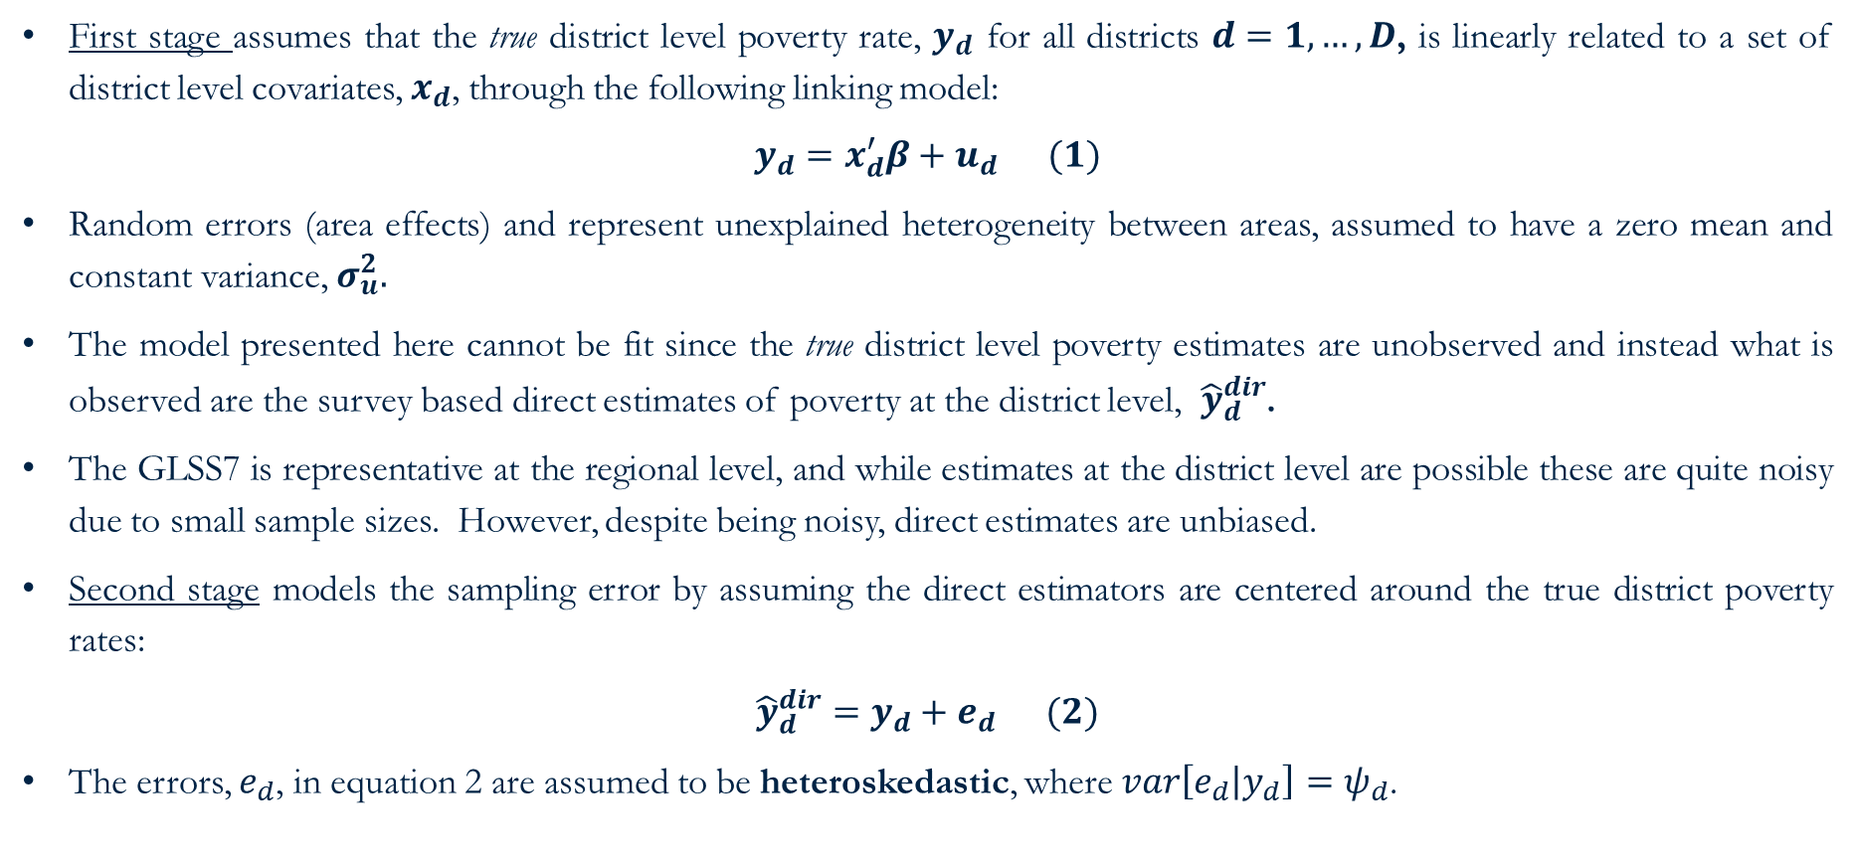
Assumed area-level model: Fay-Harriot – set-up
First stage assumes that the true district level poverty rate, $y_{d}$ for all districts $d=1,…,D$, is linearly related to a set of district level covariates, $x_{d}$, through the following linking model:
$$y_{d}=x_{d}^{′}β+u_{d} (1)$$
Random errors (area effects) and represent unexplained heterogeneity between areas, assumed to have a zero mean and constant variance, $σ_{u}^{2}.$
The model presented here cannot be fit since the true district level poverty estimates are unobserved and instead what is observed are the survey based direct estimates of poverty at the district level, ${\hat{y}}_{d}^{dir}$.
The GLSS7 is representative at the regional level, and while estimates at the district level are possible these are quite noisy due to small sample sizes. However, despite being noisy, direct estimates are unbiased.
Second stage models the sampling error by assuming the direct estimators are centered around the true district poverty rates:
$${\hat{y}}_{d}^{dir}=y_{d}+e_{d} (2)$$
The errors, $e_{d}$, in equation 2 are assumed to be heteroskedastic, where $var\left[e_{d} | y_{d}\right]=ψ_{d}$.

Slide 8
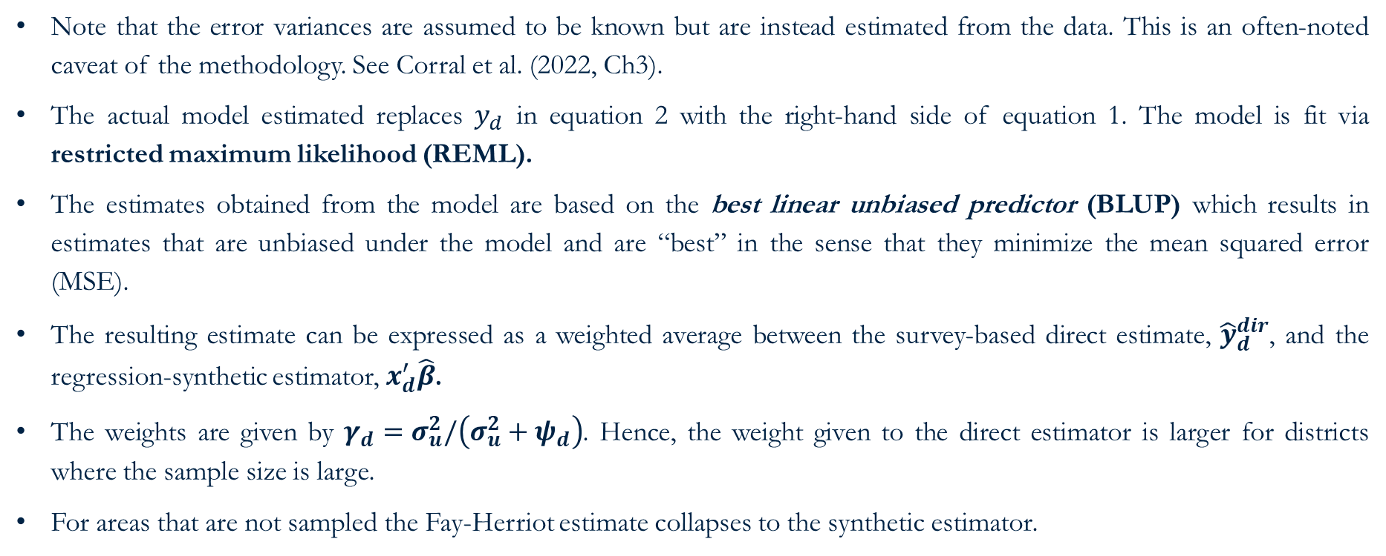
Assumed area-level model: Fay-Harriot - solution
Note that the error variances are assumed to be known but are instead estimated from the data. This is an often-noted caveat of the methodology. See Corral et al. (2022, Ch3).
The actual model estimated replaces $y_{d}$ in equation 2 with the right-hand side of equation 1. The model is fit via restricted maximum likelihood (REML).
The estimates obtained from the model are based on the best linear unbiased predictor (BLUP) which results in estimates that are unbiased under the model and are “best” in the sense that they minimize the mean squared error (MSE).
The resulting estimate can be expressed as a weighted average between the survey-based direct estimate, ${\hat{y}}_{d}^{dir}$, and the regression-synthetic estimator, $x_{d}^{′}\hat{β}$.
The weights are given by $γ_{d}=σ_{u}^{2}/\left(σ_{u}^{2}+ψ_{d}\right)$. Hence, the weight given to the direct estimator is larger for districts where the sample size is large.
For areas that are not sampled the Fay-Herriot estimate collapses to the synthetic estimator.

Slide 9
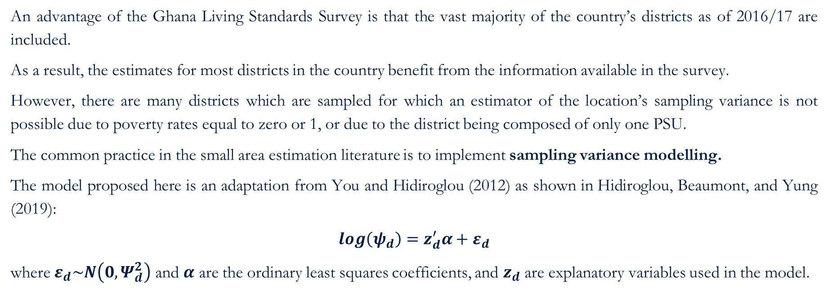
Assumed area-level model: Fay-Harriot – Sampling Variance
An advantage of the Ghana Living Standards Survey is that the vast majority of the country’s districts as of 2016/17 are included.
As a result, the estimates for most districts in the country benefit from the information available in the survey.
However, there are many districts which are sampled for which an estimator of the location’s sampling variance is not possible due to poverty rates equal to zero or 1, or due to the district being composed of only one PSU.
The common practice in the small area estimation literature is to implement sampling variance modelling.
The model proposed here is an adaptation from You and Hidiroglou (2012) as shown in Hidiroglou, Beaumont, and Yung (2019):
$$\log\left(ψ_{d}\right)=z_{d}^{′}α+ε_{d}$$
where $ε_{d}\sim N\left(0,Ψ_{d}^{2}\right)$ and $α$ are the ordinary least squares coefficients, and $z_{d}$ are explanatory variables used in the model.

Slide 10
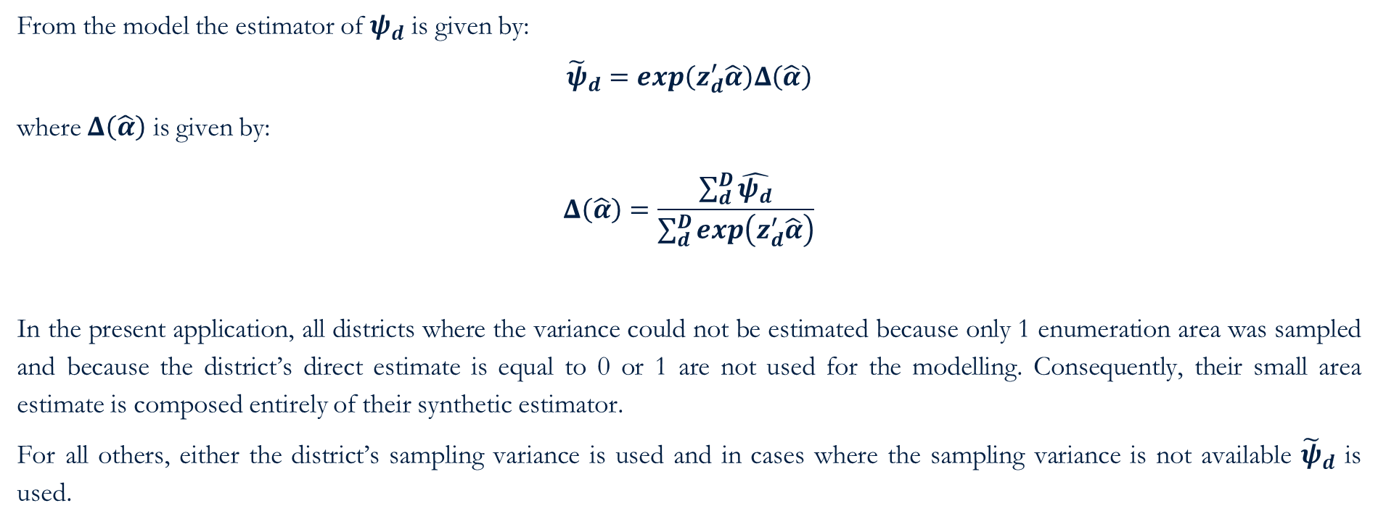
Assumed area-level model: Fay-Harriot – Sampling Variance
From the model the estimator of $ψ_{d}$ is given by:
$${\tilde{ψ}}_{d}=\exp\left(z_{d}^{′}\hat{α}\right)Δ\left(\hat{α}\right)$$
where $Δ\left(\hat{α}\right)$ is given by:
$$Δ\left(\hat{α}\right)=\frac{\sum_{d}^{D}{\hat{ψ_{d}}}}{\sum_{d}^{D}{\exp\left(z_{d}^{′}\hat{α}\right)}}$$
In the present application, all districts where the variance could not be estimated because only 1 enumeration area was sampled and because the district’s direct estimate is equal to 0 or 1 are not used for the modelling. Consequently, their small area estimate is composed entirely of their synthetic estimator.
For all others, either the district’s sampling variance is used and in cases where the sampling variance is not available ${\tilde{ψ}}_{d}$ is used.

Slide 11
Direct estimates
Direct estimators are those that come directly from the survey
Horvitz-Thompson (1952) – design unbiased but large variance
Hajek (1971) – slightly biased but smaller variance
Indirect estimators for an area’s indicators are those that make use of information of other areas; it borrows strength from other areas.
We calculate direct estimates of poverty at the district level from the 2016/17 GLSS7
See Corral et al. (2022, Ch2) for a discussion on direct estimates.
Open following do-file: ~01.dofiles/FayHerriot/1.SVY_prep.do

Slide 12
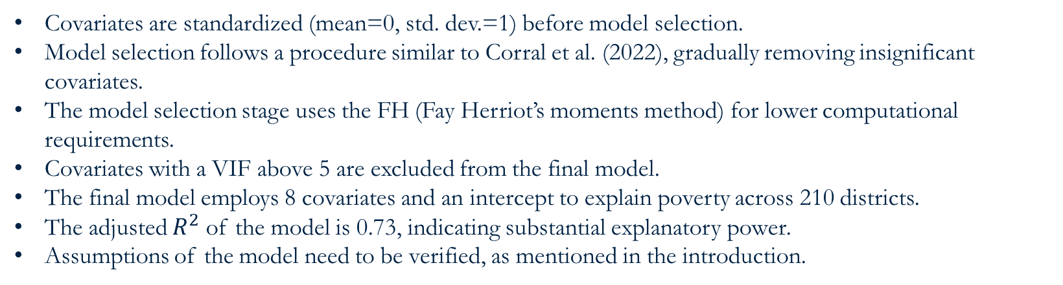
Model selection
Covariates are standardized (mean=0, std. dev.=1) before model selection.
Model selection follows a procedure similar to Corral et al. (2022), gradually removing insignificant covariates.
The model selection stage uses the FH (Fay Herriot’s moments method) for lower computational requirements.
Covariates with a VIF above 5 are excluded from the final model.
The final model employs 8 covariates and an intercept to explain poverty across 210 districts.
The adjusted $R^{2}$ of the model is 0.73, indicating substantial explanatory power.
Assumptions of the model need to be verified, as mentioned in the introduction.
Open following do-file: ~01.dofiles/FayHerriot/2.FH_model_select.do

Slide 13
Checking assumptions
Open following do-file: ~01.dofiles/FayHerriot/3.results_check.do
Figure 1: Fay-Herriot Residual Plots

Slide 14
Estimates evaluation
Figure 2: Direct vs Small Area Estimates (Left, point) (Right, SE)

Slide 15
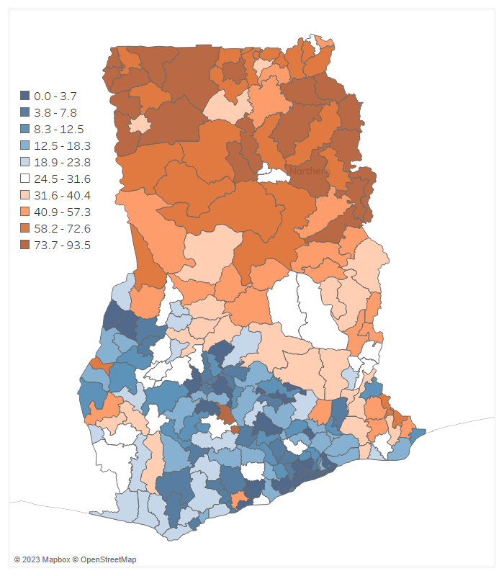
Poverty map - Fay Herriot Small Area Estimates of Poverty (deciles)
The poverty map corresponding to 2016/17 for Ghana, at the district level.
Note: Area-level small area estimates of poverty obtained from a Fay Herriot model.

Slide 16
Annex

Slide 17
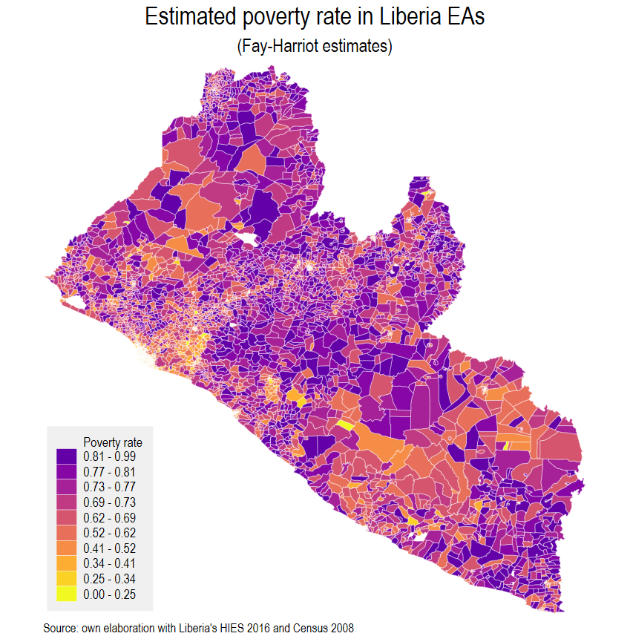
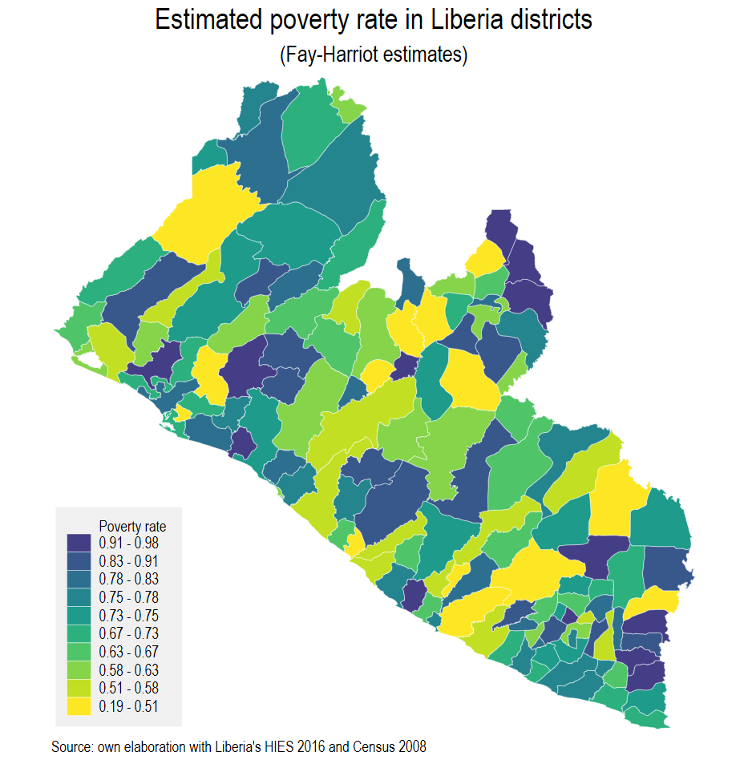
Example: Liberia 2016
Unit-level SAE wasn’t possible
Liberia’s survey is from 2016
Liberia’s Census is from 2008
We model the spatial distribution of poverty in the corresponding survey year
The method is ideal for off-census years, but since we use less information for the model it yields noisier estimates than unit-level SAEs
When data is available at a lower level than the reporting one FH estimates can be aggregated to higher levels with corresponding estimated MSE

Slide 18
Main references for unit-level small area estimation
Elbers, C., Lanjouw, J. O. [Jean O], & Lanjouw, P. (2003). Micro–level estimation of poverty and inequality. Econometrica, 71 (1), 355–364.
Molina, I., & Rao, J. (2010). Small area estimation of poverty indicators. Canadian Journal of Statistics, 38 (3), 369–385.
Marhuenda, Y., Molina, I., Morales, D., & Rao, J. (2017). Poverty mapping in small areas under a twofold nested error regression model. Journal of the Royal Statistical Society: Series A (Statistics in Society), 180 (4), 1111–1136.
Corral, P., Molina, I., & Nguyen, M. C. (2020). Pull your small area estimates up by the bootstraps. World Bank Policy Research Working Paper, (9256).
Corral, P., Himelein, K., McGee, K., & Molina, I., (2021). A map of the poor or a poor map? Mimeo.

