Slide 1

Small Area Estimation Area level models
Training prepared for the Equity Policy Lab (EPL)
November 2023
Paul Corral (pcorralrodas@worldbank.org)
Sandra Segovia Juarez (ssegoviajuarez@worldbank.org)

Slide 2
Introduction
Household surveys are the main sources of indicators of living conditions, poverty, and social exclusion.
Provide detailed information on multiple indicators of well-being
Samples too small to be representative for small sub-national units.
Do not cover all areas
Population censuses
Provide 100% coverage, permitting assessment for small areas
Very limited information on poverty and social exclusion indicators
Combine survey and census data to exploit the strengths of each information source. Requires hands-on work with national statistical institutes, use official data sources (population censuses and household surveys) to estimate risk of poverty at lowest possible sub-national level.
Small Area Estimation is a branch of statistics focused on improving reliability of estimates and the associated measures of uncertainty for populations where samples cannot produce sufficiently reliable estimates. Poverty mapping relies on survey and census data from the same time frame.

Slide 3
Census microdata is not always available
Census data are infrequently collected and may not be aligned with household survey data
A key assumption of unit-level model-based SAE is that the census and survey correspond to the same population
Questions may have been asked in a different manner
Characteristics may differ due to timing of data collection or other reasons
Data may also be subject to access restrictions
Area-level models
Combine survey based direct estimates of the desired indicator, at level of interest, and area-level characteristics
Survey-based direct estimators are noisy but unbiased
Indicator of interest is modeled directly
Combines survey estimates and area-level data (e.g. census aggregates, geospatial data, admin data, etc.) to exploit the strengths of each information source.
Area-level SAE will often yield estimates with better precision (less noisy) than those directly derived from the survey data, but because these require less information are often noisier than those from unit-level SAE.

Slide 4
FH Area Level SAE overview
Fay-Herriot models are the traditional approach for cases where access to microdata is not possible or when the census and survey are not aligned
Fay Herriot models were introduced to estimate mean per capita income in small areas in the USA (Fay and Herriot 1979)
The method consists of modelling poverty rates (or other indicators) at the area level
The resulting estimate is a weighted average between the direct estimates (those derived directly from the survey) and the model-based estimates
The weight given to each estimate in a given area depends on the sample size for that area and the quality of the model
For areas not in the sample we rely solely on the model-based estimates
Because the model is only fit on sampled areas as opposed to households, the estimates obtained are often much less efficient than those obtained under unit-level models
Notes:
Fay Herriot in 1979 introduced a model for small area estimation. The model was initially used to estimate mean per capita income in small areas, counties if I’m not mistaken, in the US
For poverty mapping the method models area level poverty rates using area level covariates, so the number of observations is much lower than those of the recently discussed models. Since less information is embedded in the models they tend to be less efficient.
Empirical best estimates are obtained in the model through taking a weighted average between the survey estimates for a given area and the model based estimate (XB). The weights are determined by the quality of the model and on the sample’s quality for that area.
So how do Fay-Herriot models perform when compared to the previous models?

Slide 5
Application of Fay-Herriot Model for Ghana
Objective
Data requirements
FH model
Direct estimates
Model selection
Check assumptions
Evaluate estimates
Download repository for training: https://github.com/pcorralrodas/wb_sae_training
Fhsae Stata command for Area-level models: https://github.com/jpazvd/fhsae
Also make sure you have groupfunction and sp_groupfunction: https://github.com/pcorralrodas/groupfunction and https://github.com/pcorralrodas/sp_groupfunction
We will be following the new Guidelines to SAE for poverty mapping: Corral, P., Molina, I., Cojocaru, A., and Segovia, S. (2022). Guidelines to small area estimation for poverty mapping. The World Bank, Washington, DC. http://hdl.handle.net/10986/37728

Slide 6
Objective
Producing an updated poverty map for Ghana at the district level using area level models.
Presents the poverty headcount for all 216 districts in Ghana in 2017
Target indicators: poverty headcount (FGT0) for all 216 districts in Ghana as of 2016/17
The poverty map presented here takes advantage of district-level aggregate characteristics derived from the 10 percent sample of the 2010 Population and Housing Census and direct estimates of poverty at the district level obtained from the Ghana Living Standards Survey corresponding to 2016/17. We use a FH model to estimate poverty.

Slide 7
Data requirements
Direct estimates of indicators of interest and its sampling variance for the areas considered (from the survey).
GLSS7: 14,009 households, nationally and regionally representative
We will need poverty estimates at the district level derived from GLSS-7
National poverty rate in GLSS7: 23.4%
Only missing a sample in a few districts
Aggregate data at district level of all necessary covariates for the model
2010 Population and Housing Census, 10% sample at the district level.
The data provides information on population and housing characteristics for the entire country, the 10 administrative regions and the 170 districts that existed at the time of the 2010 census.
District level aggregates from the 2010 census. (we will only require census aggregates, so no need for access to micro data)
3. Additionally, we need a location variable to link the census (or any other auxiliar data) and survey at that level.
→ We make sure both data sets are linkable at the district level. This is a must for the method.

Slide 8
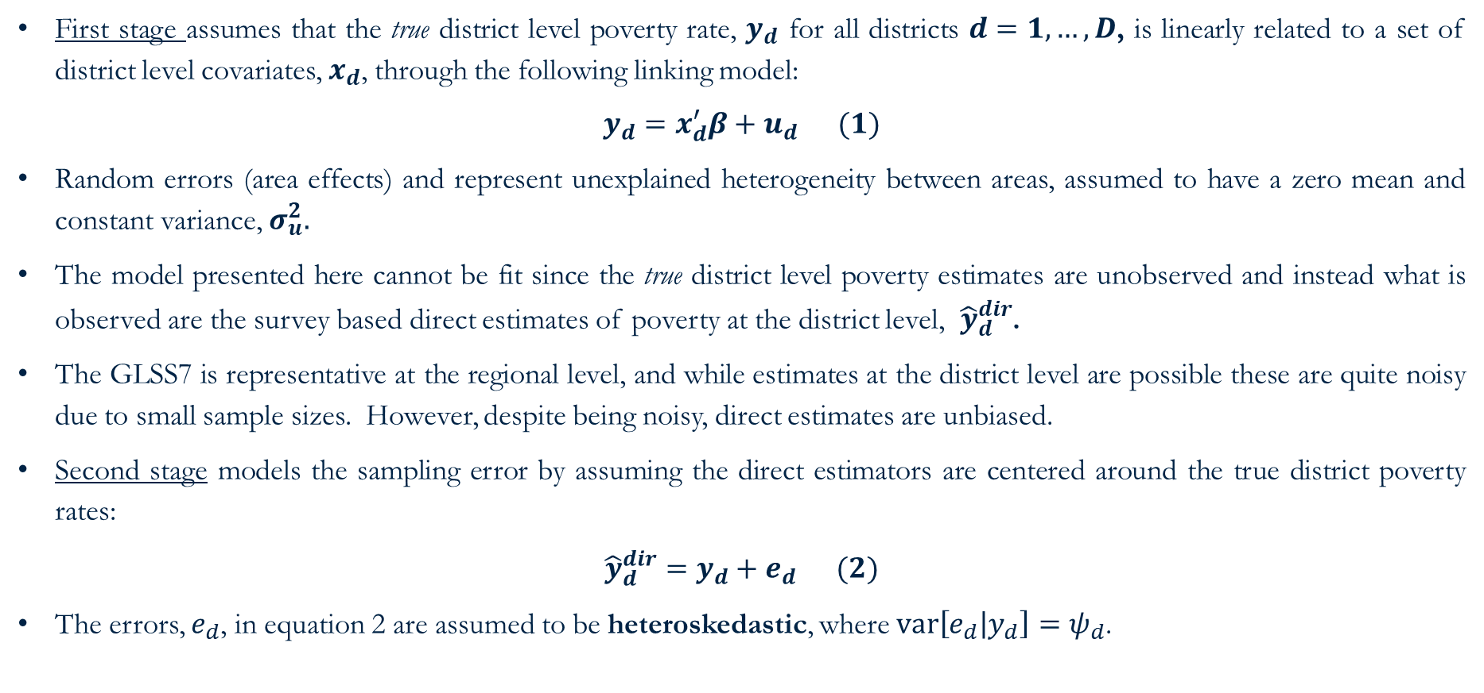
Assumed area-level model: Fay-Harriot – set-up
First stage assumes that the true district level poverty rate, $y_{d}$ for all districts $d=1,…,D$, is linearly related to a set of district level covariates, $x_{d}$, through the following linking model:
$$y_{d}=x_{d}^{′}β+u_{d} (1)$$
Random errors (area effects) and represent unexplained heterogeneity between areas, assumed to have a zero mean and constant variance, $σ_{u}^{2}.$
The model presented here cannot be fit since the true district level poverty estimates are unobserved and instead what is observed are the survey based direct estimates of poverty at the district level, ${\hat{y}}_{d}^{dir}$.
The GLSS7 is representative at the regional level, and while estimates at the district level are possible these are quite noisy due to small sample sizes. However, despite being noisy, direct estimates are unbiased.
Second stage models the sampling error by assuming the direct estimators are centered around the true district poverty rates:
$${\hat{y}}_{d}^{dir}=y_{d}+e_{d} (2)$$
The errors, $e_{d}$, in equation 2 are assumed to be heteroskedastic, where $var\left[e_{d} | y_{d}\right]=ψ_{d}$.

Slide 9
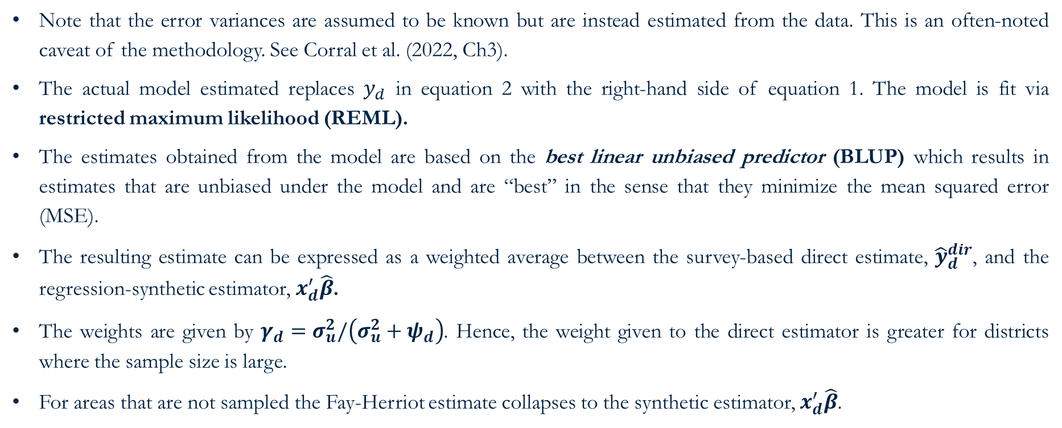
Assumed area-level model: Fay-Harriot - solution
Note that the error variances are assumed to be known but are instead estimated from the data. This is an often-noted caveat of the methodology. See Corral et al. (2022, Ch3).
The actual model estimated replaces $y_{d}$ in equation 2 with the right-hand side of equation 1. The model is fit via restricted maximum likelihood (REML).
The estimates obtained from the model are based on the best linear unbiased predictor (BLUP) which results in estimates that are unbiased under the model and are “best” in the sense that they minimize the mean squared error (MSE).
The resulting estimate can be expressed as a weighted average between the survey-based direct estimate, ${\hat{y}}_{d}^{dir}$, and the regression-synthetic estimator, $x_{d}^{′}\hat{β}$.
The weights are given by $γ_{d}=σ_{u}^{2}/\left(σ_{u}^{2}+ψ_{d}\right)$. Hence, the weight given to the direct estimator is greater for districts where the sample size is large.
For areas that are not sampled the Fay-Herriot estimate collapses to the synthetic estimator, $x_{d}^{′}\hat{β}$.

Slide 10
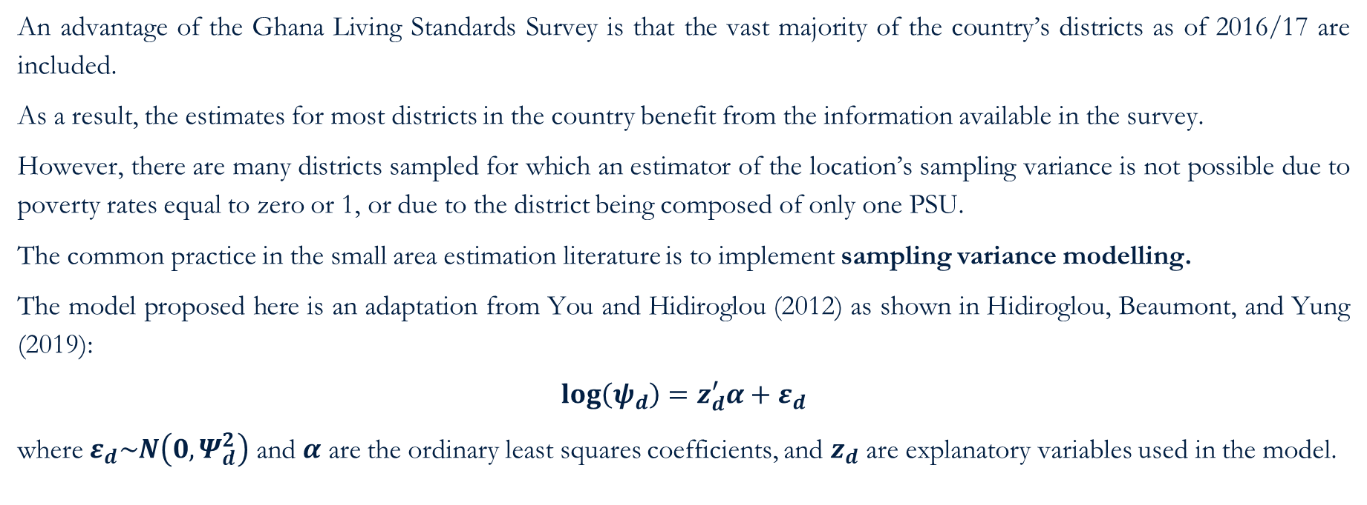
Assumed area-level model: Fay-Harriot – Sampling Variance
An advantage of the Ghana Living Standards Survey is that the vast majority of the country’s districts as of 2016/17 are included.
As a result, the estimates for most districts in the country benefit from the information available in the survey.
However, there are many districts sampled for which an estimator of the location’s sampling variance is not possible due to poverty rates equal to zero or 1, or due to the district being composed of only one PSU.
The common practice in the small area estimation literature is to implement sampling variance modelling.
The model proposed here is an adaptation from You and Hidiroglou (2012) as shown in Hidiroglou, Beaumont, and Yung (2019):
$$\log\left(ψ_{d}\right)=z_{d}^{′}α+ε_{d}$$
where $ε_{d}\sim N\left(0,Ψ_{d}^{2}\right)$ and $α$ are the ordinary least squares coefficients, and $z_{d}$ are explanatory variables used in the model.

Slide 11
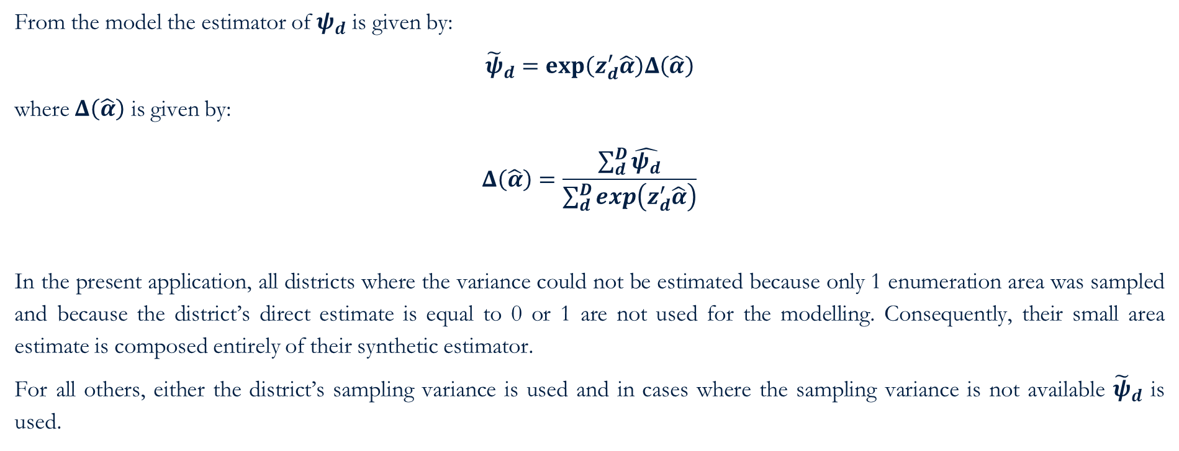
Assumed area-level model: Fay-Harriot – Sampling Variance
From the model the estimator of $ψ_{d}$ is given by:
$${\tilde{ψ}}_{d}=\exp\left(z_{d}^{′}\hat{α}\right)Δ\left(\hat{α}\right)$$
where $Δ\left(\hat{α}\right)$ is given by:
$$Δ\left(\hat{α}\right)=\frac{\sum_{d}^{D}{\hat{ψ_{d}}}}{\sum_{d}^{D}{\exp\left(z_{d}^{′}\hat{α}\right)}}$$
In the present application, all districts where the variance could not be estimated because only 1 enumeration area was sampled and because the district’s direct estimate is equal to 0 or 1 are not used for the modelling. Consequently, their small area estimate is composed entirely of their synthetic estimator.
For all others, either the district’s sampling variance is used and in cases where the sampling variance is not available ${\tilde{ψ}}_{d}$ is used.

Slide 12
Direct estimates
Direct estimators are those that come directly from the survey
Horvitz-Thompson (1952) – design unbiased but large variance
Hajek (1971) – slightly biased but smaller variance
Indirect estimators for an area’s indicators are those that make use of information of other areas; it borrows strength from other areas.
We calculate direct estimates of poverty at the district level from the 2016/17 GLSS7
See Corral et al. (2022, Ch2) for a discussion on direct estimates.
Open following do-file: ~01.dofiles/FayHerriot/1.SVY_prep.do

Slide 13
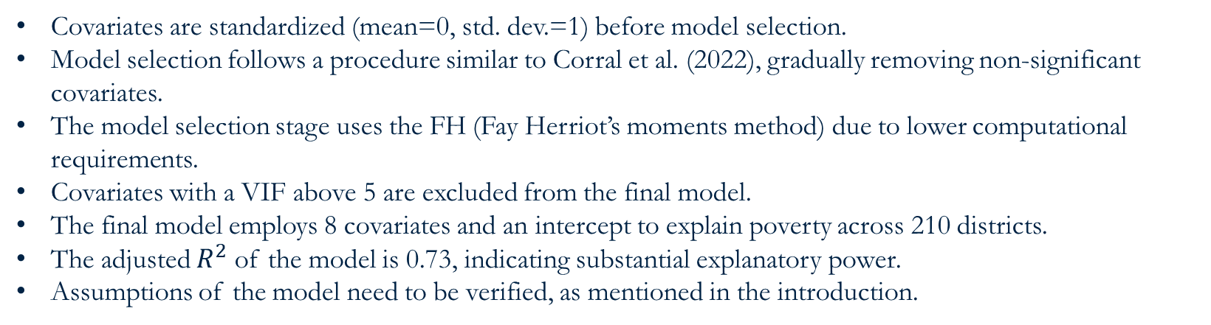
Model selection
Covariates are standardized (mean=0, std. dev.=1) before model selection.
Model selection follows a procedure similar to Corral et al. (2022), gradually removing non-significant covariates.
The model selection stage uses the FH (Fay Herriot’s moments method) due to lower computational requirements.
Covariates with a VIF above 5 are excluded from the final model.
The final model employs 8 covariates and an intercept to explain poverty across 210 districts.
The adjusted $R^{2}$ of the model is 0.73, indicating substantial explanatory power.
Assumptions of the model need to be verified, as mentioned in the introduction.
Open following do-file: ~01.dofiles/FayHerriot/2.FH_model_select.do

Slide 14
Checking assumptions
Open following do-file: ~01.dofiles/FayHerriot/3.results_check.do
Figure 1: Fay-Herriot Residual Plots

Slide 15
Estimates’ evaluation
Figure 2: Direct vs Small Area Estimates (Left, point) (Right, SE)

Slide 16
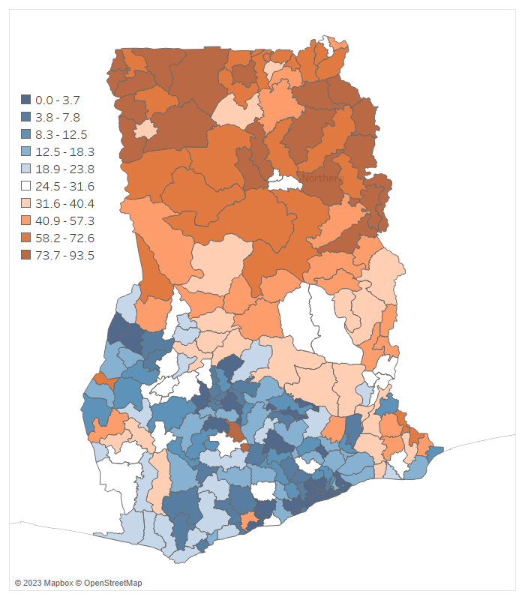
Poverty map - Fay Herriot Small Area Estimates of Poverty (FGT0 deciles)
The poverty map corresponding to 2016/17 for Ghana, at the district level.
Note: Area-level small area estimates of poverty obtained from a Fay Herriot model.

Slide 17
Main references for area-level small area estimation
Fay, Robert E and Roger A Herriot (1979). “Estimates of Income for Small Places: An Application of James-Stein Procedures to Census Data”. In: Journal of the American Statistical Association 74.366a,pp. 269–277.
Molina, Isabel (2019). Desagregación De Datos En Encuestas De Hogares: Metodologías De Estimación En áreas Pequeñas. CEPAL. url: https://repositorio.cepal.org/handle/11362/44214.
Rao, JNK and Isabel Molina (2015). Small Area Estimation. 2nd. John Wiley & Sons.
Corral, Paul, Isabel Molina, Alexandru Cojocaru, and Sandra Segovia, 2022. Guidelines to Small Area Estimation for Poverty Mapping. Washington, DC: World Bank.

