Slide 1

Poverty mapping in off-census years
Poverty and Equity Global Practice’s Summer University
June 2024
Paul Corral, Heath Henderson, and Sandra Segovia

Slide 2
Introduction – what is small area estimation?
Household surveys are the main sources of indicators of living conditions, poverty, and social exclusion.
Provide detailed information on multiple indicators of well-being
Samples too small to be representative for small sub-national units and don’t cover all areas
To obtain poverty estimates at lower levels we must combine survey and other (larger) data to exploit the strengths of each information source.
Small Area Estimation is a branch of statistics focused on improving reliability of estimates and the associated measures of uncertainty for populations where samples cannot produce sufficiently reliable estimates.
There are two main types of SAE for poverty:
Unit-level: attempt to model the household’s welfare distribution and from the simulated welfare poverty is estimated (CensusEB, EB, ELL)
Area-level: attempt to model the spatial distribution of poverty (Fay-Herriot, other ML methods)

Slide 3
Today’s first session focuses on small area estimation when we don’t have access to a valid census for poverty mapping (Fay-Herriot)
Fay-Herriot models are the traditional approach for cases where access to microdata is not possible or when the census and survey are not aligned
Originally introduced to estimate mean per capita income in small areas in the USA (Fay and Herriot 1979)
The method consists of modelling poverty rates (or other indicators) at the area level
Noisy but mostly unbiased
We obtain the joint distribution of poverty and area-level characteristics.
The data used for modeling is the same as the one used for predicting.
The resulting estimate is a weighted average between the direct estimates (those derived directly from the survey) and the model-based estimates
The weight given to each estimate in a given area depends on the sample size for that area and the quality of the model
For areas not in the sample we rely solely on the model-based estimates
Because the model is only fit on sampled areas as opposed to households, the estimates obtained are often less efficient than those obtained under unit-level models
Notes:
Fay Herriot in 1979 introduced a model for small area estimation. The model was initially used to estimate mean per capita income in small areas, counties if I’m not mistaken, in the US
For poverty mapping the method models area level poverty rates using area level covariates, so the number of observations is much lower than those of the recently discussed models. Since less information is embedded in the models, they tend to be less efficient.
Empirical best estimates are obtained in the model through taking a weighted average between the survey estimates for a given area and the model based estimate (XB). The weights are determined by the quality of the model and on the sample’s quality for that area.
So how do Fay-Herriot models perform when compared to the previous models?

Slide 4
Today’s second session focuses on small area estimation when we don’t have access to a valid census for poverty mapping (Machine Learning)
Machine learning approaches are an alternative for poverty mapping in off-census years
Relevant research in this area: Jean et al (2016), Chi et al. (2021), Corral, Henderson, Segovia (2023)
The method consists of modelling poverty rates (or other indicators) at the area level, like Fay-Herriot
Empirically and in the Mexican context performs as well as unit-level models
We obtain the joint distribution of poverty and area-level characteristics.
The data used for modeling is the same as the one used for predicting.
The resulting estimates are just the model-based estimates
Requires a large number of areas to work best
Notes:
Fay Herriot in 1979 introduced a model for small area estimation. The model was initially used to estimate mean per capita income in small areas, counties if I’m not mistaken, in the US
For poverty mapping the method models area level poverty rates using area level covariates, so the number of observations is much lower than those of the recently discussed models. Since less information is embedded in the models they tend to be less efficient.
Empirical best estimates are obtained in the model through taking a weighted average between the survey estimates for a given area and the model based estimate (XB). The weights are determined by the quality of the model and on the sample’s quality for that area.
So how do Fay-Herriot models perform when compared to the previous models?

Slide 5
Today’s session will be split into Fay-Herriot and Machine Learning models for poverty mapping
We will begin with the traditional Fay-Herriot models
Then we will discuss machine learning applications for poverty mapping
The sessions will give you intuition and understanding of the methods, but you are expected to follow up on literature and others to deepen your understanding.
Notes:
Fay Herriot in 1979 introduced a model for small area estimation. The model was initially used to estimate mean per capita income in small areas, counties if I’m not mistaken, in the US
For poverty mapping the method models area level poverty rates using area level covariates, so the number of observations is much lower than those of the recently discussed models. Since less information is embedded in the models they tend to be less efficient.
Empirical best estimates are obtained in the model through taking a weighted average between the survey estimates for a given area and the model based estimate (XB). The weights are determined by the quality of the model and on the sample’s quality for that area.
So how do Fay-Herriot models perform when compared to the previous models?

Slide 6
Fay-Herriot Area Level Models

Slide 7
Application of Fay-Herriot Model for GHANA
Download repository for training: https://github.com/pcorralrodas/wb_sae_training
In Stata type:
cap: net install github, from("https://haghish.github.io/github/")
github install jpazvd/fhsae
github install pcorralrodas/groupfunction
github install pcorralrodas/sp_groupfunction
We will be following the Guidelines to SAE for poverty mapping: Corral, P., Molina, I., Cojocaru, A., and Segovia, S. (2022). Guidelines to small area estimation for poverty mapping. The World Bank, Washington, DC. http://hdl.handle.net/10986/37728
We will be following the material from Chapter 3 and Chapter 5
Data requirements
Assumed model
Model selection
Check assumptions
Evaluation of estimates
Limitations

Slide 8
Data requirements
Direct estimates of indicators of interest and its sampling variance for the areas considered (from the survey).
GLSS-7: 14,009 households, nationally and regionally representative
We will need poverty estimates at the district level derived from GLSS7
National poverty rate in GLSS7: 23.4%
Representative at the national and regional level
We need to know the survey sample structure
Aggregate data at the area level of all covariates at hand
2010 Population and Housing Census.
District level aggregates from the 2010 census. (we will only require census aggregates, so no need for access to micro data)
3. Additionally, we need a location variable to link the census (or any other auxiliar data) and survey at that level.
→ We make sure both data sets are linkable at the district level.
Open following do-file: ~01.dofiles/FayHerriot/1.SVY_prep.do
Notes:
Direct estimators are those that come directly from the survey (two ways to get these)
Horvitz-Thompson (1952) – design unbiased but large variance
Hajek (1971) – slightly biased but smaller variance
Indirect estimators for an area’s indicators are those that make use of information of other areas; it borrows strength from other areas.
We calculate direct estimates of poverty at the district level from the 2016/17 GLSS7
See Corral et al. (2022, Ch2) for a discussion on direct estimates.

Slide 9
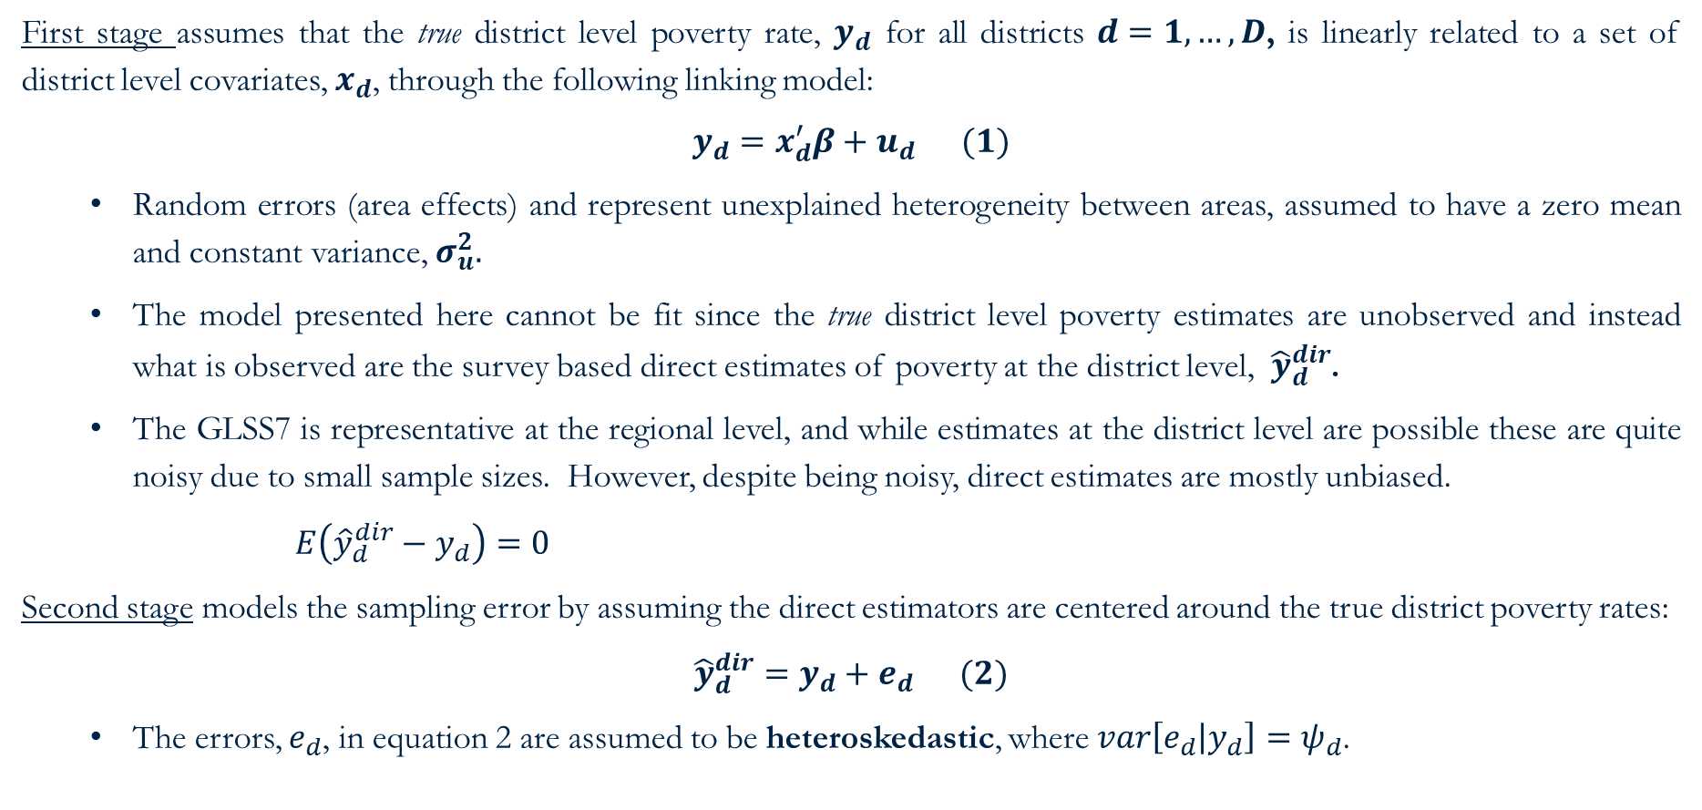
Assumed model: Fay-Herriot – set-up
First stage assumes that the true district level poverty rate, $y_{d}$ for all districts $d=1,…,D$, is linearly related to a set of district level covariates, $x_{d}$, through the following linking model:
$$y_{d}=x_{d}^{′}β+u_{d} (1)$$
Random errors (area effects) and represent unexplained heterogeneity between areas, assumed to have a zero mean and constant variance, $σ_{u}^{2}.$
The model presented here cannot be fit since the true district level poverty estimates are unobserved and instead what is observed are the survey based direct estimates of poverty at the district level, ${\hat{y}}_{d}^{dir}$.
The GLSS7 is representative at the regional level, and while estimates at the district level are possible these are quite noisy due to small sample sizes. However, despite being noisy, direct estimates are mostly unbiased.
$E\left({\hat{y}}_{d}^{dir}−y_{d}\right)=0$
Second stage models the sampling error by assuming the direct estimators are centered around the true district poverty rates:
$${\hat{y}}_{d}^{dir}=y_{d}+e_{d} (2)$$
The errors, $e_{d}$, in equation 2 are assumed to be heteroskedastic, where $var\left[e_{d} | y_{d}\right]=ψ_{d}$.
unbiased

Slide 10
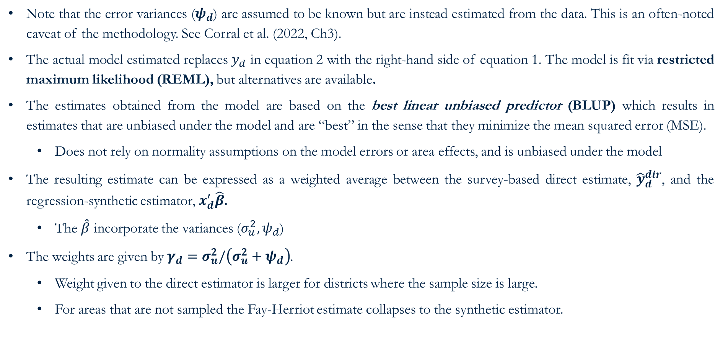
Assumed model: Fay-Herriot - solution
Note that the error variances ($ψ_{d}$) are assumed to be known but are instead estimated from the data. This is an often-noted caveat of the methodology. See Corral et al. (2022, Ch3).
The actual model estimated replaces $y_{d}$ in equation 2 with the right-hand side of equation 1. The model is fit via restricted maximum likelihood (REML), but alternatives are available.
The estimates obtained from the model are based on the best linear unbiased predictor (BLUP) which results in estimates that are unbiased under the model and are “best” in the sense that they minimize the mean squared error (MSE).
Does not rely on normality assumptions on the model errors or area effects, and is unbiased under the model
The resulting estimate can be expressed as a weighted average between the survey-based direct estimate, ${\hat{y}}_{d}^{dir}$, and the regression-synthetic estimator, $x_{d}^{′}\hat{β}$.
The $\hat{β}$ incorporate the variances ($σ_{u}^{2},ψ_{d}$)
The weights are given by $γ_{d}=σ_{u}^{2}/\left(σ_{u}^{2}+ψ_{d}\right)$.
Weight given to the direct estimator is larger for districts where the sample size is large.
For areas that are not sampled the Fay-Herriot estimate collapses to the synthetic estimator.

Slide 11
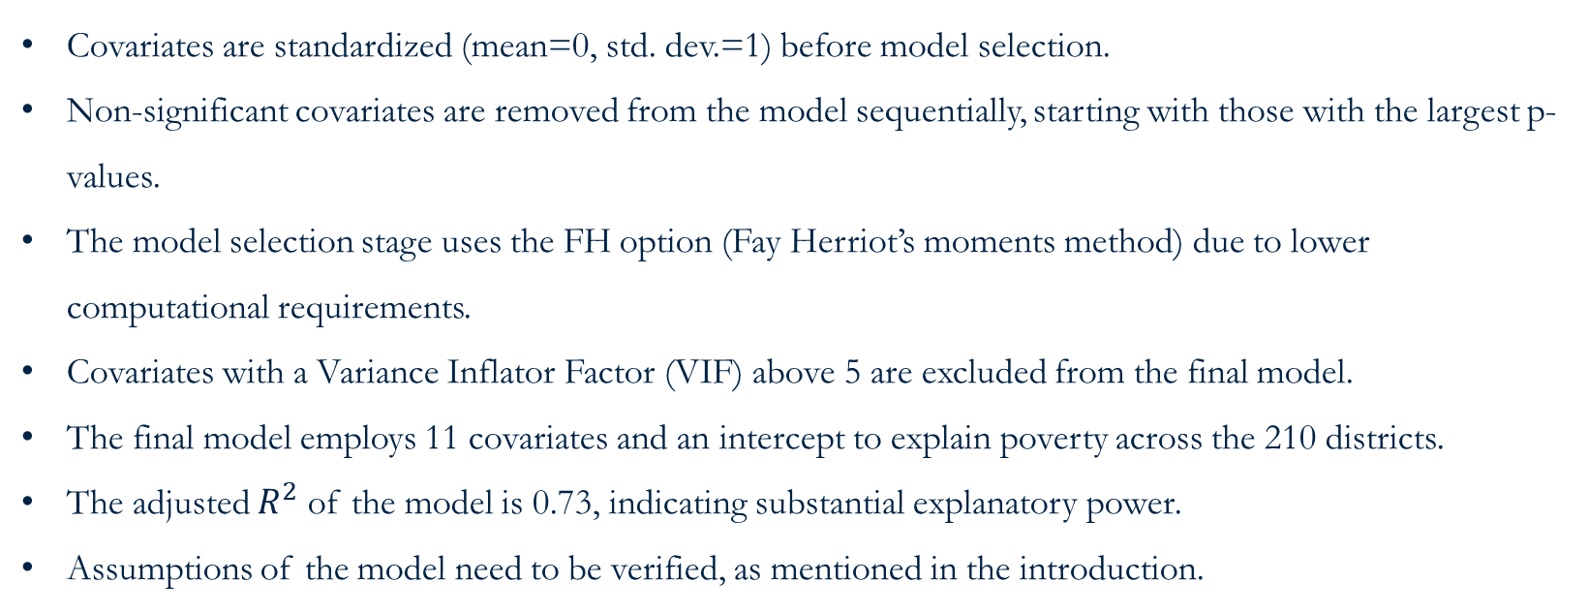
Model selection and estimates
Covariates are standardized (mean=0, std. dev.=1) before model selection.
Non-significant covariates are removed from the model sequentially, starting with those with the largest p-values.
The model selection stage uses the FH option (Fay Herriot’s moments method) due to lower computational requirements.
Covariates with a Variance Inflator Factor (VIF) above 5 are excluded from the final model.
The final model employs 11 covariates and an intercept to explain poverty across the 210 districts.
The adjusted $R^{2}$ of the model is 0.73, indicating substantial explanatory power.
Assumptions of the model need to be verified, as mentioned in the introduction.
Open following do-file: ~01.dofiles/FayHerriot/2.FH_model_select.do

Slide 12
Checking assumptions
Open following do-file: ~01.dofiles/FayHerriot/3.results_check.do
Figure 1: Fay-Herriot Residual Plots
Notes:
- Empirical Quantile graphs (q-q plots) can also be used, sometimes preferable because you can observe outliers
- Formal Normality tests are also valid depending on the sample size.

Slide 13
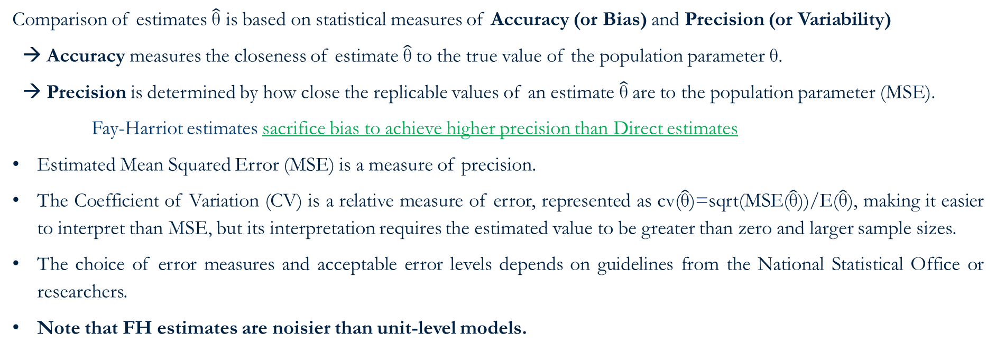
Evaluation of Estimates
Comparison of estimates $\hat{\text{θ}}$ is based on statistical measures of Accuracy (or Bias) and Precision (or Variability)
→ Accuracy measures the closeness of estimate $\hat{\text{θ}}$to the true value of the population parameter θ.
→ Precision is determined by how close the replicable values of an estimate $\hat{\text{θ}}$are to the population parameter (MSE).
Fay-Harriot estimates sacrifice bias to achieve higher precision than Direct estimates
Estimated Mean Squared Error (MSE) is a measure of precision.
The Coefficient of Variation (CV) is a relative measure of error, represented as cv($\hat{\text{θ}}$)=sqrt(MSE($\hat{\text{θ}}$))/E($\hat{\text{θ}}$), making it easier to interpret than MSE, but its interpretation requires the estimated value to be greater than zero and larger sample sizes.
The choice of error measures and acceptable error levels depends on guidelines from the National Statistical Office or researchers.
Note that FH estimates are noisier than unit-level models.
Notes:
Other common error measures include standard error, variance, coefficient of variation (CV), and MSE, with lower values indicating better estimation.
Mean squared (estimation) error (MSE): MSE( ˆθ) = E[(ˆθ − θ) 2 ], note that MSE( ˆθ) = Bias2 π ( ˆθ) + V arπ( ˆθ) in the design-based setup, where θ is not random. In the model-based setup, it is MSE( ˆθ) = Bias2 ( ˆθ) + V ar( ˆθ − θ).
Coefficient of variation (CV) of ˆθ: cv( ˆθ) = q var( ˆθ)/E( ˆθ) is the associated standard error of the estimate over the expected value of the estimate E( ˆθ) = θ when the estimator is unbiased. The CV is also known as the relative standard deviation (RSD).
For the CV to have a correct interpretation, the value of the estimate must be greater than zero.
Moreover, when estimating a proportion P (poverty rates, for example), larger sample sizes are often necessary to keep the error measure below a certain limit than the sample size required when estimating totals (Molina 2019).
Since the CV increases as the proportion P decreases, the CV is no longer a measure of the relative error but a measure of how small the proportion P is. Therefore, calculating the MSE (or its root) for proportions P is a better option.
The CV will tend to be large when the poverty rate for a given area is low since even a small variance will yield a relatively large CV. The only way to remedy such a result is by increasing the sample size.
Direct estimators are recommended for means, totals, and other additive target parameters, especially at national and disaggregated levels where CV is below a threshold.
For disaggregated levels exceeding CV or absolute relative bias (ARB) thresholds, direct estimators are not recommended; indirect estimators may be used instead.
If neither direct nor indirect estimators meet quality requirements, estimates should be highlighted as low quality.

Slide 14
Evaluation of Estimates
Figure 2: Direct vs Small Area Estimates (Left, point) (Right, SE)
Notes:
FH estimates are aligned to direct estimates.
This figure also illustrates the larger adjustment made to direct estimates in locations where the sampling variance is larger.
The resulting FH estimates also have a lower estimated root mean squared error (RMSE) than that of the direct estimates, suggesting an improved efficiency of the model-based estimates
• Benchmarking: A practice where the direct estimator is assumed to be reliable and adjustments to the small area estimates are necessary to ensure agreement with the reliable estimator (Rao and Molina 2015). For example, the direct estimator could be the national level poverty rate and small area estimates for the areas within the country are adjusted to ensure agreement between the aggregate national poverty rate and the direct estimate of national poverty.

Slide 15
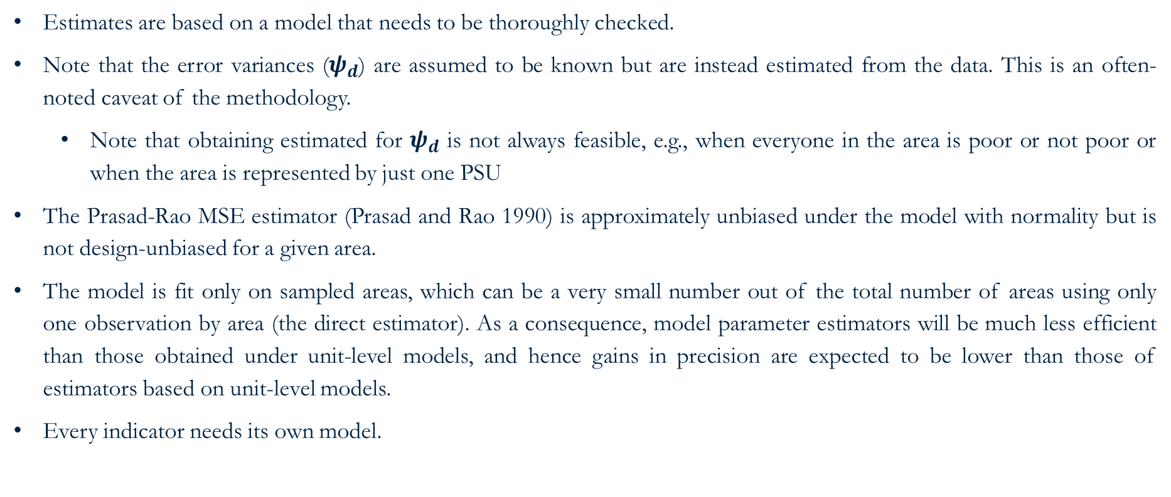
Limitations of Fay-Herriot model
Estimates are based on a model that needs to be thoroughly checked.
Note that the error variances ($ψ_{d}$) are assumed to be known but are instead estimated from the data. This is an often-noted caveat of the methodology.
Note that obtaining estimated for $ψ_{d}$ is not always feasible, e.g., when everyone in the area is poor or not poor or when the area is represented by just one PSU
The Prasad-Rao MSE estimator (Prasad and Rao 1990) is approximately unbiased under the model with normality but is not design-unbiased for a given area.
The model is fit only on sampled areas, which can be a very small number out of the total number of areas using only one observation by area (the direct estimator). As a consequence, model parameter estimators will be much less efficient than those obtained under unit-level models, and hence gains in precision are expected to be lower than those of estimators based on unit-level models.
Every indicator needs its own model.
How we address this

Slide 16
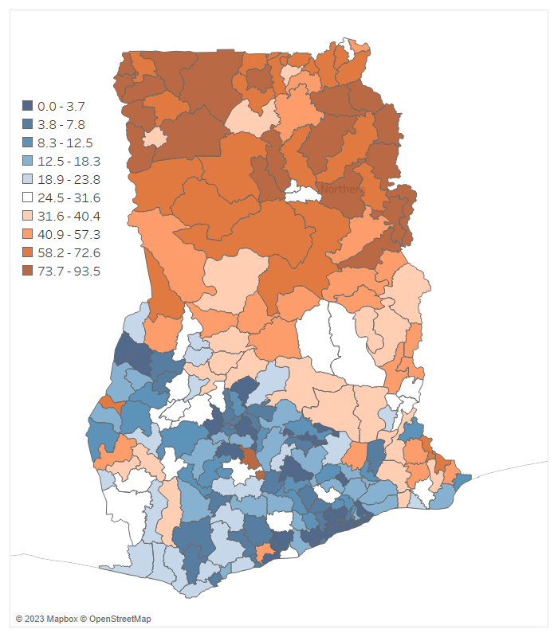
Poverty map - Fay Herriot Small Area Estimates of Poverty (deciles)
The poverty map corresponding to 2016/17 for Ghana, at the district level.
Note: Area-level small area estimates of poverty obtained from a Fay Herriot model.

Slide 17
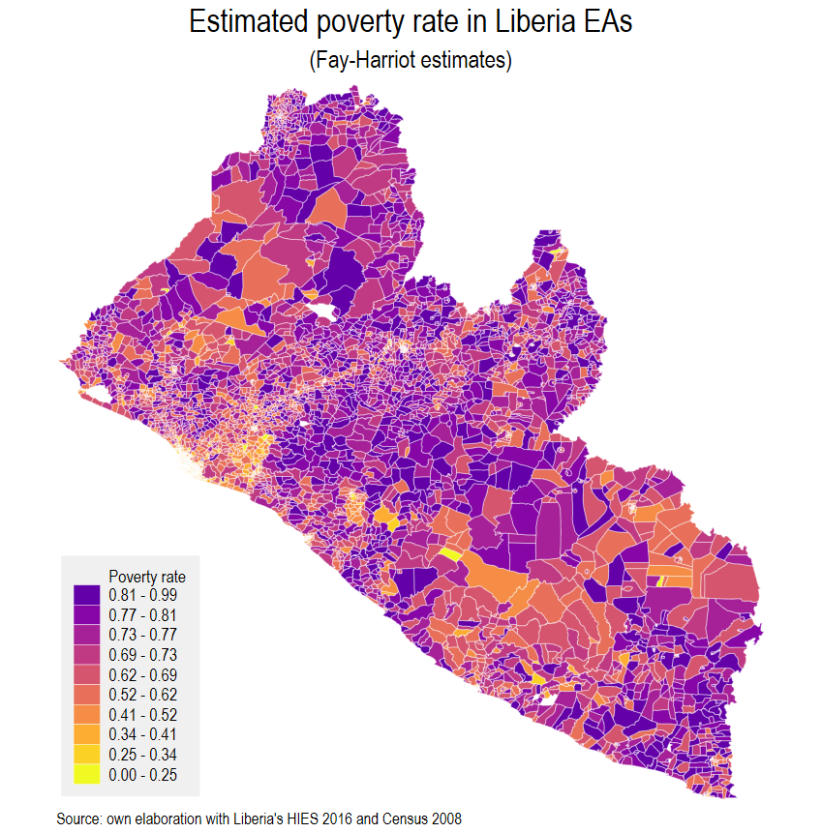
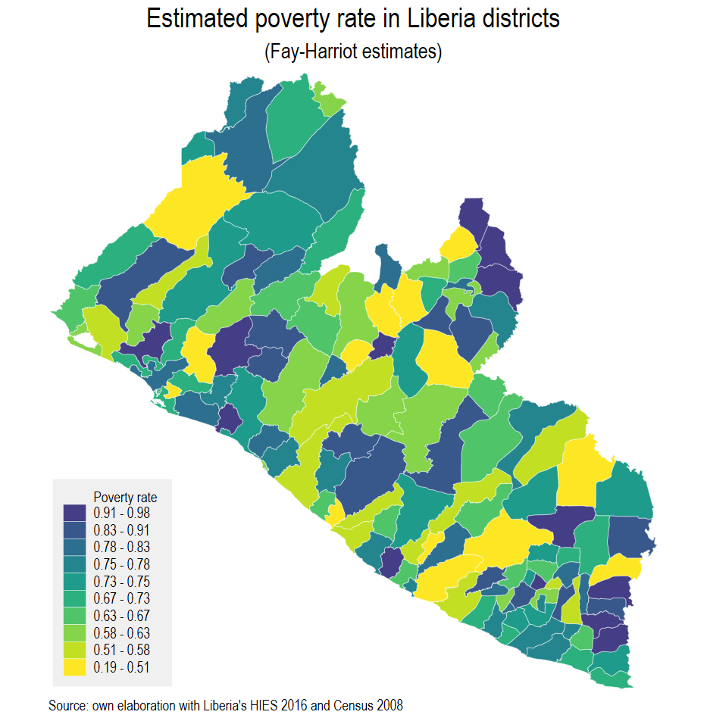
Example: Liberia 2016
Unit-level SAE wasn’t possible
Liberia’s survey is from 2016
Liberia’s Census is from 2008
We model the spatial distribution of poverty in the corresponding survey year
The method is ideal for off-census years, but since we use less information for the model it yields noisier estimates than unit-level SAEs
When data is available at a lower level than the reporting one FH estimates can be aggregated to higher levels with corresponding estimated MSE

Slide 18
Main references for area-level small area estimation
Fay III, R. E., & Herriot, R. A. (1979). Estimates of income for small places: an application of James-Stein procedures to census data. Journal of the American Statistical Association, 74(366a), 269-277.
Rao, J. N., & Molina, I. (2015). Small area estimation. John Wiley & Sons.
Pfeffermann, D. (2013). New Important Developments in Small Area Estimation. Statistical Science, 28(1), 40-68.
Corral, P., Molina, I., Cojocaru, A., & Segovia, S. (2022). Guidelines to Small Area Estimation for Poverty Mapping.

Slide 19
Unbiased but noisy
GO BACK
Notes:
Figure 2.1: Bias and MSE of direct estimates of the FGT0 indicators at the municipal level
Notice that even though the direct estimate’s bias is approximately equal to 0, its variance (or MSE) in many areas is much greater than the one from the model-based estimators.
→ Small area estimation sacrifices a tolerable amount of bias for the sake of precision.

Slide 20
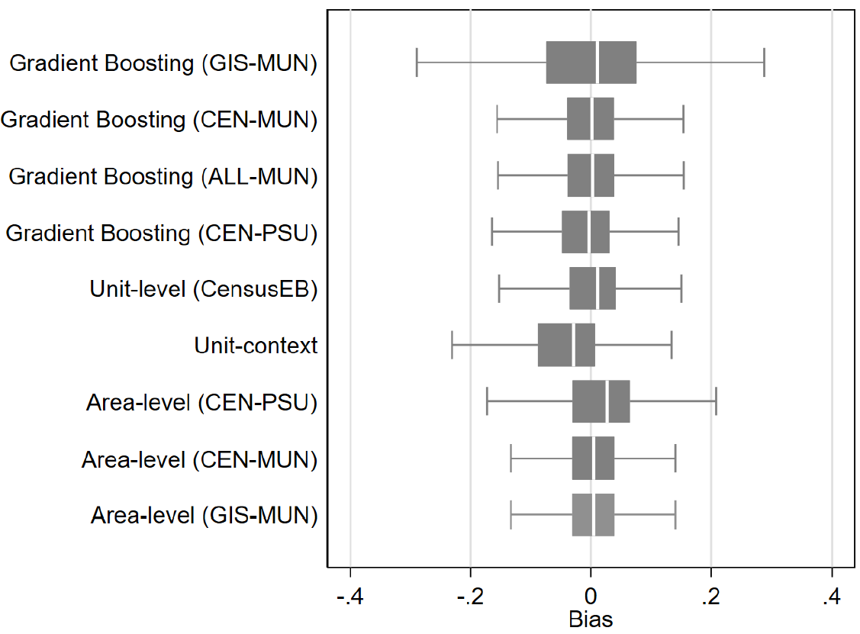
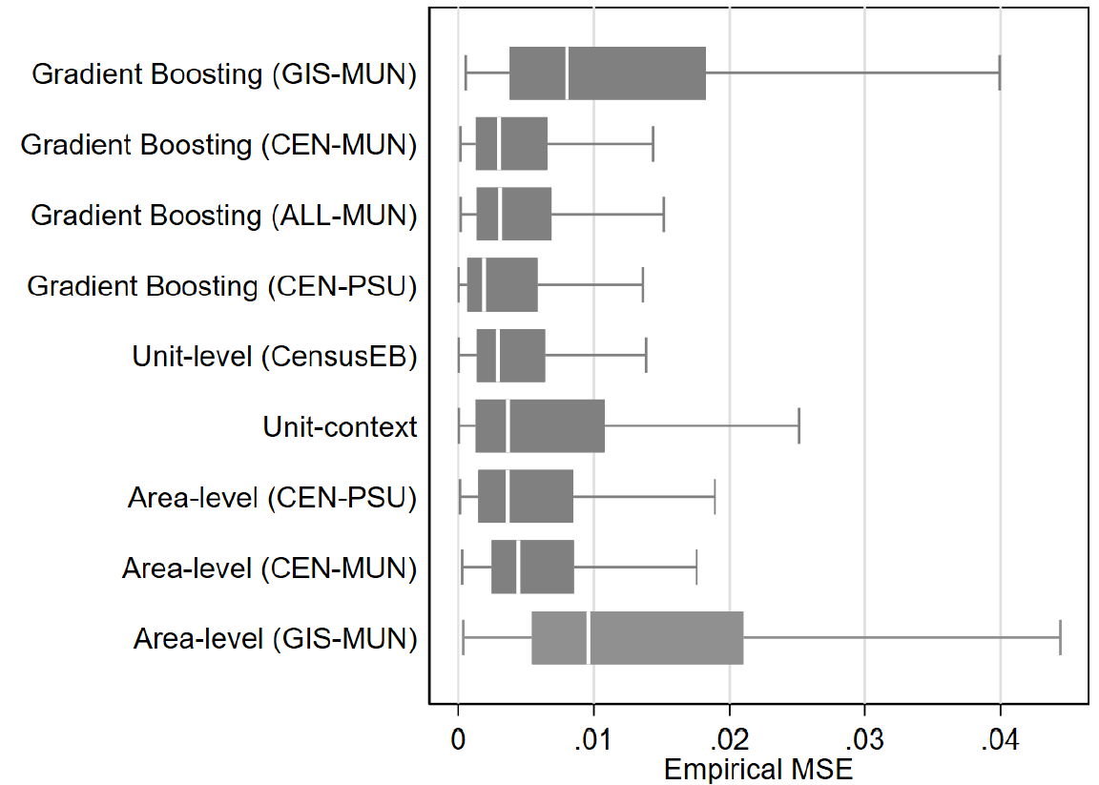
XGBoost performs nearly as well as unit-level models but it depends on the data used to model poverty rates
GO BACK
Source: Corral, Henderson, and Segovia (2023)
Mexican Intercensal Survey 2015 was used as a census for design-based simulation based on 500 samples.

Slide 21
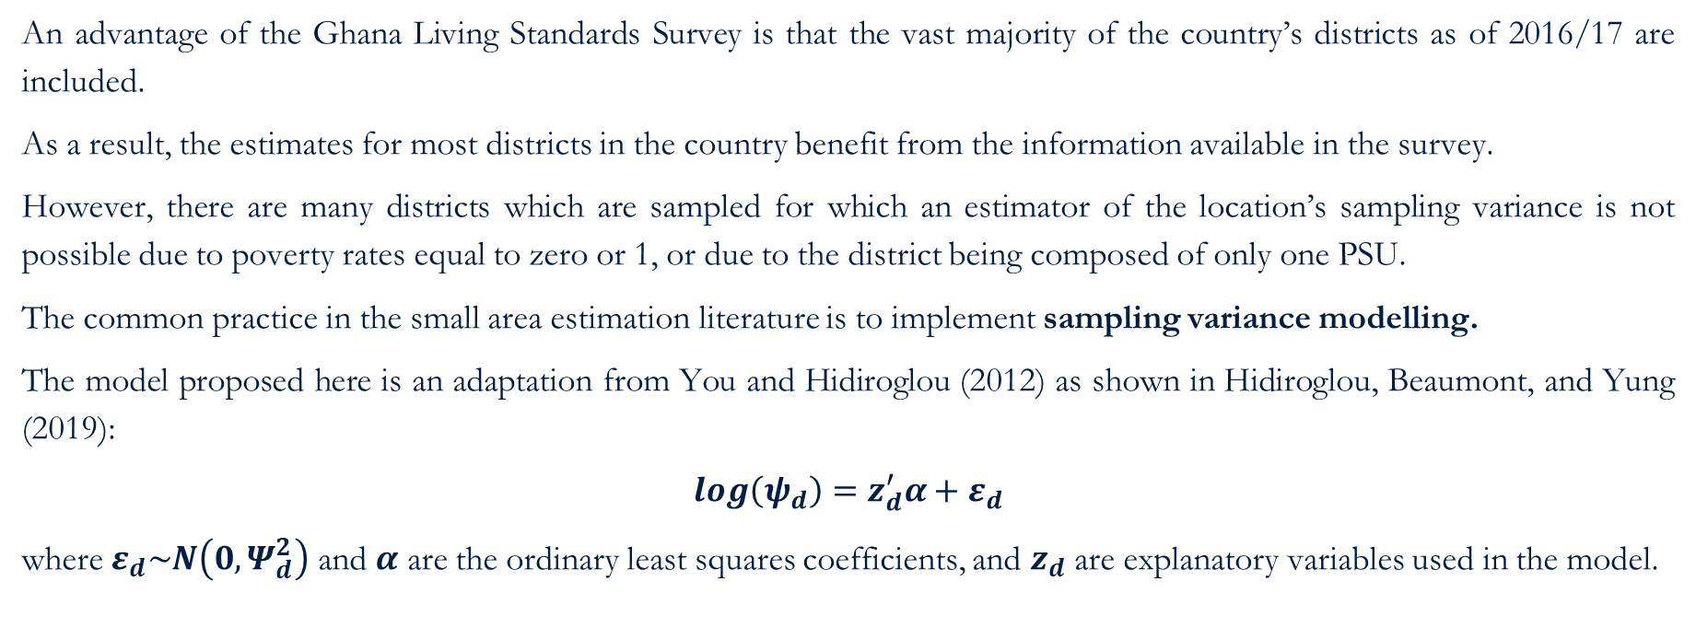
Fay-Harriot – Sampling Variance (1/2)
GO BACK
An advantage of the Ghana Living Standards Survey is that the vast majority of the country’s districts as of 2016/17 are included.
As a result, the estimates for most districts in the country benefit from the information available in the survey.
However, there are many districts which are sampled for which an estimator of the location’s sampling variance is not possible due to poverty rates equal to zero or 1, or due to the district being composed of only one PSU.
The common practice in the small area estimation literature is to implement sampling variance modelling.
The model proposed here is an adaptation from You and Hidiroglou (2012) as shown in Hidiroglou, Beaumont, and Yung (2019):
$$\log\left(ψ_{d}\right)=z_{d}^{′}α+ε_{d}$$
where $ε_{d}\sim N\left(0,Ψ_{d}^{2}\right)$ and $α$ are the ordinary least squares coefficients, and $z_{d}$ are explanatory variables used in the model.

Slide 22
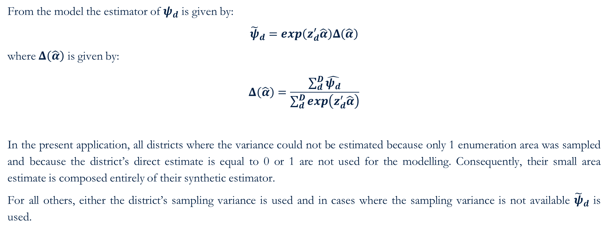
Fay-Harriot – Sampling Variance (2/2)
GO BACK
From the model the estimator of $ψ_{d}$ is given by:
$${\tilde{ψ}}_{d}=\exp\left(z_{d}^{′}\hat{α}\right)Δ\left(\hat{α}\right)$$
where $Δ\left(\hat{α}\right)$ is given by:
$$Δ\left(\hat{α}\right)=\frac{\sum_{d}^{D}{\hat{ψ_{d}}}}{\sum_{d}^{D}{\exp\left(z_{d}^{′}\hat{α}\right)}}$$
In the present application, all districts where the variance could not be estimated because only 1 enumeration area was sampled and because the district’s direct estimate is equal to 0 or 1 are not used for the modelling. Consequently, their small area estimate is composed entirely of their synthetic estimator.
For all others, either the district’s sampling variance is used and in cases where the sampling variance is not available ${\tilde{ψ}}_{d}$ is used.

